Slide 1
Crash Investigations
Investigating memory corruption issues
Davit Kalantaryan
DV-ERS
Zeuthen

Slide 2
Overview
Memory related crashes
Mehods of investigations of memory related problems
valngrid (https://valgrind.org/): X86/Linux, AMD64/Linux, ARM/Linux, ARM64/Linux, PPC32/Linux, PPC64/Linux, PPC64LE/Linux, S390X/Linux, MIPS32/Linux, MIPS64/Linux, X86/Solaris, AMD64/Solaris, ARM/Android (2.3.x and later), ARM64/Android, X86/Android (4.0 and later), MIPS32/Android, X86/FreeBSD, AMD64/FreeBSD, X86/Darwin and AMD64/Darwin (Mac OS X 10.12).
deleaker (https://www.deleaker.com/): Windows
Crash investigator

Slide 3
PITZ DAQ (Data AcQuisition). Recent activities
Added a new type of data collector. These collectors get data using the new DOOCS ZMQ publishing/subscribing.
Added possibility to collect secondary data alongside with main data. For example, if a spectrum is collected, then one can collect poly para alongside this spectrum, which later on will allow making physical value from raw measurement data.
Collectors were made more flexible
Add/remove entry on fly
Mask/unmask entry from the collection (with or without timeout) (can be done even runtime)
Mask/unmask entry errors (for example when server publishing data is switched off by purpose)

Slide 4
PITZ DAQ (Data AcQuisition). Plans
Integrate DAQ system developed by MCS for accelerators at HH DESY. This is necessary because
PITZ needs software from HH, that depends on their DAQ
We will reduce maintenance effort/time (hopefully)
For PITZ specific requirements we will do one of following
Keep minimum home-prepared systems and/or
Make changes to the current DAQ system prepared by them to meet PITZ requirements. We can contribute during the development/implementation of these changes (discussion on this and integration at all will be continued with HH)
Get rid of remnant AFS dependency of DAQ.
Fix indexes and convert them to new indexes.

Slide 5
Universal driver for mTCA devices
This driver exports APIs, which are used by different mTCA device drivers. Development is ongoing together with MCS4 colleagues from HH
Migration to Ubuntu 20
Making our device-specific drivers compatible with this scheme (for Ubuntu 16 and earlier we had one more layer in between)
User space
DOOCS server
Kernel space
Plans
Improving error handling by using PCIe AER (https://www.kernel.org/doc/Documentation/PCI/pcieaer-howto.txt) driver.
Make it possible to handle a simple device with this driver.
To have the possibility to handle interrupt of simple devices from the universal driver (when point 2 is done).
Universal driver
Provides API
Specific driver
Device

Slide 6
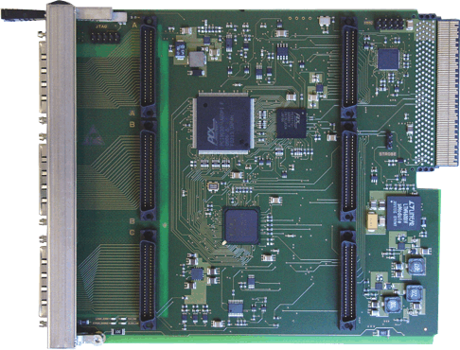
Device specific driver development
Driver for TAMC200 (Tews AMC) (https://www.tews.com/Products/ArticleGroup/TAMC/TAMC200.html) Migrated to Ubuntu 20. DKMS Debian package is hosted by Debian repository supported by MCS4.
There are plans to investigate and optimize drivers for ADC measurement devices. There is a test driver developed and tested at Zeuthen as well there is a driver developed by MCS colleagues. The goal is to use statistics on both drivers and make one with better performance and memory usage.
TAMC200 3 Slot IndustryPack Carrier for AMC

Slide 7
Windows DOOCS
Supporting XDR RPC windows version.
Contribution to port DOOCS client library to Windows.
DOOCS server library preparation and support for Windows. For server library repository was forked and code modified to make it possible to compile it for Windows.
Plans
Finalize DOOCS client part modification for making it available for Windows compilation using Microsoft compiler and finally bring it to official support by DOOCS devs.
DOOCS client utilities (currently they are compiled from forked codes).
DOOCS server library (make original code compatible with Windows).
DOOCS standard servers (watchdog for example (we are using a fork of Windows DOOCS watchdog)).

Slide 8
Emwiz migration from SL6 to SL7
Prepared qtRoot for SL7 currently needed for plotting
Fixed some bugs

Slide 9
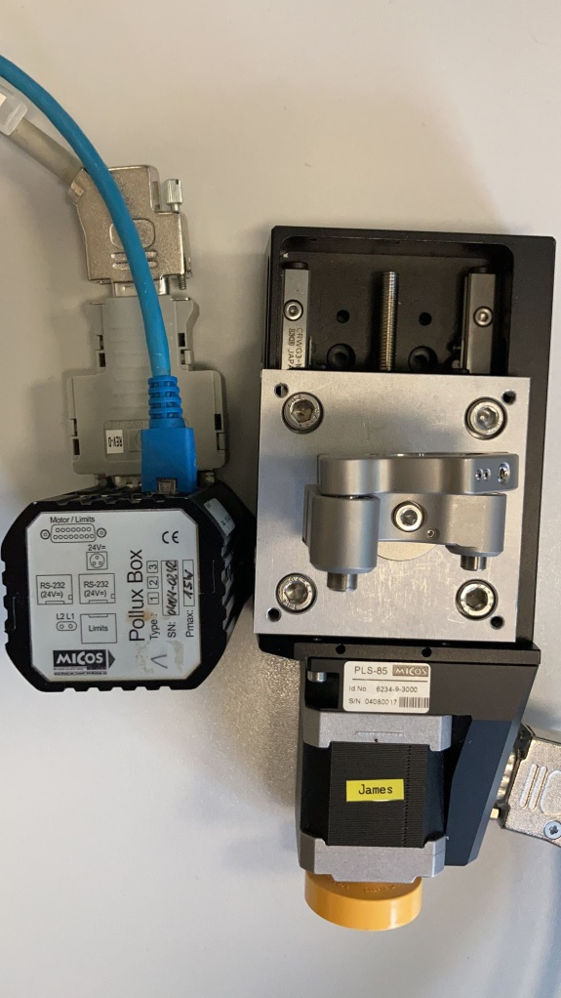
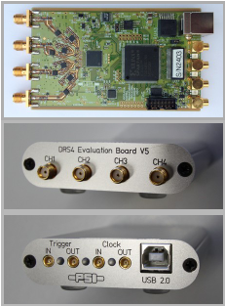
Migration from VME crates to newer technologies
Took part in the migration of several devices from VME to mTCA.
Migration of control of Micos motor controllers from VME crates to raspberry pi based newer controller box is ongoing.
Plans
DRS4 Evaluation board (https://www.psi.ch/en/drs/evaluation-board) integration to PITZ control system

