Slide 1
Using matlabdev repository

Slide 2
IDE and compilation tools supported
QT with qtcreateor. Currently tested only for LINUX
Visual Studio
Makefile Works for LINUX and WINDOWS

Slide 3
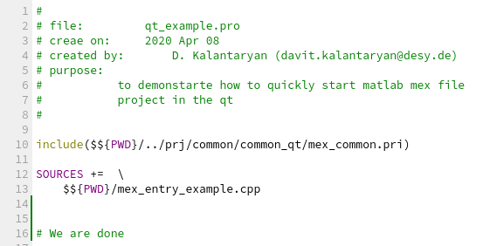
QT with qtcreateor.
There is a file ‘mex_common.pri’ in the ‘prj/common/common_qt’. Include this file from your project (pro or pri) file and you will be able to compile MATLAB MEX file

Slide 4
Visual Studio
Define variable ‘MatlabDevRoot’
Then include ‘prj/common/common_vs/mex_common.props’ to your project with these 2 steps you ae done!

