Slide 1
PITZ DAQ Data Getter
Highlighting current problems
Davit Kalantaryan
Discussions on PITZ DAQ
Zeuthen, 04.09.2019

Slide 2
Content
The problem
Necessity of having new DAQ data getter
Possible reasons of crashes
Possible solutions or workarounds.
Current solution
Problems with current solution
MATLAB emulator as one solution
Other solutions
Conclusion

Slide 3
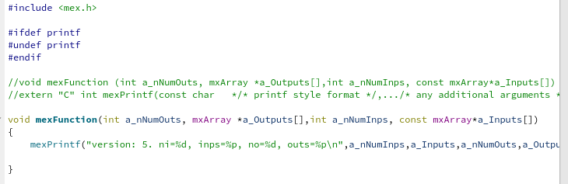
The problem
There was a decision to prepare MATLAB interface for PITZ DAQ data getting in order to provide more freedom to physicists and offload developers from necessity to prepare all DAQ data handling related software
For unknown reason, there is no possibility to run MATLAB MEX file, that uses CERN ROOT library. *) up to now for me the reason is unknown, any ideas in the end is very welcome!
Even without calling any function from ROOT library but only loading ROOT dependent MEX file to MATLAB address space crashes the MATLAB.
Crash can happen in first try or in next tries (Usually less than 10 tries are enough for reproducing crash)
Below is example of code, that does not do anything important but anyhow crashes the MATLAB if linked against ROOT libraries

Slide 4
Why do we need a new PITZ DAQ data getter
We are going to migrate our ADC measurment stuff from VME crates to mTCA. On mTCA we will have other size for spectrum measurements and most of the old DAQ GUIs working with ADC measurement data, simply will not work, because there is a assumpion in the logic concerning data size.
Soon or later we have to get rid of AFS based indexing. After migrating to a new indexing scheme the all currently existing software will not work.
So there is a necessity for new DAQ data getter. The requirements to this getter are following.
It should provide easy (or at least agreed with users) interface for getting data from dCache (Already C interface library exists).
Indexing method change (planned in near future) should not affect on the work of this module.
It should be designed in such a way, that in the case of future changes (new indexing again, new dCache directory etc.) again this module is not affected.

Slide 5
Possible solutions having scripting possibility
To forgot about ROOT and use other data compression methods. *)This is not acceptable because all PITZ historized data in root format so migration is really impossible.
To forgot about MATLAB and use for scripting more ROOT friendly tools (for example PYTHON)
An application that will get the data then transfer the data to MATLAB. *) Currently this is the working method. Now there are some problems with this method *) Another tool using already exist (matlabemulator), but in this case application transfers data to the MATLAB created inside the application
Use MATLAB for handling DAQ data from non LINUX platforms For example ROOT has port for 32 bin Windows or Mac *) I do not like this approach.
To make new scheme similar to currently existing, but re-implement some parts to make it less error prone *) details on the part that should be reimplemented is in the slide 7.

Slide 6
Current implementation
Following are the steps for current DAQ data getter used by LILI (prepared by Igor Isaev)
User calls getdata(time1,time2, GUN__COUPLER__PMT_20140905,GUN__COUPLER__E_DET_20140905,GUN__WG1__THALES_PMT_VAC_20140905,…)
The MEX file for servicing above request performs following steps a) opens 2(RW) pipes using pipe API. b) creates new process (using fork). c) loads to the new process an binary (using execv), that is able to get and unzip DAQ data. As a command line argument to this binary W(writible) pipe is given.
The binary first checks command line arguments, to find the writable pipe.
When pipe is provided the binary gets necessary files from dCache, unzips them and using W pipe sends the content (data and meta information) to MATLAB
The data transferred by helper process is stored to some memory of MATLAB by MEX.
After helper process is done MEX clears resources devoted to this process.
If no error was occurred MEX prepares final data and returns it to user. In the case of error user gets error message with empty return
MATLAB
Data pipe
Binary child

Slide 7
Why current scheme is erroneous
Following is the problems and some discussions on that
Several times after updates we accidently loosed the binary. Splitting MEX file to the part, missing of which is not marked by some standard tools (ldd for example) makes possible to have missing part, that will be highlighted (known) only during runtime. *) This is not a big issue, but anyhow one should take this into account.
More serious is following: current scheme works fine for LILI. Currently LILI works with 16 DAQ entries. All entries have spectrum data type. All data consist of 2048 float. When we started to think about replacement of existing DAQ data handling software (as data user) there was an idea to replace them by MATLAB scripts. For this reason Igor (my be also Grygorii) tried to use this MEX file with different types. With other types they started to observe problems. Most probably there is a assumption in the logic concerning data type (I already forgot a lot of details on implementation). Sending by helper binary different type of data with different meta information to MATLAB, then afterwards sorting them in MATLAB for preparing MATLAB arrays is hard. *) In order to get rid of this problem the unzipping and preparing MATLAB variables should be done in one module. The important information that all MATLAB extension functions from library mx works properly with ROOT. libmx is not real MATLAB. This library is just for preparing MATLAB specific arrays. *) matlab-emulator (presented in the slide 5) uses this method.

Slide 8
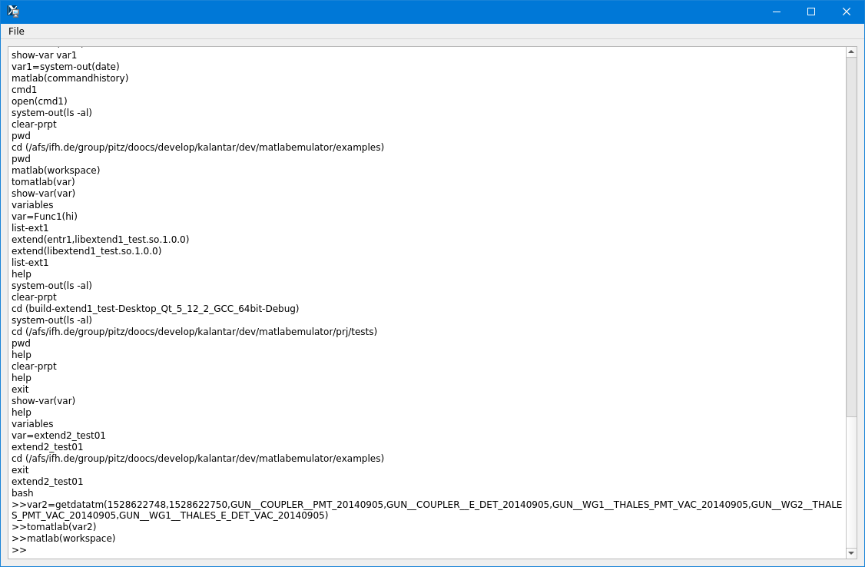
MATLABEMULATOR
Application looks like MATLAB command prompt. There is built-in commands as well several ways to extend the MATLABEMULATOR by adding new commands.
Currently there is a command ‘getdatatm’, with following arguments 1. timeStart 2. timeEnd, [3…] DAQ branch names Number of arguments for this command is 3 or more. Also there is a command ‘sendtomatlab’, that sends data to MATLABs global workspace Another command that can be helfull for MATLAB DAQ users ‘matlab(any matlab command)’

Slide 9
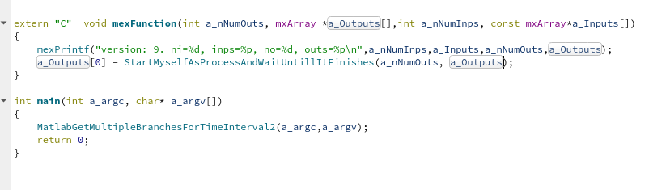
Other solution (currently ongoing)
This solution is improvement of existing solution. With this new solution described 2 errounous cases are not there. The idea is to prepare some tricky binary file, that has 2 nature. The file should have executable(1) as well shared library(2) properties. This file will be the new data getter MEX file itself. After compiling MEX file from the image header all NEEDED libraries devoted to ROOT should be taken out. If all root libraries are taken out then MATLAB will call the MEX file without crashes. When the MEX will start new process then the binary image will be MEX file itself. So the first problem is solved. The process initiated by MEX file will prepare MATLAB array itself, so the necessity to collect binary data, then finally build data on serialized data also goes away.

Slide 10
Conclusion – Problem, Existing stuff
We have problem to have DAQ data getter interface for the tool, that gives scripting possibility. If for often used cases application could be developed, then for other arbitrary cases will be nice to have scripting possibility (this will also offload developers)
pitz_daq_data_handler: This is a C library that has only 2 functions struct SPitzDaqData* GetDataFromPitzDaq(time_t startTime,time_t endTime,int numberOfBranches,…); void ClearPitzDaqData(struct SPitzDaqData* data); *) This is the base and will be maintained properly. Please design a application (specially c/c++) to use this library. a) Working directly with index files in near future will not work, because we have to get rid of AFS dependency. b) PITZ dChache base directory mapping in filesystem can be changed.
pitz_daq_data_to_matlab: There is another C library for getting data from DAQ and converting it to MATLAB format. This library uses the library ‘pitz_daq_data_handler’ (mentioned above). This library again has one function struct mxArray* GetMatlabDataFromPitzDaq(time_t startTime,time_t endTime,int numberOfBranches,…); *) This function works well from any application except MATLAB.

Slide 11
Conclusion – Suggestions
Any suggestion on MATLAB port. Is it needed or not?
If MATLAB port is needed should new emulator be used or hacky MEX file approach?
Anything concerning libraries presented in the previous slide (new functions, changing interface, …)
Is there any need to port ‘pitz_daq_data_handler’ for other languages 1. PYTHON 2. JAVA (using JNI)

Slide 14
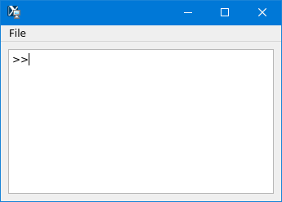
What is MATLAB emulator
MATLAB emulator is QT based GUI application. The main view looks like MATLABs command prompt (see fig.1). You can resize move window to any position to desktop(s), next time application starts it will remember its correct position.
The aim of this application is to run ROOT ([1]) and MATLAB scripts together.
Several tries to have MATLAB MEX file were unsuccessful, because of MATLAB ROOT incompatibility
In order to open this application call ‘matlabengine.sh’, that one can find in the directory ‘/afs/ifh.de/group/pitz/scripts/unix’ (for unix like systems) and ‘matlabengine.bat’ in the directory ‘/afs/ifh.de/group/pitz/scripts/windows’
[1] https://root.cern.ch/
Figure 1: MATLAB emulator

Slide 15
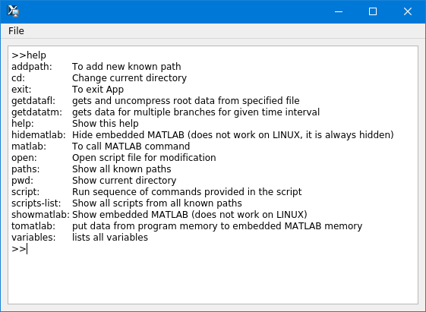
Commands

Slide 16
matlab(workspace)
matlab(commandhistory)

Slide 17
In the command prompt pressing home is not working properly
In the command prompt mouse events should be handled

Slide 18
Content
The problem
Necessity of having new DAQ data getter
Possible reasons of crashes
Possible solutions or workarounds.
Current solution
Problems with current solution
MATLAB emulator as one solution
How to use MATLAB emulator for getting data from PITZ DAQ
Use obtained data from MATLAB scripts inside the emulator
Extend emulator using C,C++

Slide 19
Possible reasons of crashes
There can be a lot of reasons. Up to now I have following ideas on this crashes.
Maybe MATLAB overrides (using weak symbols using any of overriding paradigms) some functions (or symbols) and then ROOT libraries access overloaded functions those(that) because of some condition(s) crash(es) the application. By the way, even it is possible to overload memory management functions (malloc,free and C++ memory handling functions overloading is standard and probably well known). If you are interested we can do short demo with explanations how it works for each system.
ROOT loads some library that already on MATLAB address space that is different in version and not runtime compatible. In this cases also there is a possibility for crashes.
ROOT has intensive reporting from different ROOT threads. If MATLAB redirects standard output to MATLAB command prompt directly, then again there will be crashes.
I did a lot of tests trying to find the reason, but not successful. Now I’m not sure if even in the case if I find it will be stable for ROOT and MATLAB version change

Slide 20
Content
The problem
Necessity of having new DAQ data getter
Possible reasons of crashes
Possible solutions or workarounds.
Current solution
Problems with current solution
MATLAB emulator as one solution
How to use MATLAB emulator for getting data from PITZ DAQ
Use obtained data from MATLAB scripts inside the emulator
Extend emulator using C,C++

Slide 21
Content emulator
What is MATLAB emulator
How to use it
Available commands

Slide 22
How to use MATLAB emulator
Type the command in the command prompt and press enter key.
Any argument provided to command should be in the parentheses after (for example “>>matlab(figure(1))” will call “figure(1)” command inside the MATLAB)

Slide 23
Possible solutions for MATLAB
To forgot about ROOT and use other data compression methods. *)This is not acceptable because all PITZ historized data in root format so migration is really impossible. *) Another solution also exist (matlabemulator), but in this case application transfers data to the MATLAB created inside the application
To forgot about MATLAB and use for scripting more ROOT friendly tools (for example PYTHON)
If not then following cases can be implemented 1. To have independent application that gets necessary data from dCache and unzips it, then transfers this data to MATLAB. *) Currently this is the working method. Some times ago problem was arise, that’s why searches for new approach was started. 2. To have library that is ported to all ROOT friendly platforms. Unfortunately MATLAB is not ROOT friendly *) Anyhow this should be prepared, but this is not enough. If this library is not ported to MATLAB then a lot of scripts for handling DAQ data (prepared by PITZ physicists) should be re-implemented (or by control colleagues or by physicists themselves). 3. If having MATLAB port is actual, then application can be created that will get the data then transfer the data to MATLAB. With current MATLAB version used here this MATLAB should be created inside this application. *) This solution is already implemented (matlabemulator), but I think this also will not be used

