Slide 1
Data Getter for PITZ DAQ
Using MATLAB emulator for getting data from DAQ and calling MATLAB scripts for handling that data
Davit Kalantaryan
Seminar on DAQ
Zeuthen, 26.08.2019

Slide 2
Content
The problem
Necessity of having new DAQ data getter
Possible reasons of crashes
Possible solutions or workarounds.
Current solution
Problems with current solution
MATLAB emulator as one solution
Other solutions
Conclusion

Slide 3
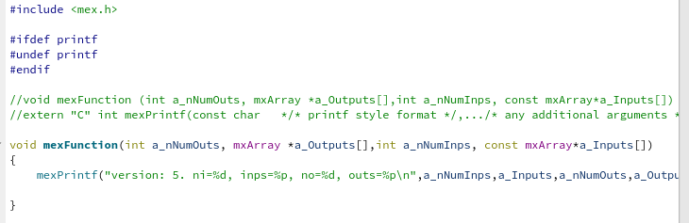
The problem
For unknown reason, there is no possibility to run MATLAB MEX file, that uses CERN ROOT library. up to now for me the reason is unknown,0 any ideas in the end is very welcome! .
Even without calling any function from ROOT library but only loading ROOT dependent MEX file to MATLAB address space crashes application.
Crash can happen in first try or in next tries (Usually less than 10 tries are enough for reproducing crash)
Quickly let’s have a look to the problem

Slide 4
Why do we need PITZ DAQ handler
We are going to migrate to mTCA, where we will have other size of arrays for spectrum measurements and most of old guis working with ADC measurement data from DAQ, simply will not work
Soon or later we have to get rid of AFS based indexing. After migrating to a new indexing scheme old GUIs will not work for any kind of data.
Taking into account this requirement arose to have unique DAQ data getter. The requirements to this getter should are following.
It should provide easy (or at least agreed with users) interface for getting data from dCache.
Planned indexing method change should not affect on the work of this module.
It should be designed in such a way, that in the case of future changes (new indexing again, new dCache directory etc.) only this module is changed and no software using this for handling DAQ data is modified.

Slide 5
Possible solutions
To forgot about ROOT and use other data compression methods. This is not acceptable because all PITZ historized data in root format so migration is really impossible
To forgot about MATLAB and think about other solutions 1. To have independent application that gets necessary data from dCache and unzips it, then transfers this data to MATLAB. *) Currently this is the working method. Some times ago problem was arise, that’s why searches for new approach was started 2. To have library that is ported to all ROOT friendly platforms. Unfortunately MATLAB is not ROOT friendly *) This is not also good solution, because most of the scripts for handling DAQ data prepared by PITZ physicists are MATLAB, so all these scripts should be re-implemented (or by control colleagues or by physicists themselves) 3. If keeping MATLAB is actual, then application can be created that will get the data then transfer the data to MATLAB. With current MATLAB version used here this MATLAB should be created inside this application. *) This solution is already implemented, but I think this also will not be used

Slide 6
Possible solutions 2
To make new scheme similar to currently existing, but re-implement some parts to make it less error prone (details in the next slide)

Slide 7
Why current scheme is errornous
MATLAB
Data pipe
Binary child

Slide 10
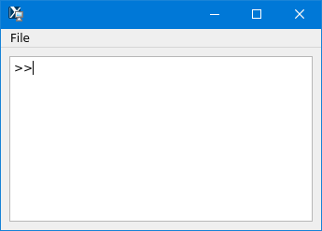
What is MATLAB emulator
MATLAB emulator is QT based GUI application. The main view looks like MATLABs command prompt (see fig.1). You can resize move window to any position to desktop(s), next time application starts it will remember its correct position.
The aim of this application is to run ROOT ([1]) and MATLAB scripts together.
Several tries to have MATLAB MEX file were unsuccessful, because of MATLAB ROOT incompatibility
In order to open this application call ‘matlabengine.sh’, that one can find in the directory ‘/afs/ifh.de/group/pitz/scripts/unix’ (for unix like systems) and ‘matlabengine.bat’ in the directory ‘/afs/ifh.de/group/pitz/scripts/windows’
[1] https://root.cern.ch/
Figure 1: MATLAB emulator

Slide 11
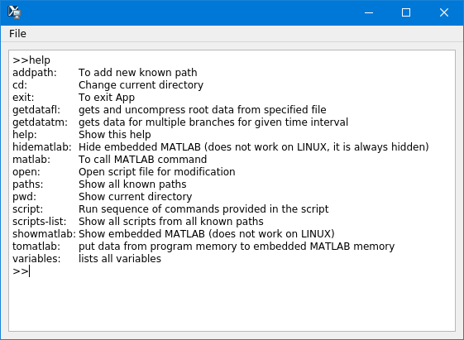
Commands

Slide 12
matlab(workspace)
matlab(commandhistory)

Slide 13
In the command prompt pressing home is not working properly
In the command prompt mouse events should be handled

Slide 14
Content
The problem
Necessity of having new DAQ data getter
Possible reasons of crashes
Possible solutions or workarounds.
Current solution
Problems with current solution
MATLAB emulator as one solution
How to use MATLAB emulator for getting data from PITZ DAQ
Use obtained data from MATLAB scripts inside the emulator
Extend emulator using C,C++

Slide 15
Possible reasons of crashes
There can be a lot of reasons. Up to now I have following ideas on this crashes.
Maybe MATLAB overrides (using weak symbols using any of overriding paradigms) some functions (or symbols) and then ROOT libraries access overloaded functions those(that) because of some condition(s) crash(es) the application. By the way, even it is possible to overload memory management functions (malloc,free and C++ memory handling functions overloading is standard and probably well known). If you are interested we can do short demo with explanations how it works for each system.
ROOT loads some library that already on MATLAB address space that is different in version and not runtime compatible. In this cases also there is a possibility for crashes.
ROOT has intensive reporting from different ROOT threads. If MATLAB redirects standard output to MATLAB command prompt directly, then again there will be crashes.
I did a lot of tests trying to find the reason, but not successful. Now I’m not sure if even in the case if I find it will be stable for ROOT and MATLAB version change

Slide 16
Content
The problem
Necessity of having new DAQ data getter
Possible reasons of crashes
Possible solutions or workarounds.
Current solution
Problems with current solution
MATLAB emulator as one solution
How to use MATLAB emulator for getting data from PITZ DAQ
Use obtained data from MATLAB scripts inside the emulator
Extend emulator using C,C++

Slide 17
Content emulator
What is MATLAB emulator
How to use it
Available commands

Slide 18
How to use MATLAB emulator
Type the command in the command prompt and press enter key.
Any argument provided to command should be in the parentheses after (for example “>>matlab(figure(1))” will call “figure(1)” command inside the MATLAB)

