Slide 1
Data Getter for PITZ DAQ
Using MATLAB emulator for getting data from DAQ and calling MATLAB scripts for handling that data
Davit Kalantaryan
Seminar on DAQ
Zeuthen, 26.08.2019

Slide 2
Content
MATLAB emulator
How to use MATLAB emulator for getting data from PITZ DAQ
Use obtained data from MATLAB scripts inside the emulator
Extend emulator using C,C++

Slide 3
Content emulator
What is MATLAB emulator
How to use it
Available commands

Slide 4
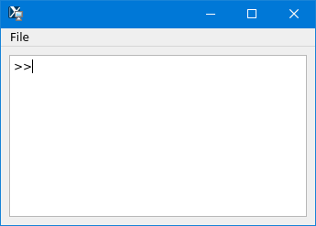
What is MATLAB emulator
MATLAB emulator is QT based GUI application. The main view looks like MATLABs command prompt (see fig.1). You can resize move window to any position to desktop(s), next time application starts it will remember its correct position.
The aim of this application is to run ROOT ([1]) and MATLAB scripts together.
Several tries to have MATLAB MEX file were unsuccessful, because of MATLAB ROOT incompatibility
In order to open this application call ‘matlabengine.sh’, that one can find in the directory ‘/afs/ifh.de/group/pitz/scripts/unix’ (for unix like systems) and ‘matlabengine.bat’ in the directory ‘/afs/ifh.de/group/pitz/scripts/windows’
[1] https://root.cern.ch/
Figure 1: MATLAB emulator

Slide 5
How to use MATLAB emulator
Type the command in the command prompt and press enter key.
Any argument provided to command should be in the parentheses after (for example “>>matlab(figure(1))” will call “figure(1)” command inside the MATLAB)

Slide 6
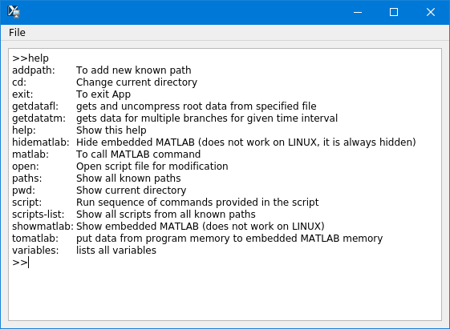
Commands

Slide 7
matlab(workspace)
matlab(commandhistory)

Slide 8
In the command prompt pressing home is not working properly
In the command prompt mouse events should be handled

