Slide 1
Crash Investigations
Investigating memory corruption issues https://gitlab.zeuthen.desy.de/ers/crash_investigator
Davit Kalantaryan
DV-ERS
Zeuthen

Slide 2
Overview
Memory handling related crashes
Tools for investigations of memory-related problems
valgrind (https://valgrind.org/): X86/Linux, AMD64/Linux, ARM/Linux, ARM64/Linux, PPC32/Linux, PPC64/Linux, PPC64LE/Linux, S390X/Linux, MIPS32/Linux, MIPS64/Linux, X86/Solaris, AMD64/Solaris, ARM/Android (2.3.x and later), ARM64/Android, X86/Android (4.0 and later), MIPS32/Android, X86/FreeBSD, AMD64/FreeBSD, X86/Darwin and AMD64/Darwin (Mac OS X 10.12).
deleaker (https://www.deleaker.com/): Windows
Crash investigator (https://gitlab.zeuthen.desy.de/ers/crash_investigator)
Reasons to implement this (cases when Valgrind will not help or will behave poorly)
How it is implemented (the idea behind)
How to use it
How to extend it
Demo

Slide 3
Memory related issues and crashes
Meaning of colors in the below list
Green: possible to investigate with the newly created crash investigator.
Yellow: theoretically possible to investigate but not implemented.
Red: not possible to investigate.
All cases are possible to investigate by Valgrind (even red cases)!
Memory leak: this will not lead to a crash but after a long run there will not be available memory for the proper functionality of an application.
Deallocation of non-existing memory:
Double free issue: most probably this will immediately crash the application.
Bad realloc issues: this kind of issue will happen when bad memory (not allocated memory/ already freed memory/ memory created with incompatible to realloc method) is provided as the first argument to the realloc call.
Allocation - deallocation mismatch: this is the case when memory is allocated using one method and memory is freed by the other method (for example new/free, new[]/delete, etc.). Similar errors will lead to crashes in some cases. Most crashes will happen immediately after corruption.
Memory overrun issue: this is a very hard detectable issue because they crash applications not immediately and not always. They crash applications when the memory behind allocated memory is responsible for sensitive data. Usually, the crash happens not during the bad call with overrun, but later when the mentioned sensitive memory is accessed.

Slide 4
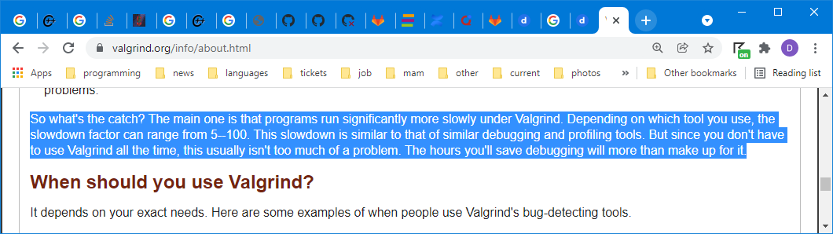
How Valgrind works. Reasons to have something else
In the previous slide, there was a note that Valgrind works for all mentioned cases. Then the question arises why do we need something else?
It slows down application 5-100 times.
It starts application on virtual environment and this can hide some issues that is there because of concurrency.
Installation is needed and I’m not sure if we will have permission to install Valgrind on our server hosts.
Extendibility: Valgrind mentions the possibility to extend, but I think it is very complicated and one should have very well knowledge of low-level programming (including GNU assembly) for handling Valgrind code. To clone and play with Valgrind code one can use the command: ‘git clone git://sourceware.org/git/valgrind.git’.
Runtime extendibility !!!
Windows!!! (for Windows proof of concept app is done, but complete system is not prepared)
Valgrind starts applications in the virtual environment where all instructions of applications are trapped by Valgrind, then analyzed and only after that the instructions executed.
This is the reason of slowing down the application dramatically.
This allows to investigate memory overflow issues by analyzing read/write instructions and by comparing memory size with read/write size in the instruction. So if we have suspension that crash is there because of memory overflow Valgrid should be used (or Valgrind also should be used alongside with other tools).
https://valgrind.org/info/about.html

Slide 5
Crash investigator - idea behind
In order to trap memory allocations functions and make some analyze the following can be done
Overloading C++ operators new (https://en.cppreference.com/w/cpp/memory/new/operator_new) and delete (https://en.cppreference.com/w/cpp/memory/new/operator_delete). Sometimes only overwriting of these functions can help to detect problems. If the problem is there because of C functions (malloc and friends), then these overloads will not be helpful.
Rewriting malloc, calloc, realloc and free. In case, if an application has its own malloc and friends function, then the application's functions will be called instead of Glibc functions. This will happen because these functions are defined as weak symbols and any new symbol with the same name(s) will be used instead. This is true only for Linux. For Windows hacking malloc is more complicated and a topic for a separate discussion.
In order to load the analyzer library to the already compiled process address space without recompilation - the following techniques are used (https://en.wikipedia.org/wiki/DLL_injection)
Linux: LD_PRELOAD environment variable
Windows: DLL injection
1. Using WriteProcessMemory+CreateRemoteThread or
2. Using registry “HKEY_LOCAL_MACHINE\SOFTWARE\Microsoft\Windows NT\CurrentVersion\Windows\AppInit_DLLs”

Slide 6
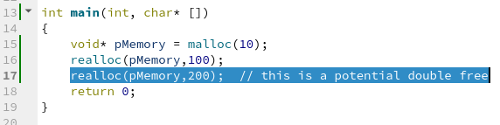
Some cases of indirect double/free
Be aware double-free will not happen only in the case when one explicitly calls 2 times to function delete or free. Double free can happen also by calling other APIs that, in turn, will allocate/deallocate buffers!!! Sometimes the problem can be there because of concurrency!!!
A wrong sequence of calling library functions internally allocating and deallocating buffers (for example fopen/fclose).
Global buffers allocation/deallocation without proper synchronization.
Realloc of the same address with the assumption that the old address is not deleted and valid after the realloc call. As you see - here crash can happen even without global visible pointer.
Working with STL containers should be properly synchronized. I think it is obvious that containers should not be protected by some synchronization mechanism (for example mutex) in the implementation. So the containers should be protected by a developer.

Slide 7
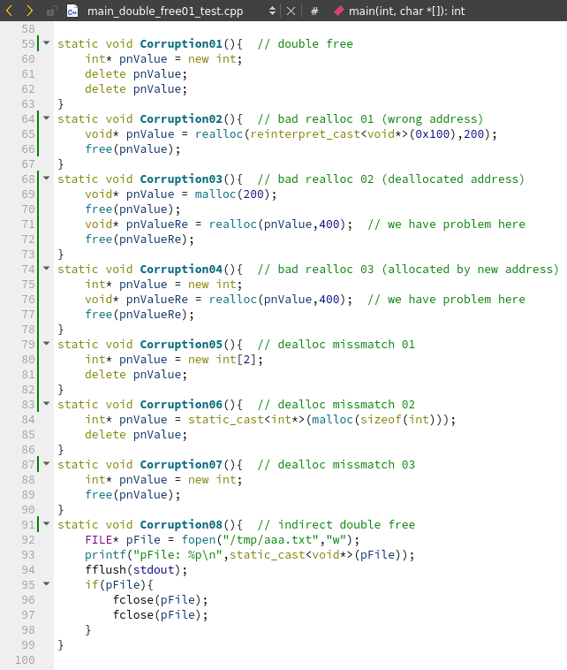
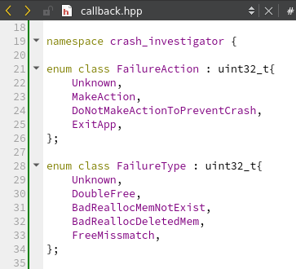
Code will be analyzed during demo
https://gitlab.zeuthen.desy.de/ers/crash_investigator/-/blob/master/src/tests/main_double_free01_test.cpp
Exit App is default behavior
Alongside these cases, the tool helps to detect bugs like in the function Corruption08.

Slide 8
addr2line -e /home/kalantar/dev/crash_investigator/sys/focal/Debug/lib/libcrash_investigator_new_malloc_0020.so -f -C 0x7d75
nm /home/kalantar/dev/crash_investigator/sys/focal/Debug/lib/libcrash_investigator_new_malloc_0020.so | grep _ZN18crash_investigator11CMemoryItem4InitEmNS_11FailureTypeEPvPNS_9BacktraceE

