Slide 1
FLOSSing proprietary code
Enlisting the help of the FLOSS community to build a commercial product
David Kaltschmidt
Notes:
When developing company has the option to develop something internally or reuse components built by others.
What are the benefits?
What do you need to be aware of?
How can obstacles be overcome?

Slide 2
Contents
Development models: private, public, private-collective
Case study¹: “Nokia Internet Tablet”
Benefits, hidden costs, strategies
Survey² of Embedded Linux developers
Licenses
Reasons to reveal
Revealing behavior
DOs and DON’Ts
M. Stuermer, S. Spaeth, and G. Von Krogh. “Extending private-collective innovation: a case study.” In: R&D Management 39.2 (2009), pp. 170–191.
J. Henkel. “Selective revealing in open innovation processes: The case of embedded Linux.” In: Research policy 35.7 (2006), pp. 953–969.
Notes:
Case study and survey will show how other companies applied this model.

Slide 3
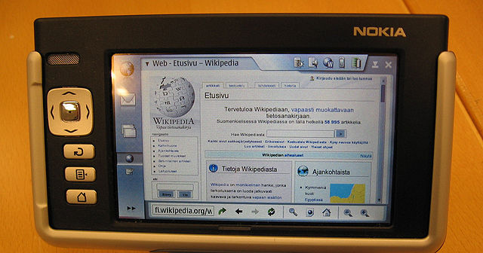
Case Study: “Nokia Internet Tablet”
Development started as early as 2000, 1st release 2005
Designed for Web-browsing and e-mail
No built-in phone
Operating system based OSS
Notes:
Google just purchased Android Inc. but Android was not released for another 3 years.

Slide 4
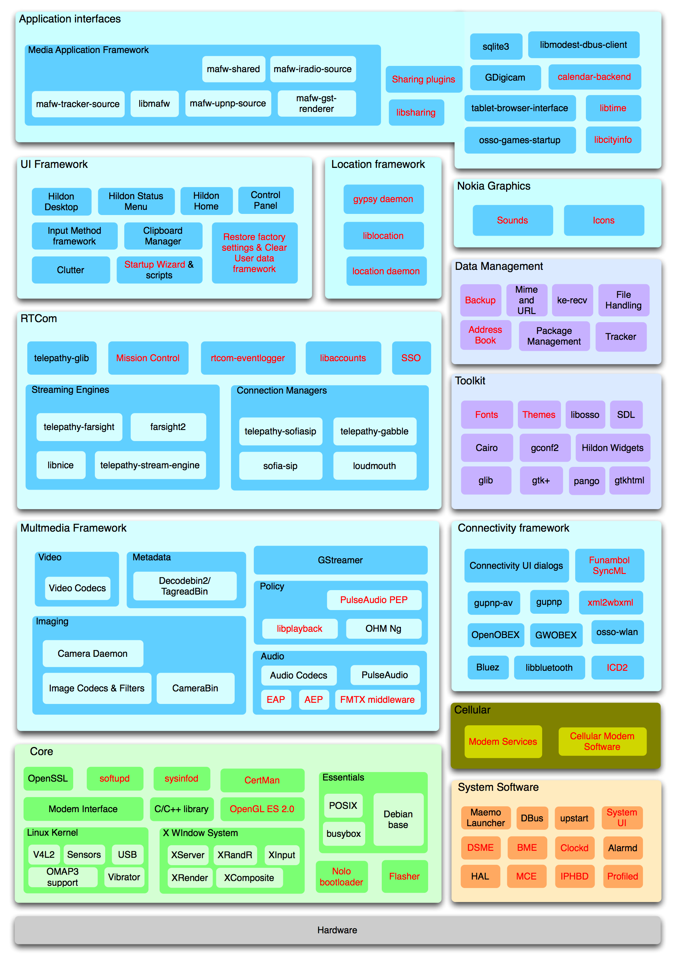
Based on OSS
Proprietary components are marked in red.
Modules dominated by proprietary software:
System software
Nokia graphics
Location framework
Single strategic components:
Boot-loader/Flasher
Restore/Backup
Fonts/Themes

Slide 5
Investment models
Private: invest and create ideas internally, commercialize and protect IP
Collective: public goods, give and take, public subsidy, non-exclusive
Private-collective: private resources to create public goods, non-exclusive, IP rights forfeited
Nokia paid open source developers, or hired them
Nokia created a software platform: Maemo
Notes:
For each of these components, Nokia had to decide, what to chose?

Slide 6
Benefits 1/2
Shared development cost
Reuse invites further contributions
Best case scenario: Higher quality at reduced fixed cost
Faster time-to-market
Nokia developed a whole operating system in a short time
System integrator of loosely coupled component providers
Learning from others’ contributions
Learn while creating something worth sharing
Learn by looking at other developers’ work
Notes:
Shared development
Faster time-to-market The use of modular open source software allowed Nokia to develop an operating system in a short time. By collaborating with outside volunteers and contributors Nokia acted as a system integrator coordinating a loosely coupled network of component providers.
Learning from others’ contributions This effect goes both ways as you can learn from the contributions of the community as well as learn in the process of creating something that you share. Nokia had started the Internet Tablet as a research project and had a lot of intimate knowledge of the whole architecture. Knowledge gaps were addressed by either outsourcing small tasks to individuals or companies experienced in open source software development. With this dual approach Nokia learned from the contributions as it had to integrate them into the final product.
GTK fork story.

Slide 7
Benefits 2/2
Reputation gain
Commitment to open source
Volunteers contribute to platform and later build apps
Recruitment opportunity for Nokia
Widespread adoption/dominant design
Low entry barrier to participate
Network effects
Consolidation, e.g. GNOME Embedded Platform
Notes:
Reputation gain
A positive reputation can be gained from a commitment to open source.
Volunteers contributing to the Maemo platform reported growing attachment to Nokia.
economical effect as these volunteers bought the device knowing that they were buying into an ecosystem which they could improve and create applications for.
Widespread adoption
The public availability of the innovation can lead to a fast and wide adoption,
accelerated by network effects that may establish a dominant design.
contributors to the OSS projects had no entry barrier to participate in the development of applications for the tablet. Nokia created GNOME Embedded Platform.
Number one: Reputation gain Being labeled “open source friendly” attracted developers who contributed to the platform, helped it grow and become increasingly appealing to other developers.

Slide 8
Costs/Dangers 1/2
Obvious: paying developers, forfeiting IP rights
Lack of differentiation
Clone with same architecture, same OSS software
Nokia kept parts of UI and hardware layer closed source
Losing business secrets
Company-specific code can be minimized
Outgoing code must be checked, NDAs
Notes:
Lack of differentiation
Nothing can stop a competitor to use the same architecture, same OSS, creating a clone
Strategy: selective revealing, architecture designed so that top and bottom layer are kept proprietary, middleware shared, middle part is generic
Losing business secrets
What is a business secret, what ends up in the source code?
Strategy: modular approach, separation of concerns

Slide 9
Costs/Dangers 2/2
Giving up control
Increasing dependency on external technology
Direction of development of the OSS
Organizational inertia
Clear platform releases by legal department
Bureaucratic process vs. dynamic community
Notes:
Giving up control
Costs increases when dependency on external sources increases
Choosing open source projects for the core of one’s product means giving up control over the direction of the development.
A thin line: Nokia poured money in the development of the GTK, improving it a lot for mobile devices, community members felt being pushed out, not given write access to Nokia’s repo, got more and more difficult to apply upstream patches
Organizational inertia
Platform software might include 3rd party software. Can it be shared with the public?
Regarding collaboration worlds collide: Nokia had internal bug-tracker, could not access public IRC channel, infrastructure was duplicated
Number one cost: Organizational inertia time-consuming processes simply proved inadequate to collaborate with a very flexible community, resulting in frustration on both sides

Slide 10
Generalizing
Was Nokia unique?
Survey of embedded Linux developers: What are conditions under which openness is feasible?
Issues:
Voluntary vs. forced openness (GPL)
Selective revealing
Proportion open vs. closed source
Type of code
Reasons to reveal
Revealing behavior
Notes:
Survey of embedded Linux developers:
one of three most widely used operating systems for embedded devices ranging from VCRs to mobile phones
device types are so different from one to another that no standard version of embedded Linux exists
Instead, developing for embedded Linux refers to the activity of extending or writing modules that make Linux more suitable for the respective device type.

Slide 11
Licenses
GPL: Recipients of software have right to see source code, Copyleft, no cross-license linking
LGPL: Copyleft only applies to the library/software itself, can be linked, GPL-compatible
APL: Permissive, attribution, GPL-compatible, track modifications
MIT/BSD: Permissive, attribution, no copyleft, GPL-compatible
Notes:
Copyleft: all derivative works be distributed under the terms of the same license

Slide 12
Ways to protect software
Release sources only upon request
If no one asks, source code remains “secret”
Lead time
Distribution of code only when released/sold to customers (GPL)
Software architecture
Consider all licenses of the reused OSS
Break up system into subsystems (a program in GPL terms)

Slide 13
Survey results
Percentage of shared code differs strongly for commercial firms: on average 49% of all code is shared, BUT σ = 35%, min = 1%, max = 100%
49% share more than 5 years ago (2000)
Generic code is shared by 63% of HW firms, 85% of SW firms
Product specific code is shared by a third of firms

Slide 14
Reasons to reveal
For HW companies:
GPL requires it
Appear as good OSS player
Bug fixes by others
Advance development
Reduced maintenance effort
Revealing good code improves technical reputation
For SW companies same result, except “revealing good code improves technical reputation“ ranked 3rd.

Slide 15
Revealing behavior
Other things being equal…
Small firms reveal more code
Policies encouraging to reveal code do not lead to more code being shared
SW firms reveal more than HW firms
Longer experience with embedded Linux leads to higher share of code being revealed
Expecting development support and reputation gain lead to higher share
Sharing as Marketing does not lead to more code being shared
GPL is not a motivator
Notes:
Companies that give the GPL as an important reason to reveal code, do not share more. These companies seem to be reluctant to share code in the first place and only do so when compelled to by a license.

Slide 16
DO and DONTs
DO read the licenses
DO identify generic parts
DO improve your architecture for reuse
DO trust the community
DO respect its meritocracy
DO lead by example
DON’T focus on protection
DON’T switch back to closed
DON’T try to control the community
DON’T take a project hostage
DON’T fork and expect to keep benefiting
Notes:
Is community-based development is viable?
Long time commitment!

Slide 17
Thank you. Questions?
DO keep sharing.
DO learn from others.
Sources:
M. Stuermer, S. Spaeth, and G. Von Krogh. “Extending private-collective innovation: a case study.” In: R&D Management 39.2 (2009), pp. 170–191.
J. Henkel. “Selective revealing in open innovation processes: The case of embedded Linux.” In: Research policy 35.7 (2006), pp. 953–969.
Wikipedia: Comparison_of_free_software_licenses, Licence_compatibility, Maemo_(operating_system)

