Slide 1
FLOSSing proprietary code
Enlisting the help of the FLOSS community to build a commercial product
David Kaltschmidt <david@inf.fu-berlin.de>
Notes:
Warm-up
How many here are working at a company?
How many are working at a company that use OSS in their products?
Among those who have contributed to those projects or created new ones by making code public?
Intro
When developing a product, a company has a choice.
Either to develop all components internally or reuse components built by others
Others can be another company or open source projects
You can just reuse these OSS components or start contributing or even start own projects

Slide 2
Contents
Development models: private, public, private-collective
Case study¹: “Nokia Internet Tablet”
Benefits, hidden costs, strategies
Survey² of Embedded Linux developers
Licenses
Reasons to reveal
Revealing behavior
DOs and DON’Ts
M. Stuermer, S. Spaeth, and G. Von Krogh. “Extending private-collective innovation: a case study.” In: R&D Management 39.2 (2009), pp. 170–191.
J. Henkel. “Selective revealing in open innovation processes: The case of embedded Linux.” In: Research policy 35.7 (2006), pp. 953–969.
Notes:
This will be explored in this talk.
After defining this sort of investment process, present case study
Nokia did exactly this, case study Nokia Internet Tablet based the development of this product mainly on open source software
made a large part of the research and product development transparent and accessible
Main questions
Help explore
What are the benefits?
What do you need to be aware of?
How can obstacles be overcome?
Generalize this by looking at a survey to find conditions when code sharing appears
Derive DOs and DONTs

Slide 3
Investment models
Private: invest and create ideas internally, commercialize and protect intellectual property rights
Collective: public goods, give and take, public subsidy, non-exclusive
Private-collective: private resources to create public goods, non-exclusive, IP rights forfeited
Nokia paid open source developers, or hired them
Nokia created a software platform: Maemo
Notes:
Private investment model
use internal processes to create ideas, knowledge, and technologies
commercialize these in the market place.
Expect to keep benefiting through intellectual property rights
Collective action model
Public subsidizes the developer who in turn contributes to the project
example: source code exchanges, like GitHub, BitBucket
Developer can be inside a company (allows free-riding) or just a student
Important thing is: non-exclusive in consumption
Private-collective model
Private companies spend resources to create public goods
Counter-intuitive: why should I make my innovations available to all and why pay for something that anyone else can use for free?
Main question you need to ask: Just free-ride or receive higher benefits when contributing to the public goods
Nokia took this further: paid or hired OSS developers and created a community software platform
This all happened for…

Slide 4
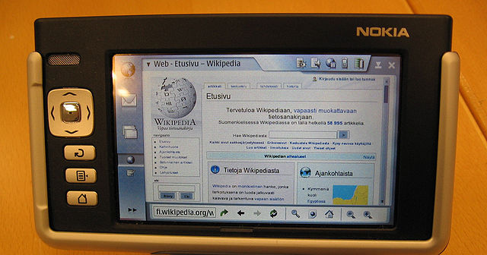
Case Study: “Nokia Internet Tablet”
Development started as early as 2000, 1st release 2005
Designed for Web-browsing and e-mail
No built-in phone
Operating system based OSS
Notes:
Nokia Internet Tablet
Nokia started to experiment with incorporating open source products, specifically based on the Linux kernel, into their devices in 2000
Release in 2005, Google just purchased Android Inc. but Android was not released for another 3 years
Smartphones were getting smarter, Internet more mobile
Built this device to probe the market, keep costs low
They included a lot of OSS into the product…

Slide 5
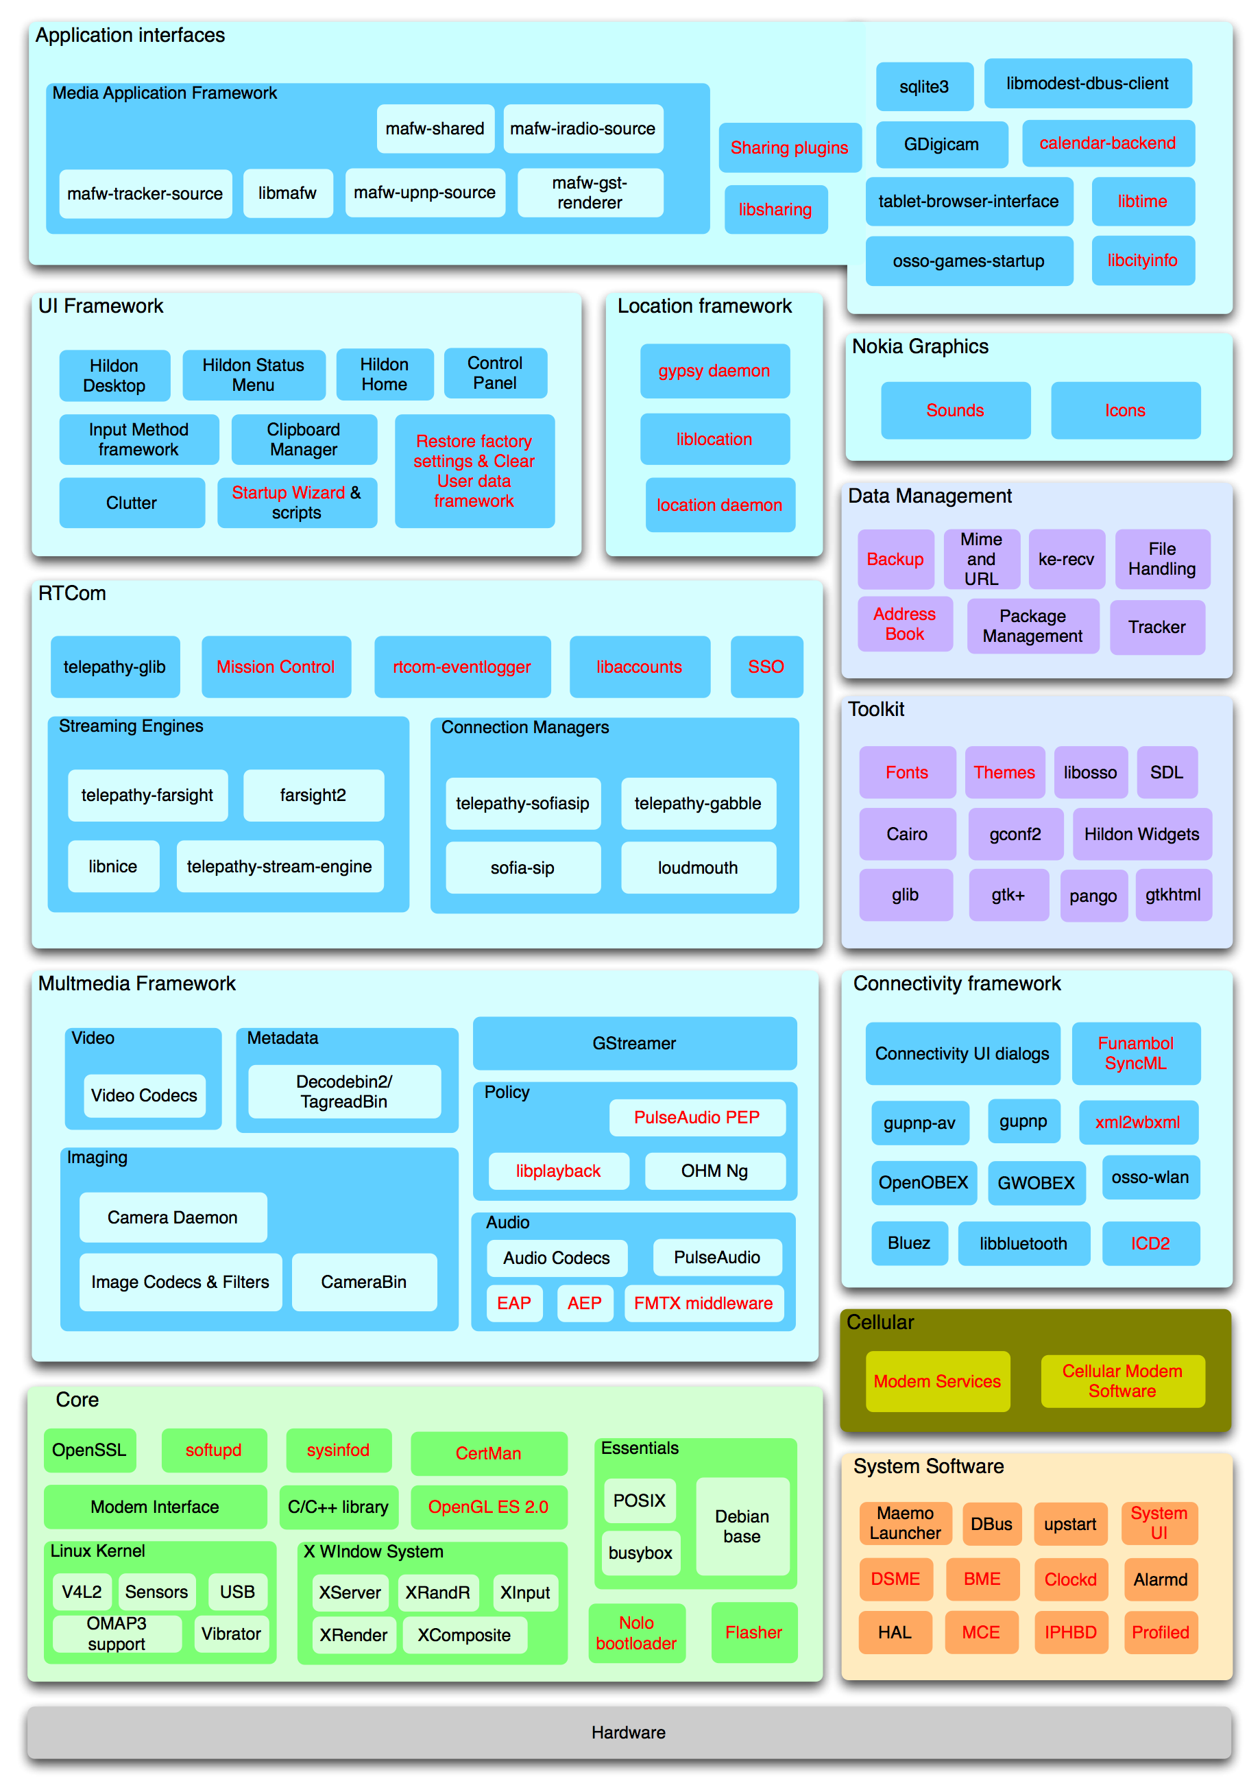
Based on OSS
Proprietary components are marked in red.
Modules dominated by proprietary software:
System software
Nokia graphics
Location framework
Single strategic components:
Boot-loader/Flasher
Restore/Backup
Fonts/Themes
Notes:
Don’t be alarmed! You are not supposed to be able to read the labels.
Shows the system design for the operating system
Hardware access in the bottom and UI components in the top
Important: share of components colored red
25% of code was closed source
Dominated by proprietary software: system software (clockd, profile manager), Nokia graphics, Location framework
Single components: boot-loader, restore/backup, fonts and themes
25% closed source, 50% modified OSS, 25% unmodified OSS
Half of the OSS was modified, improved or extended by Nokia.
Nokia helped advance more than half of these projects
Paid OSS developers
created an SDK and a community platform
Invested considerable resources, lets look at the benefits…

Slide 6
Benefits 1/2
Shared development cost
Reuse invites further contributions
Best case scenario: Higher quality at reduced fixed cost
Faster time-to-market
Nokia developed a whole operating system in a short time
System integrator of loosely coupled component providers
Learning from others’ contributions
Learn while creating something worth sharing
Learn by looking at other developers’ work
Notes:
Shared development cost
Reuse of open source software
outsourcing of software testing and bug fixing and maintenance to open source communities
Experimentation and contributions of new applications by lead users
Faster time-to-market
- The use of modular open source software allowed Nokia to develop an operating system in a short time
By collaborating with outside volunteers and contributors Nokia acted as a system integrator
coordinating a loosely coupled network of component providers
Short feedback loop from the community, good for deciding what features to include
Learning from others’ contributions
This effect goes both ways as you can learn from the contributions of the community as well as learn in the process of creating something that you share.
When creating something, you develop a better understanding than you would get from just using it.
Nokia had started the Internet Tablet as a research project and had a lot of intimate knowledge of the whole architecture.
Knowledge gaps were addressed by either outsourcing small tasks to individuals or companies experienced in open source software development.
With this dual approach Nokia learned from the contributions as it had to integrate them into the final product.
Learn about how the community works. GTK fork story: Forked early and then worked only on the fork, in effect two separate development branches, over time it gets more and more difficult to transplant changes

Slide 7
Benefits 2/2
Reputation gain
Commitment to open source
Volunteers contribute to platform and later build apps
Recruitment opportunity for Nokia
Widespread adoption/dominant design
Low entry barrier to participate, no license fees
Network effects
Consolidation, e.g. GNOME Embedded Platform
Notes:
Reputation gain
A positive reputation can be gained from a commitment to open source.
Volunteers contributing to the Maemo platform reported growing attachment to Nokia.
economical effect as these volunteers bought the device knowing that they were buying into an ecosystem which they could improve and create applications for
Nokia can fish in this pool of developers for employees
Widespread adoption
The public availability of the innovation can lead to a fast and wide adoption,
accelerated by network effects that may establish a dominant design.
contributors to the OSS projects had no entry barrier to participate in the development of applications for the tablet. Nokia created GNOME Embedded Platform.
Number one benefit: Reputation gain
Being labeled “open source friendly” attracted developers who contributed to the platform, helped it grow and become increasingly appealing to other developers.
What about the cost?

Slide 8
Costs/Dangers 1/2
Obvious: paying developers, forfeiting IP rights
Lack of differentiation
Clone with same architecture, same OSS software
Nokia kept parts of UI and hardware layer closed source
Losing business secrets
Company-specific code can be minimized
Outgoing code must be checked, NDAs
Notes:
Obvious costs
paying developers (hired and contracted)
Forfeiting IP rights that could be licensed to others
Lack of differentiation
Nothing can stop a competitor to use the same architecture, same OSS, creating a clone
Strategy: selective revealing, architecture designed so that top and bottom layer are kept proprietary, middleware shared, middle part is generic
Losing business secrets
What is a business secret, what ends up in the source code? New products?
Strategy: modular approach, separation of concerns

Slide 9
Costs/Dangers 2/2
Giving up control
Increasing dependency on external technology
Direction of development of the OSS
Organizational inertia
Clear platform releases by legal department
Bureaucratic process vs. dynamic community
Notes:
Giving up control
Costs increases when dependency on external sources increases
Choosing open source projects for the core of one’s product means giving up control over the direction of the development
A thin line: Nokia poured money in the development of the GTK, improving it a lot for mobile devices, community members felt being pushed out, not given write access to Nokia’s repo, got more and more difficult to apply upstream patches
Organizational inertia
Platform software might include 3rd party software. Can it be shared with the public?
Legal review process required
Regarding collaboration worlds collide: Nokia had internal bug-tracker, could not access public IRC channel, infrastructure was duplicated
Number one cost: Organizational inertia
time-consuming processes simply proved inadequate to collaborate with a very flexible community,
resulting in frustration on both sides

Slide 10
Generalizing
Was Nokia unique?
Survey (N=268) of embedded Linux developers: What are conditions under which openness is feasible?
Issues:
Voluntary vs. forced openness (GPL)
Selective revealing
Percentage open vs. closed source
Type of code
Reasons to reveal
Revealing behavior
Notes:
Do other companies do the same?
What are conditions for openness?
Can I apply this in my company?
Survey of embedded Linux developers
one of three most widely used operating systems for embedded devices ranging from VCRs to mobile phones
device types are so different from one to another that no standard version of embedded Linux exists
Instead, developing for embedded Linux refers to the activity of extending or writing modules that make Linux more suitable for the respective device type.
Main questions
We’ll find out that a lot of times, openness is forced by a license
But what are the reasons for voluntary openness?
Before diving looking at the results on how much code is being shared? What kind of code?
Lets look at some open source licenses…

Slide 11
Licenses
GPL: Recipients of software have right to see source code, Copyleft, no cross-license linking
LGPL: Copyleft only applies to the library/software itself, can be linked, GPL-compatible
ASL: Permissive, attribution, no copyleft, GPL-compatible, track modifications
MIT/BSD: Permissive, attribution, no copyleft, GPL-compatible
Notes:
Licenses govern the usage or redistribution of software.
Free software license grants recipients rights to modify and redistribute the software
GPL: recipients of software have right to request the source code
Copyleft: all derivative works be distributed under the terms of the same license
Linking to a GPL’ed library makes whole software GPL
LGPL addresses this issue, copyleft clause only applies to the library itself
Apache Software License is more permissive, no copyleft, but you have to keep track of the modifications to the original source
MIT and BSD have no copyleft and no other requirement than a disclaimer in the final product that the software is included
“Redistributions in binary form must reproduce the above copyright notice”

Slide 12
Ways to protect software
Software architecture
Consider all licenses of the reused OSS
Break up system into subsystems (a program in GPL terms)
Lead time
Distribution of code only when released/sold to customers (GPL)
Release sources only upon request
If no one asks, source code remains “secret”
Notes:
When forced to share source code, you have a couple of options:
Like Nokia, you can devise an architecture that allows for selective revealing
You can also not worry and count on your lead time
source code only has to be revealed when the product is released
When development cycle is long, the lead time is long
Source code must be made available only upon request, if no one asks, the code remains secret.

Slide 13
Survey results
Percentage of shared code differs strongly for commercial firms: on average 49% of all code is shared, BUT σ = 35, min = 1%, max = 100%
49% share more than 5 years ago (2000)
Generic code is shared by 63% of HW firms, 85% of SW firms
Product specific code is shared by a third of firms
Notes:
Some results are not very conclusive
On average 49% of all code is shared
But with a standard deviation of 35 percentage points, min 1%, max 100%
People share more than before, half of respondents claim they share more than 5 years ago
As expected, more generic code is shared than product specific code, like in Nokia case
Hardware companies share less generic code, because their code is more likely bound to their hardware

Slide 14
Reasons to reveal
For HW companies:
GPL requires it
Appear as good OSS player
Bug fixes by others
Advance development
Reduced maintenance effort
Revealing good code improves technical reputation
For SW companies same result, except “revealing good code improves technical reputation“ ranked 3rd.
Notes:
Reasons to reveal
12 were offered
GPL requires it, with 75% agreement of all respondents
Reputation seems important too, 70% agree
Below rank 6, agreements falls below 50%
I’m not sure about rank 2, as it was presented in the questionnaire, who would say no to that?
These are trailed by reasons related to external development support
SW firms it seems more important to have a good technical reputation, probably because they are more numerous and more competitive and therefor see reputation as a marketing tool

Slide 15
Revealing behavior
Other things being equal…
Small firms reveal more code
Policies encouraging to reveal code do not lead to more code being shared
SW firms reveal more than HW firms
Longer experience with embedded Linux leads to higher share of code being revealed
Expecting development support and reputation gain lead to higher share
Sharing as Marketing does not lead to more code being shared
GPL is not a motivator
Notes:
Conditions that lead to more openness
Small firms reveal more, benefit more from external development support
Policies that encourage to share code, have no effect
SW firms share more code than HW firms, probably because it is more generic
More experience with OSS leads to a higher portion of shared code
Companies that gave development support and reputation gain as reasons, share more
Curious: marketing reasons result in more shared code, reason: they don’t share more, but more visible
Companies that give the GPL as an important reason to reveal code, do not share more.
These companies seem to be reluctant to share code in the first place and only do so when compelled to by a license.
After all this lets distill this a bit…

Slide 16
DO and DONTs
DO read the licenses
DO identify generic parts
DO improve your architecture for reuse
DO give your code an external work-out
DO trust the community and respect its meritocracy
DO lead by example
DON’T focus on protection
DON’T switch back to closed
DON’T try to control the community rather be a steward
DON’T take a project hostage
DON’T fork and expect to keep benefiting
Notes:
and see what we can learn from the Nokia case study and the Embedded Linux survey
DO
Read the license, you may be forced to share
Identify generic parts, easy in modular approach by virtue of separation of concerns
Improve your architecture for reuse, as reuse leads to higher software quality
Give your code an external workout: If you developed a generic component yourself, the potential is that someone might find it useful and reuse it, thereby testing it and hopefully give feedback or even contribute
When going down that road, especially for bigger projects, trust the community, they have been doing this for a while, and you would not be using the project’s OSS if it had not come this far.
When sharing your own project, make sure it is in good shape and follow coding guidelines, otherwise people will be reluctant to contribute
DONT
Don’t focus on protection but on how to use the technologies to create something of value
Sharing is a commitment, you can’t take it back, if you stop sharing and start publishing binary code, your reputation is down the drain
Don’t try to control the community, there are no hard deadlines in the in community-driven development, a lot of the people work on the project in their free time, you can pay some of the developers to speed up the process like Nokia has done
Stewardship is important: Nokia managed to create a whole ecosystem with its software platform with thousands of apps developed by the community
Don’t take a project hostage, don’t take over a community project, contributor may leave if you steer a project off course just to suit your needs
Don’t fork and expect to keep on benefiting, like Nokia did with Gimp Toolkit
If this was too much I’ll leave you with the two that I think are most important…

Slide 17
Thank you. Questions?
DO keep sharing.
DO learn from others.
Sources:
M. Stuermer, S. Spaeth, and G. Von Krogh. “Extending private-collective innovation: a case study.” In: R&D Management 39.2 (2009), pp. 170–191.
J. Henkel. “Selective revealing in open innovation processes: The case of embedded Linux.” In: Research policy 35.7 (2006), pp. 953–969.
Wikipedia: Comparison_of_free_software_licenses, Licence_compatibility, Maemo_(operating_system)

