Slide 1
Where is history being written?
Georeferencing contributions to Wikipedia
Diploma thesis
David Kaltschmidt <david@inf.fu-berlin.de>
Supervisors: Dr. Claudia Müller-Birn, Prof. Dr. Robert Tolksdorf

Slide 2
Contents
Motivation and goals
Hypotheses
Application
Demo
Localness
Data set/Results
Discussion

Slide 3
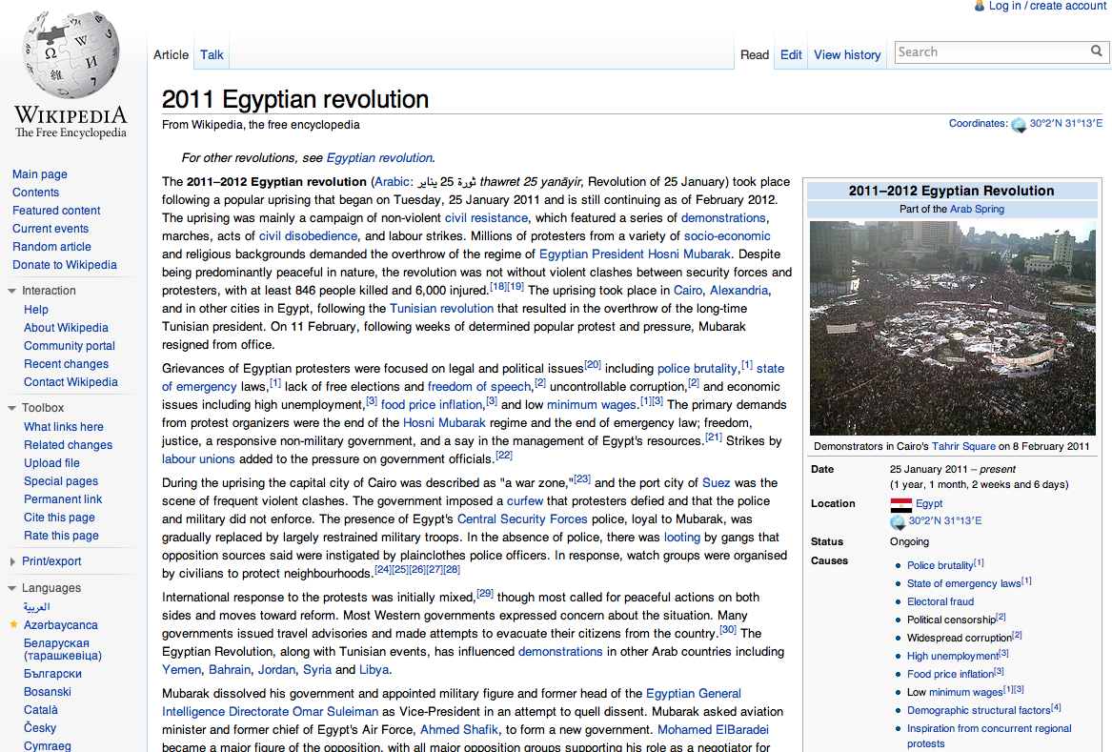
Motivation: Wikipedia & Arab Spring

Slide 4
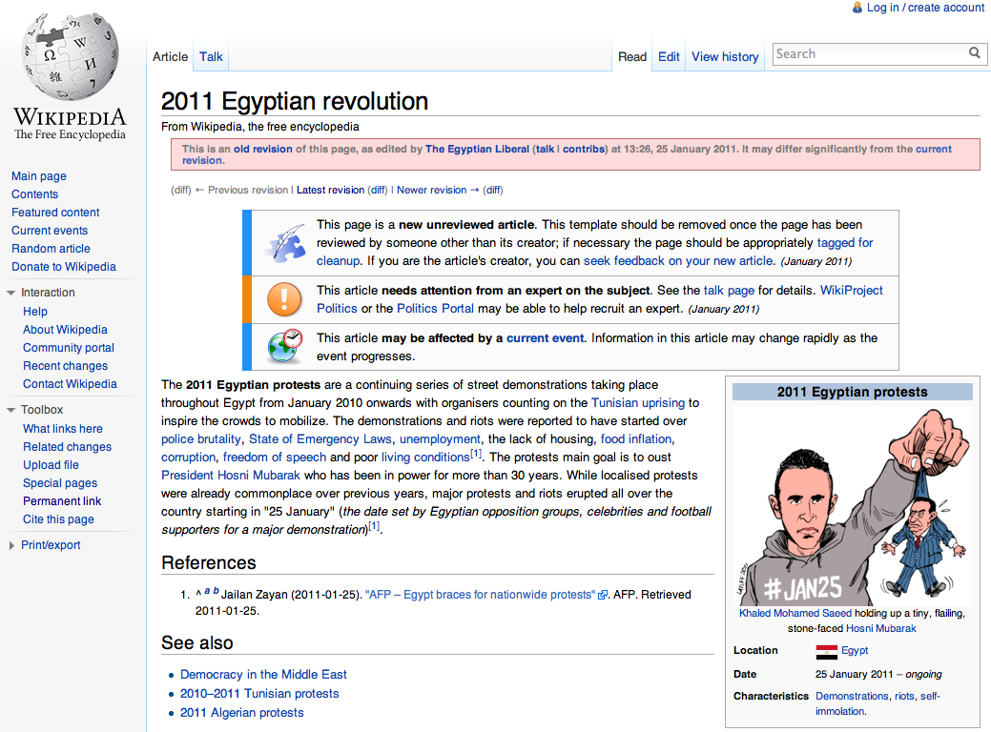
Motivation: Wikipedia & Arab Spring

Slide 5
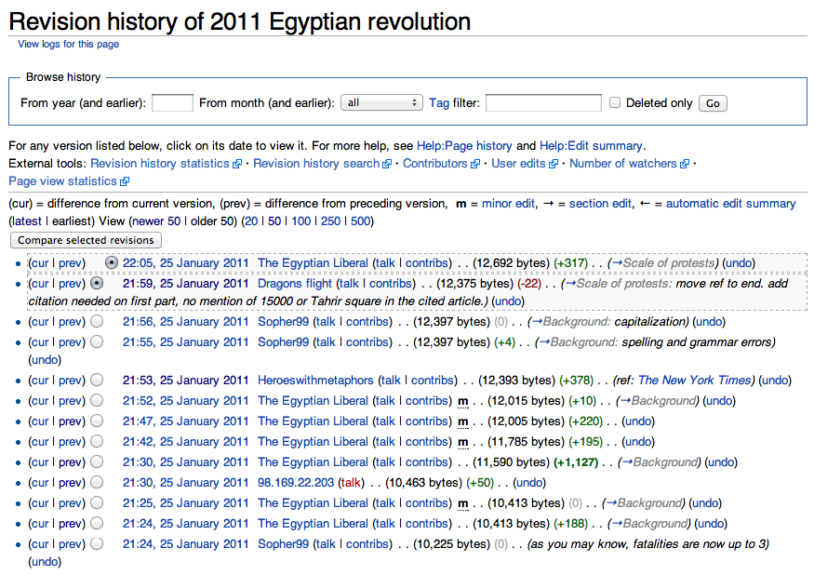
Motivation: Wikipedia & Arab Spring

Slide 6
Motivation: Wikipedia & Arab Spring
What is Wikipedia?
Online encyclopedia
News channel
History book
“In a few short years, it has become perhaps the largest work of online historical writing, the most widely read work of digital history, and the most important free historical resource on the World Wide Web. “
Roy Rosenzweig
Can History Be Open Source? Wikipedia and the Future of the Past
2006, The Journal of American History

Slide 7
Hypotheses
Article creation
  Are articles created immediately in response to the event?
  Is the English Wikipedia preferred by non-native speakers?
  Are articles created by citiizens?
Participation over time
  Local vs. distant
  Anonymous vs. registered
Survival of edits
  Are local contributions more likely to survive? (edit count)
  Is text from locals more likely to survive? (text length)
Subjects: Articles of political events in the English Wikipedia

Slide 8
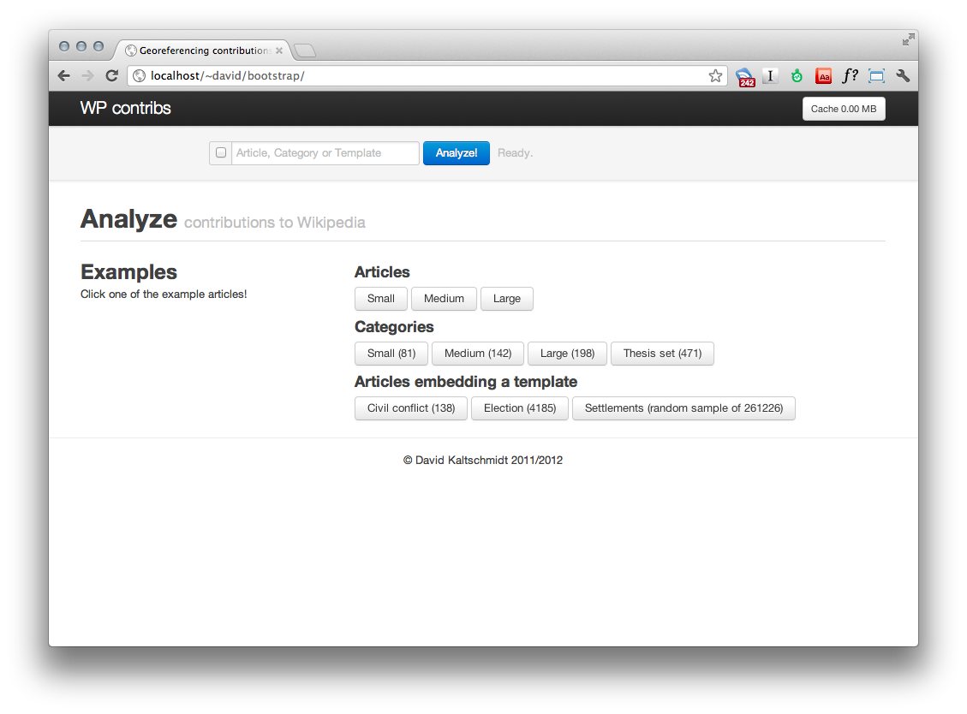
Application
http://davkal.github.com/WP-contributions/

Slide 9
Application: Data sources
WP
API
Wikitext
Tool-server
Authors
IP locations
Wiki-Trust
Annotated wikitext
HTML version
All revisions (en)
First revision of all languages
Quova
IP lookup
PM Check-user
Username -> IP
User pages

Slide 10
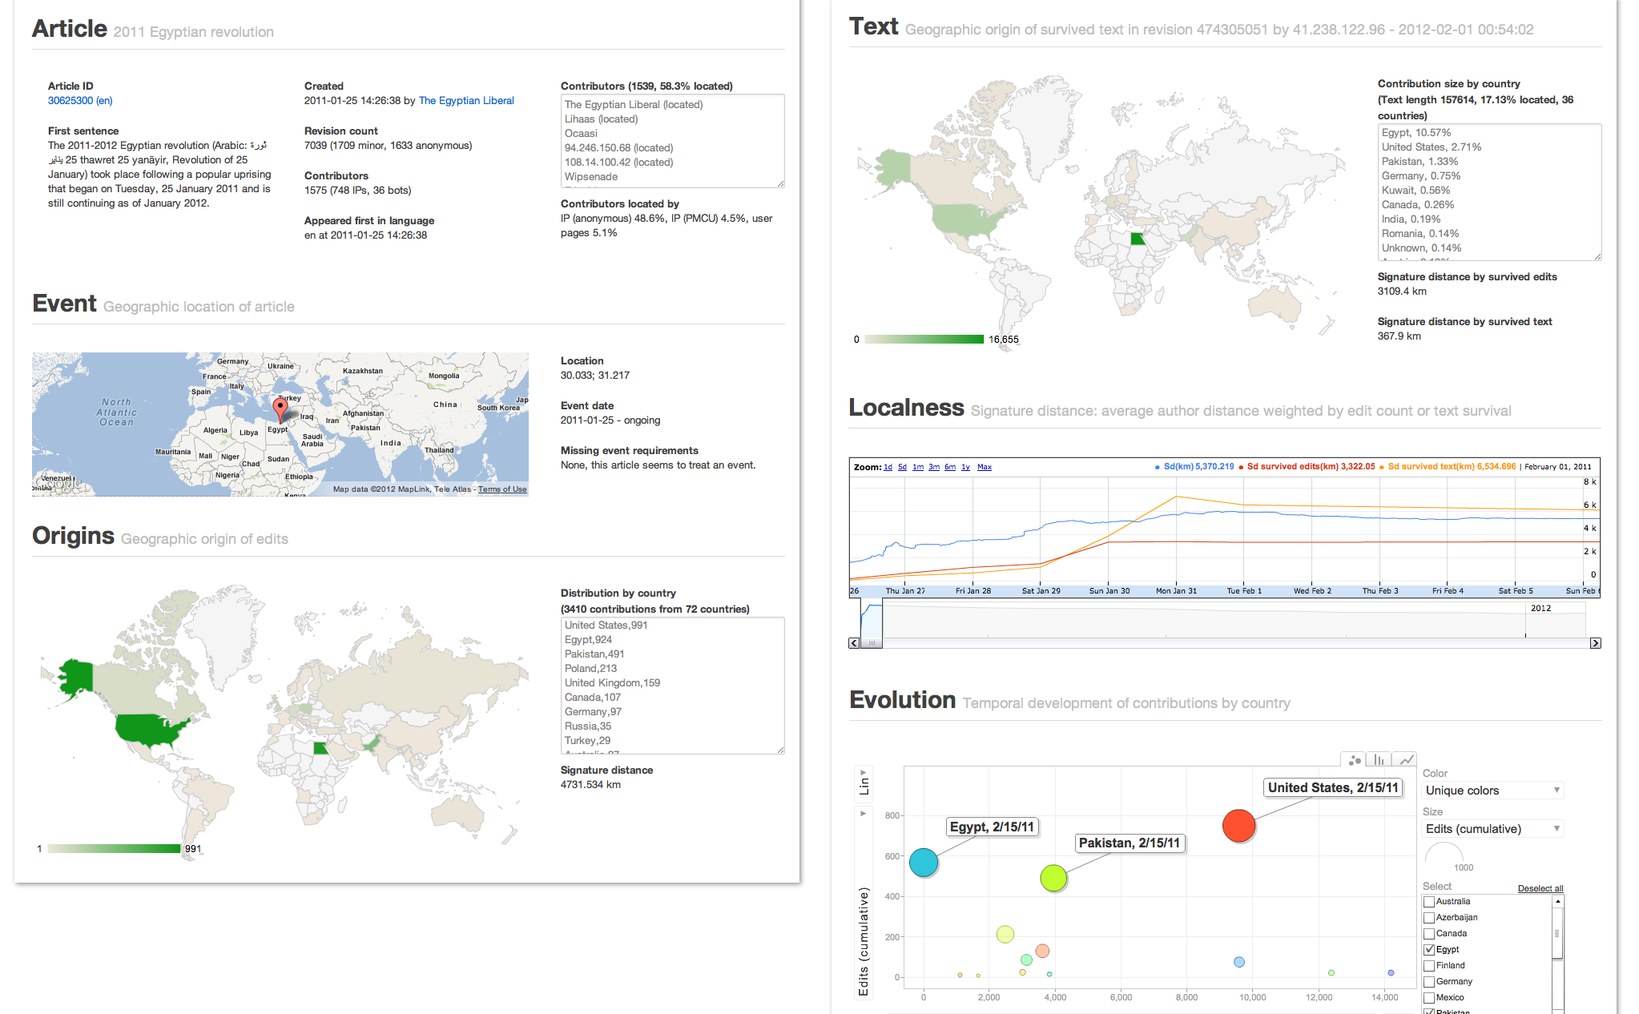
Application: Results

Slide 11
Results of individual articles
Demo
Egypt
Libya
Bahrain
Show motion charts
Berlin

Slide 12
Localness
Problem:
How to quantify the localness of contributions?
For a single article/group of articles?
Signature distance:
“Average distance between an article and its contributing authors weighted by the relative work per author.”
– Volunteered geographic information in Wikipedia
D. Hardy, 2011, PhD thesis

Slide 13
Signature distance: example
Signature distance =
Average distance of authors weighted by their work
Example article: 2011 Egyptian revolution
  Article location: Cairo
3 edits in total:
  1 by Alice (Cairo)
  2 by Bob (Berlin)
Signature distance
= (1 * dist(Cairo, Cairo) + 2 * dist(Berlin, Cairo)) / 3
= (1 * 0 + 2 * 3144 km) / 3
= 2096 km

Slide 14
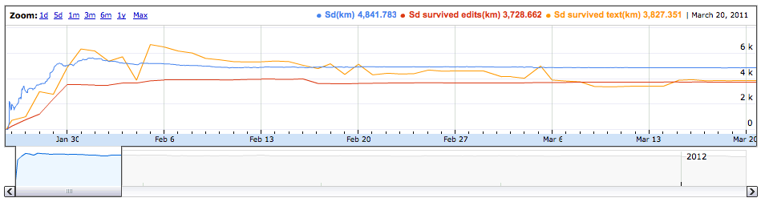
Signature distance
Signature distance weighted by
Edits
Survived edits
Survived text

Slide 15
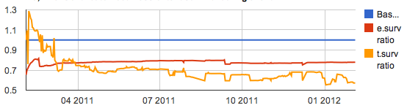
Localness Indexes
Problem: When each article has its own distance distribution,
how to compare localness across articles?
Solution: Normalize survived edits/texts by signature distance.
Signature distance (sigdist) forms baseline of 100
Index e.surv = sigdist(edit surv) / sigdist * 100
Index t.surv = sigdist(text surv) / sigdist * 100

Slide 16
Group analysis

Slide 17
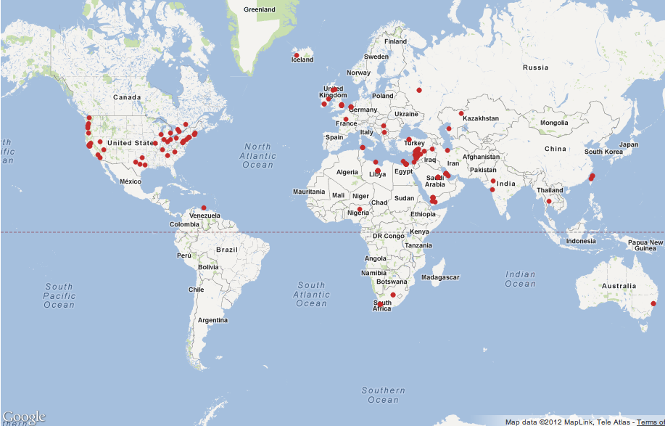
Group analysis: Dataset
Category:Protests by year
Category:2000s riots by year
Category:2010s riots by year
Category:Protests by country
Template:Infobox civil conflict
Category:Arab Spring
Analysis run on 2012-03-19: 781 articles

Slide 18
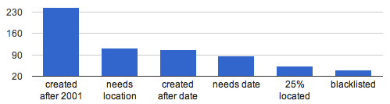
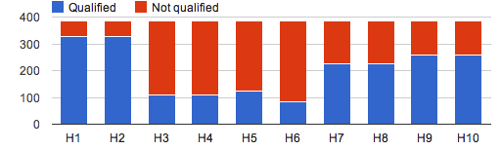
Group analysis: Article requirements
384 articles qualified (49.2%)
Hypotheses had individual requirements

Slide 19
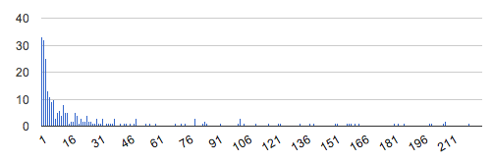
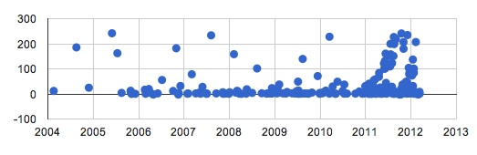
Results: Article creation
H1. Immediacy of creation (mean: 14d)
H2. Immediacy over time (R: 0.05)

Slide 20
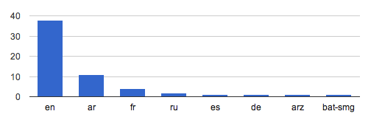
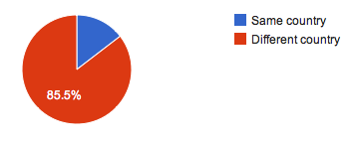
Results: Article creation
H3. First language for events in non-English speaking countries
(en: 53%)
H4. Citizen creator (14.5 %)

Slide 21


Results: Participation in the beginning
H5. Anonymous vs. registered users in the beginning
(mean: 16%, median: 14%, stddev: 13)
H6. Local vs. distant users in the beginning (mean: 19%, median: 8%, stddev: 26)

Slide 22

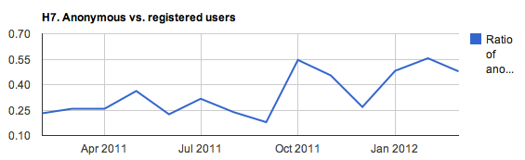
Results: Participation over time
H7. Distribution of correlation (R) of Anon./registered with article age (mean: 0.04, median: 0.00, stddev: 0.19)
For reference: 2011 Egyptian Revolution

Slide 23

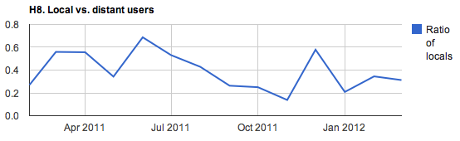
Results: Participation over time
H8. Distribution of correlation (R) of Local/distant with article age (mean: -0.03, median: 0.00, stddev: 0.19)
For reference: 2011 Egyptian Revolution

Slide 24


Results: Text Survival
H9. Distribution of means of e.surv index
(mean: 93.7, median: 95.4, stddev: 19.26)
H10. Distribution of means of t-surv index
(mean: 92.5, median: 92.5, stddev: 38.69)
For reference:
2011 Egyptian Revolution

Slide 25
Discussion
Group results not as conclusive as hoped
Individual article analysis can give more insight
Limitations
  share of located text is small -> enhance user locating algorithm
  Resolution of location is dependent on what user reveals
  (country, state, town)
  People’s mobility, mobile devices

Slide 26
Thank you.
Questions?

