Slide 1
AI Scan — MAMOGRAF
Sun'iy intellekt asosida ko'krak bezi o'smalarini erta aniqlash tizimi
To'liq ish tsikli: Upload → Auto-AI → Annotation → Dataset → Yangi model

Slide 2
Loyiha haqida
▸ MAMOGRAF — mammografiya tasvirlari yordamida ko'krak bezi o'smalarini (xavfsiz / xavfli) erta aniqlovchi AI tizim
▸ DICOM ko'ruvchi + annotatsiya muharriri + AI inference + model o'qitish — barchasi bitta veb-ilovada (FastAPI)
▸ Maqsad: radiolog ishini tezlashtirish, diagnostika aniqligini oshirish
▸ Asosiy g'oya — YOPIQ SIKL (Active Learning): tizim ishlatilgani sari aniqroq bo'lib boradi
Diqqat markazida: Upload → Auto-AI → Annotation → Dataset → Yangi model
AI Scan · MAMOGRAF

Slide 3
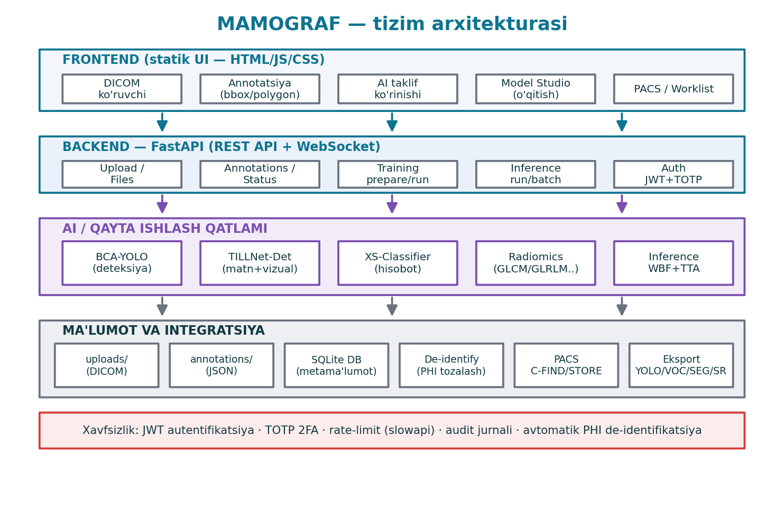
Tizim arxitekturasi
AI Scan · MAMOGRAF

Slide 4
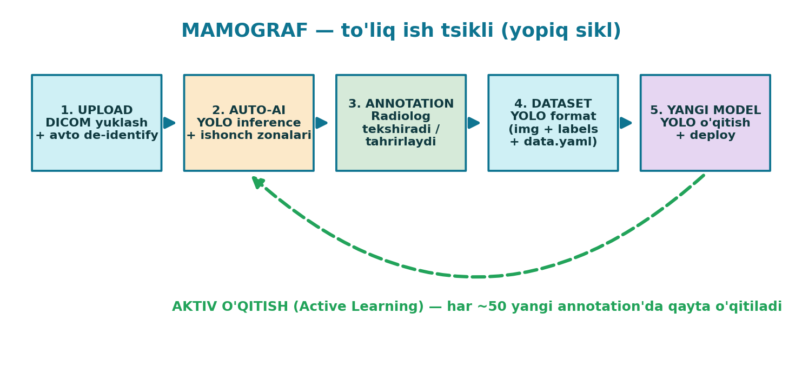
To'liq ish tsikli — umumiy ko'rinish
Har ~50 yangi (tekshirilgan) annotatsiyada model AVTOMATIK qayta o'qitiladi
AI Scan · MAMOGRAF

Slide 5
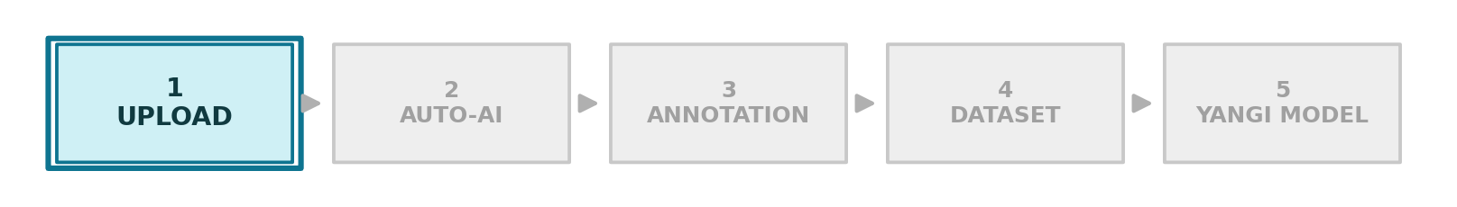
Bosqich 1 — Upload (DICOM yuklash)
BOSQICH 1/5
POST /api/upload
▸ DICOM fayl noyob ID bilan uploads/<id>.dcm ga saqlanadi
▸ pydicom validatsiyasi — yaroqsiz fayl rad etiladi (HTTP 400)
▸ AVTO DE-IDENTIFY: PHI tag'lari DARHOL tozalanadi (annotatsiyadan oldin)
▸ Metama'lumot qaytariladi: o'lcham, modality, view, laterality, kadrlar
▸ Auto-AI fon (background) vazifasiga navbatga qo'yiladi
– Upload bloklanmaydi — DICOM darhol ko'rinadi, bbox ~10–20s da paydo bo'ladi
AI Scan · MAMOGRAF

Slide 6
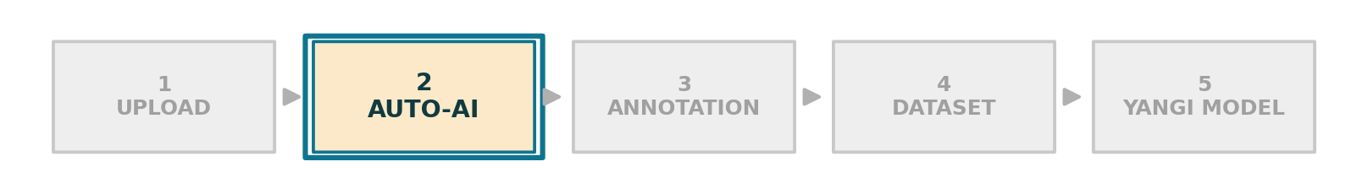
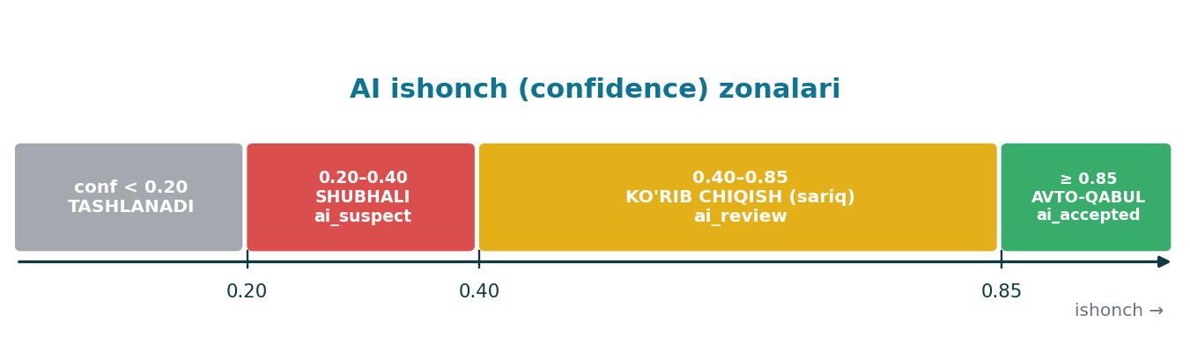
Bosqich 2 — Auto-AI (avtomatik inference)
BOSQICH 2/5
_auto_infer_uploaded (background)
▸ DICOM → PNG render → YOLO inference (infer_png)
▸ Har bir deteksiya ISHONCH (confidence) zonasiga ajratiladi
▸ Pseudo-annotatsiya: created_by = "ai:<model>"
▸ conf < 0.20 — saqlanmaydi (tashlanadi)
– Funksiya hech qachon xato qaytarmaydi — upload xavfsiz
AI Scan · MAMOGRAF

Slide 7
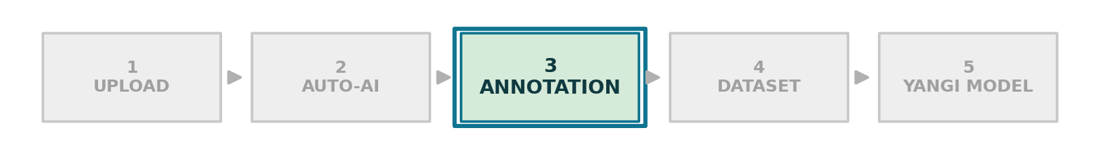
Bosqich 3 — Annotation (radiolog)
BOSQICH 3/5
PUT /api/annotations · /status · /history
▸ Radiolog AI takliflarini tasdiqlaydi / tahrirlaydi / o'chiradi
▸ Zarur bo'lsa yangi bbox yoki polygon qo'shadi
▸ Multi-label: bitta belgi bir nechta yorliqqa ega bo'lishi mumkin
▸ Status: edited / approved / submitted
▸ Har bir o'zgarish audit jurnaliga yoziladi (kim · qachon · nima)
▸ /training/suggestion → ≥50 annotatsiyada 'qayta o'qitish' tavsiyasi
AI Scan · MAMOGRAF

Slide 8
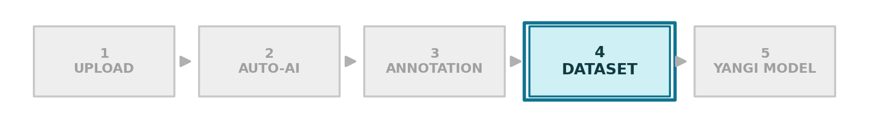
Bosqich 4 — Training dataset
BOSQICH 4/5
POST /api/training/prepare
▸ Annotatsiyalardan Ultralytics YOLO formatidagi dataset yaratiladi
▸ Filtrlar: include_ai (AI belgilarini qo'shish), statuses
▸ bbox / polygon → YOLO normalized formatga aylantiriladi
▸ BEMOR darajasida train/val split — data leakage oldini oladi
▸ seed orqali takrorlanuvchi (reproducible) bo'linish
<dest>/
images/{train,val}/
<id>.png
labels/{train,val}/
<id>.txt
data.yaml
AI Scan · MAMOGRAF

Slide 9
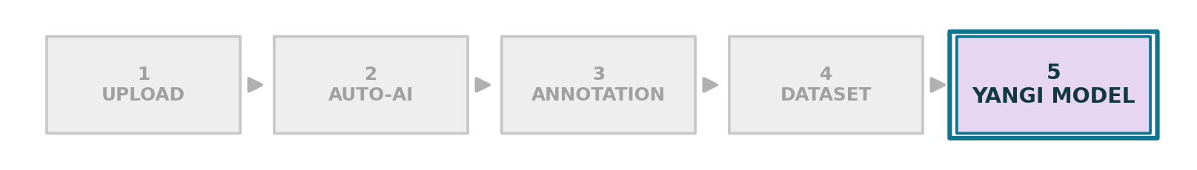
Bosqich 5 — Yangi model (o'qitish + deploy)
BOSQICH 5/5
POST /api/training/run → _run_yolo_train
▸ Ultralytics YOLO o'qitish fon rejimida boshlanadi (run_id)
▸ Parametrlar: base_model · epochs · imgsz · batch · optimizer · lr
▸ Augmentation: hsv · fliplr · scale · mosaic · mixup · early stopping
▸ deploy_after=True → o'qitilgan model AVTOMATIK joylanadi
▸ Holat kuzatuvi: /training/status/{run_id} · /training/runs
– Yangi model keyingi Auto-AI'da ishlatiladi → sikl yopiladi
AI Scan · MAMOGRAF

Slide 10
Aktiv o'qitish — nega yopiq sikl?
▸ Yangi o'qitilgan model keyingi UPLOAD'larda Auto-AI sifatida ishlatiladi
▸ Aniqroq AI → radiolog kamroq tuzatadi → annotatsiya tez to'planadi
▸ Ko'proq sifatli annotatsiya → yana aniqroq model
▸ Natija: har aylanishda model yaxshilanadi, qo'l mehnati kamayadi
AI Scan · MAMOGRAF

Slide 11
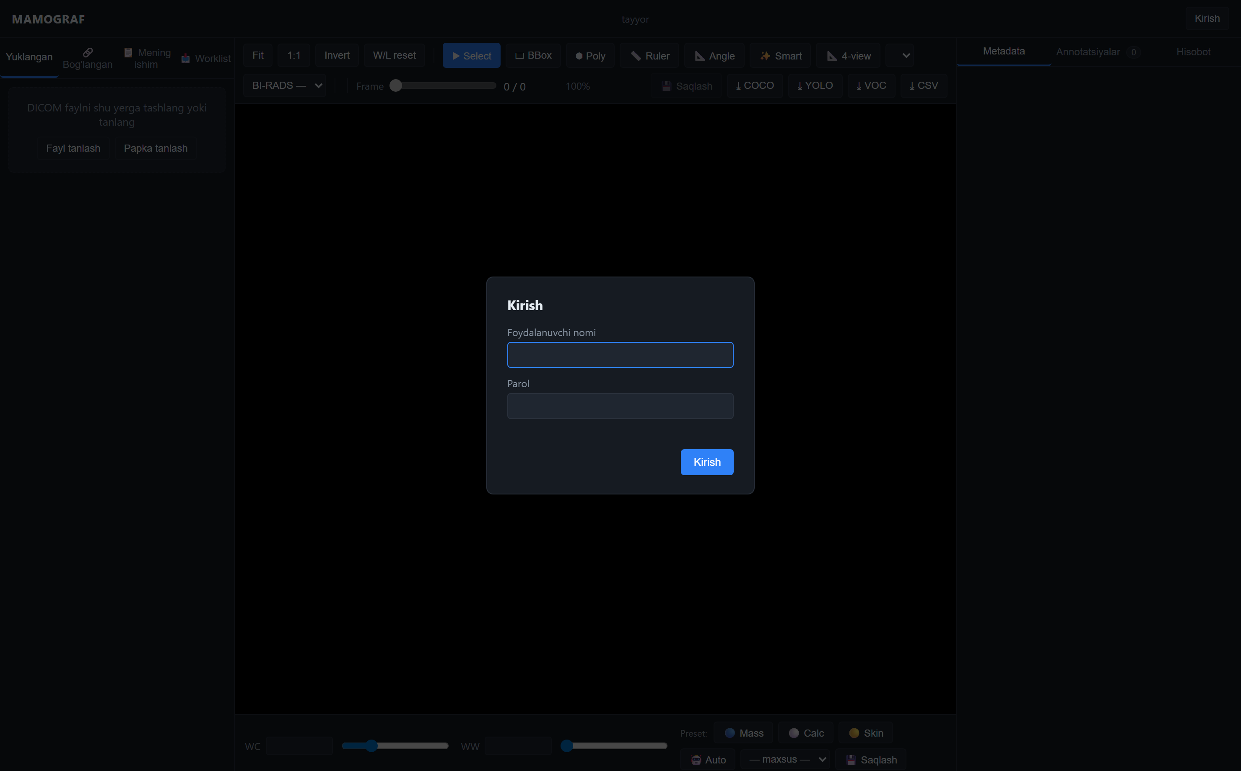
Veb-interfeys — kirish (login)
▸ JWT autentifikatsiya
▸ Ixtiyoriy TOTP (2FA)
▸ Rollar: admin · reviewer · annotator
▸ Rate-limit himoyasi (10/min)
AI Scan · MAMOGRAF

Slide 12
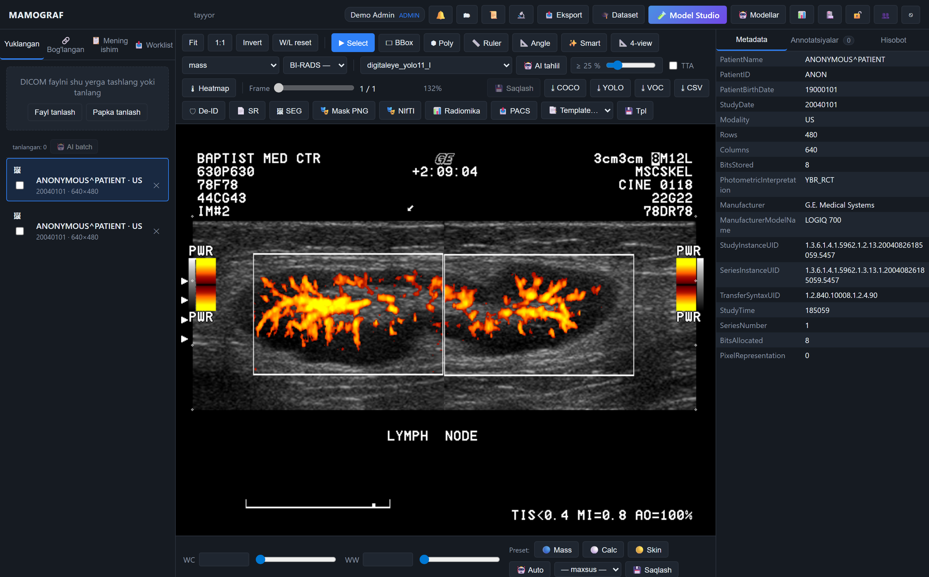
Veb-interfeys — DICOM ko'ruvchi va annotatsiya
▸ BBox · Polygon · Ruler · Angle · Smart click
▸ AI takliflari rangli zonalar bilan
▸ Metadata PHI'siz (ANONYMOUS^PATIENT)
▸ Eksport: COCO · YOLO · VOC · CSV
▸ DICOM-SEG · SR · Mask · Radiomics
AI Scan · MAMOGRAF

Slide 13
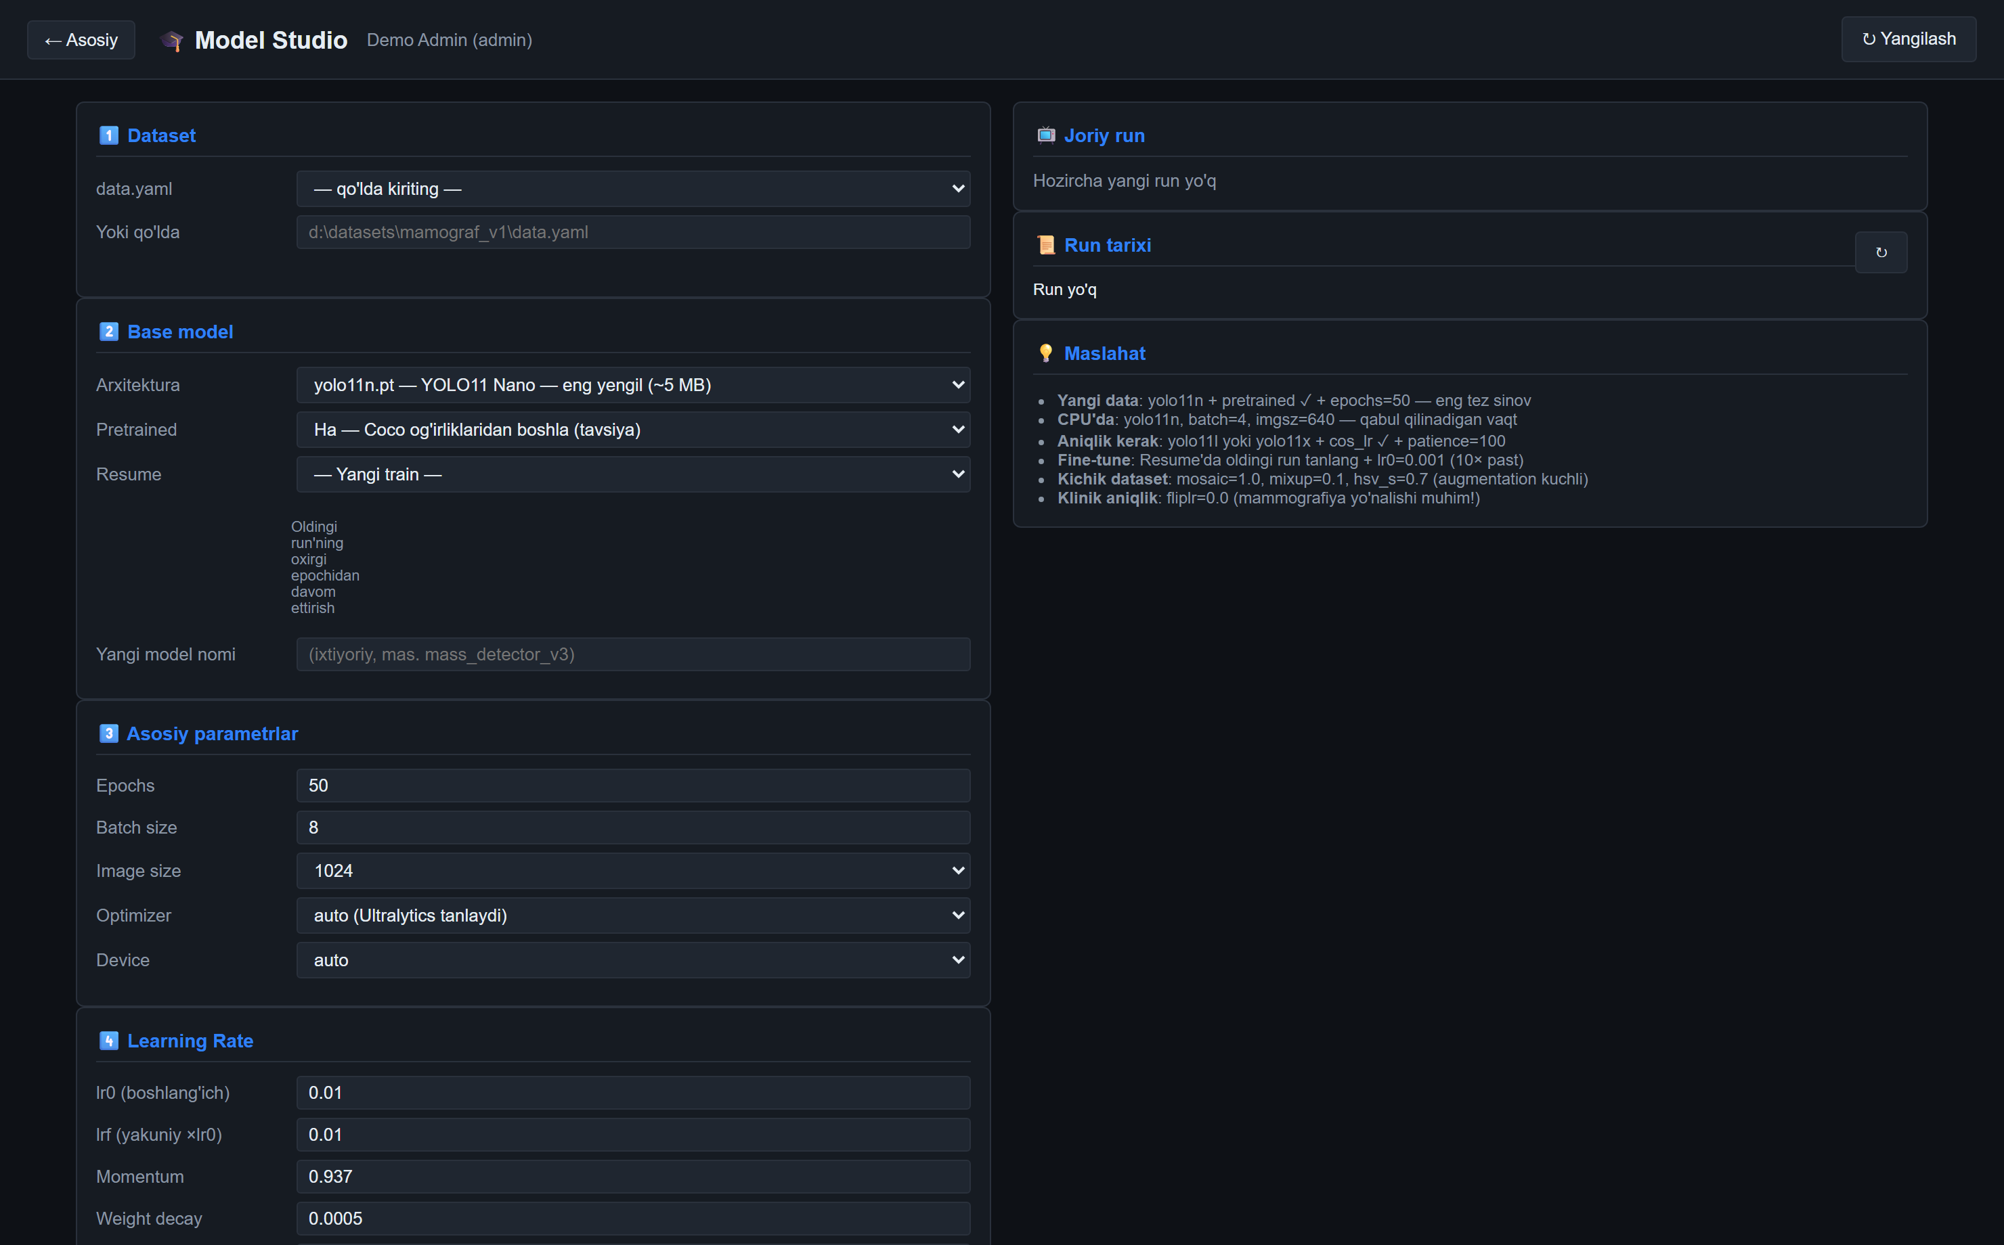
Veb-interfeys — Model Studio (o'qitish)
▸ Dataset (data.yaml) tanlash
▸ Base model · pretrained · resume
▸ Epochs · batch · imgsz · optimizer · LR
▸ Augmentation sozlamalari
▸ Run tarixi va aktiv o'qitish maslahati
AI Scan · MAMOGRAF

Slide 14
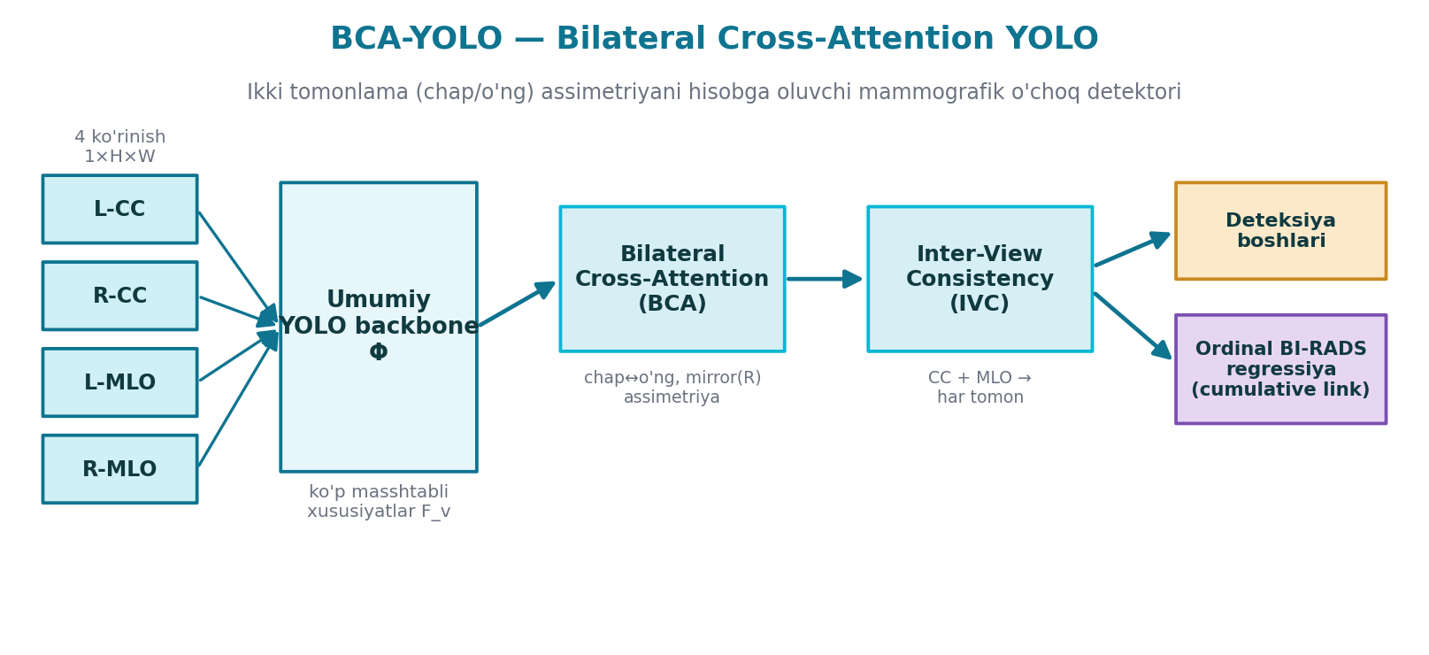
Model arxitekturasi — BCA-YOLO
▸ Bilateral Cross-Attention (BCA): chap/o'ng ko'krak assimetriyasini hisobga oladi
▸ Inter-View Consistency (IVC): CC + MLO ko'rinishlarini birlashtiradi
▸ Ordinal BI-RADS regressiya boshi (cumulative link)
AI Scan · MAMOGRAF

Slide 15
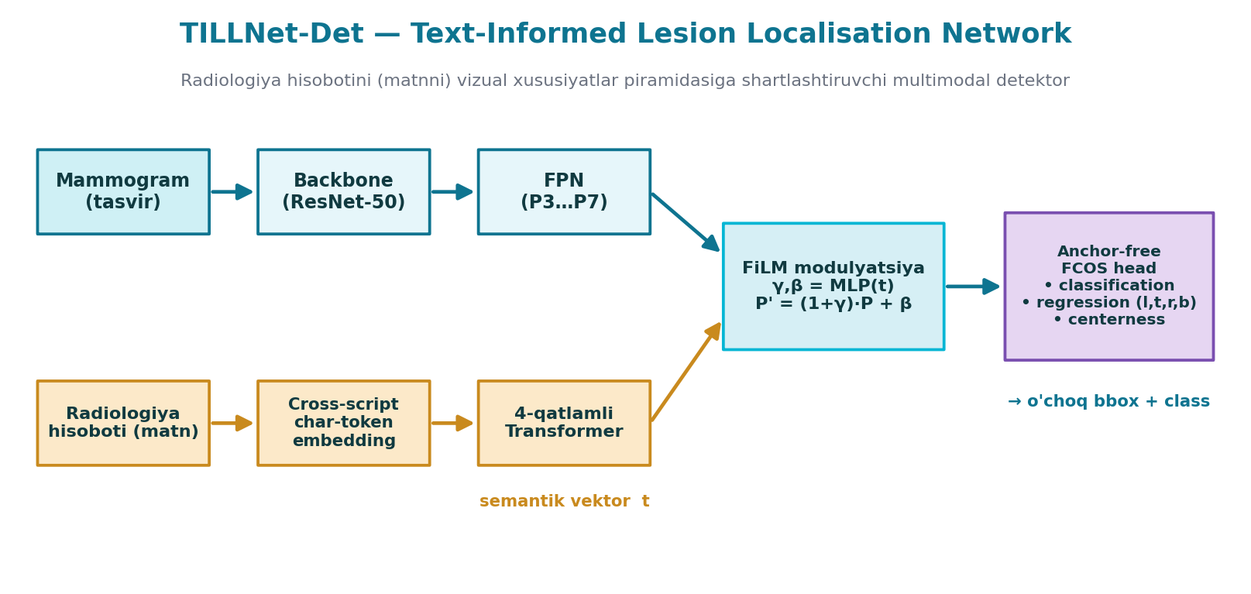
Model arxitekturasi — TILLNet-Det
▸ Cross-script matn enkoderi (o'zbek-Cy / o'zbek-Lat / rus / ingliz)
▸ FiLM modulyatsiya: hisobot matni vizual FPN'ni shartlashtiradi
▸ Anchor-free FCOS head — classification · regression · centerness
AI Scan · MAMOGRAF

Slide 16
Xulosa va texnologiyalar
▸ Yopiq AI sikli: Upload → Auto-AI → Annotation → Dataset → Yangi model
▸ Backend: Python · FastAPI · Uvicorn | AI: PyTorch · Ultralytics YOLO
▸ DICOM: pydicom · highdicom · pylibjpeg | Radiomics: GLCM/GLRLM/GLSZM/NGTDM
▸ Xavfsizlik: JWT + TOTP (2FA) · avtomatik PHI de-identifikatsiya · audit
▸ Eksport: YOLO · VOC · CSV · DICOM-SEG · DICOM-SR · NIfTI
▸ Maxsus model arxitekturalari: BCA-YOLO · TILLNet-Det · XS-Classifier
Faqat ilmiy-tadqiqot maqsadida · klinikada qo'llashdan oldin validatsiya talab etiladi
AI Scan · MAMOGRAF

