Slide 1












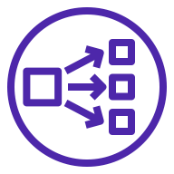





AWS Cloud
Availability Zone 1
Availability Zone 2
Availability Zone 3
VPC
Public subnet
Public subnet
Public subnet
NAT gateway
NAT gateway
NAT gateway
Auto Scaling group
Administrator
Bastion host
Bastion host
Bastion host
Private subnet
Private subnet
Private subnet
Auto Scaling group
Users
Primary Amazon EKS node
NGINX
Artifactory
Network Load Balancer
Auto Scaling group
Secondary Amazon EKS node
Secondary Amazon EKS node
NGINX
Artifactory
Xray
NGINX
Artifactory
Xray
S3 bucket
Amazon RDS
(Optional) Amazon RDS
Amazon EKS

