Slide 1
Coarse-to-Fine Gaussian Process Regression
Yusuf Erol and Dave Moore
CS281B Spring 2012
Midterm Presentation

Slide 2
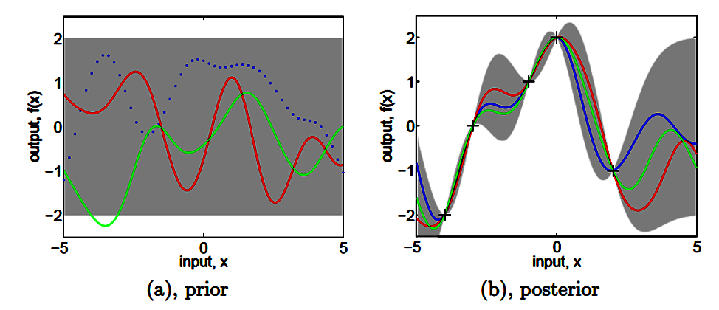
Gaussian Process Regression
Kernel-based probabilistic regression.
Bayesian inference on functions with a Gaussian Process prior: any finite set of function values f(x₁), f(x₂), …, f(x_{n}) has a multivariate normal distribution, with covariances given by a user-specified kernel k(x_{i}, x_{j}).
Predicts mean and variance conditioned on training data.

Slide 3
Applications of GPR
General nonlinear regression.
Variance estimate enables active learning, global function optimization, etc.
Integration into Bayesian models.
Knowledge engineering through choice of kernel.
Dataset | Prediction | # Training points | Dimension
Seismic arrivals | Wave propagation times from events to stations | 150,000 | 5
SARCOS | Robot arm torque | 45,000 | 21
Songs (MSD) | Year of song release | 463,000 | 90

Slide 4

Computational Issues
Expected value at a test point is:
Inversion of the Gram Matrix requires O(N³)
Prediction at a point requires O(N)
The storage of the Kernel matrix requires O(N²); for large N this has to be stored and read from disk.

Slide 5
Approximation methods
Sparse approximations (e.g. Smola & Bartlett ‘01)
Reduced-rank approximations:
Approximate eigendecomposition (Williams & Seeger ‘01)
Conjugate gradients (Gibbs & MacKay, ‘97)
Random features (Rahimi & Recht ‘08)
Bayesian Committee Machine (Tresp, ‘00)
Space-partitioning trees (Shen, Ng, Seeger ‘06)
Fast multipole methods (Yang et. al ‘05)

Slide 6
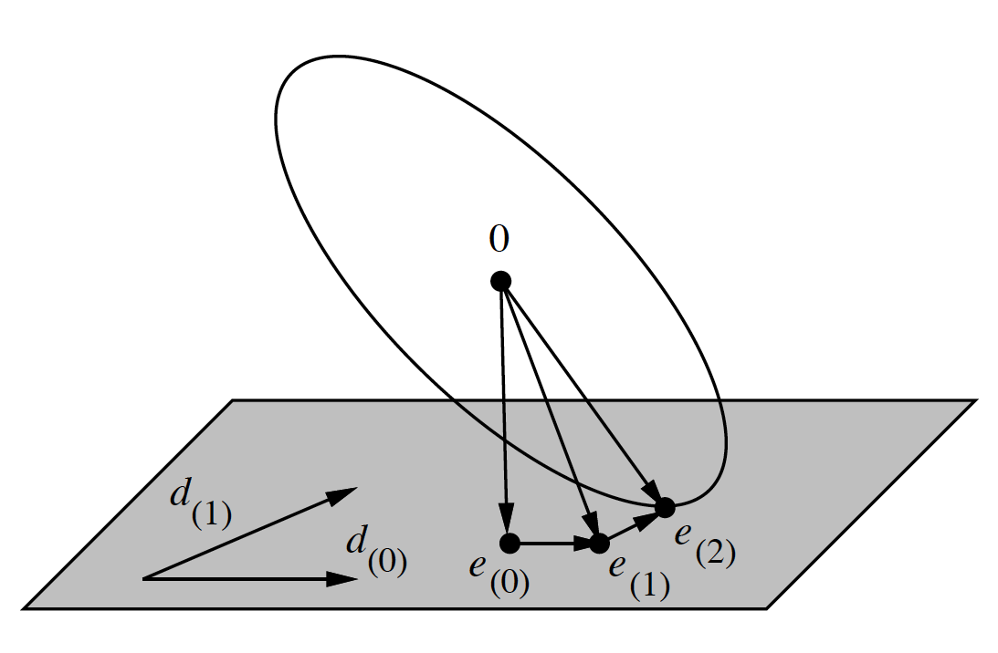




Low Rank Approximations
The main idea:
If spectrum is not flat, a solution in the subspace will be accurate.
Conjugate Gradient iterations will be O(N²), hence the total cost will be O(qN²)
Equivalently, one can find a Q, such that

Slide 7
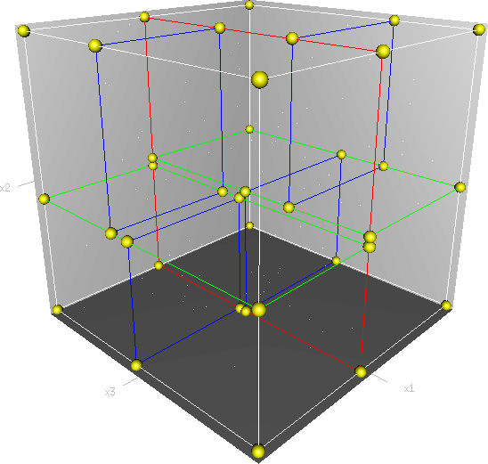
Space-partitioning trees
K-d trees form a hierarchical partitioning of the data.
Nearest neighbors in O(log n).
Shen, Ng, Seeger (2006) recursively cluster points according to their covariance with the query point.
Problem: k-d trees fail in high dimensional spaces.
Potential solutions: cover trees or ball trees.

Slide 8
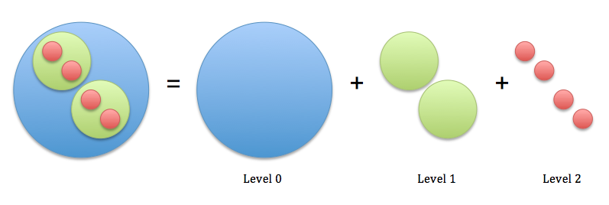
What is our Plan?
Apply a blend of proposed techniques in a such a way to allow a multiresolution solution
Space-Partitioning Trees to partition data, random features for low-rank solutions and FGT/IFGT to speed up MVM.

