Slide 2
Computational Issues
Inversion of the Gram Matrix requires O(N³)
Prediction at a point requires O(N)
The storage of the Kernel matrix requires O(N²), has to be stored in slow memory
Depending on the Kernel and the structure of the problem, one may capture most of the information that can be gathered via exact methods by approximations

Slide 3
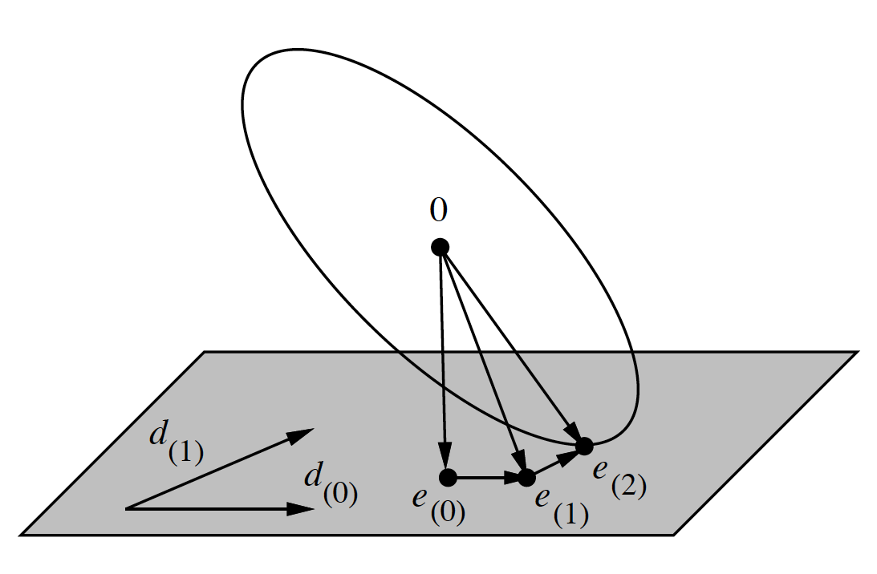





Low Rank Approximations
The main idea:
If spectrum is not flat, a solution in the subspace will be accurate.
Conjugate Gradient iterations will be O(N²), hence the total cost will be O(qN²)
Equivalently, one can find a Q, such that

Slide 4
Efficient Low Rank Approximations
To find a subspace that approximates the solution accurately, one at least needs an eigendecomposition, which is prohibitive.
Randomized and Greedy versions
Nystrom’s Method
Random Features
Greedy Subset Selection

Slide 5
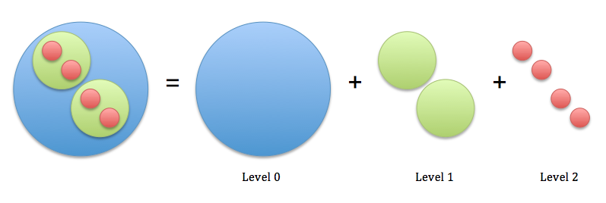
What is our Plan?
Apply a blend of proposed techniques in a such a way to allow a multiresolution solution
Space-Partitioning Trees to partition data, random features for low-rank solutions and FGT/IFGT to speed up MVM.

