Slide 1
Taxi Trajectory Cluster Analysis Presentation By, Davneet Kaur (810944556) Siddhi Shah (810933687)

Slide 2
Outline
Introduction
Data Overview
Environment Setup
Demonstration
Discussion & Future Works

Slide 3
Introduction
1

Slide 4
Cluster Analysis?
Cluster – collection of objects
Cluster Analysis – grouping similar objects together
Applications – stand-alone tool
– preprocessing step
Notes:
Cluster is a collection of data objects. The objects within a cluster are similar to one another and are dissimilar to objects in other clusters.
Cluster analysis or clustering is an unsupervised learning in which a set of objects are grouped in such a way that objects in the same cluster or group are more similar (in some sense) to each other than in other groups.
For example, in case of some trajectory data, the
Cluster analysis can be used as a stand-alone tool to get some insights into the data such as in case of data mining or machine learning or it can be used as a preprocessing step for other algorithms such as image analysis, information visualization etc.

Slide 5
Problem Definition
To filter the Taxi trajectory data for a certain time interval and perform cluster analysis of the pickup locations.
Visualize the hot pickup locations on map
Visualize customer preferences in terms of venders using bar chart
Notes:
Previously, it was a problem that researchers did not had enough spatial data to answer useful questions or build compelling visualizations. But today with lots and lots of spatial data being available, the problem is to how to effectively use/visualize this data to set some insights from it. Too many scattered points on a map can overwhelm a viewer looking for some simple information. Furthermore, rendering a JavaScript web map (like Leaflet) with millions of data points on a mobile device can swamp the processor and be unresponsive.
So, our goal is to filter the taxi data and do cluster analysis to obtain some insights from it. This application mainly finds out the hot pickup locations and customer preferences for taxi vendors at any given time.
The clustered pickup locations are displayed on the map and the customer preferences are visualized using bar chart.

Slide 6
Why Cluster Analysis?
Driver’s Perspective
Hot Pickup Location
Analyze customers preferences
Customer’s Perspective
Taxis readily available
Reduces wait time
Notes:
The main benefits of using such an application is that
Such analysis can give the taxi drivers an idea about the most picked up locations at any time and so they can be available around that locations. So, at any time the taxis are readily available for the customers and it reduces the wait time.
The venders can analyze the customer preferences and can change their per our rates or may be their enhance the taxis to increase business.

Slide 7
Data Overview
2

Slide 8
Dataset Attributes
Id
vendor_id
pickup_datetime
dropoff_datetime
pickup_longitude
pickup_latitude
dropoff_longitude
dropoff_latitude
store_and_fwd_flag
trip_duration
dist_meters
wait_sec
Notes:
The data set used for our analysis is the Mexico taxi dataset and has these attributes.
As of now, we have used the vender_id, pickup_datetime, pickup_longitude and pickup_latitude.
The other attributes can be leveraged for some analysis/data mining in future.

Slide 9
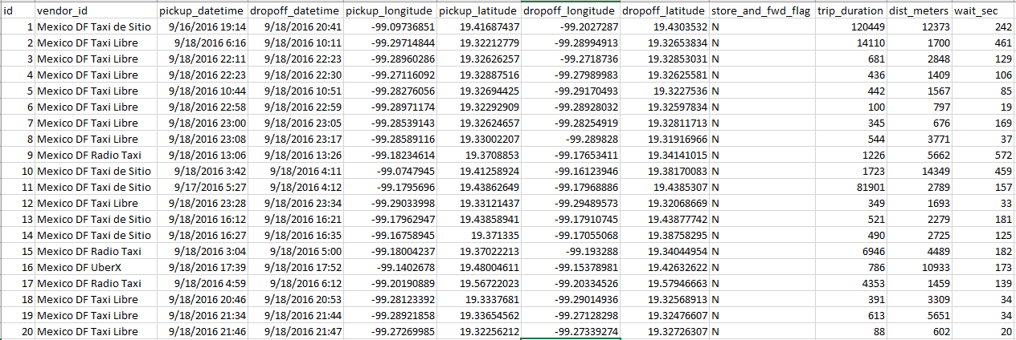
Dataset from https://www.kaggle.com
Notes:
The data set we used is obtained from Kaggle.com. These are sample rows.

Slide 10
Environment Setup
3

Slide 11
Technologies Leveraged
Data Storage
Server connection
Analysis
Display
MongoDB
Pymongo & Flask
Leaflet.js
D3.js
Notes:
These are the technologies that we used. MongoDB is used to store the dataset.
Pymongo is a python library that is used to connect to mongo db from python.
Flask is a python library that is used to connect to the local server and render the html.
Leaflet and D3 are javascript libraries that are used for cluster analysis and then finally visualize the results.

Slide 12
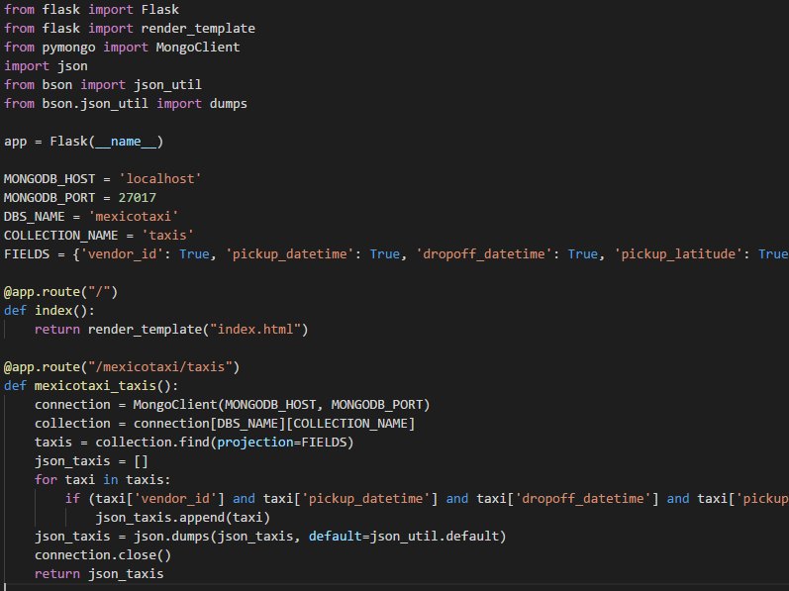
Connection to Server
Notes:
This is the app.py file in which the data is fetched from the mongo DB database after making a connection using pymongo
Once the connection is established, a condition is checked to drop records having any missing values and fetch the rest of the records.
And then flask is used to render the results to index.html where all the javascript code is implemented.

Slide 13
Demonstration
4

Slide 14
Application
Input: Start Time and End Time
Output: Map: Clusters of hot pickup locations
Bar Chart: Customer preferences for Venders

Slide 15
Algorithm
Initialize the Map to center latitude and longitude of Mexico City
Populate Start and End time to get a time range
Enter Start and end time
Filter trip records based on pickup_dateime between entered start and end time
Perform cluster analysis using Leaflet-Marker clusters for filtered trips
Display Hot pickup locations on the map
Count number of trips per vendor within the entered time range
Display Vender preferences via bar chart

Slide 16
Demo
http://localhost:5000

Slide 17
Discussion & Future Work
5

Slide 18
What Next?
Analysis and comparisons of rates among different vendors
Analysis of drop off locations along with pick ups can help people share taxi with a common route

Slide 19
THANKS!

