Slide 1
Statistical analysis & interpretation
5th session @ Computational Cytometry Summer School
Day 3
© David Novak 2024

Slide 2
Analytical pipeline
pre-processing
flowCore
flowWorkspace
CytoML
QC
PeacoQC
normalisation
CytoNorm
clustering
FlowSOM
differential expression analysis (WT vs KO)
1. FlowSOM
2. diffcyt (edgeR, limma)
FCS files
FlowJo workspace
sample annotation
marker annotation
© David Novak 2024

Slide 3
Contents of this session
Non-parametric statistical test: Wilcoxon rank sum
Multiple testing correction
Volcano plots
Parametric tests
© David Novak 2024

Slide 4
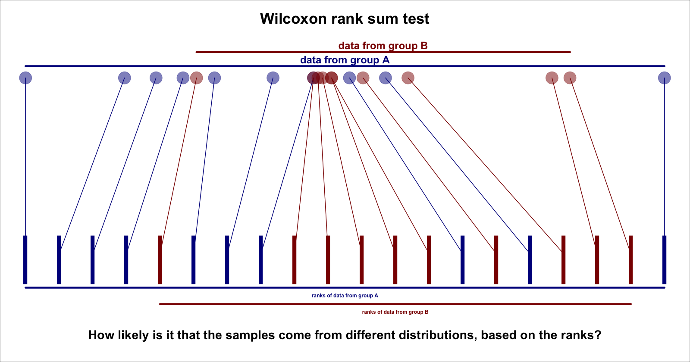
Wilcoxon rank sum test
Used in FlowSOM::GroupStats to compare metacluster abundances by condition.
Non-parametric ~ no assumptions about data distribution.
Uses ranks, not values, of data points.
We can apply this test to each metacluster.
© David Novak 2024

Slide 5
Multiple testing correction
…adjusts statistical tests to reduce the chance of mistaking random effects for real results.
Applied when running multiple tests on the same dataset.
Used in GroupStats.
Volcano plot
size of the change
is it non-radom?
metacluster over/under-abundant in KOs
…shows the size (fold-change) and likelihood (via p value) of changes in a large dataset, based on some condition.
Fold change ~ signed ratio
fold change = +1.2 …. increase by 20%
fold change = -1.4 …. decrease by 40%
log2FC = sign(FC)*log2(|FC|)
likelihood that result is significant
p=0.05
-log10padj
effect size & direction
© David Novak 2024
log2FC
0

Slide 6
DEMO
© David Novak 2024

Slide 7
Parametric tests
…make assumptions about data distribution.
If correct, more statistical power for our analysis.
The diffcyt framework tests
differential abundance: changes in abundance of MCs
edgeR: fits a negative binomial distribution to the abundance values
differential state: changes in average expression of state markers within the MCs
limma: uses linear Gaussian models
diffcyt allows for adding random effects to models (covariates: eg. batch, age, sex).
© David Novak 2024
https://valelab4.ucsf.edu/svn/3rdpartypublic/boost/libs/math/doc/sf_and_dist/html/math_toolkit/dist/dist_ref/dists/negative_binomial_dist.html

Slide 8
DEMO
© David Novak 2024

