Slide 1
Machine Learning I MATH80629A
Recommendation Systems

Slide 2
Recommendation Systems
Youtube and NetFlix video recommendations
Spotify music recommendation
Amazon product recommendation
LinkedIn user/company/job recommendation

Slide 3
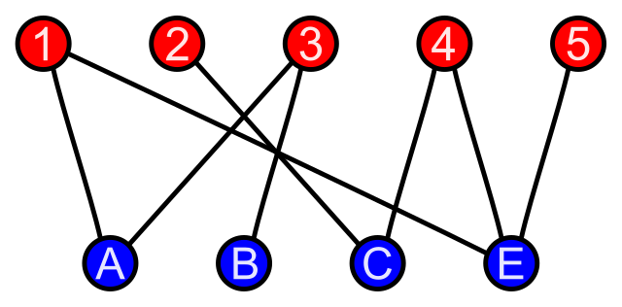
Recommendations as Graphs
Classic recommendation as bipartite graphs
Source: https://en.wikipedia.org/wiki/Bipartite_graph

Slide 4
Popularity-based Recommendation
YouTube hot videos
Twitter trending
No Cold-Start problem
Not personalized

Slide 5
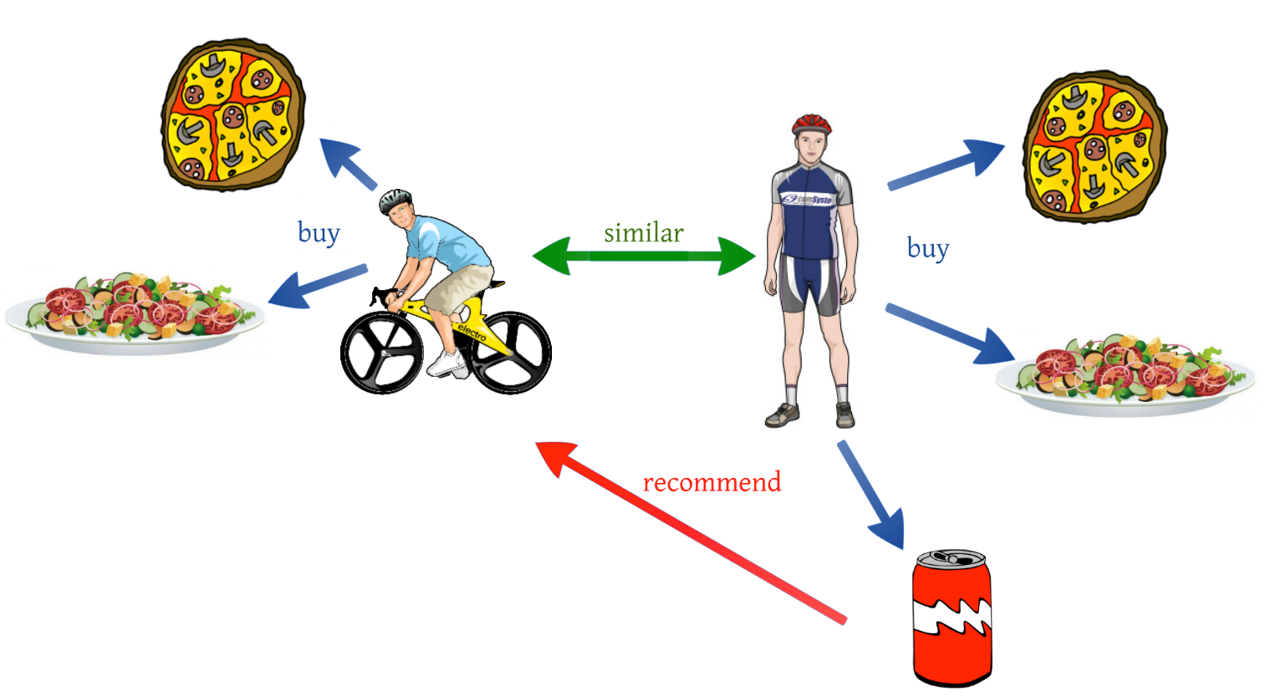
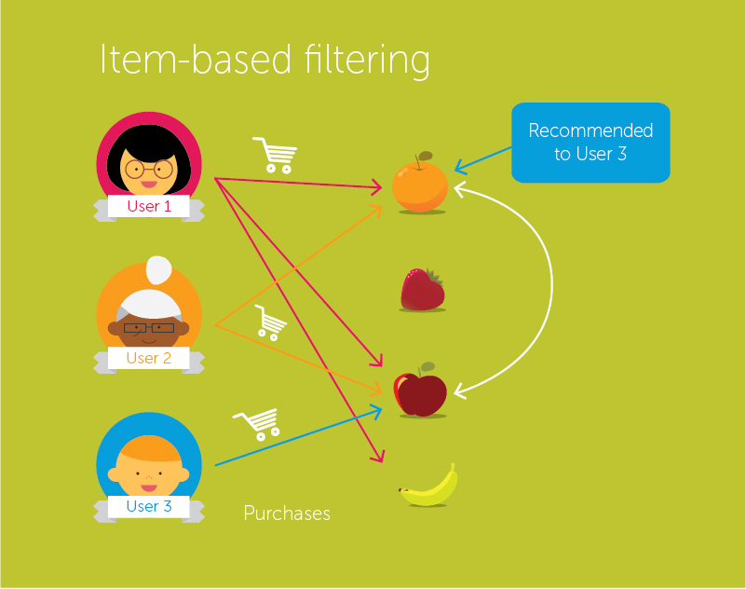
Collaborative Filtering
User-User
Item-Item
Sources: 1, 2

Slide 6
Collaborative Filtering
Advantages
Personalized
Only requires the interaction matrix
Relatively fast
Disadvantages
Cold start problem

Slide 7
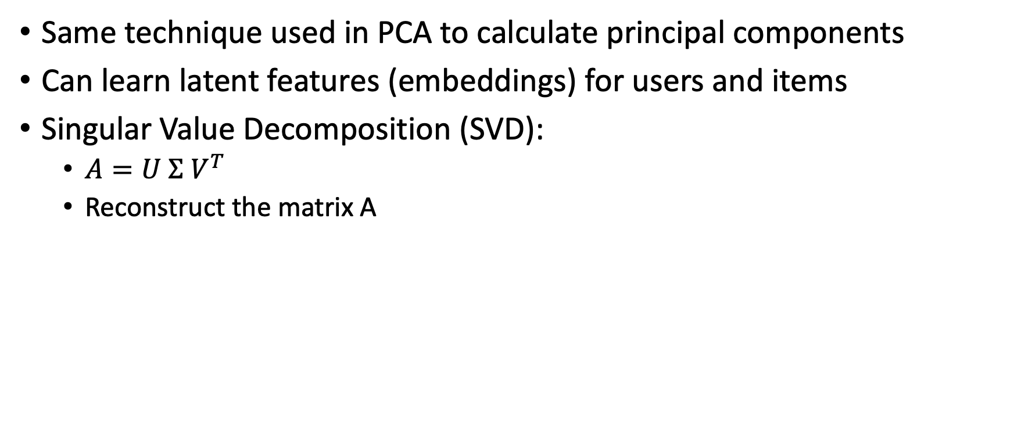
Matrix Factorization
Same technique used in PCA to calculate principal components
Can learn latent features (embeddings) for users and items
Singular Value Decomposition (SVD):
$A=U Σ V^{T}$
Reconstruct the matrix A

Slide 8
Content-based Recommendation
Uses item meta-data to find similar items
Movie plot, cast, genre
Music singer, producer, lyrics, beat
Product description
No need for interaction matrix

Slide 9
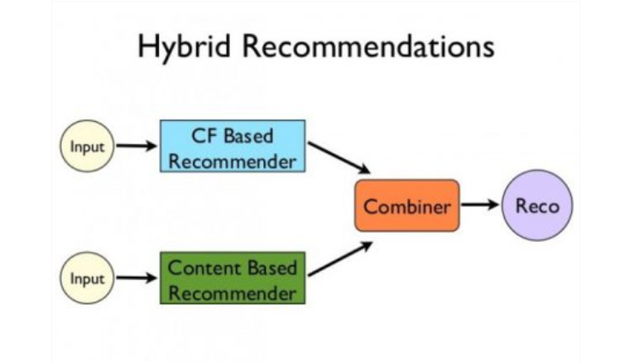
Hybrid Recommendation Systems
Combining multiple RS methods (ensemble)
More robust than a single method
Source: 1

