Slide 1
Machine Learning I MATH80629A
Recommendation Systems

Slide 2
Recommendation Systems
Youtube and NetFlix video recommendations
Spotify music recommendation
Amazon product recommendation
LinkedIn user/company/job recommendation

Slide 3
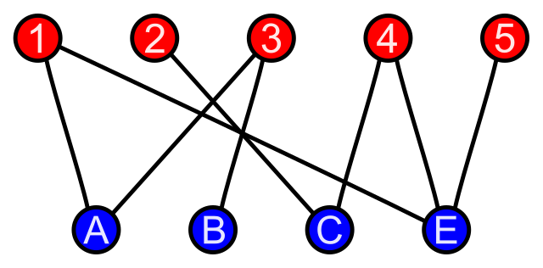
Recommendations as Graphs
Classic recommendation as bipartite graphs
Source: https://en.wikipedia.org/wiki/Bipartite_graph

Slide 4
Popularity-based Recommendation
Youtube hot videos
Twitter trending
No Cold-Start problem
Not personalized

