Slide 1
Machine Learning I MATH80629A
Reinforcement Learning I

Slide 2
Tic, Tac, Toe: A New Problem Paradigm
In each situation, take proper action to win.
Action space
Winning
Situation

Slide 3
Tic, Tac, Toe: A New Problem Paradigm
X | X | O
 | X
O | X | O

Slide 4
Supervised vs. Reinforcement Learning
Supervised
Match predictions to correct labels
Differentiable objective function w.r.t. the parameters
Minimize the objective function
Function from inputs to targets
Reinforcement
No correct labels
Rewards as performance measure
Rewards NOT differentiable w.r.t. the actions
Need to evaluate value of actions separately
Function from states to their value (and actions)

Slide 5
To Evaluate, To Instruct
Instructive feedback:
The correct answer
The best action to take
Supervised learning (e.g. image classification)
Independent of the action taken
Evaluative feedback:
How good the action taken was
NOT whether it was the best action
Need for exploration
Depends entirely on the action taken

Slide 6
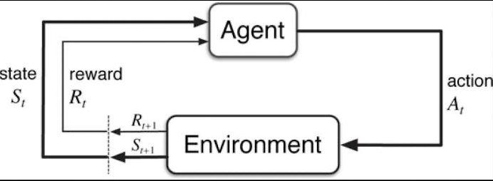
Markov Decision Process
Learning from interaction to achieve a goal
Agent:
learner or decision maker
Environment:
Anything outside the control of the agent,
Which it interacts with.
Rewards:
Numerical value the agent maximizes by adjusting its actions

Slide 7
States and Time Steps
For a set of time steps (t=0,1,2…), agent receives a representation of state.
Based on the state, takes an action
Based on the state and action, receives reward.
Reward: p(r | s, a)
Next state: p(s’ | s, a)
State (s) should represent all previous states and actions (Markov property)
(We are here; not how we got here.)

Slide 8
Rewards
Present the ultimate goal, not subgoals
NOT prior information about the task
Show the agent what to achieve, not how to achieve it.
Example: Chess

Slide 9
Agent and Environment
Human
Body
Digestive system
Agent
Direct control

Slide 10
Value Function
Turning immediate rewards (r) into long-term utilities (v)
Then we can maximize only the utility of the next state.

Slide 11
MDP example
Chess
Playing video games
Trading financial instruments
Driving

Slide 12
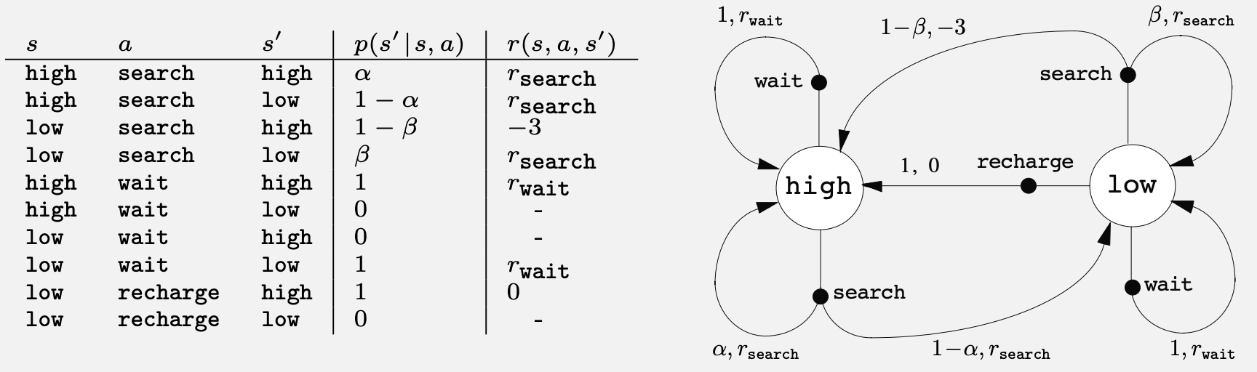

Recycling Robot
$α=0.8$
$β=0.8$
“Can” reward = 1
“Rescue” reward = -3

Slide 13
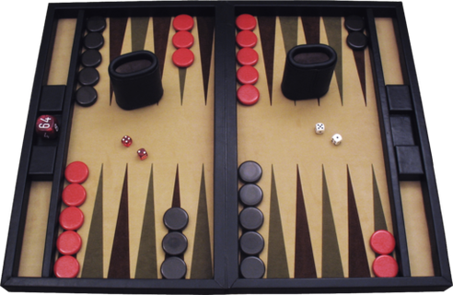
Value and Policy Approximation
Backgammon
10²⁰ combinations
Thousands of years on modern computers
Ways to approximate:
Value function
Policy function

Slide 14
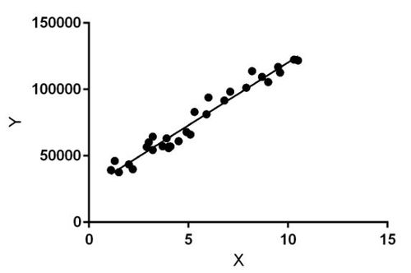
Function Approximation
By modeling Y = f(X)
For new X, get values of Y
Millions or billions of new X, same storage cost

Slide 15
Functional Approximation
To compute and store values and policies, use high-capacity models (e.g. neural networks).
Reduce storage cost
Computation on as-needed basis

Slide 16
Dynamic Programming
Algorithms for solving MDPs

Slide 17
Monte Carlo
Monte Carlo methods require only experience:
sample sequences of states, actions, and rewards from actual or simulated interaction with an environment.
Simulation:
a model is required,
the model need only generate sample transitions, not the complete probability distributions of all possible transitions that is required for dynamic programming (DP).
Source: Richard S. Sutton.

Slide 18
Monte Carlo
In many cases it is easy to generate experience sampled according to the desired probability distributions, but infeasible to obtain the distributions in explicit form.
Works only for episodic tasks
Defined (bounded) returns
Split infinite tasks (driving) into episodes.
Policy and value are updated only at the end of the episode.
Average final returns
Source: Richard S. Sutton.

Slide 19
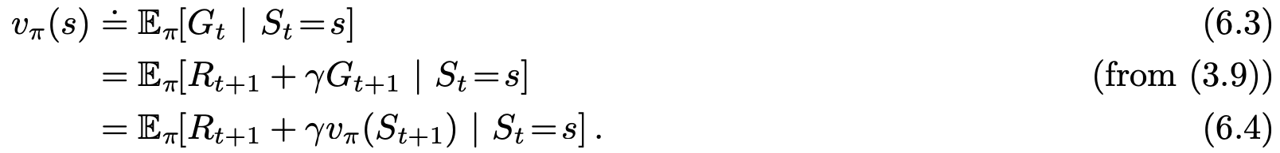
MC vs. DP
Monte Carlo estimates 6.3
DP estimates 6.4

Slide 20
Monte Carlo Prediction
Learn state-value function of a given policy
We defined value as expected returns from state S.
Returns: cumulative discounted rewards, or values
To estimate value, average all rewards received after visiting state S.

Slide 21
Monte Carlo Prediction
Each S can be visited multiple times in an episode.
Monte Carlo Exploring Starts
First-visit Monte Carlo:
V = Average return after the first visit to S
More researched method
Dates back to 1940s
Every-visit Monte Carlo:
V = Average return after all visits to S

Slide 22
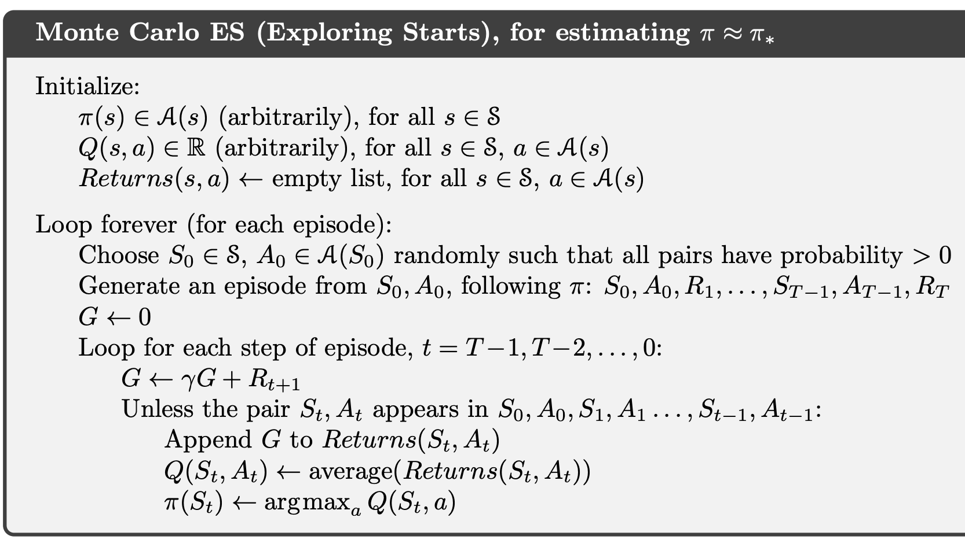
MC ES

Slide 23
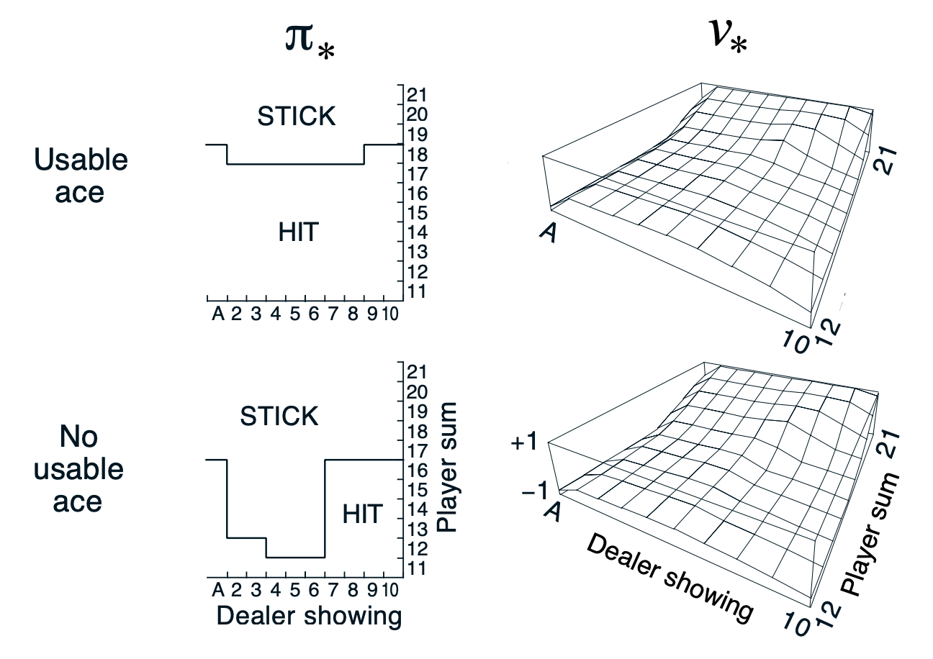
Blackjack MC ES

Slide 24
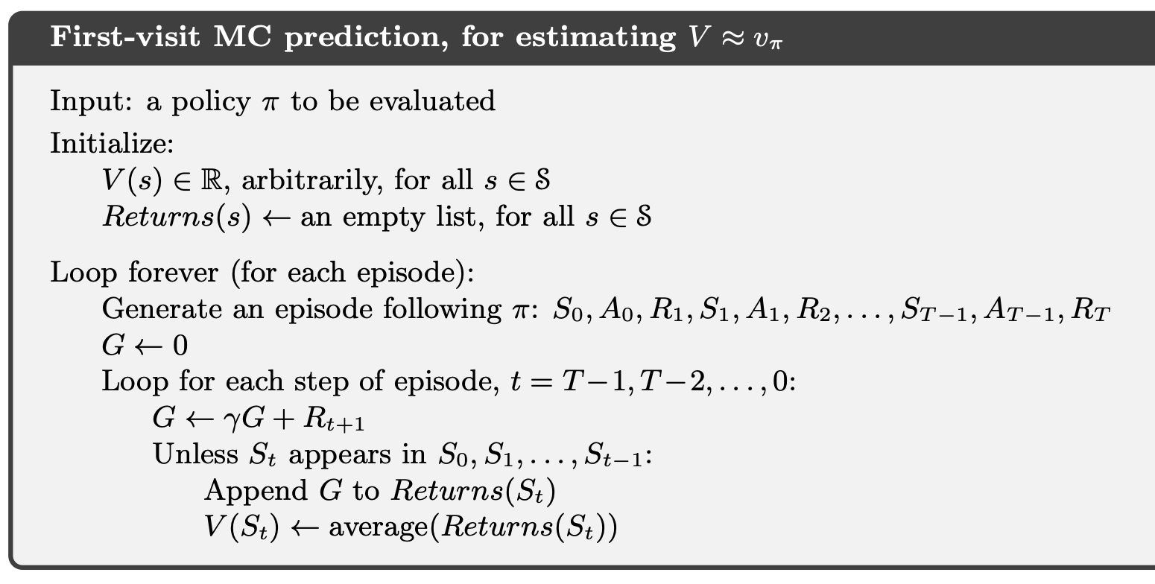
First-Visit Monte Carlo
Value iteration:
Value is average returns of all the states you can go to.
First-visit Monte Carlo:
Value is average returns of only the states you visited.
Each return is i.i.d. sample from V

Slide 25
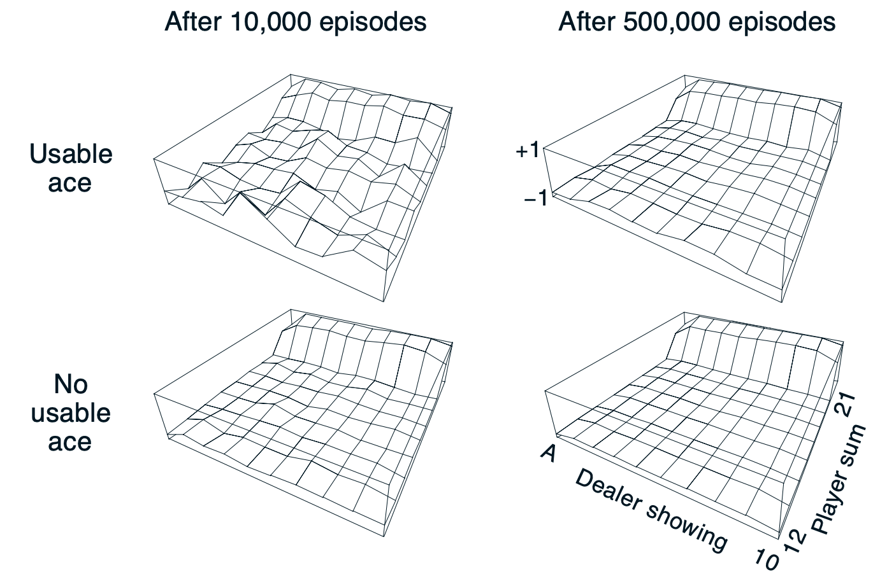
Example: Blackjack
Policy hit unless 20 or 21
Questions
Why does value jump towards the end of the chart?
Why does it drop towards the left?

Slide 26
Temporal-Difference Learning
One of the most central ideas to RL
Combination of MC and DP
Like MC: learn from interactions (no P or R function)
Like DP: update values based on estimates (~V(S’))

Slide 27
TD vs. MC
MC wait until R is known
Only episodic tasks
TD update V(S) based on estimated (S’)
Online learning

Slide 28
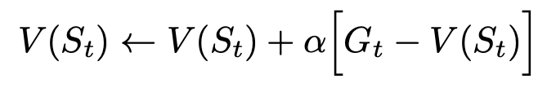
MC As TD

Slide 29
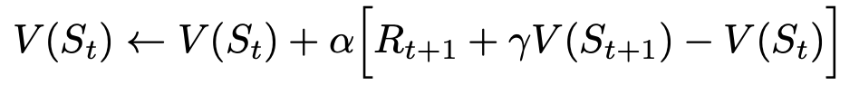
Simple TD (one-step TD)

Slide 30
TD
Updates V based on estimates of V
Bootstrapping method

Slide 31
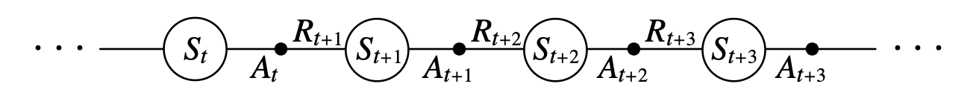
SARSA

Slide 32
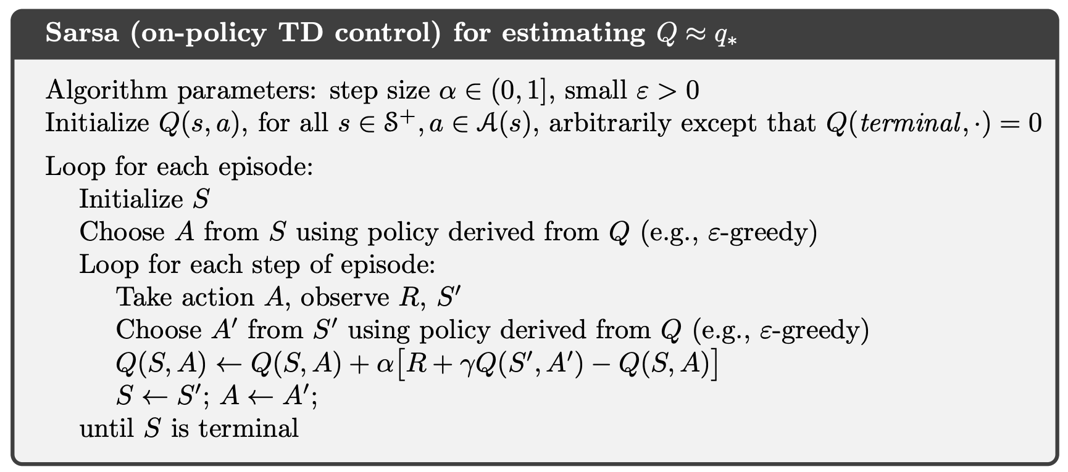
SARSA

