Slide 1
Machine Learning I MATH80629A
Reinforcement Learning I

Slide 2
Tic, Tac, Toe: A New Problem Paradigm
In each situation, take proper action to win.
Action space
Winning
Situation

Slide 3
Tic, Tac, Toe: A New Problem Paradigm
X | X | O
 | X
O | X | O

Slide 4
Supervised vs. Reinforcement Learning
Supervised
Match predictions to correct labels
Differentiable objective function w.r.t. the parameters
Minimize the objective function
Function from inputs to targets
Reinforcement
No correct labels
Rewards as performance measure
Rewards NOT differentiable w.r.t. the actions
Need to evaluate value of actions separately
Function from states (and actions) to their value

Slide 5
To Evaluate, To Instruct
Instructive feedback:
The correct answer
The best action to take
Supervised learning (e.g. image classification)
Independent of the action taken
Evaluative feedback:
How good the action taken was
NOT whether it was the best action
Need for exploration
Depends entirely on the action taken

Slide 6
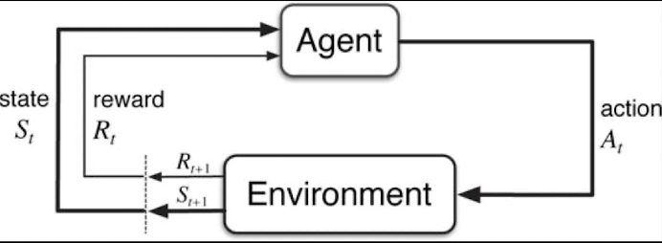
Markov Decision Process
Learning from interaction to achieve a goal
Agent:
learner or decision maker
Environment:
Anything outside the control of the agent,
Which it interacts with.
Rewards:
Numerical value the agent maximizes by adjusting its actions

Slide 7
States and Time Steps
For a set of time steps (t=0,1,2…), agent receives a representation of state.
Based on the state, takes an action
Based on the state and action, receives reward.
Reward: p(r | s, a)
Next state: p(s’ | s, a)
State (s) should represent all previous states and actions (Markov property)
(We are here; not how we got here.)

Slide 8
Agent and Environment
Human
Body
Digestive system
Agent
Direct control

Slide 9
MDP example
Chess
Playing video games
Trading financial instruments
Driving

