Slide 1
FreeFlow spas WEBSITE Davis Stryer AND Julia Larsen

Slide 2
Purpose
Basic ecommerce website to display hot tubs
Demonstrate concept of AI salesperson chatbot

Slide 3
Pages – Hot Tub Store
Home page
Product catalog
FAQ
Chat page

Slide 4
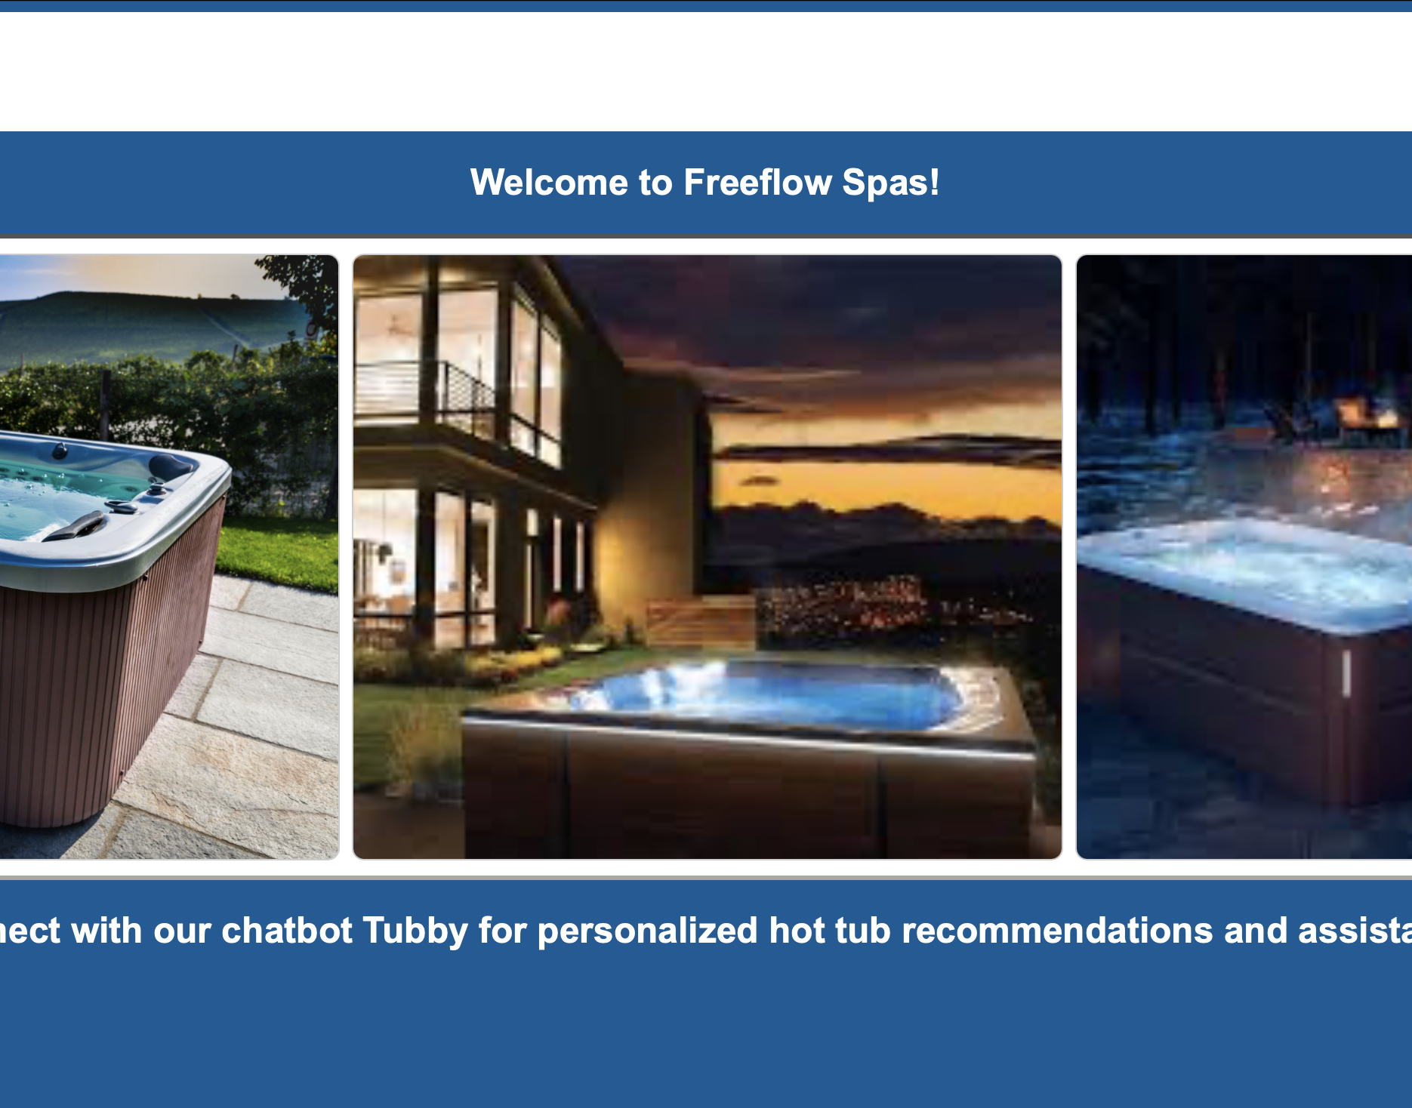
Frontend
HTML
JS
CSS
HTMX

Slide 5
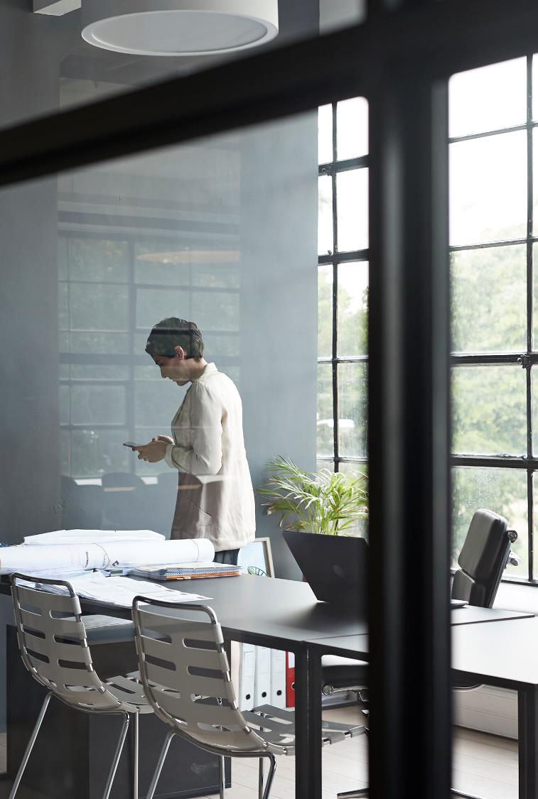
Backend
Flask (Python)
Groq AI inference platform
Deployed to Heroku

Slide 6

Chatbot - Tubby
Uses Meta Llama 4 Scout 17b-16e-instruct LLM
Has access to a Json file with all hot tub details
Given instructions to format text properly and have predictable behavior
Temperature 0.5

Slide 7
Demonstration

Slide 8
Q & A

