Slide 1
Advanced Perl Techniques
A One Day Perl Tutorial
Dave Cross
Magnum Solutions Ltd
dave@mag-sol.com

Slide 2
Advanced Perl Techniques
Advanced level training for Perl programmers
Turn intermediate programmers into advanced programmers
“Modern” Perl
Perl is not dying

Slide 3
Advanced Perl Techniques
One day isn't enough time
We'll be moving fairly fast
Lots of pointers to other information
Feel free to ask questions

Slide 4
What We Will Cover
What's new in Perl 5.10
Dates and times
Testing
  including coverage analysis
Database access
  DBIx::Class

Slide 5
What We Will Cover
Profiling & Benchmarking
Object oriented programming with Moose
Templates
MVC Frameworks
  Catalyst

Slide 6
Schedule
09:45 – Begin
11:15 – Coffee break
13:00 – Lunch
14:00 – Begin
15:30 – Coffee break
17:00 – End

Slide 7
Resources
Slides available on-line
  http://mag-sol.com/train/public/2009-02/adv
Also see Slideshare
  http://www.slideshare.net/davorg/slideshows
Mailing List
  http://lists.mag-sol.com/mailman/listinfo/adv2009
Get Satisfaction
  http://getsatisfaction.com/magnum

Slide 8
Perl 5.10

Slide 9
Perl 5.10
Released 18th Dec 2007
  Perl's 20th birthday
Many new features
Well worth upgrading

Slide 10
New Features
Defined-or operator
Switch operator
Smart matching
say()
Lexical $_

Slide 11
New Features
State variables
Stacked file tests
Regex improvements
Many more

Slide 12
Defined Or
Boolean expressions “short-circuit”
$val = $val || $default;
$val ||= $default;
What if 0 is a valid value?
Need to check “definedness”
$val = defined $val
? $val : $default;
$val = $default unless defined $val;

Slide 13
Defined Or
The defined or operator makes this easier
$val = $val // $default;
A different slant on truth
Checks definedness
Short version too
$val //= $default;

Slide 14
Switch Statement
Switch.pm was added with Perl 5.8
Source filter
Parser limitations
  Regular expressions
  eval
5.10 introduces a build-in switch statement

Slide 15
Given ... When
Switch is spelled “given”
Case is spelled “when”
Powerful matching syntax

Slide 16
Given Example
given ($foo) {
when (/^abc/) { $abc = 1; }
when (/^def/) { $def = 1; }
when (/^xyz/) { $xyz = 1; }
default { $nothing = 1; }
}
Four new keywords
  given
  when
  default
  continue

Slide 17
given
given(EXPR)
Assigns the result of EXPR to $_ within the following block
Similar to do { my $_ = EXPR; ... }

Slide 18
when
when (EXPR)
Uses smart matching to compare $_ with EXPR
Equivalent to when ($_ ~~ EXPR)
~~ is the new smart match operator
Compares two values and “does the right thing”

Slide 19
default
default defines a block that is executed if no when blocks match
default block is optional

Slide 20
continue
continue keyword falls through to the next when block
Normal behaviour is to break out of given block once the first when condition is matched
given($foo) {
when (/x/)
{say '$foo contains an x'; continue }
when (/y/)
{ say '$foo contains a y' }
default
{ say '$foo contains no x or y' }
}

Slide 21
Smart Matching
~~ is the new Smart Match operator
Different kinds of matches
Dependent on the types of the operands
See “perldoc perlsyn” for the full details

Slide 22
Smart Match Examples
$foo ~~ $bar; # == or eq
@foo ~~ $bar; # array contains value
%foo ~~ $bar; # hash key exists
$foo ~~ qr{$bar}; # regex match
@foo ~~ @bar; # arrays are identical
%foo ~~ %bar; # hash keys match
Many more alternatives

Slide 23
say()
say() is a new alternative to print()
Adds a new line at the end of each call
say($foo); # print $foo, “\n”;
Two characters shorter than print
Less typing

Slide 24
Lexical $_
$_ is a package variable
Always exists in main package
Can lead to subtle bugs when not localised correctly
Can now use my $_ to create a lexically scoped variable called $_

Slide 25
State Variables
Lexical variables disappear when their scope is destroyed
sub variables {
my $x;
say ++$x;
}
variables() for 1 .. 3;

Slide 26
State Variables
State variables retain their value when their scope is destroyed
sub variables {
state $x;
say ++$x;
}
variables() for 1 .. 3;
Like static variables in C

Slide 27
Stacked File Tests
People often think you can do this
-f -w -x $file
Previously you couldn't
Now you can
Equivalent to
-x $file && -w _ && -f _

Slide 28
Regex Improvements
Plenty of regular expression improvements
Named capture buffers
Possessive quantifiers
Relative backreferences
New escape sequences
Many more

Slide 29
Named Capture Buffers
Variables $1, $2, etc change if the regex is altered
Named captures retain their names
(?<name> ... ) to define
Use new %+ hash to access them

Slide 30
Named Capture Example
while (<DATA>) {
if (/(?<header>[\w\s]+)
:\s+(?<value>.+)/x) {
print "$+{header} -> ";
print "$+{value}\n";
}
}

Slide 31
Possessive Quantifiers
?+, *+, ++
Grab as much as they can
Never give it back
Finer control over backtracking
'aaaa' =~ /a++a/
Never matches

Slide 32
Relative Backreferences
\g{N}
More powerful version of \1, \2, etc
\g{1} is the same as \1
\g{-1} is the last capture buffer
\g{-2} is the one before that

Slide 33
New Escape Sequences
\h – Horizontal white space
\v – Vertical white space
Also \H and \V

Slide 34
Accessing New Features
Some new features would break backwards compatibility
They are therefore turned off by default
Turn them on with the feature pragma
use feature 'say';
use feature 'switch';
use feature 'state';
use feature ':5.10';

Slide 35
Implicit Loading
Two ways to automatically turn on 5.10 features
Require a high enough version of Perl
use 5.10.0; # Or higher
-E command line option
perl -e 'say “hello”'
perl -E 'say “hello”'

Slide 36
Dates and Times

Slide 37
Dates & Times
Dozens of date/time modules on CPAN
Date::Manip is almost never what you want
Date::Calc, Date::Parse, Class::Date, Date::Simple, etc
Which one do you choose?

Slide 38
Perl DateTime Project
http://datetime.perl.org/
"The DateTime family of modules present a unified way to handle dates and times in Perl"
"unified" is good
Dozens of modules that work together in a consistent fashion

Slide 39
Using DateTime
use DateTime;
my $dt = DateTime->now;
say $dt;
# 2009-02-26T11:06:07
say $dt->ymd;
# 2009-02-26
say $dt->hms;
# 11:08:16

Slide 40
Using DateTime
use DateTime;
my $dt = DateTime->new(year => 2009,
month => 2,
day => 26);
say $dt->ymd('/');
# 2009/02/26
say $dt->month; # 2
say $dt->month_name; # February

Slide 41
Arithmetic
A DateTime object is a point in time
For date arithmetic you need a duration
Number of years, weeks, days, etc

Slide 42
Arithmetic
use DateTime;
my $dt = DateTime->new(year => 2009,
month => 2,
day => 26);
my $two_weeks =
DateTime::Duration->new(weeks => 2);
$dt += $two_weeks;
say $dt;
# 2009-03-12T00:00:00

Slide 43
Formatting Output
use DateTime;
my $dt = DateTime->new(year => 2009,
month => 2,
day => 26);
say $dt->strftime('%A, %d %B %Y');
# Tuesday, 26 February 2009
Control input format with DateTime::Format::Strptime

Slide 44
Parsing & Formatting
Ready made parsers and formatters for popular date and time formats
DateTime::Format::HTTP
DateTime::Format::MySQL
DateTime::Format::Excel
DateTime::Format::Baby
  the big hand is on...

Slide 45
Alternative Calendars
Handling non-standard calendars
DateTime::Calendar::Julian
DateTime::Calendar::Hebrew
DateTime::Calendar::Mayan
DateTime::Fiction::JRRTolkien::Shire

Slide 46
Calendar Examples
use DateTime::Calendar::Mayan;
my $dt = DateTime::Calendar::Mayan->now;
say $dt->date; # 12.19.16.1.15
use DateTime::Fiction::JRRTolkien::Shire
my $dt =
DateTime::Fiction::JRRTolkien::Shire->now;
say $dt->on_date;
# Mersday 24 Solmath 7473

Slide 47
Testing

Slide 48
Testing
Never program without a safety net
Does your code do what it is supposed to do?
Will your code continue to do what it is supposed to do?
Write unit tests
Run those tests all the time

Slide 49
When to Run Tests
As often as possible
Before you add a feature
After you have added a feature
Before checking in code
Before releasing code
Constantly, automatically

Slide 50
Testing in Perl
Perl makes it easy to write test suites
A lot of work in this area over the last eight years
Test::Simple and Test::More included in Perl distribution
Many more testing modules on CPAN

Slide 51
Simple Test Program
use Test::More tests => 4;
BEGIN { use_ok('My::Object'); }
ok(my $obj = My::Object->new);
isa_ok($obj, 'My::Object');
$obj->set_foo('Foo');
is($obj->get_foo, 'Foo');

Slide 52
Simple Test Output
$ prove -v test.t
test....
1..4
ok 1 - use My::Object;
ok 2
ok 3 - The object isa My::Object
ok 4
ok
All tests successful.
Files=1, Tests=4, 0 wallclock secs ( 0.02 usr 0.00 sys + 0.05 cusr 0.00 csys = 0.07 CPU)
Result: PASS

Slide 53
Adding Test Names
use Test::More tests => 4;
BEGIN { use_ok('My::Object'); }
ok(my $obj = My::Object->new,
'Got an object');
isa_ok($obj, 'My::Object');
$obj->set_foo('Foo');
is($obj->get_foo, 'Foo',
'The foo is "Foo"');

Slide 54
Output With Names
$ prove -v test2.t
test2....
1..4
ok 1 - use My::Object;
ok 2 - got an object
ok 3 - The object isa My::Object
ok 4 - The foo is "Foo"
ok
All tests successful.
Files=1, Tests=4, 0 wallclock secs ( 0.02 usr 0.00 sys + 0.05 cusr 0.00 csys = 0.07 CPU)
Result: PASS

Slide 55
Using prove
prove is a command line tool for running tests
Runs given tests using Test::Harness
Comes with the Perl distribution
Command line options
  -v verbose output
  -r recurse
  -s shuffle tests
  Many more

Slide 56
Test Anything Protocol
Perl tests have been spitting out “ok 1” and not “ok 2” for years
Now this ad-hoc format has a definition and a name
The Test Anything Protocol (TAP)
See Test::Harness::TAP (documentation module) and TAP::Parser

Slide 57
TAP Output
More possibilities for test output
  TAP::Harness::Color
  Test::TAP::HTMLMatrix
Make sense of your test results

Slide 58
More Testing Modules
Dozens of testing modules on CPAN
Some of my favourites
Test::File
Test::Exception, Test::Warn
Test::Differences
Test::XML (includes Test::XML::XPath)

Slide 59
Writing Test Modules
These test modules all work together
Built using Test::Builder
Ensures that test modules all use the same framework
Use it as the basis of your own Test::* modules
Who tests the testers?
Test your Test::Builder test modules with Test::Builder::Tester

Slide 60
Mocking Objects
Sometimes it's hard to test external interfaces
Fake them
Test::MockObject pretends to be other objects
Gives you complete control over what they return

Slide 61
Testing Reactors
You're writing code that monitors a nuclear reactor
It's important that your code reacts correctly when the reactor overheats
You don't have a reactor in the test environment

Slide 62
Testing Reactors
Even if you did, you wouldn't want to make it overheat every time you run the tests
Especially if you're not 100% sure of your code
Or if you're running unattended smoke tests
Fake it with a mock object

Slide 63
My::Monitor Spec
If the temperature of a reactor is over 100 then try to cool it down
If you have tried cooling a reactor down 5 times and the temperature is still over 100 then return an error

Slide 64
My::Monitor Code
package My::Monitor;
sub new {
my $class = shift;
my $self = { tries => 0 };
return bless $self, $class;
}

Slide 65
My::Monitor Code
sub check {
my $self = shift;
my $reactor = shift;
my $temp = $reactor->temperature;
if ($temp > 100) {
$reactor->cooldown;
++$self->{tries};
if ($self->{tries} > 5) {
return;
}
return 1;

Slide 66
My::Monitor Code
} else {
$self->{tries} = 0;
return 1;
}
}
1;

Slide 67
Mock Reactor
Create a mock reactor object that acts exactly how we want it to
Reactor object has two interesting methods
temperature - returns the current temperature
cooldown - cools reactor and returns success or failure

Slide 68
monitor.t
use Test::More tests => 10;
use Test::MockObject->new;
# Standard tests
BEGIN { use_ok('My::Monitor'); }
ok(my $mon = My::Monitor->new);
isa_ok($mon, 'My::Monitor');

Slide 69
monitor.t
# Create Mock Reactor Object
my $t = 10;
my $reactor = Test::MockObject;
$reactor->set_bound('temperature',
\$t);
$reactor->set_true('cooldown');

Slide 70
monitor.t
# Test reactor
ok($mon->check($reactor));
$t = 120;
ok($mon->check($reactor)) for 1 .. 5;
ok(!$mon->check($reactor));

Slide 71
How Good Are Your Tests?
How much of your code is exercised by your tests?
Devel::Cover can help you to find out
Deep internal magic
Draws pretty charts
  HARNESS_PERL_SWITCHES= -MDevel::Cover make test
  cover

Slide 72
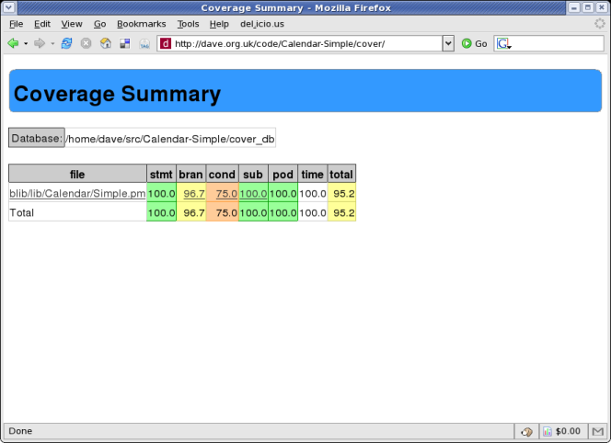
Devel::Cover Output

Slide 73
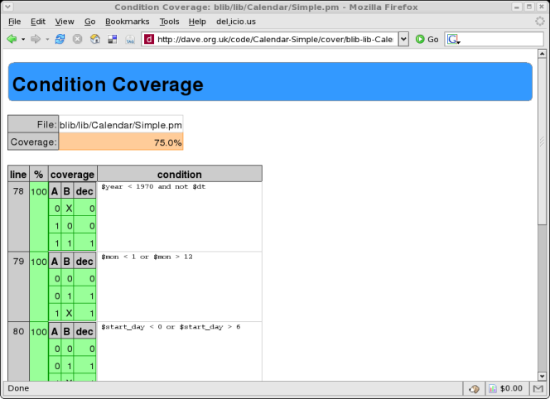
Devel::Cover Output

Slide 74
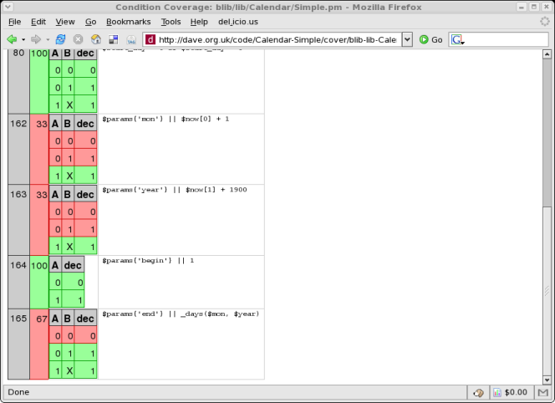
Devel::Cover Output

Slide 75
Alternative Test Paradigms
Not everyone likes the Perl testing framework
Other frameworks are available
Test::Class
  xUnit style framework
Test::FIT
  Framework for Interactive Testing
  http://fit.c2.com

Slide 76
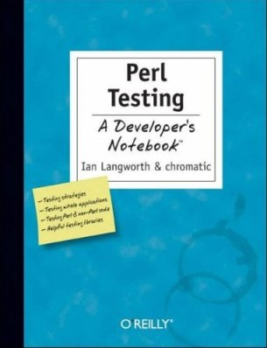
More Information
Perl Testing: A Developer's Notebook (Ian Langworth & chromatic)
perldoc Test::Tutorial
perldoc Test::Simple
perldoc Test::More
perldoc Test::Builder
etc...

Slide 77
Benchmarking

Slide 78
Benchmarking
Ensure that your program is fast enough
But how fast is fast enough?
premature optimization is the root of all evil
  Donald Knuth
  paraphrasing Tony Hoare
Don't optimise until you know what to optimise

Slide 79
Benchmark.pm
Standard Perl module for benchmarking
Simple usage
use Benchmark;
my %methods = (
method1 => sub { ... },
method2 => sub { ... },
);
timethese(10_000, \%methods);
Times 10,000 iterations of each method

Slide 80
Benchmark.pm Output
Benchmark: timing 10000 iterations of method1, method2...
method1: 6 wallclock secs \
( 2.12 usr + 3.47 sys = 5.59 CPU) \
@ 1788.91/s (n=10000)
method2: 3 wallclock secs \
( 0.85 usr + 1.70 sys = 2.55 CPU) \
@ 3921.57/s (n=10000)

Slide 81
Timed Benchmarks
Passing timethese a positive number runs each piece of code a certain number of times
Passing timethese a negative number runs each piece of code for a certain number of seconds

Slide 82
Timed Benchmarks
use Benchmark;
my %methods = (
method1 => sub { ... },
method2 => sub { ... },
);
# Run for 10,000(!) seconds
timethese(-10_000, \%methods);

Slide 83
Comparing Performance
Use cmpthese to get a tabular output
Optional export
use Benchmark 'cmpthese';
my %methods = (
method1 => sub { ... },
method2 => sub { ... },
);
cmpthese(10_000, \%methods);

Slide 84
cmpthese Output
Rate method1 method2
method1 2831802/s -- -61%
method2 7208959/s 155% --
method2 is 61% slower than method1
Can also pass negative number to cmpthese

Slide 85
Benchmarking is Hard
Very easy to produce lots of numbers
Harder to ensure that the numbers are meaningful
Compare code fragments that do the same thing

Slide 86
Bad Benchmarking
use Benchmark qw{ timethese };
timethese( 1_000, {
Ordinary => sub {
my @results = sort { -M $a <=> -M $b } glob "/bin/*";
},
Schwartzian => sub {
map $_->[0],
sort { $a->[1] <=> $b->[1] }
map [$_, -M], glob "/bin/*";
},
});

Slide 87
What to Benchmark
Profile your code
See which parts it is worth working on
Look for code that
  Takes a long time to run, or
  Is called many times, or
  Both

Slide 88
Devel::DProf
Devel::DProf is the standard Perl profiling tool
Included with Perl distribution
Uses Perl debugger hooks
perl -d:DProf your_program
Produces a data file called tmon.out
Command line program dprofpp to view results

Slide 89
Sample Output
$ perl -d:DProf ./invoice.pl 244
$ dprofpp
Total Elapsed Time = 1.173152 Seconds
User+System Time = 0.963152 Seconds
Exclusive Times
%Time ExclSec CumulS #Calls sec/call Csec/c Name
6.02 0.058 0.067 482 0.0001 0.0001 Params::Validate::_validate
5.09 0.049 0.114 7 0.0070 0.0163 Class::DBI::Loader::mysql::BEGIN
4.15 0.040 0.050 10 0.0040 0.0050 Template::Parser::BEGIN
4.15 0.040 0.166 7 0.0057 0.0237 DateTime::Locale::BEGIN
4.05 0.039 0.094 43 0.0009 0.0022 base::import
3.74 0.036 0.094 449 0.0001 0.0002 DateTime::Locale::_register
3.11 0.030 0.280 4 0.0074 0.0700 DateTime::Format::MySQL::BEGIN
2.91 0.028 0.028 170 0.0002 0.0002 Lingua::EN::Inflect::_PL_noun
2.70 0.026 0.040 1 0.0262 0.0401 Template::Parser::_parse
2.49 0.024 0.024 1113 0.0000 0.0000 Class::Data::Inheritable::__ANON__
2.08 0.020 0.020 12 0.0017 0.0017 DBD::mysql::db::_login
2.08 0.020 0.020 4 0.0050 0.0050 Template::Stash::BEGIN
2.08 0.020 0.099 9 0.0022 0.0110 Template::Config::load
2.08 0.020 0.067 9 0.0022 0.0074 Template::BEGIN
2.08 0.020 0.039 4 0.0049 0.0097 Lingua::EN::Inflect::Number::BEGIN

Slide 90
Devel::NYTProf
New profiling module
Based on work from the New York Times
Enhanced by Tim Bunce
Pretty HTML output
  “borrowed” from Devel::Cover
Far more flexible
Far more powerful

Slide 91
Using NYTProf
Similar to Devel::DProf
$ perl -d:NYTProf ./invoice.pl 244
Writes nytprof.out
$ nytprofhtml
Or
$ nytprofcsv

Slide 92
Conclusions
Don't optimise until you know you need to optimise
Don't optimise until you know what to optimise
Use profiling to find out what is worth optimising
Use benchmarking to compare different solutions

Slide 93
More Information
perldoc Benchmark
perldoc Devel::DProf
perldoc Devel::NYTProf
Chapters 5 and 6 of Mastering Perl

Slide 94
Object Relational Mapping

Slide 95
ORM
Mapping database relations into objects
Tables (relations) map onto classes
Rows (tuples) map onto objects
Columns (attributes) map onto attributes
Don't write SQL

Slide 96
SQL Is Tedious
Select the id and name from this table
Select all the details of this row
Select something about related tables
Update this row with these values
Insert a new record with these values
Delete this record

Slide 97
Replacing SQL
Instead of
SELECT *
FROM my_table
WHERE my_id = 10
and then dealing with the prepare/execute/fetch code

Slide 98
Replacing SQL
We can write
use My::Object;
# warning! not a real orm
my $obj = My::Object->retrieve(10)
Or something similar

Slide 99
Writing An ORM Layer
Not actually that hard to do yourself
Each class needs an associated table
Each class needs a list of columns
Create simple SQL for basic CRUD operations
Don't do that

Slide 100
Perl ORM Options
Plenty of choices on CPAN
Tangram
SPOPS (Simple Perl Object Persistence with Security)
Alzabo
Class::DBI
DBIx::Class
  The current favourite

Slide 101
DBIx::Class
Standing on the shoulders of giants
Learning from problems in Class::DBI
More flexible
More powerful

Slide 102
DBIx::Class Example
Modeling a CD collection
Three tables
artist (artistid, name)
cd (cdid, artist, title)
track (trackid, cd, title)

Slide 103
Main Schema
Define main schema class
DB/Main.pm
package DB::Main;
use base qw/DBIx::Class::Schema/;
__PACKAGE__->load_classes();
1;

Slide 104
Object Classes
DB/Main/Artist.pm
package DB::Main::Artist;
use base qw/DBIx::Class/;
__PACKAGE__->load_components(qw/PK::Auto Core/);
__PACKAGE__->table('artist');
__PACKAGE__->add_columns(qw/ artistid name /);
__PACKAGE__->set_primary_key('artistid');
__PACKAGE__->has_many(cds =>
'DB::Main::Cd');
1;

Slide 105
Object Classes
DB/Main/CD.pm
package DB::Main::CD;
use base qw/DBIx::Class/;
__PACKAGE__->load_components(qw/PK::Auto Core/);
__PACKAGE__->table('cd');
__PACKAGE__->add_columns(qw/ cdid artist title year /);
__PACKAGE__->set_primary_key('cdid');
__PACKAGE__->belongs_to(artist =>
'DB::Main::Artist');
1;

Slide 106
Inserting Artists
my $schema =
DB::Main->connect($dbi_str);
my @artists = ('The Beta Band',
'Beth Orton');
my $art_rs = $schema->resultset('Artist');
foreach (@artists) {
$art_rs->create({ name => $_ });
}

Slide 107
Inserting CDs
Hash of Artists and CDs
my %cds = ( 'The Three EPs' =>
'The Beta Band',
'Trailer Park' =>
'Beth Orton');

Slide 108
Inserting CDs
Find each artist and insert CD
foreach (keys $cds) {
my ($artist) = $art_rs->search(
{ name => $cds{$_} }
);
$artist->add_to_cds({
title => $_,
});
}

Slide 109
Retrieving Data
Get CDs by artist
my ($artist) = $art_rs->search({
name => 'Beth Orton',
});
foreach ($artist->cds) {
say $_->title;
}

Slide 110
Searching for Data
Search conditions can be more complex
Alternatives
  $rs->search({year => 2006},
  {year => 2007});
Like
  $rs->search({name =>
  { 'like', 'Dav%' }});
Combinations
  $rs->search({forename =>
  { 'like', 'Dav%' },
  surname => 'Cross' });

Slide 111
Don't Repeat Yourself
There's a problem with this approach
Information is repeated
Columns and relationships defined in the database schema
Columns and relationships defined in class definitions

Slide 112
Repeated Information
CREATE TABLE artist (
artistid INTEGER PRIMARY KEY,
name TEXT NOT NULL
);

Slide 113
Repeated Information
package DB::Main::Artist;
use base qw/DBIx::Class/;
__PACKAGE__->
load_components(qw/PK::Auto Core/);
__PACKAGE__->table('artist');
__PACKAGE__->
add_columns(qw/ artistid name /);
__PACKAGE__>
set_primary_key('artistid');
__PACKAGE__->has_many('cds' => 'DB::Main::Cd');

Slide 114
Database Metadata
Some people don't put enough metadata in their databases
Just tables and columns
No relationships. No constraints
You may as well make each column VARCHAR(255)

Slide 115
Database Metadata
Describe your data in your database
It's what your database is for
It's what your database does best

Slide 116
No Metadata (Excuse 1)
"This is the only application that will ever access this database"
Bollocks
All data will be shared eventually
People will update your database using other applications
Can you guarantee that someone won't use mysql to update your database?

Slide 117
No Metadata (Excuse 2)
"Our database doesn't support those features"
Bollocks
MySQL 3.x is not a database
  It's a set of data files with a vaguely SQL-like query syntax
MySQL 4.x is a lot better
MySQL 5.x is most of the way there
Don't be constrained by using inferior tools

Slide 118
DBIC::Schema::Loader
Creates classes by querying your database metadata
No more repeated data
We are now DRY
Schema definitions in one place
But...
Performance problems

Slide 119
Performance Problems
You don't really want to generate all your class definitions each time your program is run
Need to generate the classes in advance
dump_to_dir method
Regenerate classes each time schema changes

Slide 120
Alternative Approach
Need one canonical definition of the data tables
Doesn't need to be SQL DDL
Could be in Perl code
Write DBIx::Class definitions
Generate DDL from those
Harder approach
  Might need to generate ALTER TABLE

Slide 121
Conclusions
ORM is a bridge between relational objects and program objects
Avoid writing SQL in common cases
DBIx::Class is the currently fashionable module
Lots of plugins
Caveat: ORM may be overkill for simple programs

Slide 122
More Information
Manual pages (on CPAN)
DBIx::Class
DBIx::Class::Manual::*
DBIx::Class::Schema::Loader
Mailing list (Google for it)

Slide 123
Moose

Slide 124
Moose
A complete modern object system for Perl 5
Based on experiments with Perl 6 object model
Built on top of Class::MOP
  MOP - Meta Object Protocol
  Set of abstractions for components of an object system
  Classes, Objects, Methods, Attributes
An example might help

Slide 125
Moose Example
package Point;
use Moose;
has 'x' => (isa => 'Int',
is => 'ro');
has 'y' => (isa => 'Int',
is => 'rw');
sub clear {
my $self = shift;
$self->{x} = 0;
$self->y(0);
}

Slide 126
Understanding Moose
There's a lot going on here
use Moose
  Loads Moose environment
  Makes our class a subclass of Moose::Object
  Turns on strict and warnings

Slide 127
Creating Attributes
has 'x' => (isa => 'Int',
is => 'ro')
  Creates an attribute called 'x'
  Constrainted to be an integer
  Read-only accessor
has 'y' => (isa => 'Int',
is => 'rw')

Slide 128
Defining Methods
sub clear {
my $self = shift;
$self->{x} = 0;
$self->y(0);
}
Standard method syntax
Uses generated method to set y
Direct hash access for x

Slide 129
Subclassing
package Point3D;
use Moose;
extends 'Point';
has 'z' => (isa => 'Int');
after 'clear' => sub {
my $self = shift;
$self->{z} = 0;
};

Slide 130
Subclasses
extends 'Point'
  Similar to use base
  Overwrites @ISA instead of appending
has 'z' => (isa = 'Int')
  Adds new attribute 'z'
  No accessor function - private attribute

Slide 131
Extending Methods
after 'clear' => sub {
my $self = shift;
$self->{z} = 0;
};
New clear method for subclass
Called after method for superclass
Cleaner than $self->SUPER::clear()

Slide 132
Creating Objects
Moose classes are used just like any other Perl class
$point = Point->new(x => 1, y => 2);
$p3d = Point3D->new(x => 1,
y => 2,
z => 3);

Slide 133
More About Attributes
Use the has keyword to define your class's attributes
has 'first_name' => ( is => 'rw' );
Use is to define rw or ro
Omitting is gives an attribute with no accessors

Slide 134
Getting & Setting
By default each attribute creates a method of the same name.
Used for both getting and setting the attribute
$dave->first_name('Dave');
say $dave->first_name;

Slide 135
Change Accessor Name
Change accessor names using reader and writer
has 'name' => (
is => 'rw',
reader => 'get_name',
writer => 'set_name',
);
See also MooseX::FollowPBP

Slide 136
Required Attributes
By default Moose class attributes are optional
Change this with required
has 'name' => (
is => 'ro',
required => 1,
);
Forces constructor to expect a name
Although that name could be undef

Slide 137
Attribute Defaults
Set a default value for an attribute with default
has 'size' => (
is => 'rw',
default => 'medium',
);
Can use a subroutine reference
has 'size' => (
is => 'rw',
default => \&rand_size,
);

Slide 138
More Attribute Properties
lazy
  Only populate attribute when queried
trigger
  Subroutine called after the attribute is set
isa
  Set the type of an attribute
Many more

Slide 139
More Moose
Many more options
Support for concepts like delegation and roles
Powerful plugin support
  MooseX::*
Lots of work going on in this area

Slide 140
Templating

Slide 141
Templating
Many people use templates to produce web pages
Advantages are well known
Standard look and feel (static/dynamic)
Reusable components
Separation of code logic from display logic
Different skill-sets (HTML vs Perl)

Slide 142
Non-Web Templating
The same advantages apply to non-web areas
Reports
Business documents
Configuration files
Anywhere you produce output

Slide 143
DIY Templating
Must be easy - so many people do it
See perlfaq4
How can I expand variables in text strings?

Slide 144
DIY Templating
$text =
'this has a $foo in it and a $bar';
%user_defs = (
foo => 23,
bar => 19,
);
$text =~ s/\$(\w+)/$user_defs{$1}/g;
Don't do that

Slide 145
Templating Options
Dozens of template modules on CPAN
Text::Template, HTML::Template, Mason, Template Toolkit
Many, many more
Questions to consider
  HTML only?
  Template language
I choose the Template Toolkit

Slide 146
Template Toolkit
http://tt2.org/
Very powerful
Both web and non-web
Simple template language
Plugins give access to much of CPAN
Can use Perl code if you want
  But don't do that

Slide 147
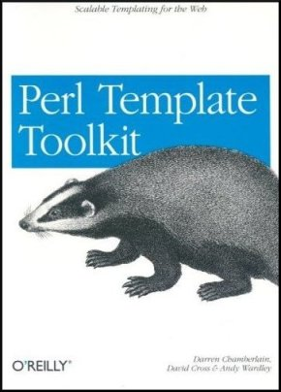
Good Book Too!

Slide 148
The Template Equation
Data + Template = Output
Data + Alternative Template = Alternative Output
Different views of the same data
Only the template changes

Slide 149
Simple TT Example
use Template;
use My::Object;
my ($id, $format) = @ARGV;
$format ||= 'html';
my $obj = My::Object->new($id)
or die;
my $tt = Template->new;
$tt->process("$format.tt",
{ obj => $obj },
"$id.$format")
or die $tt->error;

Slide 150
html.tt
<html>
<head>
<title>[% obj.name %]</title>
</head>
<body>
<h1>[% obj.name %]<h1>
<p><img src=“[% obj.img %]” /><br />
[% obj.desc %]</p>
<ul>
[% FOREACH child IN obj.children -%]
<li>[% child.name %]</li>
[% END %]
</body>
</html>

Slide 151
text.tt
[% obj.name | upper %]
Image: [% obj.img %]
[% obj.desc %]
[% FOREACH child IN obj.children -%]
* [% child.name %]
[% END %]

Slide 152
Adding New Formats
No new code required
Just add new output template
Perl programmer need not be involved

Slide 153
Equation Revisited
Data + Template = Output
  Template Toolkit
Template + Output = Data
  Template::Extract
Data + Output = Template
  Template::Generate

Slide 154
Catalyst

Slide 155
MVC Frameworks
MVC frameworks are a popular way to write applications
  Particularly web applications
Model
  Data storage & data access
View
  Data presentation layer
Controller
  Business logic to glue it all together

Slide 156
MVC Examples
Ruby on Rails
Django (Python)
Struts (Java)
CakePHP
Many examples in most languages
Perl has many options

Slide 157
MVC in Perl
Maypole
  The original Perl MVC framework
CGI::Application
  Simple MVC for CGI programming
Jifty
  Developed and used by Best Practical
Catalyst
  Currently the popular choice

Slide 158
Catalyst
MVC framework in Perl
Building on other heavily-used tools
Model uses DBIx::Class
View uses Template Toolkit
These are just defaults
Can use anything you want

Slide 159
Simple Catalyst App
Assume we already have model
  CD database from DBIx::Class section
Use catalyst.pl to create project
$ catalyst.pl CD
created "CD"
created "CD/script"
created "CD/lib"
created "CD/root"
... many more ...

Slide 160
What Just Happened?
Catalyst just generated a lot of useful stuff for us
Test web servers
  Standalone and FastCGI
Configuration files
Test stubs
Helpers for creating models, views and controllers

Slide 161
A Working Application
We already have a working application
$ CD/script/cd_server.pl
... lots of output
[info] CD powered by Catalyst 5.7015
You can connect to your server at http://localhost:3000
Of course, it doesn't do much yet

Slide 162
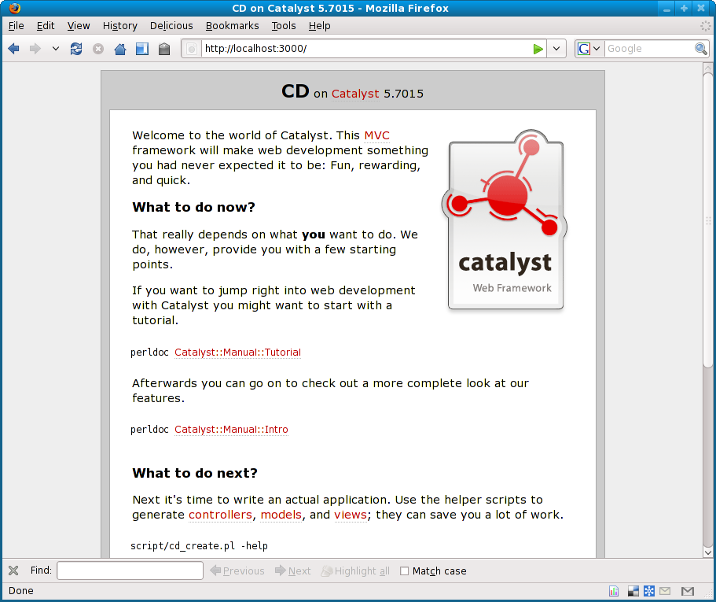
Simple Catalyst App

Slide 163
Next Steps
Use various helper programs to create models and views for your application
Write controller code to tie it all together
Many plugins to handle various parts of the process
  Authentication
  URL resolution
  Session handling
  etc...

Slide 164
Create a View
$ script/cd_create.pl view Default TT
exists "/home/dave/training/cdlib/CD/script/../lib/CD/View"
exists "/home/dave/training/cdlib/CD/script/../t"
created "/home/dave/training/cdlib/CD/script/../lib/CD/View/Default.pm"
created "/home/dave/training/cdlib/CD/script/../t/view_Default.t"

Slide 165
Remove Default Message
In lib/CD/Controller/Root.pm
sub index :Path :Args(0) {
my ( $self, $c ) = @_;
# Hello World
$c->response_body($c->welcome_message);
}
Remove response_body line
Default behaviour is to render index.tt
Need to create that

Slide 166
index.tt
root/index.tt
<html>
<head>
<title>CDs</title>
</head>
<body>
<ul>
[% FOREACH cd IN [ 1 .. 10 ] %]
<li>CD [% cd %]</li>
[% END %]
</ul>
</body>
</html>

Slide 167
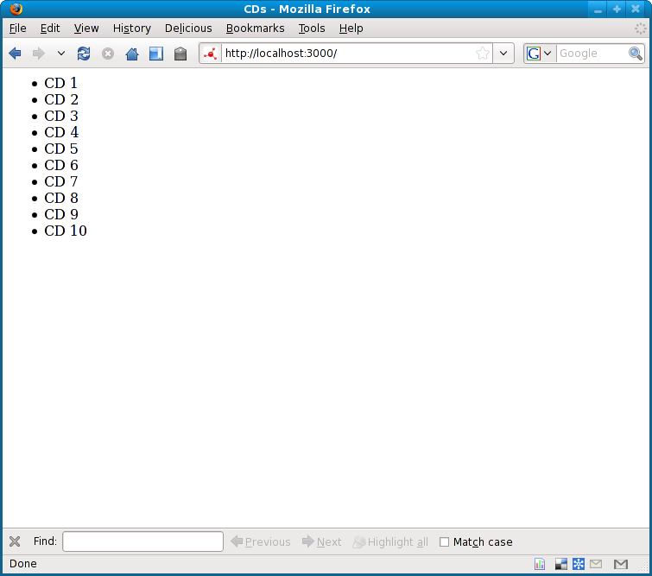
New Front Page

Slide 168
Adding Data
Of course that's hard-coded data
Need to add a model class
And then more views
And some controllers
There's a lot to do
I recommend working through a tutorial

Slide 169
Easier Catalyst
A lot of web applications do similar things
Given a database
Produce screens to edit the data
Surely most of this can be automated
It's called CatalystX::ListFramework::Builder
(Demo)

Slide 170
CatX::LFBuilder
Does a lot of work
On the fly
For every request
No security on table updates
So it's not right for every project
Very impressive though

Slide 171
Conclusions
There's a lot to bear in mind when writing a web app
Using the right framework can help
Catalyst is the most popular Perl framework
As powerful as any other framework
  In any language
Lots of work still going on
Large team, active development

Slide 172
Further Information

Slide 173
Further Information
Some suggestions for places to go for further information
Web sites
Books
Magazines
Mailing lists
Conferences

Slide 174
London Perl Mongers
http://london.pm.org/
Mailing list
Regular meetings
  Both social and technical
London Perl Workshop
Many other local Perl Monger groups
  http://pm.org/

Slide 175
Web Sites
use Perl;
  Perl news site
  Also journals
perl.com
  O'Reilly run site
  High quality articles

Slide 176
Web Sites
Perl Monks
  Best web site for Perl questions
  Many Perl experts
The Perl directory
  http://perl.org/
  Lists of many Perl-related sites

Slide 177
Books
Some recent Perl books
Perl Best Practices - Damian Conway
Advanced Perl Programming - Simon Cozens
Perl Hacks - chromatic, Conway & Poe
Intermediate Perl - Schwartz, foy & Phoenix
Mastering Perl - brian d foy

Slide 178
More Books
Higher Order Perl - Mark-Jason Dominus
Minimal Perl - Tim Maher
Pro Perl Debugging - Richard Foley & Joe McMahon
Perl & LWP - Sean M Burke
  Updated online edition
  http://lwp.interglacial.com/
See http://books.perl.org/

Slide 179
Magazines
The Perl Review
  http://www.theperlreview.com/
Randal's monthly columns
  Linux Magazine
  SysAdmin

Slide 180
Mailing Lists
Many mailing lists devoted to Perl topics
See http://lists.cpan.org/

Slide 181
Conferences
The Open Source Convention
  San Diego 20-24 July 2009
YAPC
  Pittsburgh 22-24 June 2009
  Lisbon 3-5 August 2009
  Brazil, Asia, Israel, Australia
One-Day Perl Workshops
See http://yapc.org/

Slide 182
That's all folks
Any questions?

