Slide 1
Advanced Perl Techniques
Dave Cross
Magnum Solutions Ltd
dave@mag-sol.com

Slide 2
Advanced Perl Techniques
Advanced level training for Perl programmers
Turn intermediate programmers into advanced programmers
“Modern” Perl
Perl is not dying

Slide 3
Advanced Perl Techniques
One day isn't enough time
We'll be moving fairly fast
Lots of pointers to other information
Feel free to ask questions

Slide 4
What We Will Cover
What's new in Perl 5.10
Testing
  including coverage analysis
Database access
  DBIx::Class

Slide 5
What We Will Cover
Profiling & Benchmarking
Object oriented programming with Moose
MVC Frameworks
  Catalyst

Slide 6
Schedule
09:45 – Begin
11:15 – Coffee break
13:00 – Lunch
14:00 – Begin
15:30 – Coffee break
17:00 – End

Slide 7
Resources
Slides available on-line
  http://mag-sol.com/train/public/2009-11/adv
Also see Slideshare
  http://www.slideshare.net/davorg/slideshows
Get Satisfaction
  http://getsatisfaction.com/magnum

Slide 8
Perl 5.10

Slide 9
Perl 5.10
Released 18th Dec 2007
  Perl's 20th birthday
Many new features
Well worth upgrading

Slide 10
New Features
Defined-or operator
Switch operator
Smart matching
say()
Lexical $_

Slide 11
New Features
State variables
Stacked file tests
Regex improvements
Many more

Slide 12
Defined Or
Boolean expressions “short-circuit”
$val = $val || $default;
$val ||= $default;
What if 0 is a valid value?
Need to check “definedness”
$val = defined $val
? $val : $default;
$val = $default unless defined $val;

Slide 13
Defined Or
The defined or operator makes this easier
$val = $val // $default;
A different slant on truth
Checks definedness
Shortcircuit version too
$val //= $value;

Slide 14
Switch Statement
Switch.pm was added with Perl 5.8
Source filter
Parser limitations
  Regular expressions
  eval
5.10 introduces a build-in switch statement

Slide 15
Given ... When
Switch is spelled “given”
Case is spelled “when”
Powerful matching syntax

Slide 16
Given Example
given ($foo) {
when (/^abc/) { $abc = 1; }
when (/^def/) { $def = 1; }
when (/^xyz/) { $xyz = 1; }
default { $nothing = 1; }
}

Slide 17
New Keywords
Four new keywords
  given
  when
  default
  continue

Slide 18
given
given(EXPR)
Assigns the result of EXPR to $_ within the following block
Similar to do { my $_ = EXPR; ... }

Slide 19
when
when (EXPR)
Uses smart matching to compare $_ with EXPR
Equivalent to if ($_ ~~ EXPR)
~~ is the new smart match operator
Compares two values and “does the right thing”

Slide 20
default
default defines a block that is executed if no when blocks match
default block is optional

Slide 21
continue
continue keyword falls through to the next when block
Normal behaviour is to break out of given block once the first when condition is matched

Slide 22
continue
given($foo) {
when (/x/)
{ say '$foo contains an x';
continue }
when (/y/)
{ say '$foo contains a y' }
default
{ say '$foo contains no x or y' }
}

Slide 23
Smart Matching
~~ is the new Smart Match operator
Different kinds of matches
Dependent on the types of the operands
See “perldoc perlsyn” for the full details

Slide 24
Smart Match Examples
$foo ~~ $bar; # == or cmp
@foo ~~ $bar; # array contains value
%foo ~~ $bar; # hash key exists
$foo ~~ qr{$bar}; # regex match
@foo ~~ @bar; # arrays are identical
%foo ~~ %bar; # hash keys match
Many more alternatives

Slide 25
say()
say() is a new alternative to print()
Adds a new line at the end of each call
say($foo); # print $foo, “\n”;
Two characters shorter than print
Less typing

Slide 26
Lexical $_
$_ is a package variable
Always exists in main package
Can lead to subtle bugs when not localised correctly
Can now use my $_ to create a lexically scoped variable called $_

Slide 27
State Variables
Lexical variables disappear when their scope is destroyed
sub variables {
my $x;
say ++$x;
}
variables() for 1 .. 3;

Slide 28
State Variables
State variables retain their value when their scope is destroyed
sub variables {
state $x;
say ++$x;
}
variables() for 1 .. 3;
Like static variables in C

Slide 29
Stacked File Tests
People often think you can do this
-f -w -x $file
Previously you couldn't
Now you can
Equivalent to
-x $file && -w _ && -f _

Slide 30
Regex Improvements
Plenty of regular expression improvements
Named capture buffers
Possessive quantifiers
Relative backreferences
New escape sequences
Many more

Slide 31
Named Capture Buffers
Variables $1, $2, etc change if the regex is altered
Named captures retain their names
(?<name> ... ) to define
Use new %+ hash to access them

Slide 32
Named Capture Example
while (<DATA>) {
if (/(?<header>[\w\s]+)
:\s+(?<value>.+)/x) {
print "$+{header} -> ";
print "$+{value}\n";
}
}

Slide 33
Possessive Quantifiers
?+, *+, ++
Grab as much as they can
Never give it back
Finer control over backtracking
'aaaa' =~ /a++a/
Never matches

Slide 34
Relative Backreferences
\g{N}
More powerful version of \1, \2, etc
\g{1} is the same as \1
\g{-1} is the last capture buffer
\g{-2} is the one before that

Slide 35
New Escape Sequences
\h – Horizontal white space
\v – Vertical white space
Also \H and \V

Slide 36
Accessing New Features
Some new features would break backwards compatibility
They are therefore turned off by default
Turn them on with the feature pragma
use feature 'say';
use feature 'switch';
use feature 'state';
use feature ':5.10';

Slide 37
Implicit Loading
Two ways to automatically turn on 5.10 features
Require a high enough version of Perl
use 5.10.0; # Or higher
-E command line option
perl -e 'say “hello”'
perl -E 'say “hello”'

Slide 38
Advanced
Testing

Slide 39
Writing Test Modules
Standard test modules all work together
Built using Test::Builder
Ensures that test modules all use the same framework
Use it as the basis of your own Test::* modules
Test your Test::Builder test modules with Test::Builder::Tester

Slide 40
Test::Between
package Test::Between;
use strict;
use warnings;
use base 'Exporter';
our @EXPORT = qw(is_between);
use Test::Builder;
my $test = Test::Builder->new;

Slide 41
Test::Between
sub is_between {
my ($item, $lower, $upper, $desc)
= @_;
return (
$test->ok($lower le $item &&
$item le $upper, $desc)
|| $test->diag("$item is not between $lower and $upper")
);
}
1;

Slide 42
Using Test::Between
#!/usr/bin/perl
use strict;
use warnings;
use Test::More tests => 3;
use Test::Between;
is_between('b', 'a', 'c', 'alpha');
is_between( 2, 1, 3, 'numeric');
is_between('two',1, 3, 'wrong');

Slide 43
Test::Between Output
$ prove -v test.pl
test.pl ..
1..3
ok 1 – alpha
ok 2 – numeric
not ok 3 – wrong
# Failed test 'wrong'
# at test.pl line 11.
# two is not between 1 and 3
# Looks like you failed 1 test of 3.
Dubious, test returned 1 (wstat 256, 0x100)
Failed 1/3 subtests

Slide 44
Test::Between Output
Test Summary Report
-------------------
test.pl (Wstat: 256 Tests: 3 Failed: 1)
Failed test: 3
Non-zero exit status: 1
Files=1, Tests=3, 1 wallclock secs ( 0.07 usr 0.01 sys + 0.05 cusr 0.01 csys = 0.14 CPU)
Result: FAIL

Slide 45
Mocking Objects
Sometimes it's hard to test external interfaces
Fake them
Test::MockObject pretends to be other objects
Gives you complete control over what they return

Slide 46
Testing Reactors
You're writing code that monitors a nuclear reactor
It's important that your code reacts correctly when the reactor overheats
You don't have a reactor in the test environment

Slide 47
Testing Reactors
Even if you did, you wouldn't want to make it overheat every time you run the tests
Especially if you're not 100% sure of your code
Of if you're running unattended smoke tests
Fake it with a mock object

Slide 48
My::Monitor Spec
If the temperature of a reactor is over 100 then try to cool it down
If you have tried cooling a reactor down 5 times and the temperature is still over 100 then return an error

Slide 49
My::Monitor Code
package My::Monitor;
sub new {
my $class = shift;
my $self = { tries => 0 };
return bless $self, $class;
}

Slide 50
My::Monitor Code
sub check {
my $self = shift;
my $reactor = shift;
my $temp = $reactor->temperature;
if ($temp > 100) {
$reactor->cooldown;
++$self->{tries};
if ($self->{tries} > 5) {
return;
}
return 1;

Slide 51
My::Monitor Code
} else {
$self->{tries} = 0;
return 1;
}
}
1;

Slide 52
Mock Reactor
Create a mock reactor object that acts exactly how we want it to
Reactor object has two interesting methods
temperature - returns the current temperature
cooldown - cools reactor and returns success or failure

Slide 53
monitor.t
use Test::More tests => 10;
use Test::MockObject;
# Standard tests
BEGIN { use_ok('My::Monitor'); }
ok(my $mon = My::Monitor->new);
isa_ok($mon, 'My::Monitor');

Slide 54
monitor.t
# Create Mock Reactor Object
my $t = 10;
my $reactor = Test::MockObject;
$reactor->set_bound('temperature',
\$t);
$reactor->set_true('cooldown');

Slide 55
monitor.t
# Test reactor
ok($mon->check($reactor));
$t = 120;
ok($mon->check($reactor)) for 1 .. 5;
ok(!$mon->check($reactor));

Slide 56
How Good Are Your Tests?
How much of your code is exercised by your tests?
Devel::Cover can help you to find out
Deep internal magic
Draws pretty charts
  HARNESS_PERL_SWITCHES= -MDevel::Cover make test
  cover

Slide 57
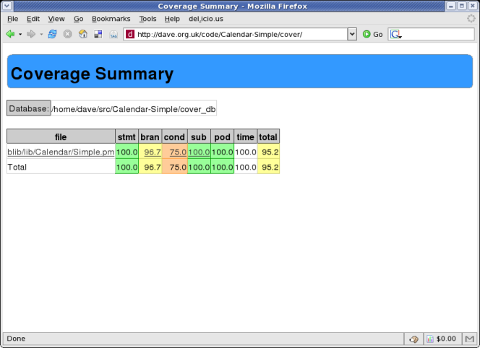
Devel::Cover Output

Slide 58
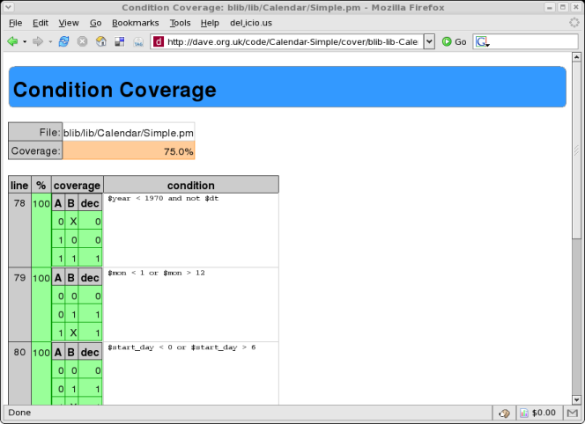
Devel::Cover Output

Slide 59
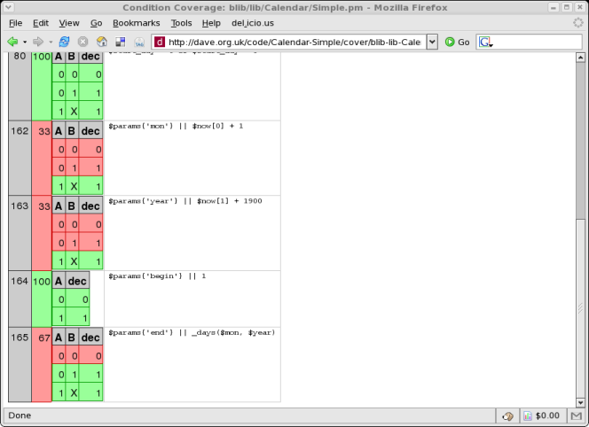
Devel::Cover Output

Slide 60
Alternative Test Paradigms
Not everyone likes the Perl testing framework
Other frameworks are available
Test::Class
  xUnit style framework
Test::FIT
  Framework for Interactive Testing
  http://fit.c2.com

Slide 61
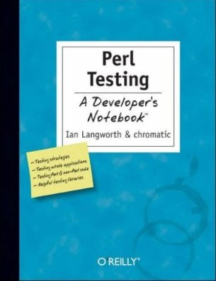
More Information
Perl Testing: A Developer's Notebook (Ian Langworth & chromatic)
perldoc Test::MockObject
perldoc Test::Builder
perldoc Devel::Cover
etc...

Slide 62
Benchmarking

Slide 63
Benchmarking
Ensure that your program is fast enough
But how fast is fast enough?
premature optimization is the root of all evil
  Donald Knuth
  paraphrasing Tony Hoare
Don't optimise until you know what to optimise

Slide 64
Benchmark.pm
Standard Perl module for benchmarking
Simple usage
use Benchmark;
my %methods = (
method1 => sub { ... },
method2 => sub { ... },
);
timethese(10_000, \%methods);
Times 10,000 iterations of each method

Slide 65
Benchmark.pm Output
Benchmark: timing 10000 iterations of method1, method2...
method1: 6 wallclock secs \
( 2.12 usr + 3.47 sys = 5.59 CPU) \
@ 1788.91/s (n=10000)
method2: 3 wallclock secs \
( 0.85 usr + 1.70 sys = 2.55 CPU) \
@ 3921.57/s (n=10000)

Slide 66
Timed Benchmarks
Passing timethese a positive number runs each piece of code a certain number of times
Passing timethese a negative number runs each piece of code for a certain number of seconds

Slide 67
Timed Benchmarks
use Benchmark;
my %methods = (
method1 => sub { ... },
method2 => sub { ... },
);
# Run for 10,000(!) seconds
timethese(-10_000, \%methods);

Slide 68
Comparing Performance
Use cmpthese to get a tabular output
Optional export
use Benchmark 'cmpthese';
my %methods = (
method1 => sub { ... },
method2 => sub { ... },
);
cmpthese(10_000, \%methods);

Slide 69
cmpthese Output
Rate method1 method2
method1 2831802/s -- -61%
method2 7208959/s 155% --
method2 is 61% slower than method1
Can also pass negative number to cmpthese

Slide 70
Benchmarking is Hard
Very easy to produce lots of numbers
Harder to ensure that the numbers are meaningful
Compare code fragments that do the same thing

Slide 71
Bad Benchmarking
use Benchmark qw{ timethese };
timethese( 1_000, {
Ordinary => sub {
my @results = sort { -M $a <=> -M $b } glob "/bin/*";
},
Schwartzian => sub {
map $_->[0],
sort { $a->[1] <=> $b->[1] }
map [$_, -M], glob "/bin/*";
},
});

Slide 72
What to Benchmark
Profile your code
See which parts it is worth working on
Look for code that
  Takes a long time to run, or
  Is called many times, or
  Both

Slide 73
Devel::DProf
Devel::DProf is the standard Perl profiling tool
Included with Perl distribution
Uses Perl debugger hooks
perl -d:DProf your_program
Produces a data file called tmon.out
Command line program dprofpp to view results

Slide 74
Sample Output
$ perl -d:DProf ./invoice.pl 244
$ dprofpp
Total Elapsed Time = 1.173152 Seconds
User+System Time = 0.963152 Seconds
Exclusive Times
%Time ExclSec CumulS #Calls sec/call Csec/c Name
6.02 0.058 0.067 482 0.0001 0.0001 Params::Validate::_validate
5.09 0.049 0.114 7 0.0070 0.0163 Class::DBI::Loader::mysql::BEGIN
4.15 0.040 0.050 10 0.0040 0.0050 Template::Parser::BEGIN
4.15 0.040 0.166 7 0.0057 0.0237 DateTime::Locale::BEGIN
4.05 0.039 0.094 43 0.0009 0.0022 base::import
3.74 0.036 0.094 449 0.0001 0.0002 DateTime::Locale::_register
3.11 0.030 0.280 4 0.0074 0.0700 DateTime::Format::MySQL::BEGIN
2.91 0.028 0.028 170 0.0002 0.0002 Lingua::EN::Inflect::_PL_noun
2.70 0.026 0.040 1 0.0262 0.0401 Template::Parser::_parse
2.49 0.024 0.024 1113 0.0000 0.0000 Class::Data::Inheritable::__ANON__
2.08 0.020 0.020 12 0.0017 0.0017 DBD::mysql::db::_login
2.08 0.020 0.020 4 0.0050 0.0050 Template::Stash::BEGIN
2.08 0.020 0.099 9 0.0022 0.0110 Template::Config::load
2.08 0.020 0.067 9 0.0022 0.0074 Template::BEGIN
2.08 0.020 0.039 4 0.0049 0.0097 Lingua::EN::Inflect::Number::BEGIN

Slide 75
Devel::NYTProf
New profiling module
Based on work from the New York Times
Enhanced by Tim Bunce
Pretty HTML output
  “borrowed” from Devel::Cover
Far more flexible
Far more powerful

Slide 76
Using NYTProf
Similar to Devel::DProf
$ perl -d:NYTProf ./invoice.pl 244
Writes nytprof.out
$ nytprofhtml
Or
$ nytprofcsv

Slide 77
Conclusions
Don't optimise until you know you need to optimise
Don't optimise until you know what to optimise
Use profiling to find out what is worth optimising
Use benchmarking to compare different solutions

Slide 78
More Information
perldoc Benchmark
perldoc Devel::DProf
perldoc Devel::NYTProf
Chapters 5 and 6 of Mastering Perl

Slide 79
Object Relational Mapping

Slide 80
ORM
Mapping database relations into objects
Tables (relations) map onto classes
Rows (tuples) map onto objects
Columns (attributes) map onto attributes
Don't write SQL

Slide 81
SQL Is Tedious
Select the id and name from this table
Select all the details of this row
Select something about related tables
Update this row with these values
Insert a new record with these values
Delete this record

Slide 82
Replacing SQL
Instead of
SELECT *
FROM my_table
WHERE my_id = 10
and then dealing with the prepare/execute/fetch code

Slide 83
Replacing SQL
We can write
use My::Object;
# warning! not a real orm
my $obj = My::Object->retrieve(10)
Or something similar

Slide 84
Writing An ORM Layer
Not actually that hard to do yourself
Each class needs an associated table
Each class needs a list of columns
Create simple SQL for basic CRUD operations
Don't do that

Slide 85
Perl ORM Options
Plenty of choices on CPAN
Tangram
SPOPS (Simple Perl Object Persistence with Security)
Alzabo
Class::DBI
DBIx::Class
  The current favourite

Slide 86
DBIx::Class
Standing on the shoulders of giants
Learning from problems in Class::DBI
More flexible
More powerful

Slide 87
DBIx::Class Example
Modeling a CD collection
Three tables
artist (artistid, name)
cd (cdid, artist, title)
track (trackid, cd, title)

Slide 88
Main Schema
Define main schema class
DB/Main.pm
package DB::Main;
use base qw/DBIx::Class::Schema/;
__PACKAGE__->load_classes();
1;

Slide 89
Object Classes
DB/Main/Artist.pm
package DB::Main::Artist;
use base qw/DBIx::Class/;
__PACKAGE__->load_components(qw/PK::Auto Core/);
__PACKAGE__->table('artist');
__PACKAGE__->add_columns(qw/ artistid name /);
__PACKAGE__->set_primary_key('artistid');
__PACKAGE__->has_many(cds =>
'DB::Main::Cd');
1;

Slide 90
Object Classes
DB/Main/CD.pm
package DB::Main::CD;
use base qw/DBIx::Class/;
__PACKAGE__->load_components(qw/PK::Auto Core/);
__PACKAGE__->table('cd');
__PACKAGE__->add_columns(qw/ cdid artist title year /);
__PACKAGE__->set_primary_key('cdid');
__PACKAGE__->belongs_to(artist =>
'DB::Main::Artist');
1;

Slide 91
Inserting Artists
my $schema =
DB::Main->connect($dbi_str);
my @artists = ('The Beta Band',
'Beth Orton');
my $art_rs = $schema->resultset('Artist');
foreach (@artists) {
$art_rs->create({ name => $_ });
}

Slide 92
Inserting CDs
Hash of Artists and CDs
my %cds = ( 'The Three EPs' =>
'The Beta Band',
'Trailer Park' =>
'Beth Orton');

Slide 93
Inserting CDs
Find each artist and insert CD
foreach (keys $cds) {
my ($artist) = $art_rs->search(
{ name => $cds{$_} }
);
$artist->add_to_cds({
title => $_,
});
}

Slide 94
Retrieving Data
Get CDs by artist
my ($artist) = $art_rs->search({
name => 'Beth Orton',
});
foreach ($artist->cds) {
say $_->title;
}

Slide 95
Searching for Data
Search conditions can be more complex
Alternatives
  $rs->search({year => 2006},
  {year => 2007});
Like
  $rs->search({name =>
  { 'like', 'Dav%' }});

Slide 96
Searching for Data
Combinations
  $rs->search({forename =>
  { 'like', 'Dav%' },
  surname => 'Cross' });

Slide 97
Don't Repeat Yourself
There's a problem with this approach
Information is repeated
Columns and relationships defined in the database schema
Columns and relationships defined in class definitions

Slide 98
Repeated Information
CREATE TABLE artist (
artistid INTEGER PRIMARY KEY,
name TEXT NOT NULL
);

Slide 99
Repeated Information
package DB::Main::Artist;
use base qw/DBIx::Class/;
__PACKAGE__->
load_components(qw/PK::Auto Core/);
__PACKAGE__->table('artist');
__PACKAGE__->
add_columns(qw/ artistid name /);
__PACKAGE__>
set_primary_key('artistid');
__PACKAGE__->has_many('cds' => 'DB::Main::Cd');

Slide 100
Database Metadata
Some people don't put enough metadata in their databases
Just tables and columns
No relationships. No constraints
You may as well make each column VARCHAR(255)

Slide 101
Database Metadata
Describe your data in your database
It's what your database is for
It's what your database does best

Slide 102
No Metadata (Excuse 1)
"This is the only application that will ever access this database"
Bollocks
All data will be shared eventually
People will update your database using other applications
Can you guarantee that someone won't use mysql to update your database?

Slide 103
No Metadata (Excuse 2)
"Database doesn't support those features"
Bollocks
MySQL 3.x is not a database
  It's a set of data files with a vaguely SQL-like query syntax
MySQL 4.x is a lot better
MySQL 5.x is most of the way there
Don't be constrained by using inferior tools

Slide 104
DBIC::Schema::Loader
Creates classes by querying your database metadata
No more repeated data
We are now DRY
Schema definitions in one place
But...
Performance problems

Slide 105
Performance Problems
You don't really want to generate all your class definitions each time your program is run
Need to generate the classes in advance
dump_to_dir method
Regenerate classes each time schema changes

Slide 106
Alternative Approach
Need one canonical definition of the data tables
Doesn't need to be SQL DDL
Could be in Perl code
Write DBIx::Class definitions
Generate DDL from those
Harder approach
  Might need to generate ALTER TABLE

Slide 107
Conclusions
ORM is a bridge between relational objects and program objects
Avoid writing SQL in common cases
DBIx::Class is the currently fashionable module
Lots of plugins
Caveat: ORM may be overkill for simple programs

Slide 108
More Information
Manual pages (on CPAN)
DBIx::Class
DBIx::Class::Manual::*
DBIx::Class::Schema::Loader
Mailing list (Google for it)

Slide 109
Moose

Slide 110
Moose
A complete modern object system for Perl 5
Based on experiments with Perl 6 object model
Built on top of Class::MOP
  MOP - Meta Object Protocol
  Set of abstractions for components of an object system
  Classes, Objects, Methods, Attributes
An example might help

Slide 111
Moose Example
package Point;
use Moose;
has 'x' => (isa => 'Int',
is => 'ro');
has 'y' => (isa => 'Int',
is => 'rw');
sub clear {
my $self = shift;
$self->{x} = 0;
$self->y(0);
}

Slide 112
Understanding Moose
There's a lot going on here
use Moose
  Loads Moose environment
  Makes our class a subclass of Moose::Object
  Turns on strict and warnings

Slide 113
Creating Attributes
has 'x' => (isa => 'Int',
is => 'ro')
  Creates an attribute called 'x'
  Constrainted to be an integer
  Read-only accessor
has 'y' => (isa => 'Int',
is => 'rw')

Slide 114
Defining Methods
sub clear {
my $self = shift;
$self->{x} = 0;
$self->y(0);
}
Standard method syntax
Uses generated method to set y
Direct hash access for x

Slide 115
Subclassing
package Point3D;
use Moose;
extends 'Point';
has 'z' => (isa => 'Int');
after 'clear' => sub {
my $self = shift;
$self->{z} = 0;
};

Slide 116
Subclasses
extends 'Point'
  Similar to use base
  Overwrites @ISA instead of appending
has 'z' => (isa = 'Int')
  Adds new attribute 'z'
  No accessor function - private attribute

Slide 117
Extending Methods
after 'clear' => sub {
my $self = shift;
$self->{z} = 0;
};
New clear method for subclass
Called after method for superclass
Cleaner than $self->SUPER::clear()

Slide 118
Creating Objects
Moose classes are used just like any other Perl class
$point = Point->new(x => 1, y => 2);
$p3d = Point3D->new(x => 1,
y => 2,
z => 3);

Slide 119
More About Attributes
Use the has keyword to define your class's attributes
has 'first_name' => ( is => 'rw' );
Use is to define rw or ro
Omitting is gives an attribute with no accessors

Slide 120
Getting & Setting
By default each attribute creates a method of the same name.
Used for both getting and setting the attribute
$dave->first_name('Dave');
say $dave->first_name;

Slide 121
Change Accessor Name
Change accessor names using reader and writer
has 'name' => (
is => 'rw',
reader => 'get_name',
writer => 'set_name',
);
See also MooseX::FollowPBP

Slide 122
Required Attributes
By default Moose class attributes are optional
Change this with required
has 'name' => (
is => 'ro',
required => 1,
);
Forces constructor to expect a name
Although that name could be undef

Slide 123
Attribute Defaults
Set a default value for an attribute with default
has 'size' => (
is => 'rw',
default => 'medium',
);
Can use a subroutine reference
has 'size' => (
is => 'rw',
default => \&rand_size,
);

Slide 124
More Attribute Properties
lazy
  Only populate attribute when queried
trigger
  Subroutine called after the attribute is set
isa
  Set the type of an attribute
Many more

Slide 125
More Moose
Many more options
Support for concepts like delegation and roles
Powerful plugin support
  MooseX::*
Lots of work going on in this area

Slide 126
Catalyst

Slide 127
MVC Frameworks
MVC frameworks are a popular way to write applications
  Particularly web applications

Slide 128
M, V and C
Model
  Data storage & data access
View
  Data presentation layer
Controller
  Business logic to glue it all together

Slide 129
MVC Examples
Ruby on Rails
Django (Python)
Struts (Java)
CakePHP
Many examples in most languages
Perl has many options

Slide 130
MVC in Perl
Maypole
  The original Perl MVC framework
CGI::Application
  Simple MVC for CGI programming
Jifty
  Developed and used by Best Practical
Catalyst
  Currently the popular choice

Slide 131
Catalyst
MVC framework in Perl
Building on other heavily-used tools
Model uses DBIx::Class
View uses Template Toolkit
These are just defaults
Can use anything you want

Slide 132
Simple Catalyst App
Assume we already have model
  CD database from DBIx::Class section
Use catalyst.pl to create project
$ catalyst.pl CD
created "CD"
created "CD/script"
created "CD/lib"
created "CD/root"
... many more ...

Slide 133
What Just Happened?
Catalyst just generated a lot of useful stuff for us
Test web servers
  Standalone and FastCGI
Configuration files
Test stubs
Helpers for creating models, views and controllers

Slide 134
A Working Application
We already have a working application
$ CD/script/cd_server.pl
... lots of output
[info] CD powered by Catalyst 5.7015
You can connect to your server at http://localhost:3000
Of course, it doesn't do much yet

Slide 135
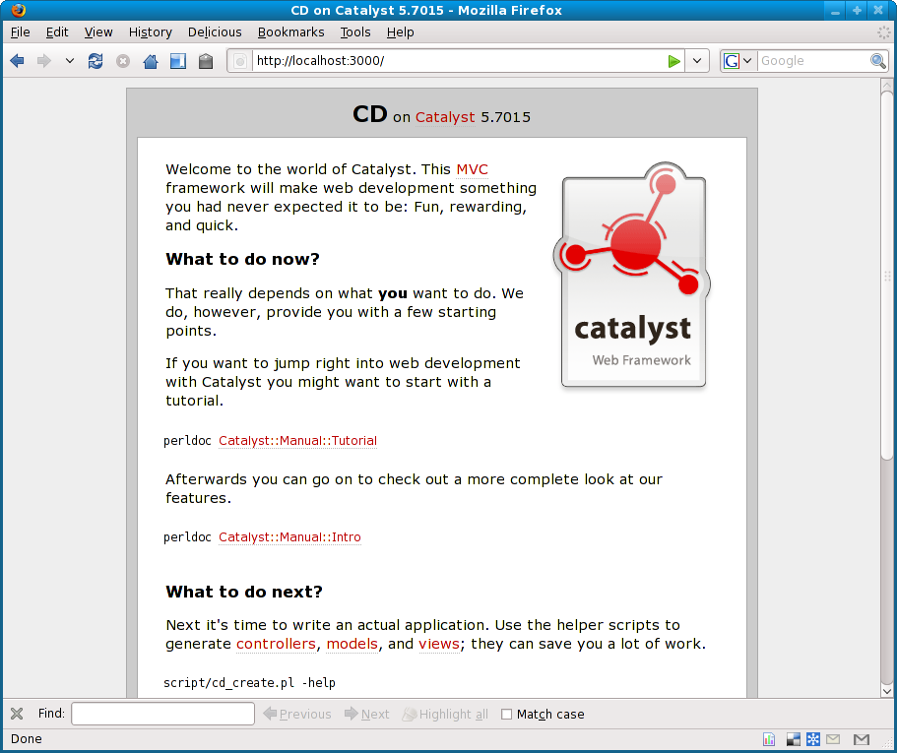
Simple Catalyst App

Slide 136
Next Steps
Use various helper programs to create models and views for your application
Write controller code to tie it all together
Many plugins to handle various parts of the process
  Authentication
  URL resolution
  Session handling
  etc...

Slide 137
Create a View
$ script/cd_create.pl view Default TT
exists "/home/dave/training/cdlib/CD/script/../lib/CD/View"
exists "/home/dave/training/cdlib/CD/script/../t"
created "/home/dave/training/cdlib/CD/script/../lib/CD/View/Default.pm"
created "/home/dave/training/cdlib/CD/script/../t/view_Default.t"

Slide 138
Remove Default Message
In lib/CD/Controller/Root.pm
sub index :Path :Args(0) {
my ( $self, $c ) = @_;
# Hello World
$c->response_body($c->welcome_message);
}
Remove response_body line
Default behaviour is to render index.tt
Need to create that

Slide 139
index.tt
root/index.tt
<html>
<head>
<title>CDs</title>
</head>
<body>
<ul>
[% FOREACH cd IN [ 1 .. 10 ] %]
<li>CD [% cd %]</li>
[% END %]
</ul>
</body>
</html>

Slide 140
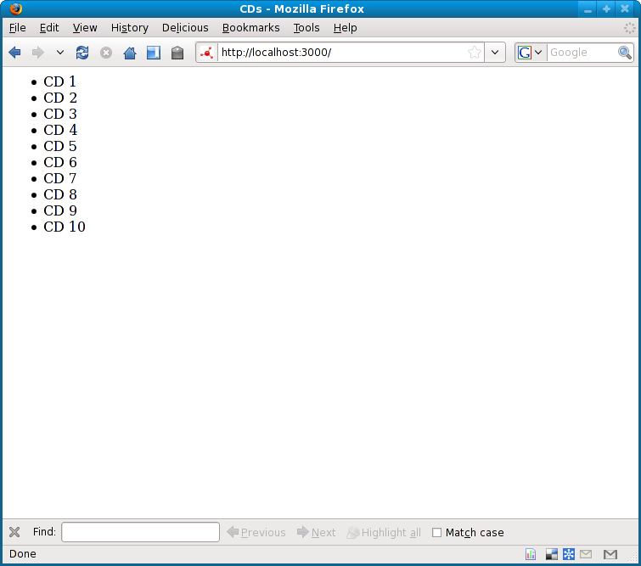
New Front Page

Slide 141
Adding Data
Of course that's hard-coded data
Need to add a model class
And then more views
And some controllers
There's a lot to do
I recommend working through a tutorial

Slide 142
Easier Catalyst
A lot of web applications do similar things
Given a database
Produce screens to edit the data
Surely most of this can be automated
It's called Catalyst::Plugin::AutoCRUD
(Demo)

Slide 143
Cat::Plugin::AutoCRUD
Does a lot of work
On the fly
For every request
No security on table updates
So it's not right for every project
Very impressive though

Slide 144
Conclusions
There's a lot to bear in mind when writing a web app
Using the right framework can help
Catalyst is the most popular Perl framework
As powerful as any other framework
  In any language
Lots of work still going on
Large team, active development

Slide 145
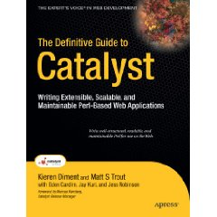
Recommended Book
The Definitive Guide to Catalyst
  Kieren Diment
  Matt S Trout

Slide 146
Further Information

Slide 147
Further Information
Some suggestions for places to go for further information
Web sites
Books
Magazines
Mailing lists
Conferences

Slide 148
London Perl Mongers
http://london.pm.org/
Mailing list
Regular meetings
  Both social and technical
London Perl Workshop
  5th December 2009
Many other local Perl Monger groups
  http://pm.org/

Slide 149
Web Sites
The Perl directory
  http://perl.org/
  Lists of many Perl-related sites
use Perl;
  Perl news site
  Also journals

Slide 150
Web Sites
Perl Monks
  Best web site for Perl questions
  Many Perl experts

Slide 151
Perl Blogs
Perl Iron Man
  http://ironman.enlightenedperl.org/
Planet Perl
  http://planet.perl.org/
Perlsphere
  http://perlsphere.net/
blogs.perl.org
  http://blogs.perl.org/

Slide 152
Books
Some recent Perl books
Perl Best Practices - Damian Conway
Advanced Perl Programming - Simon Cozens
Perl Hacks - chromatic, Conway & Poe
Intermediate Perl - Schwartz, foy & Phoenix
Mastering Perl - brian d foy

Slide 153
More Books
Higher Order Perl - Mark-Jason Dominus
Minimal Perl - Tim Maher
Pro Perl Debugging - Richard Foley & Joe McMahon
Perl & LWP - Sean M Burke
  Updated online edition
  http://lwp.interglacial.com/
See http://books.perl.org/

Slide 154
Mailing Lists
Many mailing lists devoted to Perl topics
See http://lists.cpan.org/

Slide 155
Conferences
The Open Source Convention
  Portland, Oregon 19-23 July 2010
YAPC
  Columbus, Ohio 2010
  Pisa, Italy 2010
  Brazil, Asia, Israel, Australia
One-Day Perl Workshops
See http://yapc.org/

Slide 156
That's all folks
Any questions?

