Slide 1
Advanced Perl Techniques
Day 1
Dave Cross
Magnum Solutions Ltd
dave@mag-sol.com

Slide 2
Advanced Perl Techniques
Advanced level training for Perl programmers
Turn intermediate programmers into advanced programmers
“Modern” Perl
Perl is not dying

Slide 3
Advanced Perl Techniques
One day isn't enough time
We'll be moving fairly fast
Lots of pointers to other information
Feel free to ask questions

Slide 4
What We Will Cover
What's new in Perl 5.10 & 5.12
Advanced Testing
Database access with DBIx::Class
Handling Exceptions

Slide 5
Schedule
09:45 – Begin
11:15 – Coffee break
13:00 – Lunch
14:00 – Begin
15:30 – Coffee break
17:00 – End

Slide 6
Resources
Slides available on-line
  http://mag-sol.com/train/public/2010-04/adv
Also see Slideshare
  http://www.slideshare.net/davorg/slideshows
Get Satisfaction
  http://getsatisfaction.com/magnum

Slide 7
Perl 5.10 & 5.12

Slide 8
Perl Releases
Perl 5 has moved to a regular release cycle
Major release every year
Minor releases when required
Even major numbers are production releases
  5.10, 5.12, 5.14
Odd major numbers are dev releases
  5.9, 5.11, 5.13

Slide 9
Perl 5.10
Released 18th Dec 2007
  Perl's 20th birthday
Many new features
Well worth upgrading

Slide 10
New Features
Defined-or operator
Switch operator
Smart matching
say()
Lexical $_

Slide 11
New Features
State variables
Stacked file tests
Regex improvements
Many more

Slide 12
Defined Or
Boolean expressions “short-circuit”
$val = $val || $default;
$val ||= $default;
What if 0 is a valid value?
Need to check “definedness”
$val = defined $val
? $val : $default;
$val = $default unless defined $val;

Slide 13
Defined Or
The defined or operator makes this easier
$val = $val // $default;
A different slant on truth
Checks definedness
Shortcircuit version too
$val //= $value;

Slide 14
Switch Statement
Switch.pm was added with Perl 5.8
Source filter
Parser limitations
  Regular expressions
  eval
5.10 introduces a build-in switch statement

Slide 15
Given ... When
Switch is spelled “given”
Case is spelled “when”
Powerful matching syntax

Slide 16
Given Example
given ($foo) {
when (/^abc/) { $abc = 1; }
when (/^def/) { $def = 1; }
when (/^xyz/) { $xyz = 1; }
default { $nothing = 1; }
}

Slide 17
New Keywords
Four new keywords
  given
  when
  default
  continue

Slide 18
given
given(EXPR)
Assigns the result of EXPR to $_ within the following block
Similar to do { my $_ = EXPR; ... }

Slide 19
when
when (EXPR)
Uses smart matching to compare $_ with EXPR
Equivalent to when ($_ ~~ EXPR)
~~ is the new smart match operator
Compares two values and “does the right thing”

Slide 20
default
default defines a block that is executed if no when blocks match
default block is optional

Slide 21
continue
continue keyword falls through to the next when block
Normal behaviour is to break out of given block once the first when condition is matched

Slide 22
continue
given($foo) {
when (/x/)
{ say '$foo contains an x';
continue }
when (/y/)
{ say '$foo contains a y' }
default
{ say '$foo contains no x or y' }
}

Slide 23
Smart Matching
~~ is the new Smart Match operator
Different kinds of matches
Dependent on the types of the operands
See “perldoc perlsyn” for the full details

Slide 24
Smart Match Examples
$foo ~~ $bar; # == or cmp
@foo ~~ $bar; # array contains value
%foo ~~ $bar; # hash key exists
$foo ~~ qr{$bar}; # regex match
@foo ~~ @bar; # arrays are identical
%foo ~~ %bar; # hash keys match
Many more alternatives

Slide 25
say()
say() is a new alternative to print()
Adds a new line at the end of each call
say($foo); # print $foo, “\n”;
Two characters shorter than print
Less typing

Slide 26
Lexical $_
$_ is a package variable
Always exists in main package
Can lead to subtle bugs when not localised correctly
Can now use my $_ to create a lexically scoped variable called $_

Slide 27
State Variables
Lexical variables disappear when their scope is destroyed
sub variables {
my $x;
say ++$x;
}
variables() for 1 .. 3;

Slide 28
State Variables
State variables retain their value when their scope is destroyed
sub variables {
state $x;
say ++$x;
}
variables() for 1 .. 3;
Like static variables in C

Slide 29
Stacked File Tests
People often think you can do this
-f -w -x $file
Previously you couldn't
Now you can
Equivalent to
-x $file && -w _ && -f _

Slide 30
Regex Improvements
Plenty of regular expression improvements
Named capture buffers
Possessive quantifiers
Relative backreferences
New escape sequences
Many more

Slide 31
Named Capture Buffers
Variables $1, $2, etc change if the regex is altered
Named captures retain their names
(?<name> ... ) to define
Use new %+ hash to access them

Slide 32
Named Capture Example
while (<DATA>) {
if (/(?<header>[\w\s]+)
:\s+(?<value>.+)/x) {
print "$+{header} -> ";
print "$+{value}\n";
}
}

Slide 33
Possessive Quantifiers
?+, *+, ++
Grab as much as they can
Never give it back
Finer control over backtracking
'aaaa' =~ /a++a/
Never matches

Slide 34
Relative Backreferences
\g{N}
More powerful version of \1, \2, etc
\g{1} is the same as \1
\g{-1} is the last capture buffer
\g{-2} is the one before that

Slide 35
New Escape Sequences
\h – Horizontal white space
\v – Vertical white space
Also \H and \V

Slide 36
Accessing New Features
Some new features would break backwards compatibility
They are therefore turned off by default
Turn them on with the feature pragma
use feature 'say';
use feature 'switch';
use feature 'state';
use feature ':5.10';

Slide 37
Implicit Loading
Two ways to automatically turn on 5.10 features
Require a high enough version of Perl
use 5.10.0; # Or higher
-E command line option
perl -e 'say “hello”'
perl -E 'say “hello”'

Slide 38
Perl 5.12
Released 12 April 2010
  5.12.2 7 Sept 2010
Many new enhancements
5.14 due spring 2011

Slide 39
5.12 Enhancements
package NAME VERSION syntax
... operator
Implicit strictures
Y2038 compliance
Smart match changes
New modules
  autodie
  parent

Slide 40
package NAME VER
Declare the version of a package in the package declaration
package My::Package 1.23;
Equivalent to
package My::Package;
our $VERSION = 1.23;

Slide 41
... Operator
Called the “yada-yada” operator
Used to stand in for unwritten code
sub unimplemented {
...
}
Code compiles
Throws an “unimplemented” exception when run

Slide 42
Implicit Strictures
Requiring a version of Perl greater than 5.11 implicitly turns on use strict
use 5.12.0;
Is equivalent to
use strict;
use feature ':5.12';

Slide 43
Y2038 Compliance
Core time functions are now Y2038 compliant

Slide 44
Smart Match Changes
Some changes to Smart Match operator
No longer commutative
See new table in perlsyn

Slide 45
New Modules
Some new modules in the standard distribution
autodie
parent
  Better version of base.

Slide 46
More Information
perldoc perl5100delta
perldoc perl5120delta

Slide 47
5.10 & 5.12 Examples
Write a program that uses at least three or four of the new features

Slide 48
Advanced
Testing

Slide 49
Writing Test Modules
Standard test modules all work together
Built using Test::Builder
Ensures that test modules all use the same framework
Use it as the basis of your own Test::* modules
Test your Test::Builder test modules with Test::Builder::Tester

Slide 50
Test::Between
package Test::Between;
use strict;
use warnings;
use base 'Exporter';
our @EXPORT = qw(is_between);
use Test::Builder;
my $test = Test::Builder->new;

Slide 51
Test::Between
sub is_between {
my ($item, $lower, $upper, $desc)
= @_;
return (
$test->ok($lower le $item &&
$item le $upper, $desc)
|| $test->diag("$item is not between $lower and $upper")
);
}
1;

Slide 52
Using Test::Between
#!/usr/bin/perl
use strict;
use warnings;
use Test::More tests => 3;
use Test::Between;
is_between('b', 'a', 'c', 'alpha');
is_between( 2, 1, 3, 'numeric');
is_between('two',1, 3, 'wrong');

Slide 53
Test::Between Output
$ prove -v test.pl
test.pl ..
1..3
ok 1 – alpha
ok 2 – numeric
not ok 3 – wrong
# Failed test 'wrong'
# at test.pl line 11.
# two is not between 1 and 3
# Looks like you failed 1 test of 3.
Dubious, test returned 1 (wstat 256, 0x100)
Failed 1/3 subtests

Slide 54
Test::Between Output
Test Summary Report
-------------------
test.pl (Wstat: 256 Tests: 3 Failed: 1)
Failed test: 3
Non-zero exit status: 1
Files=1, Tests=3, 1 wallclock secs ( 0.07 usr 0.01 sys + 0.05 cusr 0.01 csys = 0.14 CPU)
Result: FAIL

Slide 55
Mocking Objects
Sometimes it's hard to test external interfaces
Fake them
Test::MockObject pretends to be other objects
Gives you complete control over what they return

Slide 56
Testing Reactors
You're writing code that monitors a nuclear reactor
It's important that your code reacts correctly when the reactor overheats
You don't have a reactor in the test environment

Slide 57
Testing Reactors
Even if you did, you wouldn't want to make it overheat every time you run the tests
Especially if you're not 100% sure of your code
Of if you're running unattended smoke tests
Fake it with a mock object

Slide 58
My::Monitor Spec
If the temperature of a reactor is over 100 then try to cool it down
If you have tried cooling a reactor down 5 times and the temperature is still over 100 then return an error

Slide 59
My::Monitor Code
package My::Monitor;
sub new {
my $class = shift;
my $self = { tries => 0 };
return bless $self, $class;
}

Slide 60
My::Monitor Code
sub check {
my $self = shift;
my $reactor = shift;
my $temp = $reactor->temperature;
if ($temp > 100) {
$reactor->cooldown;
++$self->{tries};
if ($self->{tries} > 5) {
return;
}
return 1;

Slide 61
My::Monitor Code
} else {
$self->{tries} = 0;
return 1;
}
}
1;

Slide 62
Mock Reactor
Create a mock reactor object that acts exactly how we want it to
Reactor object has two interesting methods
temperature - returns the current temperature
cooldown - cools reactor and returns success or failure

Slide 63
monitor.t
use Test::More tests => 10;
use Test::MockObject;
# Standard tests
BEGIN { use_ok('My::Monitor'); }
ok(my $mon = My::Monitor->new);
isa_ok($mon, 'My::Monitor');

Slide 64
monitor.t
# Create Mock Reactor Object
my $t = 10;
my $reactor = Test::MockObject;
$reactor->set_bound('temperature',
\$t);
$reactor->set_true('cooldown');

Slide 65
monitor.t
# Test reactor
ok($mon->check($reactor));
$t = 120;
ok($mon->check($reactor)) for 1 .. 5;
ok(!$mon->check($reactor));

Slide 66
How Good Are Your Tests?
How much of your code is exercised by your tests?
Devel::Cover can help you to find out
Deep internal magic
Draws pretty charts
  HARNESS_PERL_SWITCHES= -MDevel::Cover make test
  cover

Slide 67
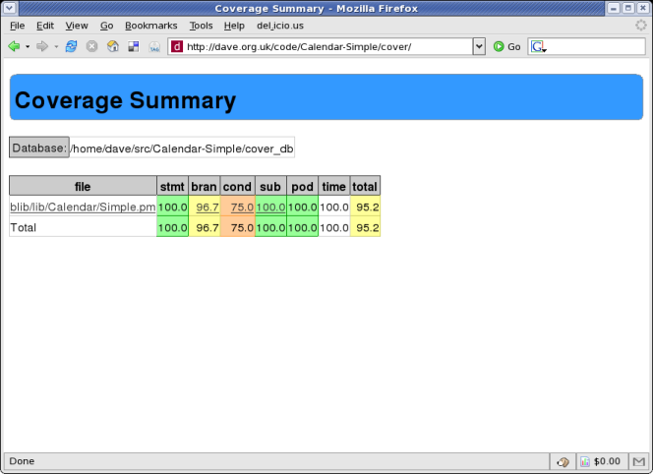
Devel::Cover Output

Slide 68
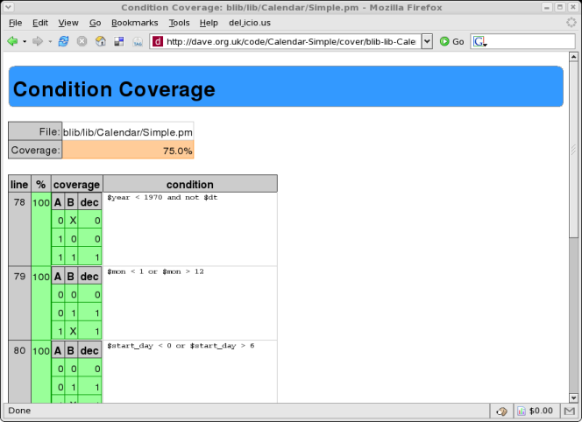
Devel::Cover Output

Slide 69
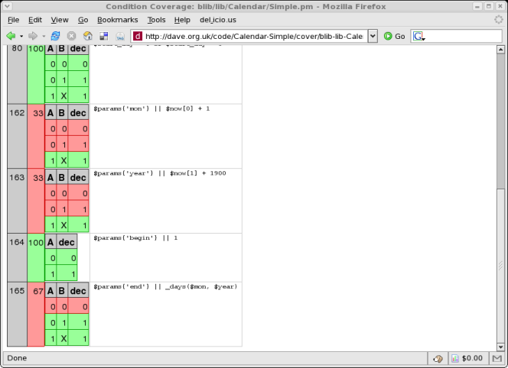
Devel::Cover Output

Slide 70
Alternative Test Paradigms
Not everyone likes the Perl testing framework
Other frameworks are available
Test::Class
  xUnit style framework
Test::FIT
  Framework for Interactive Testing
  http://fit.c2.com

Slide 71
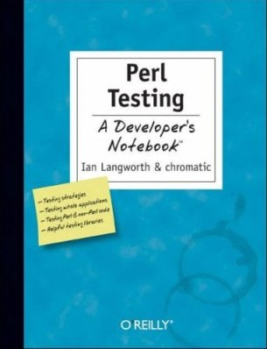
More Information
Perl Testing: A Developer's Notebook (Ian Langworth & chromatic)
perldoc Test::MockObject
perldoc Test::Builder
Devel::Cover
etc...

Slide 72
Testing Examples
Write a test plan for the supplied Perl module
Do you need to mock any of the interfaces?
How good is the coverage of your tests?

Slide 73
Object Relational Mapping

Slide 74
ORM
Mapping database relations into objects
Tables (relations) map onto classes
Rows (tuples) map onto objects
Columns (attributes) map onto attributes
Don't write SQL

Slide 75
SQL Is Tedious
Select the id and name from this table
Select all the details of this row
Select something about related tables
Update this row with these values
Insert a new record with these values
Delete this record

Slide 76
Replacing SQL
Instead of
SELECT *
FROM my_table
WHERE my_id = 10
and then dealing with the prepare/execute/fetch code

Slide 77
Replacing SQL
We can write
use My::Object;
# warning! not a real orm
my $obj = My::Object->retrieve(10)
Or something similar

Slide 78
Writing An ORM Layer
Not actually that hard to do yourself
Each class needs an associated table
Each class needs a list of columns
Create simple SQL for basic CRUD operations
Don't do that

Slide 79
Perl ORM Options
Plenty of choices on CPAN
Fey::ORM
Rose::DB
Class::DBI
DBIx::Class
  The current favourite

Slide 80
DBIx::Class
Standing on the shoulders of giants
Learning from problems in Class::DBI
More flexible
More powerful

Slide 81
DBIx::Class Example
Modeling a CD collection
Three tables
artist (artistid, name)
cd (cdid, artist, title)
track (trackid, cd, title)

Slide 82
Main Schema
Define main schema class
DB/Main.pm
package DB::Main;
use base qw/DBIx::Class::Schema/;
__PACKAGE__->load_classes();
1;

Slide 83
Object Classes
DB/Main/Artist.pm
package DB::Main::Artist;
use base qw/DBIx::Class/;
__PACKAGE__->load_components(qw/PK::Auto Core/);
__PACKAGE__->table('artist');
__PACKAGE__->add_columns(qw/ artistid name /);
__PACKAGE__->set_primary_key('artistid');
__PACKAGE__->has_many(cds =>
'DB::Main::Cd');
1;

Slide 84
Object Classes
DB/Main/CD.pm
package DB::Main::CD;
use base qw/DBIx::Class/;
__PACKAGE__->load_components(qw/PK::Auto Core/);
__PACKAGE__->table('cd');
__PACKAGE__->add_columns(qw/ cdid artist title year /);
__PACKAGE__->set_primary_key('cdid');
__PACKAGE__->belongs_to(artist =>
'DB::Main::Artist');
1;

Slide 85
Inserting Artists
my $schema =
DB::Main->connect($dbi_str);
my @artists = ('The Beta Band',
'Beth Orton');
my $art_rs = $schema->resultset('Artist');
foreach (@artists) {
$art_rs->create({ name => $_ });
}

Slide 86
Inserting CDs
Hash of Artists and CDs
my %cds = ( 'The Three EPs' =>
'The Beta Band',
'Trailer Park' =>
'Beth Orton');

Slide 87
Inserting CDs
Find each artist and insert CD
foreach (keys $cds) {
my ($artist) = $art_rs->search(
{ name => $cds{$_} }
);
$artist->add_to_cds({
title => $_,
});
}

Slide 88
Retrieving Data
Get CDs by artist
my ($artist) = $art_rs->search({
name => 'Beth Orton',
});
foreach ($artist->cds) {
say $_->title;
}

Slide 89
Searching for Data
Search conditions can be more complex
Alternatives
  $rs->search({year => 2006},
  {year => 2007});
Like
  $rs->search({name =>
  { 'like', 'Dav%' }});

Slide 90
Searching for Data
Combinations
  $rs->search({forename =>
  { 'like', 'Dav%' },
  surname => 'Cross' });

Slide 91
Don't Repeat Yourself
There's a problem with this approach
Information is repeated
Columns and relationships defined in the database schema
Columns and relationships defined in class definitions

Slide 92
Repeated Information
CREATE TABLE artist (
artistid INTEGER PRIMARY KEY,
name TEXT NOT NULL
);

Slide 93
Repeated Information
package DB::Main::Artist;
use base qw/DBIx::Class/;
__PACKAGE__->
load_components(qw/PK::Auto Core/);
__PACKAGE__->table('artist');
__PACKAGE__->
add_columns(qw/ artistid name /);
__PACKAGE__>
set_primary_key('artistid');
__PACKAGE__->has_many('cds' => 'DB::Main::Cd');

Slide 94
Database Metadata
Some people don't put enough metadata in their databases
Just tables and columns
No relationships. No constraints
You may as well make each column VARCHAR(255)

Slide 95
Database Metadata
Describe your data in your database
It's what your database is for
It's what your database does best

Slide 96
No Metadata (Excuse 1)
"This is the only application that will ever access this database"
Nonsense
All data will be shared eventually
People will update your database using other applications
Can you guarantee that someone won't use mysql to update your database?

Slide 97
No Metadata (Excuse 2)
"Database doesn't support those features"
Nonsense
MySQL 3.x is not a database
  It's a set of data files with a vaguely SQL-like query syntax
MySQL 4.x is a lot better
MySQL 5.x is most of the way there
Don't be constrained by using inferior tools

Slide 98
DBIC::Schema::Loader
Creates classes by querying your database metadata
No more repeated data
We are now DRY
Schema definitions in one place
But...
Performance problems

Slide 99
Performance Problems
You don't really want to generate all your class definitions each time your program is run
Need to generate the classes in advance
dump_to_dir method
Regenerate classes each time schema changes

Slide 100
Alternative Approach
Need one canonical definition of the data tables
Doesn't need to be SQL DDL
Could be in Perl code
Write DBIx::Class definitions
Generate DDL from those
Harder approach
  Might need to generate ALTER TABLE

Slide 101
Conclusions
ORM is a bridge between relational objects and program objects
Avoid writing SQL in common cases
DBIx::Class is the currently fashionable module
Lots of plugins
Caveat: ORM may be overkill for simple programs

Slide 102
More Information
Manual pages (on CPAN)
DBIx::Class
DBIx::Class::Manual::*
DBIx::Class::Schema::Loader
Mailing list (Google for it)

Slide 103
DBIx::Class Examples
Create the CD database on your computer
Use DBIx::Class::Schema::Loader to generate classes for your database
Write code to insert data into the tables
Write code to report on the data in the tables

Slide 104
Exception
Handling

Slide 105
Error Handling
How do you handle errors in your code?
Return error values from subroutines
sub get_object {
my ($class, $id) = @_;
if (my $obj = find_obj_in_db($id)) {
return $obj;
} else {
return;
}
}

Slide 106
Problems
What if someone doesn't check return code?
my $obj = MyClass->get_object(100);
print $obj->name; # error
Caller assumes that $obj is a valid object
Bad things follow

Slide 107
Basic Exceptions
Throw an exception instead
sub get_object {
my ($class, $id) = @_;
if (my $obj = find_obj_in_db($id)) {
return $obj;
} else {
die “No object found with id: $id”;
}
}
Now caller has to deal with exceptions

Slide 108
Dealing with Exceptions
Use eval to catch exceptions
my $obj = eval {
MyClass->get_object(100)
};
if ($@) {
# handle exception...
} else {
print $obj->name; # error
}

Slide 109
Exceptions as Objects
$@ can be set to an object
sub get_object {
my ($class, $id) = @_;
if (my $obj = find_obj_in_db($id)) {
return $obj;
} else {
die MyException->new(
type => 'obj_not_found',
id => $id,
);
}
}

Slide 110
Exception::Class
Easy way to define your own exception objects
Define exception hierarchies
As recommended in Perl Best Practices

Slide 111
Define Exceptions
use Exception::Class (
'MyException',
'AnotherException' => { isa => 'MyException' },
'YetAnotherException' => {
isa => 'AnotherException',
description =>
'These exceptions are related to IPC'
},
'ExceptionWithFields' => {
isa => 'YetAnotherException',
fields => [ 'grandiosity', 'quixotic' ],
alias => 'throw_fields',
},
);

Slide 112
Using Exceptions
eval { MyException->throw( error => 'I feel funny.' ) };
my $e;
if ( $e = Exception::Class->caught('MyException') ) {
warn $e->error, "\n", $e->trace->as_string, "\n";
warn join ' ', $e->euid, $e->egid, $e->uid,
$e->gid, $e->pid, $e->time;
exit;
}
elsif ( $e = Exception::Class->caught('ExceptionWithFields') ) {
$e->quixotic ? do_something_wacky() : do_something_sane();
}
else {
$e = Exception::Class->caught();
ref $e ? $e->rethrow : die $e;
}

Slide 113
Try Catch
TryCatch adds “syntactic sugar”
try {
...
}
catch ($e) {
...
}
Looks a lot like many other languages

Slide 114
TryCatch with Scalar
try {
some_function_that_might_die();
}
catch ($e) {
if ($e =~ /some error/) {
# handle error
} else {
die $e;
}
}

Slide 115
TryCatch with Object
try {
some_function_that_might_die();
}
catch ($e) {
if ($e->type eq 'file') {
# handle error
} else {
die $e;
}
}

Slide 116
Better Checks
try {
some_function_that_might_die();
}
catch (My::Error $e) {
# handle error
}

Slide 117
Even Better Checks
try {
some_function_that_might_die();
}
catch (HTTP::Error $e
where { $e->code == 404 }) {
# handle 404 error
}

Slide 118
Multiple Checks
try {
some_function_that_might_die();
}
catch (HTTP::Error $e where { $e->code == 404 }) {
# handle 404 error
}
catch (HTTP::Error $e where { $e->code == 500 }) {
# handle 500 error
}
catch (HTTP::Error $e) {
# handle other HTTP error
}
catch ($e) {
# handle other error
}

Slide 119
More on Exceptions
Exceptions force callers to deal with error conditions
But you have to explicitly code to throw exceptions
open my $fh, '<', 'somefile.txt'
or die $!;
What if you forget to check the return value?

Slide 120
Not Checking Errors
open my $fh, '<', 'somefile.txt';
while (<$fh>) {
# do something useful
}
If the 'open' fails, you can't read any data
You might not even get any warnings

Slide 121
Automatic Exceptions
use Fatal qw(open);
Comes with Perl since 5.003
Errors in built-in functions become fatal errors
This solves our previous problem
open my $fh, '<', 'somefile.txt';

Slide 122
However
Fatal.pm has its own problems
Unintelligent check for success or failure
Checks return value for true/false
Assumes false is failure
Can't be used if function can legitimately return a false value
  e.g. fork

Slide 123
Also
Nasty error messages
$ perl -MFatal=open -E'open my $fh, "notthere"'
Can't open(GLOB(0x86357a4), notthere): No such file or directory at (eval 1) line 4
main::__ANON__('GLOB(0x86357a4)', 'notthere') called at -e line 1

Slide 124
Enter autodie
autodie is a cleverer Fatal
In Perl core since 5.10.1
Fatal needed a list of built-ins
autodie assumes all built-ins
  use autodie;

Slide 125
Turning autodie on/off
Lexically scoped
  use autodie;
  no autodie;
Turn off for specific built-ins
  no autodie 'open';

Slide 126
Failing Calls
autodie has more intelligence about failing calls
Not just a boolean check
Understands fork, system, etc

Slide 127
Errors are Objects
Errors thrown by autodie are objects
Can be inspected for details of the error
try {
open my $fh, '<', 'not-there';
}
catch ($e) {
warn 'Error opening ', $e->args->[-1], "\n";
warn 'File: ', $e->file, "\n";
warn 'Function: ', $e->function, "\n";
warn 'Package: ', $e->package, "\n";
warn 'Caller: ', $e->caller, "\n";
warn 'Line: ', $e->line, "\n";
}

Slide 128
Nicer Errors Too
$ perl -Mautodie -E'open my $fh, "not-there"'
Can't open($fh, 'not-there'): No such file or directory at -e line 1

Slide 129
More Information
perldoc TryCatch
  See also Try::Tiny
perldoc Fatal
perldoc autodie
autodie - The art of Klingon Programming
  http://perltraining.com.au/tips/2008-08-20.html

Slide 130
Exceptions Examples
Write a program that relies on autodie to throw exceptions
Write a class which uses Exception::Class to throw exceptions
Write code which uses your class

Slide 131
That's all folks
Any questions?

