Slide 1
Advanced Perl Techniques
Day 2
Dave Cross
Magnum Solutions Ltd
dave@mag-sol.com

Slide 2
What We Will Cover
Profiling and Benchmarking
Object oriented programming with Moose
MVC Frameworks
  Catalyst
PSGI and Plack

Slide 3
Schedule
09:45 – Begin
11:15 – Coffee break
13:00 – Lunch
14:00 – Begin
15:30 – Coffee break
17:00 – End

Slide 4
Resources
Slides available on-line
  http://mag-sol.com/train/public/2011-02/adv
Also see Slideshare
  http://www.slideshare.net/davorg/slideshows
Get Satisfaction
  http://getsatisfaction.com/magnum

Slide 5
Benchmarking
& Profiling

Slide 6
Benchmarking
Ensure that your program is fast enough
But how fast is fast enough?
premature optimization is the root of all evil
  Donald Knuth
  paraphrasing Tony Hoare
Don't optimise until you know what to optimise

Slide 7
Benchmark.pm
Standard Perl module for benchmarking
Simple usage
use Benchmark;
my %methods = (
method1 => sub { ... },
method2 => sub { ... },
);
timethese(10_000, \%methods);
Times 10,000 iterations of each method

Slide 8
Benchmark.pm Output
Benchmark: timing 10000 iterations of method1, method2...
method1: 6 wallclock secs \
( 2.12 usr + 3.47 sys = 5.59 CPU) \
@ 1788.91/s (n=10000)
method2: 3 wallclock secs \
( 0.85 usr + 1.70 sys = 2.55 CPU) \
@ 3921.57/s (n=10000)

Slide 9
Timed Benchmarks
Passing timethese a positive number runs each piece of code a certain number of times
Passing timethese a negative number runs each piece of code for a certain number of seconds

Slide 10
Timed Benchmarks
use Benchmark;
my %methods = (
method1 => sub { ... },
method2 => sub { ... },
);
# Run for 10,000(!) seconds
timethese(-10_000, \%methods);

Slide 11
Comparing Performance
Use cmpthese to get a tabular output
Optional export
use Benchmark 'cmpthese';
my %methods = (
method1 => sub { ... },
method2 => sub { ... },
);
cmpthese(10_000, \%methods);

Slide 12
cmpthese Output
Rate method1 method2
method1 2831802/s -- -61%
method2 7208959/s 155% --
method2 is 61% slower than method1
Can also pass negative number to cmpthese

Slide 13
Benchmarking is Hard
Very easy to produce lots of numbers
Harder to ensure that the numbers are meaningful
Compare code fragments that do the same thing

Slide 14
Bad Benchmarking
use Benchmark qw{ timethese };
timethese( 1_000, {
Ordinary => sub {
my @results = sort { -M $a <=> -M $b } glob "/bin/*";
},
Schwartzian => sub {
map $_->[0],
sort { $a->[1] <=> $b->[1] }
map [$_, -M], glob "/bin/*";
},
});

Slide 15
What to Benchmark
Profile your code
See which parts it is worth working on
Look for code that
  Takes a long time to run, or
  Is called many times, or
  Both

Slide 16
Devel::DProf
Devel::DProf is the standard Perl profiling tool
Included with Perl distribution
Uses Perl debugger hooks
perl -d:DProf your_program
Produces a data file called tmon.out
Command line program dprofpp to view results

Slide 17
Sample Output
$ perl -d:DProf ./invoice.pl 244
$ dprofpp
Total Elapsed Time = 1.173152 Seconds
User+System Time = 0.963152 Seconds
Exclusive Times
%Time ExclSec CumulS #Calls sec/call Csec/c Name
6.02 0.058 0.067 482 0.0001 0.0001 Params::Validate::_validate
5.09 0.049 0.114 7 0.0070 0.0163 Class::DBI::Loader::mysql::BEGIN
4.15 0.040 0.050 10 0.0040 0.0050 Template::Parser::BEGIN
4.15 0.040 0.166 7 0.0057 0.0237 DateTime::Locale::BEGIN
4.05 0.039 0.094 43 0.0009 0.0022 base::import
3.74 0.036 0.094 449 0.0001 0.0002 DateTime::Locale::_register
3.11 0.030 0.280 4 0.0074 0.0700 DateTime::Format::MySQL::BEGIN
2.91 0.028 0.028 170 0.0002 0.0002 Lingua::EN::Inflect::_PL_noun
2.70 0.026 0.040 1 0.0262 0.0401 Template::Parser::_parse
2.49 0.024 0.024 1113 0.0000 0.0000 Class::Data::Inheritable::__ANON__
2.08 0.020 0.020 12 0.0017 0.0017 DBD::mysql::db::_login
2.08 0.020 0.020 4 0.0050 0.0050 Template::Stash::BEGIN
2.08 0.020 0.099 9 0.0022 0.0110 Template::Config::load
2.08 0.020 0.067 9 0.0022 0.0074 Template::BEGIN
2.08 0.020 0.039 4 0.0049 0.0097 Lingua::EN::Inflect::Number::BEGIN

Slide 18
Devel::NYTProf
New profiling module
Based on work from the New York Times
Enhanced by Tim Bunce
Pretty HTML output
  “borrowed” from Devel::Cover
Far more flexible
Far more powerful

Slide 19
Using NYTProf
Similar to Devel::DProf
$ perl -d:NYTProf ./invoice.pl 244
Writes nytprof.out
$ nytprofhtml
Or
$ nytprofcsv

Slide 20
Conclusions
Don't optimise until you know you need to optimise
Don't optimise until you know what to optimise
Use profiling to find out what is worth optimising
Use benchmarking to compare different solutions

Slide 21
More Information
perldoc Benchmark
perldoc Devel::DProf
perldoc Devel::NYTProf
Chapters 5 and 6 of Mastering Perl

Slide 22
Benchmarking Examples
Profile the code that you have been given
Where do we need to make improvements
Suggest some alternative implementations
Benchmark your suggestions

Slide 23
Moose

Slide 24
Moose
A complete modern object system for Perl 5
Based on experiments with Perl 6 object model
Built on top of Class::MOP
  MOP - Meta Object Protocol
  Set of abstractions for components of an object system
  Classes, Objects, Methods, Attributes
An example might help

Slide 25
Moose Example
package Point;
use Moose;
has 'x' => (isa => 'Int',
is => 'ro');
has 'y' => (isa => 'Int',
is => 'rw');
sub clear {
my $self = shift;
$self->{x} = 0;
$self->y(0);
}

Slide 26
Understanding Moose
There's a lot going on here
use Moose
  Loads Moose environment
  Makes our class a subclass of Moose::Object
  Turns on strict and warnings

Slide 27
Creating Attributes
has 'x' => (isa => 'Int',
is => 'ro')
  Creates an attribute called 'x'
  Constrainted to be an integer
  Read-only accessor
has 'y' => (isa => 'Int',
is => 'rw')

Slide 28
Defining Methods
sub clear {
my $self = shift;
$self->{x} = 0;
$self->y(0);
}
Standard method syntax
Uses generated method to set y
Direct hash access for x

Slide 29
Subclassing
package Point3D;
use Moose;
extends 'Point';
has 'z' => (isa => 'Int');
after 'clear' => sub {
my $self = shift;
$self->{z} = 0;
};

Slide 30
Subclasses
extends 'Point'
  Similar to use base
  Overwrites @ISA instead of appending
has 'z' => (isa = 'Int')
  Adds new attribute 'z'
  No accessor function - private attribute

Slide 31
Extending Methods
after 'clear' => sub {
my $self = shift;
$self->{z} = 0;
};
New clear method for subclass
Called after method for superclass
Cleaner than $self->SUPER::clear()

Slide 32
Creating Objects
Moose classes are used just like any other Perl class
$point = Point->new(x => 1, y => 2);
$p3d = Point3D->new(x => 1,
y => 2,
z => 3);

Slide 33
More About Attributes
Use the has keyword to define your class's attributes
has 'first_name' => ( is => 'rw' );
Use is to define rw or ro
Omitting is gives an attribute with no accessors

Slide 34
Getting & Setting
By default each attribute creates a method of the same name.
Used for both getting and setting the attribute
$dave->first_name('Dave');
say $dave->first_name;

Slide 35
Change Accessor Name
Change accessor names using reader and writer
has 'name' => (
is => 'rw',
reader => 'get_name',
writer => 'set_name',
);
See also MooseX::FollowPBP

Slide 36
Required Attributes
By default Moose class attributes are optional
Change this with required
has 'name' => (
is => 'ro',
required => 1,
);
Forces constructor to expect a name
Although that name could be undef

Slide 37
Attribute Defaults
Set a default value for an attribute with default
has 'size' => (
is => 'rw',
default => 'medium',
);
Can use a subroutine reference
has 'size' => (
is => 'rw',
default => \&rand_size,
);

Slide 38
More Attribute Properties
lazy
  Only populate attribute when queried
trigger
  Subroutine called after the attribute is set
isa
  Set the type of an attribute
Many more

Slide 39
More Moose
Many more options
Support for concepts like delegation and roles
Powerful plugin support
  MooseX::*
Lots of work going on in this area

Slide 40
Moose Examples
Write a Moose class that models a person
Write code which uses that class
Try out various attribute properties

Slide 41
Catalyst

Slide 42
MVC Frameworks
MVC frameworks are a popular way to write applications
  Particularly web applications

Slide 43
M, V and C
Model
  Data storage & data access
View
  Data presentation layer
Controller
  Business logic to glue it all together

Slide 44
MVC Examples
Ruby on Rails
Django (Python)
Struts (Java)
CakePHP
Many examples in most languages
Perl has many options

Slide 45
MVC in Perl
Maypole
  The original Perl MVC framework
CGI::Application
  Simple MVC for CGI programming
Jifty
  Developed and used by Best Practical
Catalyst
  Currently the popular choice

Slide 46
Newer MVC in Perl
Dancer
Squatting
Mojolicious

Slide 47
Catalyst
MVC framework in Perl
Building on other heavily-used tools
Model uses DBIx::Class
View uses Template Toolkit
These are just defaults
Can use anything you want

Slide 48
Simple Catalyst App
Assume we already have model
  CD database from DBIx::Class section
Use catalyst.pl to create project
$ catalyst.pl CD
created "CD"
created "CD/script"
created "CD/lib"
created "CD/root"
... many more ...

Slide 49
What Just Happened?
Catalyst just generated a lot of useful stuff for us
Test web servers
  Standalone and FastCGI
Configuration files
Test stubs
Helpers for creating models, views and controllers

Slide 50
A Working Application
We already have a working application
$ CD/script/cd_server.pl
... lots of output
[info] CD powered by Catalyst 5.7015
You can connect to your server at http://localhost:3000
Of course, it doesn't do much yet

Slide 51
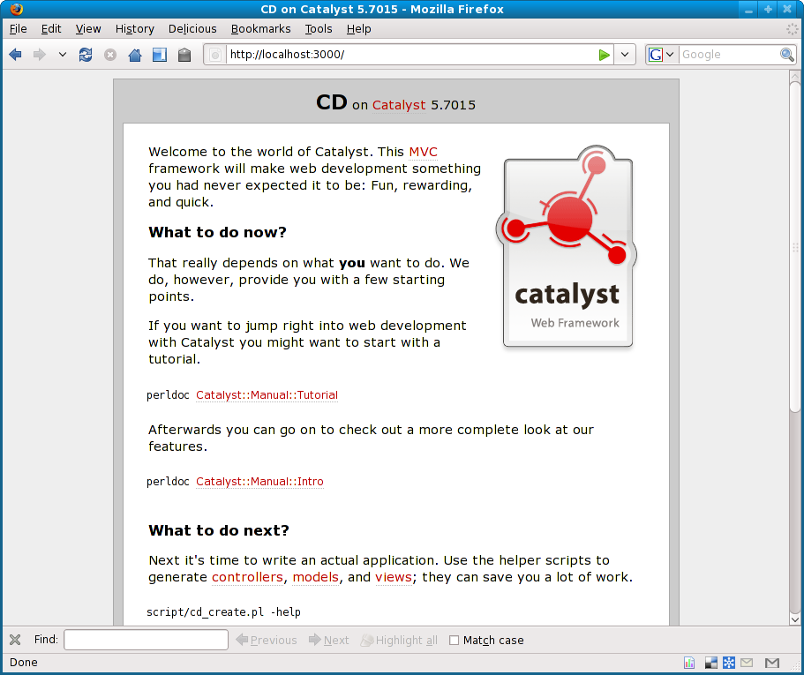
Simple Catalyst App

Slide 52
Next Steps
Use various helper programs to create models and views for your application
Write controller code to tie it all together
Many plugins to handle various parts of the process
  Authentication
  URL resolution
  Session handling
  etc...

Slide 53
Create a View
$ script/cd_create.pl view Default TT
exists "/home/dave/training/cdlib/CD/script/../lib/CD/View"
exists "/home/dave/training/cdlib/CD/script/../t"
created "/home/dave/training/cdlib/CD/script/../lib/CD/View/Default.pm"
created "/home/dave/training/cdlib/CD/script/../t/view_Default.t"

Slide 54
Remove Default Message
In lib/CD/Controller/Root.pm
sub index :Path :Args(0) {
my ( $self, $c ) = @_;
# Hello World
$c->response_body($c->welcome_message);
}
Remove response_body line
Default behaviour is to render index.tt
Need to create that

Slide 55
index.tt
root/index.tt
<html>
<head>
<title>CDs</title>
</head>
<body>
<ul>
[% FOREACH cd IN [ 1 .. 10 ] %]
<li>CD [% cd %]</li>
[% END %]
</ul>
</body>
</html>

Slide 56
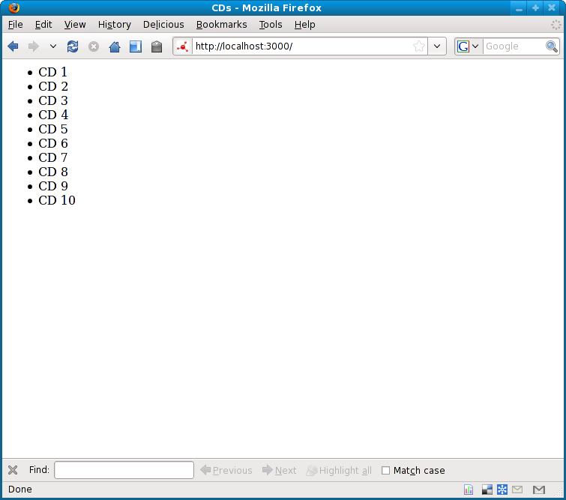
New Front Page

Slide 57
Adding Data
Of course that's hard-coded data
Need to add a model class
And then more views
And some controllers
There's a lot to do
I recommend working through a tutorial

Slide 58
Easier Catalyst
A lot of web applications do similar things
Given a database
Produce screens to edit the data
Surely most of this can be automated
It's called Catalyst::Plugin::AutoCRUD
(Demo)

Slide 59
Cat::Plugin::AutoCRUD
Does a lot of work
On the fly
For every request
No security on table updates
So it's not right for every project
Very impressive though

Slide 60
Conclusions
There's a lot to bear in mind when writing a web app
Using the right framework can help
Catalyst is the most popular Perl framework
As powerful as any other framework
  In any language
Lots of work still going on
Large team, active development

Slide 61
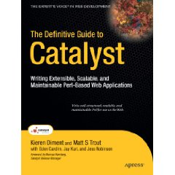
Recommended Book
The Definitive Guide to Catalyst
  Kieren Diment
  Matt S Trout

Slide 62
Catalyst Examples
Set up a basic Catalyst project based on the CD database from yesterday
We will then work together to add some simple controllers and views to the application
Add Catalyst::Plugin::AutoCRUD to your application

Slide 63
PSGI/Plack

Slide 64
PSGI/Plack
“PSGI is an interface between Perl web applications and web servers, and Plack is a Perl module and toolkit that contains PSGI middleware, helpers and adapters to web servers.”
  http://plackperl.org/

Slide 65
PSGI/Plack
PSGI is a specification (based on Python's WSGI)
Plack is a reference implementation (based on Ruby's Rack)

Slide 66
The Problem
There are many ways to write web applications
There are many ways to write web applications in Perl
Each is subtly different
Hard to move an application between server architectures

Slide 67
Server Architectures
CGI
FastCGI
mod_perl
etc...

Slide 68
Frameworks
There are many Perl web application frameworks
Each creates applications in subtly different ways
Hard to port applications between them

Slide 69
The Goal
What if we had a specification that allowed us to easily move web applications between server architectures and frameworks
PSGI is that specification

Slide 70
PSGI Application
my $app = sub {
my $env = shift;
return [
200,
[ ‘Content-Type’, ‘text/plain’ ],
[ ‘Hello World’ ],
];
};

Slide 71
PSGI Application
A code reference
Passed a reference to an environment hash
Returns a reference to a three-element array
  Status code
  Headers
  Body

Slide 72
A Code Reference
my $app = sub {
my $env = shift;
return [
200,
[ ‘Content-Type’, ‘text/plain’ ],
[ ‘Hello World’ ],
];
};

Slide 73
A Code Reference
my $app = sub {
my $env = shift;
return [
200,
[ ‘Content-Type’, ‘text/plain’ ],
[ ‘Hello World’ ],
];
};

Slide 74
Environment Hash
my $app = sub {
my $env = shift;
return [
200,
[ ‘Content-Type’, ‘text/plain’ ],
[ ‘Hello World’ ],
];
};

Slide 75
Environment Hash
my $app = sub {
my $env = shift;
return [
200,
[ ‘Content-Type’, ‘text/plain’ ],
[ ‘Hello World’ ],
];
};

Slide 76
Return Array Ref
my $app = sub {
my $env = shift;
return [
200,
[ ‘Content-Type’, ‘text/plain’ ],
[ ‘Hello World’ ],
];
};

Slide 77
Return Array Ref
my $app = sub {
my $env = shift;
return [
200,
[ ‘Content-Type’, ‘text/plain’ ],
[ ‘Hello World’ ],
];
};

Slide 78
Running PSGI App
Put code in app.psgi
Drop in into a configured PSGI-aware web server
Browse to URL

Slide 79
PSGI-Aware Server
Plack contains a simple test server called plackup
$ plackup app.psgi
HTTP::Server::PSGI: Accepting connections at http://localhost:5000/

Slide 80
Plack::Request
Plack::Request turns the environment into a request object
use Plack::Request;
use Data::Dumper;
my $app = sub {
my $req = Plack::Request->new(shift);
return [
200,
[ 'Content-type', 'text/plain' ],
[ Dumper $req ],
];
}

Slide 81
Plack::Response
Plack::Response builds a PSGI response object
use Plack::Request;
use Plack::Response;
use Data::Dumper;
my $app = sub {
my $req = Plack::Request->new(shift);
my $res = Plack::Response->new(200);
$res->content_type('text/plain');
$res->body(Dumper $req);
return $res->finalize;
}

Slide 82
Middleware
Middleware wraps around an application
Returns another PSGI application
Simple spec makes this easy
Plack::Middleware::*
Plack::Builder adds middleware configuration language

Slide 83
Middleware Example
use Plack::Builder;
use Plack::Middleware::Runtime;
my $app = sub {
my $env = shift;
return [
200,
[ 'Content-type', 'text/plain' ],
[ 'Hello world' ],
]
};
builder {
enable 'Runtime';
$app;
}

Slide 84
Middleware Example
$ HEAD http://localhost:5000
200 OK
Date: Tue, 20 Jul 2010 20:25:52 GMT
Server: HTTP::Server::PSGI
Content-Length: 11
Content-Type: text/plain
Client-Date: Tue, 20 Jul 2010 20:25:52 GMT
Client-Peer: 127.0.0.1:5000
Client-Response-Num: 1
X-Runtime: 0.000050

Slide 85
Middleware Example
$ HEAD http://localhost:5000
200 OK
Date: Tue, 20 Jul 2010 20:25:52 GMT
Server: HTTP::Server::PSGI
Content-Length: 11
Content-Type: text/plain
Client-Date: Tue, 20 Jul 2010 20:25:52 GMT
Client-Peer: 127.0.0.1:5000
Client-Response-Num: 1
X-Runtime: 0.000050

Slide 86
Plack::App::*
Ready-made solutions for common situations
Plack::App::CGIBin
  Cgi-bin replacement
Plack::App::Directory
  Serve files with directory index
Plack::App::URLMap
  Map apps to different paths

Slide 87
Plack::App::*
Many more bundled with Plack
Configured using Plack::Builder

Slide 88
Plack::App::CGIBin
use Plack::App::CGIBin;
use Plack::Builder;
my $app = Plack::App::CGIBin->new(
root => '/var/www/cgi-bin'
)->to_app;
builder {
mount '/cgi-bin' => $app;
};

Slide 89
Plack::App::Directory
use Plack::App::Directory;
my $app = Plack::App::Directory->new(
root => '/home/dave/Dropbox/psgi'
)->to_app;

Slide 90
Framework Support
Many modern Perl applications already support PSGI
Catalyst, CGI::Application, Dancer, Jifty, Mason, Maypole, Mojolicious, Squatting, Web::Simple
Many more

Slide 91
Catalyst Support
Catalyst::Engine::PSGI
use MyApp;
MyApp->setup_engine('PSGI');
my $app = sub { MyApp->run(@_) };
Also Catalyst::Helper::PSGI
script/myapp_create.pl PSGI

Slide 92
PSGI Server Support
Many new web servers support PSGI
Starman, Starlet, Twiggy, Corona, HTTP::Server::Simple::PSGI
Perlbal::Plugin::PSGI

Slide 93
PSGI Server Support
nginx support
mod_psgi
Plack::Handler::Apache2

Slide 94
Plack::Handler::Apache2
<Location /psgi>
SetHandler perl-script
PerlResponseHandler Plack::Handler::Apache2
PerlSetVar psgi_app /path/to/app.psgi
</Location>

Slide 95
PSGI/Plack Summary
PSGI is a specification
Plack is an implementation
PSGI makes your life easier
Most of the frameworks and server you use already support PSGI
No excuse not to use it

Slide 96
Further Information
perldoc PSGI
perldoc Plack
http://plackperl.org/
http://blog.plackperl.org/
http://github.com/miyagawa/Plack
#plack on irc.perl.org

Slide 97
PSGI/Plack Examples
Try out some of the simple PSGI examples from the previous slides
Use plackup to run the applications

Slide 98
That's all folks
Any questions?

