Slide 1
Advanced Web Design Project
Davor georgijev 213266
Marija Stojanoska 213024

Slide 2
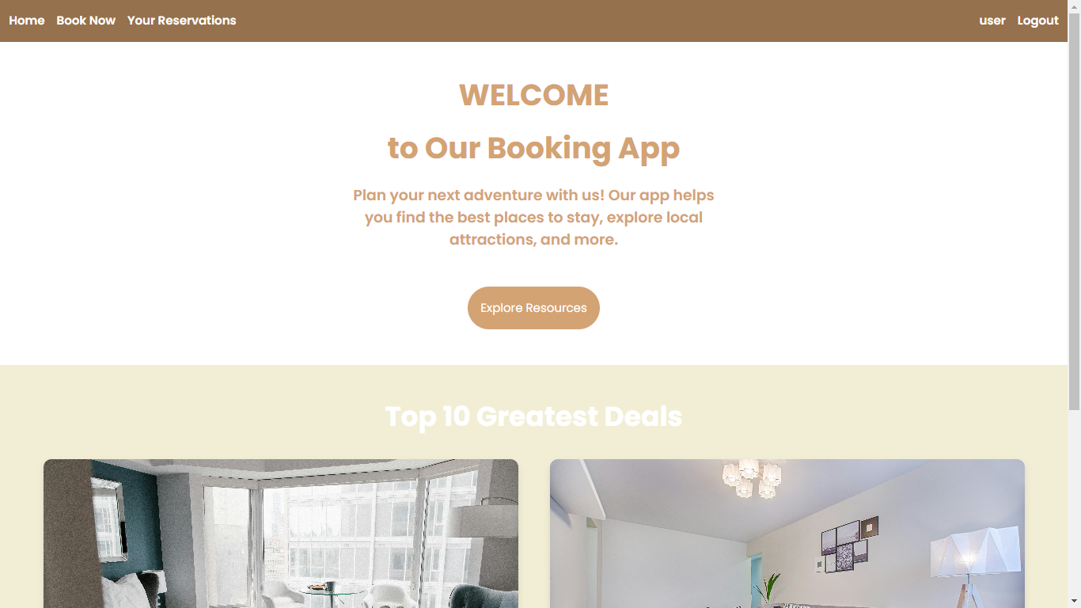
Home Page – part1

Slide 3
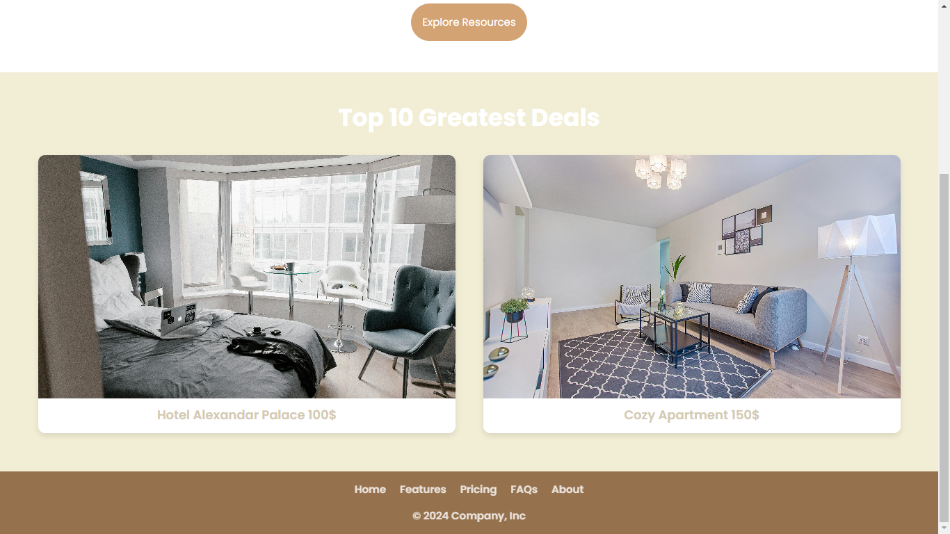
Home page – part2

Slide 4
Home Page Design Overview
The home page of our booking platform is designed to provide users with a dynamic and engaging experience right from the moment they land on our site.
At the top of the home page, users will find a sleek and intuitive navigation bar. This bar includes essential links such as Home, Explore, My Bookings, and Account, ensuring easy access to different sections of the platform.
The centerpiece of our home page is a scrolling carousel showcasing the top 10 greatest deals currently available. Each deal is presented with an enticing image that captures the essence of the accommodation or service.
Users can scroll horizontally through the carousel to view these top deals. Each deal image is clickable, allowing users to access detailed information about the accommodation or service directly from the carousel.
Upon clicking on a deal image within the carousel, users are seamlessly directed to a dedicated details page for that specific deal. Here, they can explore comprehensive information including pricing, amenities, location details, and user reviews.
The footer section of our home page provides additional information and links. It includes sections such as About Us, Contact Us, Terms of Service, and Privacy Policy, ensuring transparency and accessibility to important resources.

Slide 5
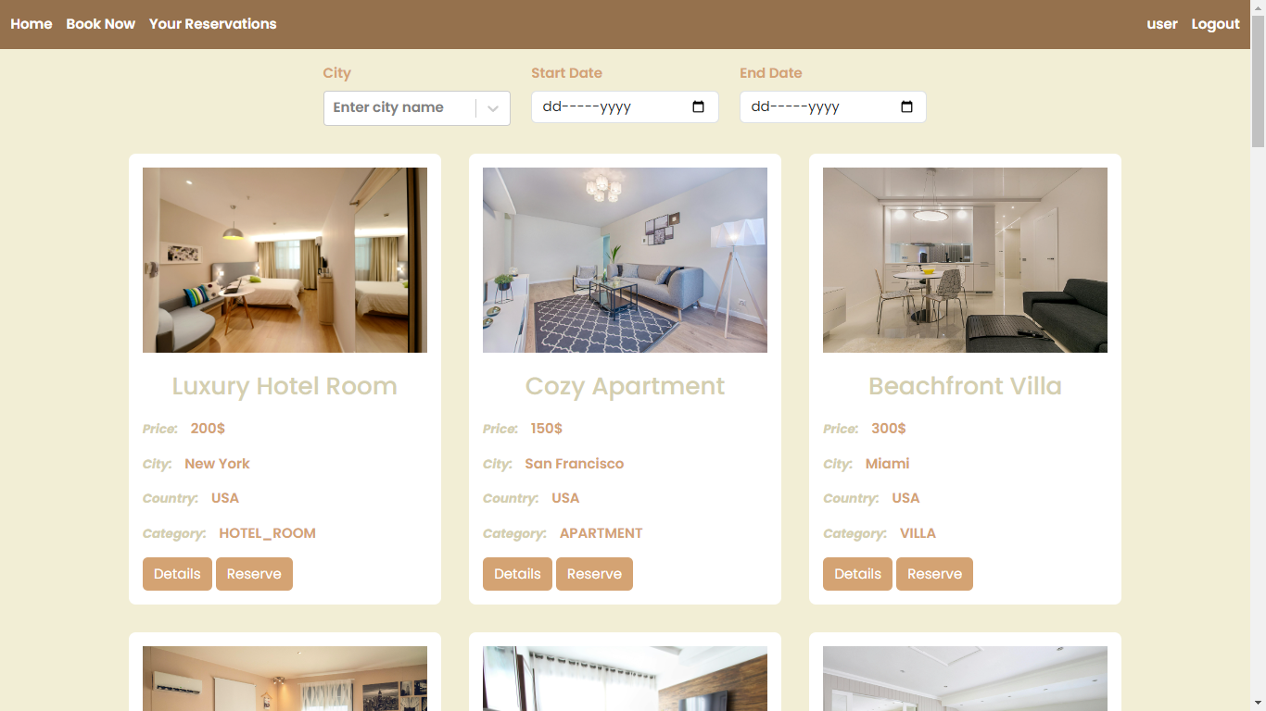
Resources page
The resources page of our booking platform serves as a central hub where users can browse and explore a wide range of accommodations and services available for booking.

Slide 6
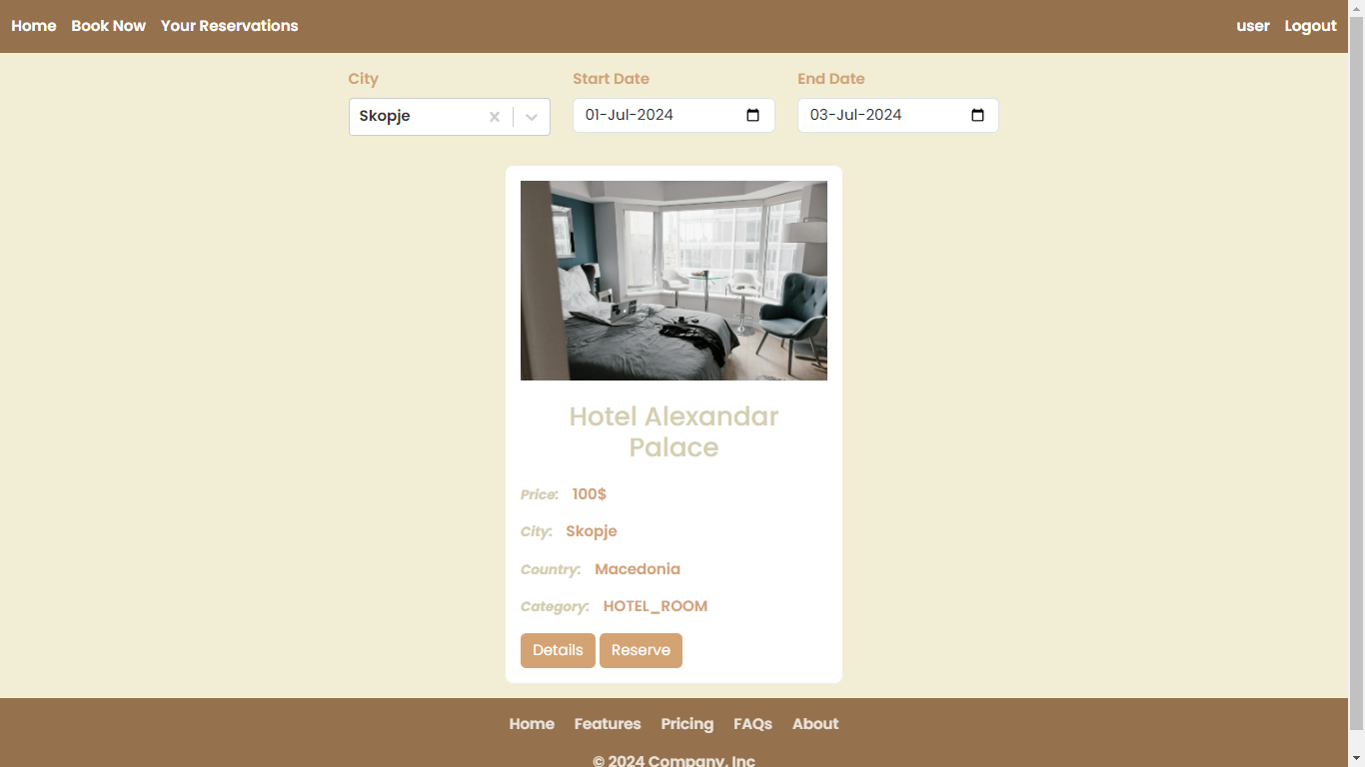
Resources Page Searching
Positioned prominently at the top of the Resources page, the search bar serves as the gateway for users to initiate their search queries. It features a clean and intuitive design, inviting users to enter their desired location, check-in/check-out dates, and any additional filtering criteria.

Slide 7
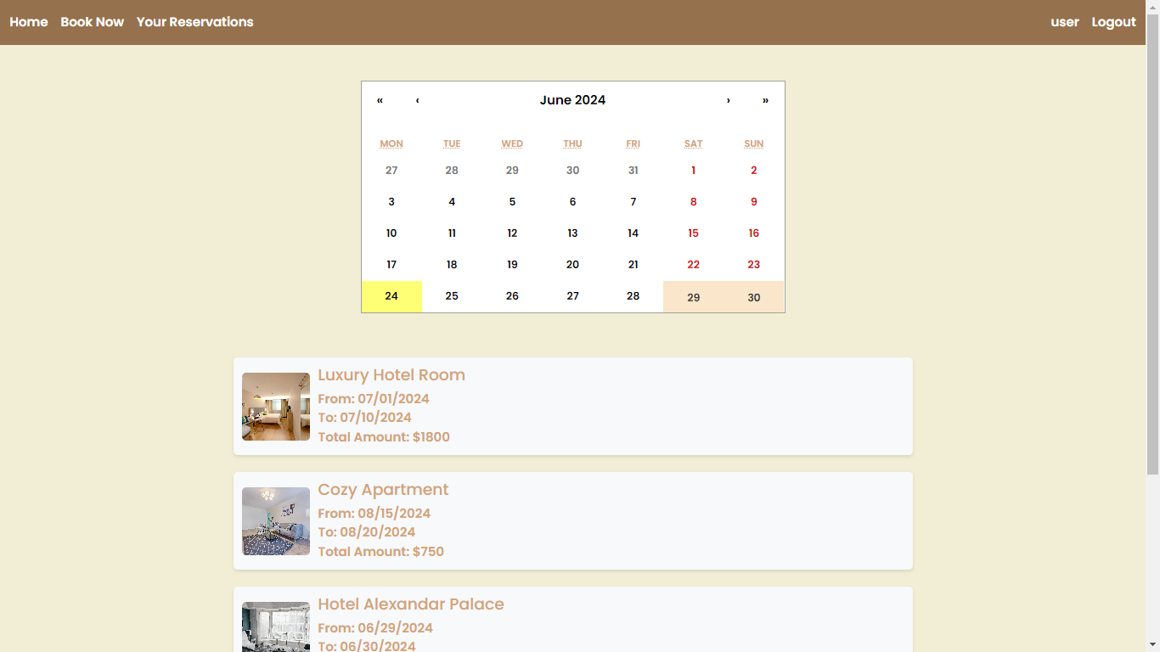
Reservations for User
This page is designed to provide users with a comprehensive view of their existing reservations within our booking platform. This section aims to enhance user convenience by offering straightforward access to booking details and enabling users to navigate through their reservations efficiently.

Slide 8
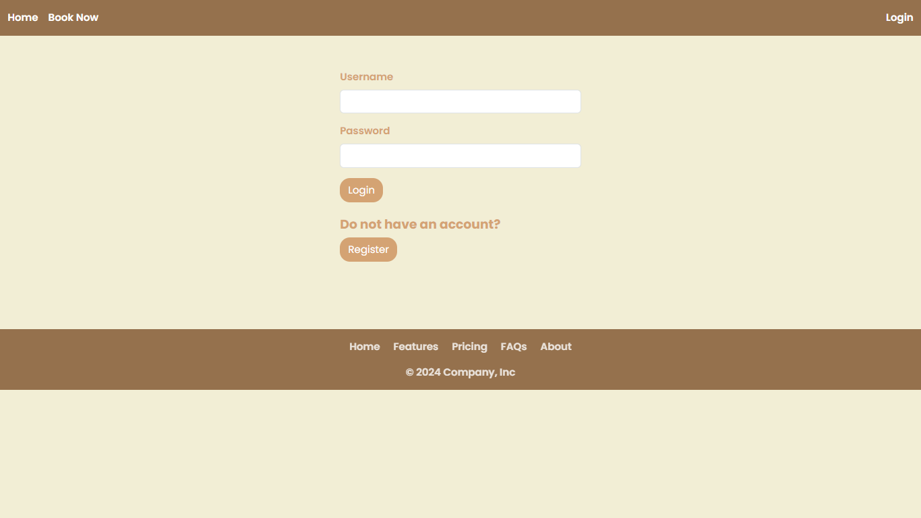
Login Page

Slide 9
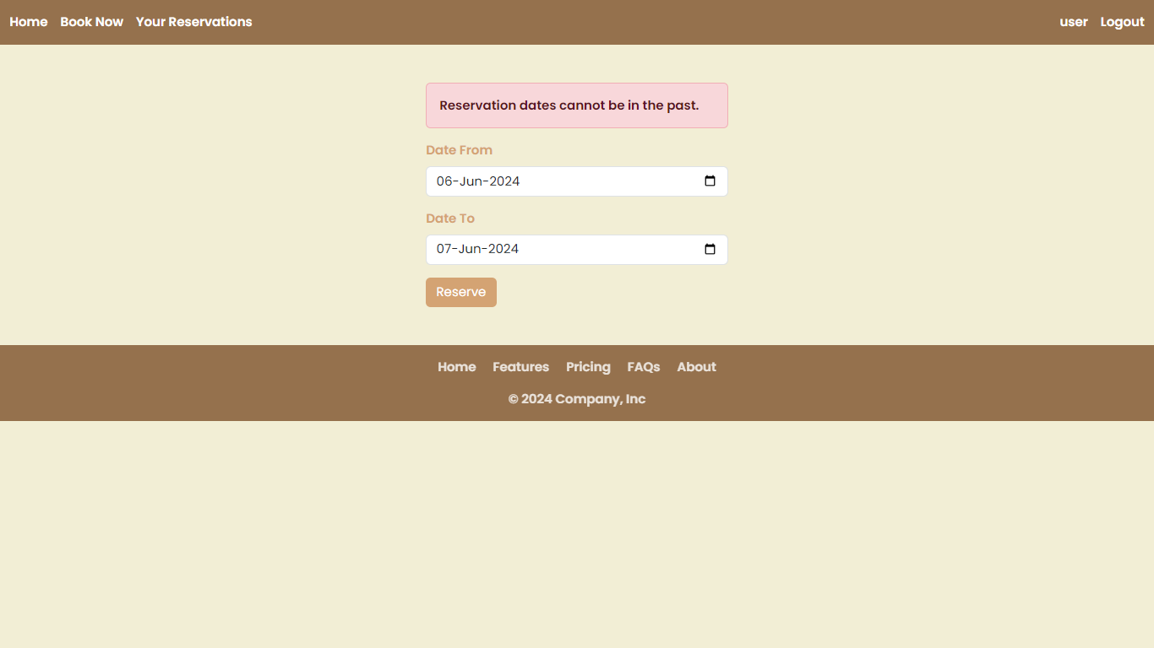
Error Handling
Render error messages inline next to the corresponding form fields when validation errors occur. For example, display a message under the check-in date field if the date format is incorrect or if the check-in date is after the check-out date.
Disable the form submission button while validation is ongoing or when errors are present to prevent invalid data from being sent to the server.

Slide 10
Thank you :)

