Slide 1

In The Name Of God
Parallel Quicksort without Element Exchange
Mansour davoudi
2018/December/29

Slide 2
Standard Quicksort
global pivot is chosen.
The processes pair up such that process i is paired with process i ⊕ p/2.
process pairs exchange data elements.
the set of processes is split into two groups.
The algorithm is invoked recursively.

Slide 3
Hyper Quicksort
processes first sort their n/p elements locally.
Instead of having to scan through the array as in the parallel Quicksort implementation, this can be done by binary search.

Slide 4
Exchange-free, parallel Quicksort
In iteration i, i = 0, . . . , log₂ p− 1 processes agree on a global pivot for each segment.
The processes then locally partition their segments, resulting in 2^{i}+1 segments for the next iteration.
After the log₂ p iterations, each process has p segments.
By an all-to-all communication operation, all jth segments are sent to process j.
after which the processes locally sort their received elements.

Slide 5
Suppose total numbers are: 35 30 22 39 40 24 40 27 23 35 36 36 37 34 32 29 p=4 n=16 and total numbers are distributed over 4 processors, so every processor has n/p numbers. P₀={35,30,22,39} p₁={40,24,40,27} p₂={23,35,36,36} p₄={37,34,32,29}

Slide 6
0
22 | 30 | 35 | 39 | 4
22 | 30 | 35 | 0 | 3
39 | 0 | 0 | 0 | 1
22 | 0 | 0 | 0 | 1
30 | 35 | 0 | 0 | 2
0 | 0 | 0 | 0 | 0
39 | 0 | 0 | 0 | 1
1
24 | 27 | 40 | 40 | 4
24 | 27 | 0 | 0 | 2
40 | 40 | 0 | 0 | 2
24 | 27 | 0 | 0 | 2
0 | 0 | 0 | 0 | 0
0 | 0 | 0 | 0 | 0
40 | 40 | 0 | 0 | 2
keep
0
1
keep
2
Global Pivot
35(p₀)
29(p₄)
36(p₂)
2
3
3
2
23 | 35 | 36 | 36 | 4
23 | 35 | 0 | 0 | 2
36 | 36 | 0 | 0 | 2
23 | 0 | 0 | 0 | 1
35 | 0 | 0 | 0 | 1
36 | 36 | 0 | 0 | 2
0 | 0 | 0 | 0 | 0
3
29 | 32 | 34 | 37 | 4
29 | 32 | 34 | 0 | 3
37 | 0 | 0 | 0 | 1
29 | 0 | 0 | 0 | 1
32 | 34 | 0 | 0 | 2
0 | 0 | 0 | 0 | 0
37 | 0 | 0 | 0 | 1
0
0
1
1
keep
2
3
keep

Slide 7
0
22 | 0 | 0 | 0 | 1
23 | 0 | 0 | 0 | 1
24 | 27 | 0 | 0 | 2
29 | 0 | 0 | 0 | 1
1
0 | 0 | 0 | 0 | 0
30 | 35 | 0 | 0 | 2
35 | 0 | 0 | 0 | 1
32 | 34 | 0 | 0 | 2
P₀={22,23,24,27,29}
P₁={30,32,34,35, 35}
36 | 36 | 0 | 0 | 2
0 | 0 | 0 | 0 | 0
0 | 0 | 0 | 0 | 0
0 | 0 | 0 | 0 | 0
3
37 | 0 | 0 | 0 | 1
39 | 0 | 0 | 0 | 1
40 | 40 | 0 | 0 | 2
0 | 0 | 0 | 0 | 0
2
P₂={36,36}
P₁={37,39,40,40}

Slide 8
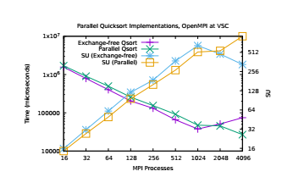
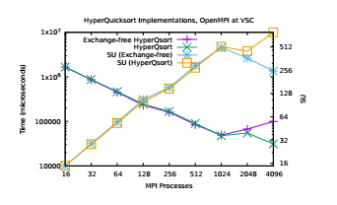
Experimental Results

