Slide 1
RNA-seq gene-level analysis and differential expression
Michael Love
@mikelove
mikelove.github.io
Dept. of Biostatistics
Dept. of Genetics
UNC-Chapel Hill
ANGUS @ DIBSI
June, 2017

Slide 2
Outline
Example RNA-seq experiment
Statistical analysis of counts
Genes and transcripts
Theory of shrinkage estimation, why?
Testing steps & statistical power

Slide 3
Our goal: what is airway transcriptome response to glucocorticoid hormone?
four human donors
extract mRNA
control
treat with
dexamethasone
airway epithelial cells

Slide 4
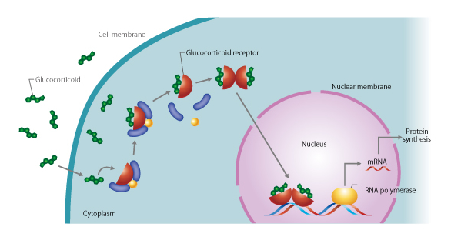
Glucocorticoid mechanism of action
(C) CSLS / University of Tokyo http://csls-text3.c.u-tokyo.ac.jp/

Slide 5
Compare gene expression across treatment, within patient-derived cell line
cDNA libraries
Visualize differences between samples
Test for differences in gene expression, one gene at a time
Visualize differences across all genes
control
treated with
dexamethasone

Slide 6
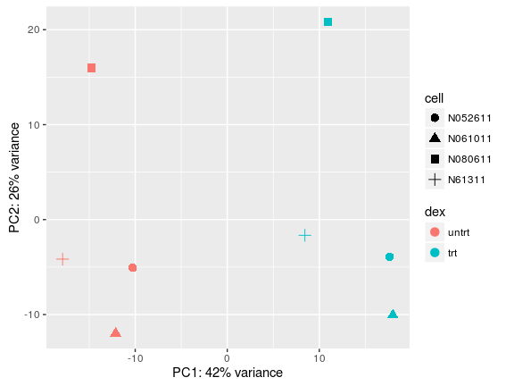
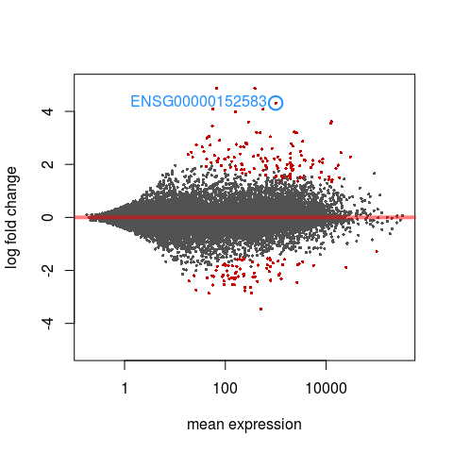
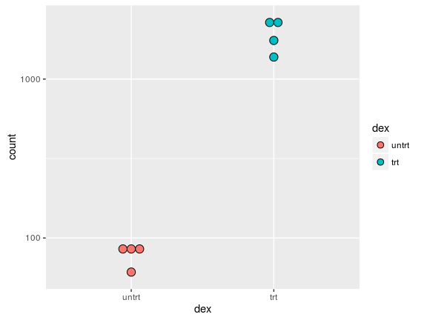
Compare gene expression across treatment, within patient-derived cell line
cDNA libraries
PCA plot
control
MA plot
"counts plot"
treated with
dexamethasone

Slide 7
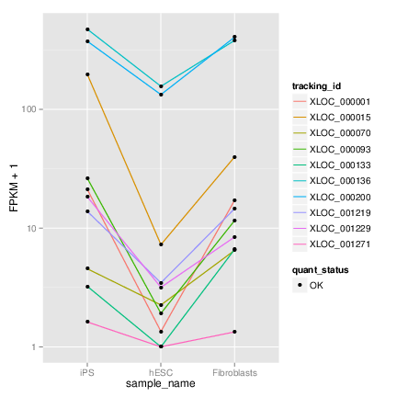
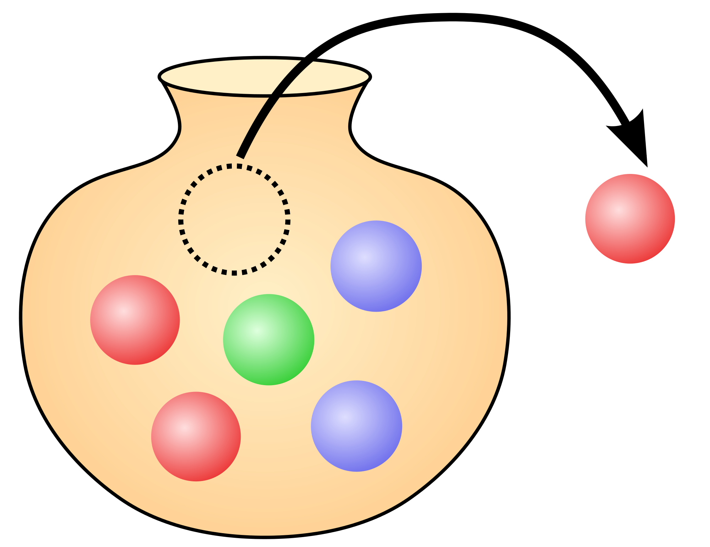
2. Statistical analysis of counts
FPKM: fragments per kilobase per million mapped reads
TPM: transcripts per million
FPKM/TPM ∝ gene expression comparable across transcripts and across genes
Counts have extra information: useful for statistical modeling, require proper offsets
cummeRbund

Slide 8
mRNAs to RNA-seq fragments
colors: different genes
K_{ij} = (estimated) count of fragments
assigned to gene i, sample j
is proportional to:
expression of RNA
length of gene
sequencing depth
RNA extraction & enrichment
lib prep factors (RT, PCR)
in silico: assignment or alignment error
SE reads or PE fragments
mRNA transcript

Slide 9
Sequencing depth
sample 1
sample 2

Slide 10
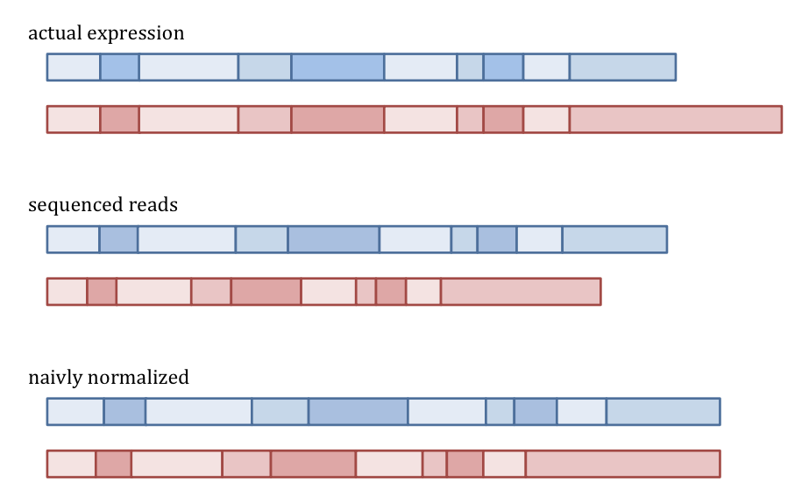
Need to have a robust estimator for sequencing depth
sample 1:
sample 2:
gene 1, 2, 3, etc.
sample 1:
sample 2:
sample 1:
sample 2:
(slide from Simon Anders)

Slide 11
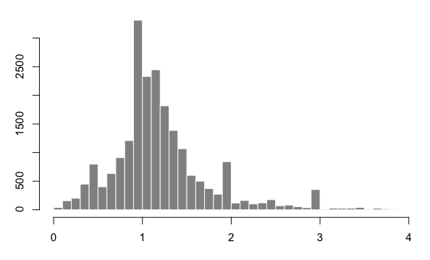
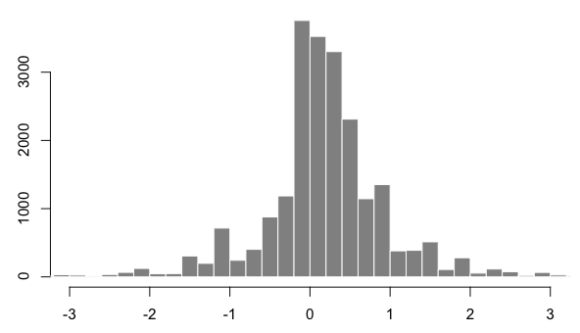
Median of ratios method
simple approach & works well for each gene look at count ratios:
sample 1 / sample 2
log2( sample1 / sample2 )
in general: create a pseudo-reference-sample (row-wise geometric mean)
calculate ratio of each sample to the reference
assumes that not ALL genes are DE (differentially expressed)
robust to imbalance in up-/down- regulation and large numbers of DE genes

Slide 12
Size factors vs normalization factors
"size factor"
multiplicative
per sample
sequencing depth
robustly estimated with median ratio
"normalization factor"
multiplicative
per sample & per gene
sequencing depth and
other factors differ across samples
(technical bias: cqn or EDASeq)
(gene length: tximport)
median ratio method for
sequencing depth can be
estimated on top

Slide 13
Transcript lengths
sample 1
sample 2
iso_{A}: 2/3
iso_{A}: 1/3
iso_{B}: 1/3
iso_{B}: 2/3
average transcript length = Σ (isoform percent × effective tx length)
gene counts will be proportional to average transcript length
extreme changes in isoform usage across samples leads to bias if we just look at gene counts
we can use transcript-level quantifiers like Salmon to solve this

Slide 14
Variance of counts
Consider one gene:

Slide 15
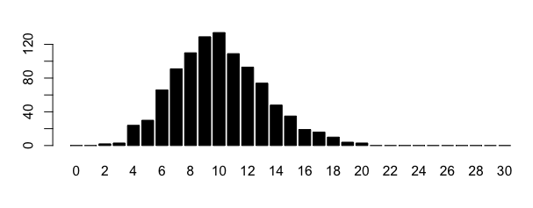
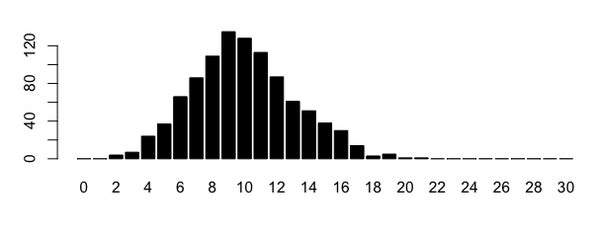
Variance of counts
Consider one gene:
Binomial sampling distribution
With millions of reads & small proportion for each gene => Poisson sampling distribution

Slide 16
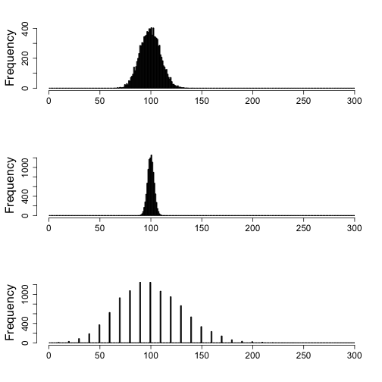
Raw counts vs. normalized counts
Raw count with mean of 100
Poisson sampling, so SD=10
Raw count mean = 1000
Scaled by 1/10
SD = ?
Raw count mean = 10
Scaled by 10
SD = ?

Slide 17
Raw counts vs normalized counts
raw count for gene i, sample j
normalization factor
∝ gene expression
statistical inference "for free"
edgeR, DESeq2
can be made to work with extra modeling e.g. limma-voom
some distribution
mean parameter
Notes:
K_{ij} &\sim \mathcal{L}(\mu_{ij} = s_{ij} q_{ij} ) \\
\frac{K_{ij}}{s_{ij}} &\sim \mathcal{L}(\mu_{ij} = q_{ij})

Slide 18
Biological replicates
If the proportions of mRNA stays exactly constant
("technical replicate") we can expect Poisson dist.
But realistically, biological variation
across sample units is expected

Slide 19
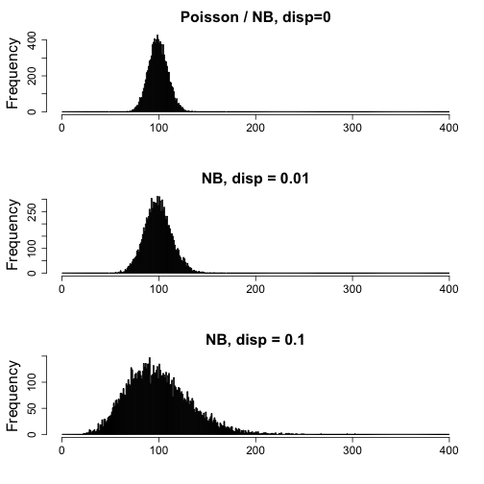
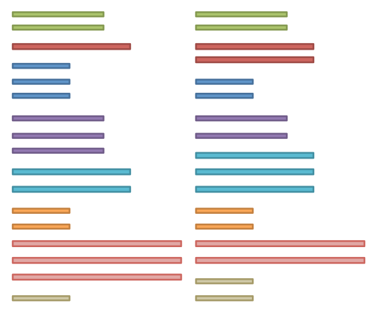
Biological replicates
Biological variation for the abundance
of a given gene produces "over-dispersion"
relative to the Poisson dist.
Negative Binomial =
Poisson with a varying mean

Slide 20
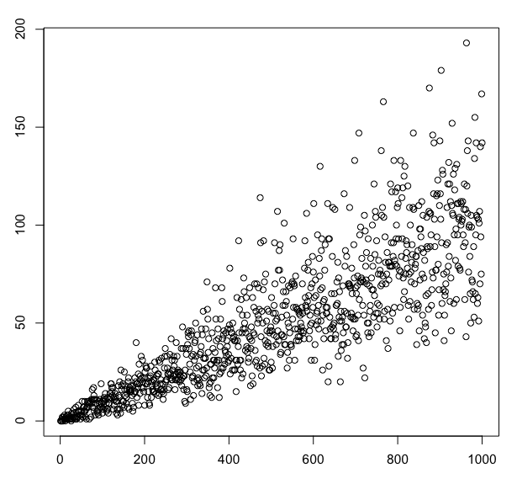
Dispersion parameter
quantity of interest
raw count for gene i, sample j
normalization factor
one dispersion per gene
variance depends on mean value though
Notes:
the figure shows random variation with increasing mean for a NB with constant dispersion parameter
K_{ij} \sim \text{NB}(s_{ij} q_{ij}, \alpha_i )
\text{Var}(K_{ij}) = \mu_{ij} + \alpha_i \mu_{ij}^2

Slide 21
Dispersion parameter
Poisson part:
sampling fragments
Extra variation
due to biological variance
for large counts:
(coefficient of variation)
alpha = 0.01 => CV 10%
alpha = 0.25 => CV 50%

Slide 22
3. Genes and transcripts
Here, I'm talking about differential gene expression
Another analysis of interest is differential transcript usage within genes
As shown in Cufflinks, tximport, Salmon pubs, accurate gene estimation requires accurate transcript estimation (or else can't get gene length or bias right)

Slide 23
Differential transcript usage: approaches (list is not complete!)
Exonic bins: DEXSeq
Exonic bins + splice junctions
Dirichlet based approaches: MISO, DRIM-seq
Use transcript abundances to infer Ψ (percent spliced in) for splicing events: SUPPA
Differential transcript expression:
Use posterior uncertainty: BitSeq
Use bootstrap variance: IsoDE, sleuth

Slide 24
4. Shrinkage estimation
distribution of 1000 darts players' ability:
not observed
each throws 3 darts:
sample variance of the average
observed distribution:
averages of 3 throws from each of 1000 players
shrink the averages
towards a center defined
by the observed distribution
"shrunken" estimates
less error overall
than individual estimates

Slide 25
Shrinkage estimation
population
distribution
dashed = unobserved
sampling variance
around true ability
empirical
distribution the center defines the prior mean
MLE maximum likelihood estimates
shrunken
estimates or
MAP maximum a posteriori

Slide 26
Shrinkage estimation
✗
✗
✓
✗
✓

Slide 27
Shrinkage estimators in genomics
A few examples. Warning: not complete!
Lönnstedt and Speed (2002): microarray
Smyth (2004): limma for microarray
Robinson and Smyth (2007): moderated tests for "digital gene expression" ideas for edgeR
DSS (2012) and DESeq2 (2014) similar: data-driven strength of prior (optional in edgeR)
An introduction to shrinkage estimators:
Baseball players as example Efron and Morris 1977
"Stein's Paradox in Statistics"

Slide 28
Shrinkage and dispersion
Different genes naturally have different scale of biological variability
Over all genes, there will be a distribution of reasonable estimates of dispersion
With small sample size (n=3-5 replicates per group), we will make very bad estimates of gene-wise dispersion unless we share information across genes

Slide 29
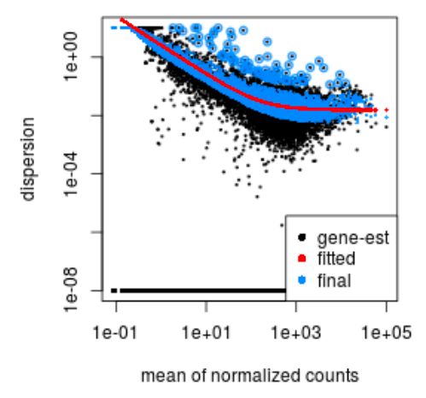
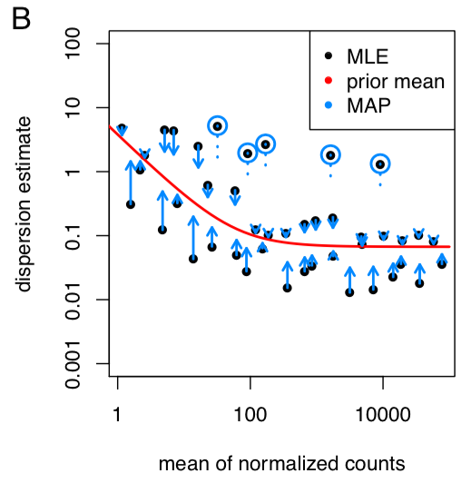
Shrinkage of dispersion for RNA-seq
all genes (Pasilla)
a subset of genes (Pickrell)
Gene estimate = maximum likelihood estimate (MLE)
Fitted dispersion trend = the mean of the prior
Final estimate = maximum a posteriori (MAP)

Slide 30
Shrinkage of fold changes
A t-statistic (signal/noise) can be large for two reasons:
large signal (big difference across groups)
small noise
With DESeq2, we wanted a way to output reliable estimates of the fold change across groups
fold changes are "noisy" when counts are small, e.g. 4/1 compared to 4,000/1,000
also "noisy" when dispersion is high

Slide 31
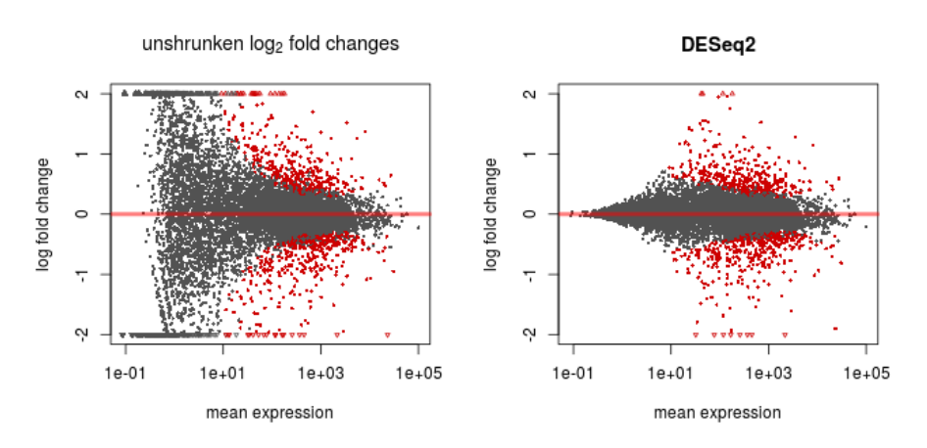
Shrinkage of fold changes
noisy estimates due to low counts
large FDR from the statistical model,
but we shouldn't trust the estimate itself
shrinkage is not equal.
strong moderation for low
information genes: low counts
almost no
shrinkage

Slide 32
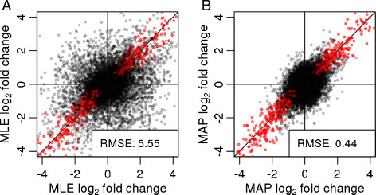
Why shrink fold changes?
Split a dataset into two equal parts, compare LFC

Slide 33
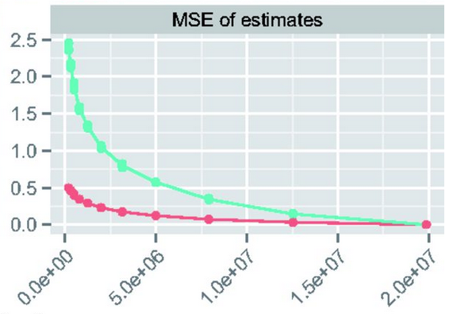

Why shrink fold changes?
Estimates remain reliable even for small sample size and low counts:
Mean Squared Error when subsampling to lower seq. depth in silico
subSeq: Determining Appropriate Sequencing Depth Through Efficient Read Subsampling
David G. Robinson and John D. Storey (2014)

Slide 34
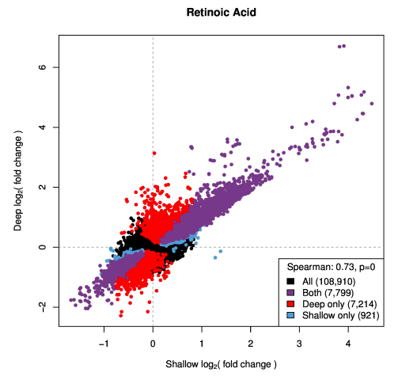
Why shrink fold changes?
Comparison of log fold changes
across groups, or experiments.
"A new two-step high-throughput approach:
1. gene expression screening of a large number of conditions
2. deep sequencing of the most relevant conditions"
G. A. Moyerbrailean et al. "A high-throughput RNA-seq approach to profile transcriptional responses" http://dx.doi.org/10.1101/018416

Slide 35
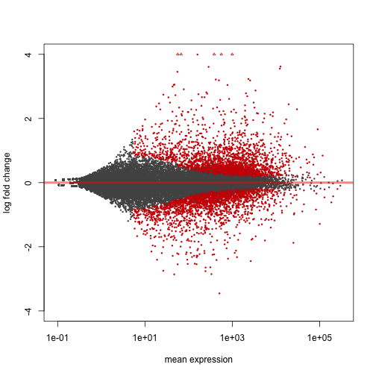
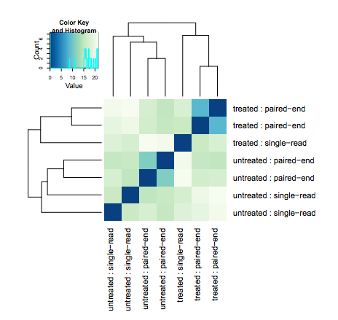
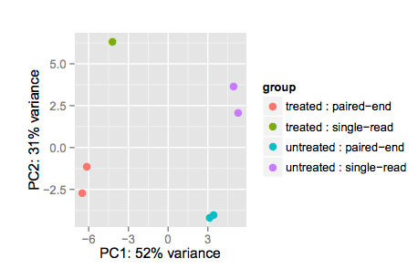
Two paths in RNA-seq gene analysis
Count matrix
Differential expression
testing, p-values, FDR
DESeq()
results() lfcShrink()
glmLRT() topTags()
Transformations and
Exploratory Data Analysis (EDA)
clustering, heatmaps, sample-sample distances
vst(), rlog(), plotPCA()
cpm(), plotMDS()
DESeq2
DESeq2
edgeR
edgeR

Slide 36
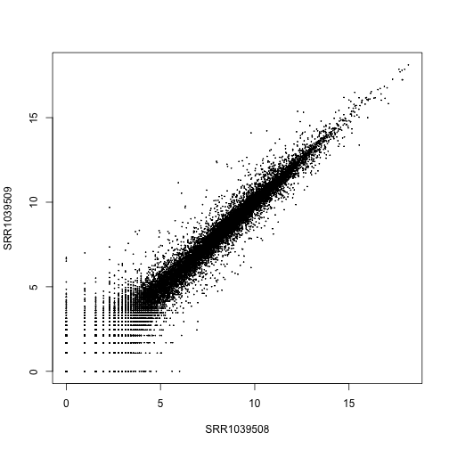
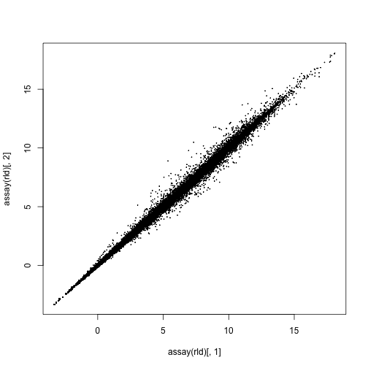
Regularized logarithm, "rlog"
similar idea as fold change shrinkage, now sample-to-sample fold changes
log2(x + 1)
"rlog"
sample 2
sample 2
sample 1
sample 1
Poisson noise from low counts, when squared
a big contribution to Euclidean distance between samples

Slide 37
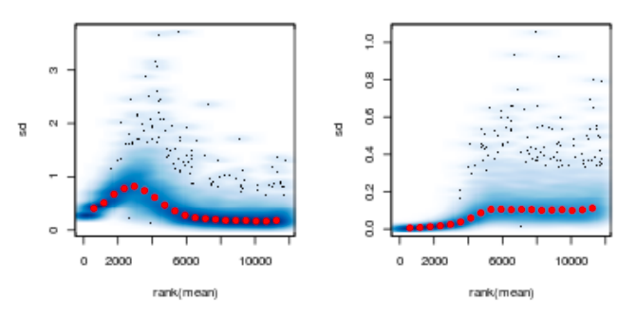
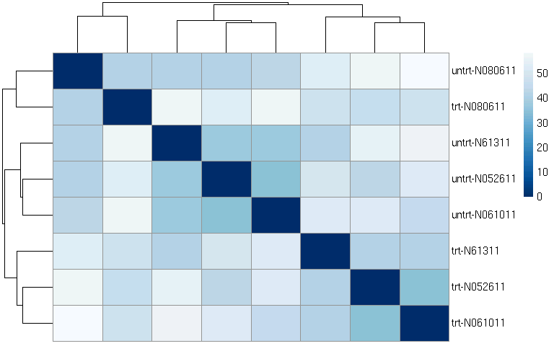
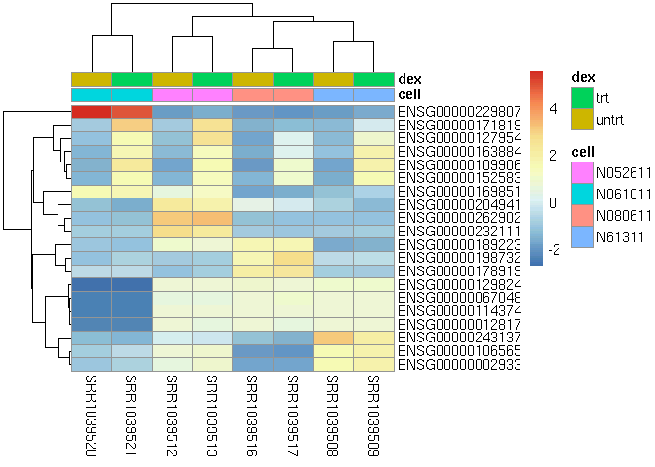
rlog stabilizes variance along the mean
log2(x + 1)
"rlog"
corrects systematic
dependencies,
doesn't force all
variances equal.
standard deviation
standard deviation
improving
distances,
clustering,
visualizations
rank( mean )
rank( mean )

Slide 38
Also in DESeq2: VST
Variance stabilizing transformation: calculate the dependence of variance on the mean (using the dispersion trend)
Closed-form expression
vst() is a fast implementation, great for EDA

Slide 39
5. Testing steps and power

Slide 40
Differences across condition
Describe experiment with formula, e.g.: ~condition
Fit the coefficients once, then extract multiple results tables. per gene the model looks like:
log₂ q1 1 0 0
log₂ q2 1 0 0
log₂ q3 = 1 1 0
log₂ q4 1 1 0
log₂ q5 1 0 1
log₂ q6 1 0 1
β_{Intercept}
β_{condition_B_vs_A}
β_{condition_C_vs_A}

Slide 41
Differences across condition
Describe experiment with formula, e.g.: ~condition
Fit the coefficients once, then extract multiple results tables. per gene the model looks like:
log₂ q1 1 0 0
log₂ q2 1 0 0
log₂ q3 = 1 1 0
log₂ q4 1 1 0
log₂ q5 1 0 1
log₂ q6 1 0 1
β_{Intercept}
β_{condition_B_vs_A}
β_{condition_C_vs_A}
results(dds, contrast=c("condition","B","A"))

Slide 42
Differences across condition
Describe experiment with formula, e.g.: ~condition
Fit the coefficients once, then extract multiple results tables. per gene the model looks like:
log₂ q1 1 0 0
log₂ q2 1 0 0
log₂ q3 = 1 1 0
log₂ q4 1 1 0
log₂ q5 1 0 1
log₂ q6 1 0 1
β_{Intercept}
β_{condition_B_vs_A}
β_{condition_C_vs_A}
results(dds, contrast=c("condition","C","A"))

Slide 43
Differences across condition
Describe experiment with formula, e.g.: ~condition
Fit the coefficients once, then extract multiple results tables. per gene the model looks like:
log₂ q1 1 0 0
log₂ q2 1 0 0
log₂ q3 = 1 1 0
log₂ q4 1 1 0
log₂ q5 1 0 1
log₂ q6 1 0 1
β_{Intercept}
β_{condition_B_vs_A}
β_{condition_C_vs_A}
results(dds, contrast=c("condition","C","B"))

Slide 44
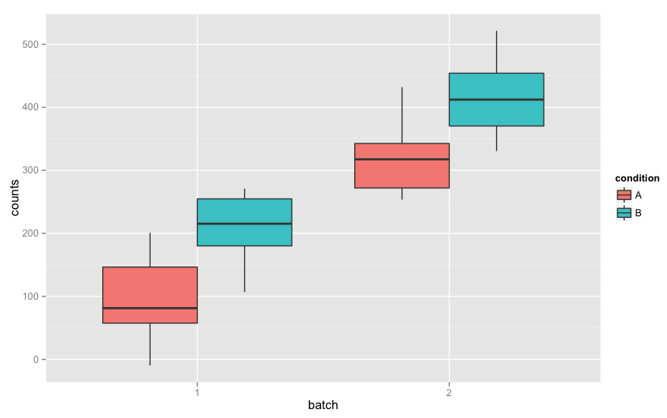
Controlling for different batches
Using a design formula: ~ batch + condition, adds terms that control for batch differences
If batches are unknown, possible to detect these with other methods: svaseq, RUVSeq
Notes:
data <- data.frame(counts=rnorm(10*4, rep(c(100,200,300,400),each=10), 50),
batch=factor(rep(1:2,each=2*10)), condition=factor(rep(c("A","B","A","B"), each=10)));
ggplot(data, aes(x=batch, y=counts, fill=condition)) + geom_boxplot()

Slide 45
Complex designs
Want to test: treatment changes for enriched samples over baseline, controlling for individual effects
~individual + enrichment + treatment +
enrichment:treatment
indiv . enrich. treat.
1 input control
1 IP control
1 input treat
1 IP treat
2 input control
2 IP control
2 input treat
2 IP treat
...

Slide 46
DESeq2 package
Available through Bioconductor since 2013
Publication: Genome Biology, Dec 2014. main text written with non-statisticians in mind
Builds on good ideas for dispersion estimation and use of GLM from the DSS and edgeR methods
See bioconductor.org/install for installation
Note that the latest Bioconductor packages are only available with latest R version. Bioconductor and R versions are linked

Slide 47


DESeq2 steps
we tried to streamline the default pipeline
count matrix from e.g. Salmon => tximport
size factors (sequencing depth)
dispersion (biological variance)
Wald test or likelihood ratio test
build results table
Shrink LFCs
DESeq()
results()
lfcShrink()

Slide 48
Statistical power
False positive rate (1 - specificity): under the null (no differences), how many called positives?
Precision (1 - false discovery rate): of the positives (called DE), how many are true positives?
Power (sensitivity): under the alternative to the null, how many called positive?

Slide 49
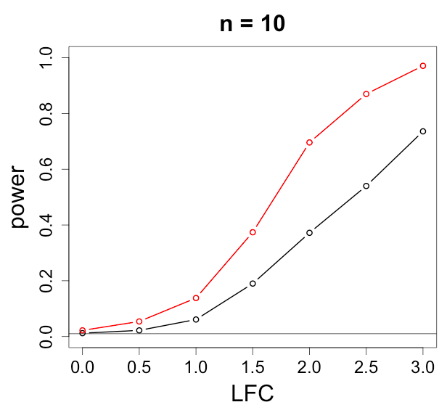
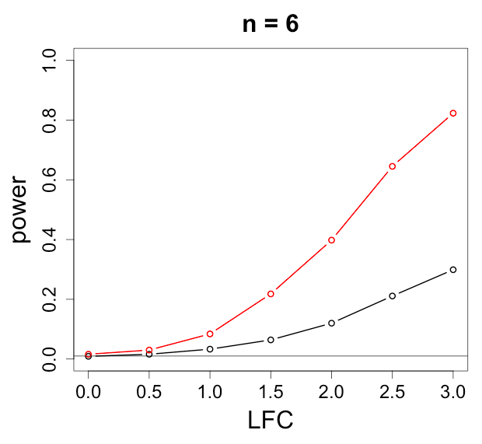
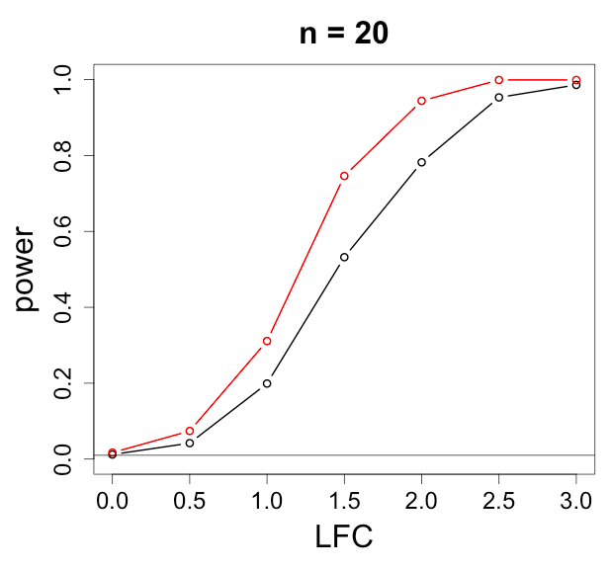
Statistical power
Why not use a simple t-test on log normalized counts?
DESeq2
t-test

Slide 50
Factors influencing power
Range of count
Sequencing depth
Expression
Gene length
Sample size
Dispersion
True fold change

Slide 51
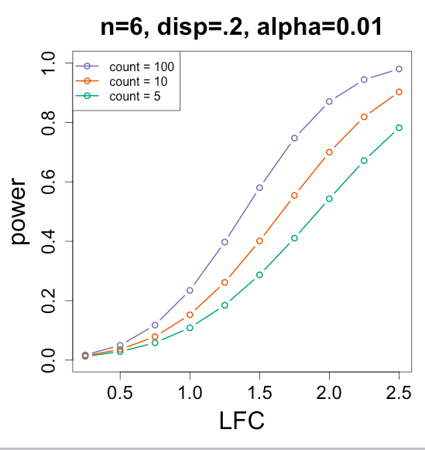
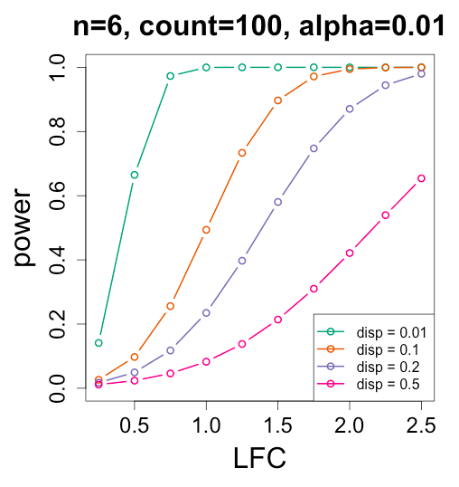
Bioc pkg: RNASeqPower
varying the count
varying the dispersion

Slide 52
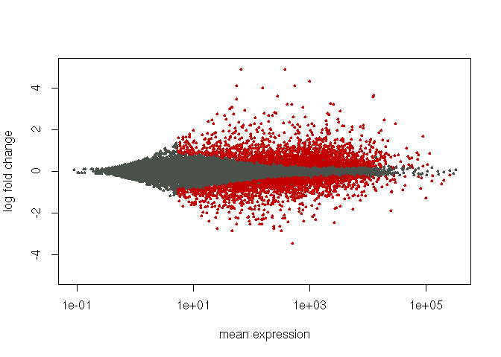
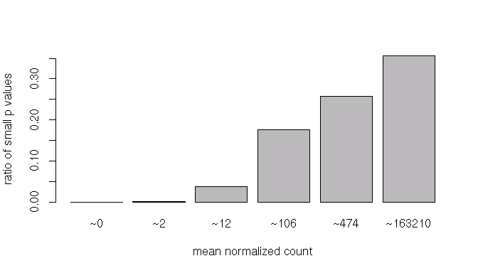
Power depends on range of counts
log fold change
ratio of small p-values
mean normalized count
mean normalized count
By excluding some tests, e.g. genes with mean normalized count < 5,
we reduce the penalty from multiple test correction,
i.e. we increase experiment-wide power.
This threshold is automatically determined (data-driven) by results()

Slide 53
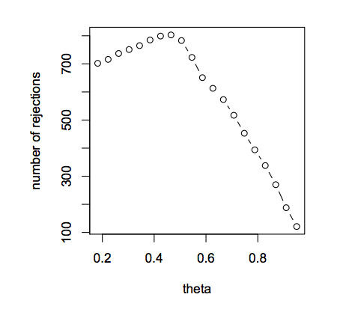
Power depends on range of counts
quantile of mean of normalized counts
Filter on a statistic which is:
independent of the test statistic under the null
correlated under the alternate hypothesis
Bourgon, Gentleman and Huber, PNAS 2010.

Slide 54
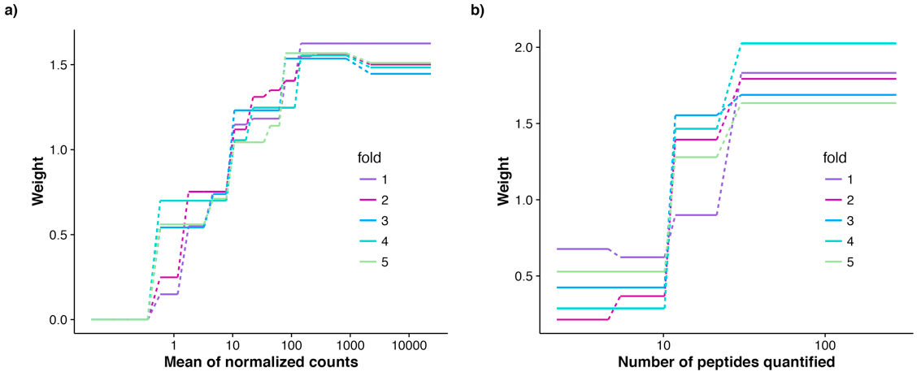
Independent Hypothesis Weighting
Data-driven hypothesis weighting increases detection power in genome-scale multiple testing
Nikolaos Ignatiadis, Bernd Klaus, Judith B Zaugg & Wolfgang Huber
results(dds, filterFun=ihw)

Slide 55
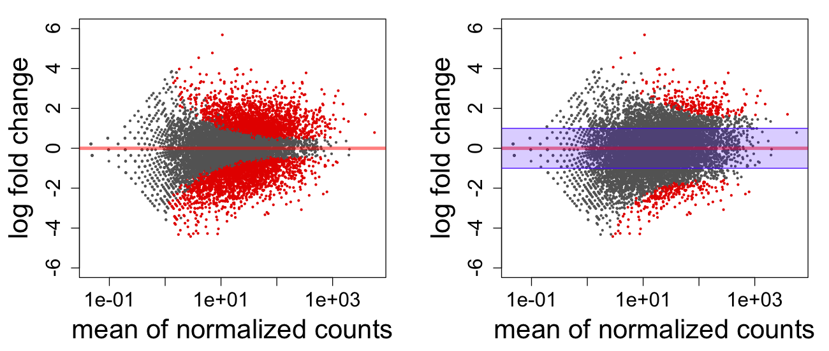
Testing against a threshold
"We get too many DEGs..."
using 'lfcThreshold' in results()
null hypothesis: LFC = 0
null hypothesis: fold change is < 2 or > 1/2
"For well-powered experiments, however, a statistical test against the conventional null hypothesis of zero LFC may report genes with statistically significant changes that are so weak in effect strength that they could be considered irrelevant or distracting."
Notes:
> dds <- makeExampleDESeqDataSet(n=10000,betaSD=1,m=20)
> dds <- DESeq(dds, quiet=TRUE); res <- results(dds); res2 <- results(dds, lfcThreshold=1)
> plotMA(res,ylim=c(-6,6));plotMA(res2,ylim=c(-6,6))
> polygon(c(1e-2,1e4,1e4,1e-2),c(-1,-1,1,1),col=rgb(0,0,1,.2),border="blue")

Slide 56
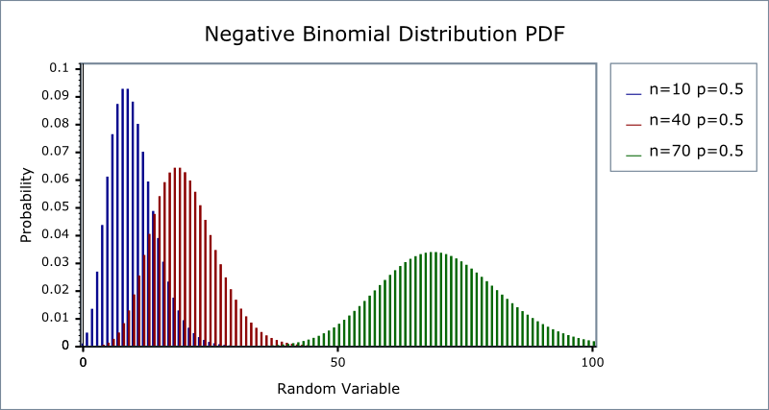
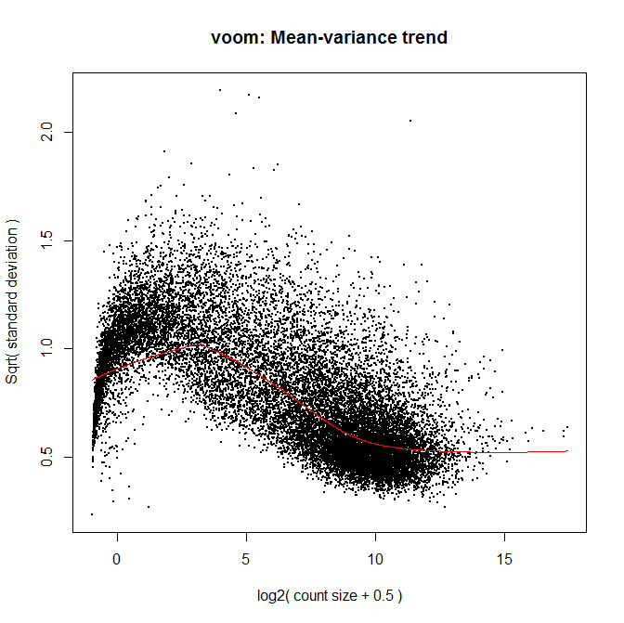
Count model vs linear model
DESeq2 and edgeR similar approach, similar results
very sensitive, may sometimes underestimate FDR
limma+voom uses a linear model, weights determined by variance over mean
strong control of FDR, may be less sensitive for small sample size
recommended (by me) when number of biological replicates per group grows large (e.g. > 20)

Slide 57
Bioconductor help
Vignettes:
> browseVignettes("DESeq2") > vignette("DESeq2")
Type ? then the function name:
> ?results
Workflows: bioconductor.org/help/workflows/rnaseqGene

Slide 58
Bioconductor help
results package:DESeq2 R Documentation
Extract results from a DESeq analysis
Description:
‘results’ extracts a result table from a DESeq analysis giving
base means across samples, log2 fold changes, standard errors,
test statistics, p-values and adjusted p-values; ‘resultsNames’
returns the names of the estimated effects (coefficents) of the
model; ‘removeResults’ returns a ‘DESeqDataSet’ object with
results columns removed.
Usage:
results(object, contrast, name, lfcThreshold = 0,
altHypothesis = c("greaterAbs", "lessAbs", "greater", "less"),
listValues = c(1, -1), cooksCutoff, independentFiltering = TRUE,
alpha = 0.1, filter, theta, pAdjustMethod = "BH",
format = c("DataFrame", "GRanges", "GRangesList"), test, addMLE = FALSE,
tidy = FALSE, parallel = FALSE, BPPARAM = bpparam())
...
Arguments:
object: a DESeqDataSet, on which one of the following functions has
already been called: ‘DESeq’, ‘nbinomWaldTest’, or
‘nbinomLRT’
contrast: this argument specifies what comparison to extract from the
‘object’ to build a results table. one of either:
• a character vector with exactly three elements: the name
of a factor in the design formula, the name of the
numerator level for the fold change, and the name of the
denominator level for the fold change (simplest case)

Slide 59
Bioconductor help
Value:
For ‘results’: a ‘DESeqResults’ object, which is a simple subclass
of DataFrame. This object contains the results columns:
‘baseMean’, ‘log2FoldChange’, ‘lfcSE’, ‘stat’, ‘pvalue’ and
‘padj’, and also includes metadata columns of variable
information....
...
References:
Richard Bourgon, Robert Gentleman, Wolfgang Huber: Independent
filtering increases detection power for high-throughput
experiments. PNAS (2010), <URL:
http://dx.doi.org/10.1073/pnas.0914005107>
See Also:
‘DESeq’
Examples:
## Example 1: simple two-group comparison
dds <- makeExampleDESeqDataSet(m=4)
...

Slide 60
Looking up help for objects
> class(dds)
[1] "DESeqDataSet"
attr(,"package")
[1] "DESeq2"
> ?DESeqDataSet
> help(package="DESeq2", help_type="html")

Slide 61
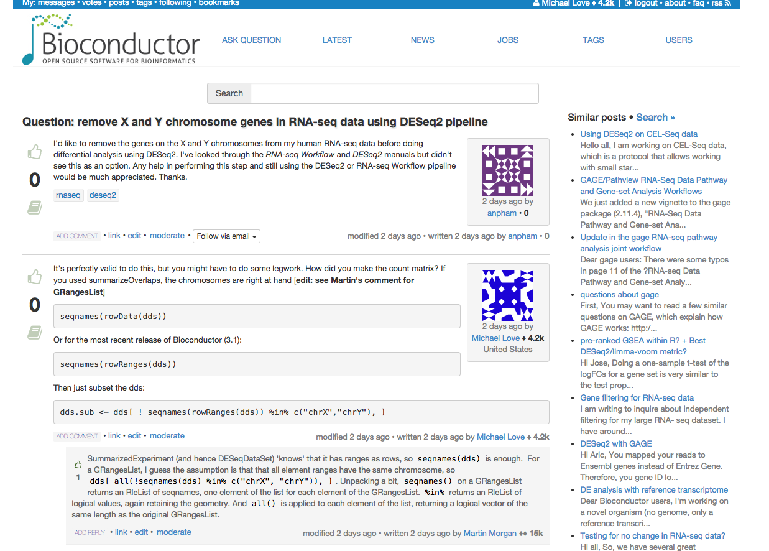
Bioconductor support site
All questions about Bioconductor software post to:
support.bioconductor.org
edit posts
voting
comment / reply
biological question
all code, any errors/warnings
sessionInfo()
always provide:

