Slide 1
Predicting Clinical Outcomes from Non-Small Cell Lung Cancer (NSCLC) Patient Data
David Abramov
CSC 423 Data Analysis and Regression
Winter Quarter 2018

Slide 2
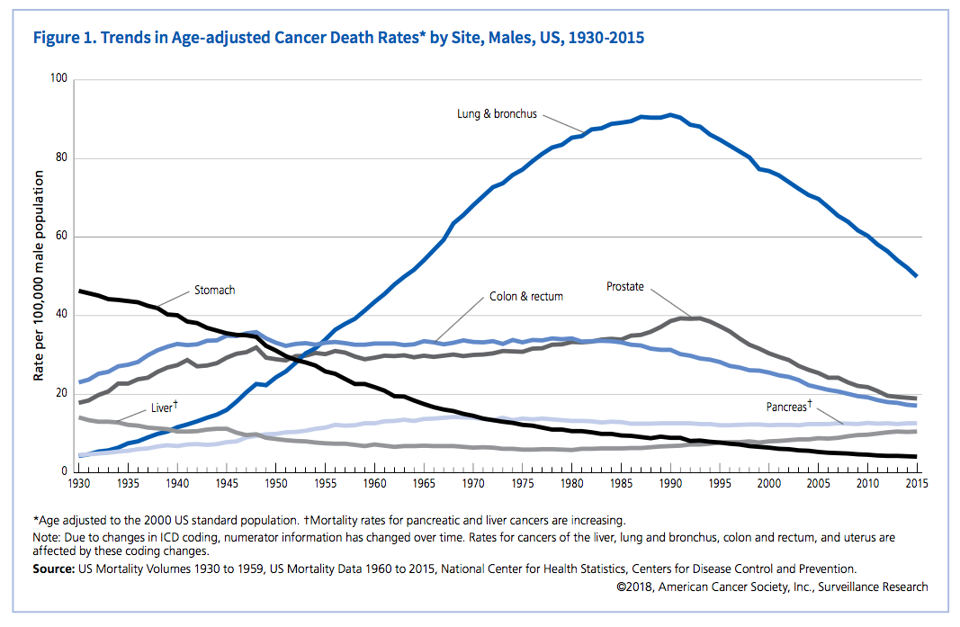

Slide 3
Objective
Build a model that predicts survival of a patient diagnosed with adenocarcinoma of the lung, the most common type of lung cancer.
https://lungevity.org/for-patients-caregivers/lung-cancer-101/types-of-lung-cancer/lung-adenocarcinoma

Slide 4
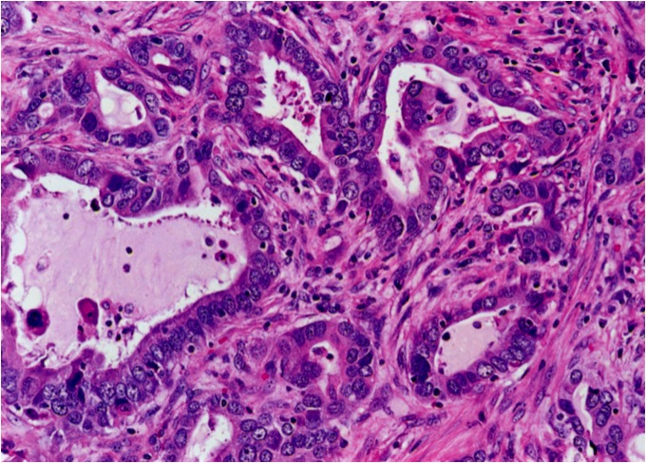
https://www.flickr.com/photos/40764007@N08/7008486711/in/photostream/

Slide 5
Dataset
National Center for Biotechnology Information
Publicly Available (https://www.ncbi.nlm.nih.gov/geo/query/acc.cgi?acc=GSE68465)
Contains data from 478 patients
28 variables
Logistic Regression → Predict Survival

Slide 6
Intuitive Variables (15)
Unintuitive Variables*
Cryptic patient information
Genetic lab results (unclear significance)
Not necessarily easily repeatable across other datasets
Makes sense for the study the data is taken from
GENDER
AGE_AT_DIAGNOSIS
RACE
ADJUVANT_CHEMO
ADJUVANT_RT
VITAL_STATUS
FIRST_PROGRESSION_OR_RELAPSE
MONTHS_TO_FIRST_PROGRESSION
MTHS_TO_LAST_CLINICAL_ASSESSMENT
MONTHS_TO_LAST_CONTACT_OR_DEATH
SMOKING_HISTORY
SURGICAL_MARGINS
PATHOLOGIC_N_STAGE
PATHOLOGIC_T_STAGE
Histologic grade
BlindedIDs
PATIENT_ID
Stratagene
DC_STUDY_ID
MICROARRAY
SITE TESTTYPE
IN_DC_STUDY
MEDIAN_INTENSITY_UNNORMALIZED
PCT_ARRAY_OUTLIER
PCT_SINGLE_OUTLIER
WARNING
LABORATORY_BATCH

Slide 7
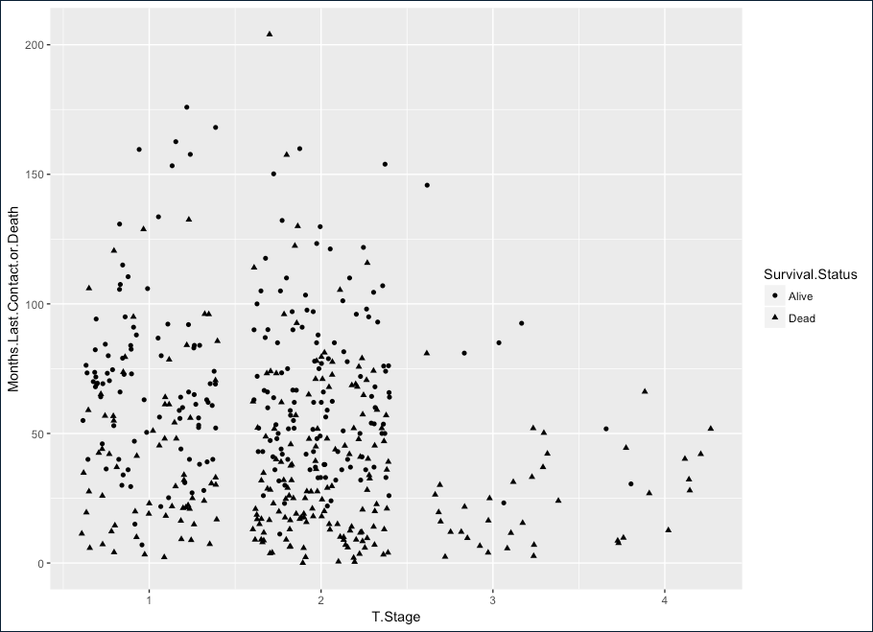
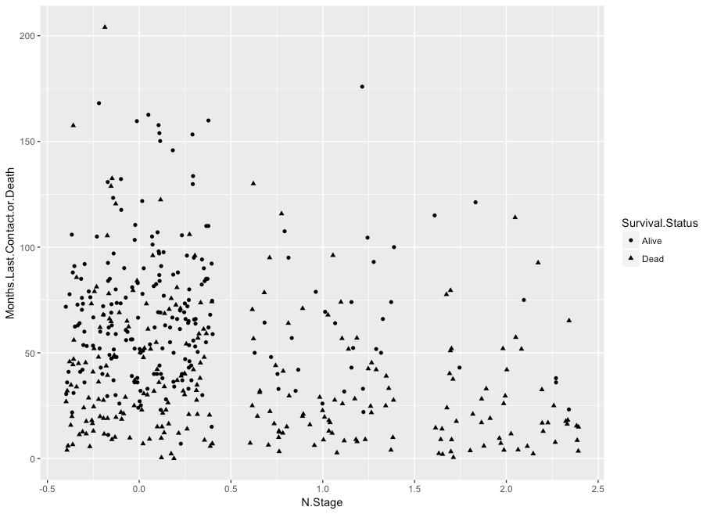
Jitter Plots of Pathologic Staging Scores
T: Corresponds to size and invasiveness of a tumor
N: Corresponds to lymph node involvement
T Stage vs Time to Last Contact or Death
N Stage vs Time to Last Contact or Death

Slide 8
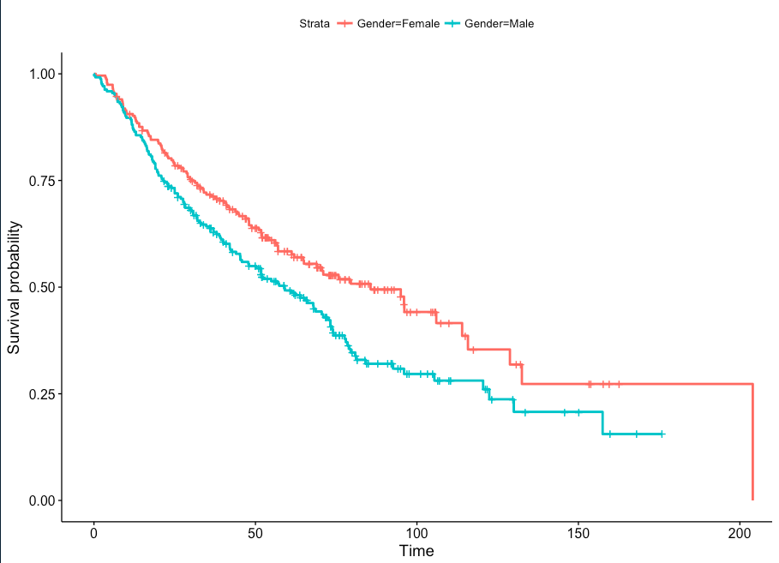
Survival Analysis
Males vs Female
Time in months

Slide 9
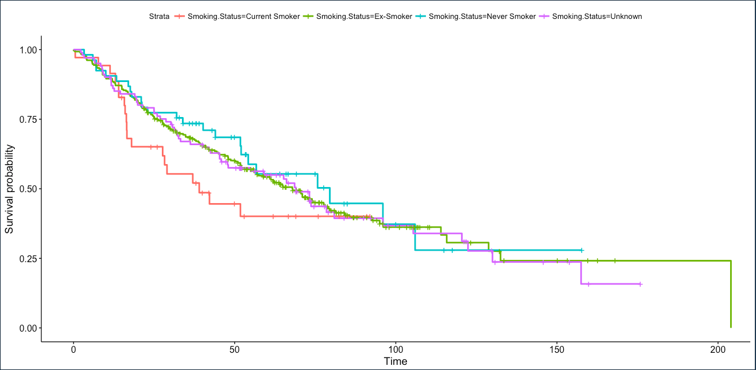
Survival Analysis
Smoking Status (current, ex, never, unknown)
Time in months

Slide 10
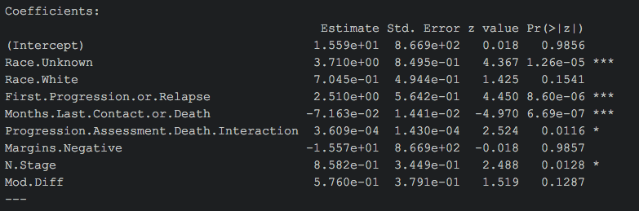
My Model – Logistic Regression
I used the > step() function on my training set (60% of the data) to try to narrow down the number of variables to the most predictive
* Variables highlighted in red are dummy variables missing their corresponding variables

Slide 11
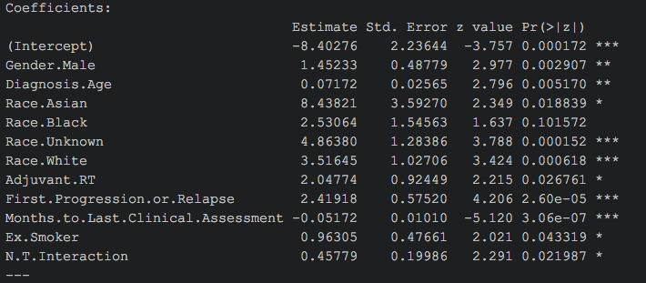
My Model – Logistic Regression
I used the > step() function again on my validation set (40% of the data) as to not over fit my model

Slide 12
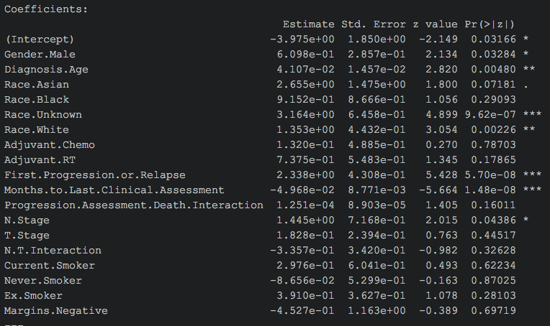
My Model – Logistic Regression (full dataset)

Slide 13
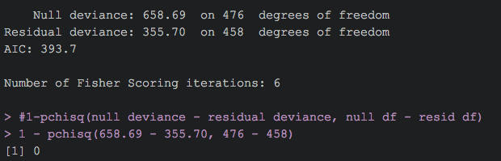
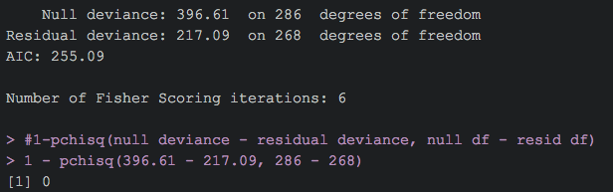
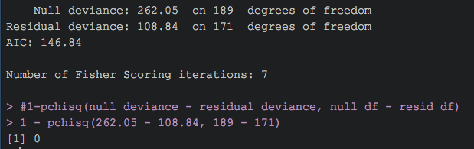
1-pchisq() = 0
Full dataset
Training dataset
Validation dataset

Slide 14
Sensitivity vs Specificity
Dataset | n | Sensitivity | Specificity
Full | 477 | 0.58174905 | 0.57943925
Training | 287 | 0.61290323 | 0.62121212
Validation | 190 | 0.53763441 | 0.50515464

Slide 15
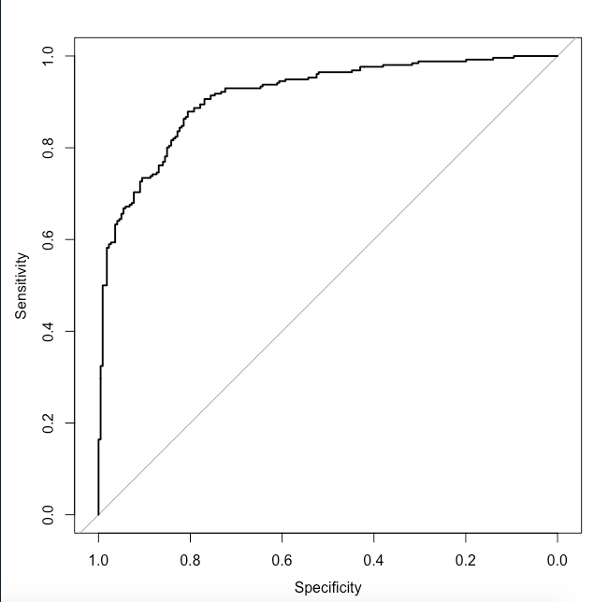
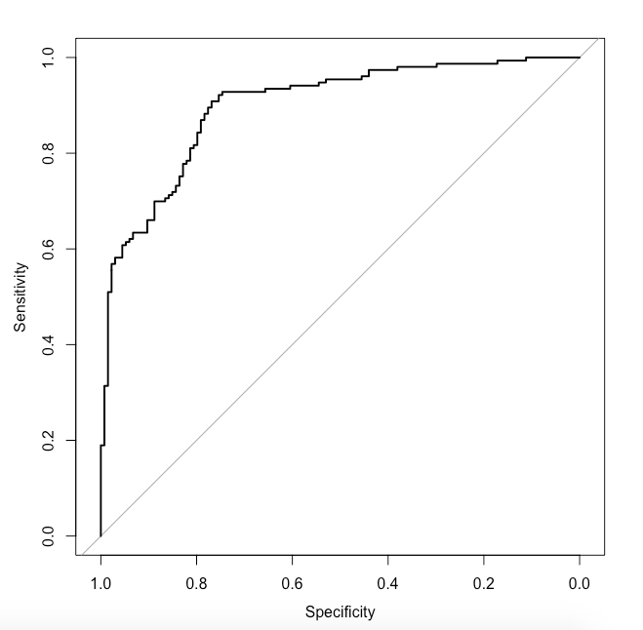
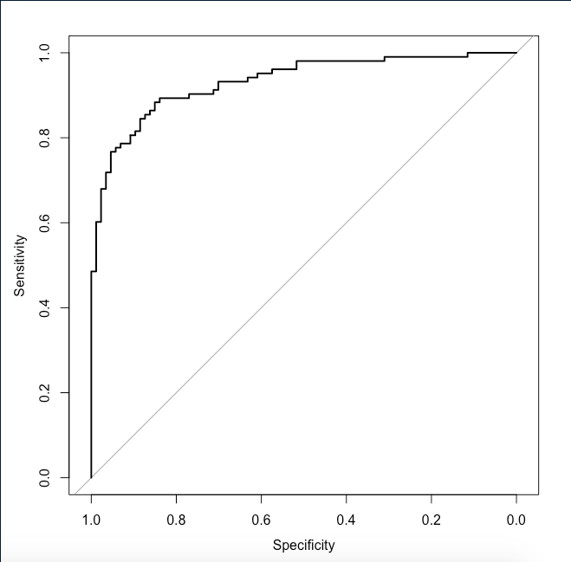
ROC Curves
Full Dataset
Area: 0.913
Training Dataset
Area: 0.8989
Validation Dataset
Area: 0.9319

