Slide 1
Smart Car using Raspberry Pi
Davron Rakhmatullaev 12174079
Saidakmal Madjidkhodjaev 12174121
Rano Sobirova 12174085
Natalya Tsoy 12174071
INHA University

Slide 2
Content
Project Outline……………………………………………………………….. 3
Result Video & Evaluation…………………………………………………... 8
System Configuration………………………………………………………. 15
Project Progress…………………………………………………………….. 21
Discussion…………………………………………………………………... 23
Team Contribution………………………………………………………….. 28
References………………………………………………………………...... 30

Slide 3
Project Outline

Slide 4
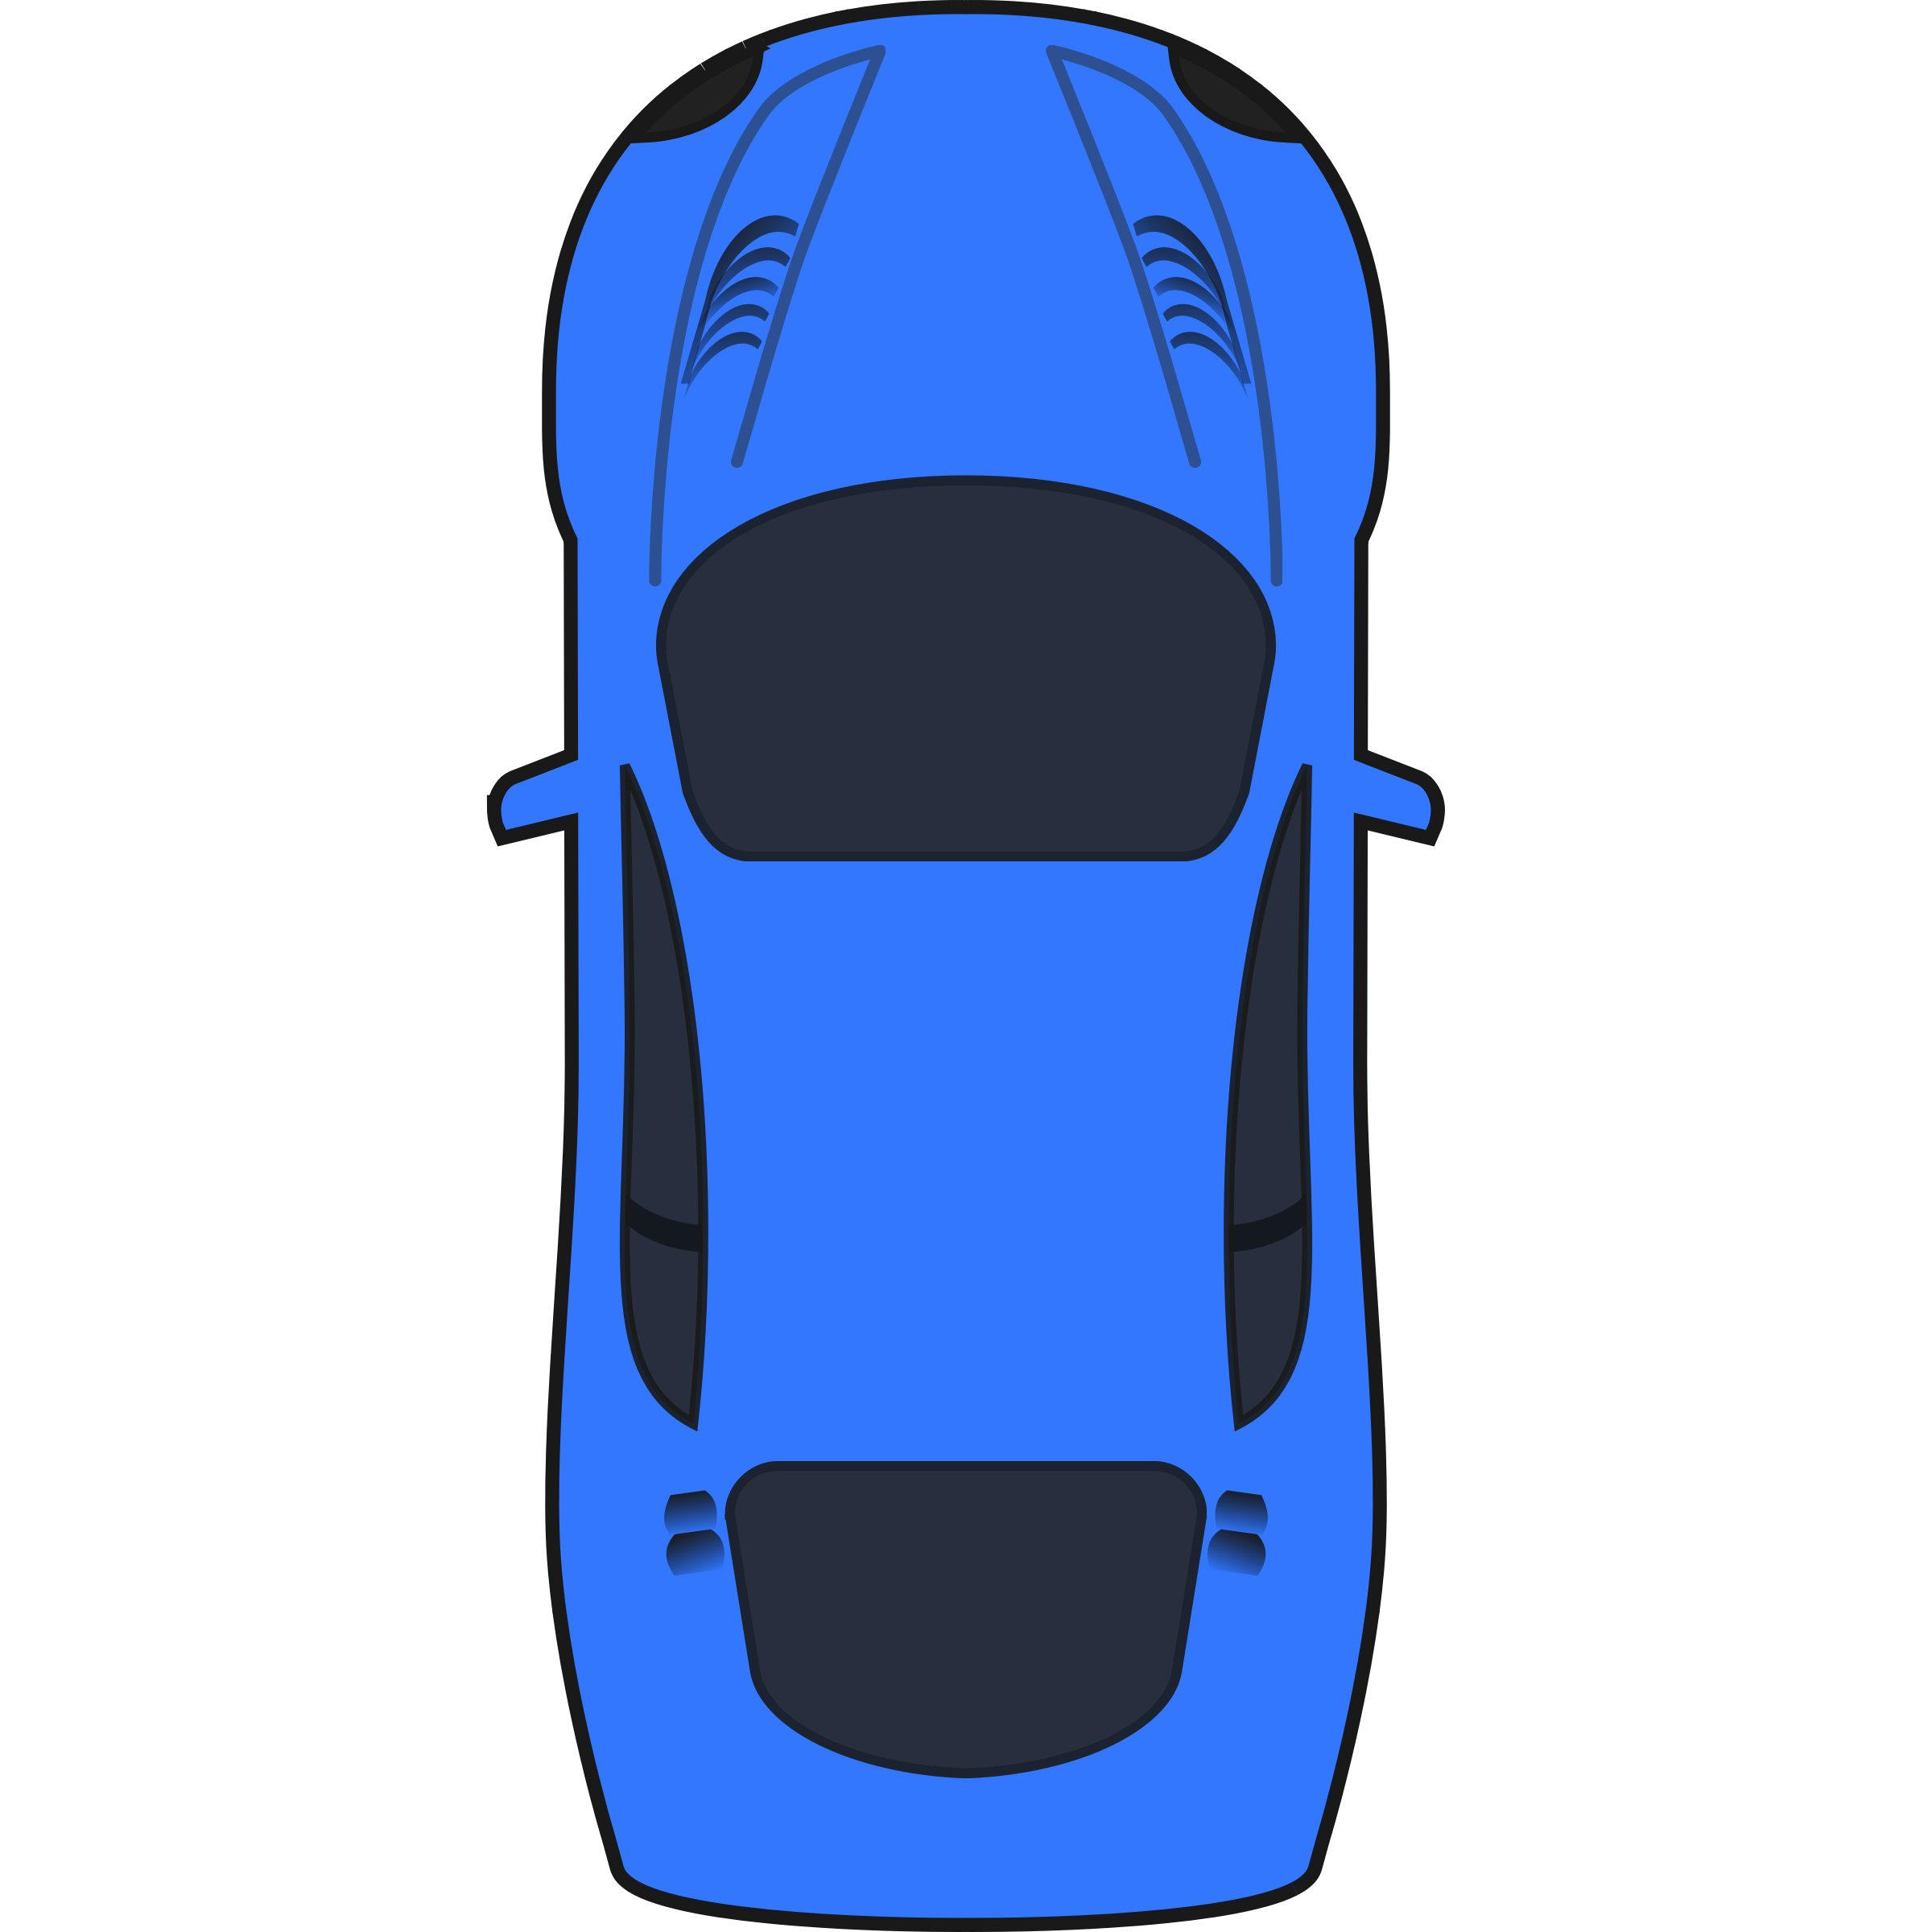
Objective
• To drive autonomously with lane detection

Slide 5
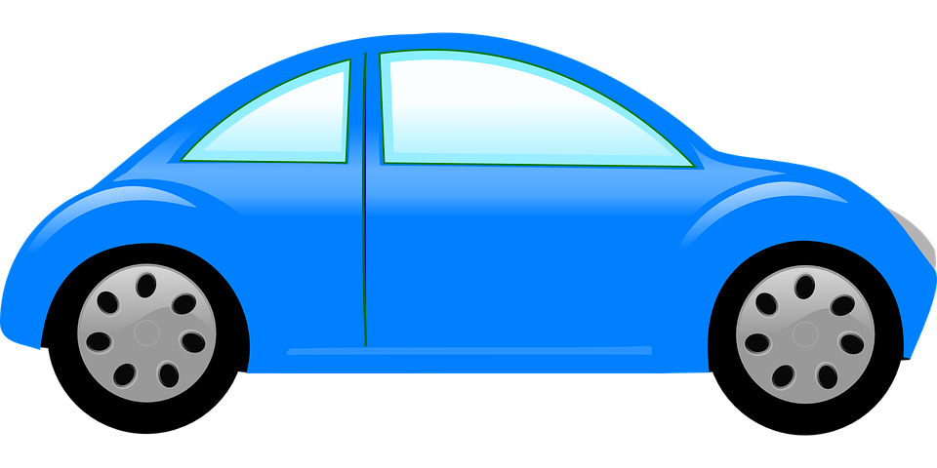

Objective
• To detect an obstacle and navigate without collision
• Smart Parking
30 cm
Notes:
Написать distance

Slide 6
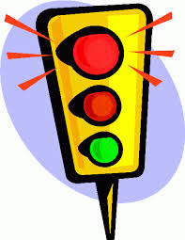
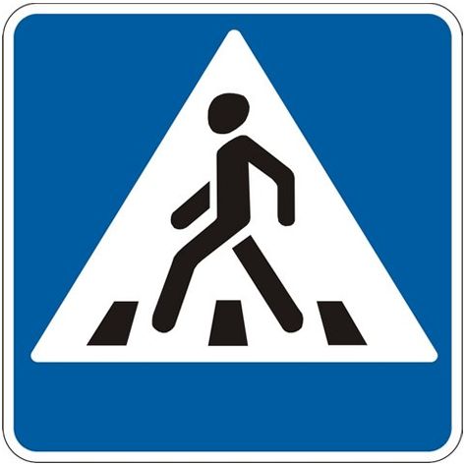
Objective
• To recognize Traffic Light
• To recognize Traffic Sign
30 cm
Notes:
Написать distance

Slide 7
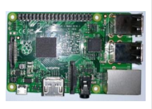
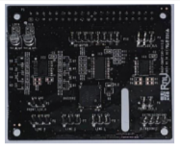
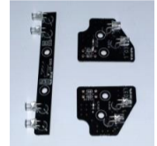
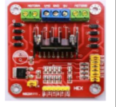
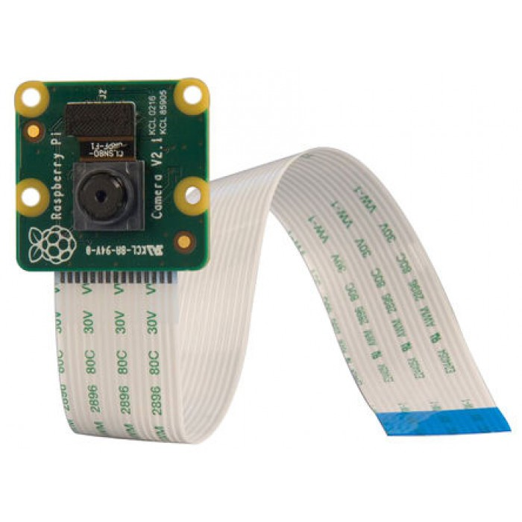
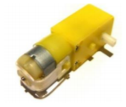
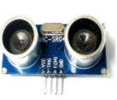
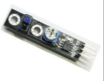
Smart Car Components
Raspberry Pi
Sensor Shield
LED Module
L298N Motor Driver
RasPi Cam
DC Geared Motor
HC-SR04 Ultrasonic sensor
TCRT5000 Line tracer Module 3EA

Slide 8
II. Result Video & Evaluation

Slide 9
Smart RC Car
 | Route Determination
Experience | 100 times
Success | 10 times
Rate | 10%

Slide 10
Evaluation
Obstacle Detection |  | Experience | Success | Rate
Obstacle Recognition | Static Obstacle | 10 times | 10 times | 100%
 | Dynamic Obstacle | 10 times | 10 times | 100%
Obstacle Avoidance | Static Obstacle | 20 times | 10 times | 50%

Slide 11
Traffic Light Detection
Color | Experience | Success | Rate
Red | 50 times | 40 times | 80%
Green | 25 times | 20 times | 80%

Slide 12
Traffic Sign Detection
Sign | Experience | Success | Rate
Stop | 10 times | 8times | 80%

Slide 13
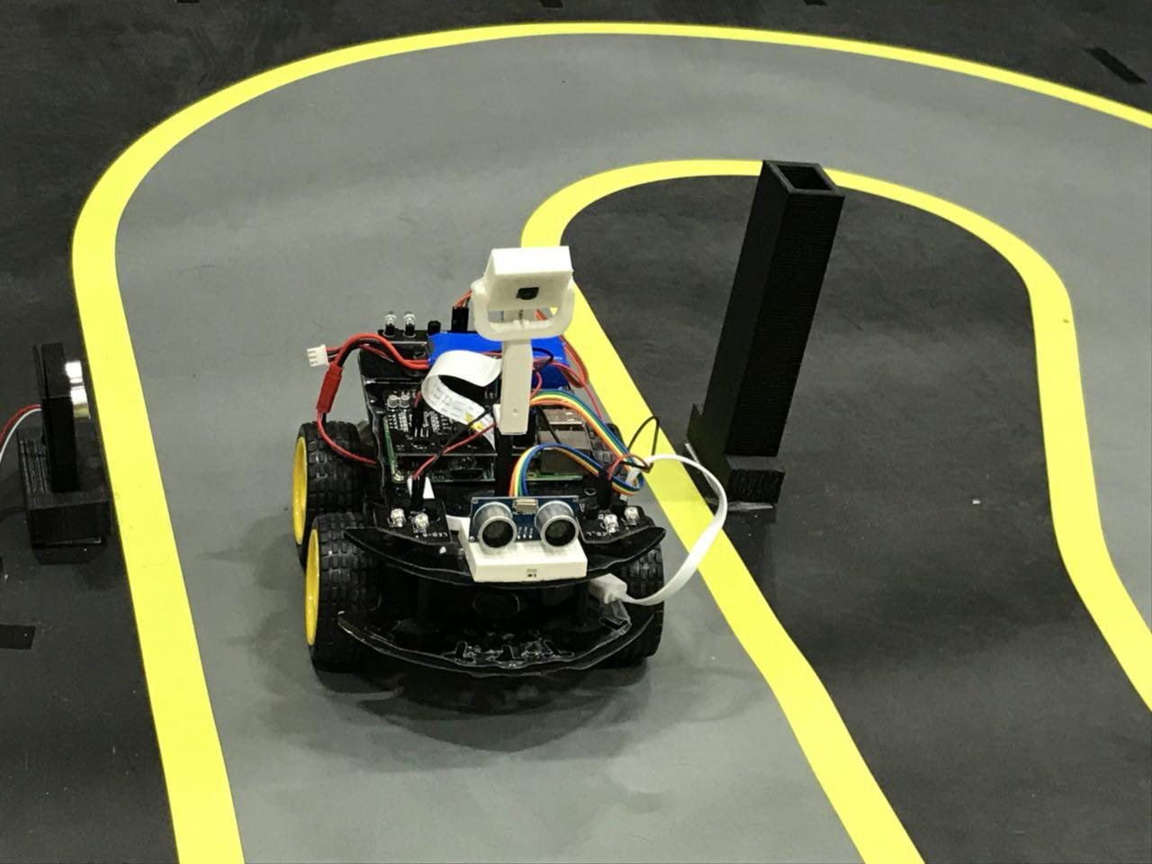
Test Condition (Video)

Slide 14
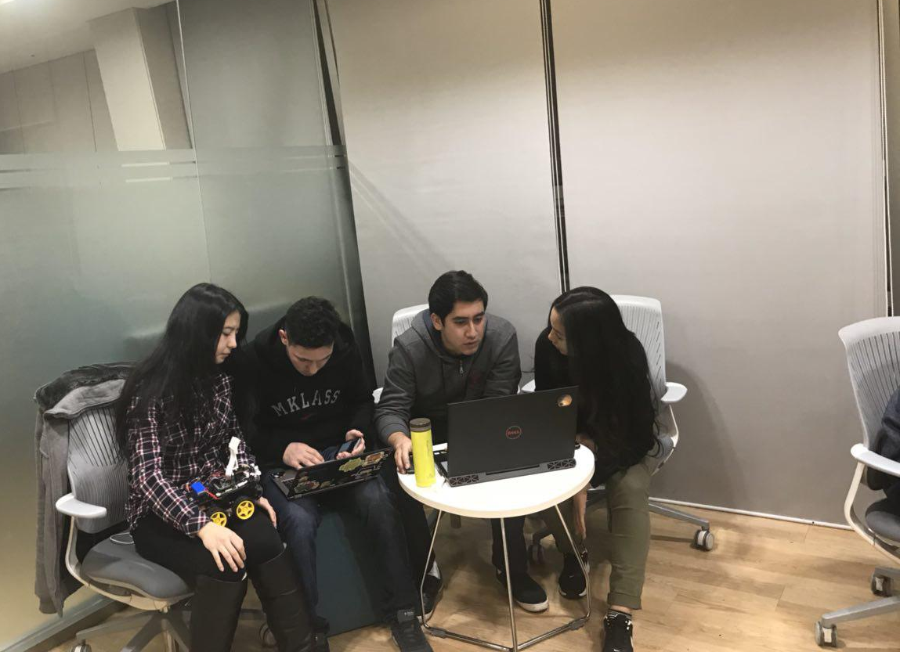
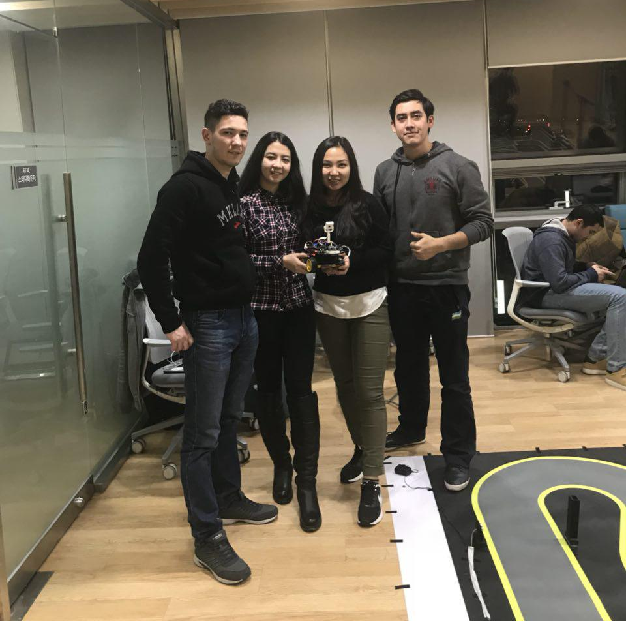
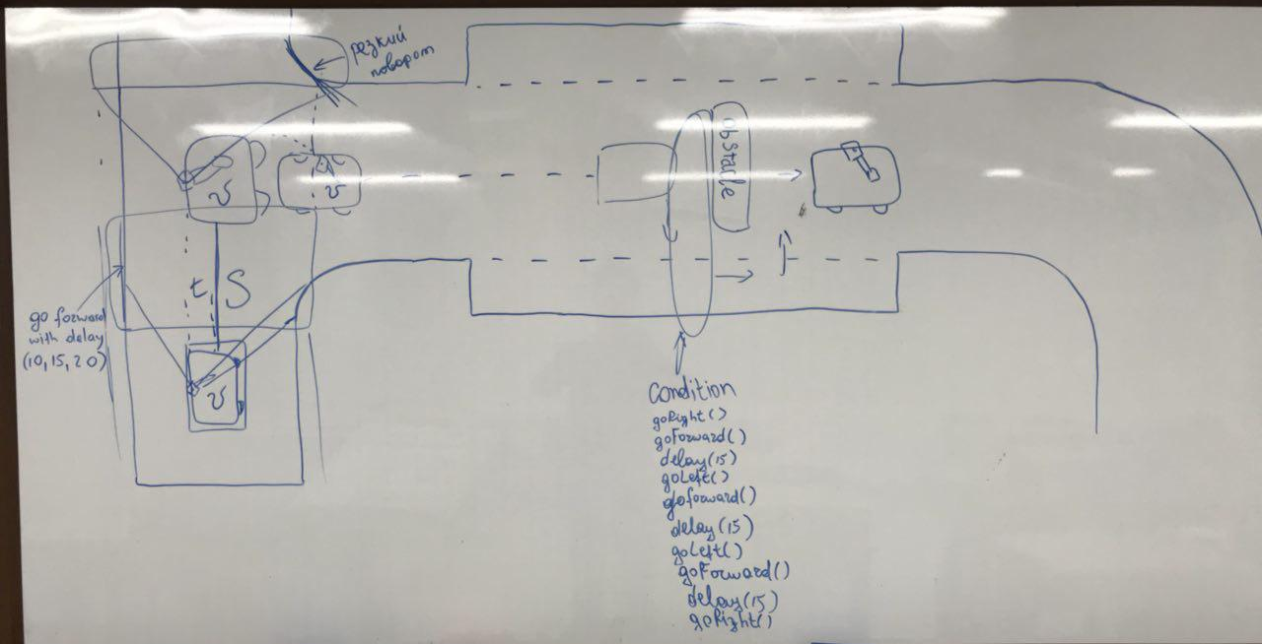
Working Process

Slide 15
III. System Configuration

Slide 16


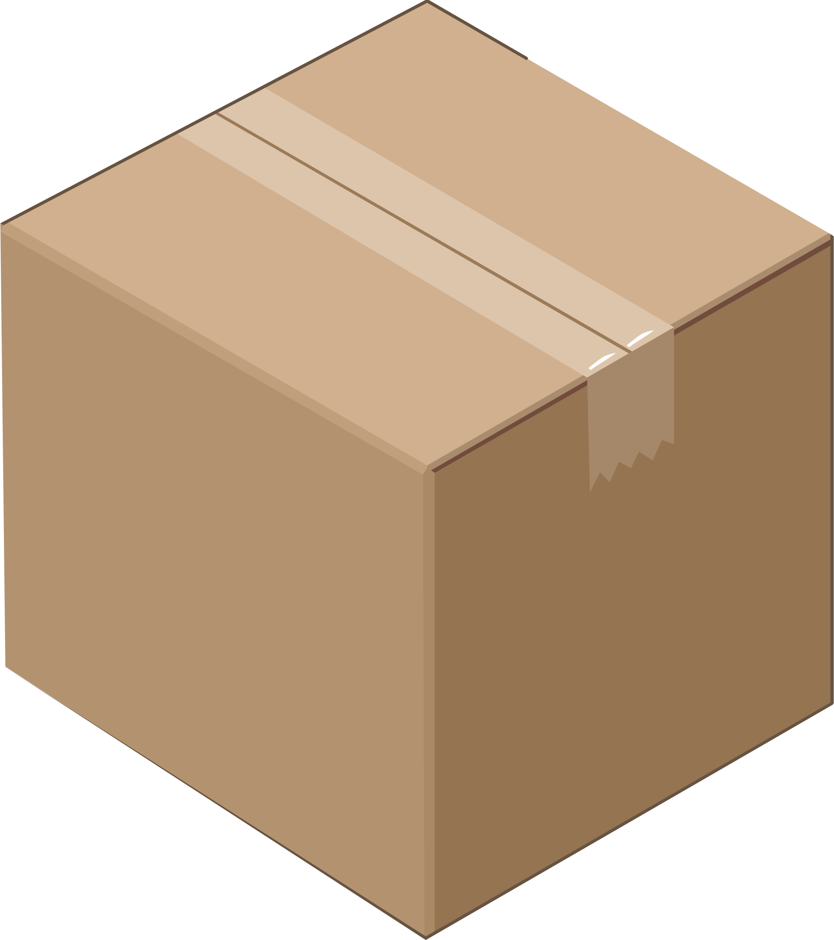
System
Environment
Detection & Recognition
Vision
Line Detection
Color Detection
Sign Detection
Object Recognition
Raspi camera
Alert
Avoidance
Object is closer than 30 cm
Static Obstacle
Control
Motor Control

Slide 17
Algorithm Explanation
Camera
Ultrasonic
Traffic Light
Obstacle Detection
yes
Red
no
n=1
Obstacle
n=0
Stop
go Forward
Stop and wait until pedestrian cross the road
Obstacle avoidance by right
Lane Detection
Notes:
он считает линии и закидывает все данные в вектор. потом мы берем все линии с вектора и определяем координации x1,y1 , 2. frame разделяем на две части чтобы определить линии с двух сторон, если нету точек с правой стороны он идет вправо.
obstacle-> справа
скорость постоянная скорость при forward (90,70)
скорость при поворотах: меняется
парковка: - delay() заходит и поворачивает налево задом(левыми колесами) и дает назад

Slide 18
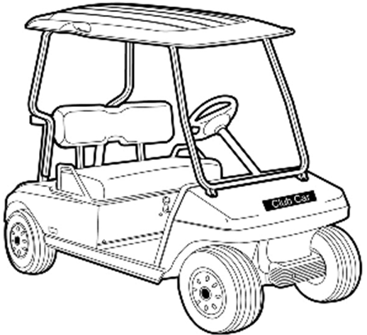
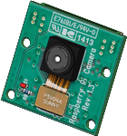
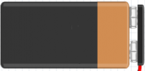
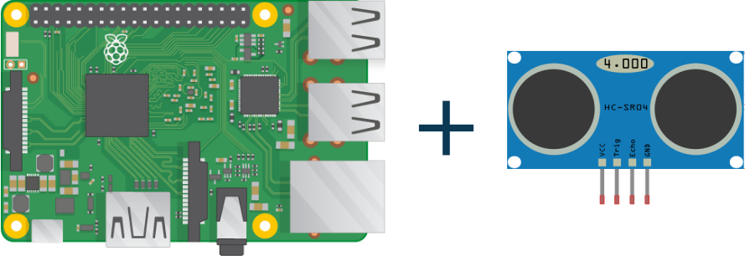
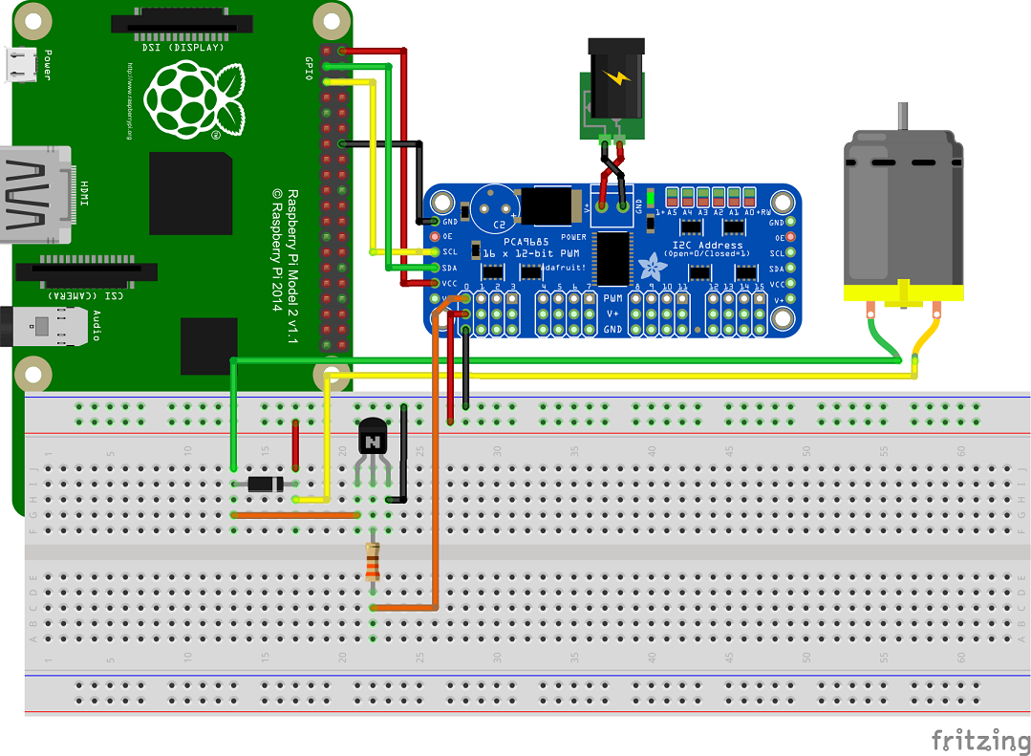
H/W Architecture and Communication
RasPi Cam
Power Supply
Ultrasonic sensor
DC motors

Slide 19
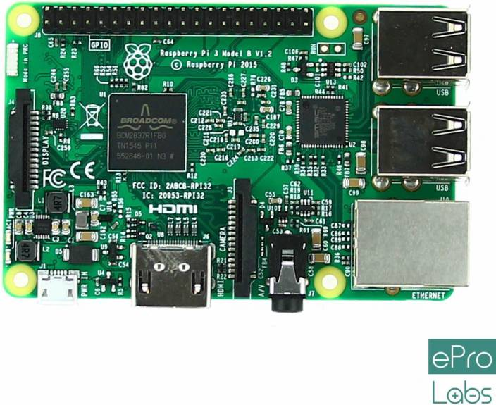
System Configuration

Slide 20
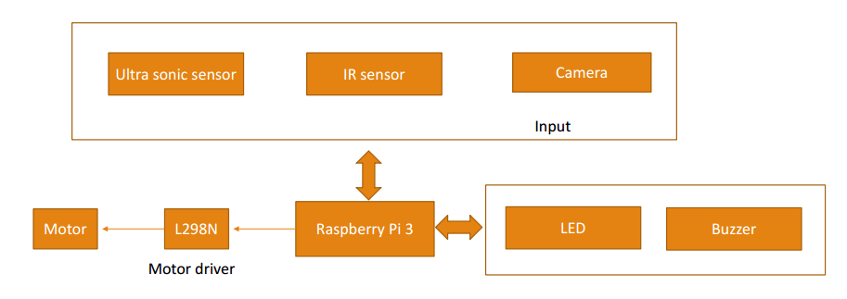
I/O devices

Slide 21
IV. Project Progress

Slide 22
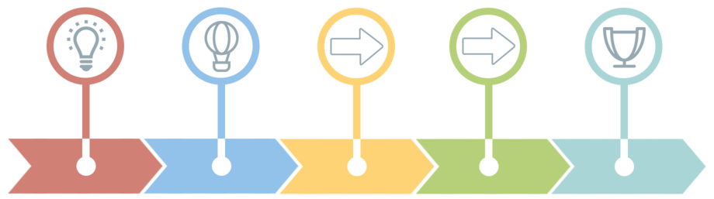
Timeline
BRAINSTORMING
Week 1
ASSEMBLING RC CAR
Week 2 - 3
IMPLEMENTING
Week 4 - 9
TESTING & CODE REVIEW
Week 10 - 15
FINAL PRESENTATION & RACE
Week 16

Slide 23
V. Discussion

Slide 24
Line Trace
<Problem>
• The smart car could not catch the signal on time due to the speed and other additional functions.
• When the black line is between two IRs, none of them does not detect it
• Two right wheels are rotating slower than two left ones.
• It goes a bit out of direction, when go forward command applied
<Solution>
• Decrease the speed of wheels
Notes:
Проблема: Камера определять две линии одновременно. Данные принимаются один за другим
Решение: Берем угол от полученной линии

Slide 25
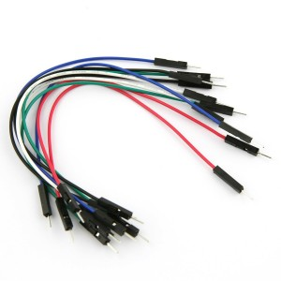
Wire Connection
<Problem>
• The power supply chain between sensors and DC motors started to work in inappropriate way.
• Power supply of the DC motors and the power supply of raspberry board, one of the supply turned off.
<Solution>
• Burned wire was found and changed to the new one.

Slide 26
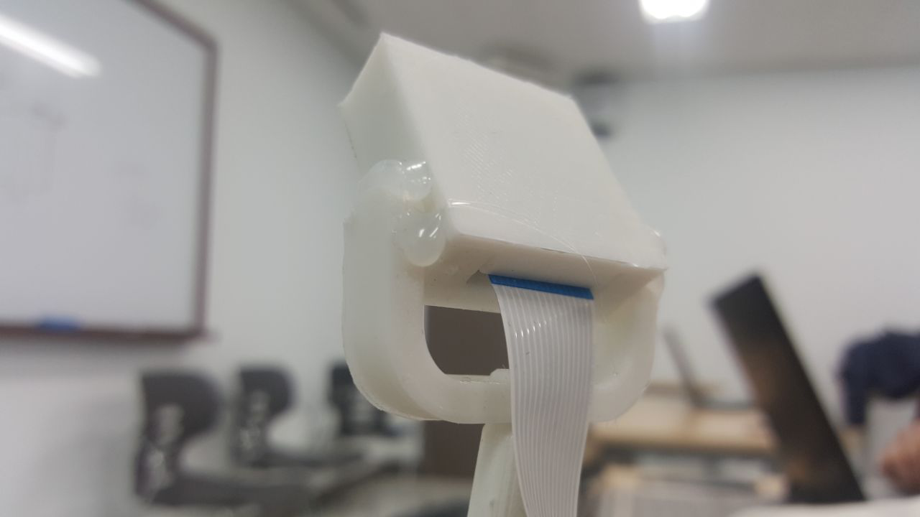
Camera Connection
<Problem>
• Opencv started to refuse connection, giving errors of execution.
<Solution>
• Modifying the design of the camera holder.

Slide 27
Lane Detection
<Problem>
• Camera cannot define the two lines simultaneously.
<Solution>
• Camera receives data sequentially and analyzes one-by-one(unsuccessful)
• Camera detect the lane according to the color.(Not the best solution)
• Camera detect the lane according to the detected line’s vector values according to HoughP (the most exact and best solution)
Power instability
The charge of the DC motor power supply is not stable, Setted Speed of the movement velocity is not constant. Main reason of the movement bugs.
Solution: change the max speed(not a perfect solution)

Slide 28
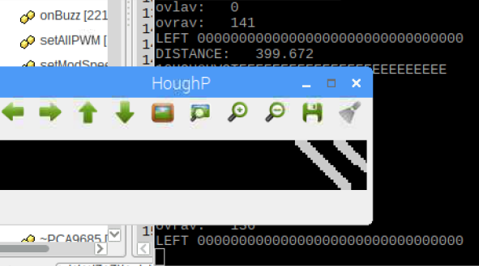
Camera detect the lane according to the detected line’s vector values according to HoughP (the most exact and best solution)
std::vector<Vec4i> li= ld.findLines(contours); //Vec4i gives 4 values (X1,Y1,X2,Y2) endpoints
cout<<"\nNumber of Lines: "<<li.size()<<"\n"<<endl; // li.size() returns the number of detected lines
for (int i = 0; i < li.size(); i++)
{
input = li[i][0];
if(input<160){ // calculates the number of end points on the left and right side of the display by dividing the display with pixels
totalLeft = totalLeft + input; //X1 left
CounterLeft++;
}
else{totalRight=totalRight + input; //X1 right
CounterRight++;
}
input2 = li[i][2];
if(input2<160){ // calculates the number of end points on the left and right side of the display by dividing the display with pixels
totalLeft2 = totalLeft2 + input2; //X2 left
CounterLeft2++;
}
else{totalRight2=totalRight2 + input2; //X2 right
CounterRight2++;
}
}

Slide 29
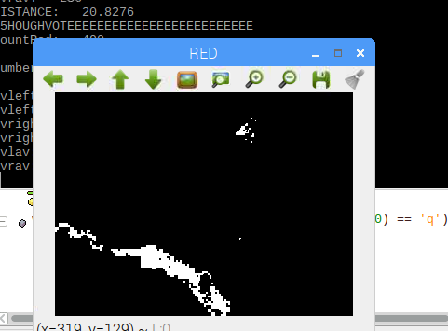
Color Detection
Mat3b hsv;
cvtColor(resized, hsv, COLOR_BGR2HSV);
Mat1b mask1;
inRange(hsv, Scalar(173, 70, 50), Scalar(210, 255, 255), mask1);
vector<vector<Point> > reddd;
vector<Vec4i> hierarchy;
findContours( mask1, reddd, hierarchy, CV_RETR_TREE, CV_CHAIN_APPROX_SIMPLE, Point(0,0));
int CountRed=0;
for(unsigned int i=0;i<reddd.size();i++){
for(unsigned int j=0;j<reddd[i].size();j++)
{
//cout<< "Point(x,y)="<< reddd[i][j] << endl;
CountRed++;
}
}
imshow("RED", mask1);
cout<<"CountRed: "<<CountRed<<endl;
Color detection first should be given range of color through inRange Function and in this given range of hsv color camera detects colored range of pixels with using point vector, after output the position and the value of the each colored point.

Slide 30
VI. Team Contribution

Slide 31
Team Participation
– Researcher, reporter, coder.
Construction of hardware part,
Adjustment of Ultrasonic and IR sensors.
Detecting and avoiding obstacles.
Color detection algorithm implementation.
Getting the capture of the image, getting frames.
Promotion and media staffs of the team.
DC motors Function and direction settings,
rotation and forward movements.
Sobirova Rano
Tsoy Natalya
Rakhmatullaev Davron
Madjidkhodjaev Saidakmal
Coder, analyst,tester
Establishment of wireless connection(using VNC server)
Creation and implementation of lane detection using HoughP, and tracking of smart car according to vector values.
Adjustment of movement strategies.
Taking and acting based on detected colors.
Image processing, setting the size and needed region of interest(ROI) of the frame.

Slide 32
VII. References

Slide 33
References
[1]. HyonChol Sin, Driverless Delivery Car, INHA University, 2014
[2]. https://docs.opencv.org/
[3]. https://stackoverflow.com/
[4]. https://kr.mathworks.com/help/matlab/
[5]. http://answers.opencv.org/
[6]. https://gist.github.com/
[7]. https://robotics.stackexchange.com/
[8]. https://opencv-srf.blogspot.kr/
[9]. http://opencvexamples.blogspot.com/

Slide 34
Thank You

