Slide 1
Smart Car using Raspberry Pi
Davron Rakhmatullaev 12174079
Saidakmal Madjidkhodjaev 12174121
Rano Sobirova 12174085
Natalya Tsoy 12174071
INHA University

Slide 2
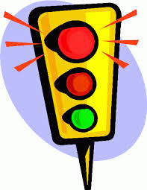
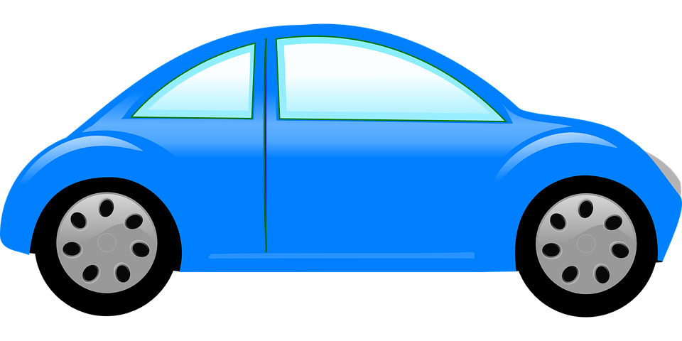
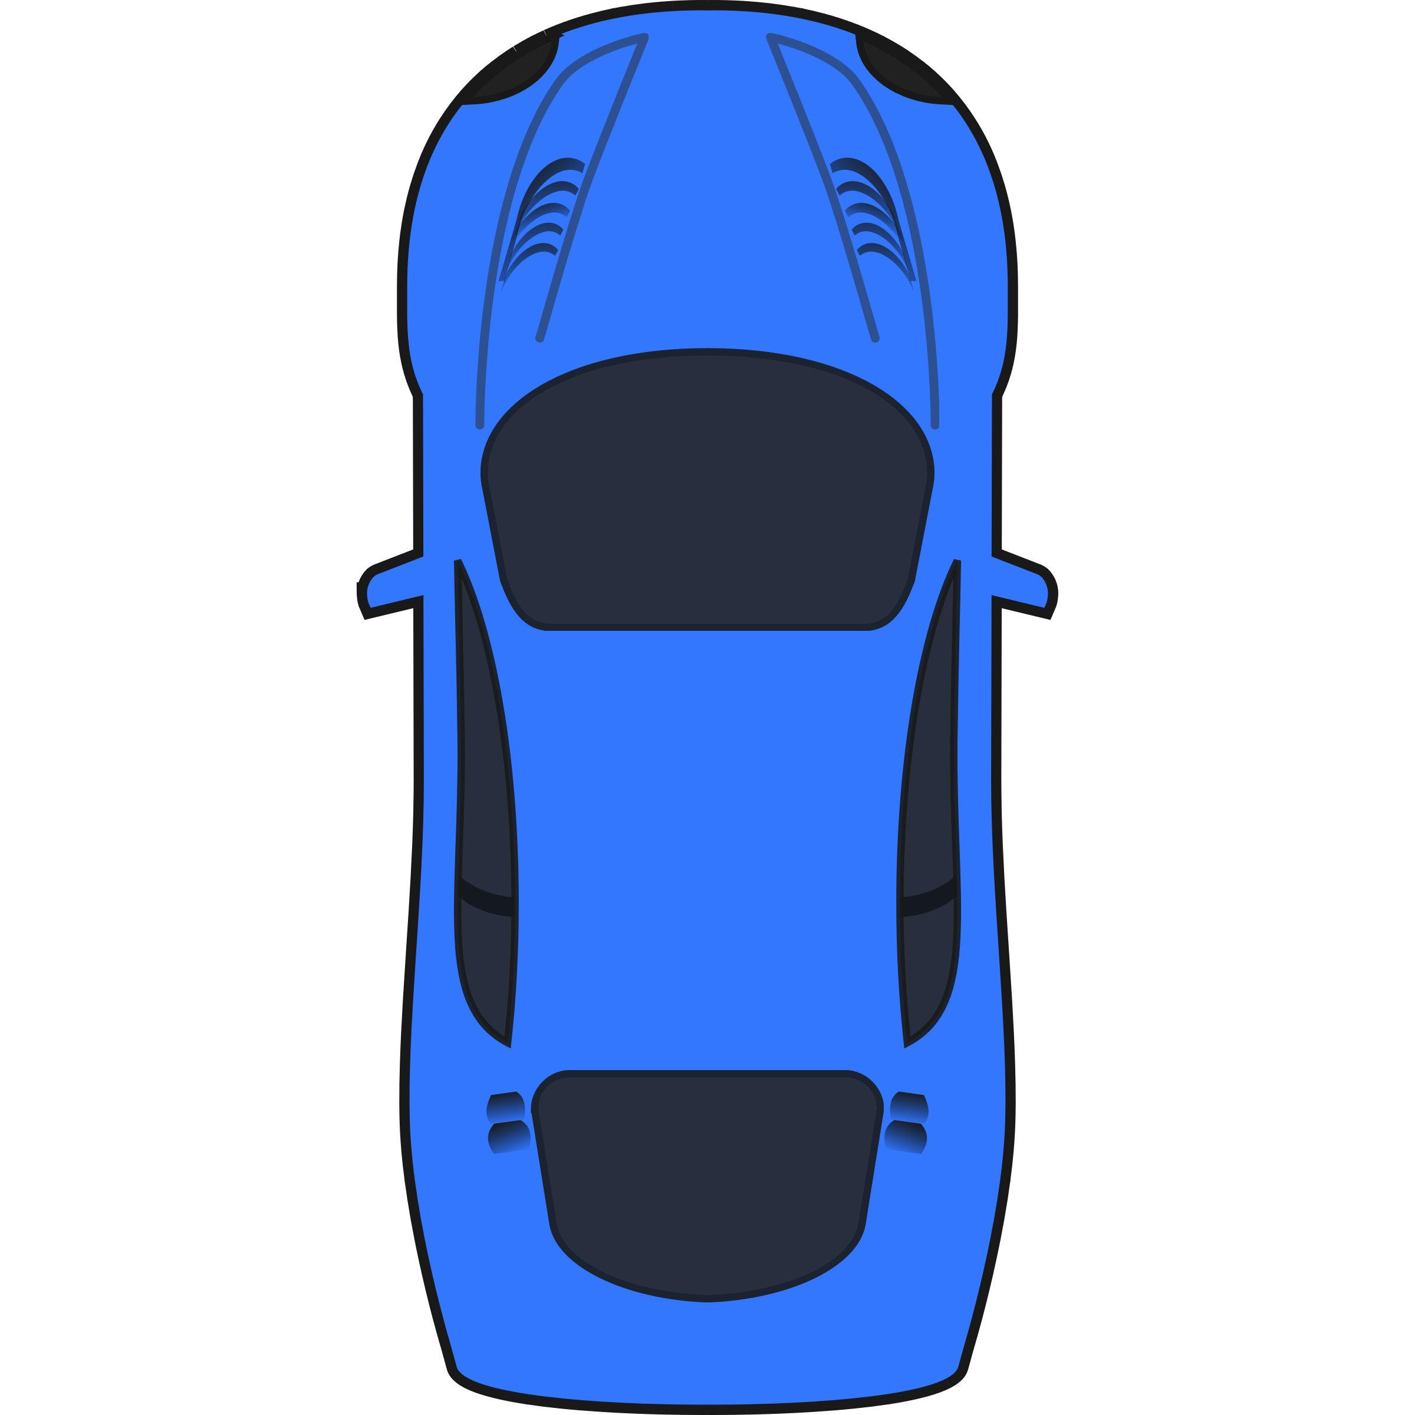

Objective
• To drive autonomously with lane detection
• To detect an obstacle and navigate without collision
• To recognize Traffic Light
• To recognize Traffic Sign
• Smart Parking
Notes:
parking

Slide 3
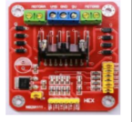
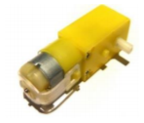
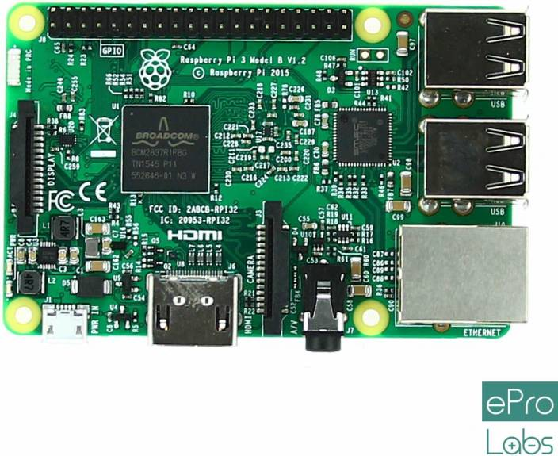
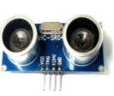
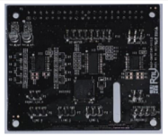
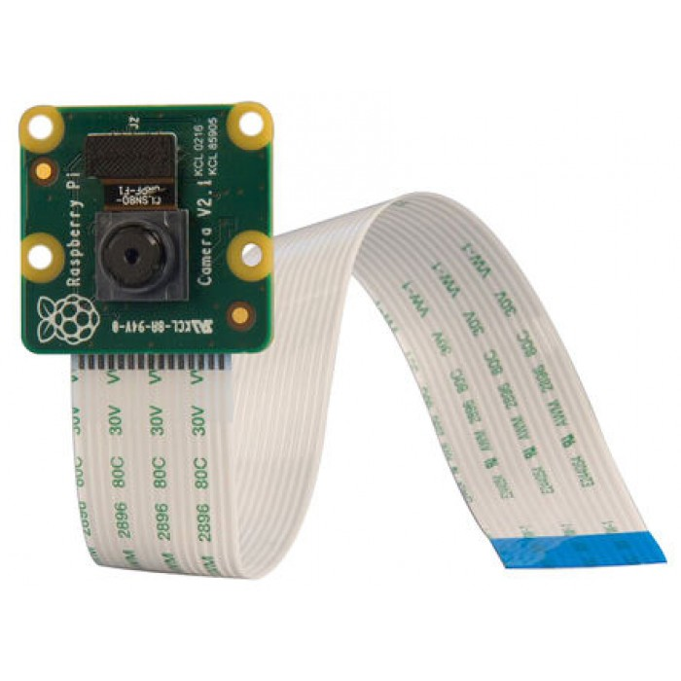
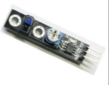
System Configuration

Slide 4
Algorithm Explanation
Camera
Ultrasonic
Traffic Light
Obstacle Detection
yes
Red
no
n=1
Obstacle
n=0
Stop
go Forward
Stop and wait until pedestrian cross the road
Obstacle avoidance by right
Lane Detection
Notes:
он считает линии и закидывает все данные в вектор. потом мы берем все линии с вектора и определяем координации x1,y1 , 2. frame разделяем на две части чтобы определить линии с двух сторон, если нету точек с правой стороны он идет вправо.
obstacle-> справа
скорость постоянная скорость при forward (90,70)
скорость при поворотах: меняется
парковка: - delay() заходит и поворачивает налево задом(левыми колесами) и дает назад

Slide 5
Problems
Line Trace
• The smart car could not catch the signal on time due to the speed and other additional functions.
• Two right wheels are rotating slower than two left ones.
<Solution>
• Decrease the speed of wheels
Power instability
The charge of the DC motor power supply is not stable, Setted Speed of the movement velocity is not constant. Main reason of the movement bugs.
Solution: change the max speed(not a perfect solution)
Notes:
Проблема: Камера определять две линии одновременно. Данные принимаются один за другим
Решение: Берем угол от полученной линии

Slide 6
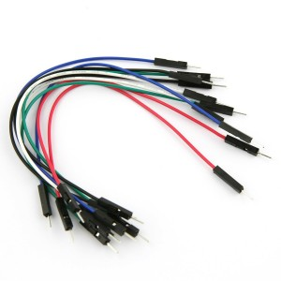
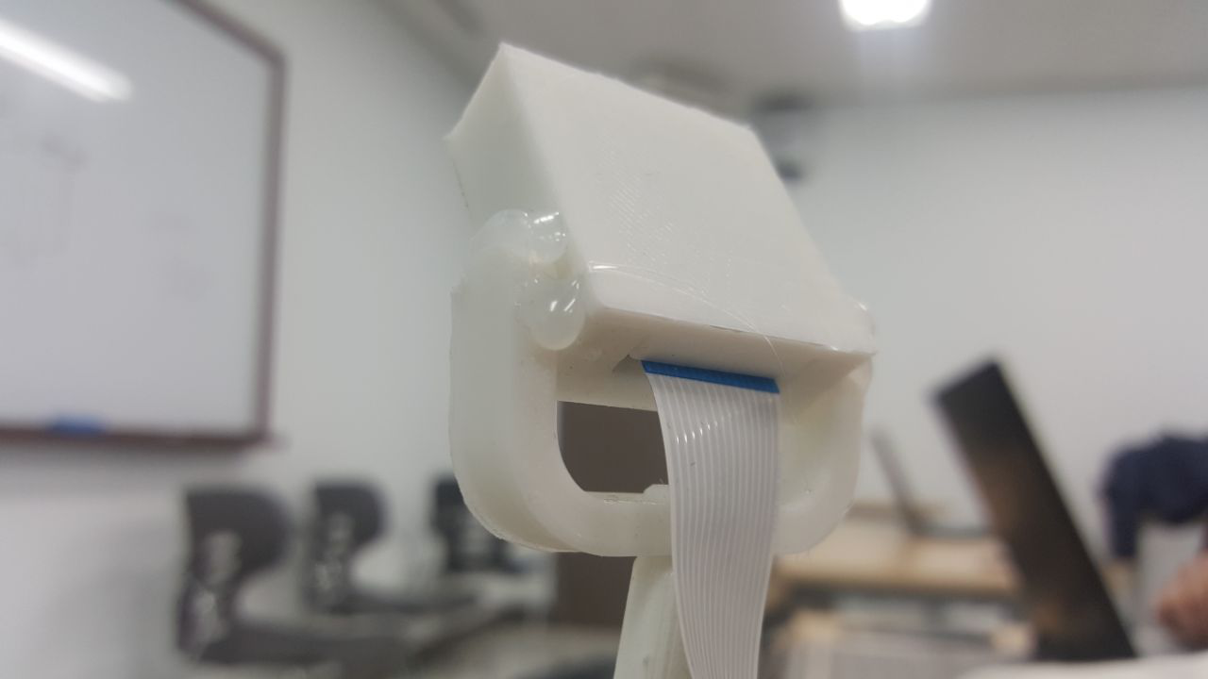
Problems
Wire Connection
• The power supply chain between sensors and DC motors started to work in inappropriate way.
<Solution>
• Burned wire was found and changed to the new one.
Camera Connection
• Opencv started to refuse connection, giving errors of execution.
<Solution>
• Modifying the design of the camera holder.

Slide 7
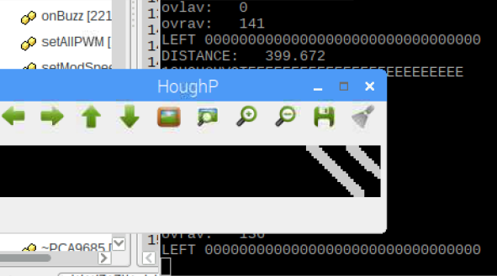
Problems
Lane Detection
• Camera cannot define the two lines simultaneously.
<Solution>
• Camera receives data sequentially and analyzes one-by-one(unsuccessful)
• Camera detect the lane according to the color.(Not the best solution)
• Camera detect the lane according to the detected line’s vector values according to HoughP .(the most exact and best solution)

Slide 8
Result & Evaluation
 |  | Experience (times) | Success (times) | Rate (%)
Rote Determination |  | ~100 | ~10 | 10
Obstacle Recognition | Static | 10 | 10 | 100
 | Dynamic | 10 | 10 | 100
Obstacle Avoidance | Static | 20 | 10 | 50
Light detection | Red | 50 | 40 | 80
 | Green | 25 | 20 | 80

Slide 9
Team Participation
– Researcher, reporter, coder.
Construction of hardware part,
Adjustment of Ultrasonic and IR sensors.
Detecting and avoiding obstacles.
Color detection algorithm implementation.
Getting the capture of the image, getting frames.
Promotion and media staffs of the team.
DC motors Function and direction settings,
rotation and forward movements.
Sobirova Rano
Tsoy Natalya
Rakhmatullaev Davron
Madjidkhodjaev Saidakmal
Coder, analyst,tester
Establishment of wireless connection(using VNC server)
Creation and implementation of lane detection using HoughP, and tracking of smart car according to vector values.
Adjustment of movement strategies.
Taking and acting based on detected colors.
Image processing, setting the size and needed region of interest(ROI) of the frame.

Slide 10
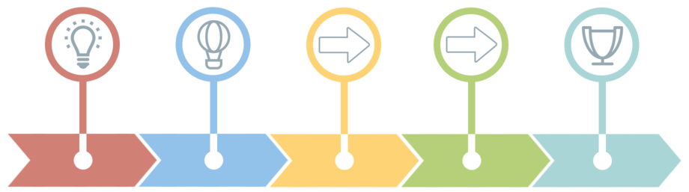
Timeline
BRAINSTORMING
Week 1
ASSEMBLING RC CAR
Week 2 - 3
IMPLEMENTING
Week 4 - 9
TESTING & CODE REVIEW
Week 10 - 15
FINAL PRESENTATION & RACE
Week 16

