Slide 1
Unit testing, mocking frameworks, continuous integration
Tapti Palit

Slide 2
Announcements
Class size expanded to 104
Office hours
M 1 – 3 PM, W 1 – 2 PM, ASB 2087
(TA) W 1:30 – 2:30 PM, Kemper 47

Slide 3
Announcements
Homework deadlines extended
3 homeworks (20 points each) + 1 extra credit homework (10 points)
HW 1 deadline extended to 1/31
Start early!

Slide 4
Announcements
HW1 grading
Will focus on the learning objectives
Will not focus on exact result of statistics
Grading script added to HW1 skeleton
https://github.com/davsec-teaching/ECS160-HW1-skeleton/blob/master/src/main/resources/grade.sh
Quiz next Friday
Will cover everything until today
5 True/False, MCQs – 10 minutes at the end of the class

Slide 5
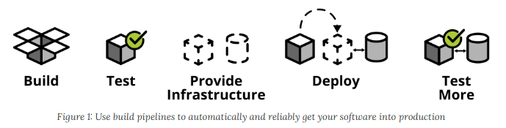
CI/CD and automated testing
Quicker software delivery timelines -> cannot rely on manual testing
Continuous integration, continuous deployment (CI/CD)
For large codebases, must automate testing
https://martinfowler.com/articles/practical-test-pyramid.html

Slide 6
What is unit testing?
Testing individual units of code (e.g., methods)
Ensures correctness and reliability
Executed during development for quick feedback
Catch regression bugs

Slide 7
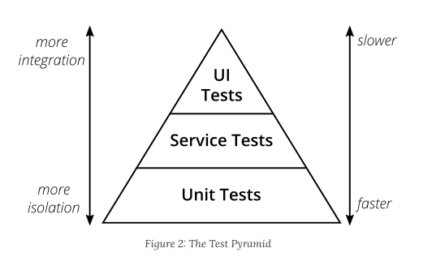
Test pyramid
Test pyramid shows how much testing on each layer
Unit tests fastest as they test single methods
UI tests slowest
1) Mike Crohn: Succeeding with Agile 2) https://martinfowler.com/articles/practical-test-pyramid.html

Slide 8
JUnit overview
Unit testing framework that simplifies testing
Without a framework how would you develop unit tests?
E.g. write unit tests for database functions (insert_sql_record(), delete_record())
Want to run your test on a clean test database
So, before running the unit test first, create a test database with the table
Then, invoke insert_sql_record() and perform any checks
Drop the table and the database after the test

Slide 9
Java annotations
Annotations are “metadata” added to Java code
They have no direct impact on code execution at runtime
Java provides some annotations, programmer can define more
Syntax: @Annotation_name
@Annotation1
public class Car {
@Annotation2
private int speed;
public Car(int speed) {
this.speed = speed;
}
@Annotation3
public void accelerate(int moreSpeed) {
this.speed += moreSpeed;
}
@Annotation3
public void decelerate(int lessSpeed) {
this.speed -= lessSpeed;
}
}

Slide 10
Java annotations
Some annotations are available only in the compiler
Java compiler checks
Some available at runtime
Widely used in popular frameworks
Framework can scan all classes with an annotation and create objects of that class at runtime
More when we study Annotations
@Annotation1
public class Car {
@Annotation2
private int speed;
public Car(int speed) {
this.speed = speed;
}
@Annotation3
public void accelerate(int moreSpeed) {
this.speed += moreSpeed;
}
@Annotation3
public void decelerate(int lessSpeed) {
this.speed -= lessSpeed;
}
}

Slide 11
Annotation targets
Annotations can be applied to
Classes
Fields
Methods
… many other program elements (Check https://docs.oracle.com/javase/tutorial/java/annotations/basics.html)

Slide 12
Key features of JUnit
Annotations simplify test creation
@Test, @BeforeEach, @AfterEach
Assertion methods validate expected outcomes
assertEquals(), assertNotEquals(), and so on…
Removes boilerplate code and simplifies test creation
Automatically generates a standardized report

Slide 13
@Test methods with JUnit
public class Car {
private String model;
private int speed;
public Car(String model, int speed) {
this.model = model;
this.speed = speed;
}
public int getSpeed() { return speed; }
public String getModel() { return model; }
... // setters
public void accelerate() {
this.speed += 10;
}
}
import org.junit.jupiter.api.Test;
import org.junit.jupiter.api.Assertions.assertEquals;
public class CarTest {
@Test
public void testAccelerate() {
Car car = new Car(“Toyota”, 50);
car.accelerate();
assertEquals(car.getSpeed(), 60);
}
}

Slide 14
Test lifecycle using JUnit
@BeforeEach, @AfterEach used to define methods that should be run before and after each test method
@BeforeClass, @AfterClass used to define methods that should be run before and after each test class
Useful for setup and cleanup operations
Create a test database, tables, and so on, before running the tests
Drop the test database, tables, and so on, after running the tests

Slide 15
Test lifecycle example
public class DbService {
public DB createDB(String db) { ... }
public Tbl createTable(Tbl tbl) { ... }
public void dropTable(String tbl) { ... }
public void insertRecord(Tbl t, ...) { ... }
public void deleteRecord(Tbl t, ...) { ... }
public void updateRecord(Tbl t, ...) { ... }
}
import org.junit.jupiter.api.Test;
import org.junit.jupiter.api.Assertions.assertEquals;
public class CarTest {
private Tbl tbl;
@BeforeClass public void setup() {
tbl = createTable(“testTbl”);
}
@Test public void testInsertRecord() {
insertRecord(tbl, <<record>>);
assertEquals(...);
}
@Test public void testDeleteRecord() { ...}
@AfterClass public void teardown() {
dropTable(tbl);
}
}

Slide 16
Continuous Integration

Slide 17


Continuous integration
Code changes are automatically built, tested, and integrated into a shared repository multiple times a day
Core process
Developer commits code
CI pipeline triggers
Build the project
Run automated tests
Integrated into GitHub and GitLab
Github Actions

Slide 18
Background: containerization
Github Actions are executed on Docker containers
Lightweight virtualization method that packages applications and their dependencies into isolated, portable containers
Containers share the host OS kernel but have their own filesystem, resources, and dependencies

Slide 19
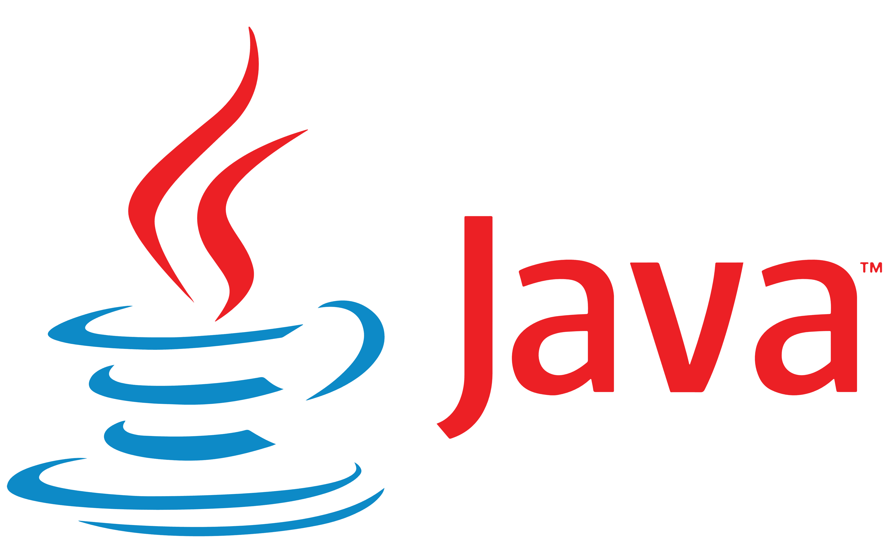

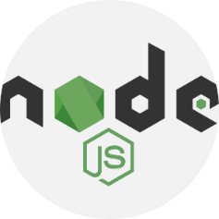




Containers
Ubuntu 22.04
Ubuntu 24.10
Fedora 24
Ubuntu 22.04
Linux kernel 5.4.1
Hardware
Will study how to create containers in Software Architecture module

Slide 20
What do containers provide?
Uniform build system for continuous integration
No weird issues with $PATH variables
No missing binaries
Automate deployment via continuous deployment
Containerize the application and deploy
… More later
Solves WOMM (Works On My Machine) issues

Slide 21
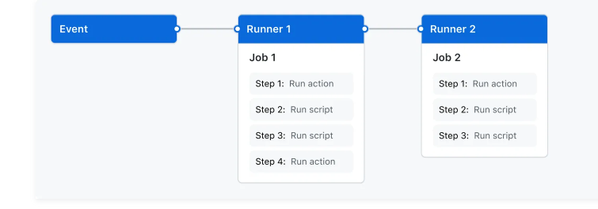
What is a Github Action?
A GitHub Actions workflow to be triggered when an event occurs
Push event, pull request opened
A workflow contains
One or more jobs
Each job has its own runner on which it is executed (typically a container)
Each job has one or more steps
Each step is either a script or command, or another Action

Slide 22
Sample scenarios
Continuous integration
Compile code and run all JUnit tests when someone pushes to main branch
Continuous deployment
Compile code, run all JUnit tests, package code, and deploy to remote server
When someone pushes to the prod (production) branch

Slide 23
Continuous deployment with Github Actions
Github Action specified in a YAML file
Configure a .github/workflows/[NAME].yml file
Define triggers (e.g., push, pull_request)
Specify jobs and steps (e.g., build, test)
name: Build and test pipeline
# Controls when the action will run. Workflow runs when manually triggered using the UI
# or API.
on: [push, pull_request]
# A workflow run is made up of one or more jobs that can run sequentially or in parallel
jobs:
build:
runs-on: ubuntu-22.04
steps:
- uses: actions/checkout@v3
- name: Set up JDK 21
uses: actions/setup-java@v3
with:
java-version: 21
distribution: 'temurin' # Use Temurin distribution (default)
- name: Verify Java version
run: java -version
- name: Build with Maven
run: mvn package
- name: Run JUnit tests
run: mvn test
Trigger
Runner
Job
Steps

Slide 24
Githubs CI/CD demo
In-class demo

Slide 25
Mocking overview
What is mocking?
Simulate the behavior of real objects in a controlled way
Why?
Isolate components for unit testing
External systems (APIs, Databases)
Complex or time-consuming operations
Example: unit test composeEmail
But don’t want to actually send an email to a client!!
public EmailService {
public boolean sendEmail(...) {
// send an email
}
}
public class EmailManager {
private EmailService emailService;
private void formatEmail(String email) { … }
private void displayError(boolean succ) { …}
public String composeEmail(...) {
String email = ...;
formatEmail(email);
boolean success = emailService.send(email);
displayError(success);
}
}

Slide 26


Mockito overview
Allows programmer to inject mock objects to stub functionality
EmailManager object
contains
EmailService object
inject
Mock EmailService object
Stubbed sendEmail() function that does nothing

Slide 27
Mock an ArrayList
Mockito’s mock() method injects a proxy
When
thenReturn
anyInt()
import java.util.List;
import static org.mockito.ArgumentMatchers.anyInt;
import static org.mockito.Mockito.mock;
import static org.mockito.Mockito.when;
public class MyApp {
public static void main(String[] args) {
List<Number> myList = mock();
when(myList.add(10)).thenReturn(true);
when(myList.add(anyInt())).thenReturn(false);
System.out.println(myList.add(30));
}
}

Slide 28
Writing a JUnit test with Mockito
public EmailService {
public boolean sendEmail(...) {
// send an email
}
}
public class EmailManager {
private EmailService emailService;
private void formatEmail(String email) { … }
private void displayError(boolean succ) { …}
public String composeEmail(...) {
String email = ...;
formatEmail(email);
boolean success = emailService.send(email);
displayError(success);
}
}
import ...;
public class EmailManagerTest {
@Mock
private EmailService emailService;
@InjectMocks
private EmailManager emailManager;
@BeforeEach
public void setUp() {
MockitoAnnotations.openMocks(this); // Initialize mocks
}
@Test
public void testComposeEmail() {
// Stub the sendEmail method to return true
when(emailService.sendEmail(anyString())).thenReturn(true);
// Call the method under test
String result = emailManager.composeEmail();
// Verify interactions with the mock
verify(emailService).sendEmail(anyString());
}
}

