Slide 1
Fuzz testing
Tapti Palit

Slide 2
What is unit testing?
Test individual functions
Add assertions to check if post-conditions hold
Test corner-cases
… is it possible to find all bugs using unit testing?

Slide 3
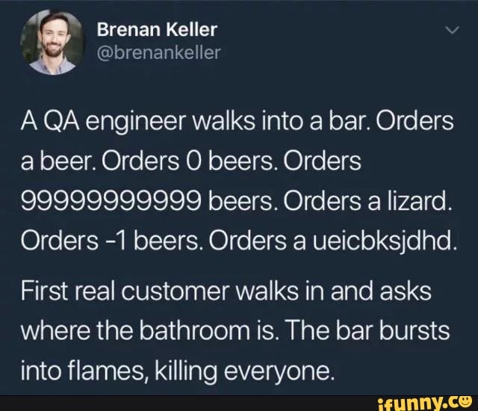
Limitations of testing

Slide 4
Fuzz testing
Goal: to find application inputs that reveal bugs
Test the entire application instead of individual functions
Generate inputs randomly until an error is uncovered

Slide 5

Fuzz testing
input
execute
/dev/random
application

Slide 6
Types of bugs
Causes: incorrect argument validation, incorrect type casting, executing untrusted code, etc.
Effects: buffer overflows, memory leak, div-by-zero, use-after-free, segmentation fault, and so on…
Impact: security, performance, reliability, correctness

Slide 7
Pros and cons
Pros: generating random inputs is simple
Cons: random inputs are not good inputs
E.g., fuzzing a SQL database software
Real inputs: CREATE TABLE mytable AS (id INTEGER, … );
Random inputs: aVkjW3txpLZ044zo5kLdUlsU2MtlLNkhwxI8Aew7c0KPfTS115i2rzfBlgod
The database will reject such statements as invalid SQL

Slide 8
Generate inputs via mutation
Start with some known valid inputs called “seeds”
Keep mutating them on the basis of some strategy
1
2
seeds
pick
mutate
execute
seeds
seeds
input’
seeds
input
application
CREATE TABLE mytable AS (id INTEGER, … );
CREATE TABLE mZtablI AS (id INTEGER, … );

Slide 9
How to mutate inputs?
Byte-level transformations
Shuffle bytes
Erase bytes
Insert byte
Change byte
Benefits:
Simple to implement
Good for binary inputs and streams
Disadvantages:
Generates many invalid inputs for applications that expect structured inputs

Slide 10
How to mutate inputs?
Dictionary-based approach
Programmer provides a dictionary of “keywords”
For SQL, could include CREATE, DELETE, INSERT, INTO, FROM, INTEGER, and so on…
For HTML, could include HTML tags <html>, <body>, <p>, and so on…
Mutate the input by replacing or adding a chosen keyword from this dictionary
Benefits:
Still simple to implement
Works reasonably well for structured inputs
Disadvantages
Still generates many invalid inputs for applications that expect structured inputs

Slide 11
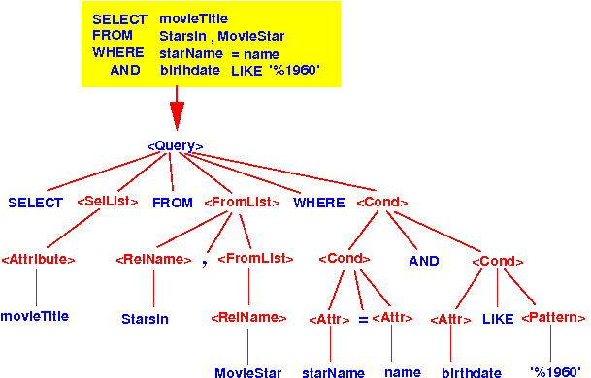
How to mutate inputs?
Grammar-aware mutation
The mutator is aware of SQL grammar
Parses a seed input into the SQL tree
Picks a node to mutate
(Almost) always generates valid inputs even when the application requires structured inputs
But mutator significantly more complex

Slide 12
Fuzzing pipeline
1
2
seeds
pick
mutate
execute
seeds
seeds
Input’
seeds
input
application
CREATE TABLE mytable AS (id INTEGER, … );
CREATE TABLE mZtablI AS (id INTEGER, … );

Slide 13
How to pick which seeds to mutate?
Goal: Should pick seeds that are “most promising” and likely to find bugs
What is “most promising”?

Slide 14
Coverage
Amount of code or execution paths explored during fuzz testing
Seeds that increase coverage are “more promising”
Explore new program behaviors
Ensures untested paths are tested
High coverage = high bug-finding potential

Slide 15
Instrumenting code to track coverage
Goal: monitor the execution paths and measure the extent of code coverage
Instruments the code to track this information
Modifies the program during compilation to insert tracking code
Adds markers to denote which program statements, branches, etc., were executed

Slide 16
Feedback loop for coverage-guided fuzzer
seeds
pick
mutate
execute
seeds
seeds
input’
seeds
input
application
CREATE TABLE mytable AS (id INTEGER, … );
CREATE TABLE mZtablI AS (id INTEGER, … );
Coverage detection
add input’ to seeds if new coverage observed

Slide 17
Recall: types of bugs
Causes: incorrect argument validation, incorrect type casting, executing untrusted code, etc.
Effects: buffer overflows, memory leak, div-by-zero, use-after-free, segmentation fault, and so on…
Impact: security, performance, reliability, correctness
Many of these bugs are silent
They do not crash the program

Slide 18
Sanitizers: oracles for bugs
Adds additional instrumentation to record object metadata
Popular sanitizers
Address sanitizer (ASAN) – can detect buffer overflow
Leak sanitizer (LSAN) – can detect memory leak
Thread sanitizer (TSAN) – can detect data races
Undefined-behavior Sanitizer (UBSAN) – can detect undefined behavior

Slide 19
American Fuzzy Loop (AFL)
Popular coverage-guided fuzzer
AFL Demo
https://github.com/davsec-teaching/AFL-demo

Slide 20
Conclusion
Fuzzing is an effective testing mechanism
Unlike other testing approaches it can find new inputs that cause program misbehavior
Mutation and coverage are important for generating effective fuzzers
Sanitizers provide additional information needed to find silent bugs

