Slide 1
Object-oriented programming using Java
Tapti Palit

Slide 2


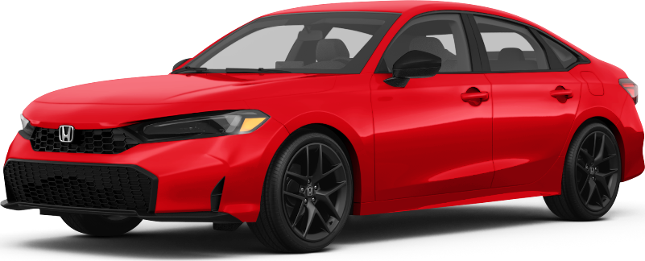

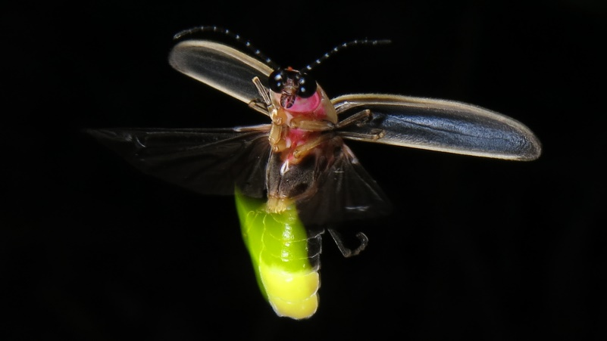

What is an object?
Objects have properties and functions
Notes:
- TODO: keep hammering that the important thing is abstraction

Slide 3
What is an object?
Objects have properties and functions
Properties
Model
Year
Mileage
Seats, and so on…
Functions
Start
Stop
Accelerate
Brake, and so on…

Slide 4
Java, an object-oriented language
Java is an object-oriented programming language
Everything is an object
A class is a blueprint for creating objects
Defines properties (fields) and behaviors (methods)
An object is an instance of a class
public class Car {
private String model;
private int year;
private int mileage;
public void start() { …}
public void stop() { … }
public void accelerate() { … }
public void brake() { … }
}
public class MyApplication {
public static void main(String[] args) {
Car car = new Car();
} }

Slide 5
Object references
References store the address of heap objects
Assigning one reference variable to another copies the reference, not the actual object
public class Car {
…
}
public class MyApplication {
public static void main(String[] args) {
Car car = new Car();
Car car2 = car;
car.setModel(“Tesla”);
System.out.println(car2.getModel());
// prints “Tesla”
} }

Slide 6
Encapsulation
Internal details of a class are hidden from outside world
Access is controlled using public, private, protected access modifiers
Direct access to private fields prevented
Needs getter and setter methods
public class Car {
private String model;
public String getModel() { return model;
}
public void setModel(String model) {
this.model = model;
} // … other fields and methods }
public class MyApplication { public static void main(String[] args) {
Car car = new Car();
car.model = “Toyota Hybrid”; // COMPILER ERROR
}
}

Slide 7
Should we ever intentionally break encapsulation?

Slide 8
Constructors
A constructor is a special method to create objects
Must have same name as the class
Must have no return type
Can have access modifiers
public class Car {
private String model;
private int year;
private int mileage; public Car(String model, int year, int mileage) {
this.model = model;
this.year = year;
this.mileage = mileage;
} }

Slide 9
Classes are often related
public class Car {
private String model;
private int year;
private int mileage;
public void start() { …}
public void stop() { … }
public void accelerate() { … }
public void brake() { … }
}
public class Bicycle {
private String model;
private int year; public void start() { …}
public void stop() { … }
public void accelerate() { … }
public void brake() { … }
public void ringBell() { … } }
Code duplication!
Notes:
- Lots of duplication

Slide 10


Inheritance
public class Vehicle { // shared properties
// and functions
private String model;
private int year;
public void start() { …}
public void stop() { … }
public void accelerate() { … }
public void brake() { … }
}
public class Car extends Vehicle {
private int mileage;
// getter and setter for mileage
}
public class Bicycle extends Vehicle {
public void ringBell() { … } }
public static void main(String[] args) {
Bicycle bicycle = new Bicycle();
bicycle.start();
bicycle.ringBell();
}
VEHICLE
extends
extends

Slide 11
Can extend only one class!
VEHICLE
MACHINE
extends
extends

Slide 12
Inheritance
public class Vehicle { // shared properties
// and functions
private String model;
private int year;
public void start() { …}
public void stop() { … }
public void accelerate() { … }
public void brake() { … }
}
public class Car extends Vehicle {
private int mileage;
// getter and setter for mileage
}
public class Bicycle extends Vehicle {
public void ringBell() { … } }
public static void main(String[] args) {
Vehicle vehicle = new Vehicle();
}
VEHICLE
What does it mean to create an object of type Vehicle?

Slide 13
Abstraction via abstract classes
An abstract class cannot be instantiated
Must be extended
Can have concrete methods
public abstract class Vehicle {
private String model;
private int year;
public void start() { …}
public void stop() { … }
public void accelerate() { … }
public void brake() { … }
}
public class Car extends Vehicle {
private int mileage;
// getter and setter for mileage
}
public class Bicycle extends Vehicle {
public void ringBell() { … } }
public static void main(String[] args) {
Vehicle vehicle = new Vehicle(); // Compiler error!!
}

Slide 14

Not all parent classes are abstract!!
public class Bicycle extends Vehicle {
public void ringBell() { … } }
public class ElectricBicycle extends Bicycle {
public void charge() { … }
}
public static void main(String[] args) {
Bicycle bike = new Bicycle();
ElectricBicycle eBike = new ElectricBicycle();
}

Slide 15
Abstraction via interfaces
Defines a contract for what a class must do but now how
Supports multiple inheritance
All methods in interface are abstract by default
Cannot instantiate interfaces
ILLUMINATABLE
implements
implements

Slide 16
Abstraction via interfaces
Defines a contract for what a class must do but now how
Supports multiple inheritance
All methods in interface are abstract by default
Cannot instantiate interfaces
public interface Illuminatable {
void emitLight();
}
public class Lamp implements Illuminatable {
public void emitLight() {
System.out.println(“Lamp emits light!”);
}
}
public class Firefly implements Illuminatable {
public void emitLight() {
System.out.println(“Firefly emits light”);
}
}

Slide 17
Compile-time polymorphism
Compile time polymorphism via method overloading
Methods having the same name but differing in
Number of parameters
Type of parameters
Order of parameters
The method to be invoked is determined at compile time
public class Calculator {
public int add (int a, int b) {
return a + b;
}
public float add (float a, float b) {
return a + b;
}
}
public static void main(String[] args) {
Calculator calculator = new Calculator();
S.o.p(calculator.add(10, 30));
S.o.p(calculator.add(10.0, 30.0));
}

Slide 18
Runtime polymorphism
A subclass provides a specific implementation of a method that is already defined in the parent class
The method to be invoked is determined at runtime, depending on the type of object
public class Bicycle {
public void accelerate() {
System.out.println(“Bike accelerating.”);
}
}
public class ElectricBicycle {
public void accelerate() {
System.out.println(“E-bike accelerating.”);
}
}
public static void main(String[] args) {
Bicycle b = new Bicycle();
b.accelerate(); // prints “Bike accelerating”
b = new ElectricBike();
b.accelerate(); // prints “E-bike accelerating”
}

Slide 19
Generics
Generics allows the programmer to define a “placeholder” for a type.
The placeholder gets replaced by the real type when the class is instantiated
Facilitates reusability
Wildcard “?”
Used to represent an unknown type
List<?> used to represent a list of any type
public class Container<T> {
private T item;
// Setter
public void setItem(T item) {
this.item = item;
}
// Getter
public T getItem() {
return item;
}
}
public class MyApplication(String[] args) {
Container<String> c1 = new Container<String>();
c1.setItem(new String(“hello”));
Container<Bicycle> c2 = new Container<Bicycle>();
c2.setItem(new Bike());
}

Slide 20
Bounded polymorphism
Allows the programmer to restrict the types that can be used in a generic class or method using “bounds”
Enforce constraints while maintaining flexibility
Upper Bound: T extends ClassName
Lower Bound: ? super ClassName
public <T extends Number> T sum (T a, T b) {
return a + b;
}
// Usage
sum(5, 6); // Works
sum(5.5, 6.6); // Works
sum(“5”, “7”); // COMPILER ERROR

Slide 21
Bounded polymorphism
Allows the programmer to restrict the types that can be used in a generic class or method using “bounds”
Enforce constraints while maintaining flexibility
Upper Bound: T extends ClassName
Lower Bound: ? super ClassName
void printNumbers(List<? super Number> list) {
for (Object obj: list) {
System.out.println(obj);
}
}
// Usage
List<Number> numbers = new ArrayList<>();
numbers.push(100);
...
printNumbers(numbers); // Works!
List<String> names = new ArrayList<>();
names.push(“ecs160”);
...
printNumbers(names); // Compiler error!

Slide 22
Exceptions
An Exception is an event that disrupts the normal flow of a program during runtime
Examples: Division by zero, file not found, invalid input, and so on…
What to do when an exception occurs?

Slide 23
Try-catch block
Try-catch block used to catch exceptions
Finally used to perform any clean up operations
try {
// Code that might cause exception } catch (ExceptionType e) {
// handle exception
} finally {
// Clean up
}

