Slide 1
Unit testing, mocking frameworks, continuous integration
Tapti Palit

Slide 2
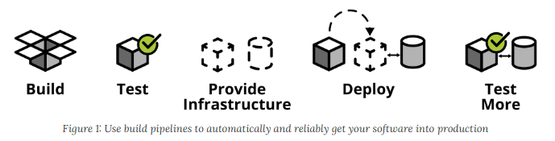
CI/CD and automated testing
Quicker software delivery timelines -> cannot rely on manual testing
Continuous integration, continuous deployment (CI/CD)
For large codebases, must automate testing
https://martinfowler.com/articles/practical-test-pyramid.html

Slide 3
What is unit testing?
Testing individual units of code (e.g., methods)
Ensures correctness and reliability
Executed during development for quick feedback
Catch regression bugs

Slide 4
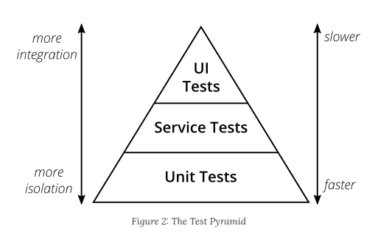
Test pyramid
Test pyramid shows how much testing on each layer
Unit tests fastest as they test single methods
UI tests slowest
1) Mike Crohn: Succeeding with Agile 2) https://martinfowler.com/articles/practical-test-pyramid.html

Slide 5
JUnit overview
Unit testing framework that simplifies testing
Without a framework how would you develop unit tests?
E.g. write unit tests for database functions (insert_sql_record(), delete_record())
Want to run your test on a clean test database
So, before running the unit test first, create a test database with the table
Then, invoke insert_sql_record() and perform any checks
Drop the table and the database after the test

Slide 6
Key features of JUnit
Annotations simplify test creation
Annotations have the syntax @AnnotationName
Used to add meta-data to classes, methods, and so on
Do not directly affect the functionality
Will be covered in detail next lecture
@Test, @BeforeEach, @AfterEach
Assertion methods validate expected outcomes
assertEquals(), assertNotEquals(), and so on…

Slide 7
@Test methods with JUnit
public class Car {
private String model;
private int speed;
public Car(String model, int speed) {
this.model = model;
this.speed = speed;
}
public int getSpeed() { return speed; }
public String getModel() { return model; }
... // setters
public void accelerate() {
this.speed += 10;
}
}
import org.junit.jupiter.api.Test;
import org.junit.jupiter.api.Assertions.assertEquals;
public class CarTest {
@Test
public void testAccelerate() {
Car car = new Car(“Toyota”, 50);
car.accelerate();
assertEquals(car.getSpeed(), 60);
}
}

Slide 8
Test lifecycle using JUnit
@BeforeEach, @AfterEach used to define methods that should be run before and after each test method
@BeforeClass, @AfterClass used to define methods that should be run before and after each test class
Useful for setup and cleanup operations
Create a test database, tables, and so on, before running the tests
Drop the test database, tables, and so on, after running the tests

Slide 9
Test lifecycle example
public class DbService {
public DB createDB(String db) { ... }
public Tbl createTable(Tbl tbl) { ... }
public void dropTable(String tbl) { ... }
public void insertRecord(Tbl t, ...) { ... }
public void deleteRecord(Tbl t, ...) { ... }
public void updateRecord(Tbl t, ...) { ... }
}
import org.junit.jupiter.api.Test;
import org.junit.jupiter.api.Assertions.assertEquals;
public class CarTest {
private Tbl tbl;
@BeforeClass public void setup() {
tbl = createTable(“testTbl”);
}
@Test public void testInsertRecord() {
insertRecord(tbl, <<record>>);
assertEquals(...);
}
@Test public void testDeleteRecord() { ...}
@AfterClass public void teardown() {
dropTable(tbl);
}
}

Slide 10
Mocking overview
What is mocking?
Simulate the behavior of real objects in a controlled way
Why?
Isolate components for unit testing
External systems (APIs, Databases)
Complex or time-consuming operations
Example: unit test composeEmail
But don’t want to actually send an email to a client!!
public EmailService {
public boolean sendEmail(...) {
// send an email
}
}
public class EmailManager {
private EmailService emailService;
private void formatEmail(String email) { … }
private void displayError(boolean succ) { …}
public String composeEmail(...) {
String email = ...;
formatEmail(email);
boolean success = emailService.send(email);
displayError(success);
}
}

Slide 11


Mockito overview
Allows programmer to inject mock objects to stub functionality
EmailManager object
contains
EmailService object
inject
Mock EmailService object
Stubbed sendEmail() function that does nothing

Slide 12
Writing a JUnit test with Mockito
public EmailService {
public boolean sendEmail(...) {
// send an email
}
}
public class EmailManager {
private EmailService emailService;
private void formatEmail(String email) { … }
private void displayError(boolean succ) { …}
public String composeEmail(...) {
String email = ...;
formatEmail(email);
boolean success = emailService.send(email);
displayError(success);
}
}
import ...;
public class EmailManagerTest {
@Mock
private EmailService emailService;
@InjectMocks
private EmailManager emailManager;
@BeforeEach
public void setUp() {
MockitoAnnotations.openMocks(this); // Initialize mocks
}
@Test
public void testComposeEmail() {
// Stub the sendEmail method to return true
when(emailService.sendEmail(anyString())).thenReturn(true);
// Call the method under test
String result = emailManager.composeEmail();
// Verify interactions with the mock
verify(emailService).sendEmail(anyString());
}
}

Slide 13


Continuous integration
Code changes are automatically built, tested, and integrated into a shared repository multiple times a day
Core process
Developer commits code
CI pipeline triggers
Build the project
Run automated tests
Provide feedback
Integrated into GitHub and GitLab

Slide 14
Continuous deployment with Github Actions
Github Actions automates workflows directly into your repository
How it works
Configure a .github/workflows file
Define triggers (e.g., push, pull_request)
Specify jobs and steps (e.g., build, test)
name: CI Pipeline
on: [push, pull_request]
jobs:
build:
runs-on: ubuntu-latest
steps:
- uses: actions/checkout@v3
- name: Build with Maven
run: mvn –B package --file pom.xml
- name: Run tests with Maven
run: mvn test

Slide 15
Githubs CI/CD demo
In-class demo

