Slide 1
Software architecture
Tapti Palit

Slide 2
What is software architecture?
Standard definitions
Fundamental organization of a software system
Design decisions that are critical for a software project
Can there be an objective definition of fundamental and critical?
Alternate definition: Shared understanding that expert developers have of the system design*
* https://martinfowler.com/architecture/

Slide 3
Why is it important?
Makes software easy to understand
Makes software easy to modify
Easier to add new features
Makes software easier to deploy

Slide 4
Software architecture concerns
Encapsulation, modularity, and reusability
Resilience
Performance
Scalability
Ease of deployability
Complexity and ease of debugging

Slide 5
Encapsulation/modularity, reusability, and resilience
Encapsulation and reusability
Can a component be easily reused by another component?
Does the user of a component need to know internal implementation details of the component or are they well-encapsulated?
Resilience
Is the system resilient to failures?
If a single component fails, does the entire system fail or is the system tolerant to partial failures?

Slide 6
Performance and scalability
Performance
Does the architecture itself cause any performance bottlenecks?
Modularity reduces performance
For example, extracting common code into its own function increases latency
Solution: compiler inlines the function so that it’s logically modular, but has no performance penalty
Observed in software architecture styles too
Scalability is the ability to dynamically adapt to load
Can individual components scale independently?
If one component requires more resources, can only that component be allocated more resources?

Slide 7
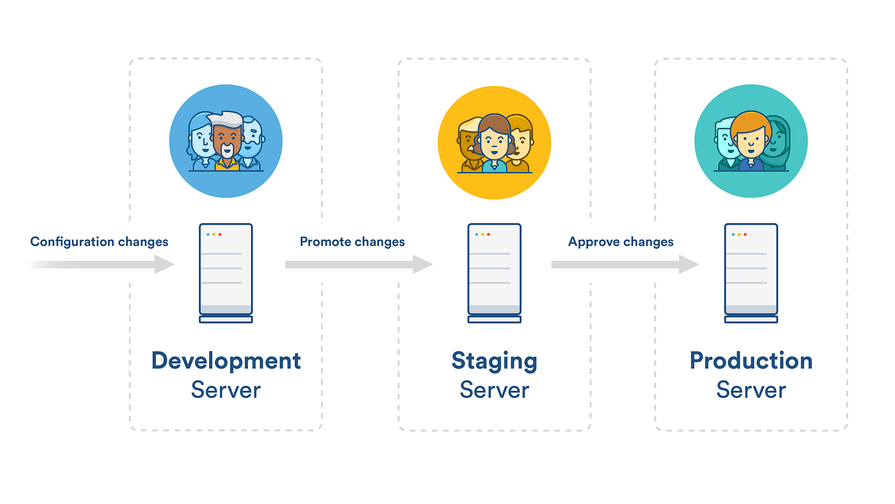
Ease of deployability
Can individual components be individually deployed?
Can deployment steps be automated?

Slide 8
Complexity and ease of debugging
Complexities increase with code size, increasing dependencies
Harder to debug software systems that are distributed over many machines (distributed systems)

Slide 9
Common software architecture styles
Client-server
Multi-tier/Layered(MVC)
Pipeline
Microservices
Message Queue
Pub-sub
RPC
Containerized architecture
How software code is organized
How different components
communicate
How software code is deployed

Slide 10
Client server architecture
A distributed computing model where the client and server interact to fulfill requests
The client initiates requests, and the server processes them and sends back responses
Key features
Two-Tier Structure: Divided into clients (frontend) and servers (backend)
Centralized Control: Servers manage data and business logic centrally
Interactivity: Clients provide user interfaces, interacting with the server over a network

Slide 11
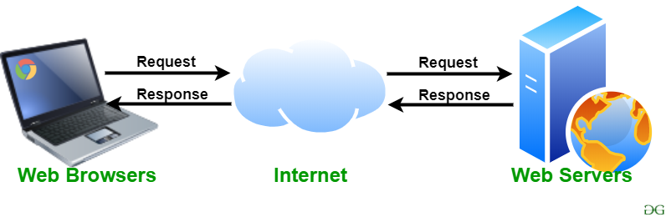
Client-server architecture examples
Web browser and web server
In reality: Rarely only two-tier these days

Slide 12
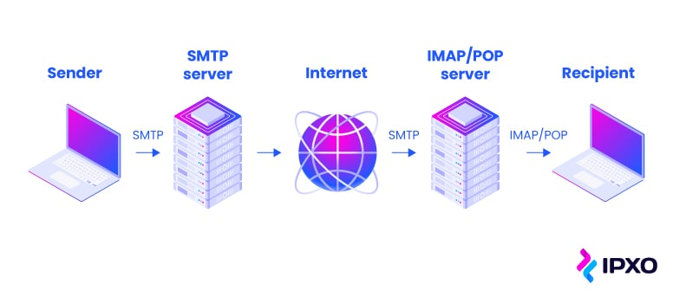
Client-server architecture examples
Email client and email server

Slide 13
Pros and cons
Benefits
Centralized management of data: all data is on the server and can be easily secured
No complex data flows
Separation between client and server business logic
Disadvantages
Single point of failure

Slide 14
Multi-tier or layered architecture
Divides the application into multiple logical layers or “tiers”
Benefits
Stronger encapsulation
Clear division of responsibilities
Easier to maintain and test
Stronger reusability
Logic in one layer can be reused across different applications
Disadvantages
Possible increase in latency

Slide 15
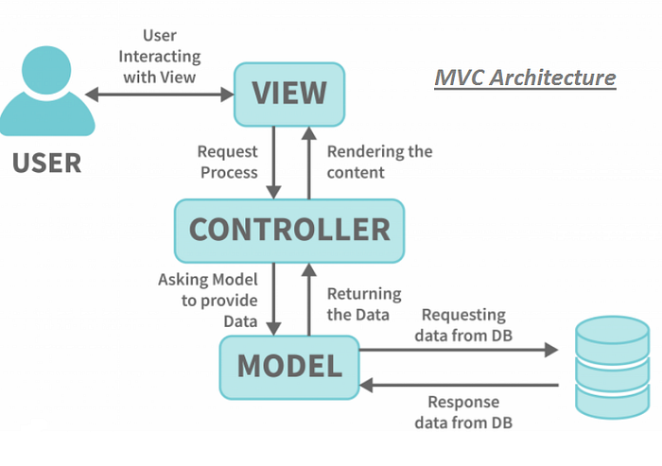
Model-view-controller (MVC) architecture
Three layers
Model: Manages data and business logic
View: Handles the presentation layer (user interface)
Controller: Acts as an intermediary, processing user input and coordinating between Model and View
https://medium.com/@cyberblogger007/mvc-architecture-with-jsp-example-5c53d1994157

Slide 16




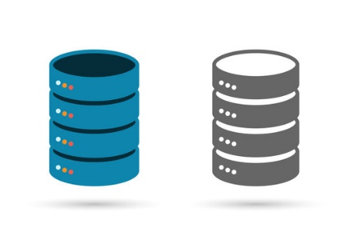


MVC frameworks
View
Controller
Model

Slide 17
Pipeline architecture
A software design pattern where data flows through a series of processing stages, or "filters," connected by channels
Each stage transforms the input data and passes the result to the next stage
Key characteristics
Modularity: Each stage performs a specific task independently
Sequential processing: Data flows linearly from one stage to another
Reusability: Each pipeline stage can be reused in other applications
Input → [Stage 1] → [Stage 2] → [Stage 3] → Output

Slide 18
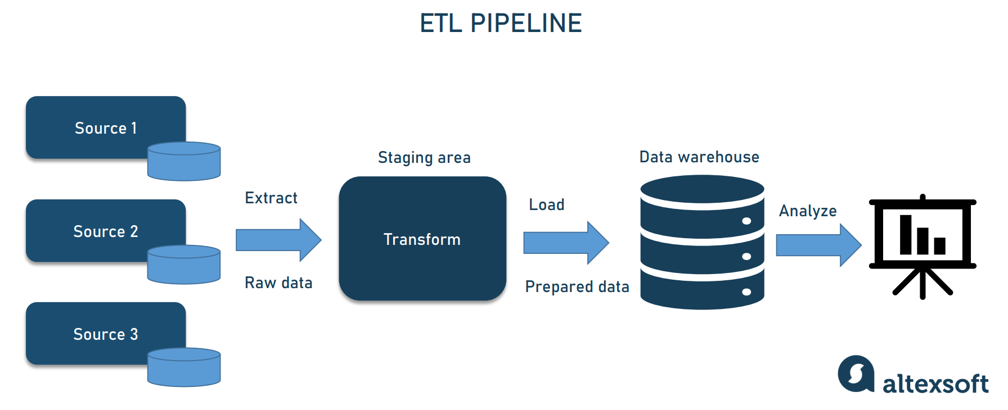
Data processing pipeline
Extract-transform-load (ETL) pipeline
https://www.altexsoft.com/blog/data-pipeline-components-and-types/

Slide 19
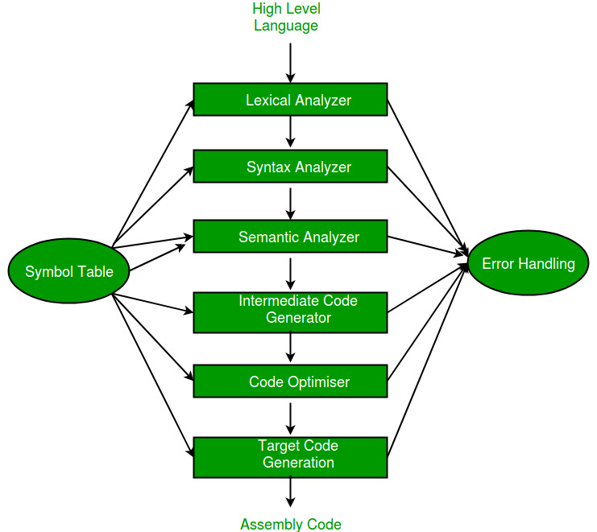
Compiler pipeline

Slide 20
Pros and cons
Benefits
Encapsulation and modularity: easy to replace individual pipeline stage
Scalability: individual stage can be scaled independently
East of testing: each stage can be tested independently
Disadvantages
Debugging: debugging complex flows through multiple stages is hard
Hard to track data flow → can cause security issues
Team A develops Microservice A, Team B develops Microservice B
Multiple pipeline stages can contribute to latency

Slide 21
Microservices
An approach to developing a single application as a suite of small services, each running in its own process and communicating with lightweight mechanisms, often an HTTP resource API
Independently deployable by automated processes
Bare minimum centralized management
Smart endpoints connected by “dumb” pipes
https://martinfowler.com/articles/microservices.html

Slide 22
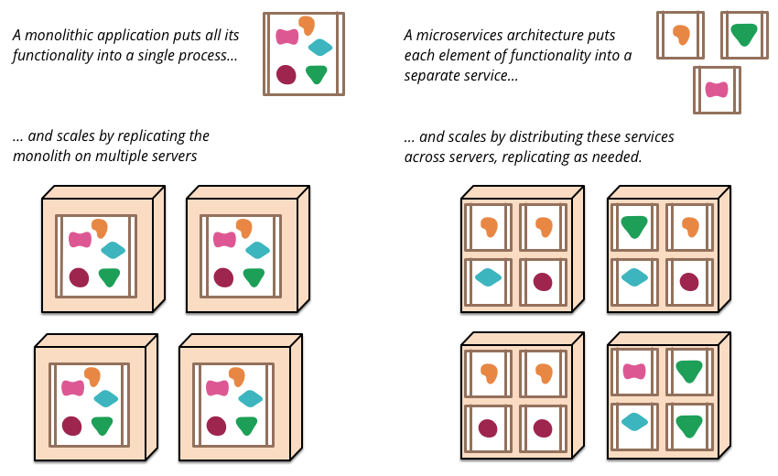
Microservices overview
https://martinfowler.com/articles/microservices.html

Slide 23
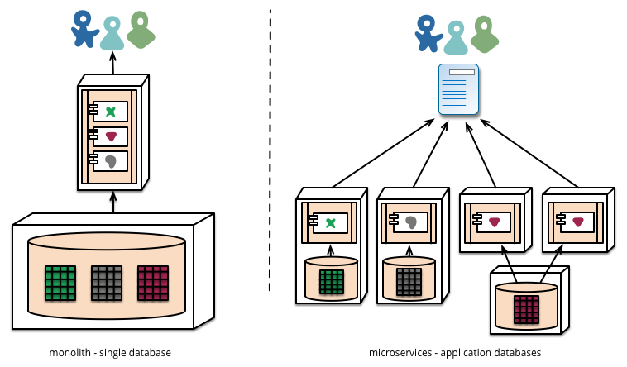
Monolithic to microservices
Each microservice can have its own database
https://martinfowler.com/articles/microservices.html

Slide 24
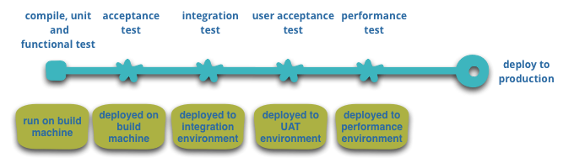
Continuous deployment using microservices
Automated deployment
E.g., pushing to the main branch in GitHub triggers GitHub Actions that
Automatically builds
Execute unit-tests
Automatically deploy to integration environment (and then production environment)
Later: microservice demo using Spring Boot

Slide 25
Pros and cons
Pros
Strong encapsulation and modularity
Better reusability
Each microservice can be scaled independently (More on this later)
Each microservice can be written in its own programming language
Fault isolation
Supports CI/CD (easier to deploy microservices than monolithic services)
Cons
Higher complexity
Debugging complex interactions is harder
Network overhead

Slide 26
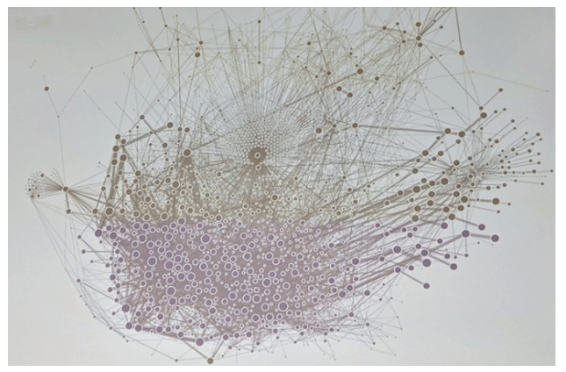
Microservices at Uber (2019)
https://x.com/msuriar/status/1110244877424578560

Slide 27
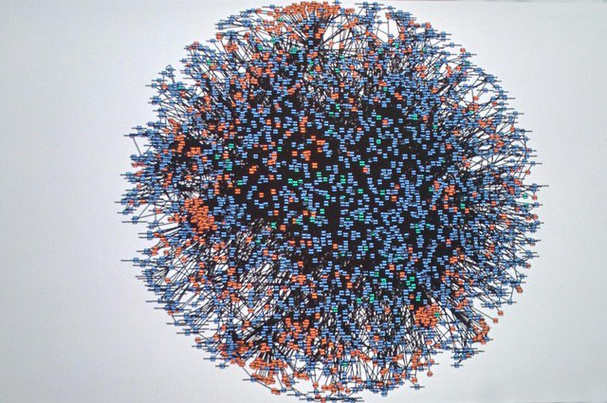
Microservices at Amazon (2008)
Code-named “Deathstar”
https://x.com/Werner/status/741673514567143424

Slide 28


Remote procedure call (RPC)
Protocol that allows a program to execute a procedure on a remote server as if it were local
Used in microservices architecture for inter-service communication
Synchronous communication
Request
Response
Microservice A
Microservice B

Slide 29
Remote procedure call (RPC)
Key features
Language agnostic: the RPC itself does not depend on the service language
Abstracts network details
Typically, over HTTP
JSON-RPC4J (https://github.com/briandilley/jsonrpc4j)
JsonRpcHttpClient client = new JsonRpcHttpClient(
new URL("http://example.com/UserService.json"));
User user = client.invoke("createUser", new Object[] { "bob", "the builder" },
User.class);

Slide 30
RPC formats
Text-based (e.g. REST APIs)
Uses Json or XML for data exchange
Human-readable, but larger payloads
Binary formats (e.g. gRPC)
Uses binary standards (such as protobuf) for serialization
Compact but faster, but less human-readable

Slide 31
Json and REST APIs
Representational State Transfer (REST) is an architectural style for web services
Uses HTTP methods (GET, POST, PUT, DELETE) to perform operations on resources
Commonly paired with JSON for data exchange
> telnet api.example.com 80
// GET Request to Fetch a User denoted by ID > GET /users/123 // Response
{
"id": 123,
"name": "John Doe",
"email": john.doe@example.com
}

Slide 32



Message queuing (MQ)
Asynchronous communication model
Messages sent to a queue and processed by consumers independently of the producer
Stronger decoupling
Message
Message
Message
Message
Microservice A
Microservice B

Slide 33




Open source and paid message queuing services

Slide 34
Pub-sub architecture
Asynchronous messaging pattern where publishers send messages to a central message broker or topic, and subscribers receive messages based on their subscriptions
Broadcasting: messages can be sent to multiple subscribers
Typically, messages are persistent at the broker and must be explicitly deleted

Slide 35


Pub-sub architecture
Message
Subscriber Microservice A
Message
Message
Subscriber Microservice B
Publisher
Microservice
Broker
Message
Subscriber Microservice C

Slide 36

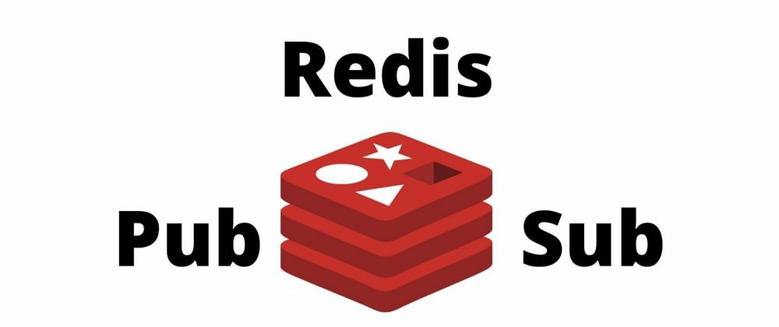
Pub-sub frameworks

Slide 37
Containerization
Lightweight virtualization method that packages applications and their dependencies into isolated, portable containers
Containers share the host OS kernel but have their own filesystem, resources, and dependencies

Slide 38

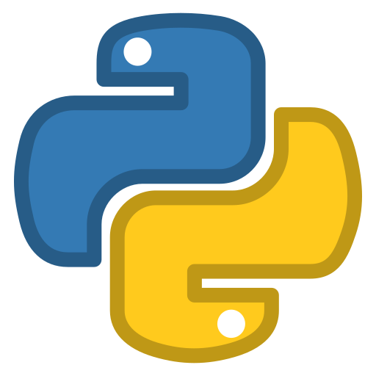





Example containerized deployment
Ubuntu 22.04
Ubuntu 24.10
Fedora 24
Linux kernel 5.4.1
Hardware

Slide 39
Sample Dockerfile
# Use the Ubuntu base image
FROM ubuntu:20.04
# Set the working directory
WORKDIR /app
# Install required dependencies: OpenJDK, Maven, Git
RUN apt-get update && apt-get install -y \
openjdk-11-jdk \
maven \
git \
&& apt-get clean \
&& rm -rf /var/lib/apt/lists/*
# Set JAVA_HOME environment variable
ENV JAVA_HOME=/usr/lib/jvm/java-11-openjdk-amd64
ENV PATH="$JAVA_HOME/bin:$PATH"
# Clone the Java application repository
RUN git clone https://github.com/example-user/java-app.git .
# Build the application using Maven
RUN mvn clean package
# Define the command to run the application
CMD ["java", "-jar", "target/java-app.jar"]
# To build the docker container
docker build -t java-app .
# To run the docker container
> docker run -p 8080:8080 java-app

Slide 40
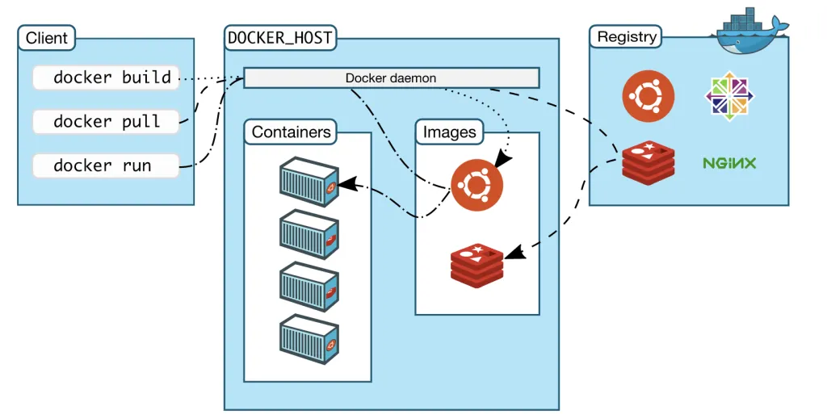
Docker architecture
Remote docker registry
Dockerhub contains docker images
Docker host
Machine running docker daemon
Stores docker images locally
Spawns containers
Docker client commands
docker pull: pulls image from registry
docker build: builds a docker image from a Dockerfile
docker run: spawns a container

Slide 41
Pros and cons
Benefits
Ease of deployability because all dependencies packaged together
Amenable to continuous deployment setup
Disadvantages
Potential resource wastage
Increased latency
Communication across containers slower than inter-process communication

Slide 42
Docker demo
Create docker container from Dockerfile

Slide 43
Can mix and match!!
Pipeline architecture using microservices with message queues deployed on a serverless architecture
Pub-sub architecture with microservices using containerizations
Pipeline architecture in one part of the system, with a pub-sub in another
… and so on
Pick what is right for your software system

