Slide 1
Software security
Tapti Palit

Slide 2








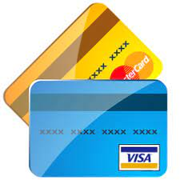

Sensitive user data

Slide 3
Software security principles
Confidentiality: information is only accessible to those authorized to it
Integrity: information is modified only by those authorized to do so
Availability: information is available to authorized users when needed

Slide 4
What is software security?
Informally, the software should perform only the programmer-intended operation
Surprisingly hard to ensure
Bugs are software flaws or defects that causes the program to behave unexpectedly
Some bugs lead to software vulnerabilities
Software vulnerabilities are software flaws that attackers can exploit to compromise the system

Slide 5
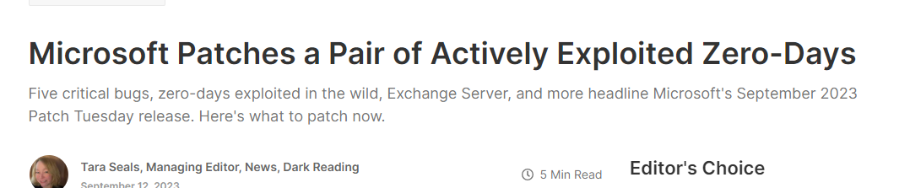

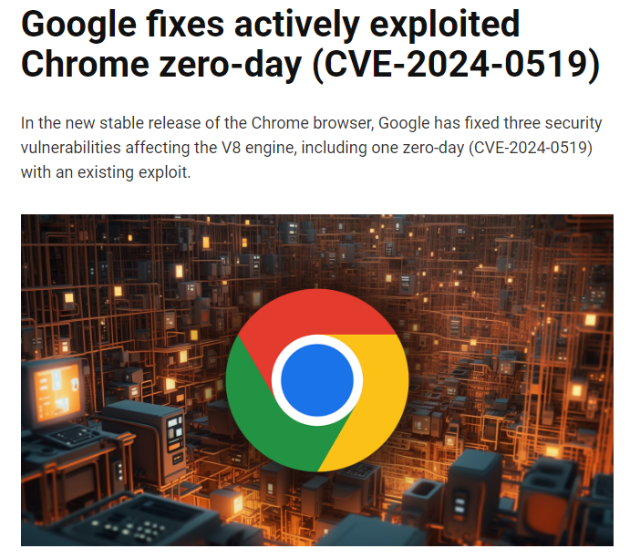
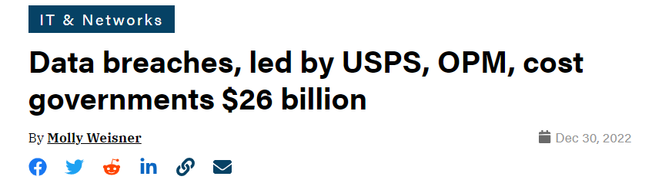
Security attacks
Notes:
- Multiple vulnerabilities
- vulnerability in the vmware cloud platform, actively exploited by attackers to compromise
- attackers exploited Microsoft Exchange disclose encryption secrets
- On the client end, bugs in the chrome browser allowed… leak sensitive user information
- Cost of these breaches is significant
- In 2022, data breaches cost the US government 26 billion dollars

Slide 6





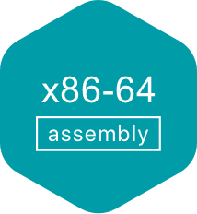
Programming languages and memory safety
Memory safety is a property of a programming language that ensures all memory accesses are
Well-defined
Adhere to object boundaries
Adhere to types of allocated objects
Some programming languages have memory safety and some do not
Memory safe
Memory unsafe

Slide 7
Memory safety and performance
Typically, ensuring memory safety requires additional runtime checks
For example, the Java compiler inserts bounds checks for array accesses that are inserted at runtime
Additional runtime checks reduces performance
Pseudo-code after Java compiler
inserts checks
Original Java code
int [] numbers = [10, 20, 30];
int index = 30;
System.out.println(numbers[index]);
int [] numbers = [10, 20, 30];
int index = 30;
if (index < numbers.length) {
System.out.println(numbers[index]);
} else {
throw new ArrayIndexOutOfBoundsException();
}

Slide 8
C vs. Java performance
https://programming-language-benchmarks.vercel.app/c-vs-java

Slide 9






Performance critical software in C/C++
Web servers
Nginx, Apache Httpd
Key-value stores
Redis, Memcached
Database servers
MySQL
Postgresql
SQLLite

Slide 10
Agenda
Types of memory safety
Vulnerabilities resulting from lack of memory safety
Buffer overflow
Use-after-free
Control flow hijack attacks
Memory safety approaches
Fuzzing for detecting memory safety bugs in C
Out of scope: techniques for defending against memory safety bugs in C

Slide 11
Types of memory safety
Memory safety
Spatial safety
Temporal safety

Slide 12
Spatial memory safety
Ensures that memory accesses are confined to the boundaries of the allocated memory block
E.g, when using a pointer to access an array, the pointer should point to memory within the array bounds
Out-of-bounds accesses are prevented
int array[4] = {10, 20, 30, 40};
10
20
30
40
‘A’
int* ptr = array; ptr++;

Slide 13
Lack of spatial memory safety
C/C++ allows out of bounds access
Out of bound access does not crash like in Java and other memory safe languages
Accesses whatever was in the adjacent memory location

Slide 14
Types of memory
Two types of memory
Stack ← will focus more on stack memory
Heap ← similar issues happen with heap memory too
Heap allocations
Car car = new Car(); // Java
int* my_array = malloc(10*sizeof(int)); // C
Stack allocations
int num; // C or Java

Slide 15
Stack layout
Stack grows downward
0x1000
Top of the stack
0xFFF
0xFFE
0xFFD
0xFFC
0xFFB

Slide 16
Buffer overflow
#include <stdlib.h>
#include <stdio.h>
int main(void) { uint8_t authenticated = 0;
uint8_t array[4];
uint8_t * p = array;
uint8_t num;
for (int i = 0; i <= 4; i++) {
printf(“Enter a number:”);
scanf(“%d”, &num);
}
return 0;
}
Stack grows downward
authenticated
0x1000
Top of the stack
array[3]
0xFFF
Grows
downward
array[2]
0xFFE
array[1]
0xFFD
array[0]
0xFFC
0xFFB

Slide 17
Buffer overflow
#include <stdlib.h>
#include <stdio.h>
int main(void) { uint8_t authenticated = 0;
uint8_t array[4];
uint8_t * p = array;
uint8_t num;
for (int i = 0; i <= 4; i++) {
printf(“Enter a number:”);
scanf(“%d”, &num);
}
return 0;
}
Stack grows downward
authenticated
0x1000
Top of the stack
array[3]
0xFFF
array[2]
0xFFE
array[1]
0xFFD
array[0]
0xFFC
0xFFB

Slide 18
Buffer overflow
#include <stdlib.h>
#include <stdio.h>
int main(void) { uint8_t authenticated = 0;
uint8_t array[4];
uint8_t * p = array;
uint8_t num;
for (int i = 0; i <= 4; i++) {
printf(“Enter a number:”);
scanf(“%d”, &num);
}
return 0;
} > Enter a number:
1 # 5 times
Stack grows downward
1
authenticated
0x1000
Top of the stack
1
array[3]
0xFFF
1
array[2]
0xFFE
array[1]
0xFFD
1
array[0]
0xFFC
1
0xFFB

Slide 19
Vulnerable string-related libc functions
scanf (with the %s modifier) , strcpy, printf (with %n modifier)
String stored can be larger than the variable size
Will overwrite the contents of the adjacent memory
char* password = malloc(5); scanf(“%s”, password); // will overflow if user enters “AAAAAAAA”
Solution: use size-limited functions such as snprintf, scanf(“%5s”, password), strncpy, and so on

Slide 20
Buffer overflow demo
https://github.com/davsec-teaching/buffer-overflow-demo

Slide 21
Function calls on X86 architectures
Push return address on stack
Allocate stack variables
0x1000
Top of the stack
0xFFF
0xFFE
0xFFD
0xFFC
0xFFB

Slide 22
Function calls on X86 architectures
#include <stdlib.h>
#include <stdio.h>
int main(void) {
authenticate();
}
void authenticate(void) { uint8_t authenticated = 0;
uint8_t password[4];
scanf(“%s”, password);
return 0;
}
void allow_access(void) {
}
Stack grows downward
return_addr
0x1000
Top of the stack
authenticated
0xFFF
password[3]
0xFFE
password[2]
0xFFD
password[1]
0xFFC
password[0]
0xFFB

Slide 23
Control flow hijack
#include <stdlib.h>
#include <stdio.h>
int main(void) {
authenticate();
}
void authenticate(void) { uint8_t authenticated = 0;
uint8_t password[4];
scanf(“%s”, password);
return 0;
}
void allow_access(void) {
}
Stack grows downward
return_addr
0x1000
Top of the stack
authenticated
0xFFF
password[3]
0xFFE
Overflow can overwrite the return_addr on the stack. Jump to attack selected address on return!!!
password[2]
0xFFD
password[1]
0xFFC
password[0]
0xFFB

Slide 24
Temporal memory safety
Ensures that memory is only accessed while it is valid
E.g., a pointer can not point to an object that is freed
No “dangling pointers”
int main(void) {
char* mystring = malloc(1024);
// some stuff
free(mystring);
// mystring not zeroed
*mystring = ‘a’; // write to a dangling pointer
return 0;
}

Slide 25
Memory leak
Occurs when the pointer or reference goes out of scope, but the memory it was pointing to is not freed
Flip-side of dangling pointer
Not generally a security issue directly
Can result in denial-of-service errors

Slide 26
Java and memory safety
Spatial memory safety
All objects have bounds associated with them
All memory accesses are bounds-checked
Temporal memory safety
Automatic memory management
Heap objects created using new
E.g. Car c = new Car();
Heap objects are automatically freed when no valid reference remain to them
“Garbage collection”

Slide 27
Garbage collection
A process of automatic memory management for dynamically allocated memory
Garbage: Objects no longer reachable or usable by the program
Once an object is classified as “garbage” it is automatically reclaimed by a garbage collector thread
Prevents both dangling pointers and memory leaks
public static void main(String[] args) {
func();
}
public void func() {
Car c = new Car();
c.setSpeed(100); // c goes out of scope here
// since no other reference points to it
// the Car object will now be freed the
// next time the garbage collector thread
// runs
}

Slide 28
Garbage collection algorithms
Mark-and-sweep
Marking phase: mark reachable objects
Sweeping phase: sweep and free unreachable objects
Reference counting
Every heap object has a reference counter associated with them
Increment when a new reference points to the object
Decrement when a reference goes out of scope
Free the object when no new references to it
Garbage collection is expensive
Some languages such as Rust aim to eliminate garbage collection and still provide temporal memory safety

Slide 29
Summary
Memory safety determines the safety of the programming language
Memory safety is expensive
Additional bounds checks
Garbage collection
Security and performance trade-off

