Slide 1
Software architecture
Tapti Palit

Slide 2
Announcements
Quiz on Friday
10 minutes
Will cover reflective programming
Reflection, annotations, and proxies
Will have MCQs and short answers

Slide 3
Agenda
Software architecture overview
Necessary background
HW2 discussion
HW1 feedback

Slide 4
What is software architecture?
Standard definitions
Fundamental organization of a software system
Design decisions that are critical for a software project
Can there be an objective definition of fundamental and critical?
Alternate definition: Shared understanding that expert developers have of the system design*
* https://martinfowler.com/architecture/

Slide 5

What is software architecture?
Standard definitions
Fundamental organization of a software system
Design decisions that are critical for a software project
Can there be an objective definition of fundamental and critical?
Alternate definition: Shared understanding that expert developers have of the system design*
MessageQueue
Microservice
Pub-sub
* https://martinfowler.com/architecture/
Notes:
Unlike previous lectures
When we say Interfaces, Abstract classes, Runtime polymorphism we mean one and only one thing
Terms we will be using will be a little fuzzy
Sometimes we will talk about the same framework providing support for more than one software architecture

Slide 6
Social media platform
User DB MySQL cluster
Redis cluster
User Onboarding Login flow
User Service
Trends
Redis cluster
User following flow
Graph Service
Apache Spark streaming cluster
User Graph MySQL cluster
K
A
F
K
A
Hadoop cluster
Adding Post UI
Tweet Injection Service
Weekly cron jobs
Cassandra Cluster
Search Kafka consumer
Notification service
Short URL Service
Tweet Service
Tweet Processor
Elastic search cluster
Live User Websockets (notifications)
User Self Profile Service
Timeline Service
Analytics
Search service
Assert Service
Redis cluster
Home Screen
CDN
Users app / browsers
Search screen

Slide 7
Till now – single component focus
OO class design
Frameworks
Reflection
Annotations
Proxies
Testing
JUnit tests
Mock testing
Tweet Processor

Slide 8
Software architecture
User DB MySQL cluster
Redis cluster
User Onboarding Login flow
User Service
System as a whole
Trends
Redis cluster
User following flow
Graph Service
Apache Spark streaming cluster
User Graph MySQL cluster
K
A
F
K
A
Hadoop cluster
Adding Post UI
Tweet Injection Service
Weekly cron jobs
Cassandra Cluster
Search Kafka consumer
Notification service
Short URL Service
Tweet Service
Tweet Processor
Elastic search cluster
Live User Websockets (notifications)
User Self Profile Service
Timeline Service
Analytics
Search service
Assert Service
Redis cluster
Home Screen
CDN
Users app / browsers
Search screen
Notes:
In this module, we will pop out a bit
Look at entire system
Design these complex systems

Slide 9
Software architecture importance
Software architecture decisions have more impact than component design
Easy to refactor a class
Affects a few team members
Harder to change the architecture of a software system
Affects the entire team and beyond…
Important to get it right the first time
Notes:
Like reflective programming, not used on a day-to-day basis
From the perspective of the software company

Slide 10
Some software architecture concerns
Encapsulation
Scalability
Resilience
Performance
Ease of deployability
Security (later module)
Module goal – learn solutions for some of these concerns
Notes:
Cares about the following things
Not comprehensive
Goal [click]

Slide 11
Encapsulation
At the component level
Does TweetInjectionService need to know anything about the internals of ShortURLService?
Adding Post UI
Tweet Injection Service
Short URL Service

Slide 12
Encapsulation
What interface does ShortURLService provide to TweetInjectionService?
Adding Post UI
Tweet Injection Service
https://twitter.com/v1/tweet/id=?
Short URL Service
Notes:
Provides an URL (called endpoint)

Slide 13

Encapsulation
Typically run on different machines
How do they communicate?
Directly call each other or is there a mediator?
Different tradeoffs
Adding Post UI
Tweet Injection Service
Short URL Service
Notes:
Different tradeoffs for each approach
We will explore these tradeoffs

Slide 14
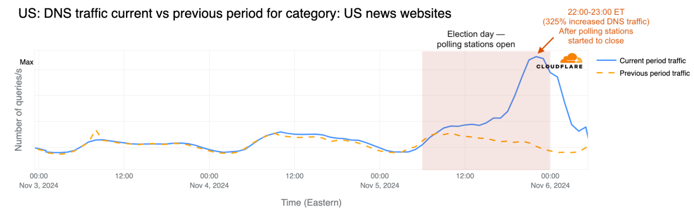
Scalability
Website traffic is not constant
Can spike due to planned events
Product launch
US elections
https://blog.cloudflare.com/exploring-internet-traffic-shifts-and-cyber-attacks-during-the-2024-us-election/

Slide 15
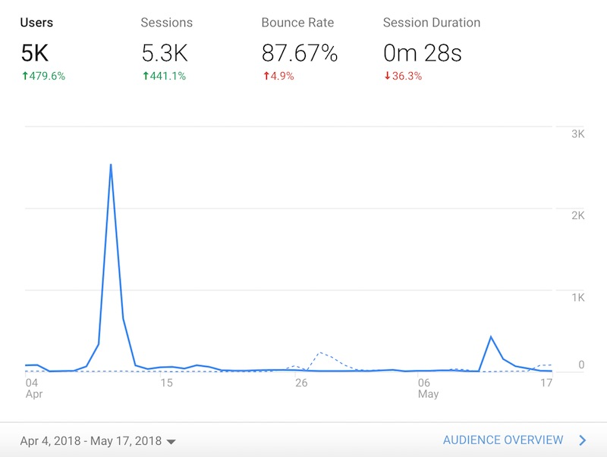
Scalability
Unplanned events
Post goes viral
Architecture should scale to handle such events
https://www.residualthoughts.com/2018/05/20/traffic-data-from-a-viral-post/
Notes:
- Taylor swift post goes viral

Slide 16
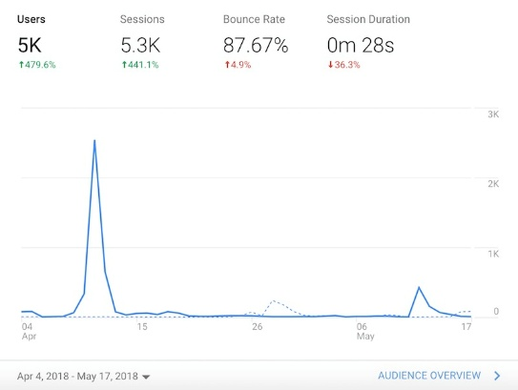
Scalability
Services run on more than one machine
Autoscaling for when traffic reaches threshold
System automatically brings up new “machines”
Available in popular cloud deployments
Amazon AWS, Digital Ocean, Google Cloud
Auto scaled-up machines
Short URL Service
Short URL Service
Short URL Service
Short URL Service
Tweet Injection Service
Adding Post UI
Tweet Injection Service
Tweet Injection Service
Short URL Service
Short URL Service
Short URL Service
Notes:
Identical to the original machines
Must be taken down when demand falls back

Slide 17
Resilience
Is the system resilient to failures?
If a single component fails does the entire system fail?
Short URL Service
Tweet Injection Service
Adding Post UI
Tweet Injection Service
Tweet Injection Service
Short URL Service
Short URL Service
Short URL Service
Failed machine

Slide 18
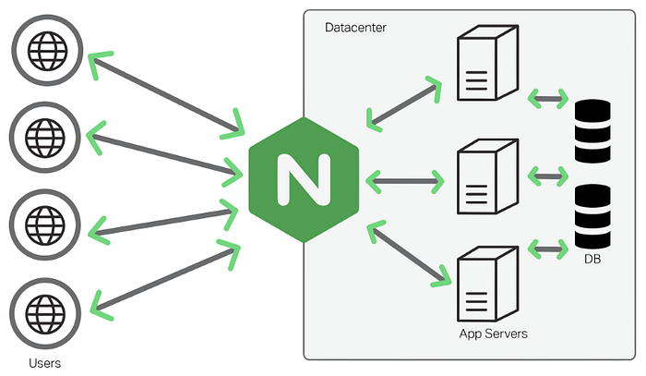


Resilience
Fault tolerance
Distribute traffic across multiple instances (load balancers)
Load balancer detects the failures and stops sending requests to faulting nodes
Nginx load balancer

Slide 19
Performance
Does the architecture itself cause any performance bottlenecks?
Modularity reduces performance
How to limit performance overhead?
Network access
Adding Post UI
Tweet Injection Service
Network access
Network access
Short URL Service

Slide 20
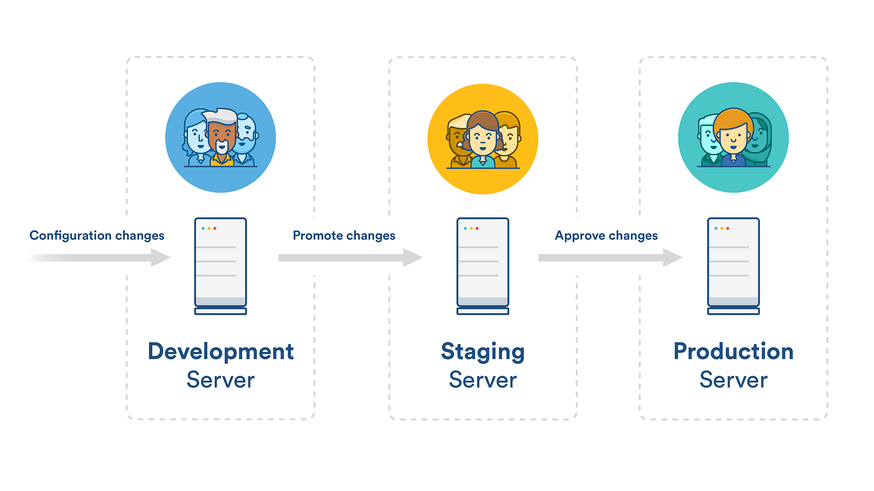
Deployability
Can individual components be individually deployed?
Do I need to deploy TweetService to deploy ShortURLService?
Can deployment steps be automated?

Slide 21
Active areas of research and innovation
Both in industry and academia
Tremendous amount of innovation happening currently
Majority of topics fall under “cloud computing”
This course will have an overview of these topics

Slide 22
Relation to systems topics
Operating systems
Virtual machines and containers for software deployment
Networking
Security (later module)
Distributed systems
Notes:
Distri
Twitter or Bsky service running in SF have consensus with service running in NY
Reconcile

Slide 23
Virtual machines and containers

Slide 24
Virtual machine and containers
Complex software architecture needs for a “virtual environment”
For example, autoscaling can not bring up physical machines
Even if it can, wasteful to have physical machines sitting around idle

Slide 25

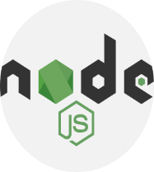


Virtual machine and containers
Provide flexible use of physical machines through dynamic reconfiguring
Ubuntu 22.04
Ubuntu 22.04
Ubuntu 23.04
Ubuntu 22.04
Ubuntu 24.04
http://app.com/app.js
Notes:
Different versions
Different Oses
Spike for JS content.
Python pages not being visited, idle

Slide 26
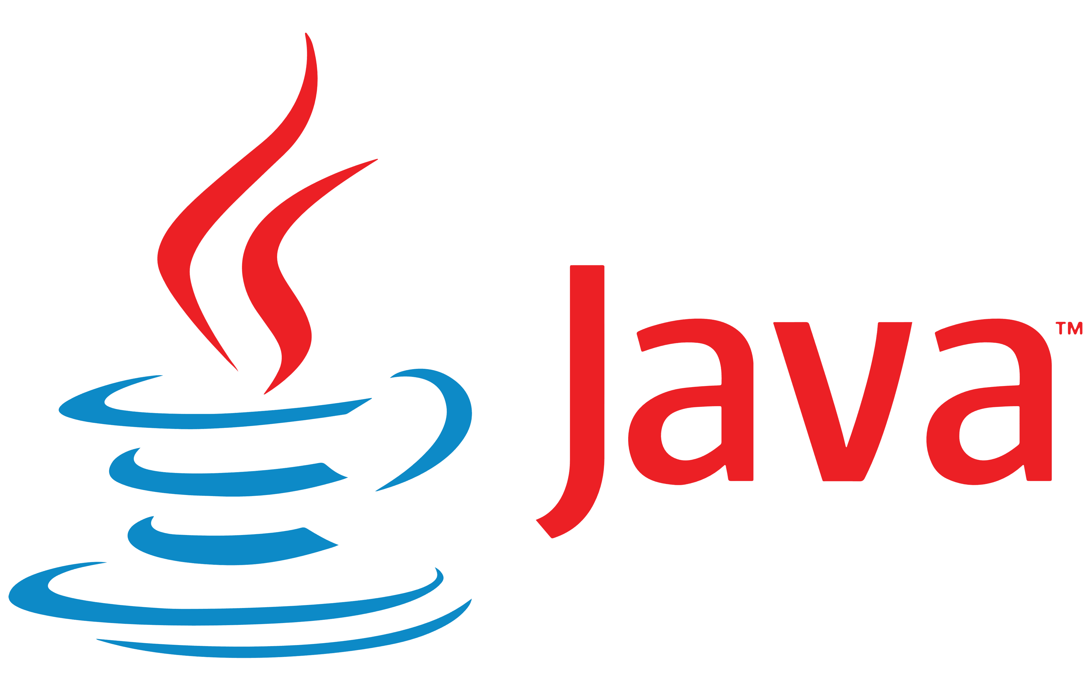
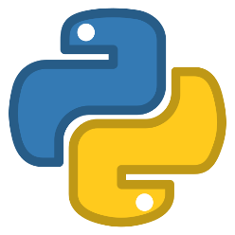



What is a virtual machine?
Isolated environment that emulates a physical machine
A hypervisor runs on the hardware
Each VM has its own kernel
Isolation enforced by hardware
Intel VT-x or AMD-V
Ubuntu 22.04
Ubuntu 24.10
Fedora 20
Linux kernel 5.4.1
Linux kernel 6.0.2
Linux kernel 4.4.7
Hypervisor
Hardware

Slide 27
What is a virtual machine?
Special CPU instructions to enter and exit VMs
VMRUN to enter “guest mode” and run the VM
VMCALL to exit “guest mode” and execute host code
Expensive instructions and also cause cache, TLB invalidations
Ubuntu 22.04
Ubuntu 24.10
Fedora 20
Linux kernel 5.4.1
Linux kernel 6.0.2
Linux kernel 4.4.7
Hypervisor
Hardware

Slide 28
What is a container?
Isolated environment that emulates a physical machine
Each container shares the host kernel
Isolation enforced by software
Namespaces and cgroups in the Linux kernel
Ubuntu 22.04
Ubuntu 24.10
Fedora 20
Linux kernel 5.4.1
Hardware

Slide 29
What is a container?
Namespaces partition kernel resources in software
E.g., a process can only see the filesystem in its own namespace
No hardware instructions executed
Ubuntu 22.04
Ubuntu 24.10
Fedora 20
Linux kernel 5.4.1
Hardware

Slide 30
VMs vs. containers
Containers are more lightweight
Switching between containers is done in the OS kernel
Containers share the OS kernel
Smaller memory footprint than a VM
Limitations – can’t run unsupported containers
Containers are less secure
Isolation between containers is maintained by software (the OS kernel)
Approaches to improve container security and reduce VM overhead
Out of scope of syllabus

Slide 31
VMs vs. containers
Choice depends on deployment scenario
On self-owned machines, containers are adequate
Personal servers, personal cloud

Slide 32
VMs vs. containers
VMs necessary for security on cloud machines
Multiple “tenants” can have their apps running on the same host machine
Needs stronger isolation between them
AWS cloud, Google cloud, etc.

Slide 33
Software architecture
Tapti Palit

Slide 34
Agenda
Networking fundamentals
HTTP methods
Apache HTTP demo
Wireshark demo
Application servers
Apache Tomcat
Client server architecture
Microservices
Continue during Discussion

Slide 35
Networking fundamentals

Slide 36
Networked components
User DB MySQL cluster
Redis cluster
User Onboarding Login flow
User Service
Trends
Redis cluster
User following flow
Graph Service
Apache Spark streaming cluster
User Graph MySQL cluster
K
A
F
K
A
Hadoop cluster
Adding Post UI
Tweet Injection Service
Weekly cron jobs
Cassandra Cluster
Search Kafka consumer
Notification service
Short URL Service
Tweet Service
Tweet Processor
Elastic search cluster
Live User Websockets (notifications)
User Self Profile Service
Timeline Service
Analytics
Search service
Assert Service
Redis cluster
Home Screen
CDN
Users app / browsers
Search screen
Notes:
In modern software architecture all the components are connected
Running on different machines
Need some networking revision
Help with microservices

Slide 37
Network layers
The kernel contains the networking code
TCP-IP is the most common networking stack
It is organized in layers
Layered architecture
Every layer has a protocol
Application Layer
Userspace
Transport Layer
TCP, UDP
Internet Layer
IP
Linux kernel
Link layer
Ethernet
Notes:
Networking code consists of different layers
Purely in software

Slide 38
What is a protocol?
Every layer/protocol has a fixed message format
Header
Payload
[optional] Checksum
Structured set of messages that follow a predefined format
Multiple messages needed to establish and tear down a connection
[more in a networking class]
Header
Checksum
Payload

Slide 39
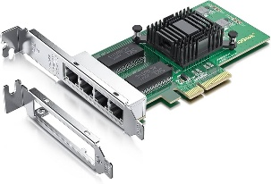
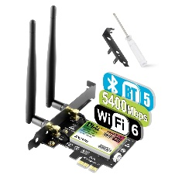
Link layer
Only layer that communicates with hardware devices
Abstracts low-level hardware details
Upper layers don’t need to worry about which NIC card plugged in
Application Layer
Userspace
Transport Layer
Internet Layer
Linux kernel
Link layer
Notes:
Networking code consists of different layers
Purely in software

Slide 40
Internet layer
Internet layer (IP layer)
Handles addressing
Unique address for each interface
localhost or 127.0.0.1 special “virtual” interface for the “loopback” interface
Userspace
Application Layer
Transport Layer
Internet Layer
130.245.42.104
24.11.201.33
Linux kernel
Link layer
Notes:
- End point provided by the kernel

Slide 41
Transport layer
Port is a logical abstraction provided by the transport layer
A port is associated with an IP address
Application Layer
Userspace
Port:80
Port:6379
Port:22
Transport Layer
Internet Layer
130.245.42.104
24.11.201.33
Linux kernel
Link layer
Notes:
- End point provided by the kernel

Slide 42
Transport layer
Port numbers go from 0 to 65535
< 1024, needs root access
Standard ports
Web servers typically bind to port 80
Redis to port 6379
Ssh to port 22
Application Layer
Userspace
Port:80
Port:6379
Port:22
Transport Layer
Internet Layer
130.245.42.104
24.11.201.33
Linux kernel
Link layer
Notes:
- End point provided by the kernel

Slide 43



Application layer
Applications talk to the rest of the networking layers using application layer protocols
Applications bind and listen to a particular transport layer port for requests
HTTP, Redis, SSH protocols
Application Layer
Userspace
Port:80
Port:6379
Port:22
Transport Layer
Internet Layer
130.245.42.104
24.11.201.33
Linux kernel
Link layer
Notes:
- End point provided by the kernel

Slide 44
Application layer
Multiple instances of the same application needs different ports
Application Layer
Userspace
Port:81
Port:80
Port:6379
Port:22
Transport Layer
Internet Layer
130.245.42.104
24.11.201.33
Linux kernel
Link layer
Notes:
- End point provided by the kernel

Slide 45
Network communication
Clients can connect to an IP address and a port
Application Layer
Application Layer
HW1-app
Transport Layer
Transport Layer
Port:80
Port:6379
Port:22
Port:15487
Internet Layer
Internet Layer
102.56.89.2
130.245.42.104
Link layer
Link layer
Machine B
Machine A
Notes:
- End point provided by the kernel

Slide 46
Socket end point
(port number, IP address) pair identifies a unique socket end point
E.g. (142.250.114.100, 80) -> google.com
(23.185.0.4, 80) -> ucdavis.edu
Socket API to open and close sockets
Userspace
Application Layer
Transport Layer
Port:80
Port:6379
Port:22
Port:81
Internet Layer
130.245.42.104
24.11.201.33
Linux kernel
Link layer
Notes:
- End point provided by the kernel

Slide 47
Networking key points
Applications bind to ports
Multiple instances of the same app needs different ports
Every physical interface has a corresponding IP address
(port, IP address) is a socket pair and uniquely identifies an internet end point
Notes:
http://httpforever.com/

Slide 48
Software architecture styles

Slide 49
Popular software architecture styles
Client-server
Microservices
FaaS frameworks
RPC
Message Queue
Pub-sub
Misc topics
Continuous deployment
How software code is organized
How different components
communicate
Notes:
- If have time then FAAS

Slide 50
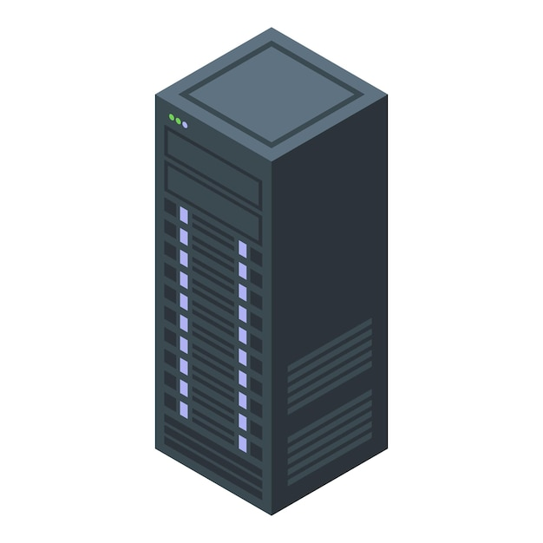
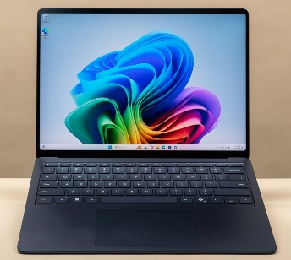
Client server architecture
A distributed computing model where the client and server interact to fulfill requests
The client initiates requests, and the server processes them and sends back responses
Client
Server

Slide 51
Client server architecture
Centralized Control: Servers manage data and business logic centrally
Clients provide user interfaces, interacting with the server over a network
Client
Server

Slide 52
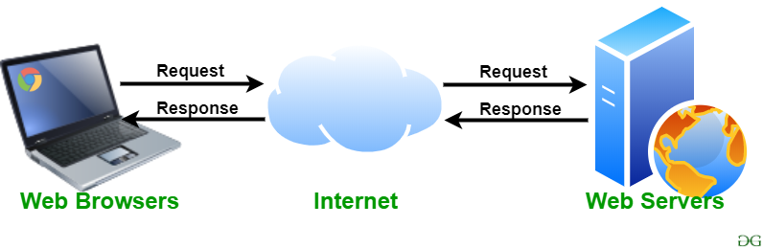
Client-server architecture examples
Web browser and web server
In reality: Rarely only two-tier these days

Slide 53

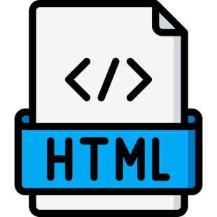
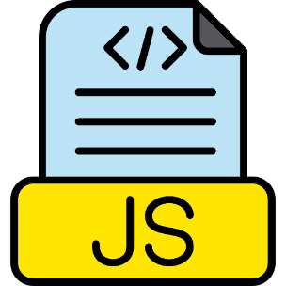
HTTP server
Example – Apache httpd
Serves HTML and Javascript pages
Encapsulates and abstracts
All HTTP protocol parsing
All socket programming code
Application Layer
Userspace
Abstraction
Port:80
Transport Layer
Internet Layer
130.245.42.104
24.11.201.33
Linux kernel
Link layer
Notes:
Everything is abstraction
Don’t want to be writing a HTTP response for each request
Hides the details of the lower layers

Slide 54
HTTP and HTTP methods
HyperText Transfer Protocol
Used for communicating with web servers, microservices, and so on…
Supports multiple “methods” or “verbs”
Common ones
GET
POST
PUT
DELETE
Different types of messages that the protocol can understand
Notes:
- Important for the microservices

Slide 55
HTTP request
Request Line: Method, URL, HTTP version
Example: GET /index.html HTTP/1.1
Headers: Metadata like Content-Type, Authorization
Body: Optional, contains data for POST/PUT requests

Slide 56
HTTP response
Status Line: HTTP version, status code (e.g., 200 OK)
Headers: Metadata like Content-Type, Content-Length
Body: Optional, contains response data (e.g., HTML, JSON)

Slide 57
HTTP GET method
Used to retrieve data from the server
Does not modify the server state
Can send parameters
GET /url?id=100 HTTP 1.1
Use cases
Fetching a webpage
Retrieving information
> telnet google.com 80
GET /index.html HTTP/1.1
<html>
<head><title>…. </title></head>
<body> … </body>
</html>

Slide 58
HTTP POST method
Used to send data to the server
Includes a body to send data to the server
Use cases
User registration
Submitting forms
> telnet site.com 80
POST /users HTTP/1.1
Content-Type: application/json
{
"name": "John Doe", "email": “john.doe@example.com”
}

Slide 59
HTTP PUT method
Used to update or replace an existing resource on the server
Includes a body to send updated data
Use cases
Updating user information
… and so on
> telnet site.com 80
PUT /users/10 HTTP/1.1
Content-Type: application/json
{
"name": "John Doe", "email": john.doe@example.com
}

Slide 60
HTTP DELETE method
Used to remove a resource from the server
Typically, does not have a request body
Use cases
Deleting user account
Removing items from a database
> telnet site.com 80
DELETE /users/10 HTTP/1.1

Slide 61
Key points
HTTP is just a protocol
The functionality of each HTTP method must be implemented by an application
Apache httpd webserver
Nginx webserver
You can develop your own webserver

Slide 62
Apache httpd demo
Start the HTTP web server
sudo service apache2 start
Update the port in /etc/apache2/ports.conf
Add any HTML/Javascript files in /var/www
Notes:
/etc/apache2 has the config
/var/www has the website

Slide 63
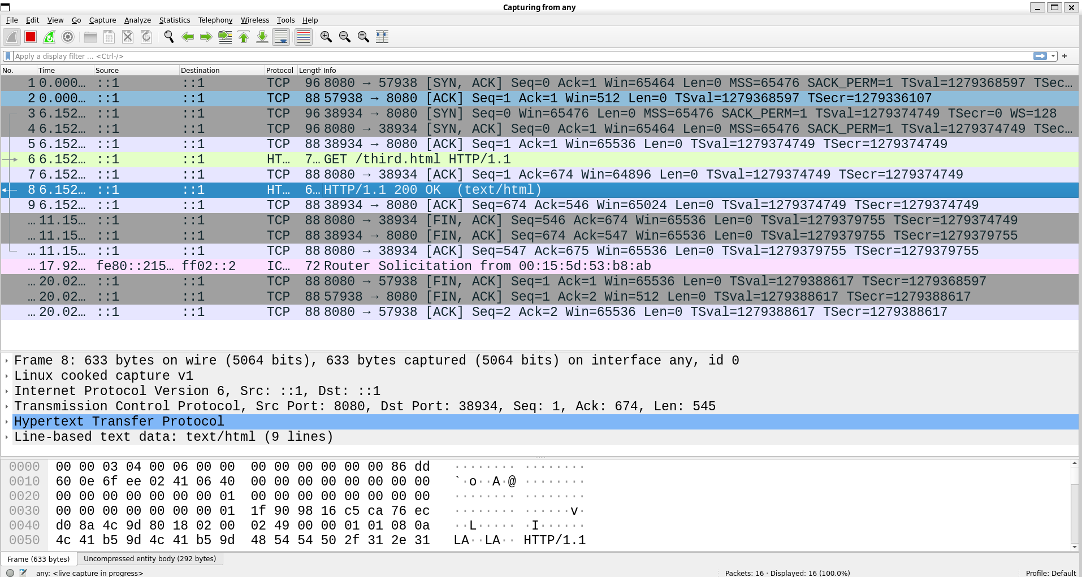
Wireshark demo
Wireshark demo for Apache httpd
Notes:
Run wireshark on the WSL
/etc/apache2 has the config
/var/www has the website

Slide 64
Pros and cons
Benefits
Centralized management of data: all data is on the server and can be easily secured
No complex data flows
Separation between client and server business logic
Disadvantages
Single point of failure
Poor scaling

Slide 65
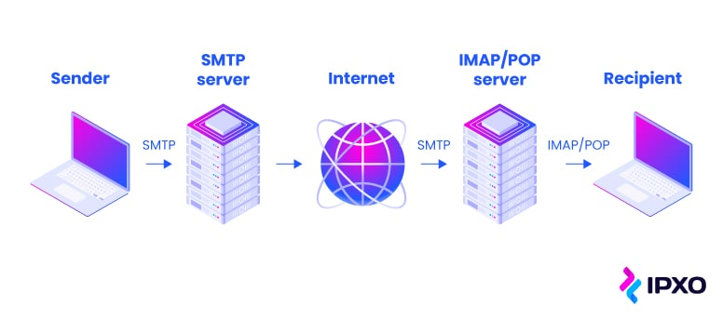
Client-server architecture examples
Email client and email server

Slide 66


Application servers
Apache Httpd can only serve “static” HTML pages
Same content is served for each request
Web is “dynamic”
User uploads something and other users can interact with it
Many technologies
Java servlets, JSP, PHP, Python, NodeJS services, and so on

Slide 67
Java servlet
Servlets are Java classes that extend server functionality
Part of the Java EE/Jakarta EE framework
Process HTTP requests and generate responses
Not used often these days
Foundation of many current web frameworks
Notes:
Sudo apt install tomcat9
/usr/share/tomcat9/bin
Copy the /var/lib/tomcat9/webapps

Slide 68
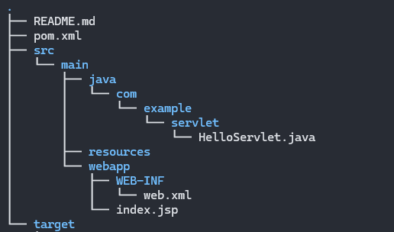
Servlet example
class Person {
private String name;
private String id;
}
@WebServlet("/hello")
public class HelloServlet extends HttpServlet {
protected void doGet(HttpServletRequest request, HttpServletResponse response) {
String name = request.getParameter("name");
String id = request.getParameter("id");
// Parse the request
// Store it in a class
Person p = new Person(name, id);
response.setContentType("text/html");
// Create the HTML output
PrintWriter out = response.getWriter();
out.println("<html><body>");
out.println("<h1>Hello, " + name + "!</h1>");
out.println("</body></html>");
}
}
Mapping URL
HTTP method
Parse GET parameters
into object
https://github.com/davsec-teaching/jakarta-servlet
Set the response

Slide 69
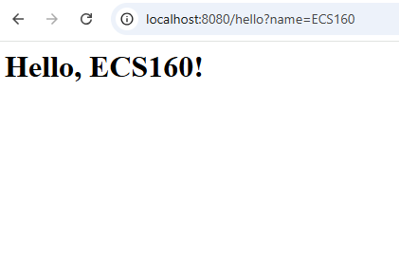
Servlet example
class Person {
private String name;
private String id;
}
@WebServlet("/hello")
public class HelloServlet extends HttpServlet {
protected void doGet(HttpServletRequest request, HttpServletResponse response) {
String name = request.getParameter("name");
String id = request.getParameter("id");
// Parse the request
// Store it in a class
Person p = new Person(name, id);
response.setContentType("text/html");
// Create the HTML output
PrintWriter out = response.getWriter();
out.println("<html><body>");
out.println("<h1>Hello, " + name + "!</h1>");
out.println("</body></html>");
}
}
> cp HelloServlet.war $CATALINA_HOME/webapps > catalina.sh start

Slide 70
Servlet example
class Person {
private String name;
private String id;
}
@WebServlet("/hello")
public class HelloServlet extends HttpServlet {
protected void doGet(HttpServletRequest request, HttpServletResponse response) {
String name = request.getParameter("name");
String id = request.getParameter("id");
// Parse the request
// Store it in a class
Person p = new Person(name, id);
response.setContentType("text/html");
// Create the HTML output
PrintWriter out = response.getWriter();
out.println("<html><body>");
out.println("<h1>Hello, " + name + "!</h1>");
out.println("</body></html>");
}
}
> mvn jetty:run # launch server

Slide 71

Key points
Many steps –
Create the directory structure
Write a servlet
Write glue code to parse the HTTP request into a Java object
Write the output
Copy the WAR (Web archive) file to the application server’s directory
Restart the application server
Need to do these steps for each servlet

Slide 72
Client server architecture
Notes:
Focusing a lot on technologies
Step back and look at the architecture

Slide 73
Microservices
An approach to developing a single application as a suite of small services, each running in its own process and communicating with lightweight mechanisms, often an HTTP resource API
Independently deployable by automated processes
Bare minimum centralized management
Smart endpoints connected by “dumb” pipes
https://martinfowler.com/articles/microservices.html

Slide 74
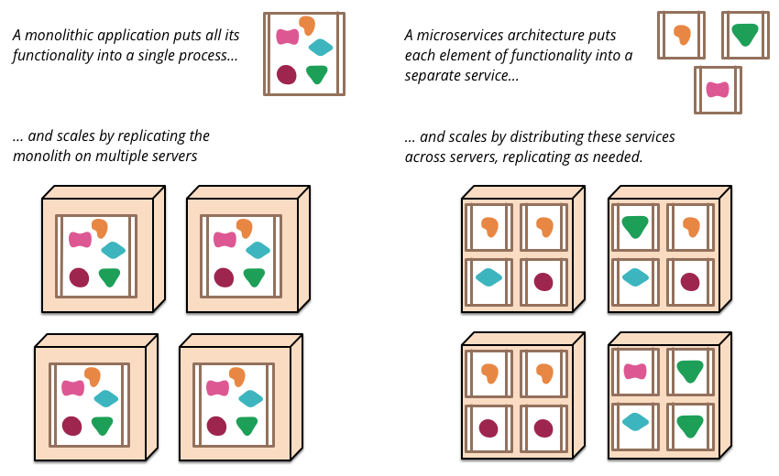
Microservices overview
https://martinfowler.com/articles/microservices.html

Slide 75
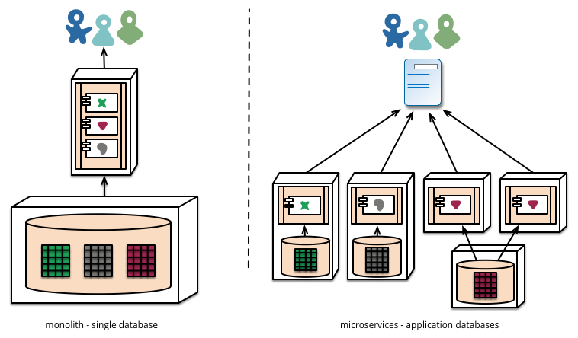
Monolithic to microservices
Each microservice can have its own database
https://martinfowler.com/articles/microservices.html

Slide 76
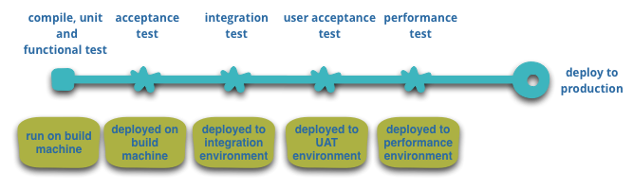
Continuous deployment using microservices
Automated deployment
E.g., pushing to the main branch in GitHub triggers GitHub Actions that
Automatically builds
Execute unit-tests
Automatically deploy to integration environment (and then production environment)

Slide 77
Pros and cons
Pros
Strong encapsulation and modularity
Better reusability
Each microservice can be scaled independently (More on this later)
Each microservice can be written in its own programming language
Fault isolation
Supports CI/CD (easier to deploy microservices than monolithic services)
Cons
Higher complexity
Debugging complex interactions is harder
Network overhead

Slide 78
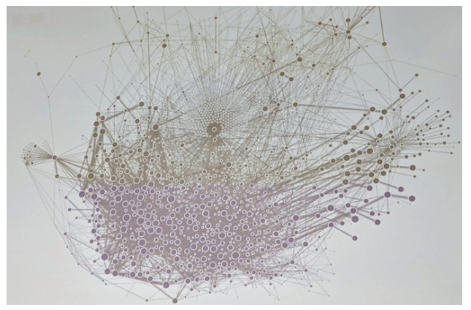
Microservices at Uber (2019)
https://x.com/msuriar/status/1110244877424578560

Slide 79
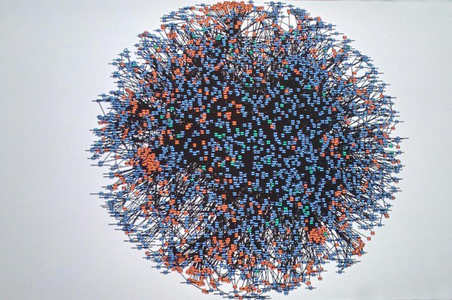
Microservices at Amazon (2008)
Code-named “Deathstar”
https://x.com/Werner/status/741673514567143424

Slide 80
What all do you need to launch a microservice?
The microservice program logic
An URL the microservice can be accessed at
A server to host the microservice
... too much boilerplate configuration code!!

Slide 81
Spring Boot Overview
What is Spring Boot?
Framework for creating standalone, production-grade Spring-based applications
Reduces boilerplate configuration code
Embedded server (Tomcat/Jetty)
Simplifies microservice creation through annotations
Built-in support for REST APIs

Slide 82
Setting up a Spring Boot application
Create a Spring Boot Project using Spring Initializr
https://start.spring.io/
Select your desired dependencies
Generates a project structure with pom.xml prepopulated

Slide 83
RESTful microservices
Create classes that can act as REST endpoints
Uses annotations to denote REST endpoint URLs
Allows complete decoupling from the boilerplate code
Types of requests
@GetMapping, @PostMapping, @PutMapping, and so on… for all HTTP methods
@PathVariable – extract variable from request
// Example of REST API using Spring Boot
@RestController
@RequestMapping("/orders")
public class OrderController {
@GetMapping("/{id}")
public Order getOrder(@PathVariable int id){
return orderService.getOrderById(id);
}
}

Slide 84
Abstractions
Apache httpd abstracts HTTP protocol parsing and network communication
Apache Tomcat supports Java servlets with abstract Java code execution on server machine
Spring Boot abstracts Java servlets to create microservice endpoints
Apache httpd
Apache Tomcat
Spring Boot microservices

Slide 85
Pipeline architecture
A software design pattern where data flows through a series of processing stages, or "filters," connected by channels
Each stage can be a microservice
Each stage transforms the input data and passes the result to the next stage
Input → [Stage 1] → [Stage 2] → [Stage 3] → Output

Slide 86
Key characteristics
Modularity: Each stage performs a specific task independently
Sequential processing: Data flows linearly from one stage to another
Reusability: Each pipeline stage can be reused in other applications

Slide 87
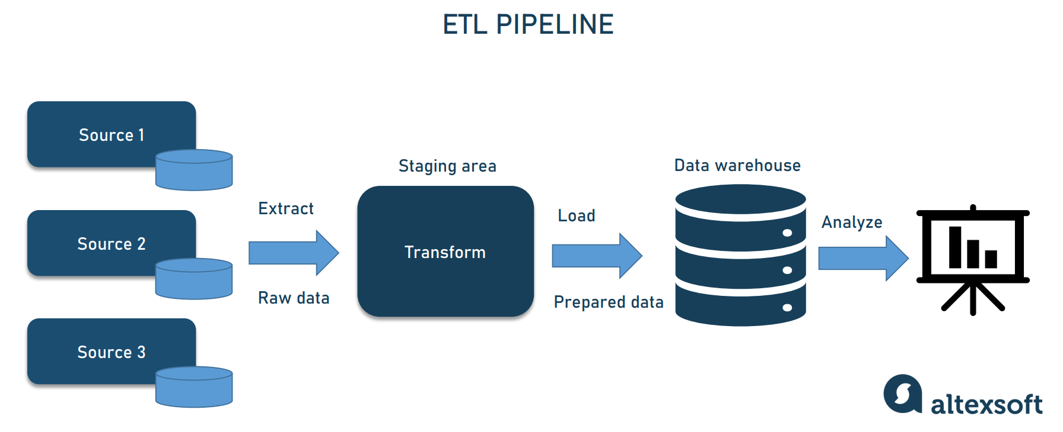
Data processing pipeline
Extract-transform-load (ETL) pipeline
https://www.altexsoft.com/blog/data-pipeline-components-and-types/

Slide 88
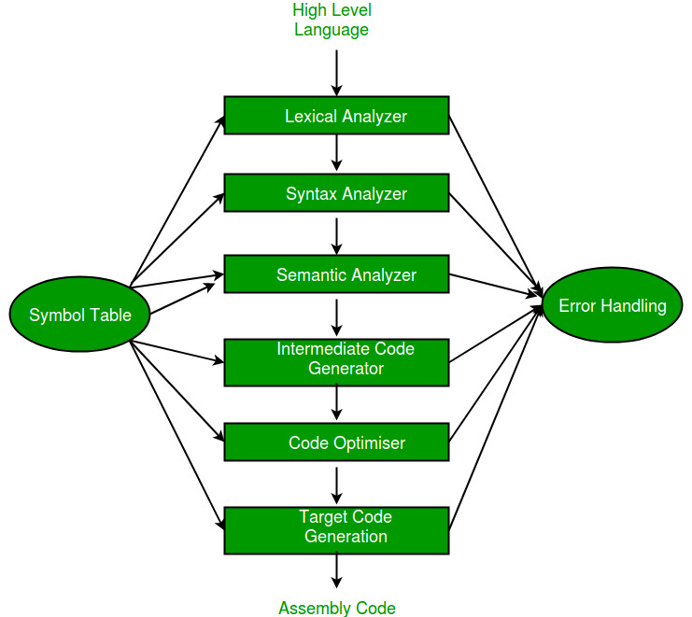
Compiler pipeline

Slide 89
Pros and cons
Benefits
Encapsulation and modularity: easy to replace individual pipeline stage
Scalability: individual stage can be scaled independently
East of testing: each stage can be tested independently
Disadvantages
Debugging: debugging complex flows through multiple stages is hard
Hard to track data flow → can cause security issues
Team A develops Pipeline A, Team B develops Pipeline B
Multiple pipeline stages can contribute to latency

Slide 90
HW3 – create a microservice
Goal: create a microservice that processes the social media posts
Spring Boot demo

Slide 91
What is a container?
Isolated environment that emulates a physical machine
Each container shares the host kernel
Isolation enforced by software
Namespaces and cgroups in the Linux kernel
Docker is leading technology for building containers
Ubuntu 22.04
Ubuntu 24.10
Fedora 20
Linux kernel 5.4.1
Hardware

Slide 92
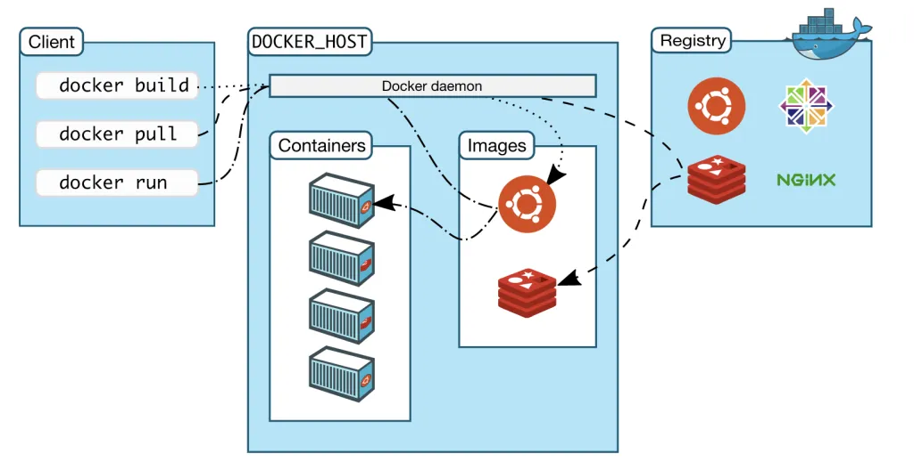
Docker architecture
Remote docker registry
Dockerhub contains docker images
Docker host
Machine running docker daemon
Stores docker images locally
Spawns containers
Docker client commands
docker pull: pulls image from registry
docker build: builds a docker image from a Dockerfile
docker run: spawns a container

Slide 93
Sample Dockerfile to run HW1
# Use the Ubuntu base image
FROM ubuntu:20.04
# Set the working directory
WORKDIR /app
# Install required dependencies: OpenJDK, Maven, Git
RUN apt-get update && apt-get install -y \
openjdk-11-jdk \
maven \
git \
&& apt-get clean \
&& rm -rf /var/lib/apt/lists/*
# Set JAVA_HOME environment variable
ENV JAVA_HOME=/usr/lib/jvm/java-11-openjdk-amd64
ENV PATH="$JAVA_HOME/bin:$PATH"
# Clone the Java application repository
RUN git clone https://github.com/example-user/java-app.git .
# Build the application using Maven
RUN mvn clean package
# Define the command to run the application
CMD ["java", "-jar", "target/java-app.jar"]
# To build the docker container
docker build -t java-app .
# To run the docker container
> docker run -p 8080:8080 java-app
Notes:
Install docker.io
Write a simple text file

Slide 94
Docker demo

Slide 95
Communication styles

Slide 96


Remote procedure call (RPC)
Protocol that allows a program to execute a procedure on a remote server as if it were local
Used in microservices architecture for inter-service communication
Synchronous communication
Request
Response
Microservice A
Microservice B

Slide 97
Remote procedure call (RPC)
Key features
Language agnostic: the RPC itself does not depend on the service language
Abstracts network details
Typically, over HTTP
JSON-RPC4J (https://github.com/briandilley/jsonrpc4j)
JsonRpcHttpClient client = new JsonRpcHttpClient(
new URL("http://example.com/UserService.json"));
User user = client.invoke("createUser", new Object[] { "bob", "the builder" },
User.class);

Slide 98
RPC formats
Text-based (e.g. REST APIs)
Uses Json or XML for data exchange
Human-readable, but larger payloads
Binary formats (e.g. gRPC)
Uses binary standards (such as protobuf) for serialization
Compact but faster, but less human-readable

Slide 99
Json and REST APIs
Representational State Transfer (REST) is an architectural style for web services
Uses HTTP methods (GET, POST, PUT, DELETE) to perform operations on resources
Commonly paired with JSON for data exchange
> telnet api.example.com 80
// GET Request to Fetch a User denoted by ID > GET /users/123 // Response
{
"id": 123,
"name": "John Doe",
"email": john.doe@example.com
}

Slide 100



Message queuing (MQ)
Asynchronous communication model
Messages sent to a queue and processed by consumers independently of the producer
Stronger decoupling
Message
Message
Message
Message
Microservice A
Microservice B

Slide 101




Open source and paid message queuing services

Slide 102
Pub-sub architecture
Asynchronous messaging pattern where publishers send messages to a central message broker or topic, and subscribers receive messages based on their subscriptions
Broadcasting: messages can be sent to multiple subscribers
Typically, messages are persistent at the broker and must be explicitly deleted

Slide 103


Pub-sub architecture
Message
Subscriber Microservice A
Message
Message
Subscriber Microservice B
Publisher
Microservice
Broker
Message
Subscriber Microservice C

Slide 104

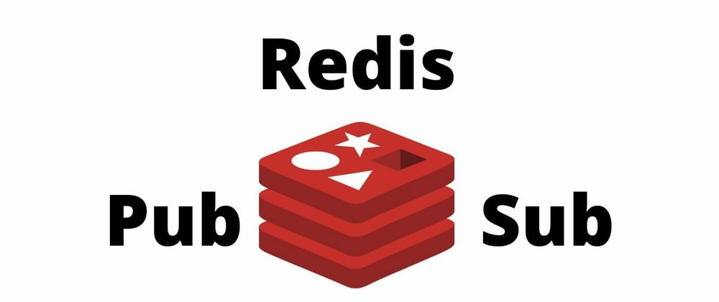
Pub-sub frameworks

Slide 105
Containerization
Lightweight virtualization method that packages applications and their dependencies into isolated, portable containers
Containers share the host OS kernel but have their own filesystem, resources, and dependencies

Slide 106
Can mix and match!!
Pipeline architecture using microservices with message queues deployed on a serverless architecture
Pub-sub architecture with microservices using containerizations
Pipeline architecture in one part of the system, with a pub-sub in another
… and so on
Pick what is right for your software system

Slide 107
What is a protocol?
Fixed message format
Header
Payload
Checksum
Structured set of messages that follow a predefined format
Multiple messages needed to establish and tear down a connection
[out of scope]
Header
Checksum
Payload

Slide 108
Network layers
When sending, each layer wraps the upper layer payload
Ethernet header
IP header
IP checksum
TCP header
TCP checksum
App. Layer payload

Slide 109
Network layers
When receiving, each layer processes its own header
Removes it
Sends the remaining payload to the upper layer
Ethernet header
IP header
IP checksum
TCP header
TCP checksum
App. Layer payload

Slide 110
Wireshark demo
Wireshark is a network packet-sniffing tool
Useful for debugging
Also, a cool tool!!

Slide 111

Networking on the internet
Internet
Your laptop at home
UC Davis server
Notes:
- UI flows

Slide 112
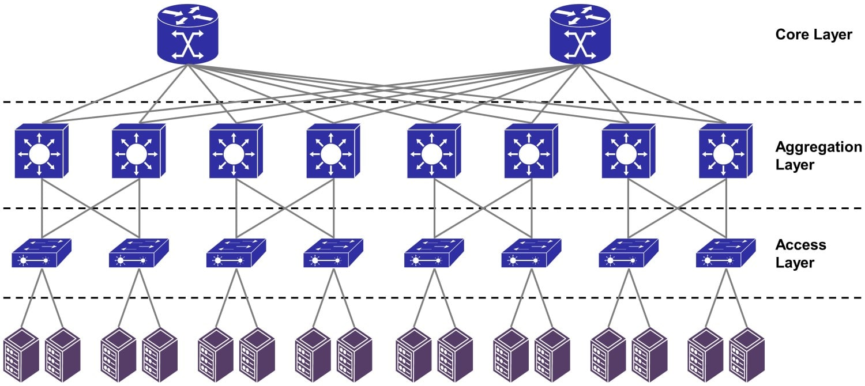
Data center networking
Each node is a machine
https://dgtlinfra.com/data-center-networking/

Slide 113
Multi-tier or layered architecture
Divides the application into multiple logical layers or “tiers”
Benefits
Stronger encapsulation
Clear division of responsibilities
Easier to maintain and test
Stronger reusability
Logic in one layer can be reused across different applications
Disadvantages
Possible increase in latency

Slide 114
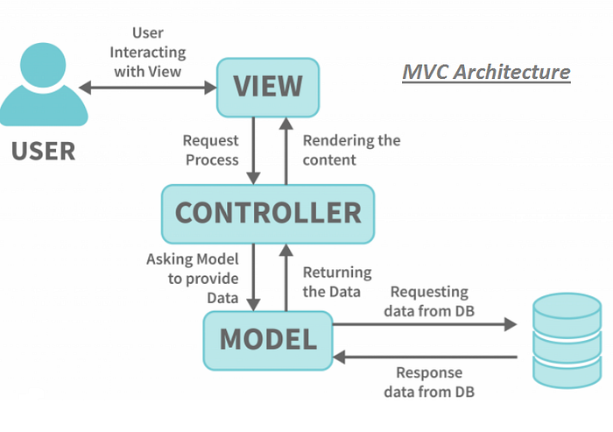
Model-view-controller (MVC) architecture
Three layers
Model: Manages data and business logic
View: Handles the presentation layer (user interface)
Controller: Acts as an intermediary, processing user input and coordinating between Model and View
https://medium.com/@cyberblogger007/mvc-architecture-with-jsp-example-5c53d1994157

Slide 115




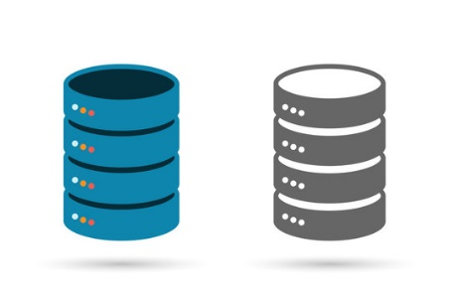


MVC frameworks
View
Controller
Model

