Slide 1
Compilers and LLVM introduction
Tapti Palit

Slide 2
Announcements
Please sign up for paper presentations
Please start thinking about forming teams for final project :)
Team registration link will be shared on Piazza

Slide 3
Recap: what is this course about?
Official title: Special topics in compilers and programming languages
Working title: Compilers, program analysis, and their applications

Slide 4


Recap: optimization stages (passes)
Source code files
Goal: run programs fast!!!
Frontend
Dead code elimination
Inlining
Dead store elimination
Loop rotation
Loop unroll
SROA
Backend
High-level IR
Low-level IR
Executable
https://llvm.org/docs/Passes.html

Slide 5
Recap: dead code elimination
DCE – need program analysis to tell us which variable assignments are “live” at which program points
If an assignment is not “live” after the program point that defines it, then the assignment is dead code and can be removed
int f (int a, int b) {
int p = a – b;
int q = a + b;
int r = 0;
int s = q++;
if (a > 10) {
r = q – 10;
} else {
r = q + 10;
}
p = q + 4;
if (q == 10) {
p = s;
}
return p + q + r;
}
Notes:
-

Slide 6
Agenda
Recap
Compilation, linking, and LTO
Computer architecture background
Case study: sample optimization
LLVM IR introduction
Live coding – optimization pass
How to read a paper?

Slide 7
Compiling process
> clang -O3 a.c b.c c.c -o app

Slide 8
Compiling and linking process
> clang -v -O3 a.c b.c c.c -o app
"/home/tpalit/clang-llvm/llvm-project-14.0.0.src/release-build/bin/clang-14" -cc1 -triple x86_64-unknown-linux-gnu -o /tmp/a-00ec8e.o -x c a.c
"/home/tpalit/clang-llvm/llvm-project-14.0.0.src/release-build/bin/clang-14" -cc1 -triple x86_64-unknown-linux-gnu -o /tmp/b-9ecfd0.o -x c b.c
"/home/tpalit/clang-llvm/llvm-project-14.0.0.src/release-build/bin/clang-14" -cc1 -triple x86_64-unknown-linux-gnu -emit-obj --mrelax-relocations -disable-free -clear-ast-before-backend -o /tmp/c-a778c9.o -x c c.c
"/usr/bin/ld" -z relro --hash-style=gnu --eh-frame-hdr -m elf_x86_64 -dynamic-linker /lib64/ld-linux-x86-64.so.2 -o app /lib/x86_64-linux-gnu/crt1.o /lib/x86_64-linux-gnu/crti.o -L/lib/../lib64 /tmp/a-00ec8e.o /tmp/b-9ecfd0.o /tmp/c-a778c9.o

Slide 9



Compiling and linking process
Compiler
a.o
a.c
Optimizations
Compiler
b.c
b.o
Compiler
c.c
c.o
Linker

Slide 10
Implications
a.c
b.c
int func_a(int a, int b) {
return a + b;
} int main(void) {
int p = 10; int q = 20;
int s = 30;
int r = func_a(p, q);
int t = func_b(r, s); printf(“%d\n”, t); return 0; }
int func_b(int a, int b) {
return b+100;
}
Can the compiler determine if this statement is dead code?

Slide 11
Solution: link time optimization (LTO)
-flto
Compiler
a.c
a.bc
-flto
Compiler
b.c
b.bc
-flto
Compiler
c.c
c.bc
-flto
Compiler
Linker
a.bc
b.bc
c.bc
linked IR
Obj file

Slide 12
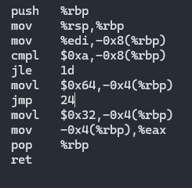
Question: why can’t the linker optimize?
C source
IR bitcode
Assembly instructions hard to rewrite
Have lost a lot of semantic information such as types
Jump offsets are hard-coded
Disassembly is the process of retrieving this lost information from assembly files
int func(int a) {
if (a > 10) {
return 100; } else { return 50; }
}
define dso_local i32 @func(i32 noundef %a) #0 {
entry:
%retval = alloca i32, align 4
%a.addr = alloca i32, align 4
store i32 %a, i32* %a.addr, align 4
%0 = load i32, i32* %a.addr, align 4
%cmp = icmp sgt i32 %0, 10
br i1 %cmp, label %if.then, label %if.else
if.then:
store i32 100, i32* %retval, align 4
br label %return
if.else:
store i32 50, i32* %retval, align 4
br label %return
return:
%1 = load i32, i32* %retval, align 4
ret i32 %1
}
Assembly

Slide 13
LTO benefits
More opportunities to optimize code
Can remove code at the function-level -> reduce binary sizes
Can safely answer questions like which program statements access this heap variable?
Whole program analysis (WPA)

Slide 14
LTO challenges
Very slow
Compiling Firefox with LTO took me 7 days on an 8-core, 32 GB machine (in 2020)!!!
Consumes a lot of memory
Final project idea: explore optimizations for LTO?

Slide 15
Demo / live coding
sudo apt install clang llvm
clang -c -flto a.c –o a.o
clang -c -flto b.c –o b.o
clang –flto a.o b.o –Wl,-plugin-opts=save-temps a.out

Slide 16
Computer architecture background

Slide 17
Compiler optimization
Optimizations, broadly
(Theory)
(Hardware)
Remove redundant computations
Automatically rewrite code to make better use of hardware
Both aspects
(Dead code elimination, common sub-expression elimination, constant propagation)
(Loop fission, vectorization, loop tiling, prefetching)
(Function inlining)
*More in next lecture

Slide 18
Need to understand some computer architecture background

Slide 19
Memory hierarchy
Socket 1
Socket 2
CPU
CPU
CPU
CPU
REGS
REGS
REGS
REGS
(32 KB)
L1 Cache
L1 Cache
L1 Cache
L1 Cache
(256 KB)
L2 Cache
L2 Cache
L2 Cache
L2 Cache
(1-8 MB)
LLC Cache
LLC Cache
Memory bus
DRAM
(Multiple GB)
Some memory is closer to the CPU and faster to access

Slide 20
Memory hierarchy
GP register access .........................~0.2 ns (1 cycle)
L1 cache reference ......................... 0.5 ns
L2 cache reference ........................... 7 ns
Main memory reference ...................... 100 ns
https://gist.github.com/hellerbarde/2843375

Slide 21
Compiler goal: improve cache locality
Original
After reordering
int function(char* a) { int sum = 0; sum += a[0]; access_other_memory(); sum += a[1]; access_other_memory(); sum += a[2]; access_other_memory(); }
int function(char* a) { int sum = 0; sum += a[0]; sum += a[1]; sum += a[2]; access_other_memory(); access_other_memory(); access_other_memory(); }
access_other_memory() does not modify sum or array a

Slide 22
Compiler goal: improve cache locality
Better cache locality
More cache hits -> lower latency
Compiler can reorder the accesses to a[]
ONLY if it can safely determine that access_other_memory() does not update sum or a
After reordering
int function(char* a) { int sum = 0; sum += a[0]; sum += a[1]; sum += a[2]; access_other_memory(); access_other_memory(); access_other_memory(); }

Slide 23
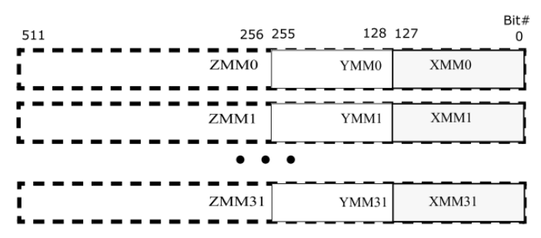
Architecture-specific registers
Some architectures (Intel X86-64) provides wide registers
Intel AVX – up to 512-bit wide registers
Instructions to operate on 512 bits at once
Compiler use these regs to improve performance

Slide 24
Case study

Slide 25
Newer memories
In addition to DRAMs and SSDs, a third category of memory technology is slowly growing in popularity
These technologies (Intel Optane, and more recently CXL) have a latency characteristic that is faster than SSDs, but slower than DRAMS
And many of them can be transparently accessed like DRAM
mov %rdi, [%rbx] ;; %rbx contains a memory access
… final project idea …

Slide 26
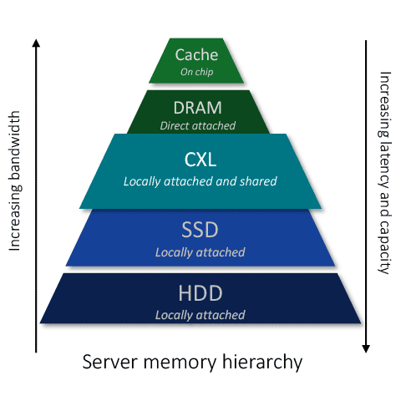
Visualizing latency
Very “hot” data
“Hot” data
Rarely-accessed data
https://www.rambus.com/cxl-memory-initiative/

Slide 27
Optimization problem
Compiler’s goal – given a C program, identify heap allocations that are “rarely” accessed and move them to this type of “slow” memory
Keep the DRAM available for frequently used heap objects
Simplification – assume that all pointers to heap memory are on the stack and are not copied to any other variable

Slide 28
Optimization problem
struct Stat { int sum; int avg; int mean; }; void function(void) { int* p = malloc(sizeof(int)*1024); struct Stat* stat = malloc(sizeof(struct S)); for (int i = 0; i < 1024; i++) { p[i] = rand()*100; } int sum = 0; for (int i = 0; i < 1024; i++) { sum += p[i]; } stat->sum = sum; }
struct Stat { int sum; int avg; int mean; }; void function(void) { int* p = malloc(sizeof(int)*1024); struct Stat* stat = slow_malloc(sizeof(struct S)); for (int i = 0; i < 1024; i++) { *p++ = rand()*100; } int sum = 0; for (int i = 0; i < 1024; i++) { sum += i; } stat->sum = sum; }
Optimization

Slide 29
LLVM Intermediate Representation
Notes:
- Get a little technical

Slide 30
Background: basic block
A sequence of instructions with one entry point and one exit point
entry
bb0
int a = 10;
bb1
if x > 10
int func(int x) {
int a = 10; if (x > 10) {
b = 20;
c = 30;
} else {
b = 200;
c = 0;
}
d = 100;
return d; }
bb2
b = 20; c = 30;
bb3
b = 200; c = 0;
bb4
d = 100;
exit

Slide 31
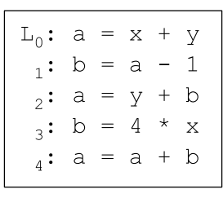
LLVM IR language
LLVM IR is in Single Static Assignment
Every (stack) variable in a SSA form program has only one definition site
Simplifies many analyses
C is clearly not in SSA form
Can do the following in C
https://homepages.dcc.ufmg.br/~fernando/classes/dcc888/ementa/slides/StaticSingleAssignment.pdf

Slide 32
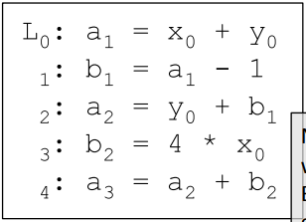
How to convert to SSA form?
Case 1: code without branches (straight line code)
Just create versions of the stack variable
Non-SSA form
SSA form

Slide 33
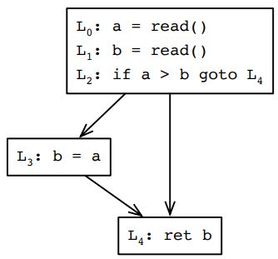
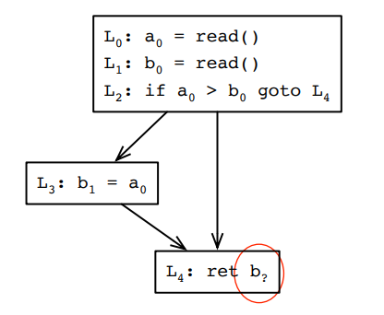
How to convert to SSA form?
Case 2: code with branches
Non-SSA form
SSA form
b₀ or b₁ ?

Slide 34
Phi-node
Recall – we want code to be in SSA-form strictly to make some analyses simpler
Solution – just “invent” an instruction that says the following
If this basic block is reached on the true-branch of the previous if-else branch, use value x, if not, use value y
Purely an intermediate representation construct that makes analysis easier
phi-nodes are broken down in conditional jump instructions at the machine-IR level

Slide 35
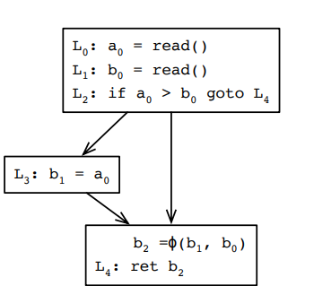
How to convert to SSA form?
Case 2: code with branches, with phi-nodes
Non-SSA form
SSA form

Slide 36
LLVM IR strongly typed
All type-casts must be explicit
Explicit cast instructions must be added to cast short to int to long
define dso_local i32 @main() #0 {
%1 = alloca i32, align 4
%2 = alloca i8, align 1
%3 = alloca i32, align 4
store i32 0, i32* %1, align 4
store i8 97, i8* %2, align 1
%4 = load i8, i8* %2, align 1
%5 = sext i8 %4 to i32
store i32 %5, i32* %3, align 4
%6 = load i32, i32* %3, align 4
ret i32 %6
}
int main(void) {
char c = 'a';
int d = c;
return d;
}

Slide 37

Declaring variables in LLVM IR
Important – in LLVM IR, a pointer is a “reference”
Stack variables
alloca instruction returns a pointer always

Slide 38
Declaring variables in LLVM IR
Global variables
Heap allocations performed via a call instruction
int arr[1024];
void f() {
arr[1] = 100;
}
@arr = dso_local global [1024 x i32] zeroinitializer, align 16
; Function Attrs: noinline nounwind optnone uwtable
define dso_local void @f() #0 {
store i32 100, i32* getelementptr inbounds ([1024 x i32], [1024 x i32]* @arr, i64 0, i64 1)
ret void
}
define dso_local i32 @main() #0 {
%1 = alloca i32, align 4
%2 = alloca i8*, align 8
store i32 0, i32* %1, align 4
%3 = call i8* @malloc(i64 noundef 4)
store i8* %3, i8** %2, align 8
ret i32 0
}
int main(void) {
char* s = malloc(sizeof(1024));
return 0;
}

Slide 39
Load and store instructions
Important points
The type of the AllocaInst for p is pointer-to-pointer
All memory accesses are explicitly performed
define dso_local i32 @main() #0 {
%1 = alloca i32, align 4
%2 = alloca i32, align 4
%3 = alloca i32*, align 8
%4 = alloca i32, align 4
store i32 0, i32* %1, align 4
store i32 10, i32* %2, align 4
store i32* %2, i32** %3, align 8
%5 = load i32*, i32** %3, align 8
%6 = load i32, i32* %5, align 4
store i32 %6, i32* %4, align 4
ret i32 0
}
int main(void) {
int a = 10;
int* p = &a;
int b = *p;
return 0;
}

Slide 40
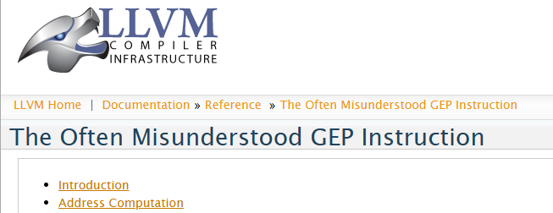
Address computation
GetElementPtrInst
Accessing fields of a struct
Accessing elements of an array
Slightly notorious – has its own dedicated page (https://llvm.org/docs/GetElementPtr.html)

Slide 41
GetElementPtrInst
<result> = getelementptr <ty>, ptr <ptrval>{, <ty2> <idx>}*
<ty>: type of the base pointer
<ptrval>: the base pointer
<ty2>: the index type
<idx>: the index being accessed

Slide 42
GEP example
; Function Attrs: noinline nounwind optnone uwtable
define dso_local i32 @main() #0 {
%1 = alloca i32, align 4
%2 = alloca i32, align 4
%3 = alloca i32, align 4
%4 = alloca i32, align 4
store i32 0, i32* %1, align 4
store i32 100, i32* %2, align 4
store i32 200, i32* %3, align 4
store i32 0, i32* %4, align 4
%5 = load i32, i32* %4, align 4
%6 = add nsw i32 %5, 1
store i32 %6, i32* %4, align 4
%7 = sext i32 %5 to i64
%8 = getelementptr inbounds [64 x i8], [64 x i8]* @name, i64 0, i64 %7
store i8 69, i8* %8, align 1
%9 = load i32, i32* %4, align 4
%10 = add nsw i32 %9, 1
store i32 %10, i32* %4, align 4
%11 = sext i32 %9 to i64
%12 = getelementptr inbounds [64 x i8], [64 x i8]* @name, i64 0, i64 %11
store i8 67, i8* %12, align 1
%13 = load i32, i32* %4, align 4
%14 = add nsw i32 %13, 1
store i32 %14, i32* %4, align 4
%15 = sext i32 %13 to i64
%16 = getelementptr inbounds [64 x i8], [64 x i8]* @name, i64 0, i64 %15
store i8 83, i8* %16, align 1
ret i32 0
}
char name[64];
int main(void) {
int a = 100;
int b = 200;
int i = 0;
name[i++] = 'E';
name[i++] = 'C';
name[i++] = 'S';
return 0;
}

Slide 43

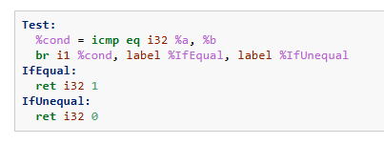
Control flow instructions
Every basic block ends with a terminator instruction
ret
Branch instruction
br i1 <cond>, label <if true>, label <if false>

Slide 44
Control flow instructions
Call instruction
<result> = call <fnty> <fnptrval> (<fn args>)
; Function Attrs: noinline nounwind optnone uwtable
define dso_local i32 @f(i32 noundef %0) #0 {
%2 = alloca i32, align 4
;;;;;; snip ;;;;;;;
ret i32 %5
}
declare i32 @printf(i8* noundef, ...) #1
; Function Attrs: noinline nounwind optnone uwtable
define dso_local i32 @main() #0 {
%1 = call i32 @f(i32 noundef 10)
ret i32 0
}

Slide 45
Other LLVM instructions
Comparison instructions (icmp )
Control flow instructions (br )
Unary, binary (add, sub, div, mul), bitwise (shl, shr) operations
https://llvm.org/docs/LangRef.html#instruction-reference

Slide 46
Important resources
https://llvm.org/docs/LangRef.html
https://llvm.org/docs/ProgrammersManual.html
All samples at: https://github.com/davsec-teaching/ECS289-ir-samples
https://llvm.org/docs/LangRef.html#instruction-reference

Slide 47
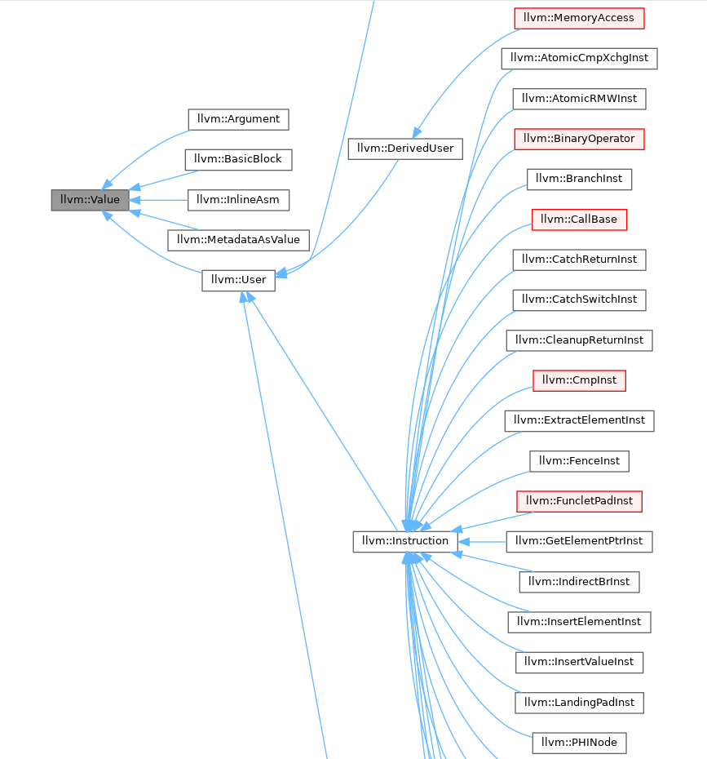
LLVM class hierarchy
https://llvm.org/doxygen/classllvm_1_1Value.html

Slide 48
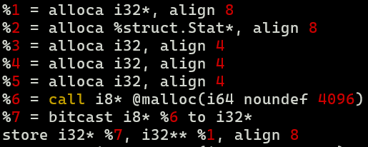

LLVM users API: def-use chains
Every llvm::Value maintains a list of its users
The instructions or constants that use it
value->users()
Def-use chain
malloc
bitcast
storeInst
allocaInst

Slide 49
LLVM RTTI (runtime type identification)
Uses custom RTTI
Three main APIs
isa<>, cast<>, dyn_cast<>
For example:
CallInst* CI = …; Instruction* I = CI; errs() << isa<CallInst>(I) << “ “ << isa<StoreInst>(I) << “\n”; // will print true false

Slide 50
The IRBuilder class
LLVM provides the IRBuilder class to add IR instructions
IRBuilder<> builder(inst);
Provides API for the creation of all types of IR instructions
https://llvm.org/doxygen/classllvm_1_1IRBuilder.html

Slide 51
Writing an LLVM pass

Slide 52
Recap: newer memories
In addition to DRAMs and SSDs, a third category of memory technology is slowly growing in popularity
These technologies (Intel Optane, and more recently CXL) have a latency characteristic that is faster than SSDs, but slower than DRAMS
And many of them can be transparently accessed like DRAM
mov %rdi, [%rbx] ;; %rbx contains a memory access

Slide 53
Recap: optimization problem
Compiler’s goal – given a C program, identify heap allocations that are “rarely” accessed and move them to this type of “slow” memory
Keep the DRAM available for frequently used heap objects
Assume a library provides a function slow_malloc to allocate an object on this slow memory
Simplification – assume that all pointers to heap memory are on the stack and are not copied to any other variable

Slide 54
Recap: optimization problem
struct Stat { int sum; int avg; int mean; }; void function(void) { int* p = malloc(sizeof(int)*1024); struct Stat* stat = malloc(sizeof(struct S)); for (int i = 0; i < 1024; i++) { p[i] = rand()*100; } int sum = 0; for (int i = 0; i < 1024; i++) { sum += p[i]; } stat->sum = sum; }
struct Stat { int sum; int avg; int mean; }; void function(void) { int* p = malloc(sizeof(int)*1024); struct Stat* stat = slow_malloc(sizeof(struct S)); for (int i = 0; i < 1024; i++) { *p++ = rand()*100; } int sum = 0; for (int i = 0; i < 1024; i++) { sum += i; } stat->sum = sum; }
Optimization

Slide 55
Step 1
LLVM provides libraries that allow you to access and manipulate IR instructions
Add new code, remove code, modify code
You must link with these libraries
Find an existing repo and clone it :)
https://github.com/sampsyo/llvm-pass-skeleton

Slide 56
Demo / live-coding
Step 2: Find all the heap allocation sites
Step 3: Track the heap pointers
Step 4: Count how many times they are accessed
Step 5: Replace the ones accessed less than 2 times with slow_malloc

Slide 57
LLVM introduction

Slide 58
Agenda
Recap
Live coding: LLVM optimization case-study
Live coding: LLVM instrumentation case-study
Discussions about case-studies
How to read a paper
Common compiler optimizations
Data flow analysis
Pointer analysis

Slide 59
Recap: memory hierarchy
CXL memory
Very “hot” data
“Hot” data
Rarely-accessed data

Slide 60
Recap: optimization
Goal: automatically rewrite the application to store less frequently used data on CXL
Very “hot” data
“Hot” data
Rarely-accessed data

Slide 61
Recap: optimization
Assumptions:
This type of memory can be accessed transparently like DRAM
mov %rdi, [%rbx] ;; %rbx contains a memory access
We have a library that provides a function slow_malloc() to allocate memory on such memory devices

Slide 62
Recap: optimization problem
struct Stat { int sum; int avg; int mean; }; void function(void) { int* p = malloc(sizeof(int)*1024); struct Stat* stat = malloc(sizeof(struct S)); for (int i = 0; i < 1024; i++) { p[i] = rand()*100; } int sum = 0; for (int i = 0; i < 1024; i++) { sum += p[i]; } stat->sum = sum; }
struct Stat { int sum; int avg; int mean; }; void function(void) { int* p = malloc(sizeof(int)*1024); struct Stat* stat = slow_malloc(sizeof(struct S)); for (int i = 0; i < 1024; i++) { *p++ = rand()*100; } int sum = 0; for (int i = 0; i < 1024; i++) { sum += i; } stat->sum = sum; }
Optimization

Slide 63
Recap: LLVM IR
Source code files
LLVM passes
Frontend
CXL Allocate
Dead code elimination
Inlining
Dead store elimination
Loop unroll
SROA
Backend
High-level IR: LLVM IR
Low-level IR
Executable
https://llvm.org/docs/Passes.html

Slide 64
LLVM pass structure
using namespace llvm;
namespace {
struct SkeletonPass : public PassInfoMixin<SkeletonPass> {
PreservedAnalyses run(Module &M, ModuleAnalysisManager &AM) {
return PreservedAnalyses::all();
};
};
}
extern "C" LLVM_ATTRIBUTE_WEAK ::llvm::PassPluginLibraryInfo
llvmGetPassPluginInfo() {
return {
.APIVersion = LLVM_PLUGIN_API_VERSION,
.PluginName = "Skeleton pass",
.PluginVersion = "v0.1",
.RegisterPassBuilderCallbacks = [](PassBuilder &PB) {
PB.registerPipelineStartEPCallback(
[](ModulePassManager &MPM, OptimizationLevel Level) {
MPM.addPass(SkeletonPass());
});
}
};
}
Pass name
Module-level pass
Pass functionality
Pass registration

Slide 65
Recap: LLVM class hierarchy
https://llvm.org/doxygen/classllvm_1_1Value.html

Slide 66

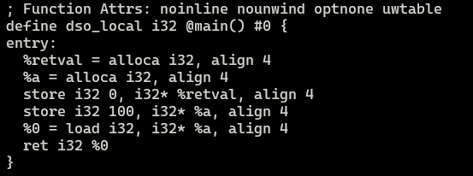
Recap: LLVM IR
Stack variables performed via the alloca instruction
alloca instruction always returns a pointer
Tip
clang -c -emit-llvm -S -fno-discard-value-names alloca.c -o alloca.ll
Retains names in SSA variables

Slide 67
Recap: LLVM IR
Heap allocations performed via a call instruction
CallInst returns a virtual register
Must be stored to a stack/global/heap variable
define dso_local i32 @main() #0 {
%1 = alloca i32, align 4
%2 = alloca i8*, align 8
store i32 0, i32* %1, align 4
%3 = call i8* @malloc(i64 noundef 4)
store i8* %3, i8** %2, align 8
ret i32 0
}
int main(void) {
char* s = malloc(sizeof(1024));
return 0;
}

Slide 68
Recap: LLVM IR
All memory accesses are explicitly performed
define dso_local i32 @main() #0 {
%1 = alloca i32, align 4
%2 = alloca i32, align 4
%3 = alloca i32*, align 8
%4 = alloca i32, align 4
store i32 0, i32* %1, align 4
store i32 10, i32* %2, align 4
store i32* %2, i32** %3, align 8
%5 = load i32*, i32** %3, align 8
%6 = load i32, i32* %5, align 4
store i32 %6, i32* %4, align 4
ret i32 0
}
int main(void) {
int a = 10;
int* p = &a;
int b = *p;
return 0;
}

Slide 69
Recap: LLVM IR
Loaded values are stored in “virtual registers”
define dso_local i32 @main() #0 {
%1 = alloca i32, align 4
%2 = alloca i32, align 4
%3 = alloca i32*, align 8
%4 = alloca i32, align 4
store i32 0, i32* %1, align 4
store i32 10, i32* %2, align 4
store i32* %2, i32** %3, align 8
%5 = load i32*, i32** %3, align 8
%6 = load i32, i32* %5, align 4
store i32 %6, i32* %4, align 4
ret i32 0
}
int main(void) {
int a = 10;
int* p = &a;
int b = *p;
return 0;
}

Slide 70
Recap: def-use chains
Every llvm::Value maintains a list of its users
The instructions or constants that use it
value->users()
Def-use chain
malloc
user
bitcast
user
storeInst
user
allocaInst

Slide 71
Steps
Find all heap allocation sites
Find the pointers where these heap objects are stored
Assumption: only stack pointers exist
Find the instructions that use these pointers
Assumption: the heap pointers aren’t copied to other pointers
Count how many times they are used
Assumption: we only care about how many times the heap object is updated
Which instruction should we care about?

Slide 72
Link to full solution
https://github.com/davsec-teaching/ECS289-optimizer-example

Slide 73
How would you complete this solution?

Slide 74
Case study: poor person’s Valgrind
Valgrind is a tool that detects memory leaks for binary objects
We will create a LLVM-based compiler tool that records the number of malloc’s and free’s
We will instrument each malloc call-site to invoke another function incr_and_print_count()
We will instrument each free call-site to invoke another function decr_and_print_count()

Slide 75
Valgrind clone
// valgring_clone.c unsigned long heap_count; void incr_and_print_count() { heap_count++; printf(“Current heap allocations: %d\n”, heap_count); }
void decr_and_print_count() { heap_count--; printf(“Current heap allocations: %d\n”, heap_count); }

Slide 76
Valgrind clone
struct Stat { int sum; int avg; int mean; }; void function(void) { int* p = malloc(sizeof(int)*1024); struct Stat* stat = malloc(sizeof(struct S)); for (int i = 0; i < 1024; i++) { p[i] = rand()*100; } int sum = 0; for (int i = 0; i < 1024; i++) { sum += p[i]; } stat->sum = sum; free(p); free(stat); }
struct Stat { int sum; int avg; int mean; }; void function(void) { incr_and_print_count(); int* p = malloc(sizeof(int)*1024);
incr_and_print_count(); struct Stat* stat = malloc(sizeof(struct S)); for (int i = 0; i < 1024; i++) { *p++ = rand()*100; } int sum = 0; for (int i = 0; i < 1024; i++) { sum += i; } stat->sum = sum; decr_and_print_count(); free(p); decr_and_print_count(); free(stat); }
Instrumented

Slide 77
The IRBuilder class
LLVM provides the IRBuilder class to add IR instructions
IRBuilder<> builder(inst); // sets up the builder to insert BEFORE the instruction inst
IRBuilder<> builder(inst->getNextNode()); // to insert after the instruction inst
Provides API for the creation of all types of IR instructions
https://llvm.org/doxygen/classllvm_1_1IRBuilder.html
[In-class review of documentation]

Slide 78
Link to full solution
https://github.com/davsec-teaching/ECS289-valgrind-clone

Slide 79
Discussion on case-studies

Slide 80
Discussion: how to read a paper

Slide 81
Common compiler optimizations

Slide 82
Announcement
First paper presentations 4/17
Please send me slides by next Monday to get feedback!!!
Everyone should read the papers:
Before the presentation, everyone must state 1 positive and 1 negative about the paper
Please let me know if you’re partnering up with anyone for the project

Slide 83
Agenda
Common compiler optimizations
Set theory review
Data flow analysis
Reaching definition analysis
Live variable analysis
Fixed point analysis – mathematical intuition
Pointer analysis

Slide 84
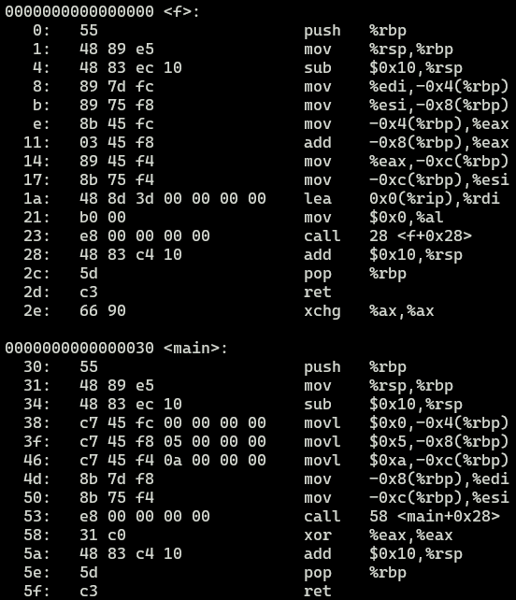
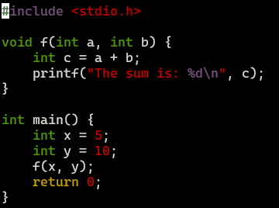
Function inlining
What does a function call look like on x86-64?

Slide 85
Anatomy of a function call in x86-64
Each function has a stack frame
Return address
Return values
Contains stack variables

Slide 86
Anatomy of a function call in x86-64
rbp
x
y
rsp

Slide 87
Anatomy of a function call in x86-64
rbp
x
y
rsp

Slide 88
Anatomy of a function call in x86-64
x
y
rbp
return_addr
a
b
rsp

Slide 89
Anatomy of a function call in x86-64
rbp
x
y
rsp
return_addr
a
b

Slide 90
Function inlining
What does a function call look like on x86-64?
28 instructions

Slide 91
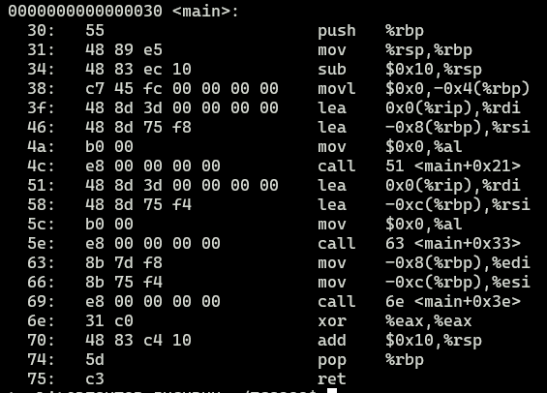
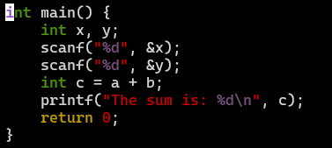
Function inlining
What if we inline the function?
19 instructions
Notes:
- No mucking around with RSP, RBP registers

Slide 92
How to inline?
Insert body of the called function in the caller function
Adjust the arguments
Adjust the return values

Slide 93
Should the compiler always inline functions?

Slide 94
Hint: instructions are also “cached”
Socket 1
Socket 2
CPU
CPU
CPU
CPU
REGS
REGS
REGS
REGS
(32 KB)
L1 Cache (I/D)
L1 Cache (I/D)
L1 Cache (I/D)
L1 Cache (I/D)
(256 KB)
L2 Cache (I/D)
L2 Cache (I/D)
L2 Cache (I/D)
L2 Cache (I/D)
(1-8 MB)
LLC Cache (I/D)
LLC Cache (I/D)
Memory bus
DRAM
(Multiple GB)

Slide 95
Should the compiler always inline functions?
Before inlining
After inlining
int function(int a) { // 20 instructions s₀ to s₁₉
}
int main(void) {
int a = 100; function(a);
int b = 20;
b++;
function(b);
}
int main(void) {
int a = 100; s₀
s₁
…
s₁₉
int b = 20;
b++;
s₀
s₁
…
s₁₉ }
i-cache doesn’t know
these instructions are
repeated
Even though it reduces # of instructions, it causes more i-cache misses
Compilers use heuristics to determine when to inline and when not to inline
Notes:
Even though it reduces the number of instructions
It can increase the static instruction count
And cause poor i-cache behavior

Slide 96
Can the compiler always inline functions?

Slide 97
Can the compiler always inline functions?
Before inlining
After inlining
int (*fptr)(int);
int main(void) {
int a = 100; (*fptr)(a);
int b = 20;
b++;
(*fptr)(b);
}
… ?????....
The compiler first needs to resolve the target of fptr to be able to inline it
Notes:
Even though it reduces the number of instructions
It can increase the static instruction count
And cause poor i-cache behavior

Slide 98
Register promotion
Main idea: promote stack variables to registers
int function() { int a, b, c;
scanf(“%d”, &a);
scanf(“%d”, &b);
scanf(“%d”, &c);
b = 10 – a;
c = a + 30;
printf(“%d %d %d\n”, a, b, c); }
Can likely be stored in hardware regs

Slide 99
SROA
Scalar Replacement of Aggregates
Breaks down aggregates into individual scalar variables
Notes:
- Acronym -> scary

Slide 100
SROA
Can struct A obj be promoted to a register?
struct A {
int a; int b; };
int main(void) { struct A obj;
scanf(“%d”, &(obj.a));
scanf(“%d”, &(obj.b));
int sum = obj.a + obj.b;
printf(“%d\n”, sum); }

Slide 101
SROA
Splitting the struct (aggregate) into its individual fields (scalars, such as int, char, etc) allows it to be promoted to a register
struct must not escape the function/module
struct A {
int a; int b; };
int main(void) { int s_a;
int s_b;
scanf(“%d”, &(s_a));
scanf(“%d”, &(s_b));
int sum = s_a + s_b;
printf(“%d\n”, sum); }
Can be promoted to registers

Slide 102
Loop unrolling
Main idea: if the compiler can determine the bounds of the loop, it can “unroll” it
Removes all loop maintenance instructions
// Without loop unrolling
void f() {
int arr[5];
for (int i = 0; i < 5; i++) {
arr[i] = i*2; }
}
// With loop unrolling
void f() {
int arr[5];
arr[0] = 0;
arr[1] = 2;
arr[2] = 4;
arr[3] = 6;
arr[4] = 8;
}

