Slide 1
Memory safety
Tapti Palit

Slide 2
Announcements
Please sign up for paper readings
Today’s class will end 10 minutes early

Slide 3
Agenda
Memory unsafe languages – C
Spatial safety: buffer overflow review
Temporal safety: Use-after-free, double-free
Approaches to memory safety
Garbage collection
Ownership-based
Compiler techniques for security transformations for C

Slide 4
C vs Java vs Python
C/C++
Java
#include <stdio.h> int main(int argc, char** argv) { char a = ‘A’; char arr[4] = {‘a’, ‘b’, ‘c’, ‘d’}; int index = atoi(argv[1]); printf(“%c\n”, arr[index]);
}
> gcc test.c –o test > ./test 10 > Output???
class MyApp {
public static void main(String[] args) { char a = ‘A’;
char arr[] = {‘a’, ‘b’, ‘c’, ‘d’};
int index = Integer.parseInt(args[0]);
System.out.println(arr[a]);
}
}
> javac MyApp.java > java MyApp.class 10 > # Output?
import sys arr = [‘a’, ‘b’, ‘c’, ‘d’] index = int(sys.argv[1]) print(arr[index]) > python3 test.py 10
Python

Slide 5
C vs Java vs Python
C/C++
Java
#include <stdio.h> int main(int argc, char** argv) { char a = ‘A’; char arr[4] = {‘a’, ‘b’, ‘c’, ‘d’}; int index = atoi(argv[1]); printf(“%c\n”, arr[index]);
}
> gcc test.c –o test > ./test 10 > �
class MyApp {
public static void main(String[] args) { char a = ‘A’;
char arr[] = {‘a’, ‘b’, ‘c’, ‘d’};
int index = Integer.parseInt(args[0]);
System.out.println(arr[a]);
}
}
> javac MyApp.java > java MyApp.class 10 > Exception in thread "main" java.lang.ArrayIndexOutOfBoundsException: Index 10 out of bounds for length 4
Undefined Behavior (UB)
import sys arr = [‘a’, ‘b’, ‘c’, ‘d’] index = int(sys.argv[1]) print(arr[index]) > python3 test.py 10 IndexError: list index out of range
Python

Slide 6
Memory layout
#include <stdio.h> int main(int argc, char** argv) { char a = ‘A’; char arr[4] = {‘a’, ‘b’, ‘c’, ‘d’}; int index = atoi(argv[1]); printf(“%c\n”, arr[index]);
}
> gcc test.c –o test > ./test 10 > �
.. garbage value ..
0x1004
… 6 bytes …
0xFFF
arr[3]
0xFFE
+10
arr[2]
0xFFD
arr[1]
0xFFC
arr[0]
0xFFB
a
0xFFA

Slide 7
C: lack of bounds checks
Buffers (arrays, strings) have bounds
[0, Size of the buffer]
char* p = malloc(128); // Bounds [0, 128]
C lacks bounds checks
p[1000]
Assume that p is pointing to a buffer that has at least 1000 elements
Try to access the 1000th element
Might crash if memory isn’t mapped
Might print whatever was in that memory

Slide 8

Memory safety and performance
Java compiler inserts bounds checks for array accesses that are inserted at runtime
Additional runtime checks reduces performance
Pseudo-code after Java compiler
inserts checks
Original Java code
char a = ‘A’; char arr[4] = {‘a’, ‘b’, ‘c’, ‘d’}; int index = atoi(argv[1]); printf(“%c\n”, arr[index]);
char a = ‘A’; char arr[4] = {‘a’, ‘b’, ‘c’, ‘d’}; int index = atoi(argv[1]); if (index < arr.length) {
System.out.println(arr[index]);
} else {
throw new ArrayIndexOutOfBoundsException();
}

Slide 9
So what?
In case of all programming languages, the program didn’t do what we wanted it to do
Java, Python -> it crashed [defined behavior]
C -> printed garbage or might crash [undefined behavior]
… why is the second option worse than the first?

Slide 10
Why is UB worse?
Undefined behavior leaves system in inconsistent state
Inconsistent state can be exploited by the attacker
… How??

Slide 11
Background: types of memory
Applications have (at least) 3 types of memory
Function local variables allocated on the “stack”
Heap variables allocated via malloc
Global variables
int global_arr[10];
int main(void) {
int a;
int b;
int local_arr[10];
int* p = malloc(10*sizeof(int));
}
Global variable
Stack variable
Heap variable

Slide 12
Background: stack layout
Stack grows downward
0x1000
Top of the stack
0xFFF
0xFFE
0xFFD
0xFFC
0xFFB

Slide 13
Buffer overflow
#include <stdlib.h>
#include <stdio.h>
int main(void) { uint8_t authenticated = 0;
uint8_t array[4];
uint8_t * p = array;
uint8_t num;
for (int i = 0; i <= 4; i++) {
printf(“Enter a number:”);
scanf(“%d”, &num);
}
return 0;
}
authenticated
0x1000
array[3]
0xFFF
array[2]
0xFFE
array[1]
0xFFD
array[0]
0xFFC
0xFFB
Notes:
- Order is compiler specific

Slide 14
Buffer overflow
#include <stdlib.h>
#include <stdio.h>
int main(void) { uint8_t authenticated = 0;
uint8_t array[4];
uint8_t * p = array;
uint8_t num;
for (int i = 0; i <= 4; i++) {
printf(“Enter a number:”);
scanf(“%d”, &num);
array[i] = num;
}
return 0;
} > Enter a number:
1 # 5 times
1
authenticated
0x1000
1
Overwrite authenticated
variable!!!
array[3]
0xFFF
1
array[2]
0xFFE
array[1]
0xFFD
1
array[0]
0xFFC
1
0xFFB

Slide 15
Vulnerable string-related libc functions
scanf (with the %s modifier) , strcpy, printf (with %n modifier)
String stored can be larger than the variable size
Will overwrite the contents of the adjacent memory
char* password = malloc(5); scanf(“%s”, password); // will overflow if user enters “AAAAAA”

Slide 16
Vulnerable string-related libc functions
char* password = malloc(5); scanf(“%s”, password)
overflow if user enters “AAAAAA”
A
0x1000
A
0xFFF
A
0xFFE
Password
A
0xFFD
A
0xFFC
A
0xFFB

Slide 17
Inside libc…
Fundamentally, a buffer overflow within libc
char* strcpy(char* dest, const char* src) {
char* dest_start = dest;
while ((*dest++ = *src++) != '\0') {
}
return dest_start;
}
Can overflow beyond src and dest limits

Slide 18





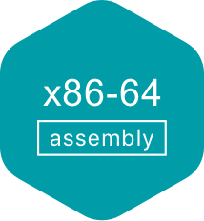
Programming languages and memory safety
Memory safety is a property of a programming language that ensures all memory accesses are
Well-defined
Adhere to object boundaries
Adhere to types of allocated objects
Some programming languages have memory safety and some do not
Memory safe
Memory unsafe

Slide 19
Then why would one use C/C++ over Java/Python???

Slide 20
Memory safety and performance
Java compiler inserts bounds checks for array accesses that are inserted at runtime
Additional runtime checks reduces performance
Pseudo-code after Java compiler
inserts checks
Original Java code
char a = ‘A’; char arr[4] = {‘a’, ‘b’, ‘c’, ‘d’}; int index = atoi(argv[1]); printf(“%c\n”, arr[index]);
char a = ‘A’; char arr[4] = {‘a’, ‘b’, ‘c’, ‘d’}; int index = Integer.parseInt(argv[1]); if (index < arr.length) {
System.out.println(arr[index]);
} else {
throw new ArrayIndexOutOfBoundsException();
}

Slide 21
C vs. Java performance
https://programming-language-benchmarks.vercel.app/c-vs-java
Notes:
Mathematical benchmarks

Slide 22
C vs. Rust performance
// insert our future paper!
Not real results!!!
Notes:
Mathematical benchmarks

Slide 23






Performance critical software in C/C++
Web servers
Nginx, Apache Httpd
Key-value stores
Redis, Memcached
Database servers
MySQL
Postgresql
SQLLite

Slide 24
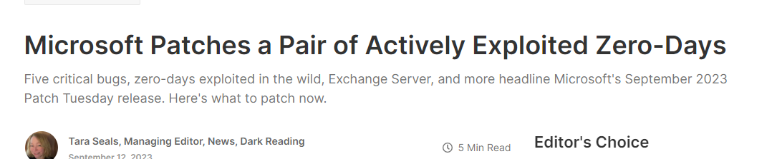

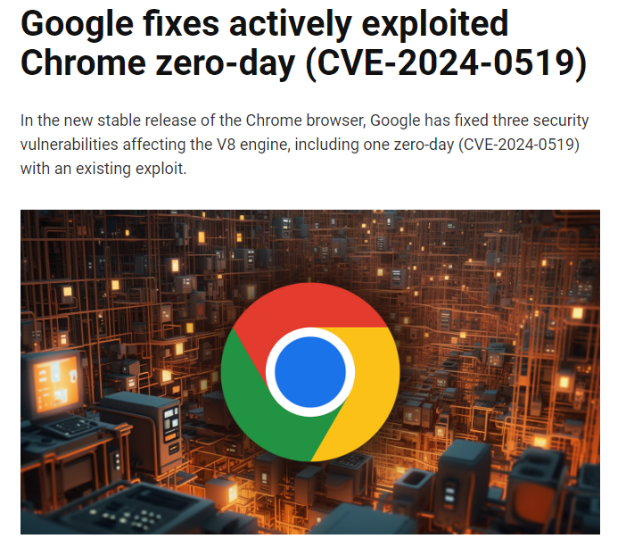
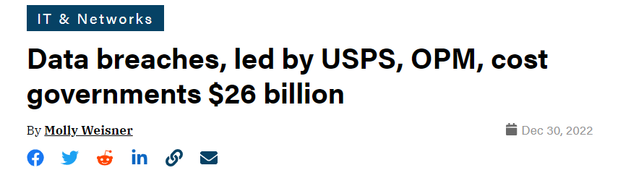
Security attacks

Slide 25
Stack memory on x86 (high-level idea)
Function local variables are stored on stack
0x1000
Top of the stack
0xFFA
0xFF8
0xFF4
0xFF0
Notes:
- Specific to x86.. Most common archs operate in this way

Slide 26
Stack memory on x86 (high-level idea)
Function local variables are stored on stack
1. int my_func(int a, int b) { 2. int result = 0; 3. if (a > b) { result = a – b; } 4. else { result = b – a; } 5. return result; 6. } 8. int main(void) { 9. int p = 10; 10. int q = 30; 11. int sub = my_func(p, q); 12. printf(“%d\n”, sub); }
p
0x1000
Top of the stack
q
0xFFA
return_addr@12
0xFF8
push
result
0xFF4
0xFF0

Slide 27
Stack memory on x86 (high-level idea)
Function local variables are stored on stack
1. int my_func(int a, int b) { 2. int result = 0; 3. if (a > b) { result = a – b; } 4. else { result = b – a; } 5. return result; 6. } 8. int main(void) { 9. int p = 10; 10. int q = 30; 11. int sub = my_func(p, q); 12. printf(“%d\n”, sub); }
Top of the stack
p
0x1000
Stack frame for
main
q
0xFFA
return_addr@12
0xFF8
Stack frame for
my_func
result
0xFF4
On x86, stack grows downwards
0xFF0

Slide 28
Stack memory on x86 (high-level idea)
Function local variables are stored on stack
1. int my_func(int a, int b) { 2. int result = 0; 3. if (a > b) { result = a – b; } 4. else { result = b – a; } 5. return result; 6. } 8. int main(void) { 9. int p = 10; 10. int q = 30; 11. int sub = my_func(p, q); 12. printf(“%d\n”, sub); }
Top of the stack
p
0x1000
Execution returns to
return_addr@12
q
0xFFA
return_addr@12
0xFF8
result
0xFF4
0xFF0

Slide 29
x86 feature
C function calls -> callq instruction
callq instruction pushes the address of the next instruction on the stack
Then, transfers control to the called function
C return statements -> retq instruction
retq instruction pops the return address from the stack
Then, transfers control to the return address

Slide 30
Implications…
Return addresses on the stack
At a higher address than function local variables
C has no protection against buffer overflows
p
0x1000
q
0xFFA
return_addr@12
0xFF8
result
0xFF4
0xFF0

Slide 31
Implications…
1. void authenticate () { 2. char password[8]; 3. printf(“Enter the password\n”); 3. scanf(“%s”, password); 4. return; 5. } 6. int main(void) { 7. authenticate(); 8. } 9. void super_secret_function() { 10. puts(“This is a super secret function\n”); 11.}
p
0x1000
Top of the stack
q
0xFFA
return_addr@7
0xFF8
&super_secret_func
Overflow
password
0xFF4
0xFF0

Slide 32
Implications…
The attacker can not only overwrite stack variables
But also hijack control flow
Known as
Control flow hijack attacks
Extremely powerful!!
“Negative synergy” between x86 architecture and C language
p
0x1000
Top of the stack
q
0xFFA
return_addr@12
0xFF8
&super_secret_func
Overflow
password
0xFF4
0xFF0

Slide 33
Interesting targets for control flow hijack
Security-critical functions in the program
Libc functions
execve() – can start executing a completely different program!!
Known as return-to-libc attacks (subset of control-flow hijack attacks)
What else?

Slide 34
What else?
No requirement that the address should be the start of a function
Can “return” to the middle of a function
00000000004012e0 <super_secret_function>:
4012e0: 55 push %rbp
4012e1: 48 89 e5 mov %rsp,%rbp
4012e4: 48 bf 15 20 40 00 00 movabs $0x402015,%rdi
4012eb: 00 00 00
4012ee: e8 3d fd ff ff call 401030 <puts@plt>
4012f3: 5d pop %rbp
4012f4: c3 ret
4012f5: 66 2e 0f 1f 84 00 00 cs nopw 0x0(%rax,%rax,1)
4012fc: 00 00 00
4012ff: 90 nop

Slide 35
What else?
No requirement that the address should be the start of a function
Can “return” to the middle of a function
Just overwrite with the address of your choice
p
0x1000
Top of the stack
q
0xFFA
return_addr@12
0xFF8
0x4012e4
Overflow
password
0xFF4
0xFF0

Slide 36
What else?
On x86
No requirement that the address should be the start of an instruction!!
00000000004012e0 <super_secret_function>:
4012e0: 55 push %rbp
4012e1: 48 89 e5 mov %rsp,%rbp
4012e4: 48 bf 15 20 40 00 00 movabs $0x402015,%rdi
4012eb: 00 00 00
4012ee: e8 3d fd ff ff call 401030 <puts@plt>
4012f3: 5d pop %rbp
4012f4: c3 ret
4012f5: 66 2e 0f 1f 84 00 00 cs nopw 0x0(%rax,%rax,1)
4012fc: 00 00 00
4012ff: 90 nop

Slide 37
What else?
00000000004012e0 <super_secret_function>:
4012e0: 55 push %rbp
4012e1: 48 89 e5 mov %rsp,%rbp
4012e4: 48 bf 15 20 40 00 00 movabs $0x402015,%rdi
4012eb: 00 00 00
4012ee: e8 3d fd ff ff call 401030 <puts@plt>
4012f3: 5d pop %rbp
4012f4: c3 ret
4012f5: 66 2e 0f 1f 84 00 00 cs nopw 0x0(%rax,%rax,1)
4012fc: 00 00 00
4012ff: 90 nop
p
0x1000
q
0xFFA
return_addr@12
0xFF8
0x4012e2
password
0xFF4
0xFF0
Overflow

Slide 38
Implications…
Can hijack control flow to middle of a real instruction
From the attacker’s POV the program is a set of byte-sequence terminating in a return/jump
Return-oriented Programming (subset of control flow hijack attacks)
Such byte-sequence is known as “ROP gadget”
Can chain byte sequences to perform complex attacks
58 5a 5e c3 5f c3 ff e0 c3 ff d0 c3 89 c2 c3 89 c1 c3 31 c0 c3 83 c0 04 c3 90 90 90 90 90 90 90 90 90 90 c3 cc c3

Slide 39

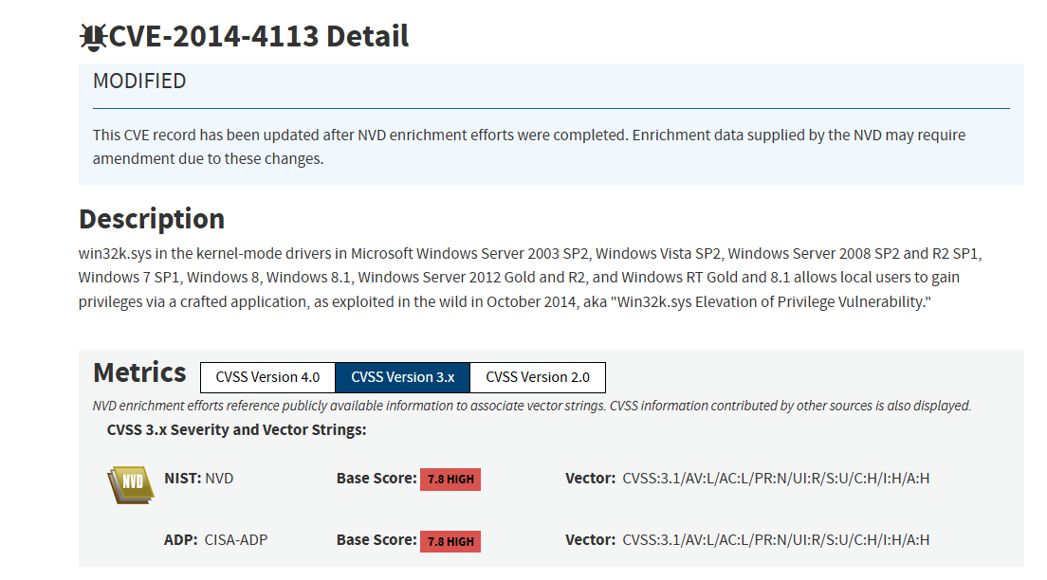

But isn’t all this too hard to exploit?
Notes:
- multi-step attacks

Slide 40
But isn’t all this too hard to exploit?
In 2025, the US Department of Defense (DoD) has been allocated approximately $30 billion for cybersecurity initiatives
Includes both defensive and offensive initiatives
2009-2010 Stuxnet attack disabled key part of Iranian nuclear program
https://www.csoonline.com/article/3632164/us-military-allocated-about-30-billion-to-spend-on-cybersecurity-in-2025.html
https://www.csoonline.com/article/562691/stuxnet-explained-the-first-known-cyberweapon.html

Slide 41
Heap-based vulnerabilities/attacks
Heap memory used for dynamic memory allocation
char* p = malloc(1024);
free(p);
char* s = malloc(128);
Heap has no directionality of growth
Objects placed according to “heap allocation policy”

Slide 42
Heap overflow attacks
0x1000
void authenticate () { char* password = malloc(8);
int* authenticated = malloc(sizeof(int)); printf(“Enter the password\n”); scanf(“%s”, password);
if (strcmp(…)
authenticated = 1;
if (authenticated) {
printf(“Authenticated!\n”);
} else {
printf(“Not allowed!\n”);
} return; } int main(void) { authenticate(); }
authenticate
0xFFA
Overflow
password
0xFF8
0xFF4
0xFF0

Slide 43
Heap overflow attacks
0x1000
void authenticate () { char* password = malloc(8);
int* authenticated = malloc(sizeof(int)); printf(“Enter the password\n”); scanf(“%s”, password);
if (strcmp(…)
authenticated = 1;
if (authenticated) {
printf(“Authenticated!\n”);
} else {
printf(“Not allowed!\n”);
} return; } int main(void) { authenticate(); }
0xFFA
Overflow
password
0xFF8
0xFF4
0xFF0
authenticate

Slide 44
Types of memory safety
Memory safety
Spatial safety
Temporal safety
Buffer overflow
Compilers of memory-safe languages add bounds-checks

Slide 45
Temporal safety vulnerabilities
C compiler will not detect updates to freed memory
void function () { char* buffer = malloc(8);
// do something with buffer
free(buffer);
// 1000 statements later
buffer[2] = ‘A’; return; }

Slide 46
Temporal safety vulnerabilities
C compiler will not detect updates to freed memory
void function () { char* buffer = malloc(8); // do something with buffer
free(buffer);
// 1000 statements later
char* SSL_KEY = malloc(8);
// 1000 statements later
buffer[2] = ‘A’; // will overwrite SSL_KEY return; }
0x1000
SSL_KEY
buffer
A
0xFFA
0xFF8
0xFF4
0xFF0

Slide 47
Temporal safety vulnerabilities
C compiler will not detect updates to freed memory
Use-after-free (UAF) vulnerability
The pointer involved is called a dangling pointer
void function () { char* buffer = malloc(8); // do something with buffer
free(buffer);
// 1000 statements later
char* SSL_KEY = malloc(8);
// 1000 statements later
buffer[2] = ‘A’; // will overwrite SSL_KEY return; }

Slide 48
Temporal safety vulnerabilities
C compiler will not detect if an object is freed twice
Messes up the heap allocator’s meta-data
Can be exploited by the attacker
Double-free vulnerability
void function () { char* buffer = malloc(8); // do something with buffer
free(buffer);
// 1000 statements later
free(buffer); // again
}

Slide 49
Defenses - stack canaries
Can detect stack overflow into return address
1. void authenticate () { 2. char password[8]; 3. printf(“Enter the password\n”); 3. scanf(“%s”, password); 4. return; 5. } 6. int main(void) { 7. authenticate(); 8. } 9. void super_secret_function() { 10. puts(“This is a super secret function\n”); 11.}
Top of the stack
return_addr@8
0xFF8
Compiler pushes a
“canary” value
CANARY=0xDEADBEEF
0xFF4
password
0xFF0

Slide 50
Defenses - stack canaries
Can detect stack overflow into return address
1. void authenticate () { 2. char password[8]; 3. printf(“Enter the password\n”); 3. scanf(“%s”, password); 4. return; 5. } 6. int main(void) { 7. authenticate(); 8. } 9. void super_secret_function() { 10. puts(“This is a super secret function\n”); 11.}
Top of the stack
return_addr@8
0xFF8
Overflow corrupts
the canary
CANARY=0xDEADBEEF
0xFF4
password
0xFF0

Slide 51
Defenses - stack canaries
Can detect stack overflow into return address
1. void authenticate () { 2. char password[8]; 3. printf(“Enter the password\n”); 3. scanf(“%s”, password); 4. return; 5. } 6. int main(void) { 7. authenticate(); 8. } 9. void super_secret_function() { 10. puts(“This is a super secret function\n”); 11.}
Top of the stack
return_addr@9
0xFF8
Overflow corrupts
the canary
CANARY=0xABCDABCD
0xFF4
password
0xFF0

Slide 52
Defenses - stack canaries
Can detect stack overflow into return address
1. void authenticate () { 2. char password[8]; 3. printf(“Enter the password\n”); 3. scanf(“%s”, password); 4. return; 5. } 6. int main(void) { 7. authenticate(); 8. } 9. void super_secret_function() { 10. puts(“This is a super secret function\n”); 11.}
Top of the stack
Compiler checks
the canary for corruption -> old_value != new_value
-> Buffer overflow
return_addr@9
0xFF8
CANARY=0xABCDABCD
0xFF4
password
0xFF0

Slide 53
Defenses - stack canaries
Can detect stack overflow into return address
1. void authenticate () { 2. char password[8]; 3. printf(“Enter the password\n”); 3. scanf(“%s”, password); 4. return; 5. } 6. int main(void) { 7. authenticate(); 8. } 9. void super_secret_function() { 10. puts(“This is a super secret function\n”); 11.}
Top of the stack
return_addr@9
0xFF8
CANARY=0xABCDABCD
0xFF4
TERMINATE EXECUTION
password
0xFF0

Slide 54
Stack canaries
Available on most popular C/C++ compilers
gcc,clang
Can typically detect overflow across stack frames
Can typically NOT detect overflow within objects in the same stack frame
Can NOT detect overflow within same object on the stack
E.g., different fields in the struct type

Slide 55
Defenses – Address Space Layout Randomization
Operating System feature
Randomizes the address where the binary is loaded
Makes it harder for the attacker to guess the target address
… defenses are ad-hoc and incomplete

Slide 56
Memory safety in Java
(and JS, Go, and to some extent Python)

Slide 57
Spatial memory safety in Java
Java compiler inserts bounds checks for array accesses that are inserted at runtime
Pseudo-code after Java compiler
inserts checks
Original Java code
char a = ‘A’; char arr[4] = {‘a’, ‘b’, ‘c’, ‘d’}; int index = atoi(argv[1]); printf(“%c\n”, arr[index]);
char a = ‘A’; char arr[4] = {‘a’, ‘b’, ‘c’, ‘d’}; int index = Integer.parseInt(argv[1]); if (index < arr.length) {
System.out.println(arr[index]);
} else {
throw new ArrayIndexOutOfBoundsException();
}

Slide 58
Temporal memory safety in Java
Automatic memory management
Heap objects created using new
E.g. Car c = new Car();
Heap objects are automatically freed when no valid reference remain to them
“Garbage collection”

Slide 59
Garbage collection
A process of automatic memory management for dynamically allocated memory
Java runtime maintains object reachability graph
Garbage: Objects no longer reachable or usable by the program
Once an object is classified as “garbage” it is automatically reclaimed by a garbage collector thread
Prevents both dangling pointers and memory leaks
Many possible algorithms – e.g., Mark and Sweep

Slide 60
Mark and Sweep algorithm
Root node tracks all variables in scope
class EnergySource {}
class Car {
private EnergySource energySource;
public Car(EnergySource source) {
this.energySource = source;
}
}
List<Car> void func() {
EnergySource electricSource = new EnergySource(“electric”);
EnergySource gasSource = new EnergySource(“gas”);
Car c1 = new Car(electricSource);
Car c2 = new Car(gasSource);
Car c3 = new Car(electricSource);
List<Car> carList = new List<Car>();
carList.push(c1);
carList.push(c3); // c2 not pushed
return carList;
}
public static void main(..) {
List<Car> cars = func();
System.out.println(…);
}
EnergySource object
EnergySource object
Car obj
Car obj
Car obj
List<Car> object
ROOT

Slide 61
Mark and Sweep algorithm
Root node tracks all variables in scope
class EnergySource {}
class Car {
private EnergySource energySource;
public Car(EnergySource source) {
this.energySource = source;
}
}
List<Car> void func() {
EnergySource electricSource = new EnergySource(“electric”);
EnergySource gasSource = new EnergySource(“gas”);
Car c1 = new Car(electricSource);
Car c2 = new Car(gasSource);
Car c3 = new Car(electricSource);
List<Car> carList = new List<Car>();
carList.push(c1);
carList.push(c3); // c2 not pushed
return carList;
}
public static void main(..) {
List<Car> cars = func();
System.out.println(…);
}
EnergySource object
EnergySource object
Car obj
Car obj
Car obj
List<Car> object
ROOT

Slide 62
Mark and Sweep algorithm
Language runtime spawns a “garbage collector” thread when memory usage reaches a threshold
Identifies “garbage” – objects no longer reachable or usable by the program -> Mark Phase
Once an object is classified as “garbage” it is automatically deleted -> Sweep Phase

Slide 63
Mark phase
Tracks all reachable objects from ROOT
class EnergySource {}
class Car {
private EnergySource energySource;
public Car(EnergySource source) {
this.energySource = source;
}
}
List<Car> void func() {
EnergySource electricSource = new EnergySource(“electric”);
EnergySource gasSource = new EnergySource(“gas”);
Car c1 = new Car(electricSource);
Car c2 = new Car(gasSource);
Car c3 = new Car(electricSource);
List<Car> carList = new List<Car>();
carList.push(c1);
carList.push(c3); // c2 not pushed
return carList;
}
public static void main(..) {
List<Car> cars = func();
System.out.println(…);
}
✓
EnergySource object
EnergySource object
✓
Car obj
✓
Car obj
Car obj
✓
List<Car> object
Imagine GC invokes here
✓
ROOT

Slide 64
Sweep phase
Deletes all non-reachable objects
class EnergySource {}
class Car {
private EnergySource energySource;
public Car(EnergySource source) {
this.energySource = source;
}
}
List<Car> void func() {
EnergySource electricSource = new EnergySource(“electric”);
EnergySource gasSource = new EnergySource(“gas”);
Car c1 = new Car(electricSource);
Car c2 = new Car(gasSource);
Car c3 = new Car(electricSource);
List<Car> carList = new List<Car>();
carList.push(c1);
carList.push(c3); // c2 not pushed
return carList;
}
public static void main(..) {
List<Car> cars = func();
System.out.println(…);
}
✓
EnergySource object
EnergySource object
✓
Car obj
✓
Car obj
Car obj
✓
List<Car> object
Imagine GC invokes here
✓
ROOT

Slide 65
Important points
Garbage collection does not occur after every function return
Occurs rarely and typically only after high memory usage

Slide 66
Memory safety guarantees
Prevents both dangling pointers and memory leaks
How?
A heap object is never freed if it is reachable -> no use-after-free
If a heap object is not reachable it is guaranteed to be freed -> no double frees and no memory leaks

Slide 67
Performance impact
Stop-the-world approach
Pauses all application threads while the garbage collector runs
Why? …
Typically, full STW approach is rare nowadays
Still partial STW

Slide 68
Performance of garbage collected languages
Garbage collection has a high overhead
Performance depends on application memory consumption
At lower memory usage, garbage collection is not triggered
Makes it hard to predict application behavior

Slide 69
Ownership-based memory safety

Slide 70

Rust language
Language imposes certain restrictions on what the programmer can do
In return, the compiler guarantees memory safety
If code compiles, then no spatial or temporal safety issues
As long as unsafe Rust is not used

Slide 71
Rust toolchain
Golang FE
ARM Backend
C/C++ FE
Middle-end
X86-64 Backend
Rust FE
ARM Backend
LLVM

Slide 72
Spatial safety
Every dynamically sized object maintains its bounds
pub struct Vec<T, A: Allocator = Global> { buf: RawVec<T, A>, len: usize, }
All accesses to dynamically sized objects are bound-checked
Raise an exception at runtime
If code compiles, then no undetected out-of-bounds access

Slide 73
Demo
fn main() {
let vector = vec![1, 2, 3, 4, 5];
// read from user input
let mut input = String::new();
println!("Please enter a number:");
std::io::stdin()
.read_line(&mut input)
.expect("Failed to read line");
let input: usize = input.trim().parse().expect("Please enter a number");
println!("You chose to read: {}", vector[input]);
println!("Hello, world!");
}

Slide 74
Ownership types
Every heap object has a single owner
The owner is responsible for creating and destroying the object
The object is automatically dropped when the owner goes out of scope
fn main() { let mut s = Box::new([1, 2, 3]); { let p = s; // p is the new owner, s can’t be accessed p[1] = 10; println!(“{}”, p[1]); // p goes out of scope // the string is dropped/freed. } println!(“{}”, s[2]); // Compiler error! }

Slide 75
Borrowing
References can borrow a value
Compiler will complain if the reference lives beyond the owner’s lifetime
fn main() { let mut s = Box::new([1, 2, 3]); { let p = s; // p is the new owner , s can’t be accessed
let r = &p;
println!(“{}”, r[1]); // works! p[1] = 10; println!(“{}”, p[1]); // p goes out of scope // the string is dropped/freed. } }

Slide 76
Can rust have temporal safety issues?
Double free bugs?
Use-after-free bugs?
Is there any performance overhead?
Garbage collection vs. ownership types

Slide 77
For completeness: data races
Data races can happen in multithreaded apps if incorrect locking is used
Data races can happen if two memory operations in different threads write to the same variable and one of them is a write

Slide 78
Mutability XOR aliasing
Rust has mutability XOR aliasing
fn main() { let mut s = String::from(“AAA”); let s_ref = &mut s; // mutable ref 1 let s_ref2 = &mut s; // mutable ref 2 <-- compiler error println!(“{}”, s_ref); }
If multithreaded code compiles, then no data race

Slide 79
Control flow integrity

Slide 80
Buffer overflow
#include <stdlib.h>
#include <stdio.h>
int main(void) { uint8_t authenticated = 0;
uint8_t array[4];
uint8_t * p = array;
uint8_t num;
for (int i = 0; i <= 4; i++) {
printf(“Enter a number:”);
scanf(“%d”, &num);
array[i] = num;
}
return 0;
} > Enter a number:
1 # 5 times
1
authenticated
0x1000
1
Overwrite authenticated
variable!!!
array[3]
0xFFF
1
array[2]
0xFFE
array[1]
0xFFD
1
array[0]
0xFFC
1
0xFFB

Slide 81
Function pointers on the heap
struct S { void (*fptr)(); int a; } void f() { } void grant_sudo_access() { } int main(void) { char* s = malloc(4); struct S* sptr = malloc(sizeof(struct S)); sptr->fptr = f; scanf(“%s”, s); (*(sptr->fptr))(); }
0x1000
0xFFF
0xFFE
0xFFD
0xFFC
0xFFB
0xFFA
Heap memory

Slide 82
Function pointers on the heap
struct S { void (*fptr)(); int a; } void f() { } void grant_sudo_access() { } int main(void) { char* s = malloc(4); struct S* sptr = malloc(sizeof(struct S)); sptr->fptr = f; scanf(“%s”, s); (*(sptr->fptr))(); }
0x1000
a
0xFFF
fptr
0xFFE
s
0xFFD
0xFFC
0xFFB
0xFFA
Heap memory

Slide 83
Function pointers on the heap
struct S { void (*fptr)(); int a; } void f() { } void grant_sudo_access() { } int main(void) { char* s = malloc(4); struct S* sptr = malloc(sizeof(struct S)); sptr->fptr = f; scanf(“%s”, s); (*(sptr->fptr))(); }
0x1000
a
0xFFF
fptr
0xFFE
s
0xFFD
0xFFC
0xFFB
0xFFA
Heap memory

Slide 84
Function pointers on the heap
struct S { void (*fptr)(); int a; } void f() { } void grant_sudo_access() { } int main(void) { char* s = malloc(4); struct S* sptr = malloc(sizeof(struct S)); sptr->fptr = f; scanf(“%s”, s); (*(sptr->fptr))(); }
0x1000
a
0xFFF
fptr =grant_sudo_access
0xFFE
s
0xFFD
0xFFC
0xFFB
0xFFA
Heap memory

Slide 85
Function pointers on the heap
struct S { void (*fptr)(); int a; } void f() { } void grant_sudo_access() { } int main(void) { char* s = malloc(4); struct S* sptr = malloc(sizeof(struct S)); sptr->fptr = f; scanf(“%s”, s); (*(sptr->fptr))(); }
0x1000
a
0xFFF
fptr =grant_sudo_access
0xFFE
s
0xFFD
0xFFC
0xFFB
0xFFA
Heap memory

Slide 86
Control flow integrity
struct S { void (*fptr)(); int a; } void f() { } void grant_sudo_access() { } int main(void) { char* s = malloc(4); struct S* sptr = malloc(sizeof(struct S)); sptr->fptr = f; scanf(“%s”, s); if (sptr->fptr != f) ABORT(); (*(sptr->fptr))(); }
0x1000
a
0xFFF
fptr =grant_sudo_access
0xFFE
s
0xFFD
0xFFC
0xFFB
0xFFA
Forward-edge CFI
Heap memory

Slide 87
Needs pointer analysis to resolve function pointer targets

Slide 88
Optimization use-cases vs. security use-cases
int (*fptr)(int);
void b() { fptr = f(); } void f(int a) { printf(“%d\n”, a); }
int main(void) {
b();
int a = 100; (*fptr)(a);
int b = 20;
b++;
(*fptr)(b);
}
struct S { void (*fptr)(); int a; } void f() { } void grant_sudo_access() { } int main(void) { char* s = malloc(4); struct S* sptr = malloc(sizeof(struct S)); sptr->fptr = f; scanf(“%s”, s); (*(sptr->fptr))(); }
Function inlining
Forward-edge CFI

Slide 89
Optimization use-cases vs. security use-cases
int (*fptr)(int);
void b() { fptr = f(); } void f(int a) { printf(“%d\n”, a); }
int main(void) {
b();
int a = 100; printf(“%d\n”, a);
int b = 20;
b++;
printf(“%d\n”, b);
}
struct S { void (*fptr)(); int a; } void f() { } void grant_sudo_access() { } int main(void) { char* s = malloc(4); struct S* sptr = malloc(sizeof(struct S)); sptr->fptr = f; scanf(“%s”, s); if (sptr->fptr != f) ABORT(); (*(sptr->fptr))(); }
Function inlining
Forward-edge CFI
Are there any differences in the analysis?

Slide 90
Optimization use-cases vs. security use-cases
For function inlining optimizations
We can tolerate false-negatives
fptr points to f, but analysis cannot determine that
Pointer analysis can be a function-level or module-level pass
For CFI
We cannot tolerate false-negatives
Pointer analysis must be a whole program analysis

