Slide 1
Data flow analysis
Tapti Palit

Slide 2
Recap: what is this course about?
Official title: Special topics in compilers and programming languages
Working title: Compilers, program analysis, and their applications
Notes:
- Some terms defined slightly differently

Slide 3
Program analysis
Program analysis techniques are static compile-time techniques for predicting safe and computable approximations to the set of values or behaviors arising dynamically at runtime when executing a program on a computer
Foundation on which many compiler optimizations are constructed
Nielson, Flemming, Hanne R. Nielson, and Chris Hankin. Principles of program analysis. springer, 2015.

Slide 4
Sets
Set theory is the mathematical theory of well-determined collections, called sets, of objects that are called members, or elements, of the set.
A Set is a collection of distinct objects
A = {1, 2, 3, 4}, B = {4, 5}
Operations –
Union: A U B = ?
Intersection: A ∩ B = ?
Difference: A / B = ?
https://plato.stanford.edu/entries/set-theory/

Slide 5
Sets
Set theory is the mathematical theory of well-determined collections, called sets, of objects that are called members, or elements, of the set.
A Set is a collection of distinct objects
A = {1, 2, 3, 4}, B = {4, 5}
Operations –
Union: A U B = {1, 2, 3, 4, 5}
Intersection: A ∩ B = {4}
Difference: A / B = {1, 2, 3}
https://plato.stanford.edu/entries/set-theory/

Slide 6
Subsets and powersets
A set A is a subset of set B if every element of A is also an element of B, written as A ⊆ B.
A = {1, 2, 3}, B = {2, 3}, then B ⊆ A.
A = {1, 2, 3}, B = {2, 4}, then B ⊄ A.
Powerset is the set of all subsets of A
P(A) = {{}, {1}, {2}, {3}, {1, 2}, {2, 3}, {1, 3}, {1, 2, 3}}

Slide 7
Relations
A relation connects two sets
A relation R on two sets A and B is a subset of the cartesian product of those two sets
R ⊆ A X B
A = {1, 2, 3}, B = {4, 5}
A X B = {(1, 4), (1, 5), (2, 4), (2, 5), (3, 4), (3, 5)}
R = {(1, 4), (3, 4), (3, 5)}

Slide 8
Cartesian products, visually
Set A
Set B
1
4
2
5
3
Domain
Co-domain

Slide 9
Relations, visually
Set A
Set B
1
4
2
5
3
R = {(1, 4), (2, 5), (3, 5)}

Slide 10
Function
Special type of relation
Every element in the domain maps to exactly one element in the co-domain
f : A -> B

Slide 11
Functions, visually
Set A
Set B
1
4
2
5
3
F = {(1, 4), (2, 5), (3, 4) }

Slide 12
A relation/function can map to itself
Set A
Set A
1
1
2
2
3
3
F = {(1, 1), (2, 3), (3, 2) }

Slide 13
WHILE language
Each elementary block has a label
[y = x]¹; [z = 1]²; while [y > 1]³ do ([z = z*y]⁴ ; [y = y -1]⁵); [y = 0]⁶
Each assignment, comparison, operation is an “elementary block”

Slide 14
Data flow analysis
Class of techniques that work well for particular analyses
Program is considered as a graph
Nodes are elementary blocks
Edges describe how control might pass from one block to another

Slide 15
Flow graph
[y = x]¹; [z = 1]²; while [y > 1]³ do ([z = z*y]⁴ ; [y = y -1]⁵); [y = 0]⁶
[y = x]¹
[z = 1]²
[y > 1]³
[y = 0]⁶
[z = z*y]⁴
[y = y -1]⁵
Notes:
- With this set up we will look at our first analysis

Slide 16
Reaching definitions analysis

Slide 17
Reaching definitions analysis
An assignment (or “definition”) of the form [x = a]^{ℓ} may reach a certain program point (typically the entry or exit of an elementary block) if there is an execution of the program where x was last assigned a value at label when the program point was reached
Reaching definitions analysis is used to construct def-use chains

Slide 18
Reaching definitions analysis
[y = x]¹; [z = 1]²; while [y > 1]³ do ([z = z*y]⁴ ; [y = y -1]⁵); [y = 0]⁶
[y = x]¹
Which elementary blocks does z = 1 assignment reach?
[z = 1]²
[y > 1]³
[y = 0]⁶
Question: why is it not all elementary blocks that are reachable from the label 2 block?
[z = z*y]⁴
[y = y -1]⁵
Notes:
- Which statements does the assignment z = 1 reach?

Slide 19
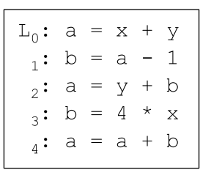
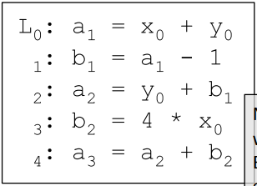
Reaching definitions analysis
RD analysis does not assume code is in SSA form
Reaching definition analysis is almost trivial in SSA variables because each variable is assigned only once
Non-SSA form
SSA form
Does the definition @ 1 reach 4?
In SSA form, we see that b₂ is used, indicating b₁ has been overwritten

Slide 20
Solving reaching definitions analysis
Express RDs at the exit of an elementary block in relation to the RDs at the entry of the same elementary block
[y = x]¹
A
[z = 1]²
B
[y > 1]³
[y = 0]⁶
[z = z*y]⁴
[y = y -1]⁵

Slide 21
Solving reaching definitions analysis
Express RDs at the exit of an elementary block in relation to the RDs at the entry of the same elementary block
Express RDs at entry of an elementary block in relation to the RDs at the exit of the predecessor elementary blocks
Solve…
[y = x]¹
[z = 1]²
B
[y > 1]³
[y = 0]⁶
A
[z = z*y]⁴
[y = y -1]⁵

Slide 22
Equational approach
Construct a system of equations
And solve them
We will gradually build this system of equations…

Slide 23
Equational approach
RD_{exit}(1) = RD_{entry}(1) \ {(y, ℓ) | ℓ ∈ Lab} U {(y, 1)}
RD_{exit}(2) = RD_{entry}(2) \ {(z, ℓ) | ℓ ∈ Lab} U {(z, 2)}
RD_{exit}(3) = RD_{entry}(3)
RD_{exit}(4) = RD_{entry}(4) \ {(z, ℓ) | ℓ ∈ Lab} U {(z, 4)}
RD_{exit}(5) = RD_{entry}(5) \ {(y, ℓ) | ℓ ∈ Lab} U {(y, 5)}
RD_{exit}(6) = RD_{entry}(6) \ {(y, ℓ) | ℓ ∈ Lab} U {(y, 6)}
[y = x]¹
[z = 1]²
[y > 1]³
[y = 0]⁶
[z = z*y]⁴
[y = y -1]⁵

Slide 24
Equational approach
RD_{entry}(2) = RD_{exit}(1)
RD_{entry} (3) = RD_{exit} (2) U RD_{exit} (5)
RD_{entry} (4) = RD_{exit} (3)
RD_{entry} (5) = RD_{exit} (4)
RD_{entry} (6) = RD_{exit} (3)
[y = x]¹
[z = 1]²
[y > 1]³
[y = 0]⁶
[z = z*y]⁴
[y = y -1]⁵

Slide 25
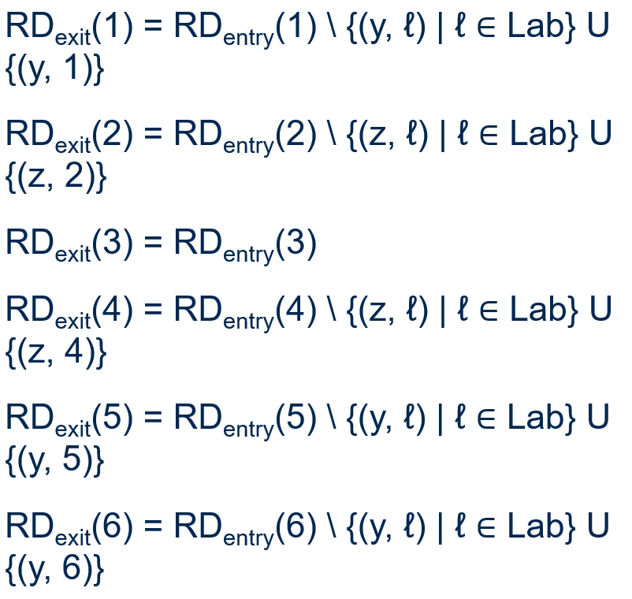
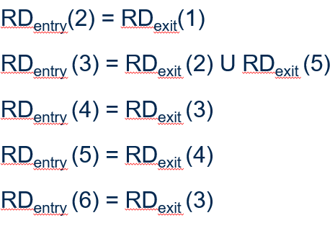
Equational approach
ℓ | RD_{entry}(ℓ) | RD_{exit}(ℓ)
1 | (x, ?) (y, ?) (z, ?)
2
3
4
5
6
[y = x]¹
[z = 1]²
[y > 1]³
[y = 0]⁶
[z = z*y]⁴
[y = y -1]⁵

Slide 26
Equational approach
ℓ | RD_{entry}(ℓ) | RD_{exit}(ℓ)
1 | (x, ?) (y, ?) (z, ?) | (x,?) (y, 1) (z, ?)
2
3
4
5
6
[y = x]¹
[z = 1]²
[y > 1]³
[y = 0]⁶
[z = z*y]⁴
[y = y -1]⁵

Slide 27
Equational approach
ℓ | RD_{entry}(ℓ) | RD_{exit}(ℓ)
1 | (x, ?) (y, ?) (z, ?) | (x,?) (y, 1) (z, ?)
2 | (x,?) (y, 1) (z, ?)
3
4
5
6
[y = x]¹
[z = 1]²
[y > 1]³
[y = 0]⁶
[z = z*y]⁴
[y = y -1]⁵

Slide 28
Equational approach
ℓ | RD_{entry}(ℓ) | RD_{exit}(ℓ)
1 | (x, ?) (y, ?) (z, ?) | (x,?) (y, 1) (z, ?)
2 | (x,?) (y, 1) (z, ?) | (x,?) (y, 1) (z, 2)
3
4
5
6
[y = x]¹
[z = 1]²
[y > 1]³
[y = 0]⁶
[z = z*y]⁴
[y = y -1]⁵

Slide 29
Equational approach
ℓ | RD_{entry}(ℓ) | RD_{exit}(ℓ)
1 | (x, ?) (y, ?) (z, ?) | (x,?) (y, 1) (z, ?)
2 | (x,?) (y, 1) (z, ?) | (x,?) (y, 1) (z, 2)
3 | (x,?) (y, 1) (z, 2)
4
5
6
[y = x]¹
[z = 1]²
[y > 1]³
[y = 0]⁶
[z = z*y]⁴
[y = y -1]⁵

Slide 30
Equational approach
ℓ | RD_{entry}(ℓ) | RD_{exit}(ℓ)
1 | (x, ?) (y, ?) (z, ?) | (x,?) (y, 1) (z, ?)
2 | (x,?) (y, 1) (z, ?) | (x,?) (y, 1) (z, 2)
3 | (x,?) (y, 1) (z, 2) | (x,?) (y, 1) (z, 2)
4
5
6
[y = x]¹
[z = 1]²
[y > 1]³
[y = 0]⁶
[z = z*y]⁴
[y = y -1]⁵

Slide 31
Equational approach
ℓ | RD_{entry}(ℓ) | RD_{exit}(ℓ)
1 | (x, ?) (y, ?) (z, ?) | (x,?) (y, 1) (z, ?)
2 | (x,?) (y, 1) (z, ?) | (x,?) (y, 1) (z, 2)
3 | (x,?) (y, 1) (z, 2) | (x,?) (y, 1) (z, 2)
4 | (x,?) (y, 1) (z, 2)
5
6
[y = x]¹
[z = 1]²
[y > 1]³
[y = 0]⁶
[z = z*y]⁴
[y = y -1]⁵

Slide 32
Equational approach
ℓ | RD_{entry}(ℓ) | RD_{exit}(ℓ)
1 | (x, ?) (y, ?) (z, ?) | (x,?) (y, 1) (z, ?)
2 | (x,?) (y, 1) (z, ?) | (x,?) (y, 1) (z, 2)
3 | (x,?) (y, 1) (z, 2) | (x,?) (y, 1) (z, 2)
4 | (x,?) (y, 1) (z, 2) | (x,?) (y, 1) (z, 4)
5
6
[y = x]¹
[z = 1]²
[y > 1]³
[y = 0]⁶
[z = z*y]⁴
[y = y -1]⁵

Slide 33
Equational approach
ℓ | RD_{entry}(ℓ) | RD_{exit}(ℓ)
1 | (x, ?) (y, ?) (z, ?) | (x,?) (y, 1) (z, ?)
2 | (x,?) (y, 1) (z, ?) | (x,?) (y, 1) (z, 2)
3 | (x,?) (y, 1) (z, 2) | (x,?) (y, 1) (z, 2)
4 | (x,?) (y, 1) (z, 2) | (x,?) (y, 1) (z, 4)
5 | (x,?) (y, 1) (z, 4) | (x,?) (y, 5) (z, 4)
6
[y = x]¹
[z = 1]²
[y > 1]³
[y = 0]⁶
[z = z*y]⁴
[y = y -1]⁵

Slide 34
Equational approach
ℓ | RD_{entry}(ℓ) | RD_{exit}(ℓ)
1 | (x, ?) (y, ?) (z, ?) | (x,?) (y, 1) (z, ?)
2 | (x,?) (y, 1) (z, ?) | (x,?) (y, 1) (z, 2)
3 | (x,?) (y, 1) (z, 2) | (x,?) (y, 1) (z, 2)
4 | (x,?) (y, 1) (z, 2) | (x,?) (y, 1) (z, 4)
5 | (x,?) (y, 1) (z, 4) | (x,?) (y, 5) (z, 4)
6
[y = x]¹
[z = 1]²
[y > 1]³
[y = 0]⁶
[z = z*y]⁴
[y = y -1]⁵

Slide 35
Equational approach
ℓ | RD_{entry}(ℓ) | RD_{exit}(ℓ)
1 | (x, ?) (y, ?) (z, ?) | (x,?) (y, 1) (z, ?)
2 | (x,?) (y, 1) (z, ?) | (x,?) (y, 1) (z, 2)
3 | (x,?) (y, 1) (y, 5) (z, 2) (z, 4) | (x,?) (y, 1) (z, 2)
4 | (x,?) (y, 1) (z, 2) | (x,?) (y, 1) (z, 4)
5 | (x,?) (y, 1) (z, 4) | (x,?) (y, 5) (z, 4)
6
[y = x]¹
[z = 1]²
[y > 1]³
[y = 0]⁶
[z = z*y]⁴
[y = y -1]⁵

Slide 36
Equational approach
ℓ | RD_{entry}(ℓ) | RD_{exit}(ℓ)
1 | (x, ?) (y, ?) (z, ?) | (x,?) (y, 1) (z, ?)
2 | (x,?) (y, 1) (z, ?) | (x,?) (y, 1) (z, 2)
3 | (x,?) (y, 1) (y, 5) (z, 2) (z, 4) | (x,?) (y, 1) (y, 5) (z, 2) (z, 4)
4 | (x,?) (y, 1) (z, 2) | (x,?) (y, 1) (z, 4)
5 | (x,?) (y, 1) (z, 4) | (x,?) (y, 5) (z, 4)
6
[y = x]¹
[z = 1]²
[y > 1]³
[y = 0]⁶
[z = z*y]⁴
[y = y -1]⁵

Slide 37
Equational approach
ℓ | RD_{entry}(ℓ) | RD_{exit}(ℓ)
1 | (x, ?) (y, ?) (z, ?) | (x,?) (y, 1) (z, ?)
2 | (x,?) (y, 1) (z, ?) | (x,?) (y, 1) (z, 2)
3 | (x,?) (y, 1) (y, 5) (z, 2) (z, 4) | (x,?) (y, 1) (y, 5) (z, 2) (z, 4)
4 | (x,?) (y, 1) (y, 5) (z, 2) (z, 4) | (x,?) (y, 1) (z, 4)
5 | (x,?) (y, 1) (z, 4) | (x,?) (y, 5) (z, 4)
6
[y = x]¹
[z = 1]²
[y > 1]³
[y = 0]⁶
[z = z*y]⁴
[y = y -1]⁵

Slide 38
Equational approach
ℓ | RD_{entry}(ℓ) | RD_{exit}(ℓ)
1 | (x, ?) (y, ?) (z, ?) | (x,?) (y, 1) (z, ?)
2 | (x,?) (y, 1) (z, ?) | (x,?) (y, 1) (z, 2)
3 | (x,?) (y, 1) (y, 5) (z, 2) (z, 4) | (x,?) (y, 1) (y, 5) (z, 2) (z, 4)
4 | (x,?) (y, 1) (y, 5) (z, 2) (z, 4) | (x,?) (y, 1) (y, 5) (z, 4)
5 | (x,?) (y, 1) (z, 4) | (x,?) (y, 5) (z, 4)
6
[y = x]¹
[z = 1]²
[y > 1]³
[y = 0]⁶
[z = z*y]⁴
[y = y -1]⁵

Slide 39
Equational approach
ℓ | RD_{entry}(ℓ) | RD_{exit}(ℓ)
1 | (x, ?) (y, ?) (z, ?) | (x,?) (y, 1) (z, ?)
2 | (x,?) (y, 1) (z, ?) | (x,?) (y, 1) (z, 2)
3 | (x,?) (y, 1) (y, 5) (z, 2) (z, 4) | (x,?) (y, 1) (y, 5) (z, 2) (z, 4)
4 | (x,?) (y, 1) (y, 5) (z, 2) (z, 4) | (x,?) (y, 1) (y, 5) (z, 4)
5 | (x,?) (y, 1) (y,5) (z, 4) | (x,?) (y, 1)(y, 5) (z, 4)
6 | (x,?) (y, 1) (y, 5) (z, 2) (z, 4)
[y = x]¹
[z = 1]²
[y > 1]³
[y = 0]⁶
[z = z*y]⁴
[y = y -1]⁵

Slide 40
Equational approach
ℓ | RD_{entry}(ℓ) | RD_{exit}(ℓ)
1 | (x, ?) (y, ?) (z, ?) | (x,?) (y, 1) (z, ?)
2 | (x,?) (y, 1) (z, ?) | (x,?) (y, 1) (z, 2)
3 | (x,?) (y, 1) (y, 5) (z, 2) (z, 4) | (x,?) (y, 1) (y, 5) (z, 2) (z, 4)
4 | (x,?) (y, 1) (y, 5) (z, 2) (z, 4) | (x,?) (y, 1) (y, 5) (z, 4)
5 | (x,?) (y, 1) (z, 4) | (x,?) (y, 5) (z, 4)
6 | (x,?) (y, 1) (y, 5) (z, 2) (z, 4) | (x,?) (y, 6) (z, 2) (z, 4)
[y = x]¹
[z = 1]²
[y > 1]³
[y = 0]⁶
[z = z*y]⁴
[y = y -1]⁵

Slide 41
Fixed point
ℓ | RD_{entry}(ℓ) | RD_{exit}(ℓ)
1 | (x, ?) (y, ?) (z, ?) | (x,?) (y, 1) (z, ?)
2 | (x,?) (y, 1) (z, ?) | (x,?) (y, 1) (z, 2)
3 | (x,?) (y, 1) (y, 5) (z, 2) (z, 4) | (x,?) (y, 1) (y, 5) (z, 2) (z, 4)
4 | (x,?) (y, 1) (y, 5) (z, 2) (z, 4) | (x,?) (y, 1) (y, 5) (z, 4)
5 | (x,?) (y, 1) (z, 4) | (x,?) (y, 5) (z, 4)
6 | (x,?) (y, 1) (y, 5) (z, 2) (z, 4) | (x,?) (y, 6) (z, 2) (z, 4)
[y = x]¹
[z = 1]²
[y > 1]³
[y = 0]⁶
[z = z*y]⁴
No new data flow facts can be derived
[y = y -1]⁵

Slide 42
How to formalize data flow analysis for any program/statement?

Slide 43
A few more definitions
A Statement can be a single statement or a sequence of statements
The blocks function (Stmt -> P(Blocks)) returns all elementary blocks in a statements
blocks([x = a]^{ℓ}) = {[x = a]^{ℓ}} blocks(S₁:S₂) = blocks(S₁) U blocks(S₂) blocks(if [b] ^{ℓ} then S₂ else S₃) = {[b] ^{ℓ}} U blocks(S₂) U blocks(S₃)

Slide 44
A few more definitions
The init function (Stmt -> Lab) returns the initial label of a statement
init([x = a]^{ℓ} ) = ℓ init(S₁:S₂) = init(S₁) init(if [b]^{ℓ} then S₂ else S₃) = ℓ init(while [b]^{ℓ} do S) = ℓ
The final function (Stmt -> Lab) returns the final label of a statement
final([x = a]^{ℓ} ) = ℓ final(S₁:S₂) = final(S₂) final(if [b]^{ℓ} then S₂ else S₃) = final(S₁) U final(S₂) final(while [b]^{ℓ} do S) = ℓ

Slide 45
A few more definitions
The Flow function (Stmt -> P(Lab x Lab)) maps statements to sets of flows
flow([x = a]^{ℓ}) = {} flow(S₁:S₂) = flow(S₁) U flow(S₂) U {(ℓ, init(S₂) | ℓ ∈ final(S₁)} flow(if [b]^{ℓ} then S₂ else S₃) = flow(S₁) U flow(S₂) U {((ℓ, init(S₁)), (ℓ, init(S₂)) flow(while [b]^{ℓ} do S) = flow(S) U {(l, init(S))} U {(l^{r}, l) | ℓ^{r} ∈ final(S)}
Notes:
- If your entire program is a single assignment statement, you can do whatever

Slide 46
A few more definitions
The Reverse Flow function: Stmt -> P(Lab x Lab)
flow^{R}(S) = {(ℓ, ℓ’) | (ℓ’, ℓ) ∈ flow(S)}

Slide 47
Data flow analysis

Slide 48
Announcements
3 papers per student
Please sign up for 4/24

Slide 49
Agenda
Reaching definitions formalization
Live variable analysis
Pointer analysis
Mathematical intuition for fixed point analysis

Slide 50
Recap: RD analysis for specific program
[y = x]¹
[z = 1]²
[y > 1]³
[y = 0]⁶
[z = z*y]⁴
[y = y -1]⁵

Slide 51
How to formalize data flow analysis for any program/statement?

Slide 52
Statements
A Statement can be a single statement or a sequence of statements
(if [b]¹ then (if [c]² then ([x = a]³) else ([x = b]⁴) ) else (if [d]⁵ then ([x = c]⁶) else ([x = d]⁷))) [y=0]
[b]¹
[c]²
[x=a]³
[x=b]⁴
[d]⁵
[x=c]⁶
[x=d]⁷
[y=0]⁸

Slide 53
Blocks function
The blocks function (Stmt -> P(Blocks)) returns all elementary blocks in a statements
blocks([x = a]^{ℓ}) = {[x = a]^{ℓ}} blocks(S₁:S₂) = blocks(S₁) U blocks(S₂) blocks(if [b] ^{ℓ} then S₂ else S₃) = {[b] ^{ℓ}} U blocks(S₂) U blocks(S₃)

Slide 54
init and final functions
The init function (Stmt -> Lab) returns the initial label of a statement
init([x = a]^{ℓ} ) = ℓ init(S₁:S₂) = init(S₁) init(if [b]^{ℓ} then S₂ else S₃) = ℓ init(while [b]^{ℓ} do S) = ℓ
The final function (Stmt -> Lab) returns the final label of a statement
final([x = a]^{ℓ} ) = ℓ final(S₁:S₂) = final(S₂) final(if [b]^{ℓ} then S₂ else S₃) = final(S₁) U final(S₂) final(while [b]^{ℓ} do S) = ℓ

Slide 55
flow function
The Flow function (Stmt -> P(Lab x Lab)) maps statements to sets of flows
Label-pair indicating a control flow
flow([x = a]^{ℓ}) = {} flow(S₁:S₂) = flow(S₁) U flow(S₂) U {(ℓ, init(S₂) | ℓ ∈ final(S₁)} flow(if [b]^{ℓ} then S₂ else S₃) = flow(S₁) U flow(S₂) U {((ℓ, init(S₁)), (ℓ, init(S₂)) flow(while [b]^{ℓ} do S) = flow(S) U {(l, init(S))} U {(l^{r}, l) | ℓ^{r} ∈ final(S)}
Notes:
- If your entire program is a single assignment statement, you can do whatever

Slide 56
flow function
The Flow function (Stmt -> P(Lab x Lab)) maps statements to sets of flows
Label-pair indicating a control flow
flow([x = a]^{ℓ}) = {} flow(S₁:S₂) = flow(S₁) U flow(S₂) U {(ℓ, init(S₂) | ℓ ∈ final(S₁)} flow(if [b]^{ℓ} then S₂ else S₃) = flow(S₁) U flow(S₂) U {((ℓ, init(S₁)), (ℓ, init(S₂)) flow(while [b]^{ℓ} do S) = flow(S) U {(l, init(S))} U {(l^{r}, l) | ℓ^{r} ∈ final(S)}
[b]¹
[c]²
[x=a]³
[x=b]⁴
[d]⁵
[x=c]⁶
[x=d]⁷
[y=0]⁸
S₁
S₂
(if [b]¹ then (if [c]² then ([x = a]³) else ([x = b]⁴) ) else (if [d]⁵ then ([x = c]⁶) else ([x = d]⁷))) [y=0]
Notes:
- If your entire program is a single assignment statement, you can do whatever

Slide 57
flow function
flow(S) = {(1,2), (2, 3), (2,4), (3,5), (4,5), (5,6), (5,7), (6,7), (7,8)}
[b]¹
[c]²
[x=a]³
[x=b]⁴
[d]⁵
[x=c]⁶
[x=d]⁷
[y=0]⁸
S₁
S₂
(if [b]¹ then (if [c]² then ([x = a]³) else ([x = b]⁴) ) else (if [d]⁵ then ([x = c]⁶) else ([x = d]⁷))) [y=0]
Notes:
- If your entire program is a single assignment statement, you can do whatever

Slide 58
Reverse flow function
The Reverse Flow function: Stmt -> P(Lab x Lab)
flow^{R}(S) = {(ℓ, ℓ’) | (ℓ’, ℓ) ∈ flow(S)}
flow(S) = {(1,2), (2, 3), (2,4), (3,5), (4,5), (5,6), (5,7), (6,7), (7,8)}
flow^{R}(S) = {(2,1), (3,2), (4,2), (5,3), (4,5), (6,5), (7,5), (7,6), (8,7)}

Slide 59
Reaching definitions: final formalization
Kill and gen functions
Kill function kills reaching definitions, typically through a new assignment
Gen function generates new reaching definitions, through an assignment in the form x = a

Slide 60
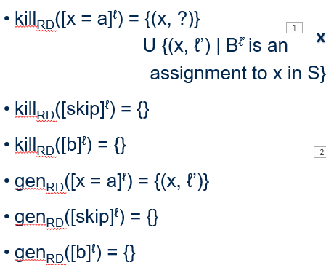
Kill and gen functions
ℓ | kill(ℓ) | gen(ℓ)
1 | {(y,?), (y,1), (y,5), (y,6)} | {(y,1)}
2 | {(z,?), (z,2), (z,4)} | {(z,2)}
3 | {} | {}
4 | {(z,?), (z,2), (z,4)} | {(z, 4)}
5 | {(y,?), (y,1), (y,5), (y,6)} | {(y, 5)}
6 | {(y,?), (y,1), (y,5), (y,6)} | {(y,6)}
[y = x]¹
[z = 1]²
[y > 1]³
[y = 0]⁶
[z = z*y]⁴
[y = y -1]⁵

Slide 61
Reaching definitions: final formalization
Kill and gen functions
kill_{RD}([x = a]^{ℓ}) = {(x, ?)} U {(x, ℓ’) | B^{ℓ’} is an assignment to x in S}
kill_{RD}([skip]^{ℓ}) = {}
kill_{RD}([b]^{ℓ}) = {}
gen_{RD}([x = a]^{ℓ}) = {(x, ℓ’)}
gen_{RD}([skip]^{ℓ}) = {}
gen_{RD}([b]^{ℓ}) = {}
x = a kills all definitions of x, at that program point
x = a generates new information in the form of a new assignment of x

Slide 62
Reaching definitions: final formalization
Kill and gen functions
kill_{RD}([x = a]^{ℓ}) = {(x, ?)} U {(x, ℓ’) | B^{ℓ’} is an assignment to x in S}
kill_{RD}([skip]^{ℓ}) = {}
kill_{RD}([b]^{ℓ}) = {}
gen_{RD}([x = a]^{ℓ}) = {(x, ℓ’)}
gen_{RD}([skip]^{ℓ}) = {}
gen_{RD}([b]^{ℓ}) = {}
Data flow equations
RD_{entry}(ℓ) = { (x, ?) | x ∈ FV(S)} .... if ℓ = init(S) = U (RD_{exit}(ℓ’) | (ℓ’, l) ∈ flow(S)) .... Otherwise
RD_{exit}(ℓ) = (RD_{entry}(ℓ) \ kill_{RD}(B^{ℓ})) U gen_{RD}(B^{ℓ}) where B^{ℓ} ∈ blocks(S)
RD_{entry}
[y > 1]³
RD_{exit}
If S is the init stmt, all free variables in S are unassigned
Otherwise, perform the union on all reaching definitions that flow into this elementary block
Remove what this block killed from whatever reached this block and then union with what this block generated

Slide 63
Reaching definitions: final formalization
RD_{exit}(1) = RD_{entry}(1) \ {(y, ℓ) | ℓ ∈ Lab} U {(y, 1)}
RD_{exit}(2) = RD_{entry}(2) \ {(z, ℓ) | ℓ ∈ Lab} U {(z, 2)}
RD_{exit}(3) = RD_{entry}(3)
RD_{exit}(4) = RD_{entry}(4) \ {(z, ℓ) | ℓ ∈ Lab} U {(z, 4)}
RD_{exit}(5) = RD_{entry}(5) \ {(y, ℓ) | ℓ ∈ Lab} U {(y, 5)}
RD_{exit}(6) = RD_{entry}(6) \ {(y, ℓ) | ℓ ∈ Lab} U {(y, 6)}
RD_{entry}(2) = RD_{exit}(1)
RD_{entry} (3) = RD_{exit} (2) U RD_{exit} (5)
RD_{entry} (4) = RD_{exit} (3)
RD_{entry} (5) = RD_{exit} (4)
RD_{entry} (6) = RD_{exit} (3)
Same equations as earlier!

Slide 64
Reaching definitions uses
For the construction of def-use (du) chains
Case-study from previous lectures
LLVM compiler constructs the def-use chains
Compiler developer can just use the def-use chains
Notes:
- Work at different abstraction levels

Slide 65
Live variable analysis

Slide 66
Live variable analysis
A variable is live at the exit from a label if there exists a path from the label to a use of the variable that does not redefine the variable
LVA computes, for each program point, which variables may be live at the exit from the point

Slide 67
LVA formalization
Kill and gen functions
Kill function kills a variable by overwriting it (e.g. x = a)
Gen function “generates” a variable by using it

Slide 68
Formalization
Kill and gen functions
kill_{LV}([x = a]^{ℓ}) = {x}
kill_{LV}([skip]^{ℓ}) = {}
kill_{LV}([b]^{ℓ}) = {}
gen_{LV}([x = a]^{ℓ}) = FV(a)
gen_{LV}([skip]^{ℓ}) = {}
gen_{LV}([b]^{ℓ}) = FV(b)
Kills x (because we overwrite x)
Generates variables appearing in a
Generates variables appearing in b
Notes:
- Think of it as bringing to life

Slide 69
Formalization
Kill and gen functions
kill_{LV}([x = a]^{ℓ}) = {x}
kill_{LV}([skip]^{ℓ}) = {}
kill_{LV}([b]^{ℓ}) = {}
gen_{LV}([x = a]^{ℓ}) = FV(a)
gen_{LV}([skip]^{ℓ}) = {}
gen_{LV}([b]^{ℓ}) = FV(b)
Data flow equations
LV_{exit}(ℓ) = {} .... if ℓ = final(S) = U (LV_{entry}(ℓ’) | (ℓ’, ℓ) ∈ flow^{R}(S)) .... Otherwise
LV_{entry}(ℓ) = (LV_{exit}(ℓ) \ kill (B^{ℓ})) U gen_{LV}(B^{ℓ}) where B^{ℓ} ∈ blocks(S)
Nothing is live if we’re exiting the final block
Otherwise, union of variables that are live at the entries of successor blocks
Subtract what is killed at ℓ from what is live at the block’s exit and union with what is generated (used) in the block
Live variable analysis is a backward analysis
gen means “use” in this analysis

Slide 70
Formalization
Kill and gen functions
kill_{LV}([x = a]^{ℓ}) = {x}
kill_{LV}([skip]^{ℓ}) = {}
kill_{LV}([b]^{ℓ}) = {}
gen_{LV}([x = a]^{ℓ}) = FV(a)
gen_{LV}([skip]^{ℓ}) = {}
gen_{LV}([b]^{ℓ}) = FV(b)
Data flow equations
Lv_{exit}(ℓ) = {} .... if ℓ = final(S) = U (LV_{entry}(ℓ’) | (ℓ’, l) ∈ flow^{R}(S)) .... Otherwise
LV_{entry}(ℓ) = (LV_{exit}(ℓ) \ kill (B^{ℓ})) U gen_{LV}(B^{ℓ}) where B^{ℓ} ∈ blocks(S)

Slide 71
Live variable analysis example
[x=2]¹; [y=4]²; [x = 1]³ if ([y > x]⁴ then [z = y]⁵) else [z = y*y] ⁶; [x = z] ⁷
[x=2]¹
[y=4]²
[x = 1]³
[y > x]⁴
[z = y]⁵
[z = y*y]⁶
[x = z]⁵

Slide 72
Live variable analysis example
ℓ | kill_{LV}(ℓ) | gen_{LV}(ℓ)
1 | {x} | {}
2 | {y} | {}
3 | {x} | {}
4 | {} | {x, y}
5 | {z} | {y}
6 | {z} | {y}
7 | {x} | {z}
[x=2]¹
[y=4]²
[x = 1]³
[y > x]⁴
[z = y]⁵
[z = y*y]⁶
[x = z]⁷

Slide 73
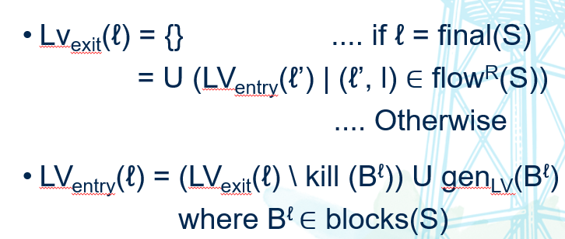
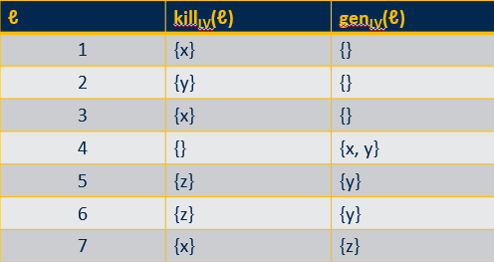
Live variable analysis example
LV_{entry}(1) = LV_{exit}(1) \ {x} LV_{entry}(2) = LV_{exit}(2) \ {y} LV_{entry}(3) = LV_{exit}(3) \ {x} LV_{entry}(4) = LV_{exit}(4) U {x, y} LV_{entry}(5) = LV_{exit}(5) \ {z} U {y} LV_{entry}(6) = LV_{exit}(6) \ {z} U {y} LV_{entry}(7) = {z}
[x=2]¹
[y=4]²
[x = 1]³
[y > x]⁴
[z = y]⁵
[z = y*y]⁶
[x = z]⁷

Slide 74
Live variable analysis example
LV_{exit}(1) = LV_{entry}(2) LV_{exit}(2) = LV_{entry}(3) LV_{exit}(3) = LV_{entry} (4) LV_{exit}(4) = LV_{entry} (5) U LV_{entry} (6) LV_{exit}(5) = LV_{entry} (7) LV_{exit}(6) = LV_{entry} (7) LV_{exit}(7) = {}
[x=2]¹
[y=4]²
[x = 1]³
[y > x]⁴
[z = y]⁵
[z = y*y]⁶
[x = z]⁷

Slide 75
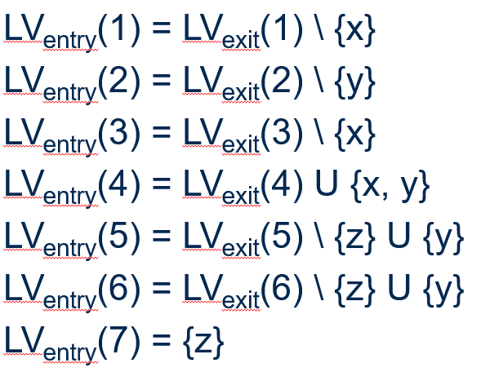
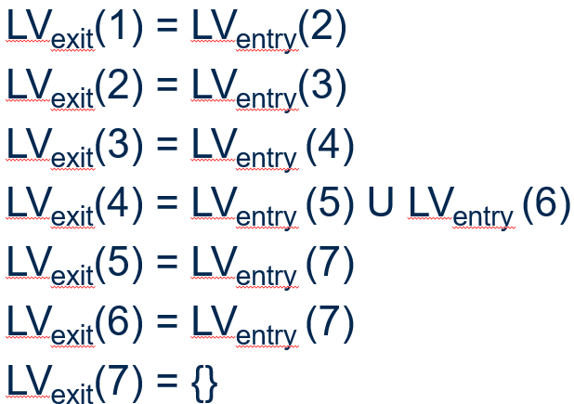
Live variable analysis example
[x=2]¹; [y=4]²; [x = 1]³ if ([y > x]⁴ then [z = y]⁵) else [z = y*y] ⁶; [x = z] ⁷
ℓ | LV_{entry}(ℓ) | LV_{exit}(ℓ)
1
2
3
4
5
6
7 | {z} | {}

Slide 76
Live variable analysis example
[x=2]¹; [y=4]²; [x = 1]³ if ([y > x]⁴ then [z = y]⁵) else [z = y*y] ⁶; [x = z] ⁷
ℓ | LV_{entry}(ℓ) | LV_{exit}(ℓ)
1
2
3
4
5
6 |  | {z}
7 | {z} | {}

Slide 77
Live variable analysis example
[x=2]¹; [y=4]²; [x = 1]³ if ([y > x]⁴ then [z = y]⁵) else [z = y*y] ⁶; [x = z] ⁷
ℓ | LV_{entry}(ℓ) | LV_{exit}(ℓ)
1
2
3
4
5
6 | {y} | {z}
7 | {z} | {}

Slide 78
Live variable analysis example
[x=2]¹; [y=4]²; [x = 1]³ if ([y > x]⁴ then [z = y]⁵) else [z = y*y] ⁶; [x = z] ⁷
ℓ | LV_{entry}(ℓ) | LV_{exit}(ℓ)
1
2
3
4
5 |  | {z}
6 | {y} | {z}
7 | {z} | {}

Slide 79
Live variable analysis example
[x=2]¹; [y=4]²; [x = 1]³ if ([y > x]⁴ then [z = y]⁵) else [z = y*y] ⁶; [x = z] ⁷
ℓ | LV_{entry}(ℓ) | LV_{exit}(ℓ)
1
2
3
4
5 | {y} | {z}
6 | {y} | {z}
7 | {z} | {}

Slide 80
Live variable analysis example
[x=2]¹; [y=4]²; [x = 1]³ if ([y > x]⁴ then [z = y]⁵) else [z = y*y] ⁶; [x = z] ⁷
ℓ | LV_{entry}(ℓ) | LV_{exit}(ℓ)
1
2
3
4 |  | {y}
5 | {y} | {z}
6 | {y} | {z}
7 | {z} | {}

Slide 81
Live variable analysis example
[x=2]¹; [y=4]²; [x = 1]³ if ([y > x]⁴ then [z = y]⁵) else [z = y*y] ⁶; [x = z] ⁷
ℓ | LV_{entry}(ℓ) | LV_{exit}(ℓ)
1
2
3
4 | {x, y} | {y}
5 | {y} | {z}
6 | {y} | {z}
7 | {z} | {}

Slide 82
Live variable analysis example
[x=2]¹; [y=4]²; [x = 1]³ if ([y > x]⁴ then [z = y]⁵) else [z = y*y] ⁶; [x = z] ⁷
ℓ | LV_{entry}(ℓ) | LV_{exit}(ℓ)
1
2
3 |  | {x, y}
4 | {x, y} | {y}
5 | {y} | {z}
6 | {y} | {z}
7 | {z} | {}

Slide 83
Live variable analysis example
[x=2]¹; [y=4]²; [x = 1]³ if ([y > x]⁴ then [z = y]⁵) else [z = y*y] ⁶; [x = z] ⁷
ℓ | LV_{entry}(ℓ) | LV_{exit}(ℓ)
1
2
3 | {y} | {x, y}
4 | {x, y} | {y}
5 | {y} | {z}
6 | {y} | {z}
7 | {z} | {}

Slide 84
Live variable analysis example
[x=2]¹; [y=4]²; [x = 1]³ if ([y > x]⁴ then [z = y]⁵) else [z = y*y] ⁶; [x = z] ⁷
ℓ | LV_{entry}(ℓ) | LV_{exit}(ℓ)
1
2 |  | {y}
3 | {y} | {x, y}
4 | {x, y} | {y}
5 | {y} | {z}
6 | {y} | {z}
7 | {z} | {}

Slide 85
Live variable analysis example
[x=2]¹; [y=4]²; [x = 1]³ if ([y > x]⁴ then [z = y]⁵) else [z = y*y] ⁶; [x = z] ⁷
ℓ | LV_{entry}(ℓ) | LV_{exit}(ℓ)
1
2 | {} | {y}
3 | {y} | {x, y}
4 | {x, y} | {y}
5 | {y} | {z}
6 | {y} | {z}
7 | {z} | {}

Slide 86
Live variable analysis example
[x=2]¹; [y=4]²; [x = 1]³ if ([y > x]⁴ then [z = y]⁵) else [z = y*y] ⁶; [x = z] ⁷
ℓ | LV_{entry}(ℓ) | LV_{exit}(ℓ)
1 |  | {}
2 | {} | {y}
3 | {y} | {x, y}
4 | {x, y} | {y}
5 | {y} | {z}
6 | {y} | {z}
7 | {z} | {}

Slide 87
Live variable analysis example
[x=2]¹; [y=4]²; [x = 1]³ if ([y > x]⁴ then [z = y]⁵) else [z = y*y] ⁶; [x = z] ⁷
ℓ | LV_{entry}(ℓ) | LV_{exit}(ℓ)
1 | {} | {}
2 | {} | {y}
3 | {y} | {x, y}
4 | {x, y} | {y}
5 | {y} | {z}
6 | {y} | {z}
7 | {z} | {}
ℓ₁ defines x but LV_{exit}(1) does not contain x. Implies x = 2 is dead code and can be removed

Slide 88
Do these analyses “stabilize” or reach a “fixed point” for all possible programs?

Slide 89
Mathematical intuition

Slide 90
Relations
A relation connects two sets
A relation R on two sets A and B is a subset of the cartesian product of those two sets
R ⊆ A X B
A = {1, 2, 3}, B = {4, 5}
A X B = {(1, 4), (1, 5), (2, 4), (2, 5), (3, 4), (3, 5)}
R = {(1, 4), (3, 4), (3, 5)}

Slide 91
Properties of a relation
Reflexive
Every element relates to itself
∀a ∈ A, (a,a) ∈ R
Example: { (1, 1), (2, 2), (1, 2)}
Symmetric
If a relates to b, then b relates to a
∀a,b ∈ A, (a,b) ∈ R => (b,a) ∈ R

Slide 92
Properties of a relation
Asymmetric
If a relates to b, then b does not relate to a
∀a,b ∈ A, (a,b) ∈ R => (b,a) ∉ R
Anti-symmetric
If a relates to b, and b relates to a, then a = b
∀a,b ∈ A, (a,b) ∈ R ∧ (b,a) ∈ R => a = b
Transitive
If a relates to b, and b relates to c, then a relates to c
∀a,b,c ∈ A, (a,b) ∈ R ∧ (b,c) ∈ R => (a, c) ∈ R

Slide 93
Questions
Is the following a reflexive relation on A = {a, b, c}?
R = {(a, a), (b, a), (c, c), (c, b)}?
Is the following an asymmetric relation on A = = {a, b, c}?
R = {(a, b), (b, c), (c, a), (b, a)}
Is the following a symmetric relation on A = = {a, b, c}?
R = {(a, b), (b, a), (c, a), (a, c)}
Is the following a transitive relation on A = {a, b, c}?
R = {(a, b), (b, a), (b, c), (a, c)}
❌
❌
✅
❌

Slide 94
Partial order
A partial order is a relation ⪯: L X L → { true, false} that is
Reflexive (∀l: l ⪯ l)
Transitive (∀l₁, l₂, l₃: l₁ ⪯ l₂, l₂ ⪯ l₃ => l₁ ⪯ l₃)
Anti-symmetric (∀ l₁, l₂ l₁ ⪯ l₂ , l₁ ⪯ l₂ => l₁ = l₂)
Is the following a partial order on L = {a, b, c, d}
R = {(a, a), (b, b), (c, c), (a, b), (b, a), (a, c), (c, b), (a, d), (d, d)}
R = {(a, a), (b, b), (c, c), (a, b), (b, c), (a,c), (a, d), (d, d)}
❌
✅

Slide 95
Partial orders, visually
R = {(a, a), (b, b), (c, c), (a, b), (b, c), (a,c), (a, d), (d, d)}
c
Gives you an ordering, ⪯
Not a complete order … no relation between b and d, or c and d
d
b
a

Slide 96
Upper bounds and LUB
A subset Y of L has l ∈ L as an upper bound if ∀ l’ ∈ Y: l’ ⪯ l
Least Upper Bound (LUB) l of Y is an upper bound of Y that satisfies l ⪯ l₀ whenever l₀ is another upper bound of L
a
Y = {f, g} UB(Y) = {d, a} LUB(Y) = {d}
b
c
d
e
f
g

Slide 97
Lower bounds and GLB
A subset Y of L has l ∈ L as a lower bound if ∀ l’ ∈ Y: l’ ⪰ l
Greatest Lower Bound (GLB) l of Y is a lower bound of Y that satisfies l ⪰ l₀ whenever l₀ is another lower bound of L
a
Y = {b, c} LB(Y) = {e} LUB(Y) = {e}
b
c
d
e
f
g

Slide 98
LUB and GLB don’t have to exist
Let Y = {b, c, e, f}
What is the LUB?
What is the GLB?
Let Y = {b, c}
What is the LUB?
What is the GLB?
a
b
c
d
e
f
g

Slide 99
Lattice
A complete lattice L = (L, ⪯, ∧, ∨, ⊤, ⊥)
Is a partially ordered set (L, ⪯)
Such that all subsets have LUB (∧) and GLB (∨)
⊤ is the greatest element and ⊥ is the least element
a
b
c
d
e
f
g
Is this a lattice?

Slide 100
Lattice
⊤
A complete lattice L = (L, ⪯, ∧, ∨, ⊤, ⊥)
Is a partially ordered set (L, ⪯)
Such that all subsets have LUB (∧) and GLB (∨)
⊤ is the greatest element and ⊥ is the least element
a
b
c
d
e
f
g
Is this a lattice?
⊥

Slide 101
Formulation of program analysis problems
Example – your program has variables a, b, and c
Vars(prog) = {a, b, c}
P(Vars) = {{}, {a}, {b}, {c}, {a, b}, {b,c}, {a, b,c}}
Consider the lattice of the power set of all variables in the program
Each set ordered by subset-inclusion
a,b,c
a,c
a,b
b,c
a
b
c
⊥

Slide 102
Formulation of program analysis problems
A lattice has a fixed height
As long as the analysis moves only in one direction the analysis will terminate as it reaches the fixed point
Such analyses are called “fixed point analyses”
a,b,c
a,c
a,b
b,c
a
b
c
⊥
Notes:
- The dataflow equations represent a lattice
- When control paths merge, we are using the JOIN operation

Slide 103
Monotone Frameworks

Slide 104
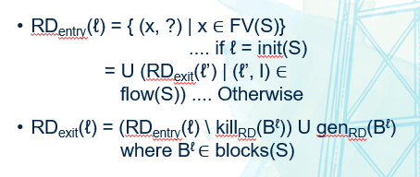
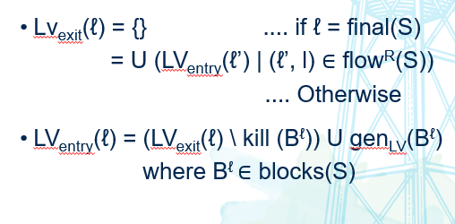
RD and LVA formalizations

