Slide 1
Message queues and pub-sub architecture
Tapti Palit

Slide 2
Outline
RPC
Message queue
  Data-structures
  Persistence
Pub/sub
  Data-structures
  Persistence

Slide 3


Remote procedure call (RPC)
Library/framework gives the illusion that the other microservice is running locally
  Protocol that allows a program to execute a procedure on a remote server as if it were local
Synchronous communication – caller waits for response before proceeding
Request
Response
Microservice A
Microservice B

Slide 4
RPC key features
Language agnostic: the RPC itself does not depend on the service language
Abstracts network details
  Typically, over HTTP

Slide 5
RPC formats
Text-based (e.g. REST APIs)
  Uses JSON or XML for data exchange
  Human-readable, but larger payloads
Binary formats (e.g. gRPC)
  Uses binary standards (such as protobuf) for serialization
  Compact but faster, but less human-readable
    … why?

Slide 6
JSON and REST APIs
Representational State Transfer (REST) is an architectural style for web services
Application/microservice exposes an URL
Uses HTTP methods (GET, POST, PUT, DELETE) to perform operations on resources
Commonly paired with JSON for data exchange
// GET Request to Fetch a User denoted by ID
> GET /users/123
// Response
{
"id": 123,
"name": "John Doe",
"email": john.doe@example.com
}
Notes:
- HW1/2

Slide 7



Message queuing (MQ)
Asynchronous communication model
  Messages sent to a queue and processed by consumers independently of the producer
Stronger decoupling
Message
Message
Message
Message
Microservice A
Microservice B

Slide 8
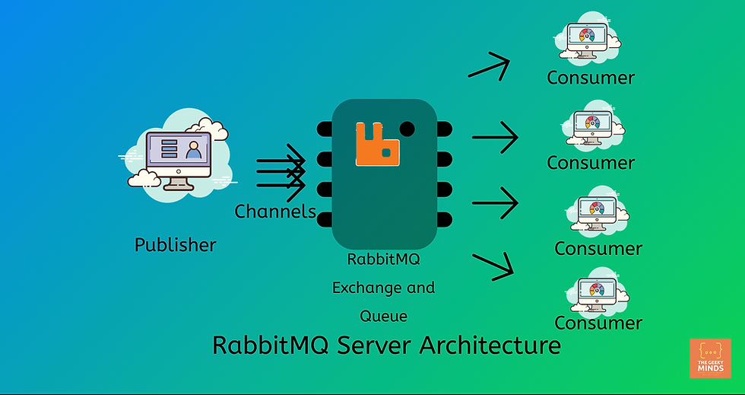
RabbitMQ architecture
or
Producer

Slide 9



RabbitMQ demo
https://www.youtube.com/watch?v=WzO6_4jeliM

Slide 10
Pub-sub architecture
Asynchronous messaging pattern where publishers send messages to a central message broker or topic, and subscribers receive messages based on their subscriptions
Broadcasting: messages can be sent to multiple subscribers
Typically, messages are persistent at the broker and must be explicitly deleted
Same frameworks often can act as both MQ or Pub-Sub depending on configuration

Slide 11


Pub-sub architecture
Message
Subscriber Microservice A
Message
Message
Subscriber Microservice B
Publisher
Microservice
Broker
Message
Subscriber Microservice C

Slide 12

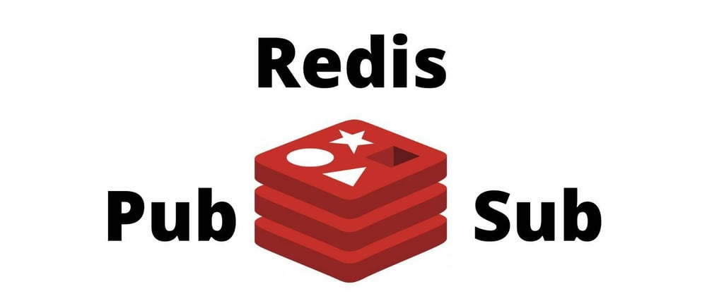
Redis pub-sub demo
https://www.youtube.com/watch?v=bSe_JBSk5w4

Slide 13
Can mix and match!!
Pipeline architecture using microservices with message queues deployed on a serverless architecture
Pub-sub architecture with microservices using containers
Pipeline architecture in one part of the system, with a pub-sub in another
… and so on
Pick what is right for your software system!

