Slide 1
Kafka – a distributed event log
Tapti Palit

Slide 2
Outline
Events vs commands vs messages
  CRQS design pattern
Log as an abstraction (LSM trees as an optimization)
Partitioning for scalability
Replication for reliability
Leader election via ISR
Zookeeper/KRaft internals
Use case

Slide 3
Why EDD?
RPC models -> question, and answer
Events trigger actions
  Asynchronous
Microservices make it hard to access another microservices database
Replayable log turns the database on the outside
When multiple microservices rely on the same data it leads to the integration database anti-pattern (https://martinfowler.com/bliki/IntegrationDatabase.html)
  Must be avoided

Slide 4
Why EDD?
Data must be loosely coupled
  Shared data on the outside is the most tightly coupled of them all
  Solution: move it to your own application!
RPC works for loosely coupled microservices
Benefits of EDD
  React to events
  Central repo that can push datasets
Rethink your application as an evolving stream of data
Related to Dataflow or Functional Languages

Slide 5
Data integration challenge
Notes:
https://docs.conduktor.io/learn/fundamentals/what-is-apache-kafka

Slide 6
Typical architecture
KAFKA
Kafka Streams/KSQL
Mobile Device
Engine
Mobile Device
Engine
Mobile Device
Engine
Mobile Device
Serving Layer
(Cassandra, HDFS, etc.)
High-throughput messaging
Data is embedded in each engine

Slide 7
Kafka streams and state
Typical streaming query (KSQL)
  CREATE STREAM crashes_per_day AS
  SELECT app_id, COUNT(*)
  FROM app_crashes
  WINDOW TUMBLING (1 day)
  GROUP BY app_id;
State backed by changelog
Requires state

Slide 8
Streaming characteristics
The streaming layer is fault-tolerant
Each stream processor node holds its own state
Each stream processor can write and store local state
  Like the previous apps_opened stat

Slide 9
Perceptions of Kafka
Kafka is like REST, but asynchronous
Kafka is like a Service Bus
Kafka is like a database (has storage afterall)
Kafka is a streaming platform
  Kafka Streams API
  KSQL API
  Connect API – whole ecosystem of connectors

Slide 10
Broker is key
APIs in many languages
Connector sources
KAFKA Broker
Connector sinks
Kstreams / KSQL

Slide 11
Kafka broker
Kafka cluster is collection of files
Goal: distribute datasets created by large social networks
  Principles derived from high throughput databases
  Previous message-queuing problems about queue depths don’t apply because data-set is stored locally
Main abstraction: A partitioned, replayable log
  Node seeks to the position of last read and then read sequentially
  Zero-copy – disk -> network, not copied to JVM

Slide 12
Terminology – log, partitions
A partition is a bucket the data is put into
  Analogous to hash-table buckets, but obviously distributed over different machines
A “log” is a replica of a partition

Slide 13
Linear Scalability
Kafka is a cluster of nodes
Topic-based – each topic has its own log
  Each log has many partitions
Each producer writes to many nodes in this cluster, because the log is partitioned across different nodes
Each consumer reads from many nodes in this cluster because the log for the same topic is partitioned across different nodes

Slide 14
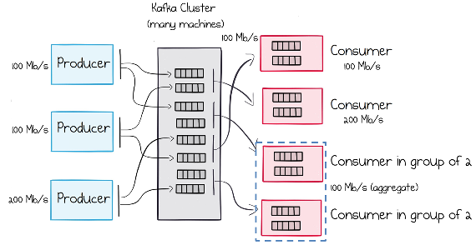
Linear Scalability
As you add more nodes, your system scales linearly

Slide 15
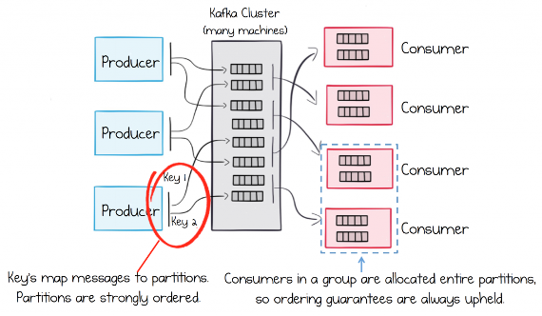
Ordering guarantees
Kafka provides ordering guarantees only within the same partition
Imagine, a customer is updating own information
  Need ordered updates, or the last update will be overwritten by older updates

Slide 16
Compacted topics and LSM

Slide 17
Commands, messages, and events
Commands are actions
  Requests for some operation to be performed
  Typically synchronously, typically indicate completion, e.g., payAmount(100)
Events are a “fact” and a notification
  Something happened in the real world
  Expect no response, e.g., CustomerDetailsUpdated{Customer}
Queries are requests to look something up, e.g., getOrder(ID=100)

Slide 18
Events
Notification that triggers services
Replication that copies data from one service to another
Leads to looser coupling
  Coupling: A measure of the impact of a change to one component will have on others
  Relevant only when we try to change something

Slide 19
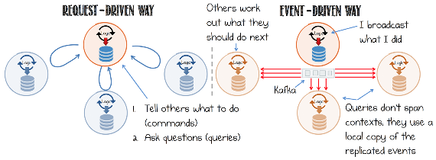
Data coupling is essential
Microservices are shared-nothing
Not feasible in real life
Event-driven systems reduce data coupling in cases where coupling is inevitable

Slide 20
Data coupling is essential
Microservices are shared-nothing
Not feasible in real life
Event-driven systems reduce data coupling in cases where coupling is inevitable

Slide 21
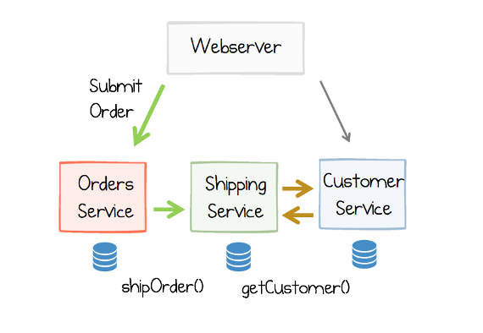
Command-driven system
In functionality

Slide 22
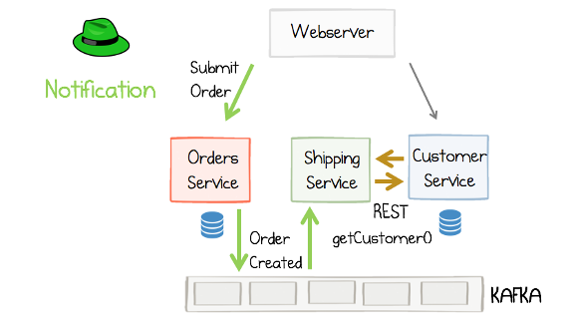
Event-driven system
The orders service does not need to be aware that a shipping service exists
Burden of responsibility is flipped
Pluggable systems

Slide 23
Event driven systems
Notification
Replication

Slide 24
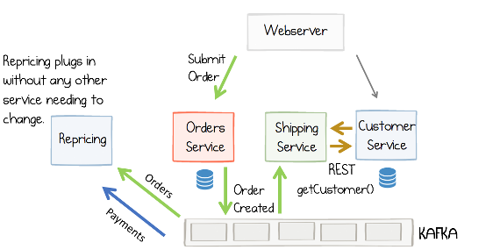
Pluggable systems
Repricing is a plugin

Slide 25
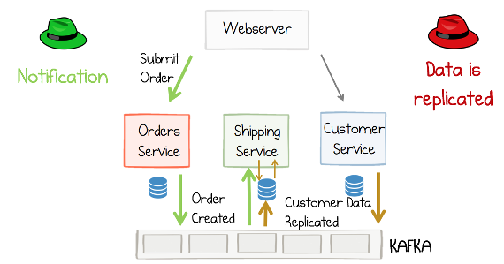
Fully event-driven system
State is pulled from Kafka and replicated in each of the services, locally

Slide 26
When to use?
Query by event-carried state transfer
  Better isolation and autonomy
  Faster data access
  Offline data availability
REST/RPC
  Singleton
  Simplicity
  Centralized control

Slide 27
Command Query Responsibility Segregation
Design pattern that separates the command and query responsibilities such that they don’t have to operate on the same data
Only one service owns a piece of data; all other services that need it hold derived, read-only copies built from events emitted by the owner
Customer service owns the customer data
  Sends out CustomerUpdated events if necessary
Shipping service maintains local read-only copies

Slide 28
Event carried state transfer

Slide 29
Kafka broker API
Wire (low-level) protocol
  Primitive on which Streams API, Flink connectors are built
Fetch
  Opens a new connection
  Reads from offset

Slide 30
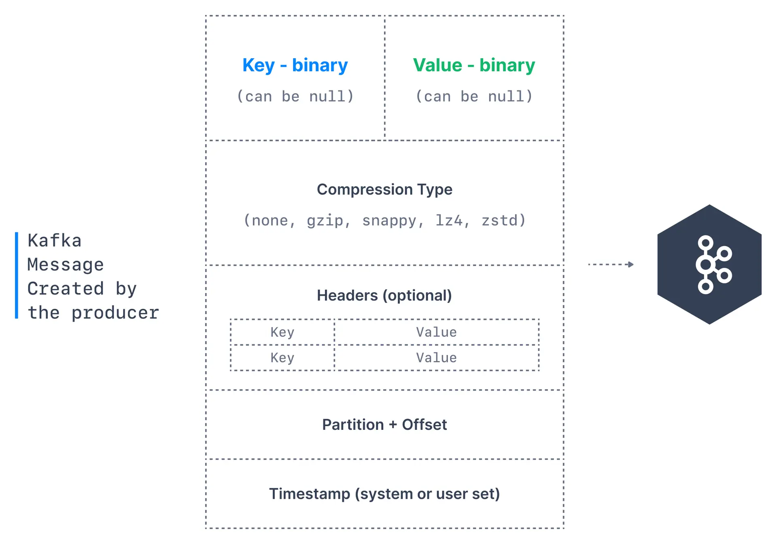
Kafka message anatomy
https://docs.conduktor.io/learn/fundamentals/producers#kafka-message-anatomy

Slide 31
Kafka Streams API

Slide 32
KSQL

Slide 33
Kafka controller, partitioning, and replication

Slide 34
Distributed system challenges
Nodes crash
Network issues lead to network “partitioning”
Network congestion delays notifications
… and so on

Slide 35
Partitioned and replicated logs
Logs are partitioned and replicated
Kafka controller maintains the replica information in Zookeeper*
When a replica goes down Kafka controller is notified

Slide 36
Partitioning
Partitioning a “topic” across multiple different brokers
Imagine a Kafka system with B brokers
A topic can have N partitions with M replicas
  Then N*M partition replicas must be allocated to B brokers
  Simple, round-robin allocation
Notes:
https://learning.oreilly.com/library/view/kafka-the-definitive/9781491936153/ch05.html#idm45788272925960

Slide 37
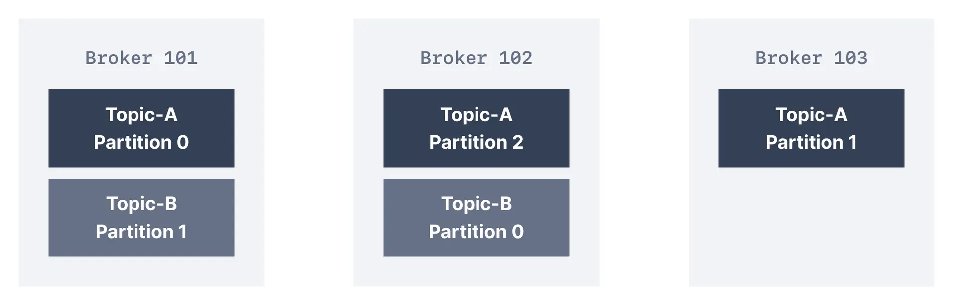
Partitioning
Notes:
https://learning.oreilly.com/library/view/kafka-the-definitive/9781491936153/ch05.html#idm45788272925960

Slide 38
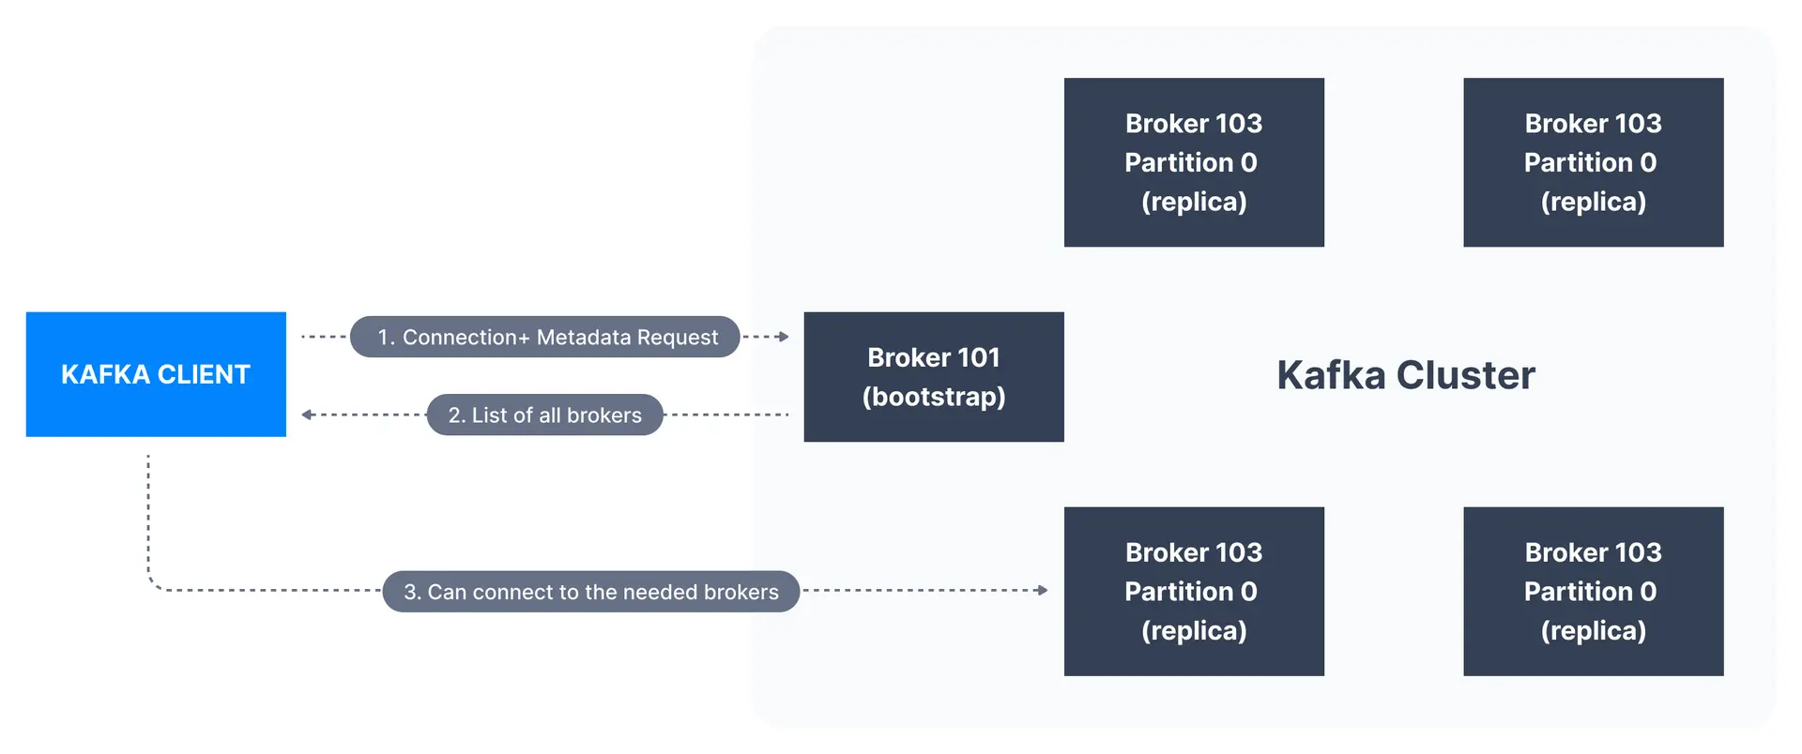
Client bootstrapping
All brokers maintain the metadata about the cluster
Client can connect to any broker in the cluster

Slide 39
Indexing
https://docs.conduktor.io/learn/advanced/topics/internals-segments-indexes

Slide 40
Indexing
https://docs.conduktor.io/learn/advanced/topics/internals-segments-indexes

Slide 41
Indexing
https://docs.conduktor.io/learn/advanced/topics/internals-segments-indexes

Slide 42
Indexing
https://docs.conduktor.io/learn/advanced/topics/internals-segments-indexes

Slide 43
Compaction
https://learning.oreilly.com/library/view/kafka-the-definitive/9781491936153/ch05.html#idm45788272918984

Slide 44
Compaction
https://learning.oreilly.com/library/view/kafka-the-definitive/9781491936153/ch05.html#idm45788272918984

Slide 45
Compaction
https://learning.oreilly.com/library/view/kafka-the-definitive/9781491936153/ch05.html#idm45788272918984

Slide 46
Replicas
Leader replicas
  All partitions have a single replica as the leader
  All produce/consume requests go through the leader to guarantee consistency
  Knows which followers are in sync
Follower replicas
  All non-leader replicas are called follower replicas
  Don’t serve client requests
  Only purpose is to act as backup if leader fails
  When leader fails one replica becomes the leader
Notes:
https://learning.oreilly.com/library/view/kafka-the-definitive/9781491936153/ch05.html#replication

Slide 47
Replication process
Follower replicas send Fetch requests to the leader to get the latest log events
  Fetch requests contains the offset in the log it wishes to receive
In-sync replicas (ISR)
  Consistently ask for the latest message
  Go out of sync if they haven’t asked for the latest in a timeout

Slide 48
Leader election

Slide 49
Kafka infrastructure

Slide 50
How to maintain metadata of all brokers?
Zookeeper
KRaft

Slide 51
Zookeeper
ZooKeeper is used to track cluster state, membership and leadership.

Slide 52
KRaft-mode
Kafka metadata is stored in a log!
  Brokers should be able to consume the log itself!
Controller election
  Raft protocol
Notes:
https://docs.conduktor.io/learn/fundamentals/kraft-mode

Slide 53
Consistency and concurrency
Notes:
- Designing EDD

Slide 54
Notes
It seems like Kafka replicates the data – does it not incur severe storage reqs?
  Compaction
Also, what happens if I need data another node is storing locally?
  Can’t – because only one owner

