Slide 1
Modern application deployment
Tapti Palit

Slide 2
Modern application deployment
Apps are deployed across many machines
Many (micro-)services are replicated across many machines for improved throughput and redundancy

Slide 3
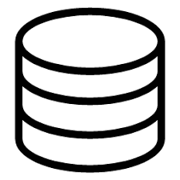


Online shop microservices
M4
M1
Product Microservice
Order MicroService
Orders DB
Product DB
Customer DB
Load Balancer
M2
Replica
Product MicroService
Order MicroService
M3
Replica
Customer MicroService
Order MicroService
User laptop

Slide 4
Automated cluster management
Microservices deployed on hundreds of nodes
Manually configuring and monitoring hundreds or thousands of nodes is not feasible
Cluster management must be automated

Slide 5
Cluster management requirements
Automatically schedule services on nodes
Each service needs its own environment
Minimize communication overhead
Deploy ”chatty” microservices on the same node
Ensure the node is well-provisioned to handle the service scheduled on it
Heterogenous clusters might have nodes with different CPU/RAM/disk capabilities
Detect node failures to stop routing requests to the failed nodes

Slide 6
Kubernetes: goal & history
Goal: automate deployment, scaling, and management of containerized applications
Origin: born from Google's internal systems Borg and Omega
Kubernetes (K8s) open-sourced in 2014

Slide 7
Virtual machines and containers

Slide 8
What is a virtual machine?
Isolated environment that emulates a physical machine
A hypervisor runs on the hardware
Each VM has its own kernel
Isolation enforced by hardware
Intel VT-x or AMD-V
VM1
VM3
VM2
Order Microservice
Customer Microservice
Product Microservice
Ubuntu 22.04
Ubuntu 25.04
Ubuntu 16.04
Linux kernel 5.4.2
Linux kernel 6.0.2
Linux kernel 4.9.3
Hypervisor software
Hardware (Intel/AMD)

Slide 9
What is a virtual machine?
Special CPU instructions to enter and exit VMs
VMRUN to enter “guest mode” and run the VM
VMCALL to exit “guest mode” and execute host code
Expensive instructions and also cause cache, TLB invalidations
VM1
VM3
VM2
Order Microservice
Customer Microservice
Product Microservice
Ubuntu 22.04
Ubuntu 25.04
Ubuntu 16.04
VMRUN
Linux kernel 5.4.2
Linux kernel 6.0.2
Linux kernel 4.9.3
Hypervisor software
Hardware (Intel/AMD)

Slide 10
What is a virtual machine?
Special CPU instructions to enter and exit VMs
VMRUN to enter “guest mode” and run the VM*
VMCALL to exit “guest mode” and execute host code
Expensive instructions and also cause cache, TLB invalidations
VM1
VM3
VM2
Order Microservice
Customer Microservice
Product Microservice
Ubuntu 22.04
Ubuntu 25.04
Ubuntu 16.04
VMCALL
(expensive)
Linux kernel 5.4.2
Linux kernel 6.0.2
Linux kernel 4.9.3
Hypervisor software
Hardware (Intel/AMD)
* For AMD machines, Intel uses VMENTER, VMEXIT

Slide 11
What is a container?
Isolated user-space environment
Each container shares the host kernel
Isolation enforced by software
Namespaces and cgroups in the Linux kernel
Container1
Container2
Container3
Order Microservice
Customer Microservice
Product Microservice
Ubuntu 22.04
Ubuntu 25.04
Ubuntu 16.04
Linux kernel 6.0.2
Hypervisor software
Hardware (Intel/AMD)

Slide 12
What is a container?
Namespaces partition kernel resources in software
E.g., a process can only see the resources in its own namespace
Container1
Container2
Container3
Order Microservice
Customer Microservice
Product Microservice
Ubuntu 22.04
Ubuntu 25.04
Ubuntu 16.04
read(“/proc”)
Linux kernel 6.0.2
ssize_t sys_read(int fd, void *buf, size_t n)
{
// check if we’re reading proc dir for_each_process(task) { if(!task_in_my_ns(task)) continue; // return the task details }
}
Hypervisor software
Hardware (Intel/AMD)

Slide 13
Tradeoffs
Virtual Machines | Containers
Full OS per VM (guest kernel) | Share the host kernel (not possible to run a containerized Windows app on Linux kernel)
Hardware-based isolation | Kernel-based isolation (namespaces + cgroups)
Heavy: GBs of memory overhead | Lightweight: MBs of overhead
Slow startup (minutes) | Fast startup (seconds)
Strong isolation boundary (better security) | Weaker isolation (shared kernel attack surface)
Commonly used in multi-tenant setups | Commonly used in single-tenant setups
Notes:
- Ask about the WSL

Slide 14
Docker containers
Docker is a tool for running software in containers
Declarative language for specifying what software should be packaged in a container
Commands to run the software as a container
Linux kernel provides system call flags for creating new namespaces (and cgroups)
For e.g., clone(child_fn, stack, CLONE_NEWUTS | CLONE_NEWPID | CLONE_NEWNS | SIGCHLD, arg);
Docker provides wrappers around these system calls

Slide 15
Sample Dockerfile
# Use the Ubuntu base image
FROM ubuntu:25.04
# Set the working directory
WORKDIR /app
ENV DEBIAN_FRONTEND=noninteractive
# Install required dependencies: OpenJDK, Maven, Git
RUN apt-get update && apt-get install -y \
openjdk-21-jdk \
maven \
git \
&& apt-get clean \
&& rm -rf /var/lib/apt/lists/*
# Set JAVA_HOME environment variable
ENV JAVA_HOME=/usr/lib/jvm/java-21-openjdk-amd64
ENV PATH="$JAVA_HOME/bin:$PATH"
# Clone the Java application repository
RUN git clone https://github.com/davsec-teaching/junit_demo.git .
# Build the application using Maven
RUN mvn clean package
RUN mvn clean test surefire-report:report
# Define the command to run the application
CMD ["bash"]
# To build the docker container
docker build -t java-app .
# To run the docker container
> docker run –it -p 8080:8080 java-app bash
# In the Docker container
> cat /etc/os-release > top
> Who # To push the docker container to remote registry
> docker push java-app:1.0
Notes:
Install docker.io
Write a simple text file

Slide 16
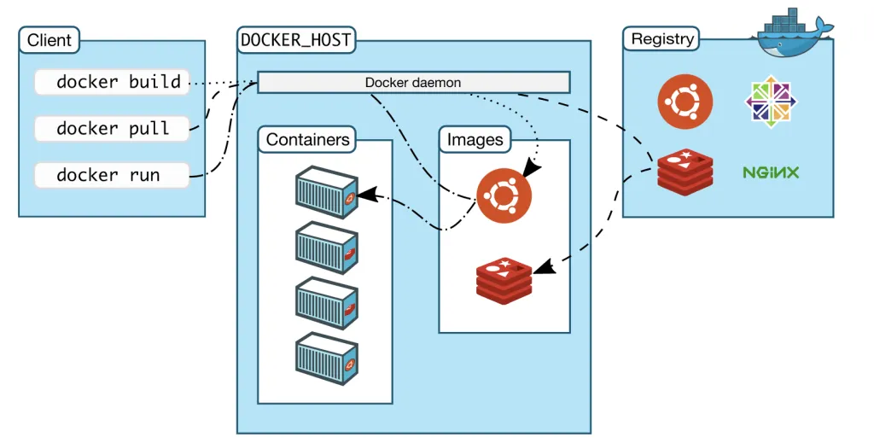
Docker: the container runtime
Remote docker registry
Dockerhub contains container images
Each container image is user-space software bundled together into a filesystem
Docker host
Machine running docker daemon
Stores docker images locally
Spawns containers

Slide 17
CI/CD
Continuous integration (CI)
Developers merge changes frequently; every change triggers automated builds + tests to catch breakages early
E.g., GitHub Actions
Continuous deployment (CD)
Passing changes are auto-deployed to production
Containers provide uniform build system for CI/CD
No weird issues with $PATH variables
No missing binaries

Slide 18
Kubernetes

Slide 19

Kubernetes overview
Developer provides an app description; Kubernetes deploys the app
OrderService
CustService
2x
OrderService
2x
CustService
CustService
Kubernetes master
Developer laptop
ProductService
1x
BatchService
OrderService
ProductService
BatchService
App descriptor
Cluster
Notes:
Simple diagram with master node

Slide 20
App descriptor
apiVersion: apps/v1
metadata:
name: order-service
spec:
replicas: 2
template:
spec:
containers:
- name: order-service
image: your-registry/orderservice:latest
---
apiVersion: apps/v1
metadata:
name: product-batch-service
spec:
replicas: 1
template:
spec:
containers:
- name: product-service
image: your-registry/productservice:latest
- name: batch-service
image: your-registry/batchservice:latest
Dev creates app descriptor in an YAML format
order-service, product-batch-service are deployment objects
Submit it to Kubernetes using
kubectl apply -f app.yaml
kubectl get pods
Notes:
Simple diagram with master node

Slide 21
The pod abstraction
apiVersion: apps/v1
metadata:
name: order-service
spec:
replicas: 2
template:
spec:
containers:
- name: order-service
image: your-registry/orderservice:latest
---
apiVersion: apps/v1
metadata:
name: product-batch-service
spec:
replicas: 1
template:
spec:
containers:
- name: product-service
image: your-registry/productservice:latest
- name: batch-service
image: your-registry/batchservice:latest
A “pod” is a group of tightly related containers
Each pod is separated logically with its own IP
Pods are units of scaling – you scale by adding or removing pods
Pod-1
Pod-2
Notes:
Detailed control and data plane

Slide 22
The pod abstraction
apiVersion: apps/v1
metadata:
name: order-service
spec:
replicas: 2
template:
spec:
containers:
- name: order-service
image: your-registry/orderservice:latest
---
apiVersion: apps/v1
metadata:
name: product-batch-service
spec:
replicas: 1
template:
spec:
containers:
- name: product-service
image: your-registry/productservice:latest
- name: batch-service
image: your-registry/batchservice:latest
Containers in each pod are guaranteed to be scheduled on the same machine
Dev can schedule “chatty” microservices in same pod
Chatty microservices
Notes:
Detailed control and data plane

Slide 23
Kubernetes components
Master node:
etcd, API server, Scheduler, Controller Manager
Worker node
Kubelet, kube-proxy
Control Plane (master)
etcd
API server
Scheduler
Controller Manager
Worker node(s)
Kubelet
kube-proxy
Container Runtime
Notes:
Detailed control and data plane

Slide 24
Pod lifecycle
API server accepts app descriptor YAML files
”Run 3 instances of order-service”
Stores state in etcd
Control Plane (master)
etcd
API server
app.yaml
Scheduler
Controller Manager
Developer laptop
Worker node(s)
Kubelet
kube-proxy
Container Runtime
Notes:
Detailed control and data plane

Slide 25
Pod lifecycle
API server accepts app descriptor YAML files
“Run 3 instances of order-service”
Stores state in etcd
etcd is a distributed KV-store used to persist and coordinate the cluster’s configuration and state
Control Plane (master)
etcd
API server
app.yaml
Scheduler
Controller Manager
Developer laptop
Worker node(s)
Kubelet
kube-proxy
Container Runtime
Notes:
Detailed control and data plane

Slide 26
Pod lifecycle
Controller Manager detects “desired state” != “actual state”
Creates pod objects in the API server
Control Plane (master)
etcd
API server
Pod objects
Scheduler
Controller Manager
Worker node(s)
Kubelet
kube-proxy
Container Runtime
Notes:
Detailed control and data plane

Slide 27
Pod lifecycle
Scheduler watches for unassigned pods on the API server
Picks a suitable worker node for each pod
Pushes the assignment to the API server
Control Plane (master)
etcd
API server
Pod-node assignments
Scheduler
Controller Manager
Worker node(s)
Kubelet
kube-proxy
Container Runtime
Notes:
Detailed control and data plane

Slide 28
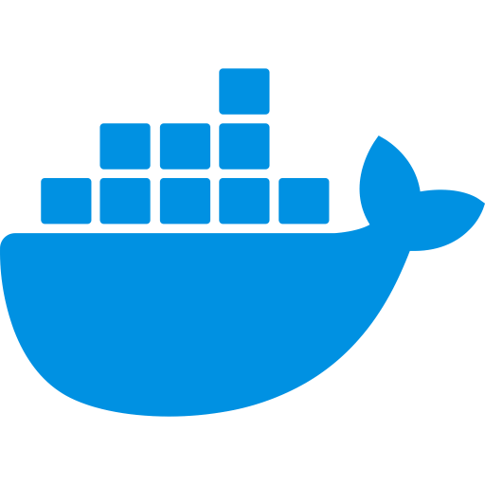
Pod lifecycle
Kubelets running on worker nodes request the API server for pods that are scheduled on their nodes
Instruct the container runtime (docker) to download and launch the containers
Control Plane (master)
etcd
API server
Scheduler
Controller Manager
Pod info?
Worker node(s)
Kubelet
kube-proxy
Docker commands
Container Runtime
Notes:
Detailed control and data plane

Slide 29
Pod lifecycle
Key design points:
Kubernetes components communicate through each other via the API server
Each component pulls the updates
Control Plane (master)
etcd
API server
Scheduler
Controller Manager
Worker node(s)
Kubelet
kube-proxy
Container Runtime
Notes:
Like Kafka clients which pull the events – the kafka broker does not push

Slide 30

Cluster management requirements
Automatically schedule services on nodes
Each service needs its own environment
Minimize communication overhead
Deploy ”chatty” microservices on the same node
Ensure the node is well-provisioned to handle the service scheduled on it
Heterogenous clusters might have nodes with different CPU/GPU/RAM/disk capabilities
Detect node failures to stop routing requests to the failed nodes

Slide 31
Label-based scheduling
Kubernetes allows assigning labels to objects (pods, worker nodes)
Labels = key-value pairs attached to object (e.g., app=frontend, env=production)
Label selectors
Match on exact key-value: env=production, app!=frontend
Scheduler assigns pod to a node that satisfies the selector constraints
Example: schedule GPU workloads only on gpu=true nodes
Notes:
Detailed control and data plane

Slide 32
Label-based scheduling
Control Plane (master)
apiVersion: apps/v1
metadata:
name: order-service
spec:
replicas: 2
template:
spec:
containers:
- name: order-service
image: your-registry/orderservice:latest nodeSelector:
- gpu: "true"
etcd
API server
Scheduler
Controller Manager
label=gpu
Worker node(s)
Kubelet
kube-proxy
Container Runtime
Notes:
Detailed control and data plane

Slide 33
Fault tolerance
When master node dies and reboots, it restores state from etcd
When container crashes (e.g., OOM, unhandled exception), Kubelet automatically restarts it
When a node goes down, Controller Manager creates replacement pods on healthy nodes
What if container is running, but not responding?
Deadlocked, infinite loop, etc..
Notes:
Detailed control and data plane

Slide 34
Liveness probes
Can configure per-pod liveness probes
Kubelet will probe the container for liveness signs
Liveness probes defines health checks
HTTP GET — hit an endpoint, expect 200
TCP socket — check if a port is open
Exec — run a command inside the container, expect exit code 0
If the probe fails repeatedly, Kubelet kills and restarts the container
Control Plane (master)
etcd
API server
Scheduler
Controller Manager
Worker node(s)
Kubelet
kube-proxy
Probe
Container Runtime
Notes:
Detailed control and data plane

Slide 35
Cluster management requirements
Automatically schedule services on nodes
Each service needs its own environment
Minimize communication overhead
Deploy ”chatty” microservices on the same node
Ensure the node is well-provisioned to handle the service scheduled on it
Heterogenous clusters might have nodes with different CPU/GPU/RAM/disk capabilities
Detect node failures to stop routing requests to the failed nodes

Slide 36

Kubernetes networking
ServiceIP: 10.2.2.1 Pod IP: 192.168.1.3
Services have a logical “Service IP”
All pod replicas share the same Service IP
CustService
Kubelet
kube-proxy
Container Runtime
ServiceIP: 10.2.2.2 Pod IP: 192.168.1.4
ServiceIP: 10.2.2.2 Pod IP: 192.168.1.5
OrderService
OrderService
Kubelet
kube-proxy
Kubelet
kube-proxy
Container Runtime
Container Runtime

Slide 37
Kubernetes networking
ServiceIP: 10.2.2.1 Pod IP: 192.168.1.3
kube-proxy maintains a list of Service IP to pod IP mappings
Rewrites outgoing Service IPs to the pod IP
CustService
Kubelet
kube-proxy
10.2.2.1 | 192.168.1.3
10.2.2.2 | 192.168.1.4, 192.168.1.5
Container Runtime
ServiceIP: 10.2.2.2 Pod IP: 192.168.1.4
ServiceIP: 10.2.2.2 Pod IP: 192.168.1.5
OrderService
OrderService
Kubelet
kube-proxy
Kubelet
kube-proxy
Container Runtime
Container Runtime

Slide 38
Kubernetes networking
ServiceIP: 10.2.2.1 Pod IP: 192.168.1.3
CustService
10.2.2.1 | 192.168.1.3
10.2.2.2 | 192.168.1.4, 192.168.1.5
Kubelet
kube-proxy
Container Runtime
ServiceIP: 10.2.2.2 Pod IP: 192.168.1.4
ServiceIP: 10.2.2.2 Pod IP: 192.168.1.5
10.2.2.1 | 192.168.1.3
10.2.2.2 | 192.168.1.4, 192.168.1.5
10.2.2.1 | 192.168.1.3
10.2.2.2 | 192.168.1.4, 192.168.1.5
OrderService
OrderService
Kubelet
kube-proxy
Kubelet
kube-proxy
Container Runtime
Container Runtime

Slide 39
Kubernetes networking
ServiceIP: 10.2.2.1 Pod IP: 192.168.1.3
CustService
10.2.2.1 | 192.168.1.3
10.2.2.2 | 192.168.1.4, 192.168.1.5
Kubelet
kube-proxy
Container Runtime
Dest IP addr: 10.22.2.2
ServiceIP: 10.2.2.2 Pod IP: 192.168.1.4
ServiceIP: 10.2.2.2 Pod IP: 192.168.1.5
10.2.2.1 | 192.168.1.3
10.2.2.2 | 192.168.1.4, 192.168.1.5
10.2.2.1 | 192.168.1.3
10.2.2.2 | 192.168.1.4, 192.168.1.5
OrderService
OrderService
Kubelet
kube-proxy
Kubelet
kube-proxy
Container Runtime
Container Runtime

Slide 40
Kubernetes networking
ServiceIP: 10.2.2.1 Pod IP: 192.168.1.3
CustService
10.2.2.1 | 192.168.1.3
10.2.2.2 | 192.168.1.4, 192.168.1.5
Kubelet
kube-proxy
Query
Container Runtime
ServiceIP: 10.2.2.2 Pod IP: 192.168.1.4
ServiceIP: 10.2.2.2 Pod IP: 192.168.1.5
10.2.2.1 | 192.168.1.3
10.2.2.2 | 192.168.1.4, 192.168.1.5
10.2.2.1 | 192.168.1.3
10.2.2.2 | 192.168.1.4, 192.168.1.5
OrderService
OrderService
Kubelet
kube-proxy
Kubelet
kube-proxy
Container Runtime
Container Runtime

Slide 41
Kubernetes networking
ServiceIP: 10.2.2.1 Pod IP: 192.168.1.3
CustService
10.2.2.1 | 192.168.1.3
10.2.2.2 | 192.168.1.4, 192.168.1.5
Kubelet
kube-proxy
Container Runtime
Dest IP addr: 192.168.1.4
ServiceIP: 10.2.2.2 Pod IP: 192.168.1.4
ServiceIP: 10.2.2.2 Pod IP: 192.168.1.5
10.2.2.1 | 192.168.1.3
10.2.2.2 | 192.168.1.4, 192.168.1.5
10.2.2.1 | 192.168.1.3
10.2.2.2 | 192.168.1.4, 192.168.1.5
OrderService
OrderService
Kubelet
kube-proxy
Kubelet
kube-proxy
Container Runtime
Container Runtime

Slide 42
Additional features
Autoscaling: supports HPA (Horizontal Pod Autoscaler)
Monitors CPU/memory utilization
Increases the replica count when threshold reached
Custom network fast-paths
CNI controls pod networking + routing
eBPF-based CNIs can avoid iptables for lower overhead

Slide 43
Kubernetes summary
Kubernetes automates deployment, scaling, and management of containerized applications across clusters of machines
Pods are the unit of deployment and scaling
Control plane manages desired state, and the worker nodes execute them
Has built-in fault tolerance and resilience

