Slide 1
Modern software architectures
Tapti Palit

Slide 2
Modern software architecture
User DB MySQL cluster
Redis cluster
User Onboarding Login flow
User Service
Trends
Redis cluster
User following flow
Graph Service
Apache Spark streaming cluster
User Graph MySQL cluster
K
A
F
K
A
Hadoop cluster
Adding Post UI
Tweet Injection Service
Weekly cron jobs
Cassandra Cluster
Search Kafka consumer
Notification service
Short URL Service
Tweet Service
Tweet Processor
Elastic search cluster
Live User Websockets (notifications)
User Self Profile Service
Timeline Service
Analytics
Search service
Assert Service
Redis cluster
Home Screen
CDN
Users app / browsers
Search screen

Slide 3
Outline
Microservice architecture and communication
Event-driven architecture with Kafka
Kubernetes

Slide 4
Microservices outline
Monolithic applications
Microservices and decentralized data
Data model and storage engine
Relational databases, log-structured merge trees (LSM), event logs (more in Kafka section), in-memory cache
Communication styles
Text-based vs binary data exchange formats
Synchronous (RPC), asynchronous (MQs), publish-subscribe models

Slide 5
All about the data!
Modern software architecture is data-intensive
Primary concerns
Who owns data?
How to optimally store data?
How is data shared?
How to limit overhead due to data-sharing?

Slide 6
Monolithic software architecture
Widely used in early, mid 2000s
All software components are part of the same application
All software components run on the same machine, in same process
Typically developed in the same language stack

Slide 7








Simple online store
Single process
CustomerService.java
Add, update, delete
OnlineStore.db
customer.html
Create, update, delete
getCustomerInfo
Create, update, delete
Add, update, delete
OrderService.java
order.html
Internet
UpdateCount
Add
ProductService.java
Product batch job
User laptop
Remote datacenter

Slide 8
Simple online store
CustomerService.java
OnlineStore.db
customer.html
ProductId | ProductName | ProductCount
OrderService.java
order.html
Internet
CustomerId | CustomerName | CustomerAddr
OrderId | CustomerId | ProductId
ProductService.java
Product batch job
User laptop
Remote datacenter

Slide 9
Relational databases
Consists of tables
Each table contains a primary key
Database will not allow insertion of two records with same primary key
Products tbl
ProductId | ProductName | ProductCount
1001 | ABC | 10
Customer tbl
CustomerId | CustomerName | CustomerAddr
9001 | XYZ | CDEF
Order tbl
OrderId | CustomerId | ProductId
110001 | 9001 | 1001

Slide 10
Foreign keys
Relational databases maintain relations through foreign keys
Foreign keys must refer to primary keys of other tables
Enforce referential integrity
A table can contain one or more foreign keys
Products tbl
ProductId | ProductName | ProductCount
1001 | ABC | 10
Customer tbl
CustomerId | CustomerName | CustomerAddr
9001 | XYZ | CDEF
9002 | UVW | ABCD
Order tbl
OrderId | CustomerId | ProductId
110001 | 9001 | 1001

Slide 11
Structured query language (SQL)
SQL used to interface between application and database
CREATE TABLE Products ( ProductId INT PRIMARY KEY, ProductName VARCHAR(100) NOT NULL, ProductCount INT NOT NULL);
INSERT INTO Products (ProductId, ProductName, ProductCount) VALUES (1001, 'ABC', 10);
Notes:
- Fixed schema

Slide 12
SQL joins
Allows table joins
For e.g. find order details for shipping, including product name, customer name, and address
Products tbl
ProductId | ProductName | ProductCount
1001 | ABC | 10
Customer tbl
CustomerId | CustomerName | CustomerAddr
9001 | XYZ | CDEF
9002 | UVW | ABCD
Order tbl
OrderId | CustomerId | ProductId
110001 | 9001 | 1001

Slide 13
SQL joins
SELECT
o.OrderId,
p.ProductName,
c.CustomerName,
c.CustomerAddr
FROM Orders o
JOIN Products p
ON o.ProductId = p.ProductId
JOIN Customers c
ON o.CustomerId =
c.CustomerId;
Products tbl
ProductId | ProductName | ProductCount
1001 | ABC | 10
Customer tbl
CustomerId | CustomerName | CustomerAddr
9001 | XYZ | CDEF
9002 | UVW | ABCD
Order tbl
OrderId | CustomerId | ProductId
110001 | 9001 | 1001
o.OrderId | p.ProductName | c.CustomerName | c.CustomerAddr
110001 | 9001 | XYZ | CDEF

Slide 14
Need for joins
Imagine no support for joins
Order information must contain product name, customer name, and customer address to ship the order
Products tbl
ProductId | ProductName | ProductCount
1001 | ABC | 10
Customer tbl
CustomerId | CustomerName | CustomerAddr
9001 | XYZ | CDEF
9002 | UVW | ABCD
Order tbl
OrderId | ProductName | CustomerName | CustomerAddr
110001 | ABC | XYZ | CDEF

Slide 15
Need for joins
Lack of join support increases data duplication
Data denormalization
Products tbl
ProductId | ProductName | ProductCount
1001 | ABC | 10
Customer tbl
CustomerId | CustomerName | CustomerAddr
9001 | XYZ | CDEF
9002 | UVW | ABCD
OrderId | ProductName | CustomerName | CustomerAddr
110001 | ABC | XYZ | CDEF
110002 | ABC | XYZ | CDEF
110003 | ABC | UVW | ABCD
Order tbl

Slide 16
Normalization
Joins reduce data duplication and allow data normalization
Database can build indexes to speed up joins
Products tbl
ProductId | ProductName | ProductCount
1001 | ABC | 10
Customer tbl
CustomerId | CustomerName | CustomerAddr
9001 | XYZ | CDEF
9002 | UVW | ABCD
OrderId | ProductId | CustomerId
110001 | 1001 | 9001
110002 | 1001 | 9001
110003 | 1001 | 9002
Order tbl

Slide 17
Relational database implications
Tighter coupling
E.g., Customer service cannot alter the Customers table without impacting the Orders service
Fixed schema
E.g., Orders service must know about the schema Customers table

Slide 18
SQL != relational databases
Note: not quite specific to relational databases
Apache Cassandra, Apache HBase, Apache Kafka + ksqlDB are not relational databases, but support SQL-like query language

Slide 19
Simple online store app
Single process
CustomerService.java
OnlineStore.db
customer.html
Customer Tbl
Order Tbl
Product Tbl
OrderService.java
order.html
Internet
ProductService.java
Product batch job
User laptop
Remote datacenter
Notes:
Entire application is run on a single machine
How things done early on
And things worked

Slide 20
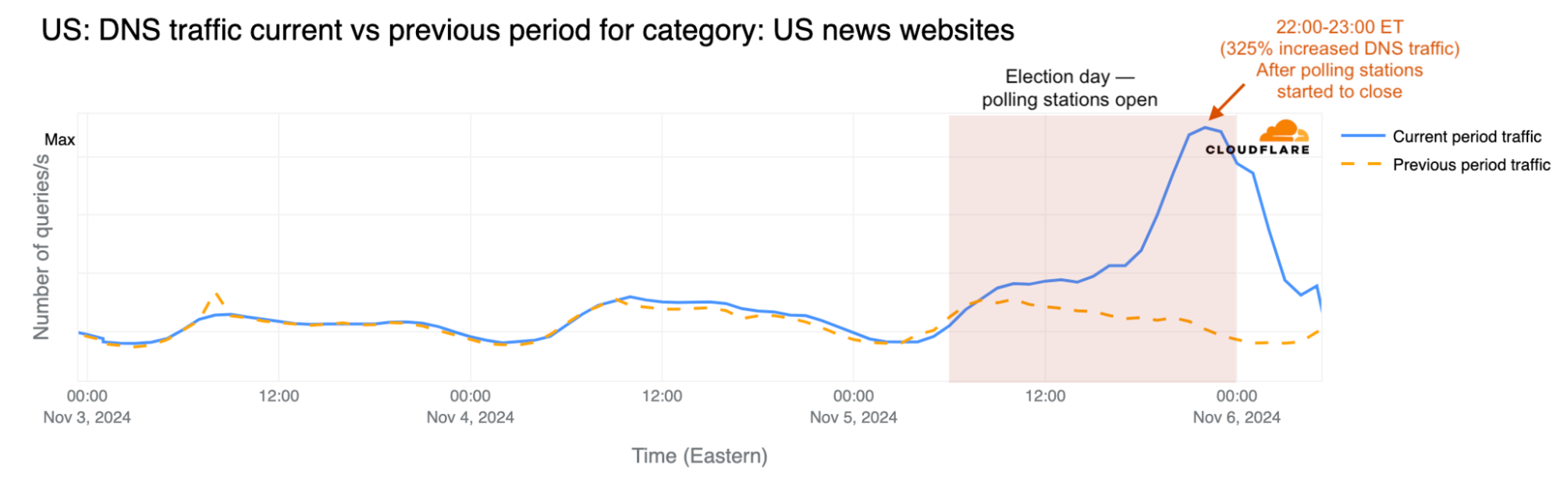
Scalability
Online traffic is variable
Can spike due to planned events
Product launches
Political events
https://blog.cloudflare.com/exploring-internet-traffic-shifts-and-cyber-attacks-during-the-2024-us-election/

Slide 21
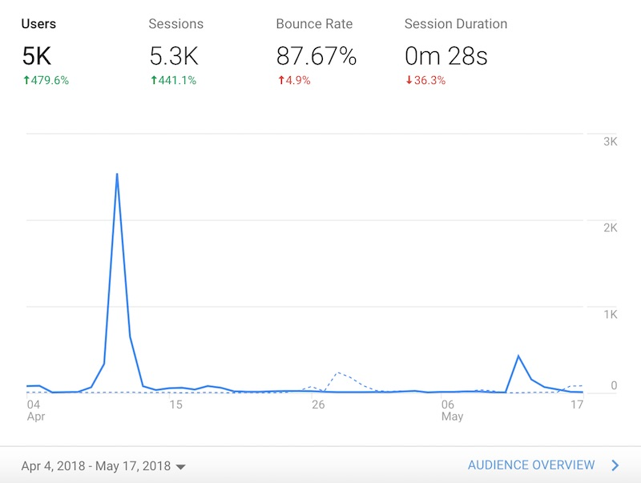
Scalability
Unplanned events
Blog post goes viral
System design should adapt to handle such events
https://www.residualthoughts.com/2018/05/20/traffic-data-from-a-viral-post/
Notes:
- Taylor swift post goes viral

Slide 22
Traffic spike to online store
At high utilizations, queuing delays spike tail latency
Many workloads aim to operate at 60-70% utilizations

Slide 23
Vertical scaling
Use more powerful machines
Add more CPUs, DRAM, network bandwidth
Peak usage is ~65%

Slide 24
Vertical scaling limitations
Resource wastage when requests are not bursty
Wasted resources

Slide 25
Vertical scaling limitations
Twitter has 200M-300M active users per day
No single machine, no matter how powerful, can support such high loads
Goal: autoscaling
Dynamically spawn new machines during high loads
Not possible using vertical scaling alone
More in Kubernetes module

Slide 26


Horizontal scaling for monolithic apps
Add more machines and replicate application on each machine
M1
Services
Database Cluster
M4
Load Balancer
M2
Services
M5
M6
M3
Services
M7
User laptop

Slide 27
Load balancer
Distributes incoming requests across multiple servers to improve scalability and availability
Strategies
Round Robin – Sequentially routes requests across servers; simple but doesn’t account for server load
Least Connections – Directs traffic to the server with the fewest active connections; adapts well to uneven load
Least Response Time – Chooses the server with the fastest response time and fewest connections; performance-oriented
Random Policy – Selects servers randomly; useful in stateless, uniform environments
Weighted Distribution – Allocates requests based on server capacity (e.g., CPU power, memory)
Each strategy has tradeoffs
More details in Kubernetes module

Slide 28
Horizonal scaling is unbounded
Necessary for applications with high load (like Twitter/X)
Can add more machines to support more requests (theoretically unbounded performance)
Better resource utilization

Slide 29
Horizontal scaling is necessary for autoscaling
Auto-scale to more machines during traffic spike (more in Kubernetes module)
M1
Services
Database Cluster
M4
Load Balancer
M2
Services
M5
M6
M3
Services
M7
User laptop

Slide 30
Horizontal scaling is necessary for autoscaling
Auto-scale to more machines during traffic spike (more in Kubernetes module)
Database Cluster
M1
M4
Load Balancer
M2
M5
M3
M6
M1’
M7
M2’
User laptop

Slide 31
Autoscaling
Minimum resource wastage
50 machines
10 machines
10 machines

Slide 32
Horizontal scaling allows autoscaling, but did we solve all problems?

Slide 33
Heterogenous resource requirements across services
Provisioning is driven by the most resource-hungry service
Example RAM requirements
CustomerService: 32 GB
OrderService: 18 GB
ProductService: 16 GB
Minimum machine RAM? 32 GB

Slide 34
Deployability concerns
Updating one component requires redeploying the entire application
Reverting a change requires redeploying the entire application
Slow, error-prone process

Slide 35
Need for low interdependence
Software often consists of thousands of components
Each component has a dedicated team working on it
Teams need to work independently
E.g., ProductService team should be able to update the Products Tbl schema without consulting other service teams
Need low coupling between services
Solution: microservices

Slide 36
Microservices
An approach to developing a single application as a suite of small services, each running in its own process and communicating with lightweight mechanisms, often an HTTP resource API
Independently deployable by automated processes
Bare minimum centralized management
Smart endpoints connected by “dumb” pipes
https://martinfowler.com/articles/microservices.html

Slide 37
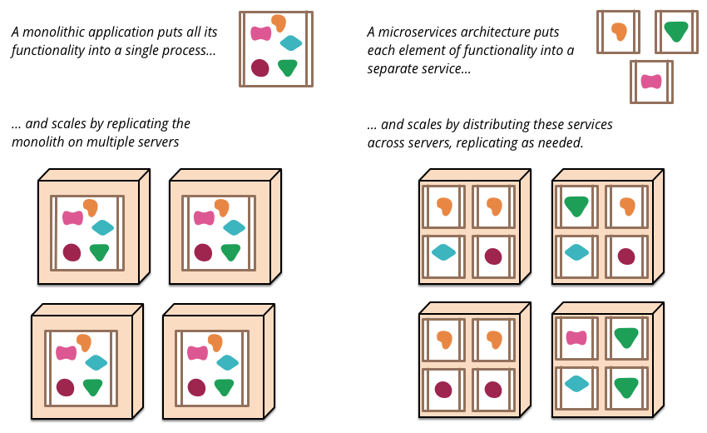
Microservices overview
https://martinfowler.com/articles/microservices.html

Slide 38
Microservice architecture for online store
M4
M1
Product Microservice
Order MicroService
Orders DB
Product DB
Customer DB
Load Balancer
M2
Product MicroService
Order MicroService
Order MicroService
Order MicroService
M3
Customer MicroService
Order MicroService
User laptop
Notes:
Makes a lot of sense, you want more instances of the Order Service to run
Let’s not forget about the databases
And to make them loosely coupled – we will say hey, each microservice can have its own type of database

Slide 39



Each microservice chooses its own database
M4
M1
Product Microservice
Order MicroService
Orders DB
Product DB
Customer DB
Load Balancer
M2
Product MicroService
Order MicroService
Order MicroService
Order MicroService
M3
Customer MicroService
Order MicroService
User laptop
Notes:
Makes a lot of sense, you want more instances of the Order Service to run
Let’s not forget about the databases
And to make them loosely coupled – we will say hey, each microservice can have its own type of database

Slide 40
What did we achieve?
Decompose monolithic app into microservices
Improve decoupling
Each microservice can be scaled independently
Each microservice can be deployed independently
Each microservice can evolve independently – DB schema, choice of programming languages
Did we solve all problems?

Slide 41
Shipping an order
M4
M1
Product Microservice
Order MicroService
Orders DB
Product DB
Customer DB
Load Balancer
M2
Product MicroService
Order MicroService
Order MicroService
Order MicroService
M3
Customer MicroService
Order MicroService
User laptop
Notes:
Makes a lot of sense, you want more instances of the Order Service to run
Let’s not forget about the databases
And to make them loosely coupled – we will say hey, each microservice can have its own type of database

Slide 42
Reusing monolithic order schema
Products tbl
ProductId | ProductName | ProductCount
1001 | ABC | 10
Product MicroService
Customer tbl
CustomerId | CustomerName | CustomerAddr
9001 | XYZ | CDEF
9002 | UVW | ABCD
Order MicroService
Customer MicroService
Order tbl
OrderId | ProductId | CustomerId
110001 | 1001 | 9001
Cannot perform joins!
Notes:
Process of shipping an order

Slide 43
Non-solution
DO NOT want to query the Customer and Product microservices during shipping
Will introduce tight coupling and interdependence
For example, what if the Customer microservice is down during shipment?

Slide 44
Denormalization
Must denormalize the data
Order microservice duplicates and store the customer details in the Order db
How? (after a few slides)
OrderId | ProductName | CustomerName | CustomerAddr
110001 | ABC | XYZ | CDEF
110002 | ABC | XYZ | CDEF
110003 | ABC | UVW | ABCD

Slide 45
Consistency guarantees
Consistency property of a system governs how and when updates to shared data become visible to different components of the system
Monolithic apps typically have strong consistency – updates reflect immediately to subsequent reads
ProductId | ProductName | ProductCount
1001 | ABC | 10
Product Service
CustomerId | CustomerName | CustomerAddr
9001 | XYZ | CDEF
9002 | UVW | ABCD
Customer Service
Store.db
Order Service
OrderId | ProductId | CustomerId
T1: AddOrder(110001, 1001, 9001)

Slide 46
Consistency guarantees
Consistency property of a system governs how and when updates to shared data become visible to different components of the system
Monolithic apps typically have strong consistency – updates reflect immediately to subsequent reads
ProductId | ProductName | ProductCount
1001 | ABC | 10
Product Service
CustomerId | CustomerName | CustomerAddr
9001 | XYZ | CDEF
9002 | UVW | ABCD
Customer Service
Store.db
Order Service
OrderId | ProductId | CustomerId
110001 | 1001 | 9001
T1: AddOrder(110001, 1001, 9001)

Slide 47
Consistency guarantees
Consistency property of a system governs how and when updates to shared data become visible to different components of the system
Monolithic apps typically have strong consistency – updates reflect immediately to subsequent reads
ProductId | ProductName | ProductCount
1001 | ABC | 10
Product Service
CustomerId | CustomerName | CustomerAddr
9001 | XYZ | CDEF
9002 | UVW | ABCD
Customer Service
Store.db
Order Service
T2: UpdateCustomer(9001, Addr=EFGC)
OrderId | ProductId | CustomerId
110001 | 1001 | 9001

Slide 48
Consistency guarantees
Consistency property of a system governs how and when updates to shared data become visible to different components of the system
Monolithic apps typically have strong consistency – updates reflect immediately to subsequent reads
ProductId | ProductName | ProductCount
1001 | ABC | 10
Product Service
CustomerId | CustomerName | CustomerAddr
9001 | XYZ | CDEF
9002 | UVW | EFGC
Customer Service
Store.db
Order Service
T2: UpdateCustomer(9001, Addr=EFGC)
OrderId | ProductId | CustomerId
110001 | 1001 | 9001

Slide 49
Consistency guarantees
Consistency property of a system governs how and when updates to shared data become visible to different components of the system
Monolithic apps typically have strong consistency – updates reflect immediately to subsequent reads
ProductId | ProductName | ProductCount
1001 | ABC | 10
Product Service
CustomerId | CustomerName | CustomerAddr
9001 | XYZ | CDEF
9002 | UVW | EFGC
Customer Service
Store.db
Order Service
T3: ShipOrder -> JOIN(1001, 9001) -> (ABC, UVW, EFGC)
OrderId | ProductId | CustomerId
110001 | 1001 | 9001

Slide 50
Microservice consistency guarantees
Core idea: a microservice owns some data
Notifies dependent microservices of change
Soft guarantees on when the updates synchronize

Slide 51
Microservice consistency guarantees
Microservice-oriented apps are distributed
Enforcing strong consistency guarantees in distributed systems is very hard
Network overhead, network partition, node failures
Typically have eventual consistency guarantees – updates are eventually visible to all components
System must work around these limitations

Slide 52
Working with eventual consistency
Product MicroService
ProductId | ProductName | ProductCount
1001 | ABC | 10
Products
tbl
Products.db
Customer MicroService
CustomerId | CustomerName | CustomerAddr
9001 | XYZ | CDEF
Customer
tbl
CustomerMicroservice owns the customer data
Customer.db
Order MicroService
OrderId | ProductName | CustomerAddr
Order
tbl
Orders.db
OrderMicroservice maintains a cache of the customer information
CustomerId | CustomerName | CustomerAddr
CustomerCache
tbl

Slide 53
Working with eventual consistency
Product MicroService
ProductId | ProductName | ProductCount
1001 | ABC | 10
Products
tbl
T1: AddCustomer(9002, UVW, ABCD)
Products.db
Customer MicroService
CustomerId | CustomerName | CustomerAddr
9001 | XYZ | CDEF
9002 | UVW | ABCD
Customer
tbl
Customer.db
Order MicroService
OrderId | ProductName | CustomerAddr
Order
tbl
Orders.db
CustomerId | CustomerName | CustomerAddr
CustomerCache
tbl

Slide 54
Working with eventual consistency
Product MicroService
ProductId | ProductName | ProductCount
1001 | ABC | 10
Products
tbl
Products.db
Customer MicroService
CustomerId | CustomerName | CustomerAddr
9001 | XYZ | CDEF
9002 | UVW | ABCD
Customer
tbl
T2: UpdateCust
(9002, UVW, ABCD)
Customer.db
Order MicroService
OrderId | ProductName | CustomerAddr
Order
tbl
Orders.db
CustomerId | CustomerName | CustomerAddr
9002 | UVW | ABCD
CustomerCache
tbl

Slide 55
Working with eventual consistency
Product MicroService
ProductId | ProductName | ProductCount
1001 | ABC | 10
Products
tbl
Products.db
Customer MicroService
CustomerId | CustomerName | CustomerAddr
9001 | XYZ | CDEF
9002 | UVW | ABCD
Customer
tbl
Customer.db
Order MicroService
OrderId | ProductName | CustomerAddr
Order
tbl
Orders.db
User 9002 tries placing an order
T3: FetchOrderAddrForConfirm() ->
(9002, UWV, ABCD)
CustomerId | CustomerName | CustomerAddr
9002 | UVW | ABCD
CustomerCache
tbl

Slide 56
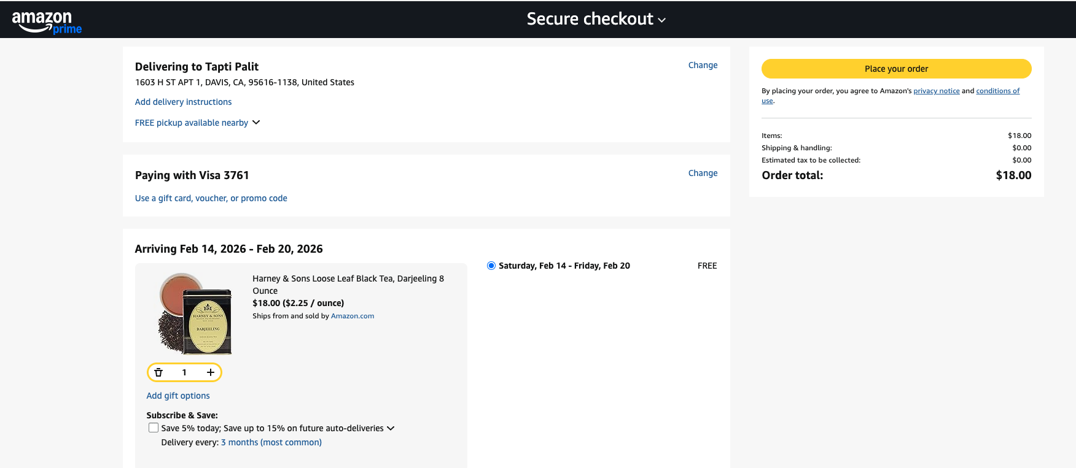
Working with eventual consistency
Name: UVW,
Address: ABCD

Slide 57
Working with eventual consistency
Product MicroService
ProductId | ProductName | ProductCount
1001 | ABC | 10
Products
tbl
Products.db
Customer MicroService
CustomerId | CustomerName | CustomerAddr
9001 | XYZ | CDEF
9002 | UVW | ABCD
Customer
tbl
Customer.db
Order MicroService
OrderId | ProductName | CustomerAddr
110001 | ABC | ABCD
Order
tbl
Orders.db
T4: AddOrder(110001, ABC, ABCD)
CustomerId | CustomerName | CustomerAddr
9002 | UVW | ABCD
CustomerCache
tbl

Slide 58
Working with eventual consistency
Product MicroService
ProductId | ProductName | ProductCount
1001 | ABC | 10
Products
tbl
Products.db
T5: UpdateCust(9002, UVW, EFGC)
Customer MicroService
CustomerId | CustomerName | CustomerAddr
9001 | XYZ | CDEF
9002 | UVW | EFGC
Customer
tbl
Customer.db
Order MicroService
OrderId | ProductName | CustomerAddr
110001 | ABC | ABCD
Order
tbl
Orders.db
CustomerId | CustomerName | CustomerAddr
9002 | UVW | ABCD
CustomerCache
tbl

Slide 59
Working with eventual consistency
Product MicroService
ProductId | ProductName | ProductCount
1001 | ABC | 10
Products
tbl
Products.db
Customer MicroService
CustomerId | CustomerName | CustomerAddr
9001 | XYZ | CDEF
9002 | UVW | EFGC
Customer
tbl
Customer.db
Order MicroService
OrderId | ProductName | CustomerAddr
110001 | ABC | ABCD
Order
tbl
Orders.db
CustomerId | CustomerName | CustomerAddr
9002 | UVW | ABCD
T6: ShipOrder(11001, ABC, ABCD)
CustomerCache
tbl

Slide 60
Working with eventual consistency
Product MicroService
ProductId | ProductName | ProductCount
1001 | ABC | 10
Products
tbl
Products.db
Customer MicroService
CustomerId | CustomerName | CustomerAddr
9001 | XYZ | CDEF
9002 | UVW | EFGC
Customer
tbl
T7: UpdateCustCache(9002, UVW, EFGC)
Customer.db
Order MicroService
OrderId | ProductName | CustomerAddr
110001 | ABC | ABCD
Order
tbl
Orders.db
CustomerId | CustomerName | CustomerAddr
9002 | UVW | EFGC
CustomerCache
tbl

Slide 61
Working with eventual consistency
Product MicroService
ProductId | ProductName | ProductCount
1001 | ABC | 10
Products
tbl
Products.db
Customer MicroService
CustomerId | CustomerName | CustomerAddr
9001 | XYZ | CDEF
9002 | UVW | EFGC
Customer
tbl
Customer.db
Order MicroService
OrderId | ProductName | CustomerAddr
110001 | ABC | ABCD
Order
tbl
Orders.db
Subsequent orders load updated customer address
CustomerId | CustomerName | CustomerAddr
9002 | UVW | EFGC
CustomerCache
tbl

Slide 62
Microservice design concerns
Solution for eventual consistency is generally use-case dependent
Reduce tight coupling
A microservice should not know the internal DB schema of another microservice
A microservice should not depend on another to be running to perform its task
Limit network communication

Slide 63
Network communication cost
Monolithic applications
Microservices
Function calls (few nanoseconds)
Network RPC calls (few microseconds)
Product Service
Order Service
Product MicroService
Order MicroService
Customer Service
Customer MicroService

Slide 64
Network overhead decomposition
Network latency
Datacenters use fast network connections
Latest technology - Infiniband has ~1-2 microsecond latency, 400+ Gbps bandwidth
Network communication is still over ethernet in most data centers
Still not as fast as a local function call
OS kernel overhead

Slide 65
Kernel overhead for network comm. (Not in syllabus)
The OS kernel contains the networking code
TCP-IP is the most common networking stack
It is organized in layers
Every layer has a protocol
Application Layer
Userspace
Transport Layer
TCP, UDP
Internet Layer
IP
Linux kernel
Link layer
Ethernet
Notes:
Networking code consists of different layers
Purely in software
OS manages most of the complexity
You only worry about the application layer (if that)

Slide 66
Each layer has a protocol (Not in syllabus)
Every layer/protocol has a fixed message format
Header
Payload
[optional] Checksum
As the packet traverses through the layers, packets are rewrapped
Header
Checksum
Payload
Notes:
Header meta-data
Checksum [drops, corruption]

Slide 67
Life of a packet (Not in syllabus)
Userspace
HTTP Layer
send()
TCP Layer
TCP Header
TCP Checksum
HTTP Header
HTTP payload
IP Layer
Linux kernel
Ethernet layer
Notes:
Header meta-data
Checksum [drops, corruption]

Slide 68
Life of a packet (Not in syllabus)
Userspace
HTTP Layer
send()
Packet encapsulation process + kernel context switch can take 100+ microseconds
TCP Layer
IP Layer
Reading 6 will discuss alternative solutions
Linux kernel
Ethernet layer
Ethernet Header
Ethernet Checksum
IP Header
IP Checksum
TCP Header
TCP Checksum
HTTP Header
HTTP payload
Notes:
Header meta-data
Checksum [drops, corruption]

Slide 69
Microservice pros
Stronger decoupling and lower interdependence
Improved scalability
Easer deployment

Slide 70
Microservice cons
Causes data denormalization
Network overhead
Higher complexity
Debugging complex interactions is harder

Slide 71
Latency vs throughput
Latency – time taken for one operation
Measured in seconds, milliseconds, microseconds, etc
Service Level Objectives/Agreements (SLO/SLA)
Example: 95% of all requests should be served in under 2 ms
Throughput – number of operations performed in unit time (requests/sec)
Microservices increase latency compared to monolithic operation, but improve throughput

Slide 72
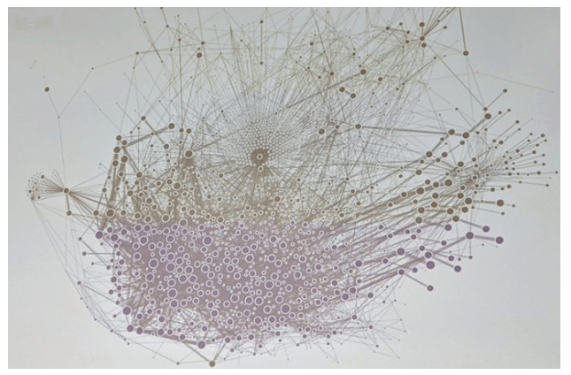
Microservices at Uber (2019)
https://x.com/msuriar/status/1110244877424578560

Slide 73
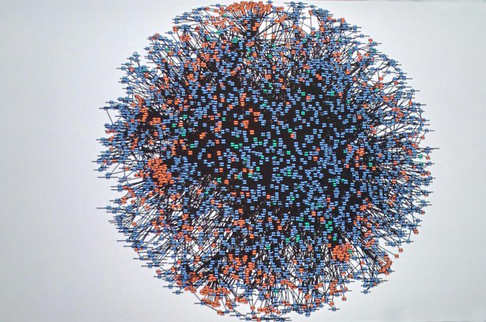
Microservices at Amazon (2008)
Code-named “Deathstar”
https://x.com/Werner/status/741673514567143424

Slide 74
Data management and communication
Once data and computation are split across services, two problems remain
How is data stored?
How services communicate?
First, Spring Boot overview

Slide 75
Spring Boot with REST API overview

Slide 76
Microservices over HTTP
DB-specific binary protocol
Product MicroService
Products.db
HTTP
HTTP
Customer MicroService
HTTP/REST, gRPC, MQs, pub-sub
Customer.db
User laptop
Internet
Order MicroService
Orders.db
Server Machine

Slide 77
HTTP GET and POST request
GET request - Used to retrieve data from the server
GET /index.html HTTP/1.1
GET /index.html?id=ECS160&count=10
URL
Request parameters

Slide 78
HTTP GET and POST request
POST request - used to send data to the server
POST /users HTTP/1.1 Content-Type: application/json{ "name": "John Doe", "email": john.doe@example.com }
URL
Post “body”

Slide 79
Spring Boot Overview
Framework for creating RESTful microservices
Reduces boilerplate configuration code
Embedded server (Tomcat/Jetty)
Simplifies microservice creation through annotations
Built-in support for REST APIs
Notes:
- RESTful - stateless

Slide 80
RESTful microservices with Spring Boot
Create classes that can act as REST endpoints
Uses annotations to denote REST endpoint URLs
Allows complete decoupling from the boilerplate code
Types of requests
@GetMapping, @PostMapping, @PutMapping, and so on… for all HTTP methods
@PathVariable – extract variable from GET request
@RequestBody – extract the post request body
class MyRequest {
private String postDate;
private String postContent;
// .. Getters and setters
}
@RestController
@RequestMapping("/myservice")
public class MyController {
@PostMapping("/sayhello")
public String sayHello(@RequestBody MyRequest request) { // do something
return "";
}
}
Effective URL: http://[serverip:port]/myservice/sayhello

Slide 81
Spring Boot Framework
Uses reflection to first look up all classes with @RestController annotation
Then automatically creates Servlets out of the methods annotated with @GetMapping, @PostMapping, etc.
Uses reflection to parse the request parameters into class objects annotated with @RequestBody
Generates the WAR file and launches the Apache Tomcat server
Simply execute mvn spring-boot:run
class MyRequest {
private String postDate;
private String postContent;
// .. Getters and setters
}
@RestController
@RequestMapping("/myservice")
public class MyController {
@PostMapping("/sayhello")
public String sayHello(@RequestBody MyRequest request) {
return "";
}
}

Slide 82
Data management and communication
Once data and computation are split across services, two problems remain
How is data stored?
How services communicate?

Slide 83
Databases

Slide 84
Microservices can have individual DBs
Product MicroService
Order MicroService
Customer MicroService
MySQL, PostgreSQL, SQLite are relational databases

Slide 85



Microservices can have individual DBs
Product MicroService
Order MicroService
Customer MicroService
Non-relational, NoSql databases

Slide 86

How to select which database to use?
Notes:
- Not specific to microservices

Slide 87
Database choice dimensions
Data model
Format of data user gives to the database
Examples - relational, document, graph, key-value
Shapes query semantics (joins, traversals, etc.)
Mechanism through which you can retrieve the data
Storage engine
How data is physically stored and indexed
B-Trees, SSTables and LSM-Trees, Hash Indexes
Impacts performance tradeoffs (read vs. write performance, range scans, etc)

Slide 88
Data models and query languages
Relational databases (discussed earlier)
Document model
Key-value stores (discussed earlier in Redis discussion)

Slide 89
Relational databases
Stores data as tables
Supports relations using foreign keys and joins
Fixed schema
Products tbl
ProductId | ProductName | ProductCount
1001 | ABC | 10
Customer tbl
CustomerId | CustomerName | CustomerAddr
9001 | XYZ | CDEF
9002 | UVW | ABCD
Order tbl
OrderId | CustomerId | ProductId
110001 | 9001 | 1001

Slide 90
Document model
Data is a document!
JSON, XML
E.g. MongoDB
The database maintains this document
Provides a query language to inspect the contents
Flexible schema

Slide 91
MongoDB BSON format
BSON is binary-encoded JSON
String that represents an object
Objects consists of key-value pairs
Values can be primitives, arrays, or nested JSON objects
Naturally supports hierarchical and semi-structured data
JSON object
[ { "id": "usr123", "username": "coder_gal", "details": { "age": 28, "city": "San Francisco” }, "skills": [ "JavaScript", "Python", "JSON", "APIs"] } ]
Nested JSON object
JSON array

Slide 92
MongoDB
MongoDB insert, find, update, delete operations
> db.createCollection(“posts”) > db.posts.insertOne({ title: “First post!”, body: “Hello world!”, likes: 3, category: “News”, tags: [“news”, “events”], author: “ABC”}) > db.posts.find( {category: “news”} )

Slide 93
MongoDB BSON format
Fields are accessed using dot notation
post.id
post.category
Arrays are accessed using index notation
post.tags[0]
> db.posts.findOne( {category: “news”} )
> db.posts.findOne( {category: “news”}).likes # prints 3
> db.posts.findOne( {category: “news”}).tags[0] # print news

Slide 94
Key-value stores
Simple key-value pairs
Redis, Memcached
Typically operate in-memory only
Usages
Cache expensive queries
Communication (PUBLISH and SUBSCRIBE primitives) (later)
Key | Value
10279811
10279812
Field | Value
Name | ABC
Age | 22
GPA | 3.8
Credits | 45
Field | Value
Name | DEF
Age | 21
GPA | 3.9
Credits | 60
Students Redis DB

Slide 95



Key-value stores
Cache results of expensive operations
For e.g. caching the results of API requests, or expensive database queries
Orders db
SELECT * FROM T1 JOIN T2 JOIN T3 ON T1.id = ...
OrderService.java

Slide 96
Key-value stores
Cache results of expensive operations
For e.g. caching the results of API requests, or expensive database queries
Orders db
SELECT * FROM T1 JOIN T2 JOIN T3 ON T1.id = ...
10000 records
OrderService.java

Slide 97
Key-value stores
Cache results of expensive operations
For e.g. caching the results of API requests, or expensive database queries
Orders db
Set(query-101, /* 10000 records */)
OrderService.java

Slide 98
Key-value stores
Cache results of expensive operations
For e.g. caching the results of API requests, or expensive database queries
Orders db
GET(query-101)
OrderService.java

Slide 99
Key-value stores
Cache results of expensive operations
For e.g. caching the results of API requests, or expensive database queries
Orders db
10000 records
OrderService.java

Slide 100
Database choice dimensions
Data model
Format of data user gives to the database
Examples - relational, document, graph, key-value
Shapes query semantics (joins, traversals, etc.)
Mechanism through which you can retrieve the data
Storage engine
How data is physically stored and indexed
B-Trees, SSTables and LSM-Trees, Hash Indexes
Impacts performance tradeoffs (read vs. write performance, range scans, etc)

Slide 101
Storage engines
Log-structured storage engines
Bitcask (for Riak distributed system)
Apache Cassandra, LevelDB, RocksDB
Page-oriented storage engines
Most relational databases – MySQL, Postgresql, etc.

Slide 102
Database as an immutable log
A log is an append-only data structure
Example, store JSON as a log
Access complexities
Insert/update is append is O(1)
Search is O(n)
{ “title”: “ABC”, “tags”: [“S”, “T”], “author”: “X” }
0 | 1 | : | { | “ | t | i | t | l | e | “ | :
“ | A | B | C | “ | , | “ | t | a | g | s | “
: | [ | ” | S | “ | , | “ | T | “ | ] | , | “
a | u | t | h | o | r | “ | : | “ | X | “ | }
0 | 2 | : | { | ...
Log
Notes:
Typically this is never in textual representation. It’s in binary
Why is this O(n) – can we do binary search?
Because its in binary, you have to store metadata

Slide 103
Hash indices
Naive design: in-memory hash map stores key and log-offset as value
O(1) insert, update, and search
Key | Value
01
03
0 | 1 | : | { | “ | t | i | t | l | e | “ | :
“ | A | B | C | “ | , | a | u | t | h | o | r
“ | : | “ | X | “ | } | \n | 0 | 3 | : | { | “
t | i | t | l | e | “ | : | “ | X | Y | Z | “
, | “ | a | u | t | h | o | r | “ | : | “ | Y
” | }
Log

Slide 104
Hash indices – update operation
Update operation consists of an append and an update of the hash index
Previous records immutable
E.g. update(03)
Key | Value
01
03
0 | 1 | : | { | “ | t | i | t | l | e | “ | :
“ | A | B | C | “ | , | a | u | t | h | o | r
“ | : | “ | X | “ | } | \n | 0 | 3 | : | { | “
t | i | t | l | e | “ | : | “ | X | Y | Z | “
, | “ | a | u | t | h | o | r | “ | : | “ | Y
” | } | 0 | 3 | : | { | “ | t | i | t | l | e
“ | : | “ | P | Q | R | “ | , | “ | a | u | t
h | o | r | “ | : | “ | Y | “ | }
Log

Slide 105
Compaction of hash indices
Divide log into segments
Reduce disk usage by periodically removing duplicates
Compaction generates a new segment
Used by Bitcask DB
Key | Value
01
03
0 | 1 | : | { | “ | t | i | t | l | e | “ | :
“ | A | B | C | “ | , | a | u | t | h | o | r
“ | : | “ | X | “ | } | \n | 0 | 3 | : | { | “
t | i | t | l | e | “ | : | “ | P | Q | R | “
, | “ | a | u | t | h | o | r | “ | : | “ | Y
” | }
Compacted
Log Segment

Slide 106
Compaction of hash indices
Compaction runs in a background thread
Compaction can be expensive
Key | Value
01
03
0 | 1 | : | { | “ | t | i | t | l | e | “ | :
“ | A | B | C | “ | , | a | u | t | h | o | r
“ | : | “ | X | “ | } | \n | 0 | 3 | : | { | “
t | i | t | l | e | “ | : | “ | P | Q | R | “
, | “ | a | u | t | h | o | r | “ | : | “ | Y
” | }
Log Segment

Slide 107
Limitations of approach
High memory usage for large logs
A sparse hash index can overcome this limitation, but needs sorting
Hash indices typically maintained only for the latest log segment
Range queries are not natively supported
Find all records with id in range [02 – 20] must scan all records
Sorting the records can solve this limitation, too
Compaction can be expensive
Solution: SSTables (memtable) and LSM trees

Slide 108
Log structured merge tree (LSM tree)
Designed by Google as part of their distributed database BigTable
Chang, Fay, et al. "Bigtable: A distributed storage system for structured data." ACM Transactions on Computer Systems (TOCS) 26.2 (2008)
Adopted by many recent databases (distributed or single-machine)

Slide 109
Log structured merge tree (LSM tree)
LSM tree components
On-disk write-ahead log (WAL)
In-memory sorted tree (memtable)
Immutable on-disk sorted string table (SSTable)
Core idea: sort in-memory before storing on disk

Slide 110
LSM tree operations
Memtable
Memory
Write-ahead log
SSTable
SSTable
File System
insert(02, ‘D’)

Slide 111
Write-ahead log
On-disk log that provides crash recovery abilities
System crashes can delete the in-memory sorted tree
Solution: write out the updates to a log on the disk before inserting into tree
During crash recovery replay the write-ahead log
Memtable
04 | ‘F’
{02: ‘D’}
Write-ahead log
Notes:
- Role of logging

Slide 112
Memtable
Maintain a sorted in-memory tree (AVL or red-black tree)
Writes update the in-memory tree
Memtable
04 | ‘F’
02 | ‘D’
{02: ‘D’}
Write-ahead log
Notes:
- Goal of compaction is to retain only the latest record

Slide 113
LSM tree write operation
Memtable
Memory
update(02, ‘D’)
Write-ahead log
SSTable
SSTable
File System
insert(02, ‘D’)

Slide 114
Memtable
Write contents to log segment (SSTable) when tree size reaches threshold
Threshold is typically a few MB
04 | ‘F’
{02:D} | {01:A} | .. | .. | .. | .. | ..
Write-ahead log
02 | ‘D’
06 | ‘X’
01 | ‘A’
03 | ‘G’
05 | ‘C’
07 | ‘Y’
In-memory sorted tree (with threshold size 8)
08 | ‘Z’
Notes:
- Goal of compaction is to retain only the latest record

Slide 115
Memtable
Write sorted contents from Memtable to log segment (SSTable) when tree size reaches threshold
Clear the WAL
0 | 1 | : | { | ‘A’ | } | \n | 0 | 2 | : | { | ‘D’
} | \n | 0 | 3 | : | { | ‘G’ | } | \n | 0 | 4 | :
{ | ‘F’ | } | \n | 0 | 5 | : | { | ‘C’ | } | \n | 0
6 | : | { | ‘X’ | } | \n | 0 | 7 | : | { | ‘Y’ | }
0 | 8 | : | { | ‘Z’ | }
Sorted segment file (on disk)
Write-ahead log
Notes:
- Because you only write out sorted values to the SSTable file, it means internally sorted
- Goal of compaction is to retain only the latest record

Slide 116
Memtable crash recovery
Memtable lives in memory
System crashes/reboots lose its contents
WAL provides crash recovery if system crashes before Memtable written to disk
On reboot, replay the WAL records
Notes:
- Because you only write out sorted values to the SSTable file, it means internally sorted
- Goal of compaction is to retain only the latest record

Slide 117
LSM tree write operation
Memtable
writeToSSTable()
Memory
update(02, ‘D’)
Write-ahead log
SSTable
SSTable
SSTable
File System
insert(02, ‘D’)

Slide 118
SSTables compaction
Recall: SSTables are immutable
Updates insert new records with same key
Needs compaction to reduce on-disk storage size
0 | 1 | : | { | ‘A’ | } | \n | 0 | 4 | : | { | ‘B’
} | \n | 0 | 5 | : | { | ‘C’ | } | ...
Segment 1
0 | 2 | : | { | ‘D’ | } | \n | 0 | 3 | : | { | ‘E’
} | \n | 0 | 4 | : | { | ‘F’ | } | ...
Segment 2
0 | 3 | : | { | ‘G’ | } | \n | 0 | 4 | : | { | ‘H’
}
Segment 3
Notes:
- Goal of compaction is to retain only the latest record

Slide 119
SSTables compaction
Recall: SSTables are immutable
Updates insert new records with same key
Needs compaction to reduce on-disk storage size
0 | 1 | : | { | ‘A’ | } | \n | 0 | 2 | : | { | ‘D’
} | \n | 0 | 3 | : | { | ‘G’ | } | \n | 0 | 4 | :
{ | ‘F’ | } | \n | 0 | 5 | : | { | ‘C’ | } | \n
Merged Segment
Notes:
- Goal of compaction is to retain only the latest record

Slide 120
SSTables compaction
The records in each log segment is sorted by key
Advantages: compaction is faster (essentially the ”merge phase” of a merge-sort algorithm)
0 | 1 | : | { | ‘A’ | } | \n | 0 | 2 | : | { | ‘D’
} | \n | 0 | 3 | : | { | ‘G’ | } | \n | 0 | 4 | :
{ | ‘F’ | } | \n | 0 | 5 | : | { | ‘C’ | } | \n
Merged Segment
Notes:
- Goal of compaction is to retain only the latest record

Slide 121
LSM tree compaction operation
Memtable
Memory
Write-ahead log
SSTable
SSTable
SSTable
File System
Background compaction thread
compact()

Slide 122
LSM tree compaction operation
Memtable
Memory
Write-ahead log
New Merged SSTable
File System
New merged SSTable can participate in further compactions
Notes:
- Can continue to participate in more merges

Slide 123
Typical overheads of LSM write path
Append to on-disk WAL has O(1) complexity
Insert into in-memory memtable (AVL tree) has O(log(n)) complexity
Eventually, append to on-disk SSTable has O(1) complexity per-key
Bulk write amortizes the disk overhead
On-disk log compaction and merging runs in a background thread
Generally, writes are fast compared to alternatives
Still, at least 3x write amplification

Slide 124
LSM tree read operation
Check if the key is in the in-memory memtable
Typically, O(log(n)) complexity
If not, scan each of the on-disk SSTables has the key
Typically, O(n) complexity
Generally, reads are slower than writes

Slide 125
LSM tree read operation
read(key=02)
findKey(02)
Memtable
Memory
Write-ahead log
SSTable
SSTable
SSTable
File System

Slide 126
LSM tree read operation
read(key=02)
Memtable
scanKey(02)
scanKey(02)
scanKey(02)
Memory
Write-ahead log
SSTable
SSTable
SSTable
File System

Slide 127
Block index for read optimization
Each SSTable is divided into blocks
Each SSTable has a block index which maps keys to block offsets inside the SSTable
SSTable segment
0 | 1 | : | { | ‘A’ | } | \n | 0 | 2 | : | { | ‘D’
} | \n | 0 | 3 | : | { | ‘G’ | } | \n | 0 | 4 | :
{ | ‘F’ | } | \n | 0 | 5 | : | { | ‘C’ | } | \n
Block Index
Block-0
Key | Offset
01
06
0 | 6 | : | { | ‘X’ | } | \n | 0 | 7 | : | { | ‘Y’
} | 0 | 8 | : | { | ‘Z’ | }
Block-1

Slide 128
Block index for read optimization
When scanning SSTable for reads, load block index into memory
Use block index to index into SSTable
SSTable segment
0 | 1 | : | { | ‘A’ | } | \n | 0 | 2 | : | { | ‘D’
} | \n | 0 | 3 | : | { | ‘G’ | } | \n | 0 | 4 | :
{ | ‘F’ | } | \n | 0 | 5 | : | { | ‘C’ | } | \n
Block Index
Block-0
Key | Offset
01
06
0 | 6 | : | { | ‘X’ | } | \n | 0 | 7 | : | { | ‘Y’
} | 0 | 8 | : | { | ‘Z’ | }
Block-1

Slide 129
LSM tree read path with block index
read(key=02)
findKey(02)
Memtable
Memory
Write-ahead log
SSTable
SSTable
SSTable
File System
Block index
Block index
Block index

Slide 130
LSM tree read path with block index
read(key=02)
loadBlockIndex()
Memtable
loadBlockIndex()
Memory
loadBlockIndex()
Write-ahead log
SSTable
SSTable
SSTable
File System
Block index
Block index
Block index

Slide 131
LSM tree read path with block index
red(key=02)
findBlockForKey(02)
findBlockForKey(02)
Memtable
Memory
Block index
Block index
Block index
Write-ahead log
SSTable
SSTable
SSTable
File System
Block index
Block index
Block index
Scan the block indices to find the corresponding SSTable blocks where the key could potentially be located

Slide 132
LSM tree read path with block index
red(key=02)
scanBlockForKey(02, b)
Memtable
scanBlockForKey(02, b)
scanBlockForKey(02, b)
Memory
Block index
Block index
Block index
Write-ahead log
SSTable
SSTable
SSTable
File System
Block index
Block index
Block index
Scan only the selected blocks in each SSTable

Slide 133
Page-oriented storage engine (B+ trees)
Used to implement primary key indexes in traditional relational databases
On-disk data structure that keeps key-value pairs sorted by key
Supports random accesses
Writes are performed directly on this on-disk sorted tree, unlike in LSM trees which operated on the in-memory Memtable

Slide 134
B+ tree
Recall: B+ trees are ”inspired” by binary search tree
B+ trees have multiple branches
Each node has a max and minimum number of keys
Branching factor – how many children each internal node has
Data only lives in the leaf nodes, intermediary nodes help navigation
Leaf nodes maintain a linked list for better range scans
Each node is stored on a “page” of 4 KB size

Slide 135
B+ tree
Example B+ tree with three levels and branching factor of 4
ref | 100 | ref | 200 | ref | 300 | ref
Level 1
key < 100
ref | 111 | ref | 150 | ref | 190 | ref
200 < key < 300
key > 300
Level 2
119 | val | 121 | val | 140 | val
159 | val | 162 | val | 188 | val
Level 3

Slide 136
B+ tree read path
Traverse the tree following the branches based on the key value
Start at the root
At each node: search the sorted keys (e.g., binary search) to find the correct child pointer
Follow the pointer to the next node and repeat until you reach the leaf
Complexity is O(log(n))
Notes:
- Base is the branching factor

Slide 137
B+ tree write path
Recall – every B+ tree has a max number of keys per node
If insertion exceeds this max number, the node must be split and tree rebalanced
Node splitting and tree balancing are expensive operations performed on disk

Slide 138
B+ tree node splitting
Assume max number of keys per node is 3
insert(152)
ref | 100 | ref | 200 | ref | 300 | ref
Level 1
key < 100
ref | 111 | ref | 150 | ref | 190 | ref
200 < key < 300
key > 300
Level 2
SPLIT!
119 | val | 121 | val | 140 | val
159 | val | 162 | val | 188 | val
Level 3

Slide 139
LSM tree vs B+ tree
LSM trees typically have higher write throughput
LSM trees can compress better, B+ trees can cause fragmentation
B-trees typically have better read performance
The key can exist at only one place, unlike LSM trees which involve scanning multiple SSTables
No clear winner – requires empirical testing on a per use-case basis

Slide 140
Summary
Decomposing monolithic apps into microservices allows per-microservice database selection
Read-heavy and write-heavy microservices can choose which db to use according to its needs

Slide 141
Communication styles

Slide 142
Intra-service communication
Product MicroService
JSON over HTTP
JSON over HTTP
JSON, gRPC, MQs, pub-sub
Products.db
Customer MicroService
JSON, gRPC, MQs, pub-sub
Customer.db
User laptop
Internet
JSON, gRPC, MQs, pub-sub
Order MicroService
Orders.db
Server Machine

Slide 143
Communication choice dimensions
Synchronous request/response (JSON over HTTP, gRPC)
Asynchronous request/response (message queues - RabbitMQ)
Event-driven publish/subscribe models

Slide 144

Communication choices
Synchronous request/response (JSON over HTTP, gRPC)
Asynchronous request/response (message queues - RabbitMQ)
Request
MicroService A
MicroService B
Response
Message
Message
MicroService A
MicroService B
Message
Message
MQ

Slide 145

Communication choices
Event-driven publish/subscribe models
MicroService B
Message
Subscriber Microservice
MicroService A
Message
Message
MicroService C
Publisher
Microservice
Subscriber Microservice
Broker
Message
MicroService D
Subscriber Microservice

Slide 146
Synchronous request/response
Designed to make a remote call feel like a local function call
Same programming model as local function calls
Caller sends a request, waits for a response
Typically, it is a blocking call
JSON over HTTP, gRPC
Note: the “synchronous” here refers to the communication paradigm or interaction pattern, not how the programmer uses the paradigm
Programmer can use async programming primitives to communicate with synchronous communication substrates

Slide 147
JSON over HTTP
{
"id": 123,
"name": "John Doe",
"email": john.doe@example.com
}
HTTP
Customer MicroService
Order MicroService

Slide 148
REST APIs
Application/microservice exposes an URL
Uses HTTP methods (GET, POST, PUT, DELETE) to perform operations on resources
Commonly paired with JSON for data exchange
// GET Request to Fetch a User denoted by ID > GET https://api.github.com/users/123 // Response
{
"id": "123",
"name": "John Doe",
"email": john.doe@example.com
}
Notes:
- HW1/2

Slide 149
HTTP JSON client
Example Java HTTP client communicating with GitHub API endpoint
HttpClient client = HttpClient.newHttpClient();
String jsonBody =
{"title":"Found a bug",
"body":"Steps to reproduce..."};
HttpRequest req = HttpRequest.newBuilder()
.uri(URI.create(
"http://api.github.com/repos/ecs160/issues"))
.header("Content-Type", "application/json”).
.POST(jsonBody).build();
HttpResponse<String> resp = client.send(req, ..);
System.out.println("Status: " + resp.statusCode());
System.out.println("Body: " + resp.body());

Slide 150
Async HTTP JSON client (Not in syllabus)
Can use language-level async primitives with synchronous communication mechanisms
Python, Rust, and other languages provide async I/O through coroutines
Java provides ”futures”
import asyncio
async def fetch(url: str) -> str:
# Simulate network I/O
await asyncio.sleep(1)
return f"fetched: {url}"
async def main():
# Start multiple coroutines concurrently
tasks = [asyncio.create_task(fetch(u)) for u in ["a", "b", "c"]]
# Do other work while they run
for i in range(3):
print("doing other work", i)
some_other_long_running_task()
# Await results (does not block the OS thread)
results = await asyncio.gather(*tasks)
print(results)
asyncio.run(main())

Slide 151
JSON implications
JSON message contains the schema
What happens if the receiver receives a message with the email field missing?
Receiver can still make sense of the rest of the fields
Receiver can ”handle” missing or extra fields
// expected
{
"id": "123",
"name": "John Doe",
"email": john.doe@example.com
}
// received
{
"id": "123",
"name": "John Doe",
}

Slide 152
JSON implications
JSON is text-based
Text-based protocols are less efficient than binary protocols
{
"id": "123",
"name": "John",
}
Text-based representation
{ | “ | i | d | “ | : | 1 | 2 | 3 | , | “ | n
a | m | e | “ | : | “ | J | O | H | N | “ | }
Binary-based representation
123 | J | O | H | N
* Assume each box is 8 bits, chars are 8 bits, integers are 32 bits

Slide 153
JSON implications
Protocol efficiency: low
Type safety (schema adherence): low
What about ease of debugging?
Can view exactly the message contents on the wire
Ease of debugging: high

Slide 154

gRPC
https://martin.kleppmann.com/2012/12/05/schema-evolution-in-avro-protocol-buffers-thrift.html
Google Remote Procedure Call
Person(
userName: "Martin",
favouriteNumber: 1337,
interests: ["daydreaming", "hacking"]
)
0a | 4d | 61 | 72 | 74 | 69 | 6e | 10 | b9 | 0a | 1a | 0b
64 | 61 | 61 | 79 | 64 | 72 | 65 | 61 | 6d | 69 | 6e | 67
1a | 07 | 68 | 61 | 63 | 6b | 6e | 67
Protobuf byte stream
HTTP
Customer MicroService
Order MicroService

Slide 155
Protobuf
Google’s binary encoding format
User must define schema in a .proto file
protoc compiler generates typed data classes and service stubs across many languages
C++, C#, Java, Kotlin, Objective-C, PHP, Python, Ruby

Slide 156
Protobuf
Define schema in .proto file
Protobuf defines standard data types
Tags are the field’s numeric identifier used in the binary format
Fields are encoded as (tag, wire-type, value)
Person(
userName: "Martin",
favouriteNumber: 1337,
interests: ["daydreaming", "hacking"]
)
// myservice.proto message Person {
required string user_name = 1;
optional int64 favourite_number = 2;
repeated string interests = 3;
}
Tag

Slide 157
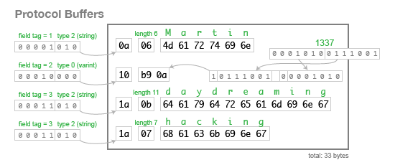
Protobuf binary format
https://martin.kleppmann.com/2012/12/05/schema-evolution-in-avro-protocol-buffers-thrift.html
// myservice.proto message Person {
required string user_name = 1;
optional int64 favourite_number = 2;
repeated string interests = 3;
}
Person(
userName: "Martin",
favouriteNumber: 1337,
interests: ["daydreaming", "hacking"]
)
Binary representation
Binary data on the wire
0a | 06 | 4d | 61 | 72 | 74 | 69 | 6e | 10 | b9 | 0a | 1a
0b | 64 | 61 | 61 | 79 | 64 | 72 | 65 | 61 | 6d | 69 | 6e
67 | 1a | 07 | 68 | 61 | 63 | 6b | 6e | 67

Slide 158
Codegen with protoc
Invoke protoc to generate classes and service stubs
protoc -I . myservice.proto --java_out=./gen
{
"userName": "Martin",
"favouriteNumber": 1337,
"interests": ["daydreaming", "hacking"]
}
// Proto schema message Person {
required string user_name = 1;
optional int64 favourite_number = 2;
repeated string interests = 3;
}
.java
.proto
protoc compiler
.py
.cpp

Slide 159
Java codegen with protoc
protoc generates Java code
Person class
Code to build the binary representation (serialization)
Parse a Person object from the binary representation (deserialization)
Classes can be used by both the server and client
// PSEUDOCODE (protobuf version 2)
public final class Person {
// -- snip (fields)
// -- snip (getters and setters)
// Serialization
public byte[] toByteArray() { ... }
public void writeTo(OutputStream out) { ... }
public int getSerializedSize() { ...}
// --- Deserialization (Des) ---
public Person parseFrom(byte[] data) { ... }
public Person parseFrom(InputStream in) { ... }
}

Slide 160
Generating gRPC endpoints
Define the interface for service endpoints in .proto file
The method name (SayHello) is the endpoint
Note: no URLs – gRPC is not HTTP
Run protoc with --grpc-java_out=gen
// myservice.proto
syntax = "proto3";
service Greeter {
rpc SayHello(HelloRequest) returns (HelloReply);
}
message HelloRequest { string name = 1; }
message HelloReply { string msg = 1; }

Slide 161
Generating gRPC endpoints
Define the service endpoints in .proto file
Run protoc with --grpc-java_out=gen
// Server code generated by protoc public final class GreeterGrpc {
static final String SERVICE_NAME = "demo.Greeter";
public abstract static class GreeterImplBase implements io.grpc.BindableService {
public void sayHello(HelloRequest req, io.grpc.stub.StreamObserver<HelloReply> resp) {
resp.onError(... EXCEPTION ...);
}
}
}

Slide 162
Generating gRPC endpoints
Define the service endpoints in .proto file
Run protoc with --grpc-java_out=gen
Extend GreeterImplBase to provide functionality
public final class GreeterImpl extends GreeterGrpc.GreeterImplBase {
@Override
public void sayHello(
HelloRequest req,
io.grpc.stub.StreamObserver<HelloReply> resp) {
resp.onNext(
HelloReply.newBuilder().setMsg("hi " +
req.getName()).build());
resp.onCompleted();
}
}

Slide 163
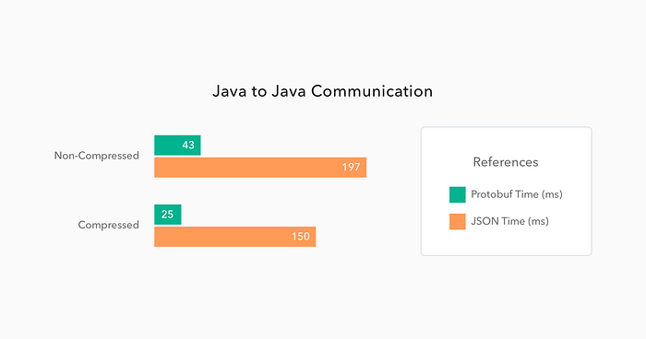
gRPC efficiency
https://itnext.io/a-minimalist-guide-to-grpc-e4d556293422

Slide 164
gRPC implications
Protocol efficiency: high
Type safety (schema adherence): high
If a field is missing, the ser-des logic will detect it and raise an Exception
What about ease of debugging?
Ease of debugging: low

Slide 165
Message queuing (MQ)
Asynchronous communication model
Messages sent to a queue and processed by consumers independently of the producer
Messages are saved on disk until the consumer acks consumption
Stronger decoupling
Message
Message
MicroService A
MicroService B
Message
Message

Slide 166
Message queuing (MQ)
Application must be aware of asynchronicity
Message sent not necessarily message delivered
Publisher can request acks
When the message exchange has received the message and saved it durably

Slide 167
RabbitMQ
Advanced Message Queuing Protocol (AMQP)
Binary protocol running on TCP
AMQP
AMQP
TCP
TCP
MicroService A
MicroService B
RabbitMQ
broker

Slide 168
AMQP model
The broker receives messages from publishers and route them to subscribers
Each route is typically an on-disk queue
Producer A
Consumer A
Producer B
Consumer B
RabbitMQ
broker
Producer C
Consumer C

Slide 169
Pub-sub architecture
Asynchronous messaging pattern where publishers send messages to a central message broker or topic, and subscribers receive messages based on their subscriptions
Broadcasting: messages can be sent to multiple subscribers
Same frameworks often can act as both MQ or Pub-Sub depending on configuration

Slide 170
RabbitMQ as message broker
RabbitMQ can bind same queue to multiple subscribers
Subscriber A
Publisher A
Subscriber B
RabbitMQ
broker
Subscriber C

Slide 171

Redis as message broker
Redis exposes “channel” that multiple subscribers can bind to
Subscriber A
Publisher A
Subscriber B
Redis
broker
Subscriber C

Slide 172

Kafka as message broker
[More in next module]
Subscriber A
Publisher A
Subscriber B
Kafka
broker
Subscriber C

Slide 173
Message queues implications
Strong decoupling
Consumer does not have to be running
Message persisted in the message queue
Potentially increased latency
Increased number of hops
Overhead for persisting the message

Slide 174
Summary
Microservices improve throughput
Microservices allow each service to have its own database
Data models – relational, document model, key-value store
Storage engine – log-based and B-tree based
Microservices can communicate
Synchronously (JSON over HTTP, gRPC)
Asynchronously (Message queues)
Event-driven pub/sub (Kafka – next module)

Slide 175
Remote procedure call (RPC)
Library/framework gives the illusion that the other microservice is running locally
Protocol that allows a program to execute a procedure on a remote server as if it were local

Slide 176
RPC key features
Language agnostic: the RPC itself does not depend on the service language
Abstracts network details
Typically, over HTTP

Slide 177
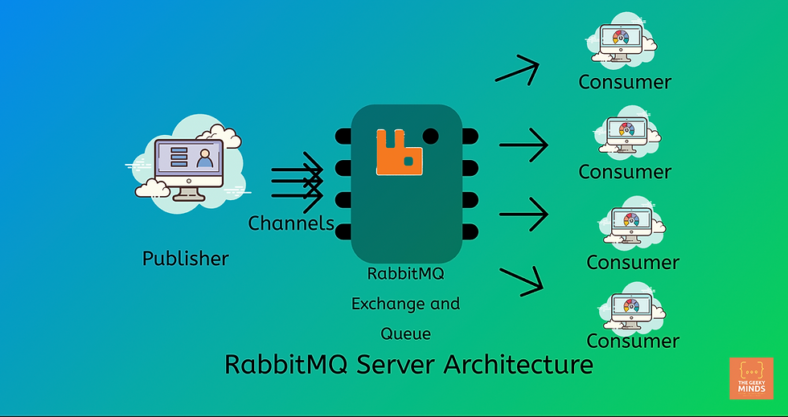
RabbitMQ architecture
or
Producer

Slide 178
Asynchronous communication with RabbitMQ
public class RabbitMQProducer {
private static final String QUEUE_NAME = "hello_queue";
public static void main(String[] args) {
// Create a connection factory
ConnectionFactory factory = new ConnectionFactory();
factory.setHost("localhost"); // RabbitMQ server address
try (Connection connection = factory.newConnection();
Channel channel = connection.createChannel()) {
// Declare a queue (it must exist before publishing)
channel.queueDeclare(QUEUE_NAME, false, false, false, null);
String message = "Hello, RabbitMQ!";
channel.basicPublish("", QUEUE_NAME, null, message.getBytes());
System.out.println(" [x] Sent: '" + message + "'");
} catch (Exception e) {
e.printStackTrace();
}
}
}
public class RabbitMQConsumer {
private static final String QUEUE_NAME = "hello_queue";
public static void main(String[] args) {
ConnectionFactory factory = new ConnectionFactory();
factory.setHost("localhost");
try {
Connection connection = factory.newConnection();
Channel channel = connection.createChannel();
// Declare the queue in case it doesn't exist
channel.queueDeclare(QUEUE_NAME, false, false, false, null);
System.out.println(" [*] Waiting for messages...");
// Create a consumer to receive messages
DeliverCallback deliverCallback = (consumerTag, delivery) -> {
String message = new String(delivery.getBody(), "UTF-8");
System.out.println(" [x] Received: '" + message + "'");
};
channel.basicConsume(QUEUE_NAME, true, deliverCallback, consumerTag -> { });
} catch (Exception e) {
e.printStackTrace();
}
}
}

Slide 179
SSTable benefits
Advantages: can have sparse hash indices
Jump to indexed key’s log offset and linear scan from that position
Key | Value
01
05
0 | 1 | : | { | ‘A’ | } | \n | 0 | 2 | : | { | ‘D’
} | \n | 0 | 3 | : | { | ‘G’ | } | \n | 0 | 4 | :
{ | ‘F’ | } | \n | 0 | 5 | : | { | ‘C’ | } | \n | 0
6 | : | { | ‘X’ | } | \n | 0 | 7 | : | { | ‘Y’ | }
0 | 8 | : | { | ‘Z’ | }
Sorted segment file (on disk)
Notes:
- Goal of compaction is to retain only the latest record

Slide 180
Sorted string tables (SSTables)
Advantages: range scans are efficient
Jump to indexed key’s log offset and linear scan from that position to find the start of range
Linear scan from that pos
Key | Value
01
05
0 | 1 | : | { | ‘A’ | } | \n | 0 | 2 | : | { | ‘D’
} | \n | 0 | 3 | : | { | ‘G’ | } | \n | 0 | 4 | :
{ | ‘F’ | } | \n | 0 | 5 | : | { | ‘C’ | } | \n | 0
6 | : | { | ‘X’ | } | \n | 0 | 7 | : | { | ‘Y’ | }
0 | 8 | : | { | ‘Z’ | }
Sorted segment file (on disk)
Notes:
- In reality, the global merging happens only on-demand

Slide 181



Open source and paid MQ services

