Slide 1
Unit testing, mocking frameworks, continuous integration
Tapti Palit

Slide 2
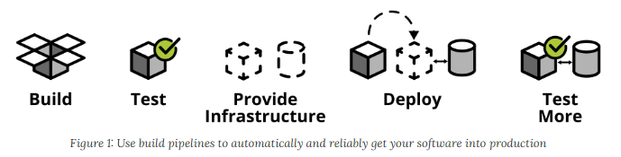
CI/CD and automated testing
Quicker software delivery timelines -> cannot rely on manual testing
Continuous integration, continuous deployment (CI/CD)
For large codebases, must automate testing
https://martinfowler.com/articles/practical-test-pyramid.html

Slide 3
What is unit testing?
Testing individual units of code (e.g., methods)
Ensures correctness and reliability
Executed during development for quick feedback
Catch regression bugs

Slide 4
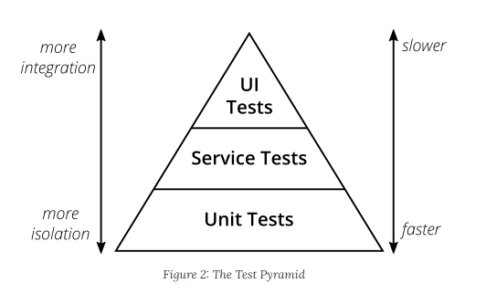
Test pyramid
Test pyramid shows how much testing on each layer
Unit tests fastest as they test single methods
UI tests slowest
Service tests also called integration tests
1) Mike Crohn: Succeeding with Agile 2) https://martinfowler.com/articles/practical-test-pyramid.html

Slide 5
JUnit overview
Unit testing framework that simplifies testing
Without a framework how would you develop unit tests?
E.g. write unit tests for database functions (insert_sql_record(), delete_record())
Want to run your test on a clean test database
So, before running the unit test first, create a test database with the table
Then, invoke insert_sql_record() and perform any checks
Drop the table and the database after the test

Slide 6
Java annotations
Annotations are “metadata” added to Java code
They have no direct impact on code execution at runtime
Java provides some annotations, programmer can define more
Syntax: @Annotation_name
@Annotation1
public class Car {
@Annotation2
private int speed;
public Car(int speed) {
this.speed = speed;
}
@Annotation3
public void accelerate(int moreSpeed) {
this.speed += moreSpeed;
}
@Annotation3
public void decelerate(int lessSpeed) {
this.speed -= lessSpeed;
}
}

Slide 7
Java annotations
Some annotations are available only in the compiler
Java compiler checks
Some available at runtime
Widely used in popular frameworks
Framework can scan all classes with an annotation and create objects of that class at runtime
More when we study Annotations
@Annotation1
public class Car {
@Annotation2
private int speed;
public Car(int speed) {
this.speed = speed;
}
@Annotation3
public void accelerate(int moreSpeed) {
this.speed += moreSpeed;
}
@Annotation3
public void decelerate(int lessSpeed) {
this.speed -= lessSpeed;
}
}

Slide 8
Annotation targets
Annotations can be applied to
Classes
Fields
Methods
… many other program elements (Check https://docs.oracle.com/javase/tutorial/java/annotations/basics.html)

Slide 9
Key features of JUnit
Annotations simplify test creation
@Test, @BeforeEach, @AfterEach
Assertion methods validate expected outcomes
assertEquals(), assertNotEquals(), and so on…
Removes boilerplate code and simplifies test creation
Automatically generates a standardized report

Slide 10
@Test methods with JUnit
public class Car {
private String model;
private int speed;
public Car(String model, int speed) {
this.model = model;
this.speed = speed;
}
public int getSpeed() { return speed; }
public String getModel() { return model; }
... // setters
public void accelerate() {
this.speed += 10;
}
}
import org.junit.jupiter.api.Test;
import org.junit.jupiter.api.Assertions.assertEquals;
public class CarTest {
@Test
public void testAccelerate() {
Car car = new Car(“Toyota”, 50);
car.accelerate();
assertEquals(car.getSpeed(), 60);
}
}

Slide 11
Test lifecycle using JUnit
@BeforeEach, @AfterEach used to define methods that should be run before and after each test method
@BeforeClass, @AfterClass used to define methods that should be run before and after each test class
Useful for setup and cleanup operations
Create a test database, tables, and so on, before running the tests
Drop the test database, tables, and so on, after running the tests

Slide 12
Unit testing and CI

Slide 13
Announcements
HW1 due date: 10/23
Friday quiz

Slide 14
Agenda
Maven recap
JUnit Demo
Containers
GitHub Actions

Slide 15
Maven
Maven’s goal: make the build process easy and uniform
Dependency management
Build management
Project Object Model (POM)

Slide 16
Project Object Model (POM)
A Maven project is represented by a pom.xml file
Contains project description, dependencies, and configures plugins for building the project
Project id: <groupId, artifactId, version>
Dependencies
Plugins (will revisit after discussing build cycle)

Slide 17
Maven dependency management
Maven provides a centralized repository where developers can host project dependencies
https://repo.maven.apache.org/maven2/
These dependencies can be downloaded by any other project
Maven also provides a tool to download dependencies from the centralized repository

Slide 18
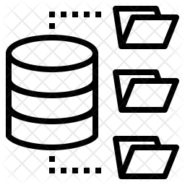

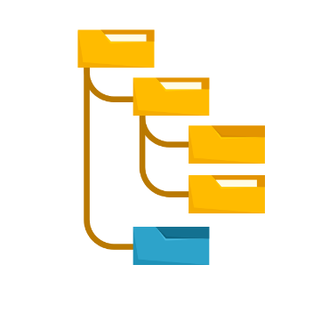
Maven workflow
pom.xml specifies the dependencies
mvn is a command-line tool that can fetch and update all dependencies
fetch
https://repo.maven.apache.org/maven2/
pom.xml
>mvn clean install

Slide 19
Sample pom.xml
<?xml version="1.0" encoding="UTF-8"?>
<project xmlns="http://maven.apache.org/POM/4.0.0"
xmlns:xsi="http://www.w3.org/2001/XMLSchema-instance"
xsi:schemaLocation="http://maven.apache.org/POM/4.0.0 http://maven.apache.org/xsd/maven-4.0.0.xsd">
<modelVersion>4.0.0</modelVersion>
<groupId>com.ecs160</groupId>
<artifactId>annotations</artifactId>
<version>1.0-SNAPSHOT</version>
<dependencies>
<!-- Jedis Dependency -->
<dependency>
<groupId>redis.clients</groupId>
<artifactId>jedis</artifactId>
<version>4.3.1</version> <!-- Use the latest version -->
</dependency>
<dependency>
<groupId>com.google.code.gson</groupId>
<artifactId>gson</artifactId>
<version>2.10.1</version>
</dependency>
</dependencies>
</project>
Multiple dependencies can be
added using multiple <dependency>
tags

Slide 20
Maven build phases
Maven build process is divided into phases
Each phase has goals which correspond to individual commands such as jar cvf … and so on.
Key phases
compile: Compile the source code
test: Run unit tests
package: Package the compiled code (e.g., JAR/WAR)
install: Install the package into the local repository
deploy: Deploy the package to a remote repository
Demo
Notes:
Mvn clean
Mvn install
java -jar ./target/jedis_demo-1.0-SNAPSHOT.jar

Slide 21
Extending Maven with plugins
Plugins add goals to a build phase
These goals can be independently executed (mvn <goal>) or executed as part of the build phase
Plugins are also centrally hosted in the Maven repo
… and developers can develop their own plugins
… a more sophisticated Makefile or CMake system

Slide 22
Maven Surefire plugin
Surefire plugin streamlines test execution
mvn clean test surefire-report:report
JUnit standardizes the testing framework
<build>
<plugins>
<!-- Runs unit tests -->
<plugin>
<groupId>org.apache.maven.plugins</groupId>
<artifactId>maven-surefire-plugin</artifactId>
<version>3.2.5</version>
</plugin>
<!-- Generates HTML reports -->
<plugin> <groupId>org.apache.maven.plugins</groupId> <artifactId>maven-surefire-report-plugin
</artifactId> <version>3.2.5</version> </plugin> </plugins> </build>

Slide 23
Installing maven
Java Development Kit
Install Java JDK from https://www.oracle.com/java/technologies/downloads/#java21
Maven
Install maven locally from https://maven.apache.org/install.html
Add mvn to the PATH variable
On Linux, add the location where you have unzipped mvn to the $PATH variable in ~/.bashrc
Add export $PATH=$PATH:<path where mvn exists> to ~/.bashrc
Run the command source ~/.bashrc in your shell
On Windows 11, open Settings -> System -> About -> Advanced System Settings -> Environment variables
Click “New” and add the <path where mvn exists>
Might have to reboot machine
Install the Maven plugin from VSCode marketplace

Slide 24
Junit Demo
https://github.com/davsec-teaching/junit_demo

Slide 25
Test lifecycle example
public class DbService {
public DB createDB(String db) { ... }
public Tbl createTable(Tbl tbl) { ... }
public void dropTable(String tbl) { ... }
public void insertRecord(Tbl t, ...) { ... }
public void deleteRecord(Tbl t, ...) { ... }
public void updateRecord(Tbl t, ...) { ... }
}
import org.junit.jupiter.api.Test;
import org.junit.jupiter.api.Assertions.assertEquals;
public class CarTest {
private Tbl tbl;
@BeforeClass public void setup() {
tbl = createTable(“testTbl”);
}
@Test public void testInsertRecord() {
insertRecord(tbl, <<record>>);
assertEquals(...);
}
@Test public void testDeleteRecord() { ...}
@AfterClass public void teardown() {
dropTable(tbl);
}
}

Slide 26
Continuous Integration

Slide 27

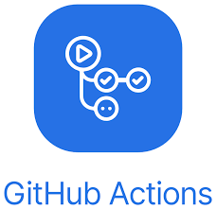
Continuous integration
Code changes are automatically built, tested, and integrated into a shared repository multiple times a day
Core process
Developer commits code
CI pipeline triggers
Build the project
Run automated tests
Integrated into GitHub and GitLab
Github Actions

Slide 28
Background: containerization
Github Actions are executed on Docker containers
Lightweight virtualization method that packages applications and their dependencies into isolated, portable containers
Containers share the host OS kernel but have their own filesystem, resources, and dependencies

Slide 29
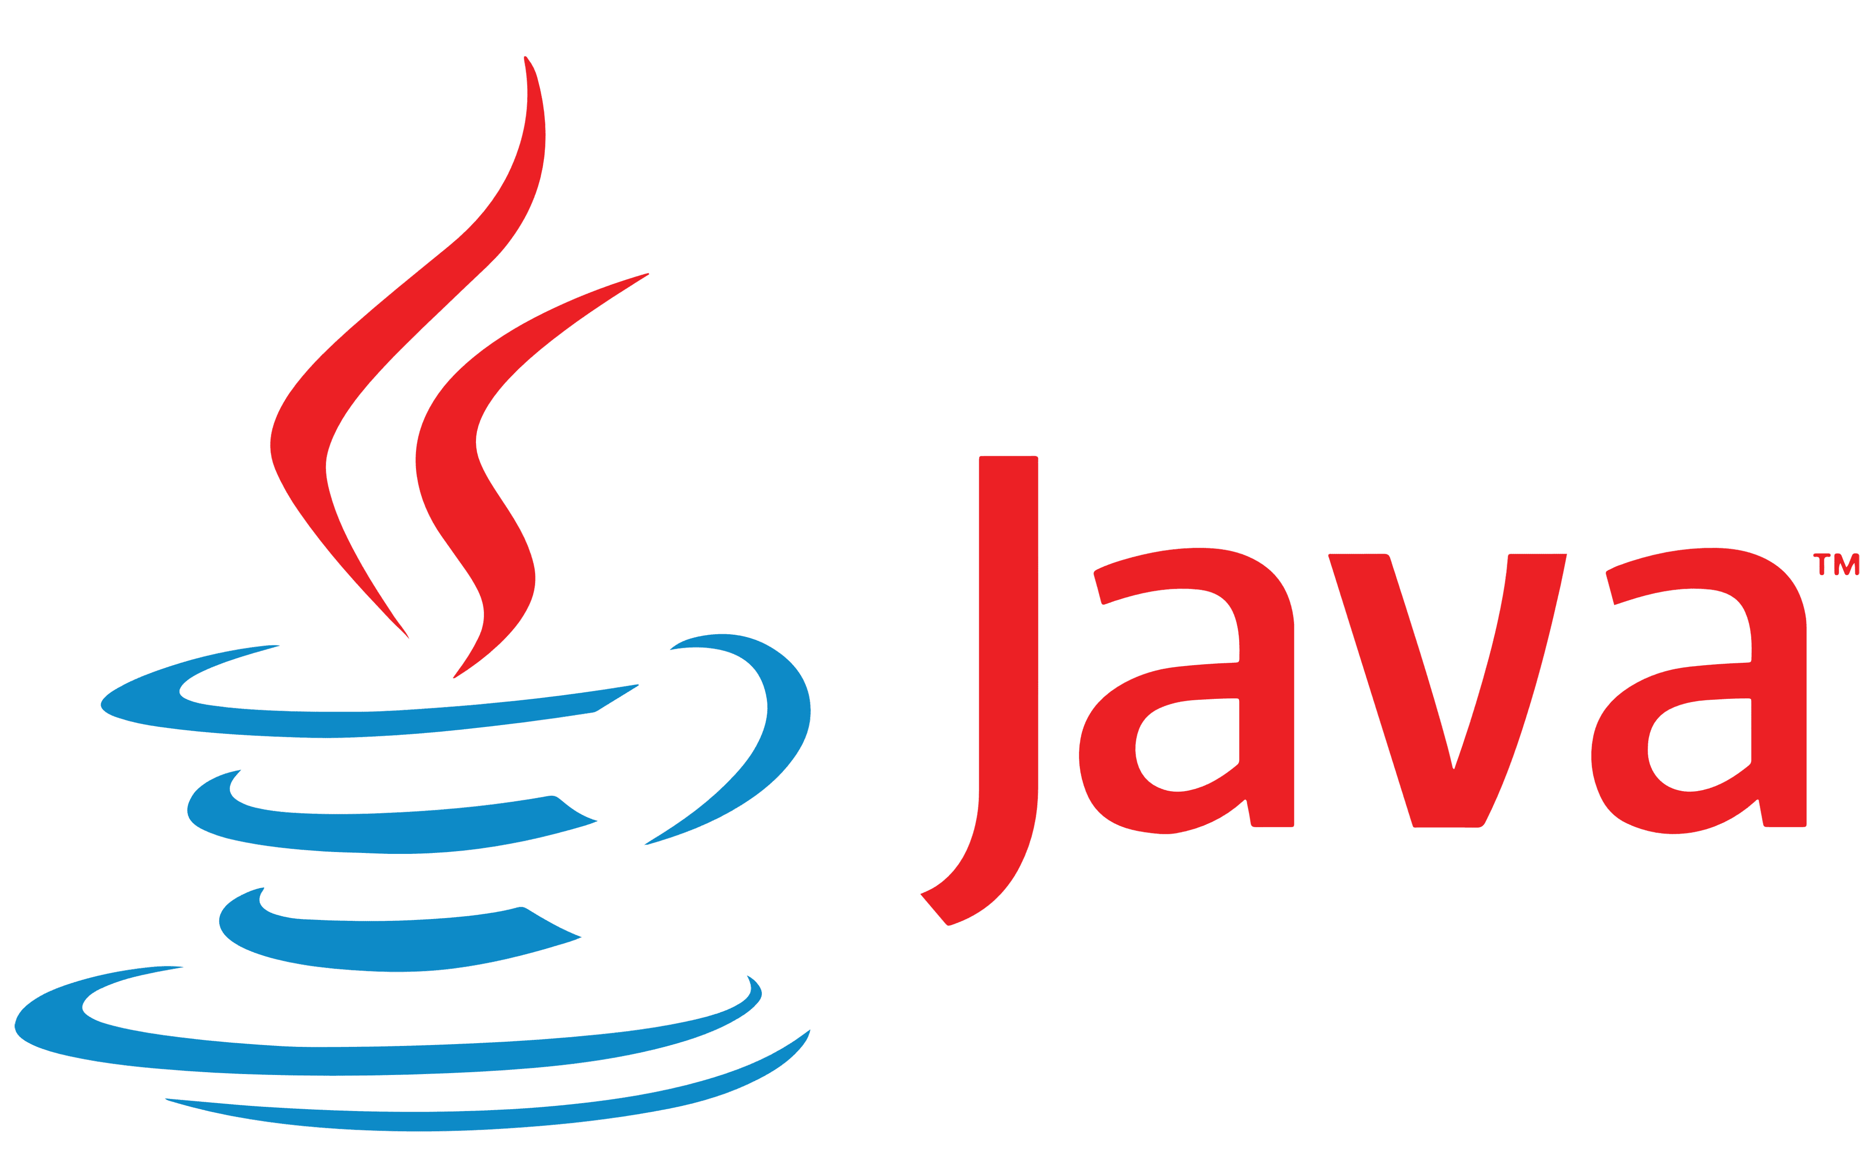
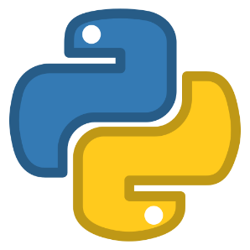
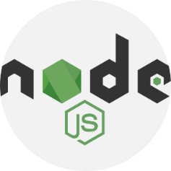




Containers
Ubuntu 22.04
Ubuntu 24.10
Fedora 24
Ubuntu 22.04
Linux kernel 5.4.1
Hardware

Slide 30


What is a container?
Isolated environment that emulates a physical machine
Each container shares the host kernel
Isolation enforced by software
Namespaces and cgroups in the Linux kernel
Docker is leading technology for building containers
Ubuntu 22.04
Ubuntu 24.10
Fedora 20
Linux kernel 5.4.1
Hardware

Slide 31
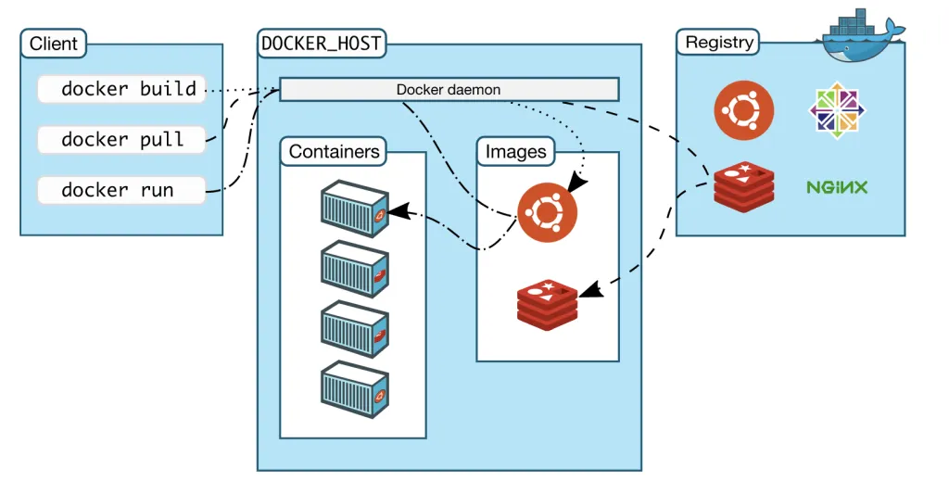
Docker architecture
Remote docker registry
Dockerhub contains docker images
Docker host
Machine running docker daemon
Stores docker images locally
Spawns containers
Docker client commands
docker pull: pulls image from registry
docker build: builds a docker image from a Dockerfile
docker run: spawns a container

Slide 32
How is it different from pyenv/venv?
Provides isolation
Isolates files, processes, security contexts
Weaker isolation than virtual machines

Slide 33
Sample Dockerfile to run HW1
# Usethe Ubuntu base image
FROM ubuntu:25.04
# Set the working directory
WORKDIR /app
ENV DEBIAN_FRONTEND=noninteractive
# Install required dependencies: OpenJDK, Maven, Git
RUN apt-get update && apt-get install -y \
openjdk-21-jdk \
maven \
git \
&& apt-get clean \
&& rm -rf /var/lib/apt/lists/*
# Set JAVA_HOME environment variable
ENV JAVA_HOME=/usr/lib/jvm/java-21-openjdk-amd64
ENV PATH="$JAVA_HOME/bin:$PATH"
# Clone the Java application repository
RUN git clone https://github.com/davsec-teaching/junit_demo.git .
# Build the application using Maven
RUN mvn clean package
RUN mvn clean test surefire-report:report
# Define the command to run the application
CMD ["bash"]
Docker overlayfs layers
mvn clean test surefire-report:report
mvn clean package
git clone https://github.com/davsec-teaching/junit_demo.git
apt-get update && apt-get install -y \ openjdk-21-jdk \ maven \ git \ && apt-get clean \ && rm -rf /var/lib/apt/lists/*
ubuntu:25.04
Notes:
Install docker.io
Write a simple text file

Slide 34
Sample Dockerfile to run HW1
# Usethe Ubuntu base image
FROM ubuntu:25.04
# Set the working directory
WORKDIR /app
ENV DEBIAN_FRONTEND=noninteractive
# Install required dependencies: OpenJDK, Maven, Git
RUN apt-get update && apt-get install -y \
openjdk-21-jdk \
maven \
git \
&& apt-get clean \
&& rm -rf /var/lib/apt/lists/*
# Set JAVA_HOME environment variable
ENV JAVA_HOME=/usr/lib/jvm/java-21-openjdk-amd64
ENV PATH="$JAVA_HOME/bin:$PATH"
# Clone the Java application repository
RUN git clone https://github.com/davsec-teaching/junit_demo.git .
# Build the application using Maven
RUN mvn clean package
RUN mvn clean test surefire-report:report
# Define the command to run the application
CMD ["bash"]
# To build the docker container
docker build -t java-app .
# To run the docker container
> docker run –it -p 8080:8080 java-app bash
# In the Docker container
> cat /etc/os-release > top
> who
Notes:
Install docker.io
Write a simple text file

Slide 35
Other Docker commands
docker ps # shows running docker containers
docker images # shows built docker images
docker rmi <image_name> # Delete an image
docker images prune –a # Prune dangling images
docker builder prune –a # Clear the builder cache
Demo

Slide 36
Docker install instructions
Add the Docker repo
sudo apt update
sudo apt install -y ca-certificates curl gnupg
# Create keyring directory
sudo install -m 0755 -d /etc/apt/keyrings
# Add Docker’s official GPG key
sudo curl -fsSL https://download.docker.com/linux/ubuntu/gpg \
-o /etc/apt/keyrings/docker.asc
sudo chmod a+r /etc/apt/keyrings/docker.asc
# Add the Docker repository (replace $(. /etc/os-release; echo "$VERSION_CODENAME") if needed)
echo \
"deb [arch=$(dpkg --print-architecture) signed-by=/etc/apt/keyrings/docker.asc] \
https://download.docker.com/linux/ubuntu \
$(. /etc/os-release; echo "$VERSION_CODENAME") stable" | \
sudo tee /etc/apt/sources.list.d/docker.list > /dev/null

Slide 37
What do containers provide for CI?
Uniform build system for continuous integration
No weird issues with $PATH variables
No missing binaries
Automate deployment via continuous deployment
Containerize the application and deploy
… More later
Solves WOMM issues
Isolation for security

Slide 38
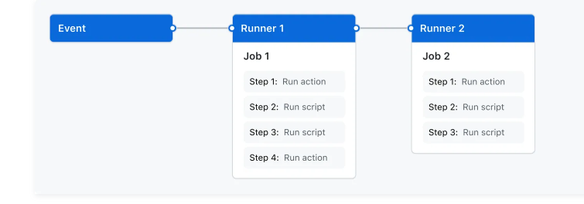
What is a Github Action?
A GitHub Actions workflow to be triggered when an event occurs
Push event, pull request opened
A workflow contains
One or more jobs
Each job has its own runner on which it is executed (typically a container)
Each job has one or more steps
Each step is either a script or command, or another Action

Slide 39
Sample scenarios
Continuous integration
Compile code and run all JUnit tests when someone pushes to main branch
Continuous deployment
Compile code, run all JUnit tests, package code, and deploy to remote server
When someone pushes to the prod (production) branch

Slide 40
Continuous deployment with Github Actions
Github Action specified in a YAML file
Configure a .github/workflows/[NAME].yml file
Define triggers (e.g., push, pull_request)
Specify jobs and steps (e.g., build, test)
name: Build and test pipeline
# Controls when the action will run. Workflow runs when manually triggered using the UI
# or API.
on: [push, pull_request]
# A workflow run is made up of one or more jobs that can run sequentially or in parallel
jobs:
build:
runs-on: ubuntu-22.04
steps:
- uses: actions/checkout@v3
- name: Set up JDK 21
uses: actions/setup-java@v3
with:
java-version: 21
distribution: 'temurin' # Use Temurin distribution (default)
- name: Verify Java version
run: java -version
- name: Build with Maven
run: mvn package
- name: Run JUnit tests
run: mvn test
Trigger
Runner
Job
Steps

Slide 41
Githubs CI/CD demo
In-class demo

