Slide 1
ECS 160 Software Engineering
Instructor: Tapti Palit
Teaching Assistant: Xingming Xu

Slide 2
Instructor details
Name: Tapti Palit
Email: tpalit@ucdavis.edu
Office: ASB 2087
Office hours: Wednesday 2 PM – 4 PM (in office)

Slide 3
TA details
Name: Xingming Xu
Email: xmxu@ucdavis.edu
Office hours: TBD

Slide 4
Course information
Class timings
Lectures - MWF 12:10 PM - 1:00 PM in Veihmeyer Hall 212
Discussion – W 10 AM - 10:50 AM in Chem 179
Lectures and discussion will be recorded and uploaded on Canvas
Course page: https://github.com/davsec-teaching/ecs160-f25
Most slides and some HWs already up, but might change before the start day
Piazza link: https://piazza.com/ucdavis/fall2025/ecs160f25/home
Textbooks:
Required: None
Recommended: check the course website

Slide 5
Course components
1 midterm, 1 final
4 homework assignments, to be performed in teams of 2
Please register your team at: https://docs.google.com/forms/d/e/1FAIpQLScjVPMoJ4U5xuh8HLbqpKGDqJJXophtRrPJSMNbIE_glnICVg/viewform?usp=dialog
A single person from a team should register
Homework assignments related to each other
No course project
Component | Weightage
Midterm | 20
Final | 25
Assignments | 50
Participation and Quizzes | 5

Slide 6
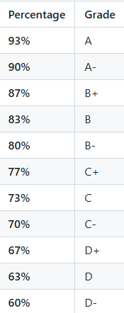
Grade cutoffs
Fixed full-step grade cutoffs
Might be curved on top of these cutoffs per instructor’s discretion

Slide 7
Academic integrity and AI policies
Inter-group collaboration and discussion is permitted
Copying code is not permitted
Submitting AI-generated code is not permitted
Using AI to understand exceptions or compilation errors is permitted
… why?

Slide 8
Why do we go to college?
Skills
Programming
Debugging
Designing
Communication
Programming languages – C/Java/C++/Rust/Haskell
Meta-skills
How to study?
How to quickly learn new things?
How to persevere?

Slide 9

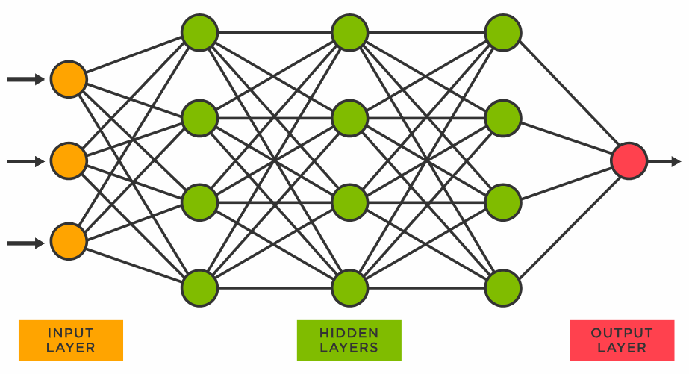


How do LLMs learn things?
PROMPT
DATA
OUTPUT
LLM

Slide 10

Implications of over-reliance on LLMs
Imagine we use LLMs for our course projects
Quantum computing becomes the next hot thing
… what are the challenges?
LLMs have no data on quantum computing and will perform poorly
Plus, we didn’t learn the meta-skills necessary to pick up a new skills
YOU WANT TO BE HERE

Slide 11
Implications of over-reliance on LLMs
How to upskill if you rely on LLMs?
… wait for next GPT model? ☹
Bottomline – please don’t use LLMs for writing code

Slide 12
Why study software engineering?
ECS 032A, ECS 036, ECS 34, …
Focused on programming, data-structures, algorithms …
… So, what is different in ECS 160?

Slide 13
What is Programming?
Writing code to solve specific problems
Focused on implementing functionality
Concerned with runtime complexity, storage complexity, and so on…
Typically involves a single (or few) programmers
Example: Creating a function to sort data
Notes:
Show a piece of code

Slide 14
Quick sort
int partition(vector<int>& arr, int low, int high) {
// Choose the pivot
int pivot = arr[high];
// Index of smaller element and indicates
// the right position of pivot found so far
int i = low - 1;
// Traverse arr[low..high] and move all smaller
// elements on left side. Elements from low to
// i are smaller after every iteration
for (int j = low; j <= high - 1; j++) {
if (arr[j] < pivot) {
i++;
swap(arr[i], arr[j]);
}
}
// Move pivot after smaller elements and
// return its position
swap(arr[i + 1], arr[high]);
return i + 1;
}
// The QuickSort function implementation
void quickSort(vector<int>& arr, int low, int high) {
if (low < high) {
// pi is the partition return index of pivot
int pi = partition(arr, low, high);
// Recursion calls for smaller elements
// and greater or equals elements
quickSort(arr, low, pi - 1);
quickSort(arr, pi + 1, high);
}
}

Slide 15
What is software engineering?
Designing, building, and maintaining software systems
Collaborative effort across teams of 1000s of software developers
Example: Building and maintaining a scalable social media platform
Software engineering is the application of a systematic, disciplined, quantifiable approach to the development, operation, and maintenance of software; that is, the application of engineering to software
(IEEE standard glossary of software engineering terminology - IEEE Std 610.12-1990)

Slide 16
Social media platform
User DB MySQL cluster
Redis cluster
User Onboarding Login flow
User Service
Trends
Redis cluster
User following flow
Graph Service
Apache Spark streaming cluster
User Graph MySQL cluster
K
A
F
K
A
Hadoop cluster
Adding Post UI
Tweet Injection Service
Weekly cron jobs
Cassandra Cluster
Search Kafka consumer
Notification service
Short URL Service
Tweet Service
Tweet Processor
Elastic search cluster
Live User Websockets (notifications)
User Self Profile Service
Timeline Service
Analytics
Search service
Assert Service
Redis cluster
Home Screen
CDN
Users app / browsers
Search screen

Slide 17
Characteristics
Heterogenous
Various components written in different languages (Java, C, Python, and so on)
Multiple components that communicate with each other
A single “logical component” can run on many machines (duplicated services for redundancy)
Multiple programmers must coordinate their development work
Too much complexity!!

Slide 18



Making sense of complexity
Abstractions

Slide 19
Abstraction
The process of identifying the essential characteristics of an object or system and ignoring the irrelevant details to reduce complexity and increase efficiency in problem-solving.
The User Following UI component does not need to know the details of the User Graph MySQL database
Only cares about the Graph Service API
(Ian Sommerville, Software Engineering, 10th Edition)

Slide 20
Social media platform
User DB MySQL cluster
Redis cluster
User Onboarding Login flow
User Service
Trends
Redis cluster
User following flow
Graph Service
Apache Spark streaming cluster
User Graph MySQL cluster
K
A
F
K
A
Hadoop cluster
Adding Post UI
Tweet Injection Service
Weekly cron jobs
Cassandra Cluster
Search Kafka consumer
Notification service
Short URL Service
Tweet Service
Tweet Processor
Elastic search cluster
Live User Websockets (notifications)
User Self Profile Service
Timeline Service
Analytics
Search service
Assert Service
Redis cluster
Home Screen
CDN
Users app / browsers
Search screen

Slide 21
User following flow
Database etc.
User following flow
Graph Service
API

Slide 22

Types of API
Database etc.
User following flow
Graph Service
API
graphservice.jar

Slide 23

Types of API
Database etc.
User following flow
Graph Service
API
https://120.67.11.8:9090/graphadd
https://120.67.11.8:9090/graphdelete

Slide 24

What APIs enable
Database etc.
User following flow
Graph Service
API
https://120.67.11.8:9090/graphadd
https://120.67.11.8:9090/graphdelete

Slide 25

User following flow
Database etc.
User following flow
Graph Service
API
https://120.67.11.8:9090/graphadd
https://120.67.11.8:9090/graphdelete

Slide 26
Modularization
The process of dividing a software system into distinct, self-contained components or modules, each encapsulating specific functionality or data
Each module provides a well-defined interface (abstraction) that hides its internal details, allowing other parts of the system to interact with it without knowing its implementation
Abstraction and modularization are closely related concepts

Slide 27
Reusability
The extent to which a software module or component can be used in more than one computing program or software system with little or no modification
Closely related to abstraction and modularization
Abstracting the low-level details and modularizing a component allows us to reuse it
(IEEE standard glossary of software engineering terminology - IEEE Std 610.12-1990)

Slide 28

Reusing the graph service
Database etc.
User following flow
Graph Service
API
User details download flow
https://120.67.11.8:9090/graphadd
https://120.67.11.8:9090/graphdelete

Slide 29
Performance
Programming language choice impacts performance
Abstraction and reuse patterns impact performance
Examples?
Python
Java
Rust
C/C++
Slower
Faster

Slide 30
Security
Programming language choice impacts security
C/C++
Python
Java
Rust
Less secure
More secure
Notes:
- These decisions matter more and more as you start making decisions at scale

Slide 31
Usability
Some programming languages have steeper learning curve
Python
Java
C/C++
Rust
Easier
Harder
Notes:
- These decisions matter more and more as you start making decisions at scale

Slide 32
Summary
Abstraction necessary to deal with complexity of modern software systems
Modularization makes abstraction possible
Abstraction and modularization allows reuse
Tradeoffs
Performance vs. security
C/C++ highly performant but lack security
Modularization improves reusability, but can reduce performance
E.g. Abstracting code as a function increases execution time, but compiler inlining can mitigate it (code: https://github.com/davsec-teaching/function_abstraction_and_inlining)

Slide 33
Syllabus overview
Week | Topic
1, 2, 3 | - OO fundamentals using Java - Advanced Java features Annotations Reflection
4, 5 | Software architecture Containerization, microservices Pipeline architecture Pub-sub architecture
6, 7, 8 | Design patterns
9 | Software security
10 | Quality control: Unit testing, fuzz testing
Abstraction,
Reusability

Slide 34
HW assignments
Latest frameworks, tools and technologies
Spring Boot for microservices, REST API
JUnit and GitHub Actions
Maven build systems
Develop our own frameworks using Java Reflection and Annotations

Slide 35
HW assignments
Goal
Answer the question - How effective are LLMs in bug finding?
HW1: Download and perform preliminary analysis on GitHub data
HW2: Develop frameworks to analyze GitHub data using locally run LLM microservices
HW3: Develop frameworks to automatically test GitHub repositories and compare against LLM results

Slide 36
Comparison against previous offerings
Course material is very similar
Assignments will be harder and open-ended
No test-cases; must submit report along with code
Will simulate real-world problems and solutions
Assignments will be long → start early!!

Slide 37
Additional logistics
Enrollment cap will likely not increase
Limited by room size
I will likely teach ECS 160 in Winter, too

