Slide 1
ECS 160 Software Engineering
Instructor: Tapti Palit
Teaching Assistant: Xingming Xu

Slide 2
Agenda
Instructor and TA introductions
Course information and policies
Software engineering overview
Course details
Background quiz (0 points)
Demo: GitHub and GitHub API

Slide 3
Instructor details
Name: Tapti Palit
Background: Software security, program analysis, systems
Ph.D. at SUNY Stony Brook, postdoc at Purdue University
2nd offering of ECS 160
Contact details
Email: tpalit@ucdavis.edu (non-coursework related topics only)
Office: ASB 2087
Office hours: Wednesday 2 PM – 4 PM (in office)

Slide 4
TA details
Name: Xingming Xu
Background:
MSCS student
Email: xmxu@ucdavis.edu
Office hours: TBD

Slide 5
Course information
Class timings
Lectures - MWF 12:10 PM - 1:00 PM in Veihmeyer Hall 212
Discussion – W 10 AM - 10:50 AM in Chem 179
Lectures and discussion will be recorded and uploaded on Canvas
Course page: https://github.com/davsec-teaching/ecs160-f25
Most slides already up; HWs will be up by weekend
But might change before the start day.
Piazza link: https://piazza.com/ucdavis/fall2025/ecs160f25/home
Textbooks:
Required: None
Recommended: check the course website

Slide 6
Course components
1 midterm, 1 final
3 homework assignments, to be performed in teams of 3
Please register your team at: https://forms.gle/BZUUYkR8ZKuD7HUs7
A single person from a team should register
Homework assignments build on top of each other
Attendance is not mandatory
Attendance != participation
… questions?
Component | Weightage
Midterm | 20
Final | 25
Assignments | 50
Participation and Quizzes | 5

Slide 7
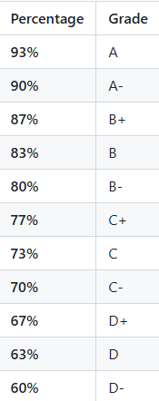
Grade cutoffs
Fixed full-step grade cutoffs
Might be curved on top of these cutoffs per instructor’s discretion
Might have extra credit assignments

Slide 8
Academic integrity and AI policies
Inter-group collaboration and discussion is permitted
Copying code is not permitted
Submitting AI-generated code is not permitted
Using AI to understand concepts, exceptions, or compilation errors is permitted
… why?

Slide 9
The purpose of college
Skills
Programming
Debugging
Designing
Communication
Programming languages – C/Java/C++/Rust/Haskell
Meta-skills
How to study?
How to quickly learn new things?
How to persevere?
… over-reliance on LLMs prevent meta-skills development

Slide 10

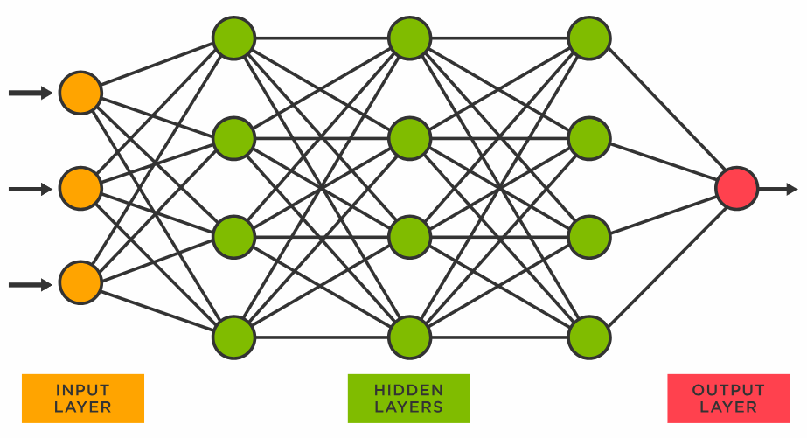


How do LLMs learn?
PROMPT
DATA
OUTPUT
LLM

Slide 11

Implications of over-reliance on LLMs
Imagine we use LLMs for our course projects
TechnologyX becomes popular in the year 2027
… what are the challenges?
LLMs have no data on TechnologyX and will perform poorly
Plus, we didn’t learn the meta-skills necessary to pick up a new skills
YOU WANT TO BE HERE
Skill Level

Slide 12
Implications of over-reliance on LLMs
How to upskill if you rely on LLMs?
E.g., improve your Rust skills
… wait for next GPT model? ☹
Bottomline – please don’t use LLMs for writing code ☺
… questions?

Slide 13
Software engineering overview
Notes:
Perspective
Different people have different ideas

Slide 14
Why study software engineering?
ECS 032A, ECS 036, ECS 34, …
Focused on programming, data-structures, algorithms …
… so, what is different in ECS 160?

Slide 15
What is Programming?
Writing code to solve specific problems
Focused on implementing functionality
Concerned with runtime complexity, storage complexity, and so on…
Typically involves a single (or few) programmers
Example: Creating a function to sort data
Notes:
Show a piece of code

Slide 16
Quick sort
int partition(vector<int>& arr, int low, int high) {
// Choose the pivot
int pivot = arr[high];
// Index of smaller element and indicates
// the right position of pivot found so far
int i = low - 1;
// Traverse arr[low..high] and move all smaller
// elements on left side. Elements from low to
// i are smaller after every iteration
for (int j = low; j <= high - 1; j++) {
if (arr[j] < pivot) {
i++;
swap(arr[i], arr[j]);
}
}
// Move pivot after smaller elements and
// return its position
swap(arr[i + 1], arr[high]);
return i + 1;
}
// The QuickSort function implementation
void quickSort(vector<int>& arr, int low, int high) {
if (low < high) {
// pi is the partition return index of pivot
int pi = partition(arr, low, high);
// Recursion calls for smaller elements
// and greater or equals elements
quickSort(arr, low, pi - 1);
quickSort(arr, pi + 1, high);
}
}

Slide 17
Social media platform
User DB MySQL cluster
Redis cluster
User Onboarding Login flow
User Service
Trends
Redis cluster
User following flow
Graph Service
Apache Spark streaming cluster
User Graph MySQL cluster
K
A
F
K
A
Hadoop cluster
Adding Post UI
Tweet Injection Service
Weekly cron jobs
Cassandra Cluster
Search Kafka consumer
Notification service
Short URL Service
Tweet Service
Tweet Processor
Elastic search cluster
Live User Websockets (notifications)
User Self Profile Service
Timeline Service
Analytics
Search service
Assert Service
Redis cluster
Home Screen
CDN
Users app / browsers
Search screen

Slide 18
What is software engineering?
Designing, building, and maintaining software systems
Collaborative effort across teams of 1000s of software developers
Example: Building and maintaining a scalable social media platform
Software engineering is the application of a systematic, disciplined, quantifiable approach to the development, operation, and maintenance of software; that is, the application of engineering to software
(IEEE standard glossary of software engineering terminology - IEEE Std 610.12-1990)

Slide 19
Characteristics
Heterogenous
Various components written in different languages (Java, C, Python, and so on)
Multiple components that communicate with each other
A single “logical component” can run on many machines (duplicated services for redundancy)
Multiple programmers must coordinate their development work
Too much complexity!!

Slide 20



Making sense of complexity
Abstractions
Notes:
- Have you heard this term before?

Slide 21
Abstraction
The process of identifying the essential characteristics of an object or system and ignoring the irrelevant details to reduce complexity and increase efficiency in problem-solving.
The User Following UI component does not need to know the details of the User Graph MySQL database
Only cares about the Graph Service API
(Ian Sommerville, Software Engineering, 10th Edition)

Slide 22

Social media platform
User DB MySQL cluster
Redis cluster
User Onboarding Login flow
User Service
Trends
Redis cluster
User following flow
Graph Service
Apache Spark streaming cluster
User Graph MySQL cluster
K
A
F
K
A
Hadoop cluster
Adding Post UI
Tweet Injection Service
Weekly cron jobs
Cassandra Cluster
Search Kafka consumer
Notification service
Short URL Service
Tweet Service
Tweet Processor
Elastic search cluster
Live User Websockets (notifications)
User Self Profile Service
Timeline Service
Analytics
Search service
Assert Service
Redis cluster
Home Screen
CDN
Users app / browsers
Search screen

Slide 23
User following flow
Database etc.
User following flow
Graph Service
API

Slide 24

Types of API
Application Programming Interface (API) is just a standard of data-interchange agreed upon by the sender and receiver
Database etc.
User following flow
Graph Service
API
graphservice.jar

Slide 25

Types of API
Can be an internet endpoint (also called REST endpoint)
Database etc.
User following flow
Graph Service
API
https://120.67.11.8:9090/graphadd
https://120.67.11.8:9090/graphdelete

Slide 26
Types of API
Some “standards” are industry standards
<xml> <data>
<userid> ABC </userid> </data> </xml>
Database etc.
User following flow
Graph Service
API
https://120.67.11.8:9090/graphadd
https://120.67.11.8:9090/graphdelete

Slide 27

What APIs enable
Database etc.
User following flow
Graph Service
API
https://120.67.11.8:9090/graphadd
https://120.67.11.8:9090/graphdelete

Slide 28

User following flow
Database etc.
User following flow
Graph Service
API
https://120.67.11.8:9090/graphadd
https://120.67.11.8:9090/graphdelete

Slide 29
Modularization
The process of dividing a software system into distinct, self-contained components or modules, each encapsulating specific functionality or data
Each module provides a well-defined interface (abstraction) that hides its internal details, allowing other parts of the system to interact with it without knowing its implementation
Abstraction and modularization are closely related concepts

Slide 30
Reusability
The extent to which a software module or component can be used in more than one computing program or software system with little or no modification
Closely related to abstraction and modularization
Abstracting the low-level details and modularizing a component allows us to reuse it
(IEEE standard glossary of software engineering terminology - IEEE Std 610.12-1990)

Slide 31

Reusing the graph service
Database etc.
User following flow
Graph Service
API
User details download flow
https://120.67.11.8:9090/graphadd
https://120.67.11.8:9090/graphdelete

Slide 32
Performance
Programming language choice impacts performance
Python
Java
Rust
C/C++
Slower
Faster

Slide 33
C vs. Java performance
https://programming-language-benchmarks.vercel.app/c-vs-java
Notes:
Mathematical benchmarks

Slide 34
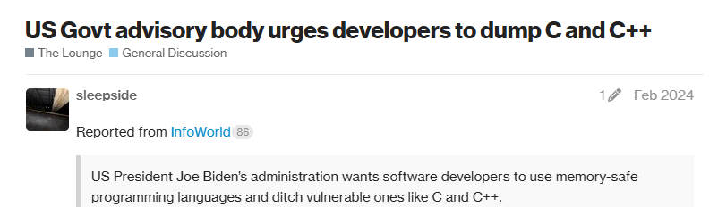
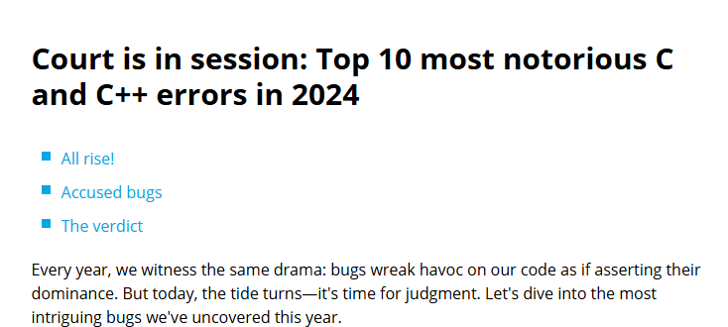
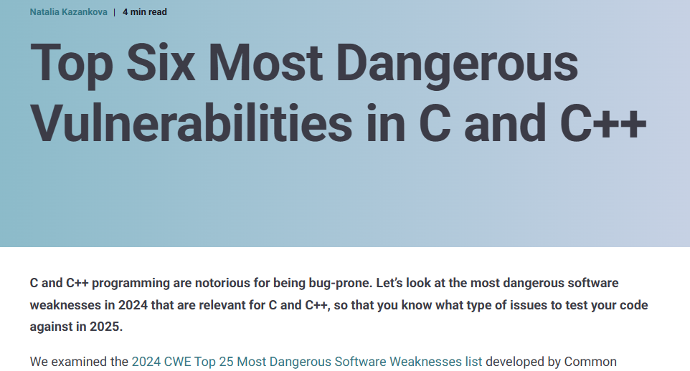
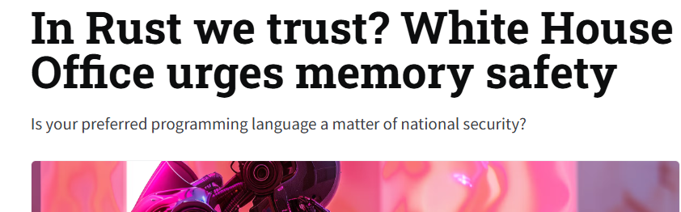
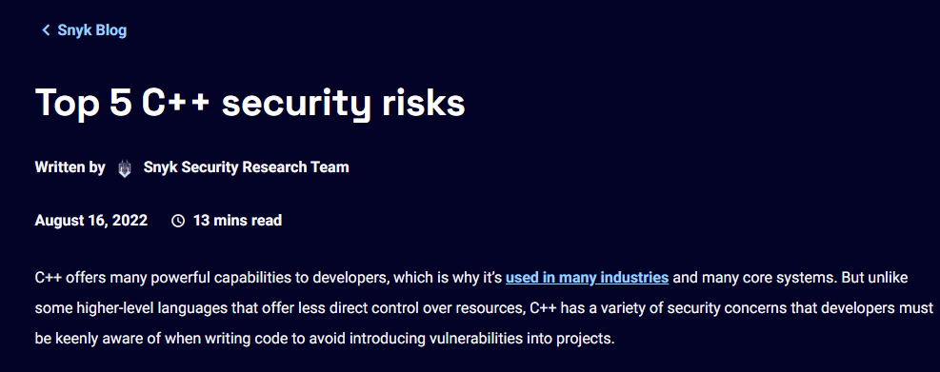
Security
Programming language choice impacts security
C/C++
Python
Java
Rust
Less secure
More secure
Notes:
- These decisions matter more and more as you start making decisions at scale

Slide 35
Usability
Some programming languages have steeper learning curve
Python
Java
C/C++
Rust
Easier
Harder
Notes:
- subjective
- These decisions matter more and more as you start making decisions at scale

Slide 36
Usability – C vs. Rust
#include <stdio.h>
int main() {
char s[] = "hello";
s[0] = 'H';
printf("%s\n", s);
return 0;
}
fn main() {
let mut s = String::from("hello");
unsafe {
let bytes = s.as_bytes_mut();
bytes[0] = b'H';
}
println!("{}", s); // "Hello"
}
Notes:
// Strings are UTF-8,
// so you can’t just index: s[0] = 'H'; won’t compile.
// You must convert to bytes, mutate, then back.

Slide 37
Summary
Abstraction necessary to deal with complexity of modern software systems
Modularization makes abstraction possible
Abstraction and modularization allows reuse
Tradeoffs
Performance vs. security
C/C++ highly performant but lack security
Modularization improves reusability, but can reduce performance
… Examples?

Slide 38
Syllabus overview
Week | Topic
1, 2, 3 | Background OO fundamentals Networking fundamentals - Advanced Java features Annotations Reflection
4, 5 | Software architecture Containerization, microservices Pipeline architecture Pub-sub architecture
6, 7, 8 | Design patterns
9 | Software security
10 | Quality control: Unit testing, fuzz testing
Abstraction,
Reusability

Slide 39
HW assignments
Latest frameworks, tools and technologies
Spring Boot for microservices, REST API
JUnit and GitHub Actions
Maven build systems
LLM integration
Develop our own frameworks using Java Reflection and Annotations
Notes:
- dimensions

Slide 40
HW theme
Answer the question - How effective are LLMs in bug finding?
HW1 - Preliminary analysis on GitHub issues using GitHub API
Maven, Json parsing, invoking APIs, Junit tests
HW2 - Analyze GitHub repos using locally-run LLMs
Develop frameworks using reflection and annotations
Microservices, mock testing
HW3 - Fuzz test GitHub repositories and compare against LLM results
Develop frameworks using reflection and annotations, fuzz testing

Slide 41
Comparison against previous offerings
Course material is very similar to W24 offering
Very different from offerings previous to that
Assignments will be harder and open-ended
Must submit report along with code
Will simulate real-world problems and solutions
Assignments will be long → start early!!

Slide 42
Additional logistics
Enrollment cap will likely not increase
Limited by room size
I will likely teach ECS 160 in W25, too
Homeworks
First HW will start on Oct 10
Third HW will be due on Dec 12
Initial drafts of all homeworks will be available on GitHub by the weekend

Slide 43
Quiz
Canvas quiz
Notes:
https://docs.github.com/en/rest/using-the-rest-api/getting-started-with-the-rest-api?apiVersion=2022-11-28&tool=curl

