Slide 1
Object-oriented programming using Java
Tapti Palit

Slide 2
Announcements
HW schedule updated
Homework handouts will have some updates
Some additional requirements
Each assignment will have 15 points
We will discuss HW1 during class on Monday

Slide 3


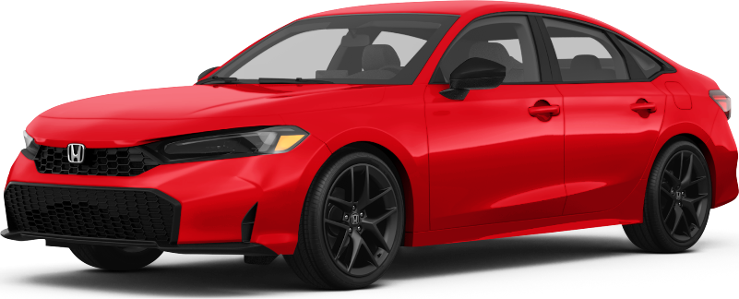
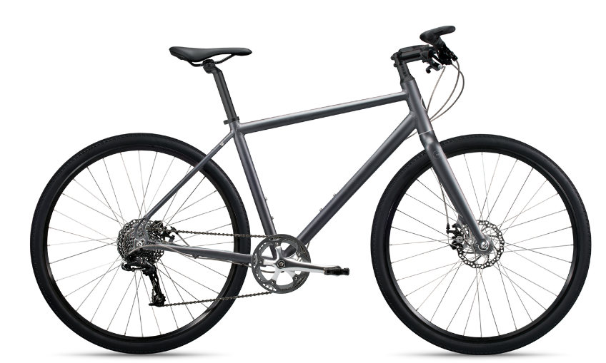
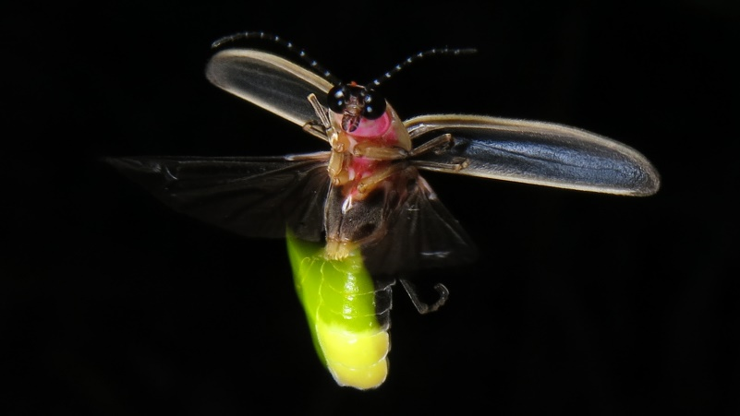

What is an object?
Objects have properties and functions

Slide 4
What is an object?
Objects have properties and functions
Properties
Model
Year
Mileage
Seats, and so on…
Functions
Start
Stop
Accelerate
Brake, and so on…

Slide 5
Java, an object-oriented language
Java is an object-oriented programming language
Everything is an object
A class is a blueprint for creating objects
Defines properties (fields) and behaviors (methods)
An object is an instance of a class
public class Car {
private String model;
private int year;
private int mileage;
public void start() { …}
public void stop() { … }
public void accelerate() { … }
public void brake() { … }
}
public class MyApplication {
public static void main(String[] args) {
Car car = new Car();
} }

Slide 6
Stack and heap
Local variables (int, float, char) are stored on the stack
Objects are stored on the heap
References to the objects are stored on the stack

Slide 7
Object references
References store the address of heap objects
Assigning one reference variable to another copies the reference, not the actual object
Objects are garbage collected
public class Car {
…
}
public class MyApplication {
public static void main(String[] args) {
Car car = new Car();
Car car2 = car;
car.setModel(“Tesla”);
System.out.println(car2.getModel());
// prints “Tesla”
} }

Slide 8
Encapsulation
Internal details of a class are hidden from outside world
Access is controlled using public, private, protected access modifiers
Direct access to private fields prevented
Needs getter and setter methods
Enables abstraction
public class Car {
private String model;
public String getModel() { return model;
}
public void setModel(String model) {
this.model = model;
} // … other fields and methods }
public class MyApplication { public static void main(String[] args) {
Car car = new Car();
car.model = “Toyota Hybrid”; // COMPILER ERROR
}
}

Slide 9
Should we ever intentionally break encapsulation?

Slide 10
Constructors
A constructor is a special method to create objects
Must have same name as the class
Must have no return type
Can have access modifiers
public class Car {
private String model;
private int year;
private int mileage; public Car(String model, int year, int mileage) {
this.model = model;
this.year = year;
this.mileage = mileage;
} }

Slide 11
Destructors?
Java provides a finalize() method
Called before an object is garbage collected
Largely never used
Garbage collection is unreliable

Slide 12
Classes are often related
public class Car {
private String model;
private int year;
private int mileage;
public void start() { …}
public void stop() { … }
public void accelerate() { … }
public void brake() { … }
}
public class Bicycle {
private String model;
private int year; public void start() { …}
public void stop() { … }
public void accelerate() { … }
public void brake() { … }
public void ringBell() { … } }
Code duplication!
What types of code duplication?

Slide 13

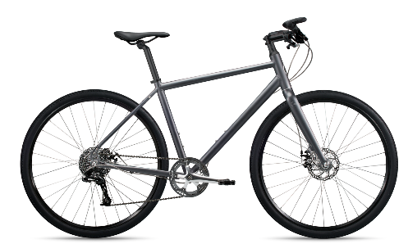
Inheritance
public class Vehicle { // shared properties
// and functions
private String model;
private int year;
public void start() { …}
public void stop() { … }
public void accelerate() { … }
public void brake() { … }
}
public class Car extends Vehicle {
private int mileage;
// getter and setter for mileage
}
public class Bicycle extends Vehicle {
public void ringBell() { … } }
public static void main(String[] args) {
Bicycle bicycle = new Bicycle();
bicycle.start();
bicycle.ringBell();
}
VEHICLE
extends
extends

Slide 14
Can extend only one class!
The Object class is at the top of the class hierarchy
VEHICLE
MACHINE
extends
extends

Slide 15
Inheritance
public class Vehicle { // shared properties
// and functions
private String model;
private int year;
public void start() { …}
public void stop() { … }
public void accelerate() { … }
public void brake() { … }
}
public class Car extends Vehicle {
private int mileage;
// getter and setter for mileage
}
public class Bicycle extends Vehicle {
public void ringBell() { … } }
public static void main(String[] args) {
Vehicle vehicle = new Vehicle();
}
VEHICLE
What does it mean to create an object of type Vehicle?

Slide 16
Abstraction via abstract classes
An abstract class cannot be instantiated
Must be extended
Can have concrete methods
public abstract class Vehicle {
private String model;
private int year;
public void start() { …}
public void stop() { … }
public void accelerate() { … }
public void brake() { … }
}
public class Car extends Vehicle {
private int mileage;
// getter and setter for mileage
}
public class Bicycle extends Vehicle {
public void ringBell() { … } }
public static void main(String[] args) {
Vehicle vehicle = new Vehicle(); // Compiler error!!
}

Slide 17

Not all parent classes are abstract!!
public class Bicycle extends Vehicle {
public void ringBell() { … } }
public class ElectricBicycle extends Bicycle {
public void charge() { … }
}
public static void main(String[] args) {
Bicycle bike = new Bicycle();
ElectricBicycle eBike = new ElectricBicycle();
}

Slide 18
Abstraction via interfaces
Defines a contract for what a class must do but now how
Supports multiple inheritance
All methods in interface are abstract by default
Cannot instantiate interfaces
ILLUMINATABLE
implements
implements

Slide 19
Abstraction via interfaces
Defines a contract for what a class must do but now how
Supports multiple inheritance
All methods in interface are abstract by default
Cannot instantiate interfaces
public interface Illuminatable {
void emitLight();
}
public class Lamp implements Illuminatable {
public void emitLight() {
System.out.println(“Lamp emits light!”);
}
}
public class Firefly implements Illuminatable {
public void emitLight() {
System.out.println(“Firefly emits light”);
}
}

Slide 20
Compile-time polymorphism
Compile time polymorphism via method overloading
Methods having the same name but differing in
Number of parameters
Type of parameters
Order of parameters
The method to be invoked is determined at compile time
public class Calculator {
public int add (int a, int b) {
return a + b;
}
public float add (float a, float b) {
return a + b;
}
}
public static void main(String[] args) {
Calculator calculator = new Calculator();
S.o.p(calculator.add(10, 30));
S.o.p(calculator.add(10.0, 30.0));
}

Slide 21
Runtime polymorphism
A subclass provides a specific implementation of a method that is already defined in the parent class
The method to be invoked is determined at runtime, depending on the type of object
public class Bicycle {
public void accelerate() {
System.out.println(“Bike accelerating.”);
}
}
public class ElectricBicycle extends Bicycle{
public void accelerate() {
System.out.println(“E-bike accelerating.”);
}
}
public static void main(String[] args) {
Bicycle b = new Bicycle();
b.accelerate(); // prints “Bike accelerating”
b = new ElectricBike();
b.accelerate(); // prints “E-bike accelerating”
}

Slide 22
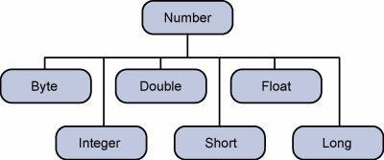
Boxing, unboxing, autoboxing
Primitives stored on the stack
Can box them into wrapper classes to store on the heap
Boxing
Integer myInt = new Integer(20);
Unboxing
int num = myInt.intValue();
Autoboxing
Integer myInt = 20; // autobox
int num = myInt ; // auto-unbox
Object

Slide 23
Generics
Generics allows the programmer to define a “placeholder” for a type.
The placeholder gets replaced by the real type when the class is instantiated
Facilitates reusability
Wildcard “?”
Used to represent an unknown type
List<?> used to represent a list of any type
public class Container<T> {
private T item;
// Setter
public void setItem(T item) {
this.item = item;
}
// Getter
public T getItem() {
return item;
}
}
public class MyApplication(String[] args) {
Container<String> c1 = new Container<String>();
c1.setItem(new String(“hello”));
Container<Bicycle> c2 = new Container<Bicycle>();
c2.setItem(new Bike());
}

Slide 24
Bounded polymorphism
Allows the programmer to restrict the types that can be used in a generic class or method using “bounds”
Enforce constraints while maintaining flexibility
Upper Bound: T extends ClassName
Lower Bound: ? super ClassName
public <T extends Number> int sum (T a, T b) {
return a.intValue() + b.intValue();
}
// Usage
sum(5, 6); // Works
sum(5.5, 6.6); // Works
sum(“5”, “7”); // COMPILER ERROR
What is the benefit of using generic type
instead of Number?

Slide 25
OO fundamentals in Java (contd.)
Tapti Palit

Slide 26
Announcements
Still waiting to hear back about class enrollment expansion
HW1 has been updated (will be discussed today)
Please post any questions on Piazza

Slide 27
Uses of boxing and unboxing
Java provides wrapper classes that are subclasses of Number to wrap numeric primitives as Objects
Use: Java collections can operate only on Object subclasses
List<int> myIntegers = new ArrayList<>();

Slide 28
Generics example
Generic type parameter must be replaced uniquely
Point class can have X and Y coordinate, both of which must be Integer, or Float, or Double, and so on
public class Point<T extends Number> {
private T xCoordinate;
private T yCoordinate;
public Point(T x, T y) {
xCoordinate = x;
yCoordinate = y;
}
// getters and setters
}
Point<Integer> point1 = new Point<>(10, 20);
Point<Double> point2 = new Point<>(10.0, 20.0);
Point<Integer> point3 = new Point(10, 20.0);
// COMPILER ERROR

Slide 29
Without generic types
Point class can have X and Y coordinates of different types as long as both types extend Number
public class Point {
private Number xCoordinate;
private Number yCoordinate;
public Point(Number x, Number y) {
xCoordinate = x;
yCoordinate = y;
}
// getters and setters
}
Point point1 = new Point<>(10, 20);
Point point2 = new Point<>(10.0, 20.0);
Point point3 = new Point(10, 20.0);
// NO COMPILER ERROR

Slide 30
Generics example with two type parameters
Can have any number of type parameters
E.g. allow mismatched coordinate types using generic type parameters
public class Point<T extends Number, U extends Number> {
private T xCoordinate;
private U yCoordinate;
public Point(T x, U y) {
xCoordinate = x;
yCoordinate = y;
}
// getters and setters
}
Point<Integer, Integer> point1 = new Point<>(10, 20);
Point<Double, Double> point2 = new Point<>(10.0, 20.0);
Point<Integer, Double> point3 = new Point(10, 20.0);
// NO COMPILER ERROR

Slide 31
Static class members
Declaring a field static ensures exactly a single copy of that field is created and shared among all instances of that class
public class Car {
private String name;
private String engine;
public static int numberOfCars;
static {
numberOfCars = 0;
}
public Car(String name, String engine) {
this.name = name;
this.engine = engine;
numberOfCars++;
}
// getters and setters
}
public static void main(..) {
Car c1 = new Car(“Jaguar, “V8”);
Car c2 = new Car(“Bugatti”, “W16”);
System.out.println(“Total number of cars: “ + Car.numberOfCars);
// Prints 2
}

Slide 32
Static class methods
A static class method does not need an object to invoke it
public class Car {
private String name;
private String engine;
private static int numberOfCars;
// .. Constructors
public static int getNumberOfCars() {
return numberOfCars;
}
}
public static void main(..) {
Car c1 = new Car(“Jaguar, “V8”);
Car c2 = new Car(“Bugatti”, “W16”);
System.out.println(“Total number of cars: “ + Car.getNumberOfCars());
// Prints 2
}

Slide 33
Exceptions
An Exception is an event that disrupts the normal flow of a program during runtime
Examples: Division by zero, file not found, invalid input, out of bounds access, null pointer access, and so on…
Caught and uncaught exceptions
What to do when an exception occurs?

Slide 34
Try-catch block
Try-catch block used to catch exceptions
Finally used to perform any clean up operations
try {
// Code that might cause exception } catch (ExceptionType e) {
// handle exception
} finally {
// Clean up
}

Slide 35
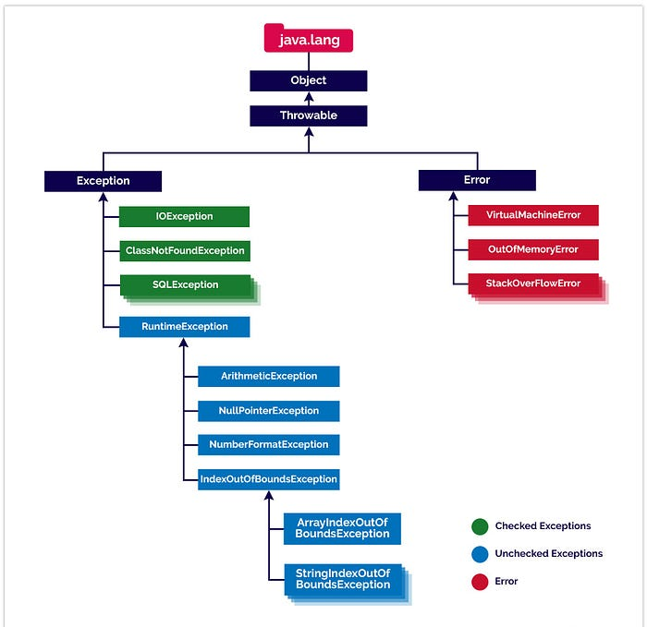
Java exception hierarchy
All exceptions except RuntimeExceptions must be explicitly handled
Uncaught exceptions extend RuntimeException
Can also catch Errors, but it is generally not useful

Slide 36
Caught and uncaught exceptions
Compiler requires a try-catch block for caught exceptions
IOException, FileNotFoundException, and so on…
A missing try-catch block for a caught exception, the code will not compile
Compiler does not require a try-catch block for uncaught exceptions
You still may specify a try-catch block for these exceptions
RuntimeException or subclass
Compiler will not throw a compilation error if you don’t specify a try-catch block
If no try-catch specified and the code raises the exception, application will terminate

Slide 37
Try-catch block
Try-catch block used to catch exceptions
Finally used to perform any clean up operations
String filePath = "nonexistentfile.txt";
try {
// Attempt to open and read a file
BufferedReader reader = new BufferedReader(new FileReader(filePath));
String line;
while ((line = reader.readLine()) != null) {
System.out.println(line);
}
reader.close();
} catch (FileNotFoundException e) {
System.err.println("Error: File not found);
} catch (IOException e) {
System.err.println("Error: An I/O error.");
}

Slide 38
Try-catch block
Exceptions also have a hierarchy
Can’t catch an exception of a superclass type before catching the subclass type exception
String filePath = "nonexistentfile.txt";
try {
// Attempt to open and read a file
BufferedReader reader = new BufferedReader(new FileReader(filePath));
String line;
while ((line = reader.readLine()) != null) {
System.out.println(line);
}
reader.close();
} catch (IOException e) {
System.err.println(“IO Exception occured.");
} catch (FileNotFoundException e) {// COMPILER ERROR
System.err.println(“File not found.");
}

Slide 39
Throw exception
Instead of handling the exception, you can just rethrow it
The encapsulating try-catch block must catch it
String filePath = "nonexistentfile.txt";
try {
try {
// Attempt to open and read a file
BufferedReader reader = new BufferedReader(new FileReader(filePath));
String line;
while ((line = reader.readLine()) != null) {
System.out.println(line);
}
reader.close();
} catch (IOException e) {
throw e;
}
} catch (IOException e) {
System.out.println(e); // e handled in outer try-catch
// block
}

Slide 40
Functions that throw exceptions
Functions can throw exceptions
If no one catches it, then the application terminates
public void readFile(…) throws IOException {
…
}
public static void main(String[] args) {
try {
readFile(…);
} catch (Exception e) {
// handle it
}
}

Slide 41
OO Fundamentals in Java (contd)
Tapti Palit

Slide 42
Agenda
Anouncements
Compilation, interpretation, and execution
Revisiting caught and uncaught exceptions
Unit testing (if time permits)
HW1 discussion continued
Redis data store

Slide 43
Announcements
Team registration extended till Friday 11:59 PM
Can change teams later if you have issues due to waitlisting
Can do the first homework alone before teaming up if waitlisted

Slide 44
Announcements
Up to waitlist #4 is very likely to get in
Potential for expanding the class size to 104, but not beyond

Slide 45
Announcements
HW1 handout updated to allow Redis data-store in addition to Postgresql
HW1 skeleton updated
Please pull and run mvn clean install
Will let you run jar -cp com.ecs160.MyApp, instead of always pressing the IDE RUN button
Please follow Piazza discussions
Clarifications of homeworks

Slide 46
What is compilation?
Compilation is the process of converting an application written in a human understandable programming language to “object code”

Slide 47

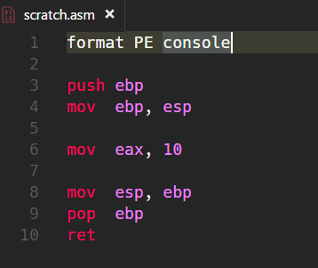

What is object code?
Object code is a representation of the source code at a lower level
C compiler translates it to machine code
Directly runnable on the hardware (hardware specific) [Demo: X86, ARM]

Slide 48
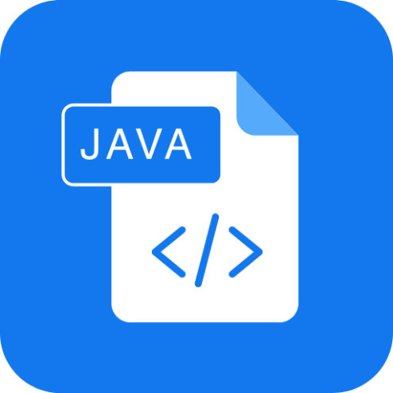
What is object code?
Object code is a representation of the source code at a lower level
Java compiler translates it to an “Intermediate Representation (bytecode)” [Demo]
Compiled from "MyApp.java"
public class MyApp {
public MyApp();
Code:
0: aload_0
1: invokespecial #1 // Method java/lang/Object."<init>":()V
4: return
public static void main(java.lang.String[]);
Code:
0: getstatic #7 // Field java/lang/System.out:Ljava/io/PrintStream;
3: ldc #13 // String Hello!
5: invokevirtual #15 // Method java/io/PrintStream.println:(Ljava/lang/String;)V
8: return
}
javac
MyApp.java
MyApp.class

Slide 49
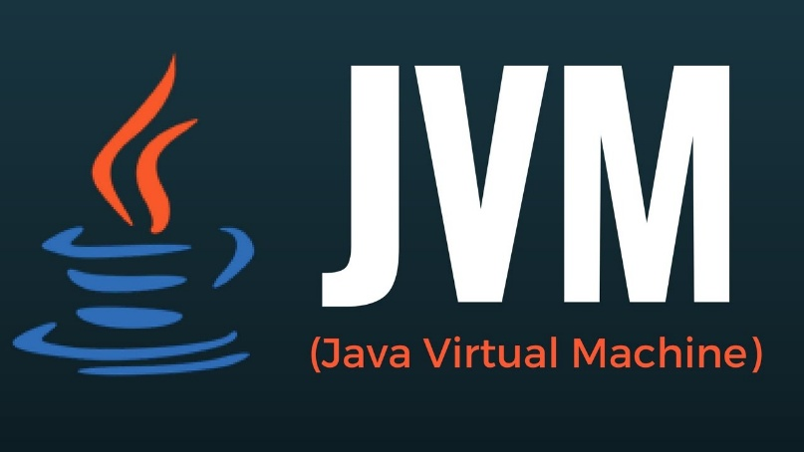
Java bytecode interpretation
Hardware does not know how to run Java bytecode
Needs a Java Virtual Machine (JVM) to execute the bytecode instructions at runtime
INTERPRETER
MyApp.class
Just-in-Time Compiler
[java]

Slide 50
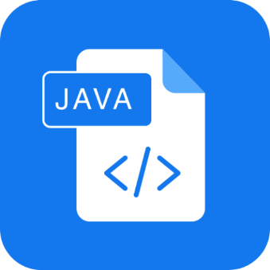

TL;DR
INTERPRETER
Compiled from "MyApp.java"
public class MyApp {
public MyApp();
Code:
0: aload_0
1: invokespecial #1 // Method java/lang/Object."<init>":()V
4: return
public static void main(java.lang.String[]);
Code:
0: getstatic #7 // Field java/lang/System.out:Ljava/io/PrintStream;
3: ldc #13 // String Hello!
5: invokevirtual #15 // Method java/io/PrintStream.println:(Ljava/lang/String;)V
8: return
}
javac
Just-in-Time Compiler
[java]
MyApp.java
Machine code
MyApp.class
Both steps performed when we press RUN on the IDE

Slide 51
Why does it matter?
Some checks happen at compile time
Syntax checking
Type-checking, generic type checking
… and so on
Other checks happen at run time
Runtime polymorphism
Array index out of bounds access
Null pointer access
File not found checks

Slide 52
Caught and uncaught exceptions revisited
Recall: The Java JVM throws an exception when unexpected situation disrupts normal program flow
Programmer can specify a try-catch block to try to recover from the exception
Notes:
java –cp . Test

Slide 53
Caught and uncaught exceptions revisited
Uncaught exceptions – javac compiler does not require you to handle it
Extends RuntimeException
NullPointerException, DivideByZeroException
You may handle it using a try catch block
If you don’t handle it and the exception occurs at runtime, the app will crash [Demo]
Notes:
java –cp . Test

Slide 54
Caught and uncaught exceptions revisited
INTERPRETER
Compiled from "MyApp.java"
public class MyApp {
public MyApp();
Code:
0: aload_0
1: invokespecial #1 // Method java/lang/Object."<init>":()V
4: return
public static void main(java.lang.String[]);
Code:
0: getstatic #7 // Field java/lang/System.out:Ljava/io/PrintStream;
3: ldc #13 // String Hello!
5: invokevirtual #15 // Method java/io/PrintStream.println:(Ljava/lang/String;)V
8: return
}
javac
Just-in-Time Compiler
[java]
MyApp.java
Machine code
Checks if try-catch blocks exist for caught exceptions
MyApp.class
Detects if exception conditions are arising at runtime

