Slide 1
Software security
Tapti Palit

Slide 2
Module goals
Understand software security concerns that influence software engineering
Memory safety and memory unsafe languages
Secure programming
Deeper dive in any topics “on-demand”

Slide 3
C vs Java vs Python
C/C++
Java
#include <stdio.h> int main(int argc, char** argv) { char a = ‘A’; char arr[4] = {‘a’, ‘b’, ‘c’, ‘d’}; int index = atoi(argv[1]); printf(“%c\n”, arr[index]);
}
> gcc test.c –o test > ./test 10 > Output???
class MyApp {
public static void main(String[] args) { char a = ‘A’;
char arr[] = {‘a’, ‘b’, ‘c’, ‘d’};
int index = Integer.parseInt(args[0]);
System.out.println(arr[a]);
}
}
> javac MyApp.java > java MyApp.class 10 > # Output?
import sys arr = [‘a’, ‘b’, ‘c’, ‘d’] index = int(sys.argv[1]) print(arr[index]) > python3 test.py 10
Python

Slide 4
C vs Java vs Python
C/C++
Java
#include <stdio.h> int main(int argc, char** argv) { char a = ‘A’; char arr[4] = {‘a’, ‘b’, ‘c’, ‘d’}; int index = atoi(argv[1]); printf(“%c\n”, arr[index]);
}
> gcc test.c –o test > ./test 10 > �
class MyApp {
public static void main(String[] args) { char a = ‘A’;
char arr[] = {‘a’, ‘b’, ‘c’, ‘d’};
int index = Integer.parseInt(args[0]);
System.out.println(arr[a]);
}
}
> javac MyApp.java > java MyApp.class 10 > Exception in thread "main" java.lang.ArrayIndexOutOfBoundsException: Index 10 out of bounds for length 4
Undefined Behavior (UB)
import sys arr = [‘a’, ‘b’, ‘c’, ‘d’] index = int(sys.argv[1]) print(arr[index]) > python3 test.py 10 IndexError: list index out of range
Python

Slide 5
Memory layout
#include <stdio.h> int main(int argc, char** argv) { char a = ‘A’; char arr[4] = {‘a’, ‘b’, ‘c’, ‘d’}; int index = atoi(argv[1]); printf(“%c\n”, arr[index]);
}
> gcc test.c –o test > ./test 10 > �
.. garbage value ..
0x1004
… 6 bytes …
0xFFF
arr[3]
0xFFE
+10
arr[2]
0xFFD
arr[1]
0xFFC
arr[0]
0xFFB
a
0xFFA

Slide 6
C: lack of bounds checks
Buffers (arrays, strings) have bounds
[0, Size of the buffer]
char* p = malloc(128); // Bounds [0, 128]
C lacks bounds checks
p[1000]
Assume that p is pointing to a buffer that has at least 1000 elements
Try to access the 1000th element
Might crash if memory isn’t mapped
Might print whatever was in that memory

Slide 7

Memory safety and performance
Java compiler inserts bounds checks for array accesses that are inserted at runtime
Additional runtime checks reduces performance
Pseudo-code after Java compiler
inserts checks
Original Java code
char a = ‘A’; char arr[4] = {‘a’, ‘b’, ‘c’, ‘d’}; int index = atoi(argv[1]); printf(“%c\n”, arr[index]);
char a = ‘A’; char arr[4] = {‘a’, ‘b’, ‘c’, ‘d’}; int index = atoi(argv[1]); if (index < arr.length) {
System.out.println(arr[index]);
} else {
throw new ArrayIndexOutOfBoundsException();
}

Slide 8
So what?
In case of all programming languages, the program didn’t do what we wanted it to do
Java, Python -> it crashed [defined behavior]
C -> printed garbage or might crash [undefined behavior]
… why is the second option worse than the first?

Slide 9
Why is UB worse?
Undefined behavior leaves system in inconsistent state
Inconsistent state can be exploited by the attacker
… How??

Slide 10
Background: types of memory
Applications have (at least) 3 types of memory
Function local variables allocated on the “stack”
Heap variables allocated via malloc
Global variables
int global_arr[10];
int main(void) {
int a;
int b;
int local_arr[10];
int* p = malloc(10*sizeof(int));
}
Global variable
Stack variable
Heap variable

Slide 11
Background: stack layout
Stack grows downward
0x1000
Top of the stack
0xFFF
0xFFE
0xFFD
0xFFC
0xFFB

Slide 12
Buffer overflow
#include <stdlib.h>
#include <stdio.h>
int main(void) { uint8_t authenticated = 0;
uint8_t array[4];
uint8_t * p = array;
uint8_t num;
for (int i = 0; i <= 4; i++) {
printf(“Enter a number:”);
scanf(“%d”, &num);
}
return 0;
}
authenticated
0x1000
array[3]
0xFFF
array[2]
0xFFE
array[1]
0xFFD
array[0]
0xFFC
0xFFB

Slide 13
Buffer overflow
#include <stdlib.h>
#include <stdio.h>
int main(void) { uint8_t authenticated = 0;
uint8_t array[4];
uint8_t * p = array;
uint8_t num;
for (int i = 0; i <= 4; i++) {
printf(“Enter a number:”);
scanf(“%d”, &num);
array[i] = num;
}
return 0;
} > Enter a number:
1 # 5 times
1
authenticated
0x1000
1
Overwrite authenticated
variable!!!
array[3]
0xFFF
1
array[2]
0xFFE
array[1]
0xFFD
1
array[0]
0xFFC
1
0xFFB

Slide 14
Vulnerable string-related libc functions
scanf (with the %s modifier) , strcpy, printf (with %n modifier)
String stored can be larger than the variable size
Will overwrite the contents of the adjacent memory
char* password = malloc(5); scanf(“%s”, password); // will overflow if user enters “AAAAAA”
Solution: use size-limited functions such as snprintf, scanf(“%5s”, password), strncpy, and so on

Slide 15
Vulnerable string-related libc functions
char* password = malloc(5); scanf(“%s”, password)
overflow if user enters “AAAAAA”
A
0x1000
A
0xFFF
A
0xFFE
Password
A
0xFFD
A
0xFFC
A
0xFFB

Slide 16
Buffer overflow demo
https://github.com/davsec-teaching/buffer-overflow-demo

Slide 17





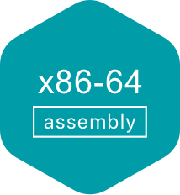
Programming languages and memory safety
Memory safety is a property of a programming language that ensures all memory accesses are
Well-defined
Adhere to object boundaries
Adhere to types of allocated objects
Some programming languages have memory safety and some do not
Memory safe
Memory unsafe

Slide 18
Then why would one use C/C++ over Java/Python???

Slide 19
Memory safety and performance
Java compiler inserts bounds checks for array accesses that are inserted at runtime
Additional runtime checks reduces performance
Pseudo-code after Java compiler
inserts checks
Original Java code
char a = ‘A’; char arr[4] = {‘a’, ‘b’, ‘c’, ‘d’}; int index = atoi(argv[1]); printf(“%c\n”, arr[index]);
char a = ‘A’; char arr[4] = {‘a’, ‘b’, ‘c’, ‘d’}; int index = Integer.parseInt(argv[1]); if (index < arr.length) {
System.out.println(arr[index]);
} else {
throw new ArrayIndexOutOfBoundsException();
}

Slide 20
C vs. Java performance
https://programming-language-benchmarks.vercel.app/c-vs-java
Notes:
Mathematical benchmarks

Slide 21






Performance critical software in C/C++
Web servers
Nginx, Apache Httpd
Key-value stores
Redis, Memcached
Database servers
MySQL
Postgresql
SQLLite

Slide 22
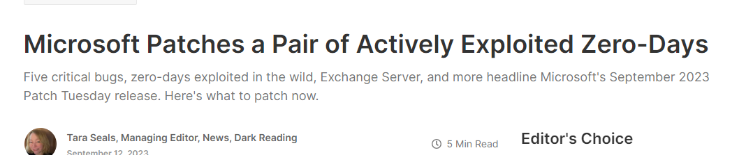

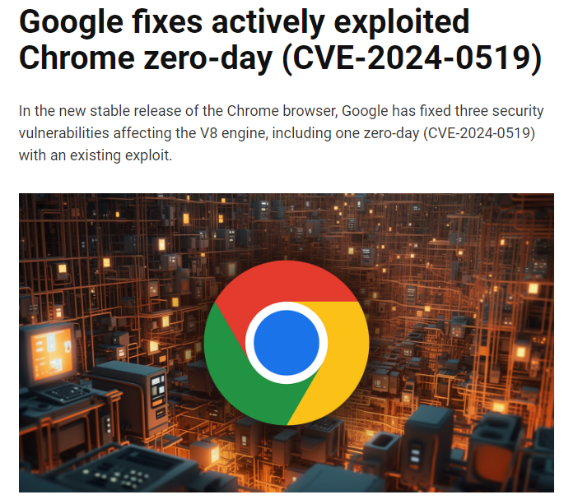
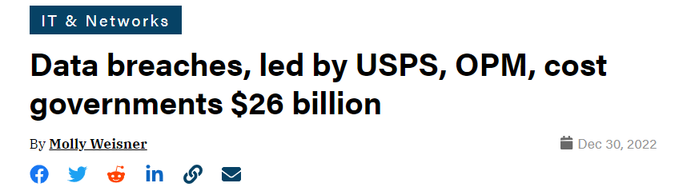
Security attacks

Slide 23
Software security
Tapti Palit

Slide 24
Announcements
Quiz on Friday
Will cover software architecture and design patterns
HW2 grades will be out by the end of the week
3/14 will be a revision session

Slide 25
Agenda
More about stack memory on x86
Stack-based control flow hijack attacks
Stack-based control flow hijack defenses
Heap-based attacks
Spatial and temporal memory safety
Secure programming
Temporal safety approaches

Slide 26
Buffer overflow
#include <stdlib.h>
#include <stdio.h>
int main(void) { uint8_t authenticated = 0;
uint8_t array[4];
uint8_t * p = array;
uint8_t num;
for (int i = 0; i <= 4; i++) {
printf(“Enter a number:”);
scanf(“%d”, &num);
}
return 0;
}
authenticated
0x1000
array[3]
0xFFF
array[2]
0xFFE
array[1]
0xFFD
array[0]
0xFFC
0xFFB

Slide 27
Buffer overflow
#include <stdlib.h>
#include <stdio.h>
int main(void) { uint8_t authenticated = 0;
uint8_t array[4];
uint8_t * p = array;
uint8_t num;
for (int i = 0; i <= 4; i++) {
printf(“Enter a number:”);
scanf(“%d”, &num);
array[i] = num;
}
return 0;
} > Enter a number:
1 # 5 times
1
authenticated
0x1000
1
Overwrite authenticated
variable!!!
array[3]
0xFFF
1
array[2]
0xFFE
array[1]
0xFFD
1
array[0]
0xFFC
1
0xFFB

Slide 28
Vulnerable string-related libc functions
char* password = malloc(5); scanf(“%s”, password)
overflow if user enters “AAAAAA”
A
0x1000
A
0xFFF
A
0xFFE
Password
A
0xFFD
A
0xFFC
A
0xFFB

Slide 29
Stack memory on x86 (high-level idea)
Function local variables are stored on stack
0x1000
Top of the stack
0xFFA
0xFF8
0xFF4
0xFF0
Notes:
- Specific to x86.. Most common archs operate in this way

Slide 30
Stack memory on x86 (high-level idea)
Function local variables are stored on stack
1. int my_func(int a, int b) { 2. int result = 0; 3. if (a > b) { result = a – b; } 4. else { result = b – a; } 5. return result; 6. } 8. int main(void) { 9. int p = 10; 10. int q = 30; 11. int sub = my_func(p, q); 12. printf(“%d\n”, sub); }
p
0x1000
Top of the stack
q
0xFFA
return_addr@12
0xFF8
push
result
0xFF4
0xFF0

Slide 31
Stack memory on x86 (high-level idea)
Function local variables are stored on stack
1. int my_func(int a, int b) { 2. int result = 0; 3. if (a > b) { result = a – b; } 4. else { result = b – a; } 5. return result; 6. } 8. int main(void) { 9. int p = 10; 10. int q = 30; 11. int sub = my_func(p, q); 12. printf(“%d\n”, sub); }
Top of the stack
p
0x1000
Stack frame for
main
q
0xFFA
return_addr@12
0xFF8
Stack frame for
my_func
result
0xFF4
On x86, stack grows downwards
0xFF0

Slide 32
Stack memory on x86 (high-level idea)
Function local variables are stored on stack
1. int my_func(int a, int b) { 2. int result = 0; 3. if (a > b) { result = a – b; } 4. else { result = b – a; } 5. return result; 6. } 8. int main(void) { 9. int p = 10; 10. int q = 30; 11. int sub = my_func(p, q); 12. printf(“%d\n”, sub); }
Top of the stack
p
0x1000
Execution returns to
return_addr@12
q
0xFFA
return_addr@12
0xFF8
result
0xFF4
0xFF0

Slide 33
x86 feature
C function calls -> callq instruction
callq instruction pushes the address of the next instruction on the stack
Then, transfers control to the called function
C return statements -> retq instruction
retq instruction pops the return address from the stack
Then, transfers control to the return address

Slide 34
Implications…
Return addresses on the stack
At a higher address than function local variables
From the last lecture –
C has no protection against buffer overflows
p
0x1000
q
0xFFA
return_addr@12
0xFF8
result
0xFF4
0xFF0

Slide 35
Implications…
1. void authenticate () { 2. char password[8]; 3. printf(“Enter the password\n”); 3. scanf(“%s”, password); 4. return; 5. } 6. int main(void) { 7. authenticate(); 8. } 9. void super_secret_function() { 10. puts(“This is a super secret function\n”); 11.}
p
0x1000
Top of the stack
q
0xFFA
return_addr@7
0xFF8
&super_secret_func
Overflow
password
0xFF4
0xFF0

Slide 36
Implications…
The attacker can not only overwrite stack variables
But also hijack control flow
Known as
Control flow hijack attacks
Extremely powerful!!
“Negative synergy” between x86 architecture and C language
p
0x1000
Top of the stack
q
0xFFA
return_addr@12
0xFF8
&super_secret_func
Overflow
password
0xFF4
0xFF0

Slide 37
Demo
https://github.com/davsec-teaching/control-flow-hijack-demo

Slide 38
Interesting targets for control flow hijack
Security-critical functions in the program
Libc functions
execve() – can start executing a completely different program!!
Known as return-to-libc attacks (subset of control-flow hijack attacks)
What else?

Slide 39
What else?
No requirement that the address should be the start of a function
Can “return” to the middle of a function
00000000004012e0 <super_secret_function>:
4012e0: 55 push %rbp
4012e1: 48 89 e5 mov %rsp,%rbp
4012e4: 48 bf 15 20 40 00 00 movabs $0x402015,%rdi
4012eb: 00 00 00
4012ee: e8 3d fd ff ff call 401030 <puts@plt>
4012f3: 5d pop %rbp
4012f4: c3 ret
4012f5: 66 2e 0f 1f 84 00 00 cs nopw 0x0(%rax,%rax,1)
4012fc: 00 00 00
4012ff: 90 nop

Slide 40
What else?
No requirement that the address should be the start of a function
Can “return” to the middle of a function
Just overwrite with the address of your choice
p
0x1000
Top of the stack
q
0xFFA
return_addr@12
0xFF8
0x4012e4
Overflow
password
0xFF4
0xFF0

Slide 41
What else?
On x86
No requirement that the address should be the start of an instruction!!
00000000004012e0 <super_secret_function>:
4012e0: 55 push %rbp
4012e1: 48 89 e5 mov %rsp,%rbp
4012e4: 48 bf 15 20 40 00 00 movabs $0x402015,%rdi
4012eb: 00 00 00
4012ee: e8 3d fd ff ff call 401030 <puts@plt>
4012f3: 5d pop %rbp
4012f4: c3 ret
4012f5: 66 2e 0f 1f 84 00 00 cs nopw 0x0(%rax,%rax,1)
4012fc: 00 00 00
4012ff: 90 nop

Slide 42
What else?
00000000004012e0 <super_secret_function>:
4012e0: 55 push %rbp
4012e1: 48 89 e5 mov %rsp,%rbp
4012e4: 48 bf 15 20 40 00 00 movabs $0x402015,%rdi
4012eb: 00 00 00
4012ee: e8 3d fd ff ff call 401030 <puts@plt>
4012f3: 5d pop %rbp
4012f4: c3 ret
4012f5: 66 2e 0f 1f 84 00 00 cs nopw 0x0(%rax,%rax,1)
4012fc: 00 00 00
4012ff: 90 nop
p
0x1000
q
0xFFA
return_addr@12
0xFF8
0x4012e2
password
0xFF4
0xFF0
Overflow

Slide 43
Implications…
Can hijack control flow to middle of a real instruction
From the attacker’s POV the program is a set of byte-sequence terminating in a return/jump
Return-oriented Programming (subset of control flow hijack attacks)
Such byte-sequence is known as “ROP gadget”
Can chain byte sequences to perform complex attacks
58 5a 5e c3 5f c3 ff e0 c3 ff d0 c3 89 c2 c3 89 c1 c3 31 c0 c3 83 c0 04 c3 90 90 90 90 90 90 90 90 90 90 c3 cc c3

Slide 44
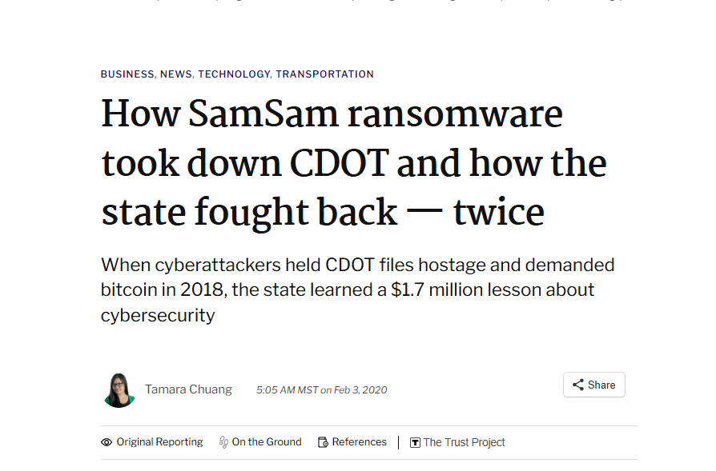
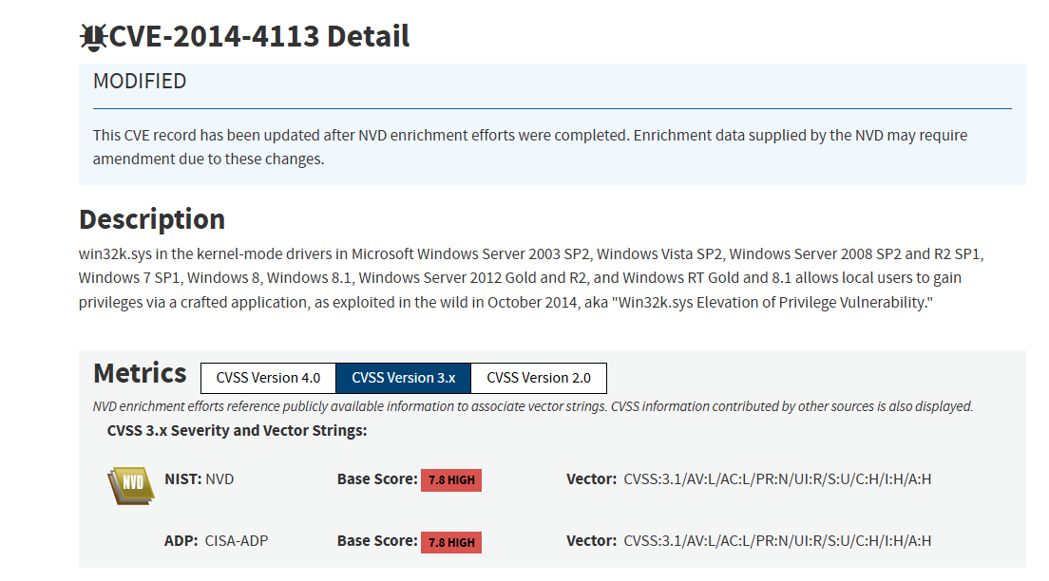

But isn’t all this too hard to exploit?
Notes:
- multi-step attacks

Slide 45
But isn’t all this too hard to exploit?
In 2025, the US Department of Defense (DoD) has been allocated approximately $30 billion for cybersecurity initiatives
Includes both defensive and offensive initiatives
2009-2010 Stuxnet attack disabled key part of Iranian nuclear program
https://www.csoonline.com/article/3632164/us-military-allocated-about-30-billion-to-spend-on-cybersecurity-in-2025.html
https://www.csoonline.com/article/562691/stuxnet-explained-the-first-known-cyberweapon.html

Slide 46
Heap-based vulnerabilities/attacks
Heap memory used for dynamic memory allocation
char* p = malloc(1024);
free(p);
char* s = malloc(128);
Heap has no directionality of growth
Objects placed according to “heap allocation policy”

Slide 47
Heap overflow attacks
0x1000
void authenticate () { char* password = malloc(8);
int* authenticated = malloc(sizeof(int)); printf(“Enter the password\n”); scanf(“%s”, password);
if (strcmp(…)
authenticated = 1;
if (authenticated) {
printf(“Authenticated!\n”);
} else {
printf(“Not allowed!\n”);
} return; } int main(void) { authenticate(); }
authenticate
0xFFA
Overflow
password
0xFF8
0xFF4
0xFF0

Slide 48
Heap overflow attacks
0x1000
void authenticate () { char* password = malloc(8);
int* authenticated = malloc(sizeof(int)); printf(“Enter the password\n”); scanf(“%s”, password);
if (strcmp(…)
authenticated = 1;
if (authenticated) {
printf(“Authenticated!\n”);
} else {
printf(“Not allowed!\n”);
} return; } int main(void) { authenticate(); }
0xFFA
Overflow
password
0xFF8
0xFF4
0xFF0
authenticate

Slide 49
Types of memory safety
Memory safety
Spatial safety
Temporal safety
Buffer overflow
Compilers of memory-safe languages add bounds-checks

Slide 50
Temporal safety vulnerabilities
C compiler will not detect updates to freed memory
void function () { char* buffer = malloc(8);
// do something with buffer
free(buffer);
// 1000 statements later
buffer[2] = ‘A’; return; }

Slide 51
Temporal safety vulnerabilities
C compiler will not detect updates to freed memory
void function () { char* buffer = malloc(8); // do something with buffer
free(buffer);
// 1000 statements later
char* SSL_KEY = malloc(8);
// 1000 statements later
buffer[2] = ‘A’; // will overwrite SSL_KEY return; }
0x1000
SSL_KEY
buffer
A
0xFFA
0xFF8
0xFF4
0xFF0

Slide 52
Temporal safety vulnerabilities
C compiler will not detect updates to freed memory
Use-after-free (UAF) vulnerability
The pointer involved is called a dangling pointer
void function () { char* buffer = malloc(8); // do something with buffer
free(buffer);
// 1000 statements later
char* SSL_KEY = malloc(8);
// 1000 statements later
buffer[2] = ‘A’; // will overwrite SSL_KEY return; }

Slide 53
Temporal safety vulnerabilities
C compiler will not detect if an object is freed twice
Messes up the heap allocator’s meta-data
Can be exploited by the attacker
How? (in one of the next classes!)
Double-free vulnerability
void function () { char* buffer = malloc(8); // do something with buffer
free(buffer);
// 1000 statements later
free(buffer); // again
}

Slide 54
Secure programming
Observation: a few programming patterns lead to the majority of vulnerabilities
Solution: avoid those programming patterns

Slide 55
String functions
Strings end with ‘\0’
Use the size-checked variants of common string functions
char buffer[10]; scanf( “%9s”, buffer);
char dest[10]; char src[10]; strncpy(dest, src, 10);
strncmp, strncat

Slide 56
Avoiding temporal safety bugs
Avoid use-after-free bugs by setting freed pointers to 0 immediately
char* p = malloc(…); //… free(p); p = (char*) 0;
C++ provides reference-counted pointers
std::unique_ptr - Once the pointer goes out of scope, the heap object is automatically dropped
std::shared_ptr – Once the reference count reaches zero, the heap object is automatically dropped

Slide 57
Software security
Tapti Palit

Slide 58
Agenda
Buffer overflow recap
Stack canaries and ASLR-based defenses
Secure programming contd.
Smart pointers in C++
Memory leaks
Sample software security questions
Memory safety in Java

Slide 59
Memory safety
Memory safety – the ability of a programming language to ensure certain types of memory-related bugs/vulnerabilities do not exist
Spatial memory safety bugs
Buffer overflows
int arr[4]; arr[10] = 10; // Language detects this and prevents this
Temporal memory safety bugs
Use-after-free bugs - free(p); *p = 10; OR delete(p); *p = 10;
Double-free bugs – free(p); … ; free(p); OR delete(p); delete(p);

Slide 60
Buffer overflow to corrupt sensitive stack data
Security-critical variable on the stack
scanf(“%s”, password);
authenticated
0x1000
Overflow
password
0xFFA
0xFF8
0xFF4
0xFF0

Slide 61
Buffer overflow to hijack control flow
Return addresses on the stack
At a higher address than function local variables
scanf(“%s”, password);
p
0x1000
q
0xFFA
return_addr@12
0xFF8
Overflow
password
0xFF4
0xFF0

Slide 62
Defenses - stack canaries
Can detect stack overflow into return address
1. void authenticate () { 2. char password[8]; 3. printf(“Enter the password\n”); 3. scanf(“%s”, password); 4. return; 5. } 6. int main(void) { 7. authenticate(); 8. } 9. void super_secret_function() { 10. puts(“This is a super secret function\n”); 11.}
Top of the stack
return_addr@8
0xFF8
Compiler pushes a
“canary” value
CANARY=0xDEADBEEF
0xFF4
password
0xFF0

Slide 63
Defenses - stack canaries
Can detect stack overflow into return address
1. void authenticate () { 2. char password[8]; 3. printf(“Enter the password\n”); 3. scanf(“%s”, password); 4. return; 5. } 6. int main(void) { 7. authenticate(); 8. } 9. void super_secret_function() { 10. puts(“This is a super secret function\n”); 11.}
Top of the stack
return_addr@8
0xFF8
Overflow corrupts
the canary
CANARY=0xDEADBEEF
0xFF4
password
0xFF0

Slide 64
Defenses - stack canaries
Can detect stack overflow into return address
1. void authenticate () { 2. char password[8]; 3. printf(“Enter the password\n”); 3. scanf(“%s”, password); 4. return; 5. } 6. int main(void) { 7. authenticate(); 8. } 9. void super_secret_function() { 10. puts(“This is a super secret function\n”); 11.}
Top of the stack
return_addr@9
0xFF8
Overflow corrupts
the canary
CANARY=0xABCDABCD
0xFF4
password
0xFF0

Slide 65
Defenses - stack canaries
Can detect stack overflow into return address
1. void authenticate () { 2. char password[8]; 3. printf(“Enter the password\n”); 3. scanf(“%s”, password); 4. return; 5. } 6. int main(void) { 7. authenticate(); 8. } 9. void super_secret_function() { 10. puts(“This is a super secret function\n”); 11.}
Top of the stack
Compiler checks
the canary for corruption -> old_value != new_value
-> Buffer overflow
return_addr@9
0xFF8
CANARY=0xABCDABCD
0xFF4
password
0xFF0

Slide 66
Defenses - stack canaries
Can detect stack overflow into return address
1. void authenticate () { 2. char password[8]; 3. printf(“Enter the password\n”); 3. scanf(“%s”, password); 4. return; 5. } 6. int main(void) { 7. authenticate(); 8. } 9. void super_secret_function() { 10. puts(“This is a super secret function\n”); 11.}
Top of the stack
return_addr@9
0xFF8
CANARY=0xABCDABCD
0xFF4
TERMINATE EXECUTION
password
0xFF0

Slide 67
Stack canaries
Available on most popular C/C++ compilers
gcc,clang
Can typically detect overflow across stack frames
Can typically NOT detect overflow within objects in the same stack frame
Can NOT detect overflow within same object on the stack
E.g., different fields in the struct type

Slide 68
Defenses – Address Space Layout Randomization
Operating System feature
Randomizes the address where the binary is loaded
Makes it harder for the attacker to guess the target address
… defenses are ad-hoc and incomplete

Slide 69
Secure programming
Observation: a few programming patterns lead to the majority of vulnerabilities
Solution: avoid those programming patterns

Slide 70
String functions
Strings end with ‘\0’
Use the size-checked variants of common string functions
char buffer[10]; scanf( “%9s”, buffer);
char dest[10]; char src[10]; strncpy(dest, src, 10);
strncmp, strncat

Slide 71
Avoiding temporal safety bugs
Avoid use-after-free bugs by setting freed pointers to 0 immediately
char* p = malloc(…); //… free(p); p = (char*) 0;
C++ provides “smart” pointers
std::unique_ptr
std::shared_ptr
How C++ prevents temporal safety bugs

Slide 72
Background: variable’s scope
Region of a program where the variable is accessible or can be referenced
int function() {
for (int i = 0; i < 10; i++) {
int temp = i;
printf(“%d\n”, temp);
}
printf(“%d\n”, temp); }
Scope of temp
COMPILER ERROR!

Slide 73
C++ smart pointers

Slide 74
C++ smart pointers
Goal: to eliminate temporal memory errors
Use-after-free bugs
Double-free bugs
How?
Automatically manage heap memory
Remove the burden of heap memory-management from the programmer

Slide 75
unique_ptr
How to create a new heap object using unique_ptr?
unique_ptr “owns” the heap object
When the pointer goes out of scope the heap object is automatically deleted
The pointer can be used transparently as its managed type
#include <memory>
struct MyClass {
int value;
MyClass(int v) : value(v) {}
~MyClass() {
std::cout << “Dropping object\n”;
}
};
void function() {
std::unique_ptr<MyClass> ptr = std::make_unique<MyClass>(42);
std::cout << ptr->value << “\n”;
}
int main() {
function();
return 0;
}

Slide 76
unique_ptr
Ownership can be moved to another unique_ptr
Moving the ownership automatically sets the source pointer to zero
Prevents use-after-free bugs
#include <memory>
struct MyClass {
int value;
MyClass(int v) : value(v) {}
~MyClass() {
std::cout << “Dropping object\n”;
}
};
void function() {
std::unique_ptr<MyClass> ptr = std::make_unique<MyClass>(42);
std::cout << ptr->value << “\n”;
std::unique_ptr<MyClass> ptr2 =
std::move(ptr);
std::cout << ptr2->value << “\n”;
}
int main() {
function();
return 0;
}

Slide 77
unique_ptr
How does this prevent double-free bugs?
The programmer doesn’t have to worry about freeing memory at all
In-class demo
#include <memory>
struct MyClass {
int value;
MyClass(int v) : value(v) {}
~MyClass() {
std::cout << “Dropping object\n”;
}
};
void function() {
std::unique_ptr<MyClass> ptr = std::make_unique<MyClass>(42);
std::cout << ptr->value << “\n”;
std::unique_ptr<MyClass> ptr2 =
std::move(ptr);
std::cout << ptr2->value << “\n”;
}
int main() {
function();
return 0;
}

Slide 78
What about multiple pointers to same var?
In C/C++, you can have multiple pointers to the same variable
Can you still do this using smart pointers?
#include <memory>
struct MyClass {
int value;
MyClass(int v) : value(v) {}
~MyClass() {
std::cout << “Dropping object\n”;
}
};
void function() {
MyClass* ptr = new MyClass(10);
MyClass* ptr2 = ptr;
ptr->v = 100; // update via ptr
std::cout << ptr2->v << “\n”; // print via ptr2
}
int main() {
function();
return 0;
}

Slide 79
Desired behavior
struct MyClass {
int value;
MyClass(int v) : value(v) {}
~MyClass() {
std::cout << “Dropping object\n”;
}
};
int main(void) { Myclass* p = new MyClass(10);
MyClass* q = p; // …
delete p;
// …
delete q;
// … 100 other statements }
p
q
Heap object

Slide 80
shared_ptr
Can share the object
Maintains a reference count of how many pointers point to the object
Object automatically deleted if the reference count goes to zero
At no point can you accidentally free an object too early!
#include <iostream>
#include <memory>
struct MyClass {
int value;
MyClass(int v) : value(v) {
std::cout << "MyClass(" << value << ") created\n";
}
~MyClass() {
std::cout << "MyClass(" << value << ") destroyed\n";
}
};
int main() {
std::shared_ptr<MyClass> ptr1 = std::make_shared<MyClass>(42);
{
std::shared_ptr<MyClass> ptr2 = ptr1; // Shared ownership
std::cout << "Value: " << ptr2->value << "\n";
std::cout << ptr1->value << "\n";
} // ptr2 goes out of scope
std::cout << ptr1->value << "\n";
} // ptr1 goes out of scope, and object is destroyed

Slide 81
More about smart pointers
https://en.cppreference.com/w/cpp/memory
How to specify custom destructors for smart pointers
shared_ptr can not have cyclical references
Need weak_ptr references to allow cyclical references
Takeaway – if you’re writing C++ code, please use smart pointers!!

Slide 82
Sample software security questions

Slide 83
Question – find vulnerabilities in code and fix them
void secret_function() {
printf("You have successfully exploited the buffer overflow!\n");
}
void vulnerable_function(char *input) {
char buffer[32];
strcpy(buffer, input);
printf("You entered: %s\n", buffer);
}
int main(int argc, char *argv[]) {
if (argc < 2) {
printf("Usage: %s <input>\n", argv[0]);
return 1;
}
vulnerable_function(argv[1]);
return 0;
}

Slide 84
Can the code below result in control flow hijack?
How to prevent it?
typedef struct {
char name[32];
void (*print_message)(); // Function pointer
} User;
void greet() {
printf("Hello, user!\n");
}
void hacked() {
printf("Exploit successful! Arbitrary code execution achieved.\n");
}
int main() {
User *user1 = (User *)malloc(sizeof(User));
scanf(“%s”, user1->name);
(*(user1->print_message))();
}

Slide 85
Can the code below result in control flow hijack?
How to prevent it?
typedef struct {
char name[32];
void (*print_message)(); // Function pointer
} User;
void greet() {
printf("Hello, user!\n");
}
void hacked() {
printf("Exploit successful! Arbitrary code execution achieved.\n");
}
int main() {
User *user1 = (User *)malloc(sizeof(User));
char temp_buff[100];
scanf(“%99s”, temp_buff);
strcpy(user1->name, temp_buff);
(*(user1->print_message))();
}

Slide 86
Software security
Tapti Palit

Slide 87
Agenda
Memory safety in Java
Sample design patterns questions
Sample software security questions
Quiz
Next week
Fuzz testing, sanitizers, and Valgrind
Revision

Slide 88
Temporal memory safety bugs
Use-after-free bugs
Using a heap object after freeing it
Double-free bugs
Freeing a heap object twice
// Use after free
void fn() {
char* p = malloc(…);
free(p);
// some stuff
p[0] = 10;
}
void fn() {
char* p = new char[20];
delete p;
// some stuff
p[0] = 10;
}
// Double free
void fn() {
char* p = malloc(…);
free(p);
// some stuff
free(p);
}
void fn() {
char* p = new char[20];
delete p;
// some stuff
delete p;
}

Slide 89
C++ smart pointers
unique_ptr
Contains a heap object
Heap object automatically deleted when the pointer goes out of scope
E.g. when function() returns, ptr goes out of scope and the MyClass heap object is automatically deleted
#include <memory>
struct MyClass {
int value;
MyClass(int v) : value(v) {}
~MyClass() {
std::cout << “Dropping object\n”;
}
};
void function() {
std::unique_ptr<MyClass> ptr = std::make_unique<MyClass>(42);
std::cout << ptr->value << “\n”;
}
int main() {
function();
return 0;
}

Slide 90
C++ smart pointers
shared_ptr
Contains a reference to a shared heap object
Maintains a reference count, incremented for each reference to that object
Heap object automatically deleted when reference count becomes zero
#include <iostream>
#include <memory>
struct MyClass {
int value;
MyClass(int v) : value(v) {
std::cout << "MyClass(" << value << ") created\n";
}
~MyClass() {
std::cout << "MyClass(" << value << ") destroyed\n";
}
};
int main() {
std::shared_ptr<MyClass> ptr1 = std::make_shared<MyClass>(42);
{
std::shared_ptr<MyClass> ptr2 = ptr1; // Shared ownership
std::cout << "Value: " << ptr2->value << "\n";
std::cout << ptr1->value << "\n";
} // ptr2 goes out of scope
std::cout << ptr1->value << "\n";
} // ptr1 goes out of scope, and object is destroyed

Slide 91
Memory leak
Occurs when the pointer or reference goes out of scope, but the memory it was pointing to is not freed
Not a security issue directly
Can result in denial-of-service errors
#include <iostream>
#include <memory>
struct MyClass {
int value;
MyClass(int v) : value(v) {
std::cout << "MyClass(" << value << ") created\n";
}
~MyClass() {
std::cout << "MyClass(" << value << ") destroyed\n";
}
};
int main() {
do {
MyClass* ptr = new MyClass(100);
} while (// user doesn’t enter q);
}

Slide 92
Memory safety in Java
(and JS, Go, and to some extent Python)

Slide 93
Spatial memory safety in Java
Java compiler inserts bounds checks for array accesses that are inserted at runtime
Pseudo-code after Java compiler
inserts checks
Original Java code
char a = ‘A’; char arr[4] = {‘a’, ‘b’, ‘c’, ‘d’}; int index = atoi(argv[1]); printf(“%c\n”, arr[index]);
char a = ‘A’; char arr[4] = {‘a’, ‘b’, ‘c’, ‘d’}; int index = Integer.parseInt(argv[1]); if (index < arr.length) {
System.out.println(arr[index]);
} else {
throw new ArrayIndexOutOfBoundsException();
}

Slide 94
Temporal memory safety in Java
Automatic memory management
Heap objects created using new
E.g. Car c = new Car();
Heap objects are automatically freed when no valid reference remain to them
“Garbage collection”
No smart pointers

Slide 95
Garbage collection
A process of automatic memory management for dynamically allocated memory
Java runtime maintains object reachability graph
Garbage: Objects no longer reachable or usable by the program
Once an object is classified as “garbage” it is automatically reclaimed by a garbage collector thread
Prevents both dangling pointers and memory leaks
Many possible algorithms – e.g., Mark and Sweep

Slide 96
Mark and Sweep algorithm
Root node tracks all variables in scope
class EnergySource {}
class Car {
private EnergySource energySource;
public Car(EnergySource source) {
this.energySource = source;
}
}
List<Car> void func() {
EnergySource electricSource = new EnergySource(“electric”);
EnergySource gasSource = new EnergySource(“gas”);
Car c1 = new Car(electricSource);
Car c2 = new Car(gasSource);
Car c3 = new Car(electricSource);
List<Car> carList = new List<Car>();
carList.push(c1);
carList.push(c3); // c2 not pushed
return carList;
}
public static void main(..) {
List<Car> cars = func();
System.out.println(…);
}
electricSource
gasSource
c1
c3
c2
carList
ROOT

Slide 97
Mark and Sweep algorithm
Root node tracks all variables in scope
class EnergySource {}
class Car {
private EnergySource energySource;
public Car(EnergySource source) {
this.energySource = source;
}
}
List<Car> void func() {
EnergySource electricSource = new EnergySource(“electric”);
EnergySource gasSource = new EnergySource(“gas”);
Car c1 = new Car(electricSource);
Car c2 = new Car(gasSource);
Car c3 = new Car(electricSource);
List<Car> carList = new List<Car>();
carList.push(c1);
carList.push(c3); // c2 not pushed
return carList;
}
public static void main(..) {
List<Car> cars = func();
System.out.println(…);
}
electricSource
gasSource
c1
c3
c2
carList
ROOT

Slide 98
Mark and Sweep algorithm
Language runtime spawns a “garbage collector” thread when memory usage reaches a threshold
Identifies “garbage” – objects no longer reachable or usable by the program -> Mark Phase
Once an object is classified as “garbage” it is automatically deleted -> Sweep Phase

Slide 99
Mark phase
Tracks all reachable objects from ROOT
class EnergySource {}
class Car {
private EnergySource energySource;
public Car(EnergySource source) {
this.energySource = source;
}
}
List<Car> void func() {
EnergySource electricSource = new EnergySource(“electric”);
EnergySource gasSource = new EnergySource(“gas”);
Car c1 = new Car(electricSource);
Car c2 = new Car(gasSource);
Car c3 = new Car(electricSource);
List<Car> carList = new List<Car>();
carList.push(c1);
carList.push(c3); // c2 not pushed
return carList;
}
public static void main(..) {
List<Car> cars = func();
System.out.println(…);
}
✓
electricSource
gasSource
✓
c1
✓
c3
c2
✓
carList
Imagine GC invokes here
✓
ROOT

Slide 100
Sweep phase
Deletes all non-reachable objects
class EnergySource {}
class Car {
private EnergySource energySource;
public Car(EnergySource source) {
this.energySource = source;
}
}
List<Car> void func() {
EnergySource electricSource = new EnergySource(“electric”);
EnergySource gasSource = new EnergySource(“gas”);
Car c1 = new Car(electricSource);
Car c2 = new Car(gasSource);
Car c3 = new Car(electricSource);
List<Car> carList = new List<Car>();
carList.push(c1);
carList.push(c3); // c2 not pushed
return carList;
}
public static void main(..) {
List<Car> cars = func();
System.out.println(…);
}
✓
electricSource
gasSource
✓
c1
✓
c3
c2
✓
carList
Imagine GC invokes here
✓
ROOT

Slide 101
Important points
Garbage collection does not occur after every function return
Occurs rarely and typically only after high memory usage

Slide 102
Memory safety guarantees
Prevents both dangling pointers and memory leaks
How?
A heap object is never freed if it is reachable -> no use-after-free
If a heap object is not reachable it is guaranteed to be freed -> no double frees and no memory leaks

Slide 103
Performance impact
Stop-the-world approach
Pauses all application threads while the garbage collector runs
Why? …
Typically, full STW approach is rare nowadays
Still partial STW

Slide 104
Performance of garbage collected languages
Garbage collection has a high overhead
Performance depends on application memory consumption
At lower memory usage, garbage collection is not triggered
Makes it hard to predict application behavior

Slide 105
Summary
Memory safety is critical for security
Lack of memory safety -> sensitive data corruption, control flow hijack
Secure programming can mitigate lack of memory safety in C/C++
scanf(“%9s”, buffer), strncpy(d, s, size);
C++ smart pointers
Other languages achieve temporal memory safety through garbage collection
High overhead

Slide 106
Sample design pattern questions

Slide 107
Question 1
Suppose you are implementing a Chess board game. You want to separate the game logic (which moves are legal, how a player wins, how a player loses, etc) from the actual display logic. Why? Because you want to reuse the same game logic to display for 1) web pages, 2) text-only terminals, 3) hi-resolution graphics terminals, 4) low-resolution small screens. The idea would be that you simply encapsulate the type of device in a “display” object, create an instance of this object for a particular kind of device, and pass it off to the game logic when you begin the game; the game logic simply calls the methods on the display object to display all the different pieces. Consider two main display method, displayBoard and displayPiece. Which pattern would you use?

Slide 108
Question 2
You are developing software to support the automated feeding and watering of expensive flowering/fruiting Chocolate Truffle Persimmon plants at a computer-controlled greenhouse. These plants (depending on the season, and time of day) are in different biological conditions: dormant, growing, flowering, fruiting, and seeded. Depending on the condition, (don’t worry about how you know this, just assume you know) they will need to be watered differently, and fed different things. Do the wrong thing at the wrong time, they’re dead. A separate timing mechanism (not your responsibility) periodically (say twice a day) issues requests to feed, and water, the plants. Your system should do the right thing, depending on the biological conditions of the plants. Which pattern would you use ?

Slide 109
Question 3
Which design pattern should be applicable here? I want to implement a WebServer class. There should be exactly 3 webservers in a system at the most (let’s call them larry, moe, and curly); there should never be more than 3, and it shouldn’t be possible for programmers to accidentally create more than 3. These servers will be created only when needed. i.e., if no requests arrive, no webservers will be created; all 3 servers will exist only after the first 3 requests have arrived. Explain how you would design this system.

Slide 110
More sample software security questions

Slide 111
Question 1
#include <stdio.h>
#include <stdlib.h>
#include <string.h>
typedef struct {
char *data;
} Buffer;
void freeBuffer(Buffer *buf) {
free(buf->data);
}
void process(Buffer *buf) {
freeBuffer(buf);
if (strlen(buf->data) > 5) {
printf("Buffer contains: %s\n", buf->data);
}
}
int main() {
Buffer *buf = malloc(sizeof(Buffer));
buf->data = malloc(20);
strcpy(buf->data, "Hello, world!");
process(buf);
free(buf);
return 0;
}
Does this code have a memory safety bug?

Slide 112
Question 2
Does this code have a memory safety bug?
How can the attacker exploit it?

Slide 113
Question 2 (Challenging!)
void run_cmd(char *msg) {
system(msg);
}
void print_msg(char *msg) {
printf("Message: %s\n", msg);
}
void *admin_func(void *arg) {
while (1) {
char *buf = malloc(10);
strcpy(buf, “time”);
run_cmd(buf);
free(buf);
// … 1000 statements later …
run_cmd(buf);
}
return NULL;
}
void *user_func(void *arg) {
char temp[100];
while (1) {
Buffer* buf = malloc(10);
scanf(“%s”, buf);
print_msg(buf);
}
return NULL;
} int main(void) {
pthread_t t1, t2; pthread_create(&t1, NULL, admin_func, NULL);
pthread_create(&t2, NULL, user_func, NULL);
pthread_join(t1, NULL);
pthread_join(t2, NULL);
return 0; }
Heap feng-shui!!

Slide 114










Sensitive user data

Slide 115
Software security principles
Confidentiality: information is only accessible to those authorized to it
Integrity: information is modified only by those authorized to do so
Availability: information is available to authorized users when needed

Slide 116
What is software security?
Informally, the software should perform only the programmer-intended operation
Surprisingly hard to ensure
Bugs are software flaws or defects that causes the program to behave unexpectedly
Some bugs lead to software vulnerabilities
Software vulnerabilities are software flaws that attackers can exploit to compromise the system

Slide 117
Spatial memory safety
Ensures that memory accesses are confined to the boundaries of the allocated memory block
E.g, when using a pointer to access an array, the pointer should point to memory within the array bounds
Out-of-bounds accesses are prevented
int array[4] = {10, 20, 30, 40};
10
20
30
40
‘A’
int* ptr = array; ptr++;

Slide 118
Lack of spatial memory safety
C/C++ allows out of bounds access
Out of bound access does not crash like in Java and other memory safe languages
Accesses whatever was in the adjacent memory location

Slide 119
Types of memory
Two types of memory
Stack ← will focus more on stack memory
Heap ← similar issues happen with heap memory too
Heap allocations
Car car = new Car(); // Java
int* my_array = malloc(10*sizeof(int)); // C
Stack allocations
int num; // C or Java

Slide 120
Function calls on X86 architectures
Push return address on stack
Allocate stack variables
0x1000
Top of the stack
0xFFF
0xFFE
0xFFD
0xFFC
0xFFB

Slide 121
Function calls on X86 architectures
#include <stdlib.h>
#include <stdio.h>
int main(void) {
authenticate();
}
void authenticate(void) { uint8_t authenticated = 0;
uint8_t password[4];
scanf(“%s”, password);
return 0;
}
void allow_access(void) {
}
Stack grows downward
return_addr
0x1000
Top of the stack
authenticated
0xFFF
password[3]
0xFFE
password[2]
0xFFD
password[1]
0xFFC
password[0]
0xFFB

Slide 122
Control flow hijack
#include <stdlib.h>
#include <stdio.h>
int main(void) {
authenticate();
}
void authenticate(void) { uint8_t authenticated = 0;
uint8_t password[4];
scanf(“%s”, password);
return 0;
}
void allow_access(void) {
}
Stack grows downward
return_addr
0x1000
Top of the stack
authenticated
0xFFF
password[3]
0xFFE
Overflow can overwrite the return_addr on the stack. Jump to attack selected address on return!!!
password[2]
0xFFD
password[1]
0xFFC
password[0]
0xFFB

Slide 123
Temporal memory safety
Ensures that memory is only accessed while it is valid
E.g., a pointer can not point to an object that is freed
No “dangling pointers”
int main(void) {
char* mystring = malloc(1024);
// some stuff
free(mystring);
// mystring not zeroed
*mystring = ‘a’; // write to a dangling pointer
return 0;
}

