Slide 1
Review
Tapti Palit

Slide 2
Main topics
OO concepts
Reflective programming (reflection, dynamic proxies)
Software architecture (HTTP methods, monolithic vs. microservice, RPC, MQ, pub/sub)
Design patterns (12 design patterns)
Software security (spatial and temporal safety, smart pointers, gc)
Testing (unit testing, mock testing, fuzz testing)

Slide 3
OO concepts

Slide 4
Runtime polymorphism
A reference to a parent class can point to an object of the child class
Invoking a method on such a reference will invoke the method of the child class

Slide 5
Abstract classes and interfaces
Abstract classes are part of the class hierarchy
Vehicle is an abstract class. Car and Bicycle are concrete subclasses that extend it
Interfaces can be implemented
Illuminatable is an interface. Firefly and Lamp implement this interface

Slide 6
Static fields and methods
Static fields are shared by all instances of that class
Static methods do not need an object to invoke them
public class Car {
private String name;
private String engine;
private static int numberOfCars;
static { numberOfCars = 0; }
public Car() { numberOfCars++; }
public static int getNumberOfCars() {
return numberOfCars;
}
}
public static void main(..) {
System.out.println(“Total number of cars: “ + Car.getNumberOfCars());
// Prints 0
}

Slide 7

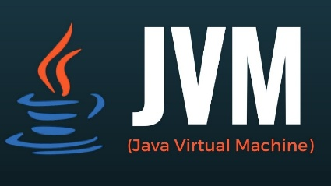
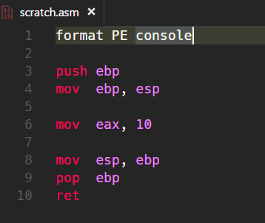
Java compilation and execution
INTERPRETER
Compiled from "MyApp.java"
public class MyApp {
public MyApp();
Code:
0: aload_0
1: invokespecial #1 // Method java/lang/Object."<init>":()V
4: return
public static void main(java.lang.String[]);
Code:
0: getstatic #7 // Field java/lang/System.out:Ljava/io/PrintStream;
3: ldc #13 // String Hello!
5: invokevirtual #15 // Method java/io/PrintStream.println:(Ljava/lang/String;)V
8: return
}
javac
Just-in-Time Compiler
[java]
MyApp.java
Machine code
MyApp.class

Slide 8
Annotations
Meta-data added to Java classes, fields, methods
Retention policy
SOURCE
CLASS
RUNTIME
@Retention(RetentionPolicy.RUNTIME)
public @interface Persistable {
}
class Post {
@Persistable
private String content;
private Integer tempVal;
}

Slide 9
Reflective programming

Slide 10
Reflection
Meta-programming technique
Allows you to access fields, methods, and classes like regular Java objects

Slide 11
Java reflection API
java.lang.reflect.Class
An object of this type encapsulates the class information for a particular class
Class clazz = Class.forName(“com.ecs160.MyApp”);
Class clazz = obj.getClass();
java.lang.reflect.Method
java.lang.reflect.Field
Reflection can bypass access modifiers using the setAccessible(true) method

Slide 12
Persistence framework
persistence.jar
Compiled separately into a JAR file
Provides @persistable annotation
Import
Any codebase
public class MyClass {
@Persistable
String myField;
...
}
RedisSession rs = new RedisSession();
rs.add(new MyClass());
rs.persistAll();

Slide 13






Frameworks that use reflection

Slide 14
Downsides of reflection
Cannot generate new methods, fields, etc.
Reflection causes full loss of type safety
If you do s.setName(new Integer(123)); compiler will catch it at compile time
If you do setNameMethod.invoke(s, new Integer(123)); it will throw an exception at runtime
Performance is slower than directly accessing the field/method
In some cases, it is okay
Database persistence, network communications
Why?
Notes:
- performance

Slide 15
Proxy design pattern
Proxy object wraps and extends target class
ProxyObject
Object
func()
additional_functionality()
func()

Slide 16
Proxy object wraps and extends target class
class Jedis {
public String hget(String id) { … }
public void hset(String id, String val) { … }
}
class JedisProxy extends Jedis{
private Jedis jedis; // Wrap jedis obj
public log() { S.o.p(…); }
public String hget(String id) {
log();
return jedis.hget(id);
}
public void hset(String id, String val) {
log();
hset(id, val);
}
}
hget
JedisProxy object
Jedis object
hget()
hset()
log()
log()
hget()
hset()
Proxies intercept the method invocations

Slide 17
Dynamic proxies
Allows you to dynamically create proxy classes
Uses Java bytecode generation

Slide 18
Dynamic proxy code
Object createProxy(Object object) {
Class<?> clazz = object.getClass();
ProxyFactory proxyFactory = new ProxyFactory();
proxyFactory.setSuperclass(clazz);
MethodHandler methodHandler = new MethodHandler() {
@Override
public Object invoke(Object self,
Method thisMethod,
Method proceed,
Object[] args) throws Throwable {
log(“accessing method” + thisMethod.getName());
return proceed.invoke(self, args);
}
};
Class<?> proxyClass = proxyFactory.createClass();
Object proxyObject = proxyClass.getDeclaredConstructor().newInstance();
((javassist.util.proxy.Proxy) proxyObject).setHandler(methodHandler);
return proxyObject;
}
Jedis jedis = …;
Jedis jedisProxy = (Jedis) createProxy(jedis);
jedisProxy.hset(…);
// jedisProxy has type “subclass of Jedis” and is generated at runtime
// hset will first print the log and then perform hset operation
Student student = …;
Student studentProxy = createProxy(student);
studentProxy.getName();
// studentProxy has type “subclass of Student” and is generated at runtime
// getName() will first print the log and then perform the getName operation
// … Can dynamically create proxies of _any_
// object using createProxy() method

Slide 19
Software architecture

Slide 20
Networking key points
Applications bind to ports
Multiple instances of the same app needs different ports
Every physical interface has a corresponding IP address
(port, IP address) is a socket pair and uniquely identifies an internet end point
Notes:
http://httpforever.com/

Slide 21


Client server architecture
A distributed computing model where the client and server interact to fulfill requests
The client initiates requests, and the server processes them and sends back responses
Client
Server

Slide 22
Client server architecture
Centralized Control: Servers manage data and business logic centrally
Clients provide user interfaces, interacting with the server over a network
Client
Server

Slide 23
Pros and cons
Benefits
Centralized management of data: all data is on the server and can be easily secured
No complex data flows
Separation between client and server business logic
Disadvantages
Single point of failure
Poor scaling

Slide 24
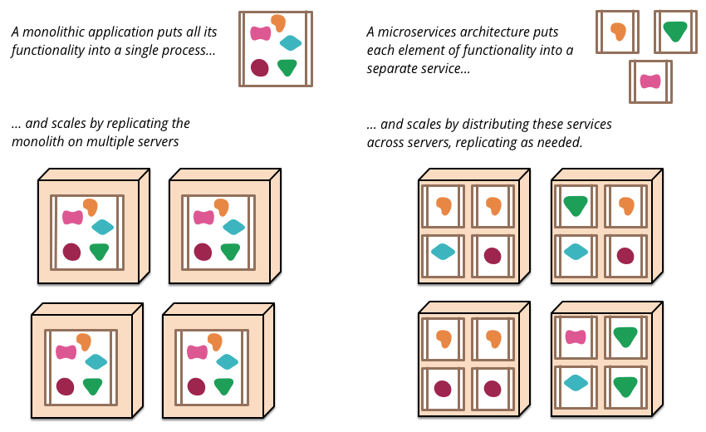
Microservices overview
https://martinfowler.com/articles/microservices.html

Slide 25
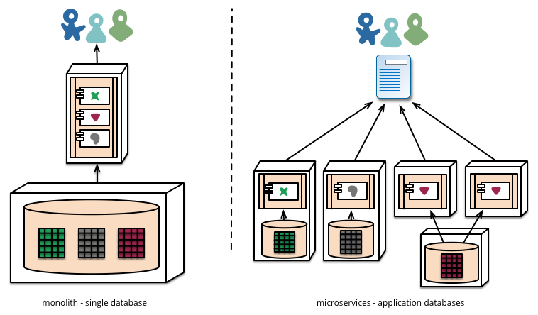
Monolithic to microservices
Each microservice can have its own database
https://martinfowler.com/articles/microservices.html

Slide 26
Pros and cons
Pros
Strong encapsulation and modularity
Better reusability
Each microservice can be scaled independently
Each microservice can be written in its own programming language
Fault isolation
Supports CI/CD (easier to deploy microservices than monolithic services)
Cons
Higher complexity
Debugging complex interactions is harder
Network overhead

Slide 27
HTTP methods
GET - Used to retrieve data from the server
POST - Used to send data to the server
PUT - Used to update or replace an existing resource on the server
DELETE - Used to remove a resource from the server

Slide 28


Remote procedure call (RPC)
Library/framework gives the illusion that the other microservice is running locally
Protocol that allows a program to execute a procedure on a remote server as if it were local
Synchronous communication – caller waits for response before proceeding
Request
Response
Microservice A
Microservice B

Slide 29
RPC key features
Language agnostic: the RPC itself does not depend on the service language
Abstracts network details
Typically, over HTTP

Slide 30
RPC formats
Text-based (e.g. REST APIs)
Uses JSON or XML for data exchange
Human-readable, but larger payloads
Binary formats (e.g. gRPC)
Uses binary standards (such as protobuf) for serialization
Compact but faster, but less human-readable

Slide 31



Message queuing (MQ)
Asynchronous communication model
Messages sent to a queue and processed by consumers independently of the producer
Stronger decoupling
Message
Message
Message
Message
Microservice A
Microservice B

Slide 32


Pub-sub architecture
Message
Subscriber Microservice A
Message
Message
Subscriber Microservice B
Publisher
Microservice
Broker
Message
Subscriber Microservice C

Slide 33
Design patterns

Slide 34
Creational patterns
Control how objects are created
Abstract the instantiation process
Provides flexibility in
What gets created
Who creates it
How it is created and when

Slide 35
Singleton pattern
Ensures a single object of a class is created
Provide a static method getLogger() that instantiates the logger
Turn the constructor private
All object creation goes through getLogger()
getLogger() reuses existing logger if already created, if not, creates a new logger
class Logger {
private FileStream outputFile;
private static Logger logger = nullptr;
private Logger(String outputFileName) {
outputFile = FileStream(outputFileName);
}
public static Logger getLogger(
String outputFileName) {
if (logger == nullptr) {
logger = new Logger(outputFileName);
}
return logger;
}
public log(String msg) {
outputFile.write(log);
}
// … more stuff
}
public static void main(String[] args) { anotherFunction();
}
public void anotherFunction() {
Logger logger = Logger.getLogger(“/mypath);
logger.log(“This is a log message”);
}

Slide 36
Abstract factory pattern
Provide an interface for creating families of related or dependent objects without specifying their concrete classes
An abstract factory class provides an abstract interface for object creation
Concrete factory sub-classes implement that abstract interface
public class Button { // button stuff }
public class WinButton extends Button { // … }
public class MacOSButton extends Button { // … }
abstract Class UIFactory { … }
public class WinFactory extends UIFactory { … }
public class MacOSFactory extends UIFactory { …}
public class Application {
private UIFactory uiFactory;
public Application() {
String platform = detectPlatform();
if (platform == “win”) {
uiFactory = new WinFactory();
} else if (platform == “macos”) {
uiFactory = new MacOSFactory();
}
}
public drawGUI() {
Button button = uiFactory.createButton();
}
}

Slide 37
Structural design patterns
Control how objects and classes are composed
Deal with object relationships

Slide 38
Adapter pattern
Convert the interface of a class into another interface clients expect
Allows classes to work together that couldn't otherwise because of incompatible interfaces
interface PaymentProcessor { void pay(int amount); }
class PaypalProcessor implements PaymentProcessor {
void pay (int amount) {
// paypal functionality
}
}
public static void main(…) {
PaymentProcessor p = new PaypalProcessor();
handlePurchase(p);
} public void handlePurchase(PaymentProcessor p) {
p.pay(2000);
}
class StripeProcessor {
void makePayment(double amount) {
// stripe functionality
}
}
Third party payment gateway

Slide 39
Payment adapter
Wrap the StripeProcessor object (adaptee) in an Adapter
The StripeAdapter implements the PaymentProcessor interface
And internally invokes the adaptee’s makePayment() method
Can use StripeAdapter wherever PaymentProcessor is used
class StripeAdapter implements PaymentProcessor{
private StripeProcessor stripeProcessor;
public StripeAdapter(StripeProcessor p) {
this.stripeProcessor = p;
}
public void pay(double amount) {
stripeProcessor.makePayment(amount);
}
}
public static void main(…) {
StripeProcessor stripe = new StripeProcessor();
PaymentProcessor p = new StripeAdapter(stripe);
handlePurchase(p);
} public void handlePurchase(PaymentProcessor p) {
p.pay(200.0);
}
Notes:
Adapter, Bridge, Composite, Decorator, Proxy

Slide 40

Composite pattern
Composite pattern allows clients to treat individual objects and compositions of objects uniformly
A Post is an individual social media entry
A Thread is a collection of posts and/or threads
Both Post and Thread should have similar operations such as show,hide, report, etc.
Post
Thread
Thread

Slide 41
Decorator design pattern
Can attach additional functionalities to an object dynamically
Basic idea: enclose the object in another object (the decorator) that adds the additional functionality
Implementation can look the same as a proxy
Intent is somewhat different

Slide 42
Decorators visually
CurrencyConversionDecorator object
hget
hget
hget
FraudDetectionDecorator object
FraudDetectionDecorator object
PaypalProcessor object
PaypalProcessor object
pay()
pay()
detectFraud()
detectFraud()
pay()
pay()
convert()
pay()

Slide 43
Bridge design pattern
Split a large class or group of classes into two separate hierarchies – abstraction and implementation – which can be developed independently of each other
When an abstraction can have one of several possible implementations, the usual way to accommodate them is to use inheritance

Slide 44
Bridge pattern
Vehicle
contains
EnergySource
extends
extends
extends
extends
extends
extends
extends
Car
Bicycle
Motorcycle
Electric
Gas
Diesel
Manual
Abstraction*
Implementation
*Not an abstract class; just means that it abstracts the implementation details

Slide 45
Façade pattern
Provide a unified interface to a set of interfaces in a subsystem
It shields clients from subsystem components
Client
compile()
CompilerFacade
Scanner
BytecodeStream
ProgramNode
Builder
ObjectWriter
Parser
ProgramNode
Compiler library

Slide 46
Flyweight pattern
Aims to reduce memory consumption
Separate shared and unique state
// With flyweight design pattern
class Flyweight {
private Sprite terrainSprite;
public FlyWeight(String key) { // create sprite images
// getters and setters
}
class TerrainTile {
private int xLoc;
private int yLoc;
// getters and setters
} class FlyweightFactory {
private static Map<String, Flyweight> flyweights = new HashMap<>();
public static Flyweight getFlyweight(String key) {
if (!flyweights.containsKey(key)) {
flyweights.put(key, new Flyweight(key));
}
return flyweights.get(key);
}
}

Slide 47
Behavioral patterns
Control how objects distribute responsibilities
Concerned with algorithms and the assignment of responsibilities between objects

Slide 48
Observer pattern
Define a one-to-many dependency between objects so that when one object changes state, all its dependents are notified and updated automatically
The object being observed is called “subject” or “model”
The object doing the observing is called “observer”
E.g. in Design Pattern slide

Slide 49
Observer pattern
Subject/model role
Stores all registered observers in a list
Register/de-register API for observers to register or de-register themselves
Call observer.update() for each registered observer when model values change
Observer role
Provides an update() method that performs actions in response to subject updates

Slide 50
State pattern
Localizes state-specific behavior and partitions behavior for different states
Makes state transitions explicit
The class contains a currentState object that encapsulates current state
The operation simply forward the operation to the currentState object
class MediaPlayer {
private MediaPlayerState currentState;
public MediaPlayer() {
// Default state is "Stopped"
this.currentState = new StoppedState();
}
public void setState(MediaPlayerState state) {
this.currentState = state;
}
public void play() {
currentState.play(this);
}
public void pause() {
currentState.pause(this);
}
public void stop() {
currentState.stop(this);
}
}

Slide 51
State pattern
Localizes state-specific behavior and partitions behavior for different states
Makes state transitions explicit
The class contains a currentState object that encapsulates current state
The operation simply forward the operation to the currentState object
interface MediaPlayerState {
void play(MediaPlayer context);
void pause(MediaPlayer context);
void stop(MediaPlayer context);
}
class PlayState implements MediaPlayerState {
@Override
public void play(MediaPlayer context) {
System.out.println("Media is already playing.");
}
@Override
public void pause(MediaPlayer context) {
System.out.println("Pausing media...");
context.setState(new PausedState());
}
@Override
public void stop(MediaPlayer context) {
System.out.println("Stopping media...");
context.setState(new StoppedState());
}
}
// Similarly, for PauseState and StopState

Slide 52
Template method pattern
Define the skeleton of an algorithm in an operation, deferring some steps to subclasses
Allows subclasses to redefine certain steps of an algorithm without changing the algorithm's structure
Typically used to design variants of the same algorithm
Notes:
template method, visitor

Slide 53
Visitor pattern
Abstracts visiting logic
Separates operations (behavior) from the object structure (elements) they act upon
Makes it easy to add operations after class is created
Widely used in
Compilers/interpreters
Serialization/deserialization (JSON parsing)
Static analysis/code auditing

Slide 54
Visitor design pattern
Allow the parent class for all nodes to accept a Visitor
Provide concrete implementations of the accept method for each type
The accept method invokes the visitor on the shape object
class Point {private int x; private int y; }
abstract class Shape {
void accept(ShapeVisitor visitor);
} class Circle extends Shape {
/// … fields and getters/setters
void accept(ShapeVisitor visitor) {
visitor.visit(this);
}
}
class Rectangle extends Shape {
/// …
void accept(ShapeVisitor visitor) {
visitor.visit(this);
}
}

Slide 55
Visitor design pattern
Define the visitor abstract class
This class contains the visitor logic
Define a visit() method overloaded with arguments of subclass of Shape
Provide a concrete default implementation of visit(CompoundShape c)
abstract class ShapeVisitor {
void visit(Circle circle) {}
void visit(Rectangle rectangle) {}
void visit(CompoundShape c) {
for (Shape shape: c.getShapeList()) {
shape.accept(this);
}
}
}

Slide 56
Visitor design pattern
Define the concrete subclasses of ShapeVisitor
Implement the visit method for each shape
TranslationVisitor
class TranslationVisitor extends ShapeVisitor {
int x; int y; TranslationVisitor(int x, int y) {
this.x = x; this.y = y;
}
@Override
public void visit(Triangle t) {
t.getP1().setX(t.getP1().getX() + x);
/// for other points
}
@Override
public void visit(Rectangle rectangle) {
// translate 4 points
}
// No need to override visit for CompoundShape
}

Slide 57
Software security

Slide 58
Memory safety
Spatial memory safety
Temporal memory safety

Slide 59
Buffer overflow
#include <stdlib.h>
#include <stdio.h>
int main(void) { uint8_t authenticated = 0;
uint8_t array[4];
uint8_t * p = array;
uint8_t num;
for (int i = 0; i <= 4; i++) {
printf(“Enter a number:”);
scanf(“%d”, &num);
array[i] = num;
}
return 0;
} > Enter a number:
1 # 5 times
1
authenticated
0x1000
1
Overwrite authenticated
variable!!!
array[3]
0xFFF
1
array[2]
0xFFE
array[1]
0xFFD
1
array[0]
0xFFC
1
0xFFB

Slide 60
Vulnerable string-related libc functions
char* password = malloc(5); scanf(“%s”, password)
overflow if user enters “AAAAAA”
A
0x1000
A
0xFFF
A
0xFFE
Password
A
0xFFD
A
0xFFC
A
0xFFB

Slide 61
Control flow hijack
1. void authenticate () { 2. char password[8]; 3. printf(“Enter the password\n”); 3. scanf(“%s”, password); 4. return; 5. } 6. int main(void) { 7. authenticate(); 8. } 9. void super_secret_function() { 10. puts(“This is a super secret function\n”); 11.}
p
0x1000
Top of the stack
q
0xFFA
return_addr@7
0xFF8
&super_secret_func
Overflow
password
0xFF4
0xFF0

Slide 62
Control flow hijack
The attacker can not only overwrite stack variables
But also hijack control flow
Known as
Control flow hijack attacks
Extremely powerful!!
p
0x1000
Top of the stack
q
0xFFA
return_addr@12
0xFF8
&super_secret_func
Overflow
password
0xFF4
0xFF0

Slide 63
Defenses
Stack canaries
Address Space Layout Randomization (ASLR)

Slide 64
Temporal safety vulnerabilities
C compiler will not detect updates to freed memory
Use-after-free (UAF) vulnerability
The pointer involved is called a dangling pointer
void function () { char* buffer = malloc(8); // do something with buffer
free(buffer);
// 1000 statements later
char* SSL_KEY = malloc(8);
// 1000 statements later
buffer[2] = ‘A’; // will overwrite SSL_KEY return; }

Slide 65
Temporal safety vulnerabilities
C compiler will not detect if an object is freed twice
Messes up the heap allocator’s meta-data
Can be exploited by the attacker
Double-free vulnerability
void function () { char* buffer = malloc(8); // do something with buffer
free(buffer);
// 1000 statements later
free(buffer); // again
}

Slide 66
C++ smart pointers: unique_ptr
std::make_unique to create new unique_ptr
unique_ptr “owns” the heap object
When the pointer goes out of scope the heap object is automatically deleted
The pointer can be used transparently as its managed type
Ownership can be moved to another unique_ptr
Moving the ownership automatically sets the source pointer to zero
#include <memory>
struct MyClass {
int value;
MyClass(int v) : value(v) {}
~MyClass() {
std::cout << “Dropping object\n”;
}
};
void function() {
std::unique_ptr<MyClass> ptr = std::make_unique<MyClass>(42);
std::cout << ptr->value << “\n”;
std::unique_ptr<MyClass> ptr2 =
std::move(ptr);
std::cout << ptr2->value << “\n”;
}
int main() {
function();
return 0;
}

Slide 67
C++ smart pointers: shared_ptr
Can share the object
Maintains a reference count of how many pointers point to the object
Object automatically deleted if the reference count goes to zero
At no point can you accidentally free an object too early!
#include <iostream>
#include <memory>
struct MyClass {
int value;
MyClass(int v) : value(v) {
std::cout << "MyClass(" << value << ") created\n";
}
~MyClass() {
std::cout << "MyClass(" << value << ") destroyed\n";
}
};
int main() {
std::shared_ptr<MyClass> ptr1 = std::make_shared<MyClass>(42);
{
std::shared_ptr<MyClass> ptr2 = ptr1; // Shared ownership
std::cout << "Value: " << ptr2->value << "\n";
std::cout << ptr1->value << "\n";
} // ptr2 goes out of scope
std::cout << ptr1->value << "\n";
} // ptr1 goes out of scope, and object is destroyed

Slide 68
Java: garbage collection
A process of automatic memory management for dynamically allocated memory
Java runtime maintains object reachability graph
Garbage: Objects no longer reachable or usable by the program
Once an object is classified as “garbage” it is automatically reclaimed by a garbage collector thread
Prevents both dangling pointers and memory leaks
Many possible algorithms – e.g., Mark and Sweep

Slide 69
Testing

Slide 70
Unit testing with JUnit
@Test annotation indicate test cases
@BeforeEach, @AfterEach annotations indicate methods to run before and after each test case (method)
@BeforeClass, @AfterClass annotations indicate methods to run before and after each test class
Assertion methods validate expected outcomes
assertEquals(), assertNotEquals(), and so on…

Slide 71
JUnit question
Why should you use assertEquals and not just !=?
import org.junit.jupiter.api.Test;
import org.junit.jupiter.api.Assertions.assertEquals;
public class CarTest {
@Test
public void testAccelerate() {
Car car = new Car(“Toyota”, 50);
car.accelerate();
assertEquals(car.getSpeed(), 60);
// Why not the following?
// if (car.getSpeed() != 60) { // System.out.println(“FAILED”);
//}
}
}

Slide 72
Mocking overview
What is mocking?
Simulate the behavior of real objects in a controlled way
Useful during unit-testing
Why?
Isolate components for unit testing
External systems (APIs, Databases)
Complex or time-consuming operations

Slide 73
Mocking overview
Example: unit test composeEmail
But don’t want to actually send an email to a client!!
public EmailService {
public boolean sendEmail(...) {
// send an email
if (success) return true;
return false;
}
}
public class EmailManager {
private EmailService emailService;
private void formatEmail(String email) { … }
private void displayError(boolean succ) { …}
public String composeEmail(...) {
String email = ...;
formatEmail(email);
boolean success = emailService.send(email);
displayError(success);
}
}

Slide 74


Mockito overview
Allows programmer to inject mock objects to stub functionality
EmailManager object
contains
EmailService object
inject
Mock EmailService object
Stubbed sendEmail() function that does nothing
Notes:
- Want to do is stub out or “simulate” some functionality

Slide 75

Fuzz testing
Source for random input on *nix systems
input
execute
/dev/random
application

Slide 76
Mutation fuzzer - generate inputs via mutation
Start with some known valid inputs called “seeds”
Keep mutating them based on some “strategy”
1
2
seeds
pick
mutate
execute
seeds
seeds
input’
seeds
input
application
CREATE TABLE mytable AS (id INTEGER, … );
CREATE TABLE mZtablI AS (id INTEGER, … );

Slide 77
How to pick which input seed to mutate?
1
2
seeds
pick
mutate
execute
seeds
seeds
Input’
seeds
input
application
CREATE TABLE mytable AS (id INTEGER, … );
CREATE TABLE mZtablI AS (id INTEGER, … );

Slide 78
Coverage-guided fuzzer pipeline
1
2
seeds
pick
mutate
execute
seeds
seeds
input’
seeds
input
application
CREATE TABLE mytable AS (id INTEGER, … );
CREATE TABLE mZtablI AS (id INTEGER, … );
Coverage detection
Add input’ to seeds if new coverage observed

Slide 79
Final exam format
True/false and Multiple-choice (10 points) [any topic]
Short answers (10 points) [any topic]
Design pattern (20 points)
Software security (10 points)

Slide 80
All the best!

